Slide 1
Parameter declaration & return values
Chapter 6 (Pt 1):
Modularity using functions
ELEMENTS OF PROGRAMMING
CSC 1100

Slide 2
Objectives
CSC 1100 – Wk7
In this chapter, you will learn about:
Function and Parameter Declarations
Returning a Single Value
2
A First Book of C++ 4th Edition

Slide 3
CSC 1100 – Wk7
At the end of this chapter, you should be able to:
design and implement functions
become familiar with the concept of parameter passing
appreciate the importance of function comments
develop strategies for decomposing complex tasks into simpler ones
3
A First Book of C++ 4th Edition

Slide 4
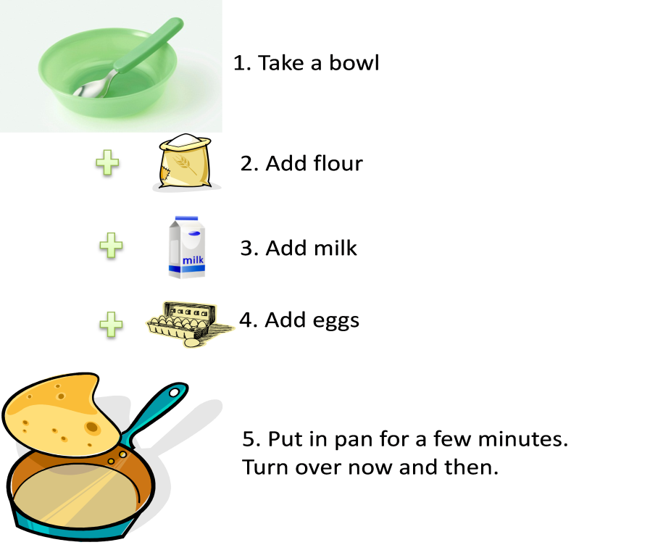
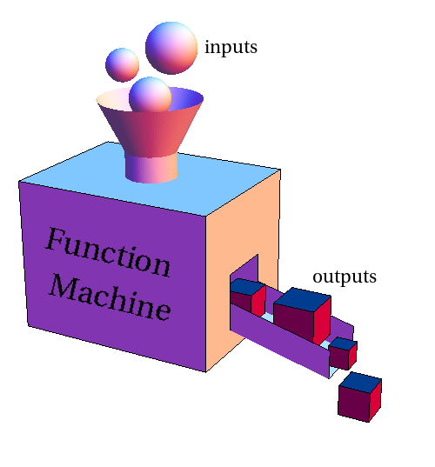
What is a Function?
CSC 1100 – Wk7
A function is a sequence of instructions with a name (e.g, make_pancake() )
A function packages a computation into a form that can be easily understood and reused (Horstmann, 2012)
4
C++ for Everyone, 2nd ed.

Slide 5
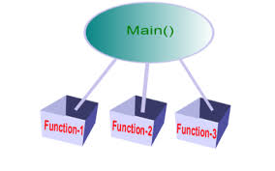
Function and Parameter Declarations
CSC 1100 – Wk7
All C++ programs must contain a main() function
May also contain unlimited additional functions
Major programming concerns when creating functions:
How does a function interact with other functions (including main)?
Correctly passing data to function
Correctly returning values from a function
5
A First Book of C++ 4th Edition

Slide 6
Function and Parameter Declarations (cont'd.)
CSC 1100 – Wk7
Function call process:
Give function name
Pass data to function as arguments/parameters in parentheses () following function name
Example: make_pancake (double amt_flour, int amt_eggs, double amt_milk)
Only after called function receives data successfully can the data be manipulated within the function
6
A First Book of C++ 4th Edition

Slide 7
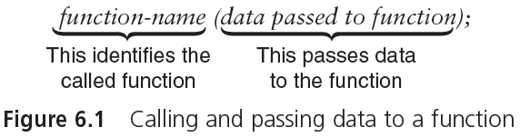
Function and Parameter Declarations (cont'd.)
CSC 1100 – Wk7
arguments (inputs/data passed to function)
header line void sum (int a, int b) pow(x,2)
{
}
7
A First Book of C++ 4th Edition

Slide 8
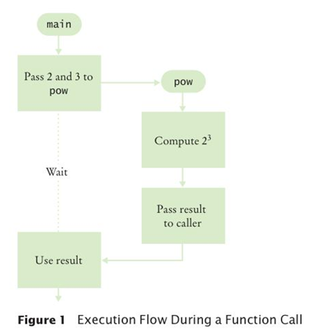
Function and Parameter Declarations (cont'd.)
CSC 1100 – Wk7
Example:
<cmath> function
pow(2.0, 3)
data 1
data 2
8
A First Book of C++ 4th Edition

Slide 9
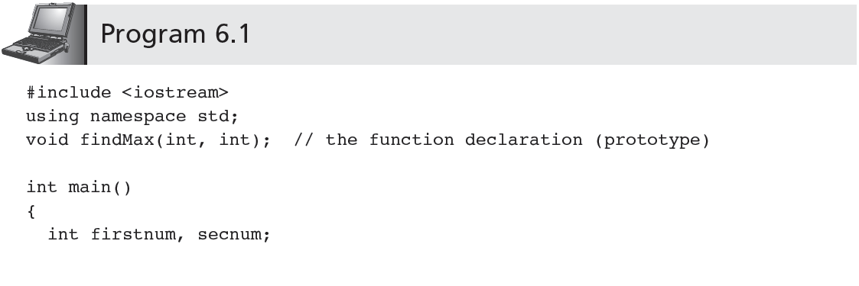
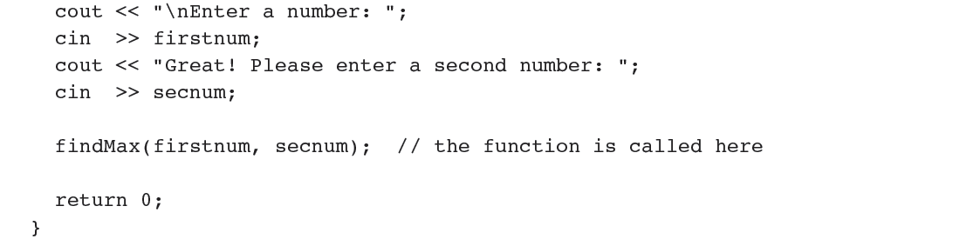
Function and Parameter Declarations (cont'd.)
CSC 1100 – Wk7
What is missing here ???
input 1
input 2
function
call
9
A First Book of C++ 4th Edition

Slide 10
Function and Parameter Declarations (cont'd.)
CSC 1100 – Wk7
Program 6.1 is not complete
The function findMax() must be written and added
Done in slide 18
Complete program components:
main(): referred to as calling function (the one that calls)
findMax(): referred to as called function (the one being called)
Only complete program can be compiled and executed
10
A First Book of C++ 4th Edition

Slide 11
Function Prototypes
CSC 1100 – Wk7
Function prototype: declaration statement for a function
Before a function can be called, it must be declared to the calling function (just like variable declaration)
Provides the calling function with the following info:
The type of value to be returned, if any
The data type and order of values the calling function should transmit/pass to the called function
11
A First Book of C++ 4th Edition

Slide 12
Function Prototypes (cont'd.)
CSC 1100 – Wk7
Example: the function prototype in Program 6.1
void findMax(int, int);
Declares that findMax() expects two integer values sent to it
findMax() returns no value
Prototype statement placement options:
Together with variable declaration statements just above calling function name (as in Program 6.1)
In a separate header file to be included using a #include preprocessor statement
* void means None
12
A First Book of C++ 4th Edition

Slide 13
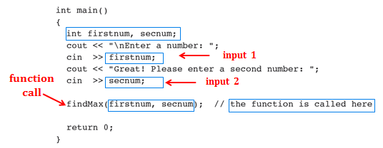
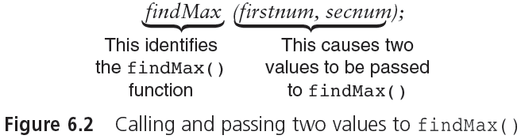
Calling a Function (Program 6.1)
CSC 1100 – Wk7
function name
variables/value passed
13
A First Book of C++ 4th Edition

Slide 14
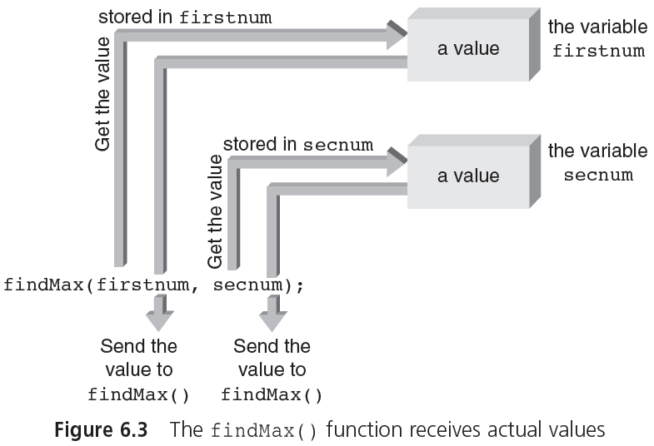
Calling a Function (cont'd.)
CSC 1100 – Wk7
14
A First Book of C++ 4th Edition

Slide 15
Defining a Function
CSC 1100 – Wk7
A function is defined when it is written
Can then be used by any other function that suitably declares it
Format: two parts
Function header identifies:
Data type returned by the function
Function name
Number, order, and type of arguments expected by the function
Function body: statements that operate on data
Returns one value back to the calling function
15
A First Book of C++ 4th Edition

Slide 16
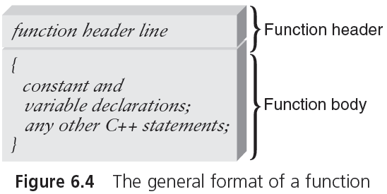
Defining a Function (cont'd.)
CSC 1100 – Wk7
16
A First Book of C++ 4th Edition

Slide 17
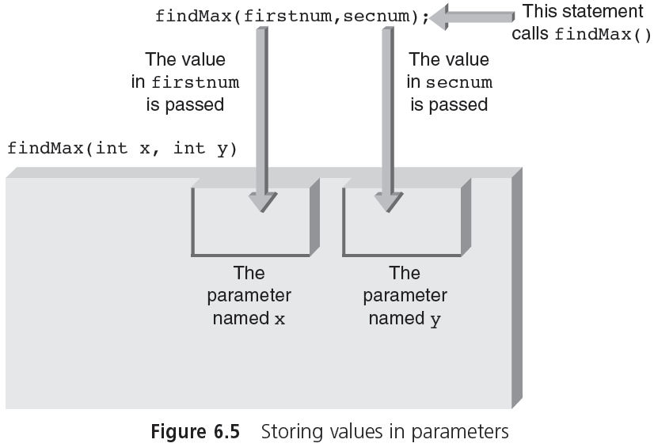
CSC 1100 – Wk7
17
A First Book of C++ 4th Edition

Slide 18
Defining a Function (cont'd.)
CSC 1100 – Wk7
//function header
void findMax (int x, int y) // x = firstnum , y = secnum
{ // start of function body
int maxnum; // variable declaration
if (x >= y) // find the maximum between 2 numbers
maxnum = x;
else
maxnum = y;
cout << "\nThe maximum of the two numbers is " <<maxnum << endl;
return;
} // end of function body and end of function
18
A First Book of C++ 4th Edition

Slide 19
Defining a Function (cont'd.)
CSC 1100 – Wk7
Order of functions in a program:
Any order is allowed
main() usually first
main() is the driver function
Gives reader overall program concept before details of each function encountered
Each function must be defined outside any other function
Each function is separate and independent
Nesting functions is never permitted (no nested function)
19
A First Book of C++ 4th Edition

Slide 20
Function Exercise 6a
CSC 1100 – Wk7
Create a function called calcAvg() that calculates the average of two numbers:
Steps:
Write your main() function
Get 2 inputs from the user
Call the empty function calcAvg()
Create the function calcAvg()
Pass the 2 inputs from the user as arguments to the function calcAvg()
Calculate the total
Calculate and print out the average
20
A First Book of C++ 4th Edition

Slide 21
Placement of Statements
CSC 1100 – Wk7
Programming requirements:
Items that must be either declared or defined before they are used:
Preprocessor directives
Named constants
Variables
Functions
Otherwise, C++ is flexible in requirements for ordering of statements
21
A First Book of C++ 4th Edition

Slide 22
Placement of Statements (cont'd.)
CSC 1100 – Wk7
Recommended ordering of statements
Good programming practice
preprocessor directives
function prototypes
int main()
{
// symbolic constants (using ‘const’)
// variable declarations
// other executable statements
// return value
}
// function definitions
22
A First Book of C++ 4th Edition

Slide 23
Function Stubs
CSC 1100 – Wk7
Possible programming approach:
Write main() first and add functions as developed
Program cannot be run until all functions are included
Stub: beginning of a final function
Can be used as a placeholder for a function until the function is completed
A “fake” function that accepts parameters and returns values in proper form (incomplete but working)
Allows main to be compiled and tested before all functions are completed

Slide 24
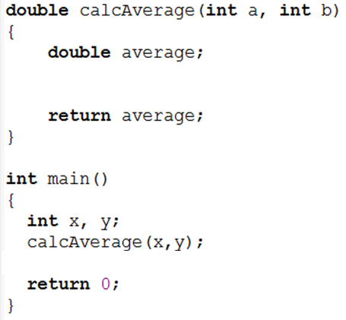
Example for Stub
CSC 1100 – Wk7
steps in function not yet
defined/written
main() still executes
successfully

Slide 25
Functions with Empty Parameter Lists
CSC 1100 – Wk7
Extremely limited use
Prototype format:
int display ( );
int display (void);
Information provided in above prototypes:
display takes no parameters
display returns an integer
no parameter/argument
25
A First Book of C++ 4th Edition

Slide 26
Default Arguments
CSC 1100 – Wk7
Values listed in function prototype
Automatically transmitted to the called function when the arguments are omitted from function call
Example (prototype):
void example (int, int = 5, double = 6.78);
Provides default values for last two arguments
Following function calls are valid:
example(7, 2, 9.3) // no defaults used
example(7, 2) // same as example(7, 2, 6.78)
example(7) // same as example(7, 5, 6.78)
26
A First Book of C++ 4th Edition

Slide 27
Reusing Function Names (Overloading)
CSC 1100 – Wk7
Function overloading: using same function name for more than one function
Compiler must be able to determine which function to use based on data types of parameters (not data type of return value)
Each function must be written separately
Each exists as a separate entity
Use of same name does not require code to be similar
Good programming practice: functions with the same name perform similar operations
27
A First Book of C++ 4th Edition

Slide 28
Reusing Function Names (Overloading) (cont'd.)
CSC 1100 – Wk7
Example: two functions named cdabs()
void cdabs(int x) //compute and display the abs. value of integer
{
if ( x < 0 )
x = -x;
cout << "The absolute value of the integer is " << x << endl;
}
void cdabs(float x) //compute and display the abs. value of float
{
if ( x < 0 )
x = -x;
cout << "The absolute value of the float is " << x << endl;
}
28
A First Book of C++ 4th Edition

Slide 29
Reusing Function Names (Overloading) (cont'd.)
CSC 1100 – Wk7
Function call: cdabs(10);
Causes compiler to use the function named cdabs() that expects and integer argument
Function call: cdabs(6.28);
Causes compiler to use the function named cdabs() that expects a double-precision argument
Major use of overloaded functions
Constructor functions
29
A First Book of C++ 4th Edition

Slide 30
Function Templates
CSC 1100 – Wk7
Most high-level languages require each function to be coded separately
Can lead to a profusion of names
Example: functions to find the absolute value
Three separate functions and prototypes required
void abs (int);
void fabs (float);
void dabs (double);
Each function performs the same operation
Only difference is data type handled
30
A First Book of C++ 4th Edition

Slide 31
Function Templates (cont'd.)
CSC 1100 – Wk7
Example of function template:
template <class T>
void showabs(T number)
{
if (number < 0)
number = -number;
cout << "The absolute value of the number "
<< " is " << number << endl;
return;
}
Template allows for one function instead of three
T represents a general data type
T replaced by an actual data type when compiler encounters a function call
31
A First Book of C++ 4th Edition

Slide 32
Function Templates (cont'd.)
CSC 1100 – Wk7
Example (cont'd.):
int main()
{
int num1 = -4;
float num2 = -4.23F;
double num3 = -4.23456;
showabs(num1);
showabs(num2);
showabs(num3);
return 0;
}
Output from above program:
The absolute value of the number is 4
The absolute value of the number is 4.23
The absolute value of the number is 4.23456
Calling function
Called function
Pass by value arguments
32
A First Book of C++ 4th Edition

Slide 33
Returning a Single Value
CSC 1100 – Wk7
Passing data to a function:
Called function receives only a copy of data sent to it
Protects against unintended change
Passed arguments called pass by value arguments
A function can receive many values (arguments) from the calling function
33
A First Book of C++ 4th Edition

Slide 34
Returning a Single Value (cont'd.)
CSC 1100 – Wk7
Returning data from a function
Only one value directly returned from function
Called function header indicates type of data returned
Examples:
void findMax(int x, int y)
findMax accepts two integer parameters and returns no value
float findMax (float x, float y)
findMax accepts two floating-point values and returns a floating-point value
To return a value, a function must use a return statement
x and y are of type integers
34
A First Book of C++ 4th Edition

Slide 35
Returning a Single Value (cont'd.)
CSC 1100 – Wk7
//Program 6.4
#include <iostream>
using namespace std;
int findMax(int, int);// function prototype
int main()
{
int firstnum, secnum, max ;
cout << "\nEnter a number: ";
cin >> firstnum;
cout << "Great! Please enter a second number: ";
cin >> secnum;
max = findMax(firstnum, secnum);//max store result of function
cout << "\nThe maximum of the two numbers is " << max <<endl;
return 0;
}
35
A First Book of C++ 4th Edition

Slide 36
Returning a Single Value (cont'd.)
CSC 1100 – Wk7
//Program 6.4 (cont’d…)
int findMax(int x, int y) // function header
{
int maxnum;
if (x >= y)
maxnum = x;
else
maxnum = y;
// returning a single value, no cout, result printed in main()
return maxnum;
}
36
A First Book of C++ 4th Edition

Slide 37
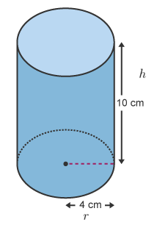
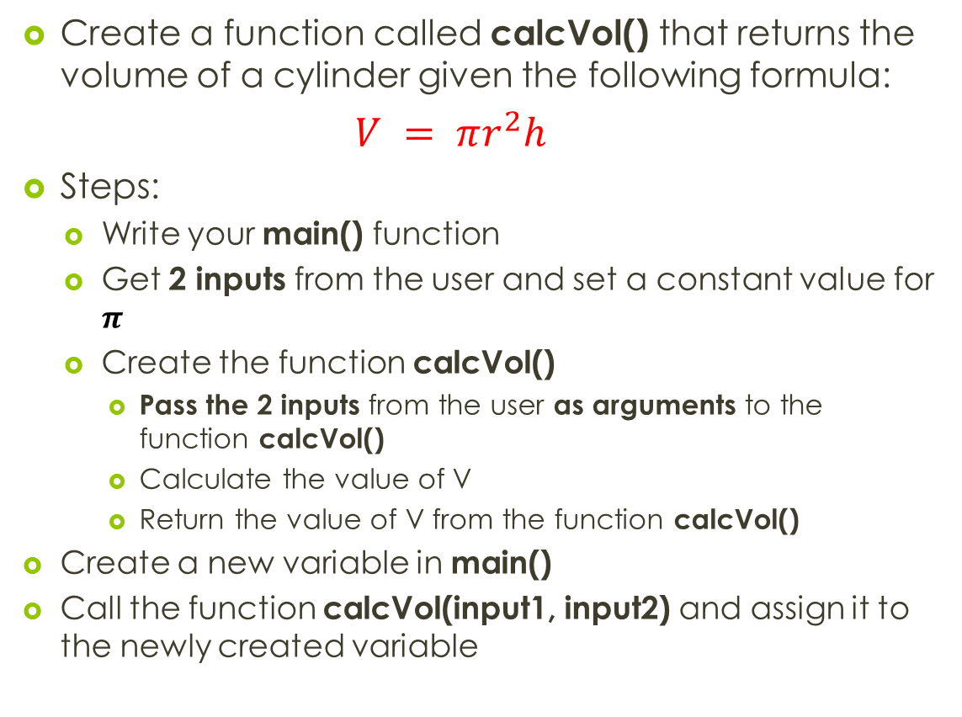
Function Exercise 6b
CSC 1100 – Wk7
Create a function called calcVol() that returns the volume of a cylinder given the following formula:
$$V = πr^{2}h$$
Steps:
Write your main() function
Get 2 inputs from the user and set a constant value for $π$
Create the function calcVol()
Pass the 2 inputs from the user as arguments to the function calcVol()
Calculate the value of V
Return the value of V from the function calcVol()
Create a new variable in main()
Call the function calcVol(input1, input2) and assign it to the newly created variable
37
A First Book of C++ 4th Edition

Slide 38
Inline Functions
CSC 1100 – Wk7
Calling functions associate some overhead (excessive usage of memory)
Placing arguments in reserved memory (stack)
Passing control to the function
Providing stack space for any returned value
Returning to correct point in calling program
Overhead is justified when function is called many times
Better than repeating code
38
A First Book of C++ 4th Edition

Slide 39
Inline Functions (cont'd.)
CSC 1100 – Wk7
Overhead is not justified for small functions that are not called frequently
Still convenient to group repeating lines of code into a common function name
Inline function: avoids overhead problems
C++ compiler instructed to place a copy of inline function code into the program wherever the function is called
39
A First Book of C++ 4th Edition

Slide 40
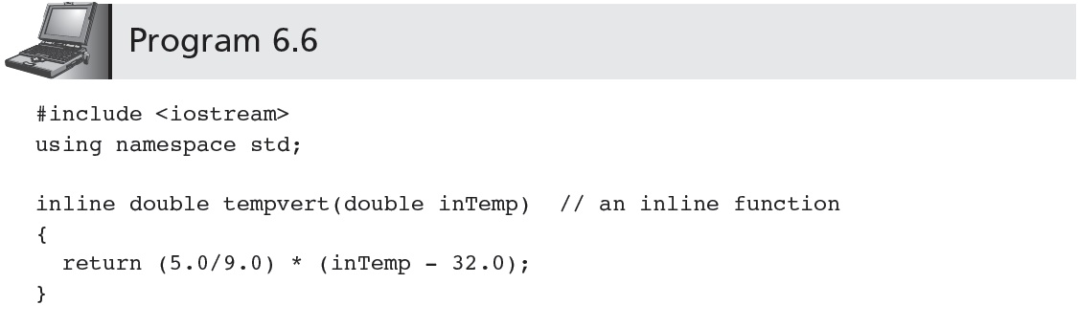
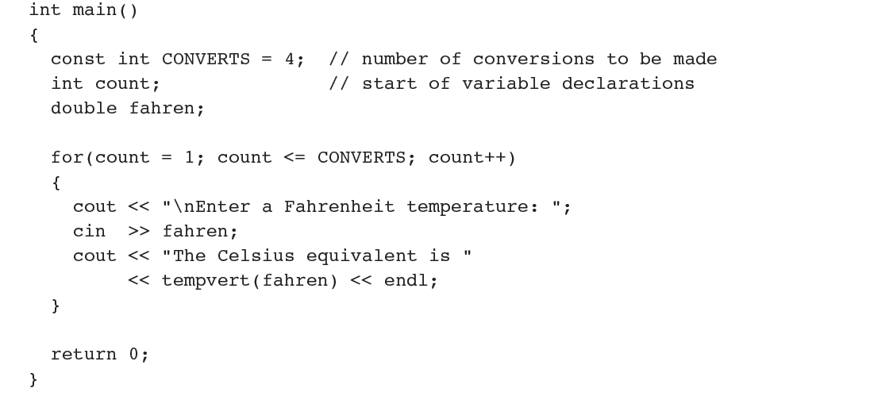
CSC 1100 – Wk7
40
A First Book of C++ 4th Edition

Slide 41
Templates with a Return Value
CSC 1100 – Wk7
Returning a value from a function template is identical to returning a value from a function
Data type T is also used to declare the return type of the function
41
A First Book of C++ 4th Edition

Slide 42
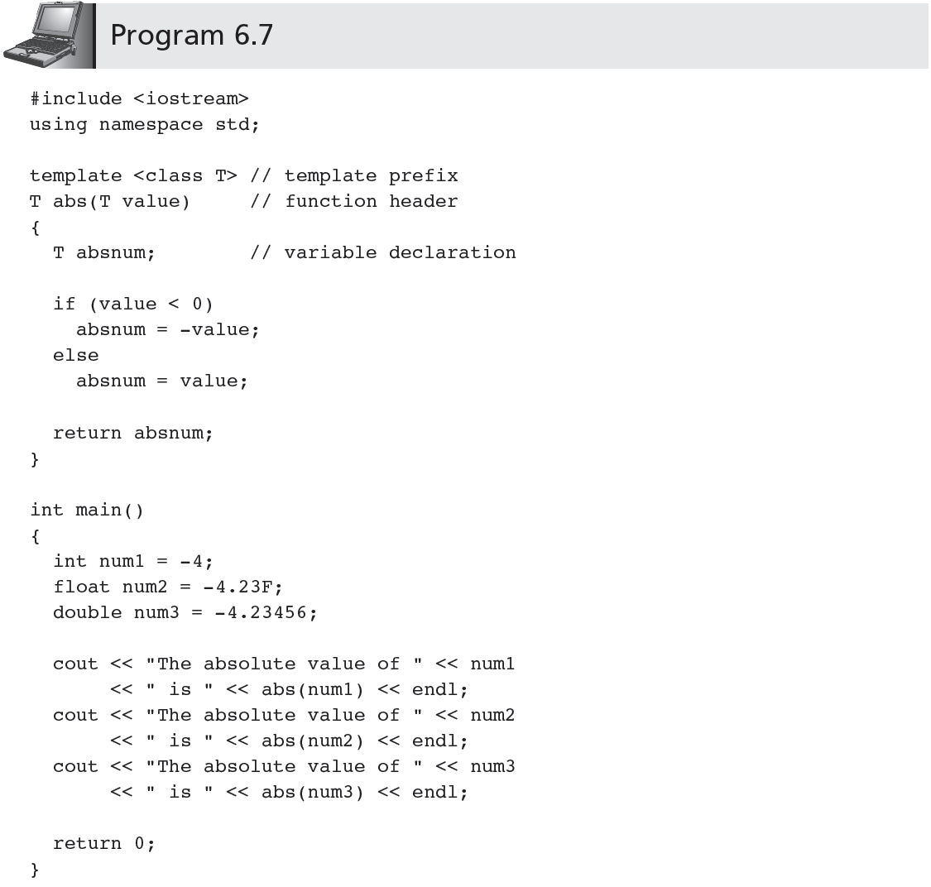
CSC 1100 – Wk7
template & function
declared before main ( )
42
A First Book of C++ 4th Edition

