Slide 1
C++ Programming: From Problem Analysis to Program Design (D.S. Malik, 2018) A First Book of C++, (G. Bronson, 2012) C++ for Everyone (C.S. Horstman, 2012)
CHAPTER 7 (Pt 1)
Single Dimensional Arrays:
Array Initialization & Arguments
ELEMENTS OF PROGRAMMING
CSC 1100

Slide 2
Objectives
CSC 1100 – Week8
DCS, KICT
In this chapter, you will learn about:
One-Dimensional Arrays
Array Initialization
Arrays as Arguments

Slide 3
One-Dimensional Arrays
CSC 1100 – Week8
DCS, KICT
One-dimensional array (single-dimension array or vector) :
A list of related values
All items in list have same data type
All list members stored using single group name
Example: a list of grades
98, 87, 92, 79, 85
All grades are integers and must be declared
Can be declared as single unit under a common name (the array name)
A First Book of C++ 4th Edition

Slide 4
One-Dimensional Arrays (cont'd.)
CSC 1100 – Week8
DCS, KICT
Array declaration statement provides:
The array (list) name
The data type of array items
The number of items in array
Syntax
dataType arrayName[numberOfItems]
Common programming practice requires defining number of array items as a constant before declaring the array
normally define as a
constant
A First Book of C++ 4th Edition

Slide 5
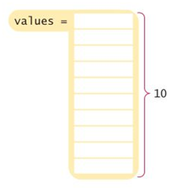
One-Dimensional Arrays (cont'd.)
CSC 1100 – Week8
DCS, KICT
Examples of array declaration statements:
// define constant for number of items
const int NUMS = 10;
int values[NUMS]; // declare array values
const int MAX = 4;
char code[MAX]; // array name code
const int SIZE = 100;
double amount[SIZE]; // array name amount
Use constants to define size of array
A First Book of C++ 4th Edition

Slide 6
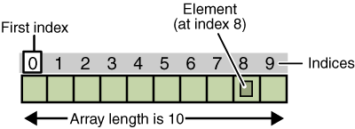
One-Dimensional Arrays (cont'd.)
CSC 1100 – Week8
DCS, KICT
array
element
int num[10]
Each array allocates sufficient memory to hold the number of data items given in declaration
Array element (component): an item of the array
Individual array elements stored sequentially
A key feature of arrays that provides a simple mechanism for easily locating single elements
A First Book of C++ 4th Edition

Slide 7
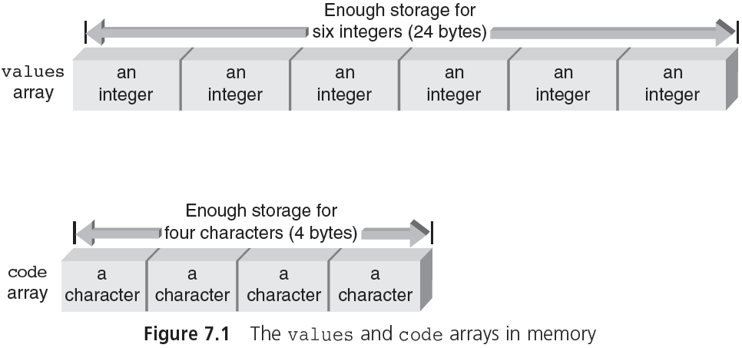
One-Dimensional Arrays (cont'd.)
CSC 1100 – Week8
DCS, KICT
int num[6]
1 int = 4 bytes
6 int = 4 x 6 = 24 bytes
char ch[4]
1 char = 1 byte
4 char = 4 x 1 = 4 bytes
A First Book of C++ 4th Edition

Slide 8
One-Dimensional Arrays (cont'd.)
CSC 1100 – Week8
DCS, KICT
Index (subscript value): position of individual element in an array
Accessing of array elements: done by giving array name and element’s index
grade[0] refers to first grade stored in grade array
Subscripted variables can be used anywhere that scalar variables are valid:
grade[0] = 95.75;
grade[1] = grade[0] - 11.0;
assigning value to an array
index/subscript
subtracting value from an array
A First Book of C++ 4th Edition

Slide 9
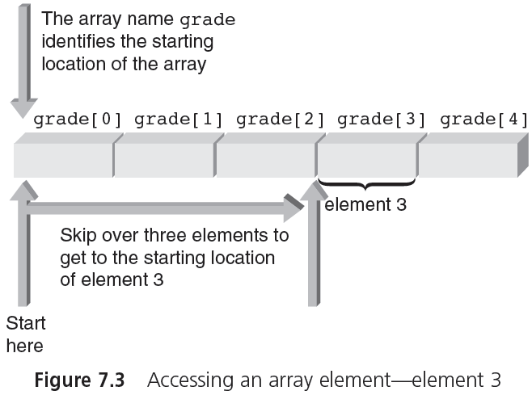
One-Dimensional Arrays (cont'd.)
CSC 1100 – Week8
DCS, KICT
4
4
4
A First Book of C++ 4th Edition

Slide 10
One-Dimensional Arrays (cont'd.)
CSC 1100 – Week8
DCS, KICT
Subscripts[ ]: do not have to be integers
Any expression that evaluates to an integer may be used as a subscript
Subscript must be within the declared range
Examples of valid subscripted variables (assumes i and j are int variables):
grade[i]
grade[2*i]
grade[j-i]
A First Book of C++ 4th Edition

Slide 11
Input and Output of Array Values
CSC 1100 – Week8
DCS, KICT
Individual array elements can be assigned values interactively using a cin stream object
cin >> grade[0];
cin >> grade[1] >> grade[2] >> grade[3];
cin >> grade[4] >> prices[6];
More efficient method, a for loop can be used
const int NUMELS = 5;
for (int i = 0; i < NUMELS; i++)
{
cout << "Enter a grade: ";
cin >> grade[i];
}
A First Book of C++ 4th Edition

Slide 12
Input and Output of Array Values (cont'd.)
CSC 1100 – Week8
DCS, KICT
Bounds checking: C++ does not check if value of an index is within declared bounds
If an out-of-bounds index is used, C++ will not provide notification
Program will attempt to access out-of-bounds element, causing program error or crash
Using symbolic constants (to define size of array) helps avoid this problem
A First Book of C++ 4th Edition

Slide 13
Input and Output of Array Values (cont'd.)
CSC 1100 – Week8
DCS, KICT
Using cout to display subscripted variables:
Example 1
cout << prices[5];
Example 2
cout << "The value of element " << i
<< " is " << grade[i];
Example 3
const int NUMELS = 20;
for (int k = 5; k < NUMELS; k++)
cout << k << " " << amount[k];
A First Book of C++ 4th Edition

Slide 14
Input and Output of Array Values (cont'd.)
CSC 1100 – Week8
DCS, KICT
Program example of array I/O (Program 7.1):
#include <iostream>
using namespace std;
int main()
{
const int NUMELS = 5;
int i, grade[NUMELS];//array grade of type int of size 5
for (i = 0; i < NUMELS; i++) // Enter the grades
{
cout << "Enter a grade: ";
cin >> grade[i]; // user enter 5 different values
}
cout << endl;
//loop through array list and display each item’s value
for (i = 0; i < NUMELS; i++) // Print the grades
cout << "grade [" << i << "] is " << grade[i] << endl;
return 0;
}
A First Book of C++ 4th Edition

Slide 15
Input and Output of Array Values (cont'd.)
CSC 1100 – Week8
DCS, KICT
Sample run using Program 7.1:
Enter a grade: 85
Enter a grade: 90
Enter a grade: 78
Enter a grade: 75
Enter a grade: 92
grade[0] is 85
grade[1] is 90
grade[2] is 78
grade[3] is 75
grade[4] is 92
A First Book of C++ 4th Edition

Slide 16
Array Initialization
CSC 1100 – Week8
DCS, KICT
Array elements can be initialized within declaration statements
Initializing elements must be included in braces
Example:
const int NUMGALS = 20;//size of array is 20
int gallons[NUMGALS] =
{19, 16, 14, 19, 20, 18, // initializing values
12, 10, 22, 15, 18, 17, // can extend across
16, 14, 23, 19, 15, 18, // multiple lines
21, 5}; // 20 different values for gallons
gallon[0] = 19;
gallon[6] = 12;
gallon[12] = 16;
gallon[19] = 21;
A First Book of C++ 4th Edition

Slide 17
Array Initialization (cont'd.)
CSC 1100 – Week8
DCS, KICT
Size of array may be omitted when initializing values are included in declaration statement
Example: the following different ways to define an array of with the same content:
const int NUMCODES = 6;
char code[6] = {'s', 'a', 'm', 'p', 'l', 'e'};
char code[NUMCODES] = {'s', 'a', 'm', 'p', 'l', 'e'};
char code[ ] = {'s', 'a', 'm', 'p', 'l', 'e'};
All declarations set aside six character locations for an array named code
similar
A First Book of C++ 4th Edition

Slide 18
Array Initialization (cont'd.)
CSC 1100 – Week8
DCS, KICT
Simplified method for initializing character arrays
char codes[ ] = "sample"; //a string, no braces or commas
This statement uses the string “sample” to initialize the code array
The array is comprised of seven characters
The first six characters are the letters:
s, a, m, p, l, e
The last character (the escape sequence \0) is called the null character ("sample\0")
Strings stored as an array of characters are known as C-Strings
A First Book of C++ 4th Edition

Slide 19
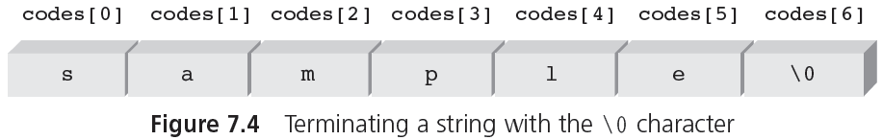
CSC 1100 – Week8
DCS, KICT
Array Initialization (cont'd.)
char codes[ ] = "sample"
null character
used as a sentinel to mark end of string
A First Book of C++ 4th Edition

Slide 20
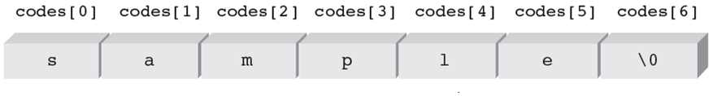
Array Initialization (cont'd.)
CSC 1100 – Week8
DCS, KICT
char code[ ] = {'s', 'a', 'm', 'p', 'l', 'e'}
no null character
A First Book of C++ 4th Edition

Slide 21
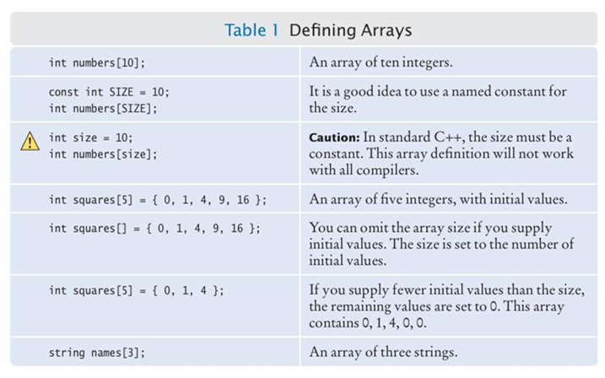
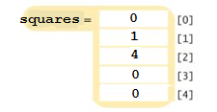
More Examples for Array Declarations
CSC 1100 – Week8
DCS, KICT

Slide 22
Arrays as Arguments
CSC 1100 – Week8
DCS, KICT
Array elements are passed to a called function in same manner as individual scalar variables
Example (function call):
findMax(grades[2], grades[6]);
Passing a complete array to a function provides access to the actual array, NOT a copy
Making copies of large arrays is wasteful of storage
Just like pass by reference, any changes is permanent
A First Book of C++ 4th Edition

Slide 23
Arrays as Arguments (cont'd.)
CSC 1100 – Week8
DCS, KICT
Examples of array declaration:
int nums[5]; // an array of five integers
char keys[256]; // an array of 256 characters
double units[500], grades[500];// two arrays of // 500 doubles
The following function calls can then be made:
findMax(nums); //use only the name of array
findCharacter(keys);
calcTotal(nums, units, grades); //pass 3 arrays
A First Book of C++ 4th Edition

Slide 24
Arrays as Arguments (cont'd.)
CSC 1100 – Week8
DCS, KICT
Suitable receiving side function header lines:
//from nums[5]
int findMax(int vals[5])
//from keys[256]
char findCharacter(char inKeys[256])
//from nums[5],units[500],grades[500]
void calcTotal(int arr1[5],double arr2[500],
double arr3[500])
The names of arrays passed as arguments from main() NEED NOT BE THE SAME
A First Book of C++ 4th Edition

Slide 25
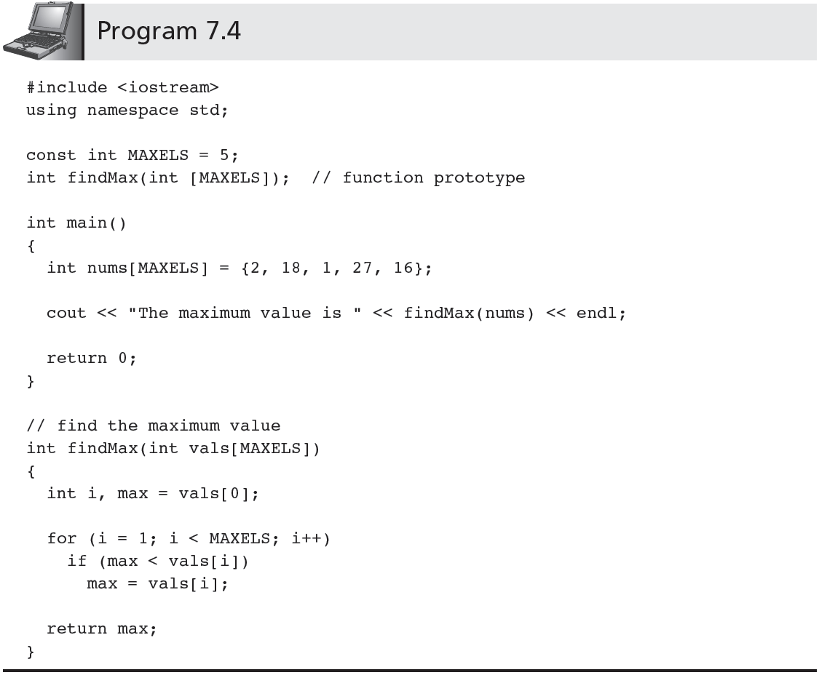
CSC 1100 – Week8
DCS, KICT
pass datatype & size in prototype
declare array with size
pass name of array in function call
pass name & size of array in fucntion header
A First Book of C++ 4th Edition

Slide 26
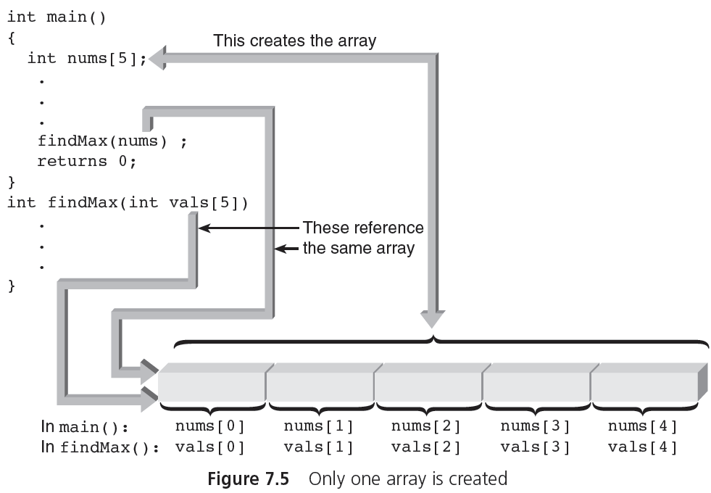
Arrays as Arguments (cont'd.)
CSC 1100 – Week8
DCS, KICT
=
nums is mapped to vals
A First Book of C++ 4th Edition

