Slide 1
C++ Programming: From Problem Analysis to Program Design (D.S. Malik, 2018) A First Book of C++, (G. Bronson, 2012) C++ for Everyone (C.S. Horstman, 2012)
CHAPTER 7 (Pt 2)
Typedef, Enum &Two Dimensional Arrays
ELEMENTS OF PROGRAMMING
CSC 1100

Slide 2
Objectives
CSC 1100 – Week9
DCS, KICT
In this chapter, you will learn about:
User defined data types: typedef & enums
Two-Dimensional Arrays
Common Programming Errors
Searching and Sorting Methods

Slide 3
User define data type 1: typedef
CSC 1100 – Week9
DCS, KICT
In C++, you can create synonyms or aliases to a previously defined data type by using the typedef statement shown in the following syntax :
typedef existingTypeName newTypeName;
typedef int integer;
typedef double decimal;
typedef is a reserved word in C++. It does not create a new datatype, but create aliases to an existing datatype.
creates an alias “integer” for data type int
creates an alias “decimal” for data type double

Slide 4

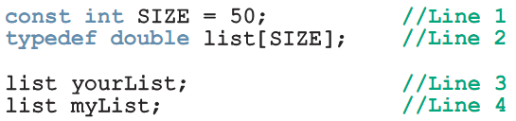
Example : Using typedef
CSC 1100 – Week9
DCS, KICT
creates an array alias “list[SIZE]” of data type double
uses the alias “list” to define a new variable yourList & myList as arrays of data type double

Slide 5
User define data type 2: enum
CSC 1100 – Week9
DCS, KICT
enum is user-defined data type in C++ consisting of a set of named values called elements, members, enumeral, or enumerators of the type.
To define an enumeration data type, you need the following items:
Name of the data type
A set of values for the data type (must be valid identifiers/ variables)
A set of operations on the values
The syntax for enumeration type :
enum typeName{value1, value2, ....};
C++ allows any integral type to be used as an array index
Improves code readability
C++ Programming: From Problem Analysis to Program Design (D.S. Malik, 2018)

Slide 6
Example : Using enum
CSC 1100 – Week9
DCS, KICT
No arithmetic operations or decrement/increment are allowed on the enumeration type without casting:
paint = paint + 1; (illegal)
paint++; (illegal)
paint = static_cast<paintType>(paint + 1); (legal)
The last statement will change the value of paint from GREEN to RED.
C++ Programming: From Problem Analysis to Program Design (D.S. Malik, 2018)

Slide 7
Example : Using enum
CSC 1100 – Week9
DCS, KICT

Slide 8
Two-Dimensional Arrays
CSC 1100 – Week9
DCS, KICT
Two-dimensional array (table): consists of both rows and columns of elements
Example: two-dimensional array of integers
col[0] col[1] col[2] col[3]
row[0] 8 16 9 5
row[1] 3 15 27 6
row[2] 14 25 2 10
Array declaration: names the array val and reserves storage for it
int val[2][2];
row col
col 0 col 1
row 0
row 1
array val with 2 cols and 2 rows
A First Book of C++ 4th Edition

Slide 9
Two-Dimensional Arrays (cont'd.)
CSC 1100 – Week9
DCS, KICT
Locating array elements
val[1][3] uniquely identifies element in row 1, column 3
Examples using elements of val array:
price = val[2][3]; // assign value in row 2, // col 3 into variable price
val[0][0] = 62;//assign 62 to row 0, col 0
newnum = 4 * (val[1][0] - 5);
sumRow = val[0][0] + val[0][1] + val[0][2] +
val[0][3];
The last statement adds the elements in row 0 and sum is stored in sumRow
A First Book of C++ 4th Edition

Slide 10
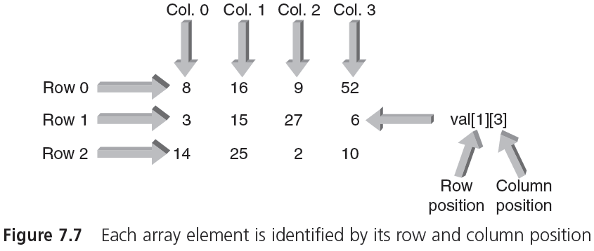
Two-Dimensional Arrays (cont'd.)
CSC 1100 – Week9
DCS, KICT
A First Book of C++ 4th Edition

Slide 11
Two-Dimensional Arrays (cont'd.)
CSC 1100 – Week9
DCS, KICT
Initialization: can be done within declaration statements (similar to single-dimension arrays)
Example:
int val[3][4] = { {8,16,9,52},
{3,15,27,6},
{14,25,2,10} };
First set of internal braces contains values for row 0, second set for row 1, and third set for row 2
Commas in initialization braces are required; inner braces can be omitted
col 0 1 2 3
row
0
1
2
A First Book of C++ 4th Edition

Slide 12
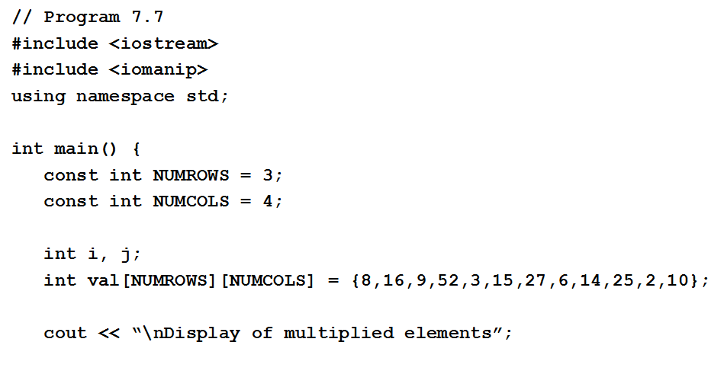
Two-Dimensional Arrays (cont'd.)
CSC 1100 – Week9
DCS, KICT
A First Book of C++ 4th Edition

Slide 13
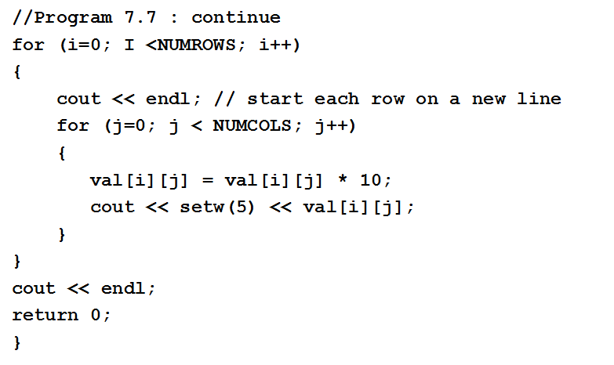
Two-Dimensional Arrays (cont'd.)
CSC 1100 – Week9
DCS, KICT
//rows
//cols
nested loop
A First Book of C++ 4th Edition

Slide 14
Two-Dimensional Arrays (cont'd.)
CSC 1100 – Week9
DCS, KICT
Processing two-dimensional arrays:
nested for loops are typically used
Easy to cycle through each array element
A pass through outer loop corresponds to a row
A pass through inner loop corresponds to a column
Nested for loop in Program 7.7 used to multiply each val element by 10 and display results
Output of Program 7.7
Display of multiplied elements
80 160 90 520
30 150 270 60
140 250 20 100
A First Book of C++ 4th Edition

Slide 15
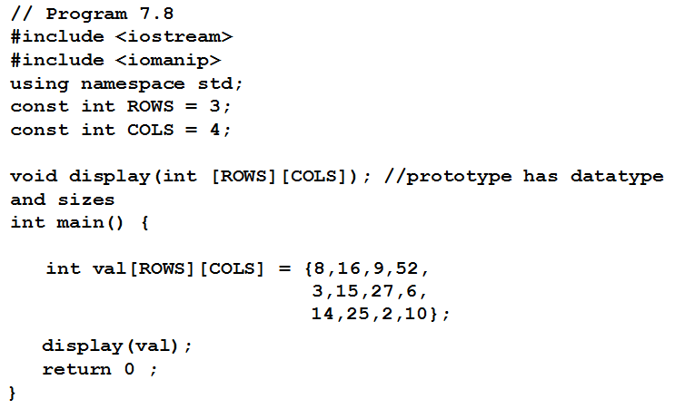
Two-Dimensional Arrays (cont'd.)
CSC 1100 – Week9
DCS, KICT
A First Book of C++ 4th Edition

Slide 16
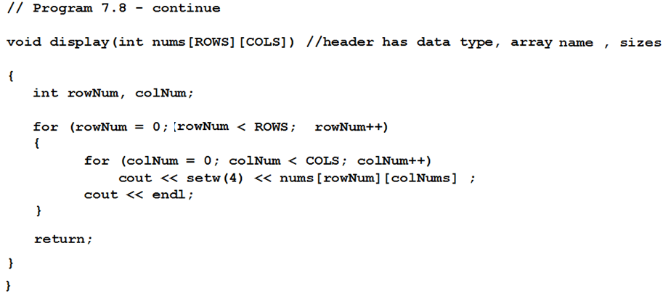
Two-Dimensional Arrays (cont'd.)
CSC 1100 – Week9
DCS, KICT
A First Book of C++ 4th Edition

Slide 17
Two-Dimensional Arrays (cont'd.)
CSC 1100 – Week9
DCS, KICT
Prototypes for functions that pass two-dimensional arrays can omit the row size of the array
Example (Program 7.8):
display (int [ ][4]);
Row size is optional, but column size is required
Assuming 4 bytes for an int, the element val[1][3] is located 28 bytes from the start of the array (i.e., offset)
A First Book of C++ 4th Edition

Slide 18
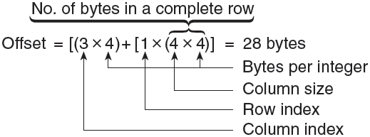
Two-Dimensional Arrays (cont'd.)
CSC 1100 – Week9
DCS, KICT
Determining offset of an array (int val [1][3])
Computer uses row index, column index, and column size to determine offset
3+1
A First Book of C++ 4th Edition

Slide 19
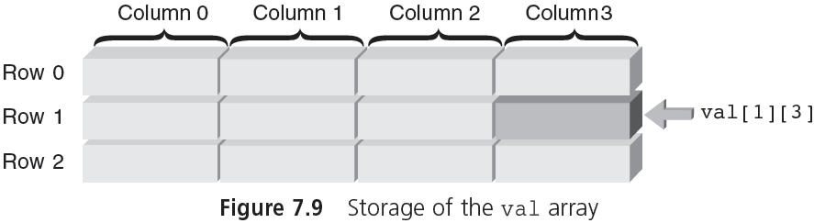
Two-Dimensional Arrays (cont'd.)
CSC 1100 – Week9
DCS, KICT
4 bytes
4 bytes
4 bytes
4 bytes
4 bytes
4 bytes
4 bytes
A First Book of C++ 4th Edition

Slide 20
Larger Dimensional Arrays
CSC 1100 – Week9
DCS, KICT
Arrays with more than two dimensions allowed in C++ but not commonly used
Example: int response[4][10][6]
First element is response[0][0][0]
Last element is response[3][9][5]
A three-dimensional array can be viewed as a book of data tables (Figure 7.10)
First subscript (rank) is page number of table
Second subscript is row in table
Third subscript is desired column
A First Book of C++ 4th Edition

Slide 21
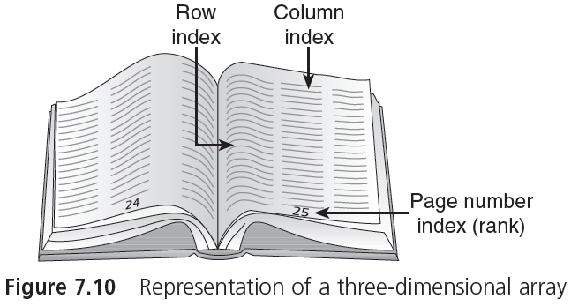
Larger Dimensional Arrays (cont'd.)
CSC 1100 – Week9
DCS, KICT
A First Book of C++ 4th Edition

Slide 22

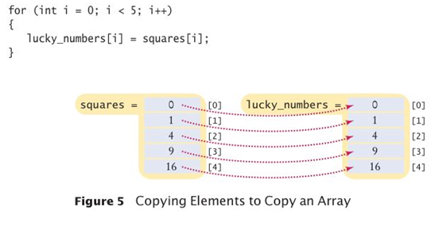
CSC 1100 – Week9
DCS, KICT
Copying Arrays
A First Book of C++ 4th Edition

Slide 23
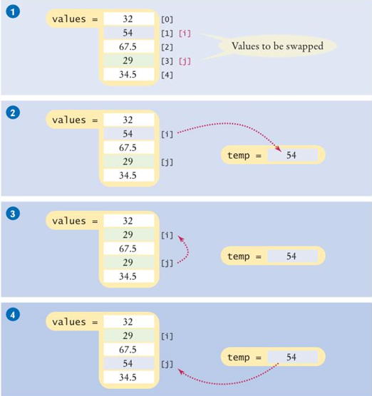
CSC 1100 – Week9
DCS, KICT
Swapping Arrays
Assume we want to swap
between values[1] (i) and
values[3] (j)
Copy values[i] in temp.
Copy values[j] to values[i].
Now values[i] get replaced with values[j]
Copy temp back to values[j].
A First Book of C++ 4th Edition

Slide 24
CSC 1100 – Week9
DCS, KICT
Sorting Arrays using Swapping Method (Bubble Sort)
A sorting algorithm rearranges the elements of a sequence so that they are stored in sorted order.
A First Book of C++ 4th Edition

Slide 25
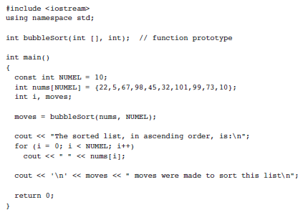
CSC 1100 – Week9
DCS, KICT
main function
A First Book of C++ 4th Edition

Slide 26
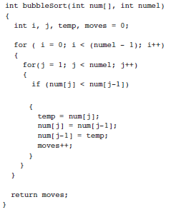
CSC 1100 – Week9
DCS, KICT
sort function
No of passes/iterations/rounds sorting is done
Compare pairs of numbers size-1 times
Compare first pair, '22' and '5' (first and second element)
If current number less than previous (if 5 < 22)
1. Assign current to temp (temp = 5)
2. Assign previous to current (nums[j] = 22)
3. Assign temp to previous (nums[j-1] = 5
4. Add one to moves counter to keep track of num. of moves
A First Book of C++ 4th Edition

Slide 27
Searching and Sorting Methods
CSC 1100 – Week9
DCS, KICT
Most programmers encounter the need to both sort and search a list of data items at some time in their programming careers
Example, in a list of names and phone numbers, you might search for a specific name so that the corresponding phone number can be printed, or you might need to search the list simply to determine whether a name is there
The two most common methods of performing these searches are the linear and binary search algorithms.
A First Book of C++ 4th Edition

Slide 28
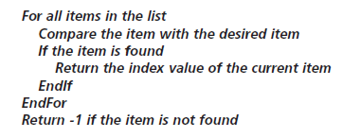
Linear Search Algorithm
CSC 1100 – Week9
DCS, KICT
Linear (sequential) search
Each item in the list is examined in the order in which it occurs until the desired item is found or the end of the list is reached
List doesn’t have to be in sorted order to perform the search
pseudo-code
A First Book of C++ 4th Edition

Slide 29
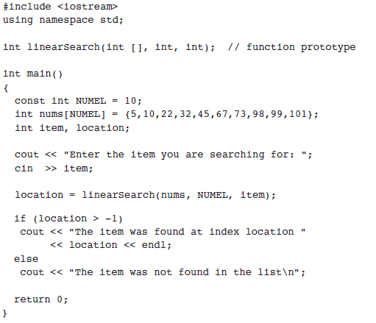
Linear Search
CSC 1100 – Week9
DCS, KICT
main function
A First Book of C++ 4th Edition

Slide 30
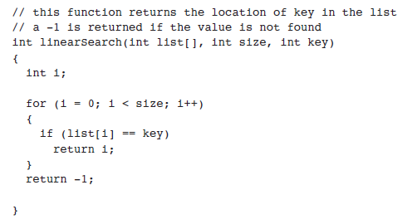
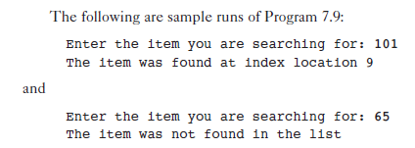
Linear Search (cont')
CSC 1100 – Week9
DCS, KICT
search function
Output
A First Book of C++ 4th Edition

Slide 31
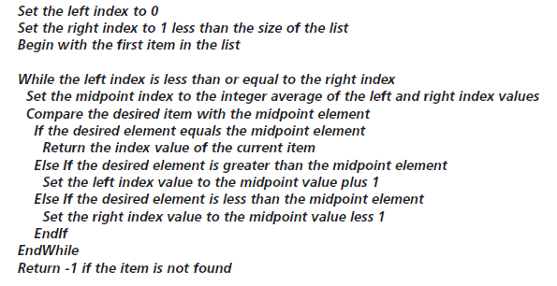
Binary Search Algorithm
CSC 1100 – Week9
DCS, KICT
Binary search
Starting with an ordered list, the desired item is first compared with the element in the middle of the list
If item is not found, you continue the search on either the first or second half of the list
pseudo-code
A First Book of C++ 4th Edition

Slide 32
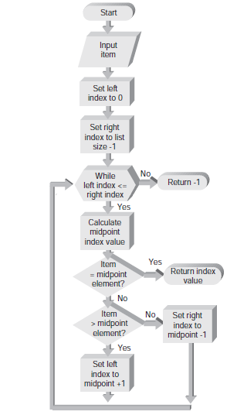
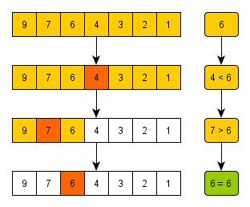
Binary Search
CSC 1100 – Week9
DCS, KICT
We cut the size of the search in half in each step.
Items must be sorted
Example: Search value -> 6
A First Book of C++ 4th Edition

Slide 33
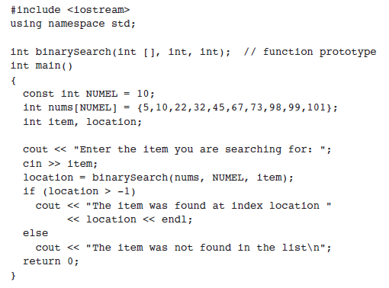
Binary Search
CSC 1100 – Week9
DCS, KICT
main function
A First Book of C++ 4th Edition

Slide 34
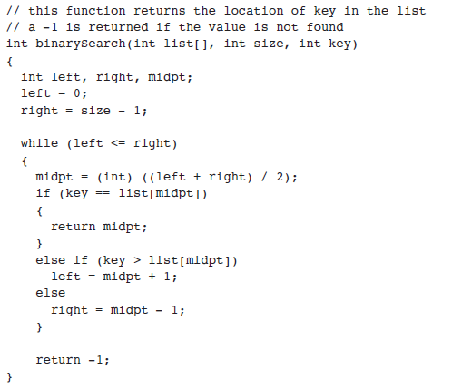

Binary Search (cont')
CSC 1100 – Week9
DCS, KICT
search function
Output:
A First Book of C++ 4th Edition

Slide 35
Common Programming Errors
CSC 1100 – Week9
DCS, KICT
Forgetting to declare an array
Results in a compiler error message equivalent to “invalid indirection” each time a subscripted variable is encountered within a program
Using a subscript that references a nonexistent array element (exceeding declared size/index)
For example, declaring array to be of size 20 (e.g, int val[20]) and using a subscript value of 25 (e.g, val[25])
Not detected by most C++ compilers and will probably cause a runtime error
A First Book of C++ 4th Edition

Slide 36
Common Programming Errors (cont'd.)
CSC 1100 – Week9
DCS, KICT
Not using a large enough counter value in a for loop counter to cycle through all array elements
Forgetting to initialize array elements
Don’t assume compiler does this.
Example:
val [8] = 60; // initialize or assign value to your array element
C++ does not allow functions to return a value of type array

Slide 37
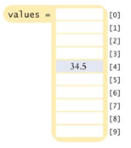
Summary
CSC 1100 – Week9
DCS, KICT
One-dimensional array: a data structure that stores a list of values of same data type
Must specify data type and array size
Example:
int num[100]; //creates an array of 100 integers
Array elements are stored in contiguous locations (in sequence) in memory and referenced using the array name and a subscript
Example: values[4]
means access the 5th element of the values array at index 4
A First Book of C++ 4th Edition

Slide 38
Summary (cont'd.)
CSC 1100 – Week9
DCS, KICT
Two-dimensional array is declared by listing both a row and column size with data type and name of array
Arrays may be initialized when they are declared
For two-dimensional arrays, you list the initial values, in a row-by-row manner, within braces and separating them with commas
Arrays are passed to a function by passing name of array as an argument
A First Book of C++ 4th Edition

Slide 39
2d Array Exercise
CSC 1100 – Week9
DCS, KICT
Given the following table listing the sold items in an electrical store, write a function with a 2d array argument that displays the Cost and Selling Price of each item (as shown in table) and compute the Profit/Loss (Selling Price – Cost) gained for each item. All values for Cost and Selling Price shall be entered by the user (cin >> ).
jth (column)
 | Cost | Selling Price | Profit/Loss
Fridge | 4500 | 4000 | ?
Air-conditioner | 1200 | 1900 | ?
Washing machine | 3300 | 3100 | ?
Television | 2555 | 3600 | ?
Oven | 2100 | 2999 | ?
ith row

Slide 40
CSC 1100 – Week9
DCS, KICT
Steps:
Create a 1d array of strings with 5 rows.
Initialize the 1d array with the names of the items (fridge, air-conditioner, etc...)
Create another empty 2d array with i row and j columns
Request the user to cin the values up until j-1 columns only (col 0 and col 1)
Pass the 2d array with user values to your function
In your function, calculate the profit/loss and update only the final jth column (col 2)
Display the items from the 1d array of strings
Display the selling price, cost and the profit/loss (negative values indicate loss)

