Slide 1
Chapter 8 (Pt 1):
ELEMENTS OF PROGRAMMING
CSC 1100
Introduction to Pointers & Array names as pointers

Slide 2
Self Reflection
CSC 1100 – Wk10
KICT motto: “Codes to Heaven”
Prophet Muhammad(s.a.w) said:
"Whoever bears arms against us is not one of us, and whoever cheats us is not one of us." (Saheeh Muslim)
“ASK ourselves what WRONG have we done yesterday
AND NOT
what GOOD have we done today…”
A First Book of C++ 4th Edition

Slide 3
Objectives
CSC 1100 – Wk10
In this chapter, you will learn about:
Introduction to Pointers
Array Names as Pointers
A First Book of C++ 4th Edition

Slide 4
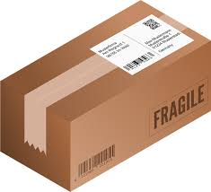




Introduction to Pointers: The Concept
CSC 1100 – Wk10
My Parents' Address:
777, Jalan Sulaman,
88400 Kota Kinabalu, Sabah
My Address:
123, Taman Greenwood,
68100 Batu Caves, Selangor
ship to
ship to
My Friend's Address:
321, Kent Street, Sydney, NSW 2000, Australia
A First Book of C++ 4th Edition

Slide 5
Introduction to Pointers
CSC 1100 – Wk10
Three major items of a variable:
Value stored
Number of bytes reserved
Where in memory these bytes are located
A First Book of C++ 4th Edition

Slide 6
Introduction to Pointers (cont'd.)
CSC 1100 – Wk10
Programmers are usually only concerned with a variable’s value, not its address
Address operator &: determines the address of a variable
& means “address of”
When placed in front of variable num, is translated as “the address of num” (&num)
Program 8.2 uses the address operator to display the address of variable num
A First Book of C++ 4th Edition

Slide 7
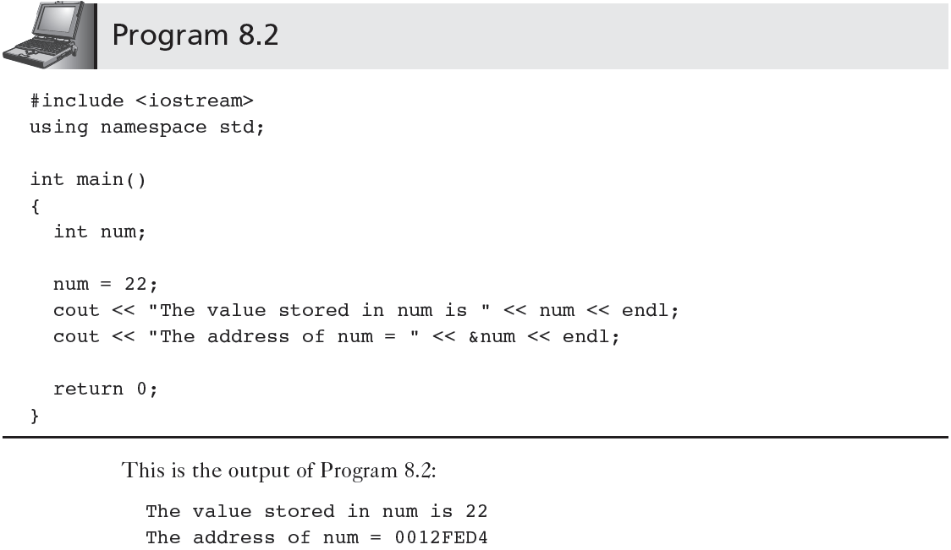
Introduction to Pointers (cont'd.)
CSC 1100 – Wk10
A First Book of C++ 4th Edition

Slide 8
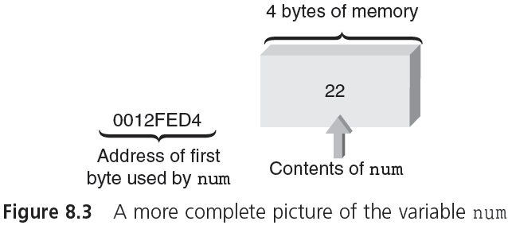
Introduction to Pointers (cont'd.)
CSC 1100 – Wk10
size
location
value
A First Book of C++ 4th Edition

Slide 9
Introduction to Pointers (cont'd.)
CSC 1100 – Wk10
A pointer tells you where a value is located, not what the value is.
With a variable, you can access a value at a fixed location, with a pointer the location can vary.
Pointers can be used to share values among different parts of a program
A First Book of C++ 4th Edition

Slide 10
Storing Addresses
CSC 1100 – Wk10
Address can be stored in suitably declared variables
Example:
int *numAddr; //declare pointer
numAddr = &num; //store addr into pointer
Statement stores address of num in variable numAddr
numAddr is a pointer
A First Book of C++ 4th Edition

Slide 11
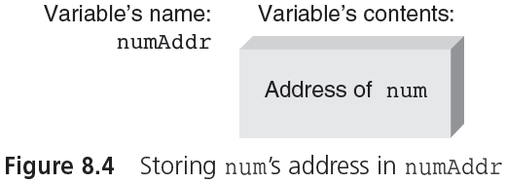
Storing Addresses (cont'd.)
CSC 1100 – Wk10
A First Book of C++ 4th Edition

Slide 12
Using Addresses
CSC 1100 – Wk10
Indirection Operator * : the * symbol, when followed by a pointer, means “the variable whose address is stored in”
If y is a pointer, then *y means “the variable whose address is stored in y”
Commonly shortened to “the variable pointed to by y”
Example (Figure 8.6):
The content of y is the address mmmm
The variable pointed to by y is qqqq
The content at address mmmm is qqqq
A First Book of C++ 4th Edition

Slide 13
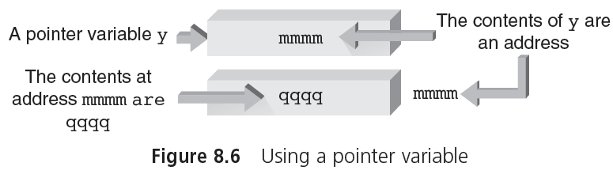
Using Addresses (cont'd.)
CSC 1100 – Wk10
*y
Indirect Addressing
A First Book of C++ 4th Edition

Slide 14
Using Addresses (cont'd.)
CSC 1100 – Wk10
Using a pointer requires a double lookup
First an address is retrieved
Address is used to retrieve actual data
Why store addresses if data can be retrieved in one step using variable’s name?
Pointers make it possible to create and delete new storage locations dynamically during program execution
A First Book of C++ 4th Edition

Slide 15
Declaring Pointers
CSC 1100 – Wk10
Pointers must be declared before they can store an address
Example: if address in pointer numAddr is the address of an integer, the declaration is:
int *numAddr;
This declaration is read as “the variable pointed to by numAddr is an integer”
The declaration specifies:
The variable pointed to by numAddr is an integer
numAddr is a pointer (because it is used with the indirection operator *)
A First Book of C++ 4th Edition

Slide 16
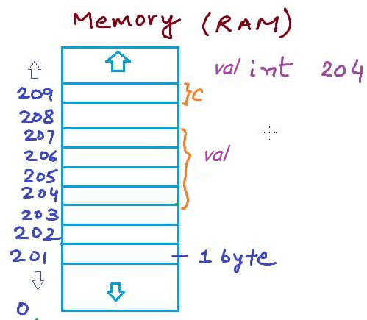
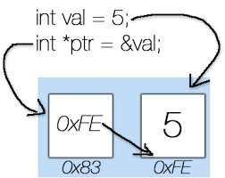
Declaring Pointers (cont'd.)
CSC 1100 – Wk10
char c;
int val;
A First Book of C++ 4th Edition

Slide 17
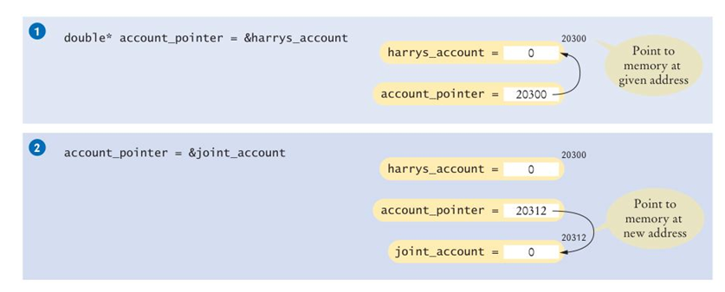
Pointers and Memory
CSC 1100 – Wk10
C++ for Everyone

Slide 18
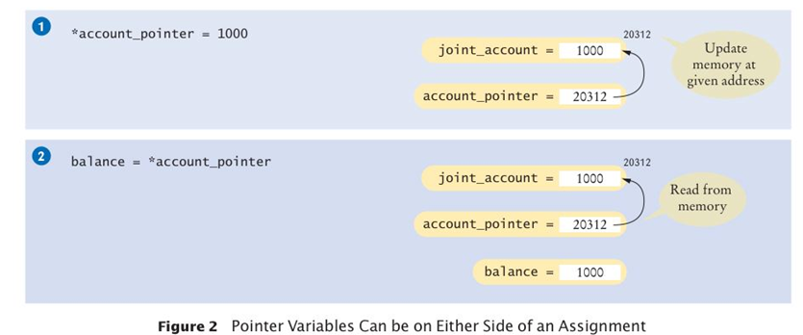
Pointers and Memory
CSC 1100 – Wk10
A First Book of C++ 4th Edition

Slide 19
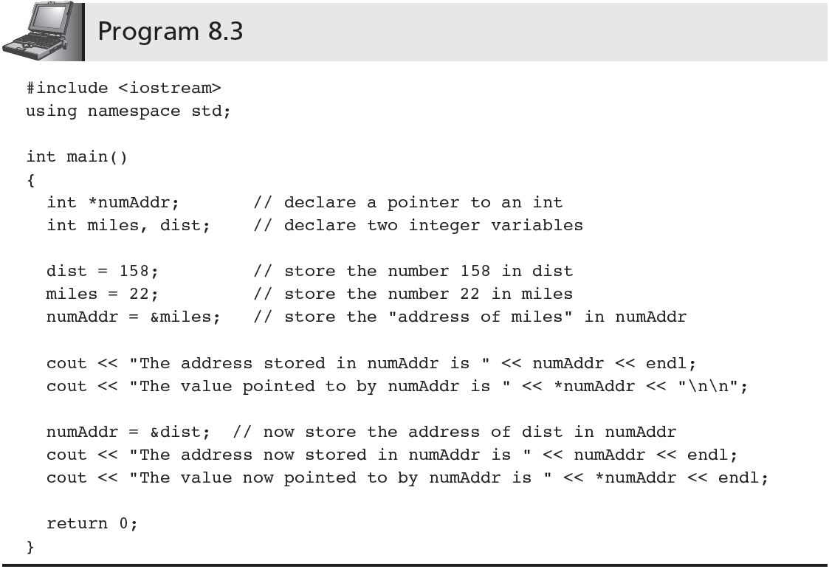
CSC 1100 – Wk10
A First Book of C++ 4th Edition

Slide 20
Declaring Pointers (cont'd.)
CSC 1100 – Wk10
Program 8.3 output:
The address stored in numAddr is 0012FEC8
The value pointed to by numAddr is 22
The address now stored in numAddr is 0012FEBC
The value now pointed to by numAddr is 158
A First Book of C++ 4th Edition

Slide 21
Declaring Pointers (cont'd.)
CSC 1100 – Wk10
Program 8.3 actions:
Declaration statement int *numAddr;
declares numAddr as pointer variable storing the address of an integer variable
Data type determines pointer storage requirements
Statement numAddr = &miles;
stores address of variable miles into pointer numAddr
First cout statement: displays address
Second cout statement: uses indirection operator (*) to retrieve and display the value pointed to by numAddr (the value stored in miles)
A First Book of C++ 4th Edition

Slide 22
Declaring Pointers (cont'd.)
CSC 1100 – Wk10
Program 8.3 actions:
Statement numAddr = &dist;
changes numAddr’s value to address of variable dist
This is allowed because the pointer numAddr can be used to point to any integer value (miles and dist are both integer values)
Last two cout statements:
Verify change in numAddr value
Confirm that new stored address points to variable dist
A First Book of C++ 4th Edition

Slide 23
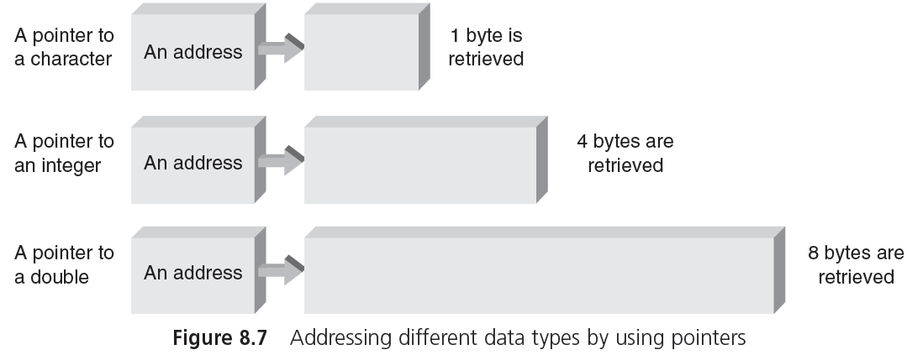
Declaring Pointers (cont'd.)
CSC 1100 – Wk10
A First Book of C++ 4th Edition

Slide 24
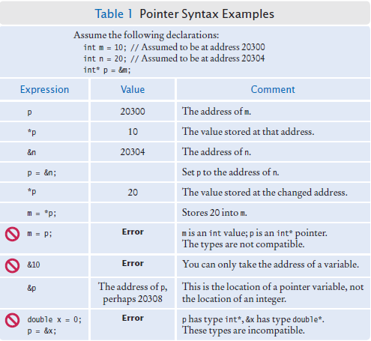
Pointer Declarations Examples
CSC 1100 – Wk10
C++ for Everyone 2nd Edition

Slide 25
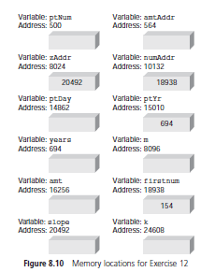
Exercise
CSC 1100 – Wk10
18938
24608
For the variables and addresses in Figure 8.10, fill in the data determined by the
following statements (Pg 353, 354):
a. ptNum =&firstnum;
b. amtAddr =&k;
c. *zAddr = 48;
d. m =*numAddr;
e. ptDay = amtAddr;
f. *ptYr = 2016;
g. *amtAddr = *zAddr;
24608
2016
154
48
48
A First Book of C++ 4th Edition

Slide 26
References and Pointers
CSC 1100 – Wk10
Reference: named constant for an address
Address named as a reference can’t be altered after the address has been assigned
Automatic dereference: an indirect access of a variable’s value without using the indirection operator symbol (*)
Instead, uses reference pointer(&)
A First Book of C++ 4th Edition

Slide 27
References and Pointers (cont'd.)
CSC 1100 – Wk10
Example of automatic dereference (using & instead of * get values of pointers):
int b; // b is an integer variable
int &a = b; // a is a reference variable that stores b's address
a = 10; // this changes b's value to 10
Statement int &a = b;
a declared a reference variable
Compiler assigns address of b (not the contents of b)
Statement a = 10; compiler uses address stored in a to change the value stored in b to 10
A First Book of C++ 4th Edition

Slide 28
References and Pointers (cont'd.)
CSC 1100 – Wk10
Repeat of previous example using pointers instead of automatic dereferencing (use * instead of & to get values of pointers)
int b; // b is an integer variable
int *a = &b; // a is a pointer // store b's address in a
*a = 10; // this changes b's value
// to 10
a is a pointer initialized to store address of b
A First Book of C++ 4th Edition

Slide 29
References and Pointers (cont'd.)
CSC 1100 – Wk10
Pointer a can be altered to point to a different variable
int b, c; // b is an integer variable
int *a = &b; // a is a pointer – store b's address in a
*a = 10; // this changes b's value to 10
int *a = &c; // a is a pointer – store c's address in a
*a = 15; // this changes c's value to 15
Reference variable a (from previous example) cannot be altered to refer to any variable except one to which it was initialized
int b, c; // b is an integer variable
int &a = b; // a is a reference variable that store b's
// address
a = 10; // this changes b's value to 10
int &a = c; // this is an invalid assignment
a = 15; // this is an invalid assignment
A First Book of C++ 4th Edition

Slide 30
References and Pointers (cont'd.)
CSC 1100 – Wk10
//Program 8.4
#include <iostream>
using namespace std;
int main()
{
double total = 20.5; //declare and initialize total
double &sum = total; // declare another name for total
cout << "sum = " << sum << endl; // displays address of total
sum = 18.6; //changes the value of total
cout << "total = " << total << endl; //display 18.6
return 0;
}
A First Book of C++ 4th Edition

Slide 31
Array Names as Pointers
CSC 1100 – Wk10
If grade is a single-dimensional array containing five integers, the fourth element is grade[3]
C++ compiler computation of the address of grade[3]: (assuming 4 bytes per integer)
&grade[3] = &grade[0] + (3 * 4)
col*byte size (offset)
This statement reads as “the address of grade[3] equals the address of grade[0] plus 12”
Figure 8.12 illustrates the address computation used to locate grade[3]
A First Book of C++ 4th Edition

Slide 32
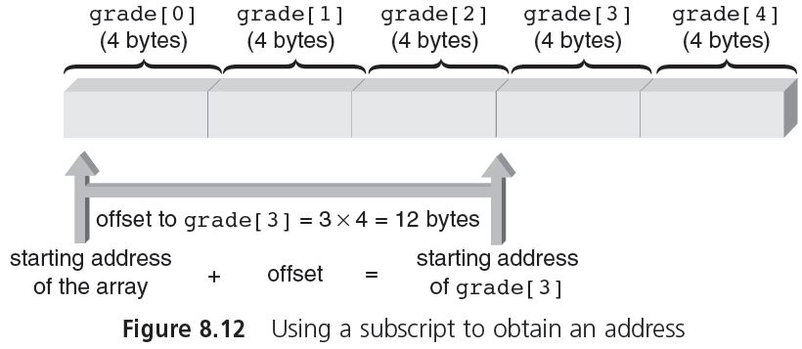
Array Names as Pointers (cont'd.)
CSC 1100 – Wk10
A First Book of C++ 4th Edition

Slide 33
Array Names as Pointers (cont'd.)
CSC 1100 – Wk10
Offset: number of positions beyond first element in array
Using offset, we can simulate process used by computer to access array elements
Example (Figure 8.14 and Table 8.1):
Store address of grade[0] in pointer gPtr
Use offset to find location of grade[3]
Expression *(gPtr + 3) references variable that is three integers beyond variable pointed to by gPtr
A First Book of C++ 4th Edition

Slide 34
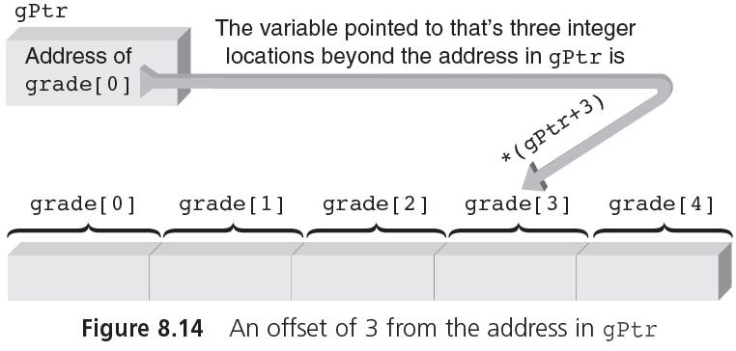
Array Names as Pointers (cont'd.)
CSC 1100 – Wk10
A First Book of C++ 4th Edition

Slide 35
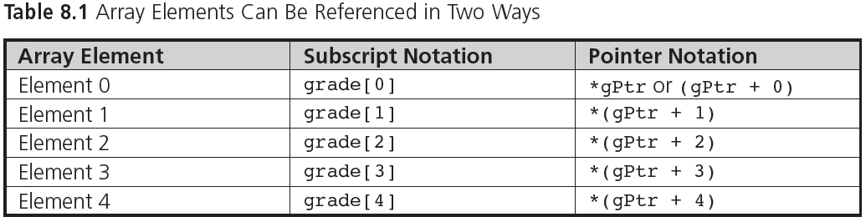
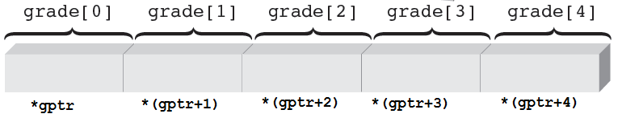
Array Names as Pointers (cont'd.)
CSC 1100 – Wk10
A First Book of C++ 4th Edition

Slide 36
Accessing Array Elements using Pointers 1
CSC 1100 – Wk10
//Program 8.6 – Method 1, assign starting address to pointer
#include <iostream>
using namespace std;
int main()
{
const int ARRAYSIZE = 5;
int *gptr; // declare a pointer to an int
int i, grade[ARRAYSIZE] = {98,87,92,79,85};
gptr = &grade[0]; // store starting of array address in ptr
for (i=0; i < ARRAYSIZE; i++)
cout << "\nElement " << i << " is " << *(gptr + i);
cout << endl;
return 0;
}
A First Book of C++ 4th Edition

Slide 37
Accessing Array Elements Using Pointers 2
CSC 1100 – Wk10
//Program 8.7 – Method 2, use array itself as pointer
#include <iostream>
using namespace std;
int main()
{
const int ARRAYSIZE = 5;
int i, grade[ARRAYSIZE] = {98,87,92,79,85};
for (i=0; i < ARRAYSIZE; i++)
cout << "\nElement " << i << " is " << *(grade + i);
cout << endl;
return 0;
}
A First Book of C++ 4th Edition

Slide 38
Have you understood your pointers?
CSC 1100 – Wk10
What are the printouts for the following statements?
int a = 45;
int *x = &a;
cout << *x;
int b = 35;
x = &b;
cout << *x;
double m = 3.4;
double *p1 = &m;
double n = 5.5;
double *p2 = &n;
cout << *p2 - *p1;
int x = 5;
float *qY = &x;
cout << *qY;
Compilation error
(cannot convert int to float)
45
35
2.1
A First Book of C++ 4th Edition

Slide 39
Pointer Exercise
CSC 1100 – Wk10
Create a one dimensional array named myMessage that stores the string “Pointers are confusing”.
Create a pointer variable that points to the content of myMessage. Using a function, display only the characters at locations of multiples of 3 (i.e, index 3,6,9,12, ...) of the message in reverse order.
Your output shall display the following:
gsn arn
A First Book of C++ 4th Edition

