Slide 1
Chapter 8 (Pt 2):
ELEMENTS OF PROGRAMMING
CSC 1100
Pointer Arithmetic & Passing Addresses

Slide 2
Objectives
CSC 1100 – Wk10
In this chapter, you will learn about:
Pointer Arithmetic
Passing Addresses
Common Programming Errors
A First Book of C++ 4th Edition

Slide 3
Dynamic Array Allocation
CSC 1100 – Wk10
Static array allocation: as variables are defined, storage is assigned from a memory pool
Specific memory locations are fixed for life of a variable, used or not
Example: function requests storage for an array of 500 integers
If application requires less than 500 integers, unused storage is not released until array goes out of scope
If more than 500 integers required, array size must be increased and the function recompiled
A First Book of C++ 4th Edition

Slide 4
Dynamic Array Allocation (cont’d.)
CSC 1100 – Wk10
Dynamic allocation: storage allocated is determined and adjusted as program is run
Useful when dealing with lists
Allows list to expand and contract as list items are added and deleted
Example: constructing list of grades
Don’t know number of grades ultimately needed
Need a mechanism to enlarge and shrink array
new and delete operators: provide capability
A First Book of C++ 4th Edition

Slide 5
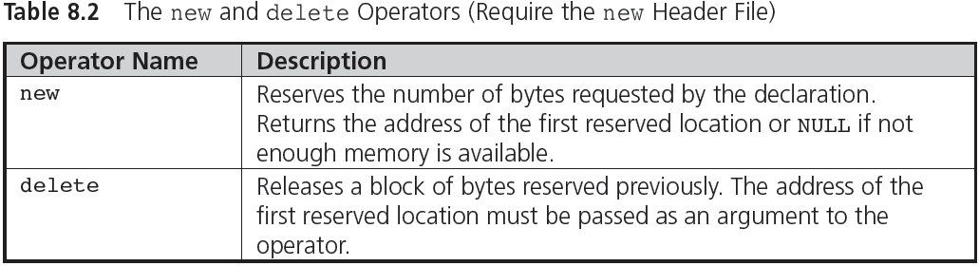
Dynamic Array Allocation (cont’d.)
CSC 1100 – Wk10
A First Book of C++ 4th Edition

Slide 6
Dynamic Array Allocation (cont'd.)
CSC 1100 – Wk10
Dynamic storage requests for scalar variables or arrays made in declaration or assignment statements
Example 1 (assign value to pointer upon declaration):
int *num = new int;
Reserves space for an integer variable
Stores address of this variable into pointer num
A First Book of C++ 4th Edition

Slide 7
Dynamic Array Allocation (cont'd.)
CSC 1100 – Wk10
Example 2: same function as Example 1
(declare pointer first, assign value in next
statement)
int *num;
num = new int;
Heap: free storage area of a computer
Consists of unallocated memory, can be allocated to a running program
In Examples 1 and 2, new storage comes from free storage area (heap)
A First Book of C++ 4th Edition

Slide 8
Dynamic Array Allocation (cont'd.)
CSC 1100 – Wk10
Example of dynamic allocation of an array:
int *grade = new int[200];
Statement reserves storage for 200 integers and places address of first integer into pointer grade
Same example with variable dimension
cout << "Enter the number of grades to be"
<< " processed: ";
cin >> numgrades;
int *grades = new int[numgrades];
Size of array depends on user input
Values accessed by array notation: grades[i]
Values accessed by pointer notation: *(grades+i)
A First Book of C++ 4th Edition

Slide 9
CSC 1100 – Wk10
Example: Dynamic array allocation at runtime
#include <iostream>
using namespace std;
int main()
{
int numgrades;
//dynamic array allocation
cout << "Enter the number of grades to be processed: ";
cin >> numgrades;
int *grades = new int[numgrades];
for (int i = 0; i < numgrades; i++)
{
cout << "Please enter grade " << i << " ";
cin >> *(grades + i);
}
for (int j = 0; j < numgrades; j++)
{
cout << *(grades + j) << endl;
}
return 0;
}
A First Book of C++ 4th Edition

Slide 10
Pointer Arithmetic
CSC 1100 – Wk10
By adding to and subtracting from pointers, we can obtain different addresses
Pointers can be compared using relational operators ( ==, !=, <, >, etc.)
Consider declarations:
int nums[100];
int *nPt;
Set address of nums[0] into nPt using:
nPt = &nums[0];
nPt = nums;
similar (an array is by default a pointer)
A First Book of C++ 4th Edition

Slide 11
Pointer Arithmetic (cont'd.)
CSC 1100 – Wk10
After nPt is assigned a valid address, values can be added or subtracted to produce new addresses
Scaling: automatic adjustment of computed address, ensures points to value of correct type
Example: nPt = nPt + 4;
Assuming an integer requires 4 bytes, the computer multiplies 4 by 4 and adds 16 to the address in nPt
computing new address
A First Book of C++ 4th Edition

Slide 12
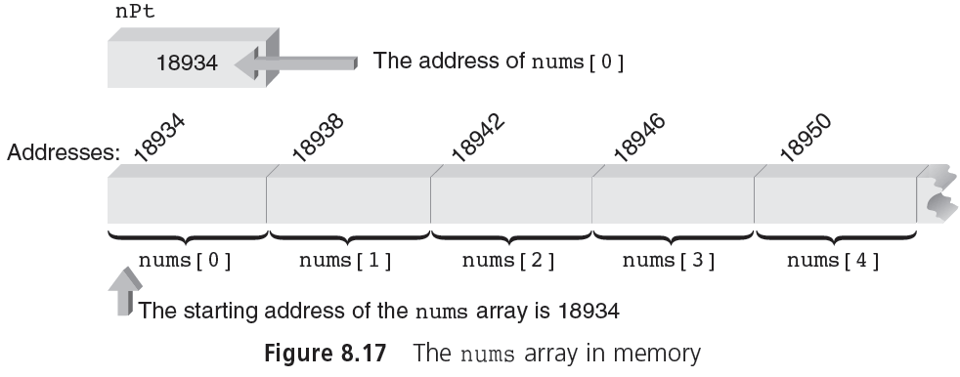
Pointer Arithmetic (cont'd.)
CSC 1100 – Wk10
+4 bytes
+4 bytes
+4 bytes
+4 bytes
A First Book of C++ 4th Edition

Slide 13
Pointer Initialization
CSC 1100 – Wk10
Pointers can be initialized when declared
Example: int *ptNum = &miles;
Above initialization valid only if miles was declared as an integer prior to above statement
The following statements produce an error
int *ptNum = &miles;//miles not declared yet
int miles;
Arrays can be initialized within declarations
double *zing = &prices[0];
This statement is valid if prices has already been declared as a double-precision array
A First Book of C++ 4th Edition

Slide 14
Passing Addresses
CSC 1100 – Wk10
Passing addresses to function using reference variables was addressed in Chapter 6
Implied use of addresses because the reference does provide the function with an address
The function call swap(num1, num2) does not tell whether parameters are passed by value or reference
Must look at function prototype or header line to determine
A First Book of C++ 4th Edition

Slide 15
Passing Addresses (cont'd.)
CSC 1100 – Wk10
Explicit passing of an address to a function: place the address operator (&) in front of variable being passed
Example (Figure 8.19 and Program 8.11):
swap(&firstnum, &secnum);//in function call
This function call passes the addresses of firstnum and secnum to swap()
Explicitly passing addresses using the address operator is effectively a pass by reference
A First Book of C++ 4th Edition

Slide 16
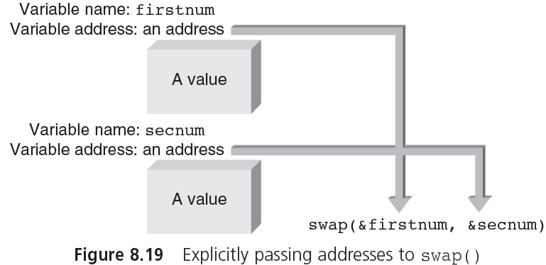
Passing Addresses (cont'd.)
CSC 1100 – Wk10
A First Book of C++ 4th Edition

Slide 17
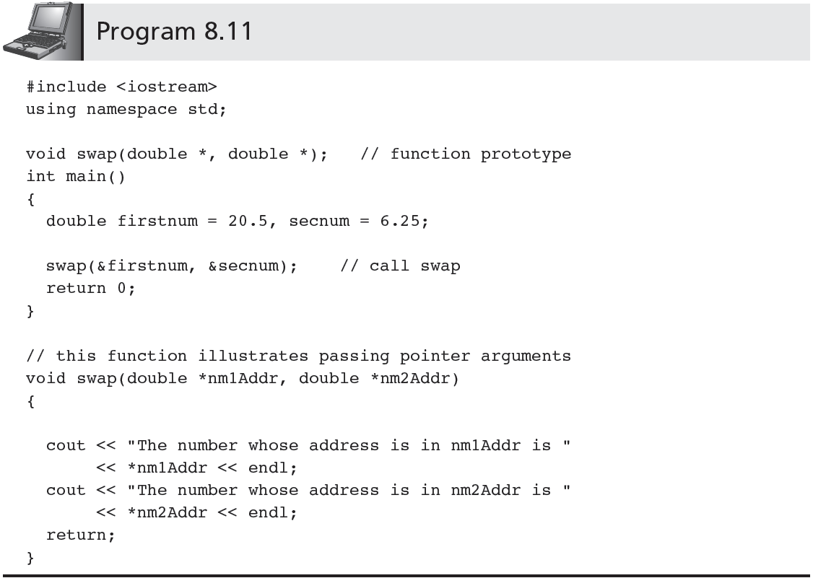
Passing Addresses (cont'd.)
CSC 1100 – Wk10
A First Book of C++ 4th Edition

Slide 18
Passing Arrays
CSC 1100 – Wk10
When array is passed to a function, address of first location is the only item passed
Program 8.13 passes an array to a function using conventional array notation
A First Book of C++ 4th Edition

Slide 19
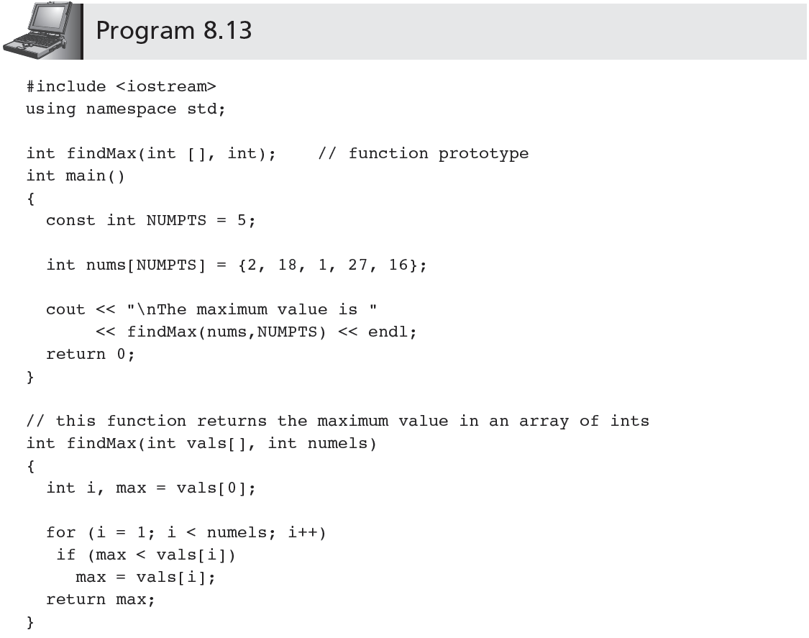
CSC 1100 – Wk10
//vals = &nums[0]
A First Book of C++ 4th Edition

Slide 20
Passing Arrays (cont'd.)
CSC 1100 – Wk10
Parameter vals in header line declaration for findMax() in Program 8.13 actually receives the address of array nums
Thus, val is really a pointer
Another suitable header line for findMax() is:
int findMax(int *vals, int numels)
// here vals is declared as a pointer
// to an integer
A First Book of C++ 4th Edition

Slide 21
Advanced Pointer Notation
CSC 1100 – Wk10
Access to multidimensional arrays can be made using pointer notation
Example: consider the declaration:
int nums[2][3] = { {16,18,20},
{25,26,27} };
Creates an array of elements and a set of pointer constants named nums, nums[0], and nums[1] (as shown in Figure 8.26)
A First Book of C++ 4th Edition

Slide 22
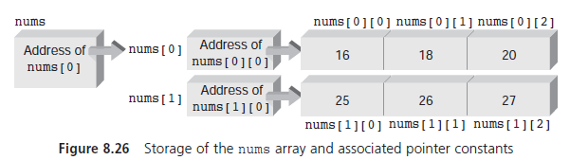
Advanced Pointer Notation (cont'd.)
CSC 1100 – Wk10
A First Book of C++ 4th Edition

Slide 23
Advanced Pointer Notation (cont'd.)
CSC 1100 – Wk10
Two-dimensional array pointer constants allow for accessing array elements in several ways
Address of first element in first row of nums is nums[0]
Address of first element in second row is nums[1]
Variable pointed to by nums[0] is num[0][0]
Variable pointed to by nums[1] is num[1][0]
Each element can be accessed by applying an offset to the correct pointer
A First Book of C++ 4th Edition

Slide 24
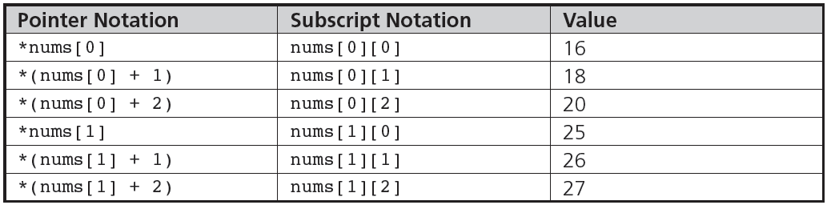
Advanced Pointer Notation (cont'd.)
CSC 1100 – Wk10
Pointer Notation | Subscript Notation | Values
*(*nums) | nums[0][0] | 16
*(*nums + 1) | nums[0][1] | 18
*(*nums + 2) | nums[0][2] | 20
*(*(nums + 1)) | nums[1][0] | 25
*(*(nums + 1) + 1) | nums[1][1] | 26
*(*(nums + 1) + 2) | nums[1][2] | 27
A First Book of C++ 4th Edition

Slide 25
Common Programming Errors
CSC 1100 – Wk10
Attempting to explicitly store an address in a variable that has not been declared as a pointer
Using a pointer to access nonexistent array elements
Incorrectly applying address and indirection operators
If pt is a pointer variable, the expressions:
pt = &45 //must be variable name, e.g:&num
pt = &(miles + 10) //&(miles + num)-> ok
are both invalid because they attempt to take
the address of a value
A First Book of C++ 4th Edition

Slide 26
Common Programming Errors (cont'd.)
CSC 1100 – Wk10
Taking addresses of pointer constants
For example, given the declarations:
int nums[25];
int *pt;
the assignment pt = &nums; //INVALID
nums is a pointer constant that is itself equivalent to an address; the correct assignment is :
pt = nums OR pt = &nums[0]
Taking addresses of a reference argument, reference variable, or register variable
A First Book of C++ 4th Edition

Slide 27
Common Programming Errors (cont'd.)
CSC 1100 – Wk10
Initializing pointer variables incorrectly
Initialization int *pt = 5; // INVALID
pt is a pointer to an integer; it must be initialized with a valid address
Becoming confused about whether a variable contains an address or is an address
int &dist = miles; // contains an address or is an address???
int dist = &miles; // contains an address or is an address???
Forgetting to use the bracket set, [ ], after the delete or new operator when dynamically allocating or deallocating memory
A First Book of C++ 4th Edition

Slide 28
Summary
CSC 1100 – Wk10
Every variable has: data type, address, value
A pointer is a variable that is used to store the address of another variable
An array name is a pointer constant
Access to an array element using a subscript can always be replaced using a pointer
Arrays can be dynamically created as a program is executing
A First Book of C++ 4th Edition

Slide 29
Summary (cont'd.)
CSC 1100 – Wk10
Arrays are passed to functions as addresses
When a single-dimensional array is passed to a function, the parameter declaration for the function can be either an array declaration or a pointer declaration
Pointers can be incremented, decremented, compared, and assigned
A First Book of C++ 4th Edition

