Slide 1
C++ Programming: From Problem Analysis to Program Design (D.S. Malik, 2018) C++ for Everyone (C.S. Horstman, 2012)
CHAPTER 10 (Pt 1) :
Introduction to Object Oriented Concepts: Classes & Data Abstraction
ELEMENTS OF PROGRAMMING
CSC 1100

Slide 2
Objectives
CSC 1100 – Week13
DCS, KICT
In this chapter, you will learn about:
Structured vs Object Oriented Programming
Introduction to Classes and Objects
Creating and using Objects
Defining member functions
Constructors
Data Field Encapsulation

Slide 3
Abstraction
CSC 1100 – Week14
DCS, KICT
A general model or general characteristics of an object.
Details of internal components, organizations and operations of an object are kept separate from the description of what it can do and how to operate it
Object-oriented model is based on abstraction
Example:
Washing machines, microwaves,
We know how to operate them, but do not need to know how they work inside.

Slide 4
Object Oriented Programming
CSC 1100 – Week13
DCS, KICT
Structured Programming
Attributes
Step 1
Step 1
Object
Step 2
Methods
Step 2
Step 3
Step 3

Slide 5
Object Oriented Programming
CSC 1100 – Week13
DCS, KICT
Object-oriented programming (OOP) involves programming using objects.
An object represents an entity in the real world that can be distinctly identified.
For example, a student, a desk, a circle, a button, and even a loan can all be viewed as objects.
An object has a unique identity, state, and behaviors

Slide 6
Object Oriented Programming Concept
CSC 1100 – Week13
DCS, KICT
The state of an object consists of a set of data fields (also known as properties) with their current values.
The behavior of an object is defined by a set of methods.

Slide 7
Introduction to Classes
CSC 1100 – Week13
DCS, KICT
Defining Classes for Object
An object has both a state and behavior.
The state defines the object, and the behavior defines what the object does.

Slide 8
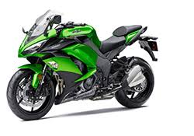
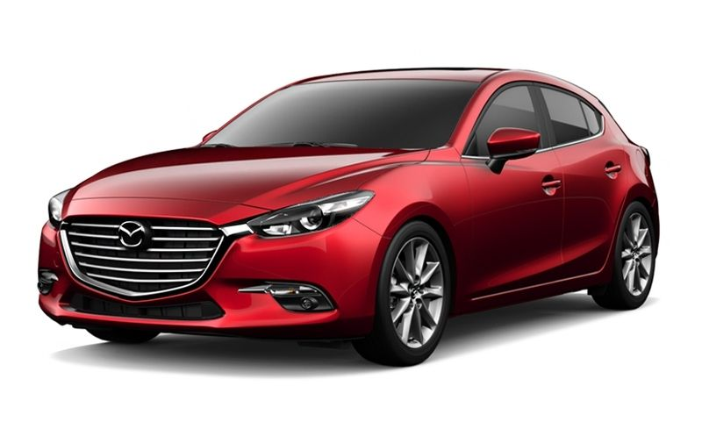
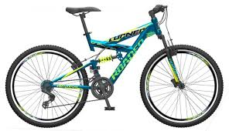
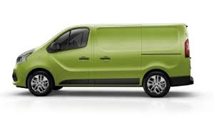
What is a class?
CSC 1100 – Week13
DCS, KICT
What is an object?
A car is an object
State/Attribute: color, model
Behavior: move(), turn()
Vehicle is a class

Slide 9
Introduction to Classes
CSC 1100 – Week13
DCS, KICT
.
Class Name : Circle
Data Fields: radius is _____
Functions: getArea()
A class template
Circle Object1
Data Fields: radius is 10
Circle Object2
Data Fields: radius is 25
Circle Object3
Data Fields: radius is 125
Three objects of the Circle class

Slide 10
Classes
CSC 1100 – Week13
DCS, KICT
Class Circle {
/** The radius of the circle */
double radius = 1.0;
/** Construct a circle object */
Circle() {
}
/** Construct a circle object */
Circle(double newRadius) {
radius = newRadius;
}
/** Return the area of this circle*/
double getArea() {
return radius * radius * 3.14159;
}
}
Data field
Constructors
Function

Slide 11
Unified Modeling Language Class Diagram
CSC 1100 – Week13
DCS, KICT
.
Circle
Class Name
+radius : double
Data fields
+Circle()
+Circle(newRadius : double)
+getArea() : double
Constructors and functions
The + symbol
means public
(accessible
to all)
Circle1: Circle
Circle2: Circle
Circle3: Circle
UML notation for objects
Radius= 1.0
Radius= 25
Radius= 125

Slide 12
Code Example 1 : Class Person
CSC 1100 – Week13
DCS, KICT
// Header Files
#include <iostream>
#include <conio.h>
using namespace std;
// Class Declaration
class person {
//Access - Specifier
public:
//Variable Declaration (member)
string name;
int number;
};
//Main Function
int main() {
// Object Creation For Class
person obj;
//Get Input Values For Object Variables
cout << "Enter the Name :";
cin >> obj.name;
cout << "Enter the Number :";
cin >> obj.number;
//Show the Output
cout << obj.name << ": " << obj.number << endl;
getch();
return 0;
}
Sample output
Enter the Name : Aisyah
Enter the Number : 1234
Aisyah: 1234

Slide 13
Example : Defining Classes and Creating Object
CSC 1100 – Week13
DCS, KICT
.
Consider TV sets:
Each TV is an object with states,
current channel
current volume level
power on or off.
and object with behaviors:
change channels
adjust volume
turn on/off

Slide 14
Example : Defining Classes and Creating Object
CSC 1100 – Week13
DCS, KICT
TV
The TV class models TV sets
channel : int
volumenLevel : int
on : booelan
The current channel (1 to 120) of this TV.
The current volume level (1 to 7) of this TV.
Indicates whether this TV is on/off.
+TV()
+turnOn(): void
+turnOff(): void
+setChannel(newChannel: int): void
+setVolume(newVolumeLevel: int): void
+channelUp(): void
+channelDown(): void
Constructs a default TV object.
Turns on this TV.
Turns off this TV.
Sets a new channel for this TV.
Sets a new volume level for this TV.
Increases the channel number by 1.
Decreases the channel number by 1.

Slide 15
Constructors
CSC 1100 – Week13
DCS, KICT
Constructors are a special kind of methods that are invoked(i.e., call forth) to construct objects.
A constructor with no parameters is referred to as a no-arg constructor.

Slide 16
CSC 1100 – Week13
DCS, KICT
Constructors (con't.)
Constructors must have the same name as the class itself.
Constructors do not have a return type—not even void.
Constructors are invoked using the new operator when an object is created.
Constructors play the role of initializing objects

Slide 17
Default Constructor
CSC 1100 – Week13
DCS, KICT
A class may be defined without constructors. In this case, a no-arg constructor with an empty body is implicitly defined in the class.
This constructor, called a default constructor, is provided automatically only if no constructors are explicitly defined in the class

Slide 18
Declaring Object Reference Variable
CSC 1100 – Week13
DCS, KICT
To reference an object, assign the object to a reference variable.
To declare a reference variable, use the syntax:
ClassName objectName;
Example:
Circle circle1;
Circle circle2(25);

Slide 19
Declaring Object Reference in a Single Step
CSC 1100 – Week13
DCS, KICT
ClassName objectName = new ClassName ();
Example:
Circle circle1 = new Circle();
Create an object
Assign object reference

Slide 20
Code Example 2 :
CSC 1100 – Week13
DCS, KICT
20
// TV.cpp
// Header Files
#include <iostream>
using namespace std;
// Class Declaration
class TV {
//Access - Specifier
public:
//Variable Declaration
int channel;
int volumeLevel;
bool on;
TV() // constructor (name the same as class)
{
channel = 101; // Default channel is 101
volumeLevel = 5; // Default volume level is 5
on = false; // By default TV is off
}
void turnOn()
{
on = true;
}
void turnOff()
{
on = false;
}
void setChannel(int newChannel)
{
if (on && newChannel >=1 && newChannel <=120)
channel = newChannel;
}
void setVolume(int newVolumeLevel)
{
if (on && newVolumeLevel >=1 && newVolumeLevel <=7)
volumeLevel = newVolumeLevel;
}
void channelUp()
{
if (on && channel <=120)
channel++;
}
void channelDown()
{
if (on && channel >1)
channel--;
}
void volumeUp()
{
if (on && volumeLevel < 7)
volumeLevel++;
}
void volumeDown()
{
if (on && volumeLevel > 1)
volumeLevel--;
}
};
1
2

Slide 21
CSC 1100 – Week13
DCS, KICT
21
//Main function
int main() {
TV tv1;
tv1.turnOn();
tv1.setChannel(101);
tv1.setVolume(3);
TV tv3;
tv3.turnOn();
tv3.channelUp();
tv3.channelUp();
cout << "tv1's channel is "
<< tv1.channel
<< " and volume level is "
<< tv1.volumeLevel
<< endl;
cout << "tv3's channel is "
<< tv3.channel
<< " and volume level is "
<< tv3.volumeLevel
<< endl;
return 0;
}
Sample Output:
tv1’s channel is 101 and volume level is 3
tv3’s channel is 103 and volume level is 4
3

Slide 22
Data Field Encapsulation
CSC 1100 – Week13
DCS, KICT
For Data Field Encapsulation, we make the data fields in a class private and provide access to them via public method.
Why???
To protect data
To make code easy to maintain

Slide 23
Data Field Encapsulation
CSC 1100 – Week13
DCS, KICT
Circle
-radius : double
-numberOfObjects:int
The radius of this circle (default: 1.0).
The number of circle objects created.
The - sign
indicates
private modifier
+Circle()
+Circle(radius: double)
+getRadius(): double
+setRadius(radius: double): void
+getNumberOfObjects(): int
+getArea(): double
Constructs a default circle object.
Constructs a circle object with the specified radius.
Returns the radius of this circle.
Sets a new radius for this circle.
Returns the number of circle objects created.
Returns the area of this circle.

Slide 24
CSC 1100 – Week13
DCS, KICT
Code sample: Encapsulation
Class Circle {
/** The radius of the circle */
double radius = 1.0;
/** Construct a circle object */
Circle() {
}
/** Construct a circle object */
Circle(double newRadius) {
radius = newRadius;
}
/** Return the area of this circle*/
double getArea() {
return radius * radius * 3.14159;
}
}

