Slide 1


CSC 1706
Probability & Statistics
Dr. Raini Hassan
Office: C2 – 14, Level 2 Department: Computer Science, Level 4, KICT Building
Email: hrai@iium.edu.my Phone no: 03-61965655
Dr. Afidalina Tumian
Office: C4 - 33, Level 4
Department: Computer Science, Level 4, KICT Building
Email: afidalina@iium.edu.my Phone no: 03-61965676

Slide 2

Du’a for Study

Slide 3

Chapter 01:
The Nature of Probability and Statistics

Slide 4
1.1
The Nature of
Probability of Statistics
CHAPTER
1
Descriptive and Inferential Statistics
Outline
1-1 | Descriptive and Inferential Statistics
1-2 | Variables and Types of Data
1-3 | Data Collection and Sampling Techniques
1-4 | Experimental Design
Slide 4
Copyright © 2012 The McGraw-Hill Companies, Inc.

Slide 5
Learning Objectives
1 | Demonstrate knowledge of statistical terms.
2 | Differentiate between the two branches of statistics.
3 | Identify types of data.
4 | Identify the measurement level for each variable.
1.1
Descriptive and inferential statistics
5 | Identify the four basic sampling techniques.
6 | Explain the difference between an observational and an experimental study.
7 | Explain how statistics can be used and misused.

Slide 6
1.1
Descriptive and Inferential Statistics

Slide 7
Introduction
Statistics is the science of conducting studies to
collect,
organize,
summarize,
analyze, and
draw conclusions from data.

Slide 8
Rationale to Study Statistics
Must be able to read and understand the various statistical studies performed in the field.
May be called on to conduct research that involves statistical procedures.
Becoming better consumers and citizens.

Slide 9
1-1 Descriptive and Inferential Statistics
To gain knowledge about seemingly haphazard situations, statisticians collect information for variables, which describe the situation.

Slide 10
1-1 Descriptive and Inferential Statistics
A variable is a characteristic or attribute that can assume different values.
The values that a variable can assume are called data.
A collection of data values forms a data set.
Each value in the data set is called data value or a datum.

Slide 11
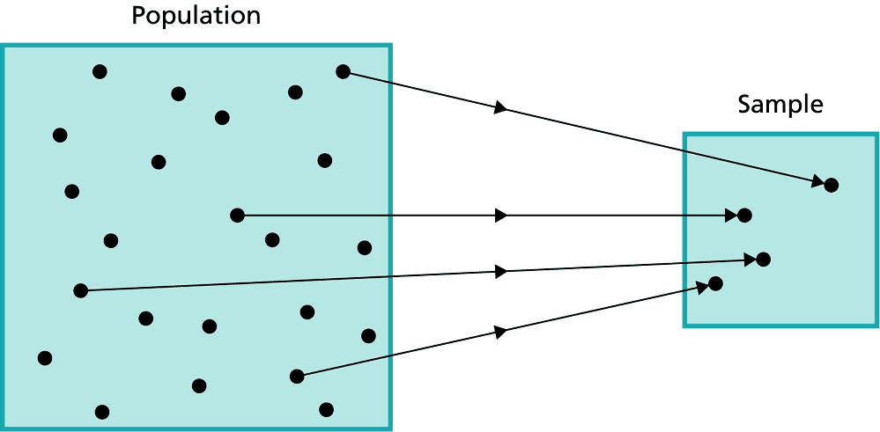
1-1 Descriptive and Inferential Statistics
A population consists of all subjects (human or otherwise) that are studied.
When data are collected from every subject in the population, it is called a census.
A sample is a subset of the population.

Slide 12
1-1 Descriptive and Inferential Statistics
If the subjects of a sample are poorly selected, most of the time they should possess the same or similar characteristics as the subjects in the population.
Bias happened when:
The results from the sample of a population are radically different from the results of a census of the population.
If it does not represent the population from which it has been selected.

Slide 13
1-1 Descriptive and Inferential Statistics
The body of knowledge (statistics) is sometimes divided into 2 main areas or branches, depending on how data are used.
They are:
Descriptive statistics
Inferential statistics

Slide 14
1-1 Descriptive and Inferential Statistics
The body of knowledge (statistics) is sometimes divided into 2 main areas or branches, depending on how data are used.
They are:
Descriptive statistics
Inferential statistics
consists of the collection, organization, summarization, and presentation of data.
The statistician can try to describe a situation in this statistics branch.

Slide 15
1-1 Descriptive and Inferential Statistics
The body of knowledge (statistics) is sometimes divided into 2 main areas or branches, depending on how data are used.
They are:
Descriptive statistics
Inferential statistics
consists of generalizing from samples to populations, performing estimations and hypothesis tests, determining relationships among variables, and making predictions.
Here, the statistician tries to make inferences from samples to populations.
Probability, i.e. the chance of an event occurring is used.

Slide 16
1-1 Descriptive and Inferential Statistics
The area of inferential statistics called hypothesis testing is a decision-making process for evaluating claims about a population, based on information obtained from samples.
Inferential statistics can also be used to determine relationships among variables and to do predictions based on past and present data and conditions.

Slide 17
Exercise (Example 1-1; page 4)
Determine whether descriptive or inferential statistics were used.
A study done by the American Academy of Neurology suggests that older people who had a high caloric diet more than doubled their risk of memory loss.
Based on a survey of 9317 consumers done by the National Retail Federation, the average amount that consumers spent on Valentine’s Day in 2011 was $116.
Scientists at the University of Oxford in England found that a good laugh significantly raises a person’s pain level of intolerance.

Slide 18
1.2
Variables and Types of Data

Slide 19
1-2 Variables and Types of Data
Data
Qualitative
Categorical
Quantitative
Numerical,
Can be ranked
Discrete
Countable
5, 29, 8000, etc.
Continuous
Can be fractions and decimals
2.59, 312.1, etc.

Slide 20
1-2 Variables and Types of Data
Qualitative variables:
are variables that have distinct categories according to some characteristics or attribute.
Female/male, malay/chinese/indian
What is the general category?
Quantitative variables:
Are variables that can be counted or measured, e.g. kg.

Slide 21
1-2 Variables and Types of Data
Discrete variables:
Assume values that can be counted. E.g. 1, 2, 3, 4, 5.
Anything that can be counted.
Continuous variables:
Can assume an infinite number of values between any 2 specific value. E.g. 0 ≤ x ≤ 5
They are obtained by measuring. E.g. height, weight.
They often include fractions and decimals.

Slide 22
1-2 Variables and Types of Data
Since continuous data must be measured, answers must be rounded because of the limits of the measuring device.
Usually, answers are rounded to the nearest given unit.

Slide 23
1-2 Recorded Values and Boundaries
Variable | Recorded Value | Boundaries
Length | 15 centimeters (cm)
Temperature | 86° Fahrenheit (°F)
Time | 0.43 second (sec)
Mass | 1.6 grams (g)
14.5-15.5 cm
85.5-86.5 °F
0.425-0.435 sec
1.55-1.65 g

Slide 24
1-2 Variables and Types of Data
Nominal-level data | Ordinal-level data | Interval-level data | Ratio-level data
Zip code / postcode Gender (male / female) Eye color (blue, brown, etc.) Nationality Major field (CS, IS | Grade (A, B, C, D, E, F) Judging (1st place, 2nd place, 3rd place) Rating scale (poor, god, excellent) | SPM score A-Level score IQ Temperature | Height Weight Time Salary Age

Slide 25
1-2 Variables and Types of Data
Levels of Measurement
Nominal – categorical (names)
Ordinal – nominal, plus can be ranked (order)
Interval – ordinal, plus intervals are consistent
Ratio – interval, plus ratios are consistent, true zero

Slide 26
1-2 Variables and Types of Data
Nominal:
Classifies data into mutually exclusive (non-overlapping) categories in which no order or ranking can be imposed on the data.
Ordinal:
Classifies data into categories that can be ranked; however, precise differences between the ranks do not exist.

Slide 27
1-2 Variables and Types of Data
Interval:
Ranks data, and precise differences between units of measure do exist; however, there is no meaningful zero.
Ratio:
Possesses all the characteristics of interval measurement, and there exists a true zero.
In addition, true ratios exist when the same variable is measured on two different members of the population.

Slide 28
1-2 Variables and Types of Data
How to do categorization?
Variable | Nominal | Ordinal | Interval | Ratio | Level
Hair color | Yes | No |  |  | Nominal
Zip code | Yes | No |  |  | Nominal
Letter Grade | Yes | Yes | No |  | Ordinal
High School Exam Score | Yes | Yes | Yes | No | Interval
Height | Yes | Yes | Yes | Yes | Ratio
Age | Yes | Yes | Yes | Yes | Ratio
Temperature (C) | Yes | Yes | Yes | No | Interval

Slide 29
Exercise (Example 1-4; page 9)
What level of measurement would be used to measure each variable?
The ages of patients in a local hospital.
The ratings of movies released this month.
Colors of athletic shirts sold by Oak Park Health Club.
Temperatures of hot tubs in local health clubs

Slide 30
1.3
Data Collection and Sampling Techniques

Slide 31
1-3 Data Collection and Sampling Techniques
Data can be collected in a variety of ways; the most common one is the use of surveys.
Surveys can be conducted through:
Telephone
Mailed questionnaire
Personal interview
Other methods of data collection include surveying records or direct observation of situations.

Slide 32
1-3 Data Collection and Sampling Techniques
Some Sampling Techniques
Random – random number generator
Systematic – every k^{th} subject
Stratified – divide population into “layers”
Cluster – use intact groups
Convenient sample – mall surveys
Volunteer sample or self-selected sample – respondents volunteer
Sampling error – Sample vs. population

Slide 33
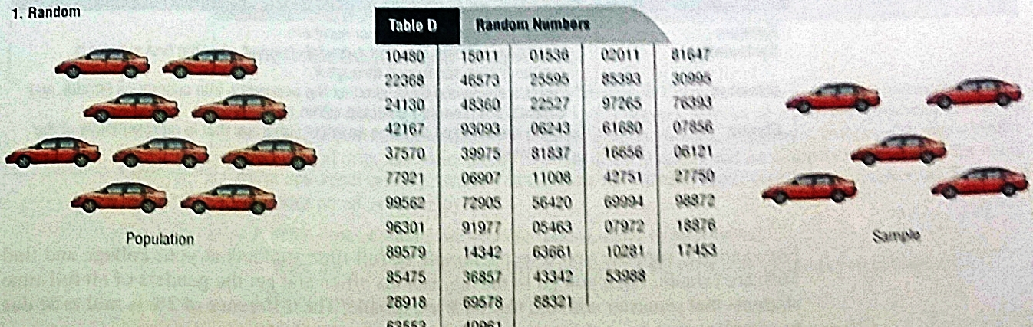
1-3 Data Collection and Sampling Techniques
Random sampling:
Is a sample in which all members of the population have an equal chance of being selected.

Slide 34
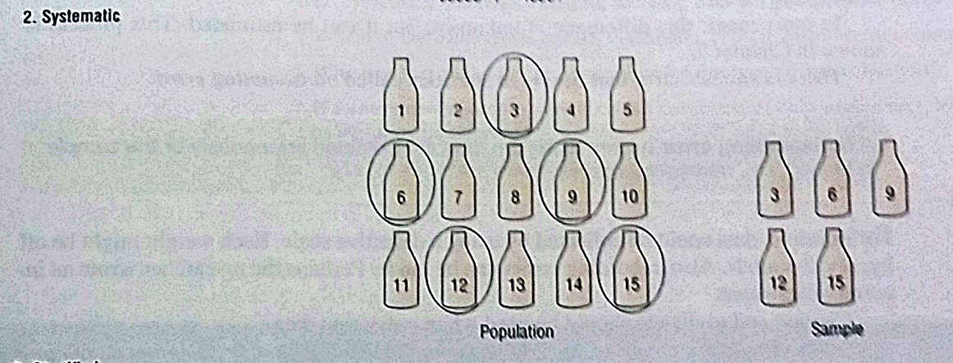
1-3 Data Collection and Sampling Techniques
Systematic sampling:
Is a sample obtained by selecting every k^{th} member of the population where k is a counting number.

Slide 35
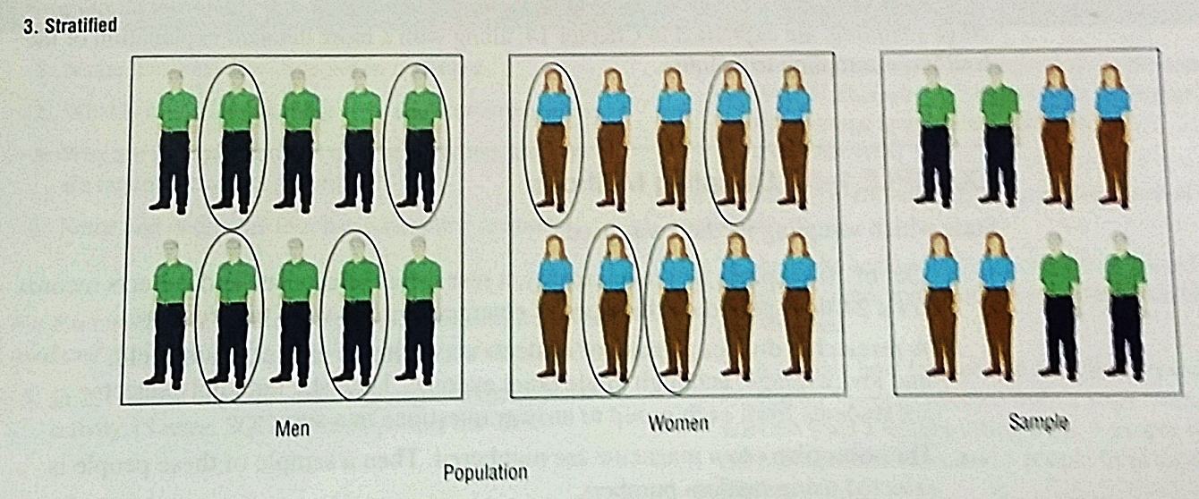
1-3 Data Collection and Sampling Techniques
Stratified sampling:
Is a sample obtained by dividing the population into subgroups or strata according to some characteristic relevant to the study. (There can be several subgroups). Then subjects are selected from each subgroup.

Slide 36
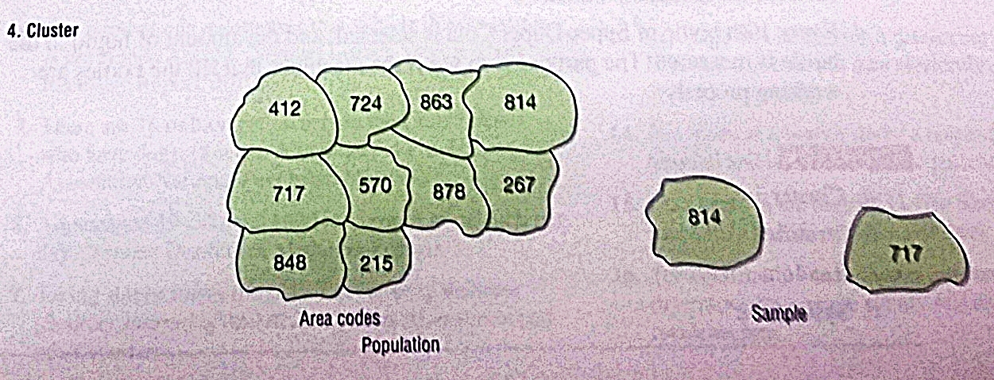
1-3 Data Collection and Sampling Techniques
Cluster sampling:
Is obtained by dividing the population into sections or clusters and then selecting one or more clusters and using all members in the cluster(s) as the members of the sample.

Slide 37
Summary of Sampling Methods
Sampling Methods | Summary
Random | Subjects are selected by random numbers.
Systematic | Subjects are selected by using every k^{th} number after the first subject is randomly selected from 1 through k.
Stratified | Subjects are selected by dividing the population into subgroups (strata), and subjects are randomly selected within subgroups.
Cluster | Subjects are selected by using an intact subgroup that is representative of the population.

Slide 38
Exercise (Example 1-5; page 16)
State which sampling method used.
Out of 10 hospitals in a municipality, a researcher selects one and collects records for a 24-hour period on the types of emergencies that were treated there.
A researcher divides a group of students according to gender, major field, and low, average, and high grade point average. Then she randomly selects six students from each group to answer questions in a survey.
The subscribers to a magazine are numbered. Then a sample of these people is selected using random numbers.
Every 10th bottle of Super-Duper-Cola is selected, and the amount of liquid in the bottle is measured. The purpose is to see if the machines that fill the bottles are working properly.

Slide 39
1.4
Experimental Design

Slide 40
1-4 Experimental Design
In an observational study, the researcher merely observes and tries to draw conclusions based on the observations.
3 main types:
Cross-sectional study – when all the data are collected at one time.
Retrospective study – when the data are collected using records obtained from the past.
Longitudinal study – if the data are collected over a period of time (past and present).

Slide 41
1-4 Experimental Design
In an experimental study , the researcher manipulates the independent (explanatory) variable and tries to determine how the manipulation influences the dependent (outcome) variable.
A confounding variable influences the dependent variable but cannot be separated from the independent variable.
Statistical studies usually include one or more independent variables and one depending variable.
The independent variable (also called explanatory variable) in an experimental study is the one that is being manipulated by the researcher.
The resulting variable is called the dependent variable or the outcome variable.

Slide 42
1-4 Experimental Design
Confounding / Hidden variable (Discipline) | Independent Variable 1 (Exercise hours – per day) | Independent Variable 2 (Diet plan – per day) | Dependent / Outcome Variable (Weight Loss - per week)
Weak | 1 hr | No carbo | 2 kgs
Very Weak | 2 hrs | No carbo | 4 kgs
Quite ok | 3 hrs | No carbo | 6 kgs
No discipline | 4 hrs | No carbo | 8 kgs

Slide 43
1-4 Experimental Design
Misuses of Statistics
Suspect Samples
Is the sample large enough?
How was the sample selected?
Is the sample representative of the population?
Ambiguous Averages
What particular measure of average was used and why?

Slide 44
1-4 Experimental Design
Changing the Subject
Are different values used to represent the same data?
Detached Statistics
One third fewer calories…….than what?
Implied Connections
Studies suggest that some people may understand what this statement means.

Slide 45
1-4 Experimental Design
Misleading Graphs
Are the scales for the x-axis and y-axis appropriate for the data?
Faulty Survey Questions
Do you feel that statistics teachers should be paid higher salaries?
Do you favor increasing tuition so that colleges can pay statistics teachers higher salaries?

