Slide 1

Artificial Intelligence Project
Intellectra
Virtual Study AI Assistant

Slide 2
Artificial Intelligence Project
Intellectra
Virtual Study AI Assistant
Presented by:
Muhammad Umar (137) Zaid Ahmed (111) Abdullah (103)
Asad Rasheed (114) Muhammad Meeran (120)

Slide 3

Introduction
Introducing Intellectra
Intellectra, a next-generation AI study assistant engineered to provide students with instant, intelligent, and personalized academic support. It functions as a virtual learning companion capable of understanding educational context and responding with precision. The system is curated using a RAG-based retrieval pipeline, NLP-driven query analysis, and real-time fallback search mechanisms. Intellectra bridges the gap between static notes and dynamic learning.

Slide 4
Problem Statement
Limited Availability
Inefficient Utilization
Teachers are not always available. It helps take all documents from the teachers, and answer any query
Educational resources such as PDFs, notes, and presentations remain static and difficult to search manually
Context Awareness
Self Assessment
Conventional chatbots are frequently restricted to poor contextual understanding
Most available learning systems focus only on information delivery and fail to provide revision mechanisms such as quizzes, flashcards.

Slide 5
Objectives
Provide contextual academic Q&A from uploaded study materials
Support all major document formats
Enable interactive revision via quizzes and flashcards
Handle out-of-context queries through live web fallback

Slide 6
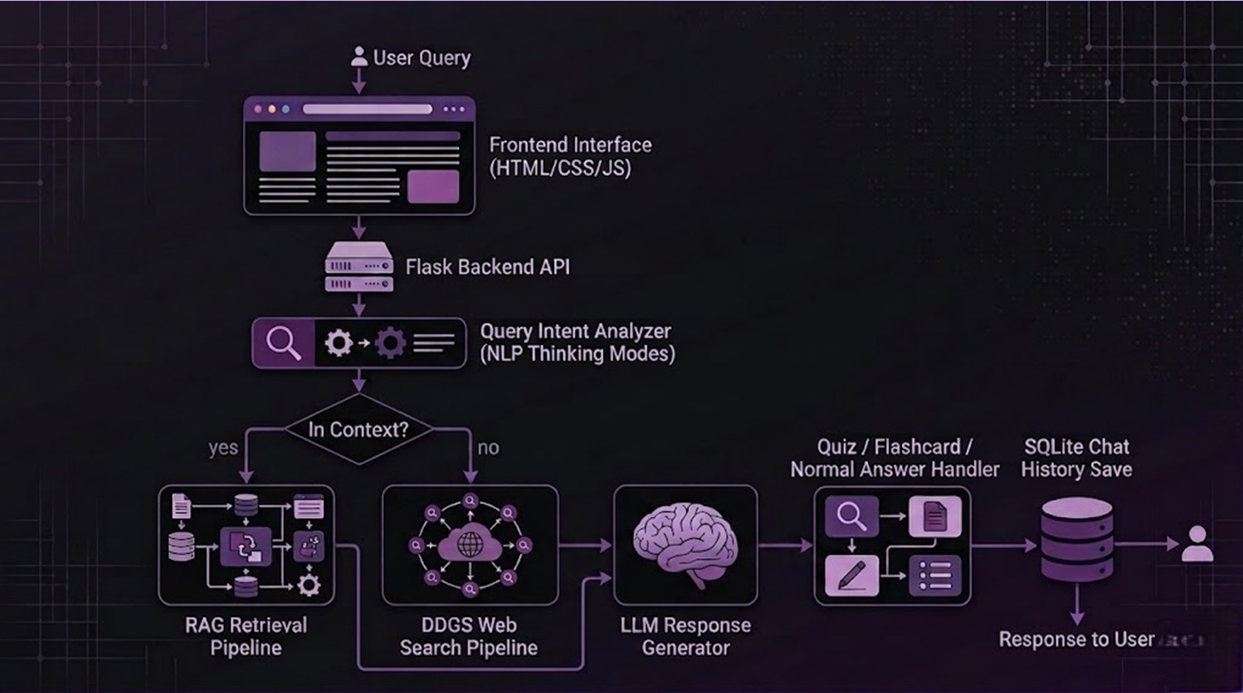
Flow Diagram

Slide 7







Tech Stack
FRONTEND
AI/NLP
BACKEND
HTML
CSS
Python
Flask
Sentence Transformers
ChromaDB
JS
Langchain
Langchain Libraries
Database
FallBack Strategy
SQLite
DDGS API

Slide 8
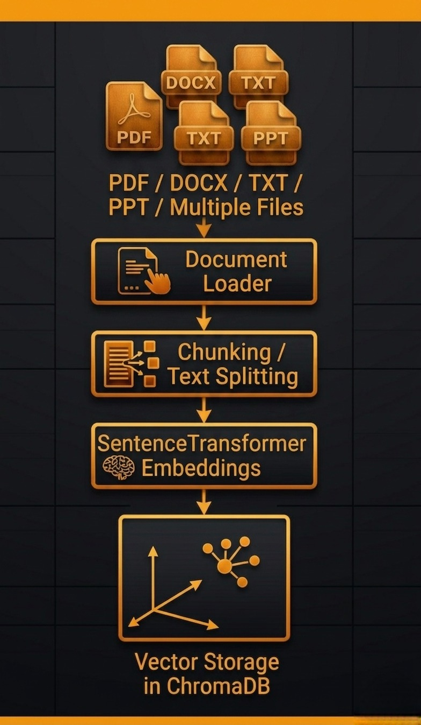
Document Processing Flow

Slide 9
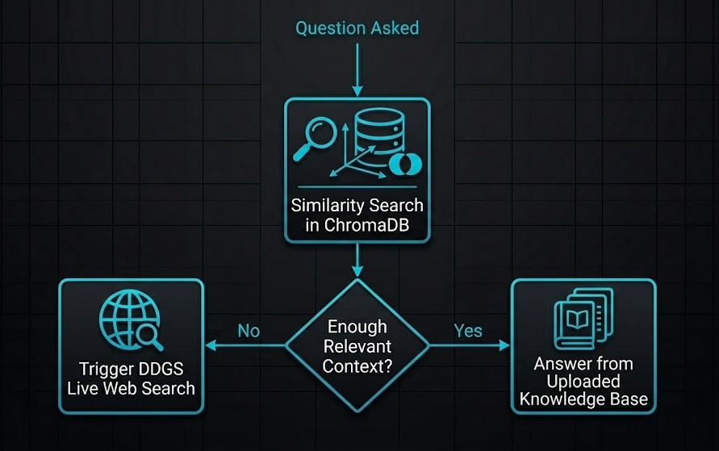
Hybrid Knowledge Retrieval Strategy

Slide 10
NLP Thinking Modes
Standard Mode
ELI-5 Mode
template
template
Advanced Mode
Quiz Mode / Flashcard Mode
template
template

Slide 11
LIVE DEMO

Slide 12
LIVE DEMO

Slide 13
CONCLUSION

Slide 14
CONCLUSION

Slide 15
TEMPLATES:-

Slide 16



NLP Thinking Modes
Buffer Cache Issues
Packet Distribution
Parameters such as Buffer, Max Buffer needed to be tuned for finding the ideal transfer speed.
Increasing the packet size over ideal spot caused the file transfer speed to spike abnormally over ideal limit
Security Protocols
As local systems don’t allow HTTPS protocol, browsers tended to disable file transfer through HTTP websites.

Slide 17



Solutions Implemented
Trial & Error for Chunk
Browser Settings
Ideal spot for Chunk size was found through many trial and error sessions.
Browser settings were explored thoroughly to find the setting to allow our local systems to transfer files ideally
Four Parallel Streams
Centralized servers can read your history. Even 'encrypted' services often hold the keys.

