Slide 1
Introduction To Database/ Database Management System
Instructor
Engr. Poonam K.K

Slide 2
What is the Difference Between Data and Information?
Data and information are interrelated.
Data usually refers to raw data or unprocessed data. It is the basic form of data, data that hasn’t been analyzed or processed in any manner. Once the data is analyzed, it is considered information.
Once the data is analyzed, it is considered information.
Basically, information is the message that is being conveyed, whereas data are plain facts.
Once the data is processed, organized, structured, or presented in each context, it can become useful. Then data will become information,

Slide 3
Database
A Database is a collection of related data organized in a way that data can be easily accessed, managed, and updated.
Any piece of information can be data, for example, the name of your school.
Database is a place where a related piece of information is stored, and various operations can be performed.

Slide 4
File system v/s DBMS
In the early days, database applications were built on top of file systems.
Used before the DBMS.
Manage its data in the file form.
OS has a built-in file system.
E.g., NFS, CIFS.
DBMS- Client-server architecture.
Centralized location and can access data all over the world.

Slide 5
Purpose of Database System
Drawbacks of using file systems to store data:
Data redundancy and inconsistency
✔ Multiple file formats, duplication of information in different files
Difficulty in accessing data
✔ Need to write a new program to carry out each new task
Integrity problems
✔ Hard to add new constraints or change existing ones

Slide 6
Purpose of Database Systems (Cont.)
Drawbacks of using file systems (cont.)
Concurrent access by multiple users
✔ Uncontrolled concurrent accesses can lead to inconsistencies
– E.g. two people reading a balance and updating it at the same time
Security problems
Database systems offer solutions to all the above problems

Slide 7
Data Base Management System DBMS
DBMS is software that allows the creation, definition, and manipulation of databases.
Dbms is actually a tool used to perform any kind of operation on data in the database.
Dbms also provides protection and security to the database. It maintains data consistency in the case of multiple users.
Here are some examples of popular DBMS, MySql, Oracle, Sybase, Microsoft Access and IBM DB2, etc.

Slide 8
Database Applications:
Banking: transactions
Airlines: reservations, schedules
Universities: registration, grades
Sales: customers, products, purchases
Online retailers: order tracking, customized recommendations
Manufacturing: production, inventory, orders, supply chain
Human resources: employee records, salaries, tax deductions

Slide 9
University Database Example
Application program examples
Add new students, instructors, and courses
Register students for courses, and generate class rosters
Assign grades to students, compute grade point averages (GPA) and generate transcripts
In the early days, database applications were built directly on top of file systems

Slide 10
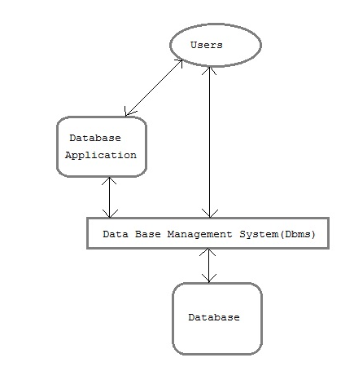
Components of Database System
The database system can be divided into four components.

Slide 11
Components of Database System
Users : Users may be of various type such as DB administrator, System developer and End users.
Database application : Database application may be Personal, Departmental, Enterprise and Internal
DBMS : Software that allow users to define, create and manages database access, Ex: MySQL, Oracle etc.
Database : Collection of related data.

Slide 12
Disadvantages of DBMS
Complexity
Costly
Large in size

Slide 13
Database Models
A Database model defines the logical design of data.
The model describes the relationships between different parts of the data.
In history of database design, three models have been in use.
Hierarchical Model
Network Model
Relational Model

Slide 14
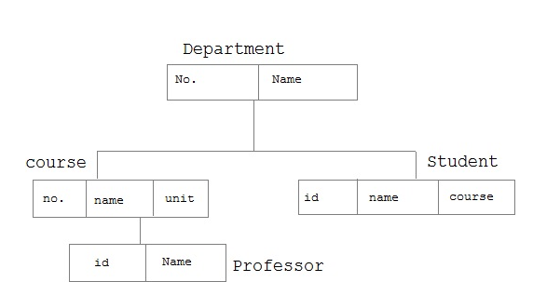
Hierarchical Model
In this model each entity has only one parent but can have several children . At the top of hierarchy there is only one entity which is called Root.

Slide 15
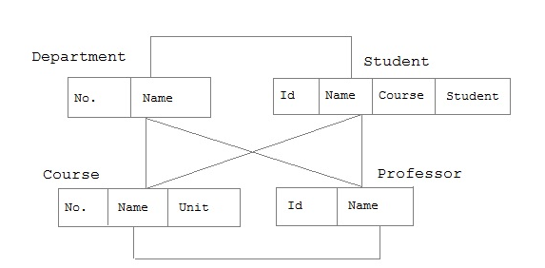
Network Model
In the network model, entities are organized in a graph, in which some entities can be accessed through several path

Slide 16
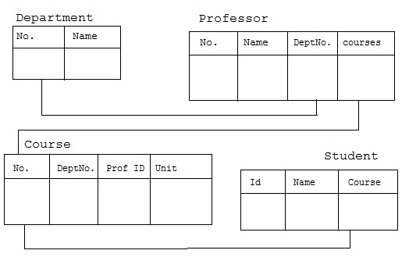
Relational Model
In this model, data is organized in two-dimensional tables called relations. The tables or relation are related to each other.

Slide 17
RDBMS Concepts
A Relational Database management System(RDBMS) is a database management system based on the relational model
Rdbms was developed by a Scientist E.F Codd (Edgar F. “Ted” Codd) in 1970 this model was created based on a mathematical concept called relational algebra.
In a relational model, data is represented in tuples(rows).
All modern database management systems like SQL, MS SQL Server, IBM DB2, Oracle, My-SQL, and Microsoft Access are based on Rdbms.

Slide 18
RDBMS is used to manage Relational databases.
Relational database is a collection of an organized set of tables from which data can be accessed easily. Relational Database is the most used database.
It consists of several tables and each table has its own primary key.

Slide 19
Relations
Relations are classified into three types, they are;
1:1
1:M or M:1
M:M (many to many)

Slide 20

one-one Relationship
In this relationship one object have only one relation with another object.
In above image one employee have only one emp_id. this is the example of 1:1 relationship

Slide 21
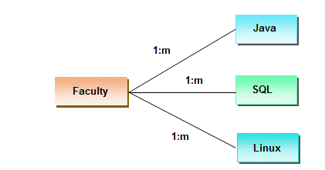
one-many or many-one Relationship
In this relationship one object have relation with many other object.
In above image one faculty can teach many subjects. This is the example of 1:m relationship

Slide 22
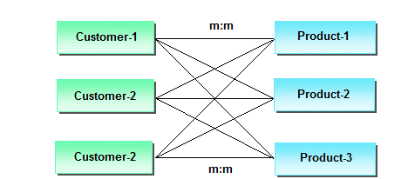
many-many Relationship
In this relationship many object has the relationship with many other object.
In above image one customer can purchase many items and one item can purchase by many customers, this is the example of m:m relationship

Slide 23
Properties of Rdbms
Data should be stored in the form of a table.
A table can be defined as a collection of rows and columns
The horizontal lines are known as row tuples or records.
The vertical lines are known as columns or fields or attributes.
The intersection of row and column is known as cell.
A cell is a place where you can store your data.
The other name of the table is called an entry class or object.

Slide 24
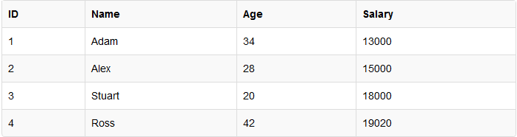
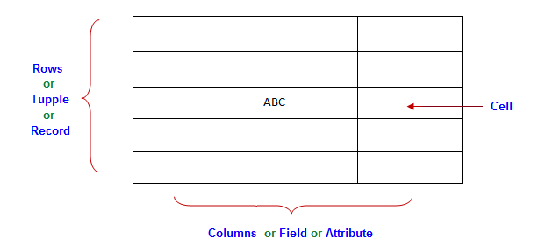
Table
In a Relational database, a table is a collection of data elements organized in terms of rows and columns. A table is also considered a convenient representation of relations
Table is the simplest form of data storage. Below is an example of an Employee table.

Slide 25
Record
A single entry in a table is called a Record or Row.
A Record in a table represents set of related data. For example, the above Employee table has 4 records. Following is an example of single record.

Slide 26

Column
In Relational table, a column is a set of value of a particular type.
The term Attribute is also used to represent a column.
For example, in Employee table, Name is a column that represent names of employee.

Slide 27

What is cell
A cell is a place where you can store your data.

Slide 28
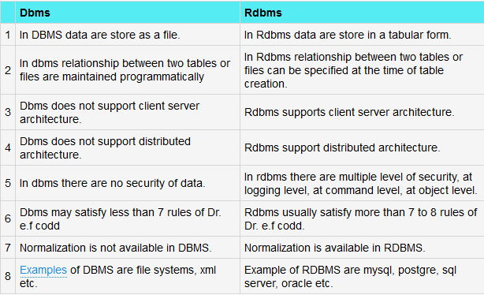
Dbms and Rdbms
Dbms and Rdbms both are used to store information in physical database, but they have some differences, which is given below;

Slide 29
Database Keys
Keys are very important part of Relational database. They are used to establish and identify relation between tables.
They also ensure that each record within a table can be uniquely identified by combination of one or more fields within a table.

Slide 30
THANK YOU…!

