Slide 1

تصميم الدارات الالكترونية بلغة /VHDL/ 2
مخبر النظم الالكترونية المتقدمة
الجلسة الثالثة

Slide 2

VHDL Coding Basics
مراجعة سريعة :

Slide 3
Entity
Define inputs and outputs
Example:
Entity test is
Port( A,B,C,D: in std_logic;
E: out std_logic);
End test;

Slide 4
VHDL - Entity
entity test is
port ( inputa : in std_logic ;
inputb : in std_logic ;
output : out std_logic
);
end test;
DO NOT have ; here
Entity name should be same as the file name

Slide 5
Architecture
Define functionality of the chip
X <= A AND B;
Y <= C AND D;
E <= X OR Y;

Slide 6
Signal
All internal variables
Signal X,Y : std_logic;

Slide 7
Final code
LIBRARY IEEE;
USE IEEE.STD_LOGIC_1164.ALL;
ENTITY TEST IS
PORT (A,B,C,D : IN STD_LOGIC;
E : OUT STD_LOGIC);
END TEST;
ARCHITECTURE BEHAVIOR OF TEST IS
SIGNAL X,Y : STD_LOGIC;
BEGIN
X <= (not A) AND B;
Y <= C AND D;
E <= X OR Y;
END BEHAVIOR;

Slide 8
Port Map
Chip1 : Chip_A
Port map (A,B,C,X,Y);
Chip2 : Chip_B
Port map (X,Y,D,E);

Slide 9
Final code
LIBRARY IEEE;
USE IEEE.STD_LOGIC_1164.ALL;
ENTITY TEST IS
PORT (A,B,C,D : IN STD_LOGIC;
E : OUT STD_LOGIC);
END TEST;
ARCHITECTURE BEHAVIOR OF TEST IS
SIGNAL X,Y : STD_LOGIC;
COMPONENT Chip_A
PORT (L,M,N : IN STD_LOGIC;
O,P : OUT STD_LOGIC);
END COMPONENT;
COMPONENT Chip_B
PORT (Q,R,S : IN STD_LOGIC;
T : OUT STD_LOGIC);
END COMPONENT;
BEGIN
Chip1 : Chip_A
PORT MAP (A,B,C,X,Y);
Chip2 : Chip_B
PORT MAP (X,Y,D,E);
END BEHAVIOR;

Slide 10
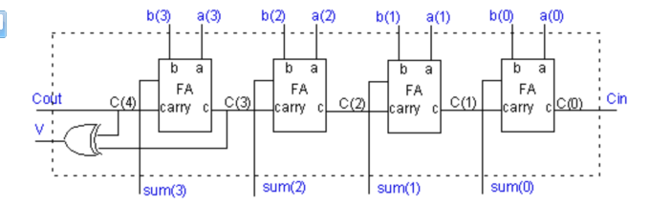
Example:
sum = (A ⊕ B) ⊕ C
carry = AB + C(A ⊕ B)

Slide 11
Example of a four bit adder
library ieee;
use ieee.std_logic_1164.all;
-- definition of a full adder
entity FULLADDER is
port (a, b, c: in std_logic;
sum, carry: out std_logic);
end FULLADDER;
architecture fulladder_behav of FULLADDER is
begin
sum <= (a xor b) xor c ;
carry <= (a and b) or (c and (a xor b));
end fulladder_behav;

Slide 12
library ieee;
use ieee.std_logic_1164.all;
entity FOURBITADD is
port (a, b: in std_logic_vector(3 downto 0);
Cin : in std_logic;
sum: out std_logic_vector (3 downto 0);
Cout, V: out std_logic);
end FOURBITADD;
architecture fouradder_structure of FOURBITADD is
signal c: std_logic_vector (4 downto 0);
component FULLADDER
port(a, b, c: in std_logic;
sum, carry: out std_logic);
end component;
begin
FA0: FULLADDER
port map (a(0), b(0), Cin, sum(0), c(1));
FA1: FULLADDER
port map (a(1), b(1), C(1), sum(1), c(2));
FA2: FULLADDER
port map (a(2), b(2), C(2), sum(2), c(3));
FA3: FULLADDER
port map (a(3), b(3), C(3), sum(3), c(4));
V <= c(3) xor c(4);
Cout <= c(4);
end fouradder_structure;

Slide 13
الوظيفة
توصيف الجامع الكامل بنيوياً و محاكاته عملياً .
s1
In1
HA
HA
sum
In2
s2
OR
c_out
s3
c_in
the full adder.

Slide 14

العمليات الأساسية المتوفرة في لغة (VHDL)
logical | not
 | and | or | nand | nor | xor | xnor
relational | = | /= | < | <= | >= | >
shift | sll | srl | sla | sra | rol | ror
arithmetic | + | -
 | * | / | mod | rem
 | ** | abs

Slide 15
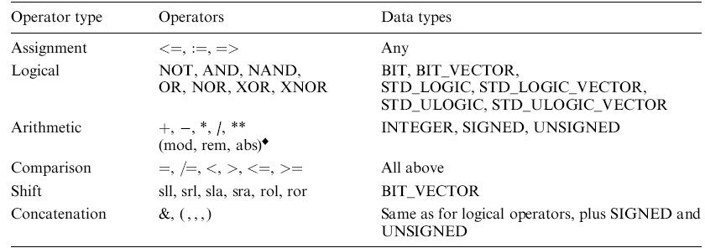

Slide 16
Reserved VHDL keywords
ABS ACCESS AFTER ALIAS ALL AND ARCHITECTURE ARRAY ASSERT ATTRIBUTE
BEGIN BLOCK BODY BUFFER BUS
CASE COMPONENT CONFIGURATION CONSTANT
DISCONNECT DOWNTO
ELSE ELSIF END ENTITY EXIT
FILE FOR FUNCTION
GENERATE GENERIC GROUP GUARDED
IF IMPURE
IN INERTIAL INOUT IS
LABEL LIBRARY LINKAGE LITERAL LOOP
MAP MOD
NAND NEW NEXT NOR NOT NULL
OF ON OPEN OR OTHERS OUT
PACKAGE PORT POSTPONED PROCEDURE PROCESS PURE
RANGE RECORD REGISTER REM REPORT ROL ROR
RETURN
SELECT SEVERITY SIGNAL SHARED SLA SLL SRA SRL SUBTYPE
THEN TO TRANSPORT TYPE
UNAFFECTED UNITS UNTIL USE
VARIABLE
WAIT WHEN WHILE WITH
XNOR XOR
Notes:
3

Slide 17
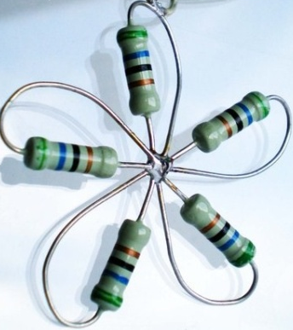
Thank You

