Slide 1
Shyft-Labs
School Management System

Slide 2
Technologies used
I have used React js on frontend, Node js on backend and used postgres for database.
Implemented REST structure.
Used Sequelize as ORM.

Slide 3
configuration
Database config is in .env
Frontend api config is in apiConfig.json file

Slide 4
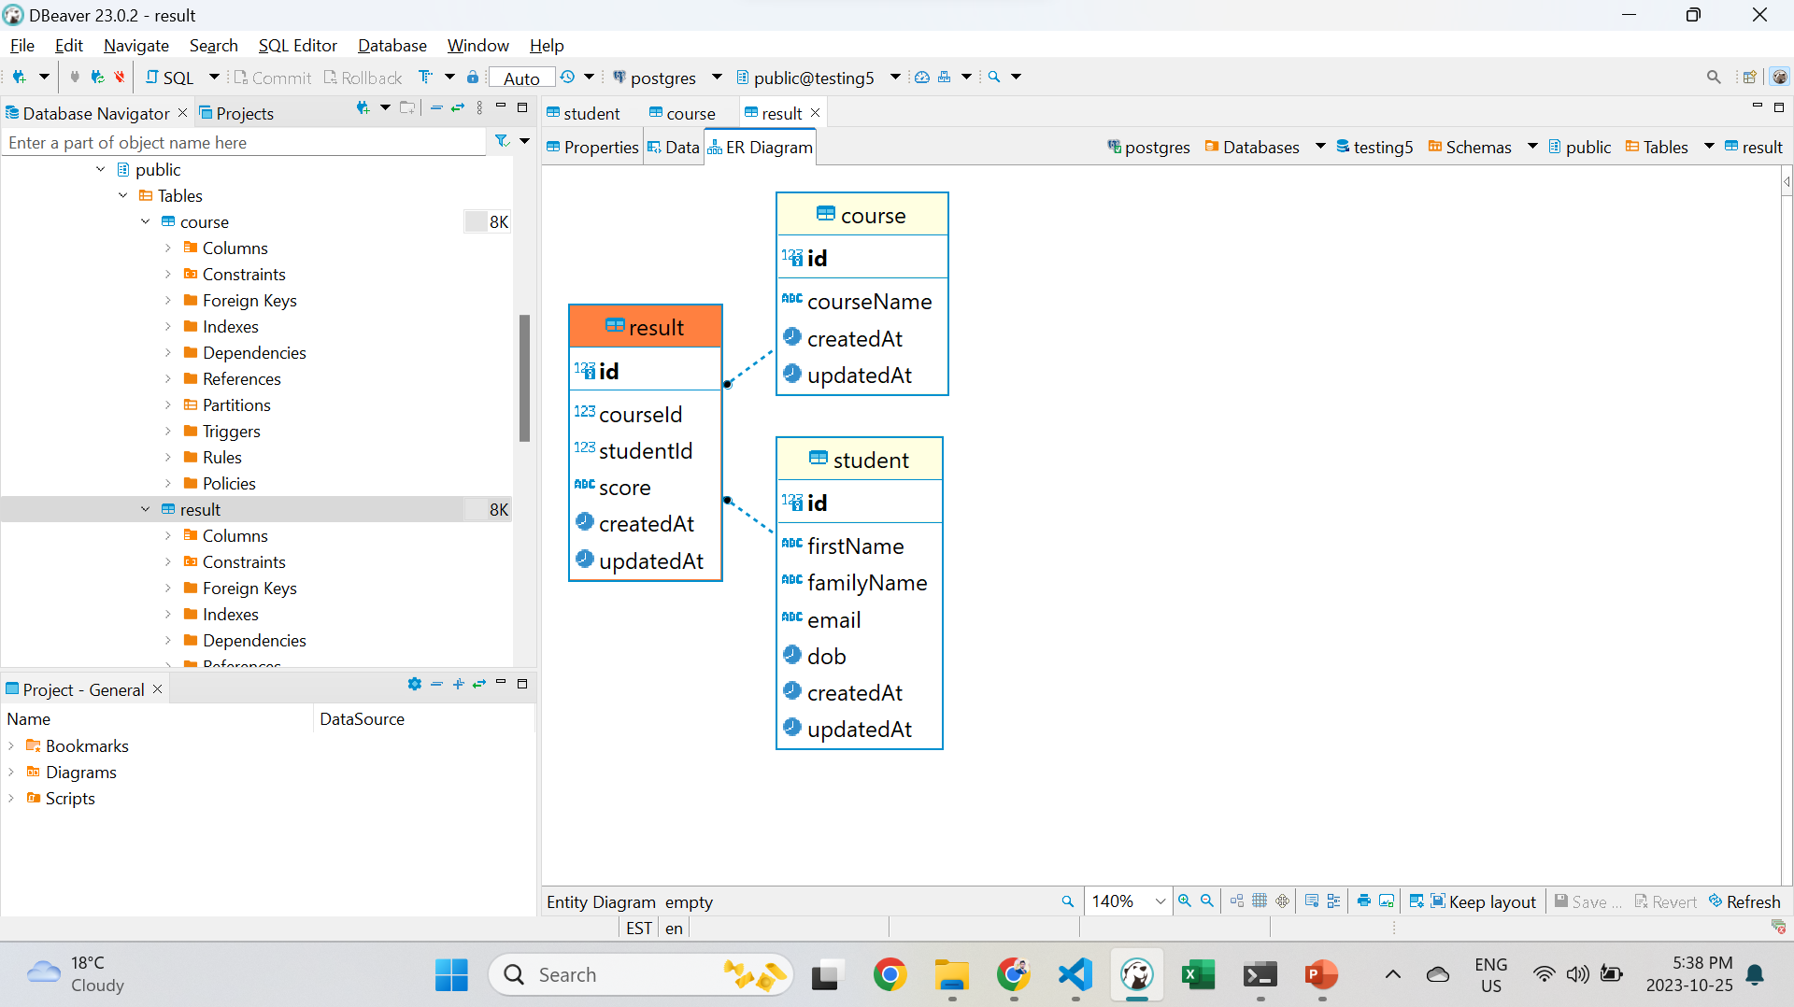
Database STRUCTURE
ERD
One to Many relationship
between student, course
and results.

Slide 5
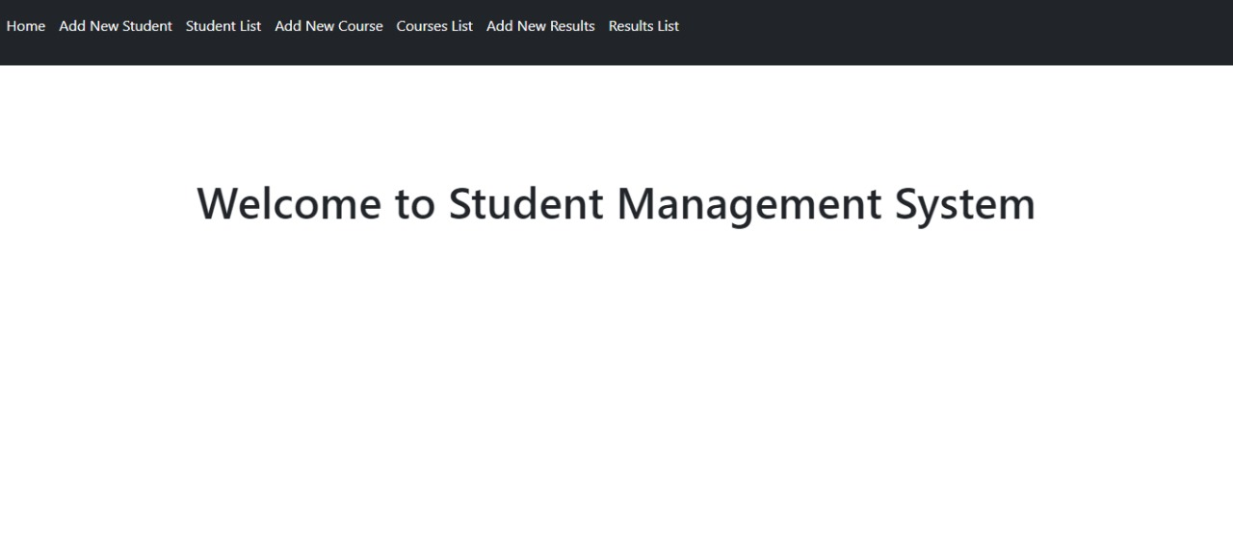
pages
Welcome screen with top nav bar

Slide 6
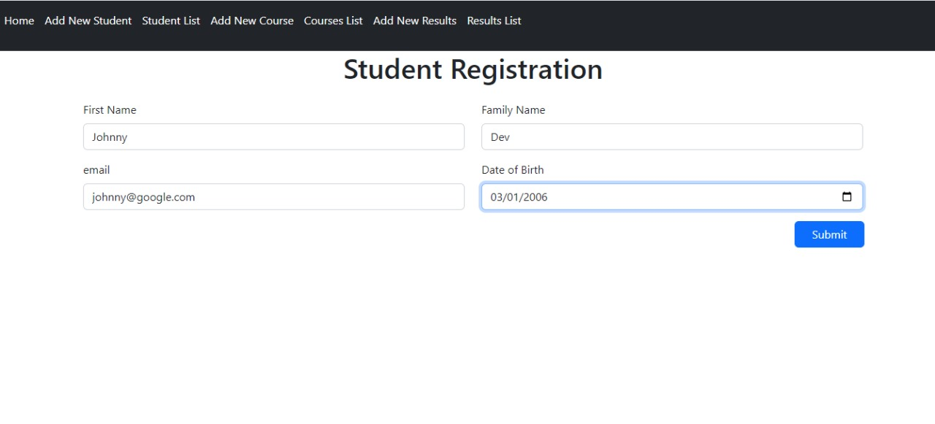
Student registration form
Implemented all checks

Slide 7
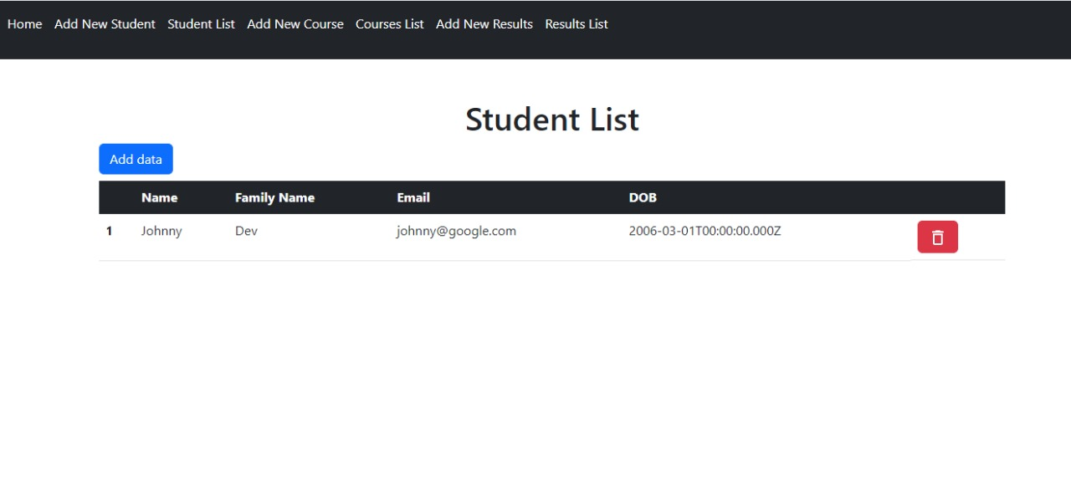
Student list
Student list where we can delete student as well

Slide 8
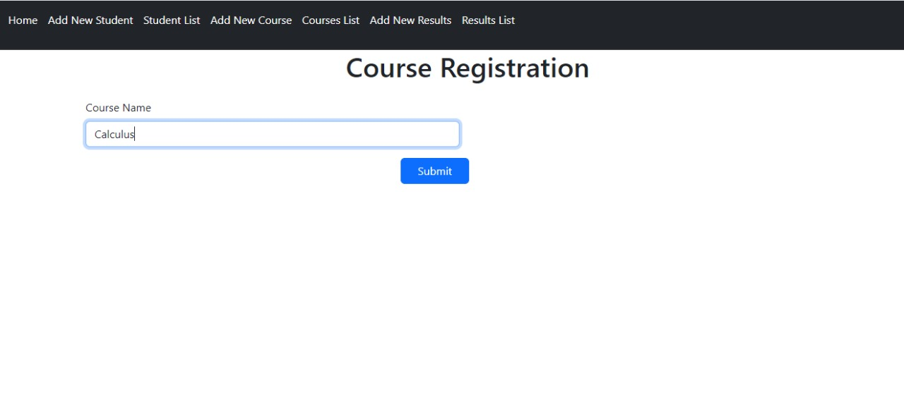
Course add form

Slide 9
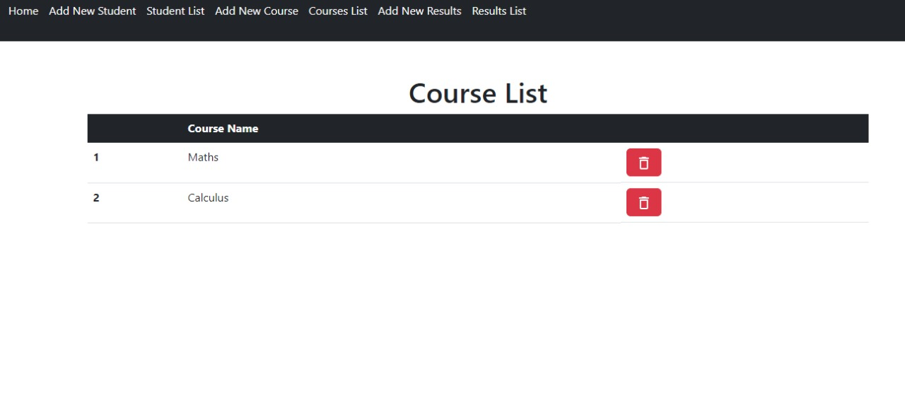
Course list
We can add and delete courses

Slide 10
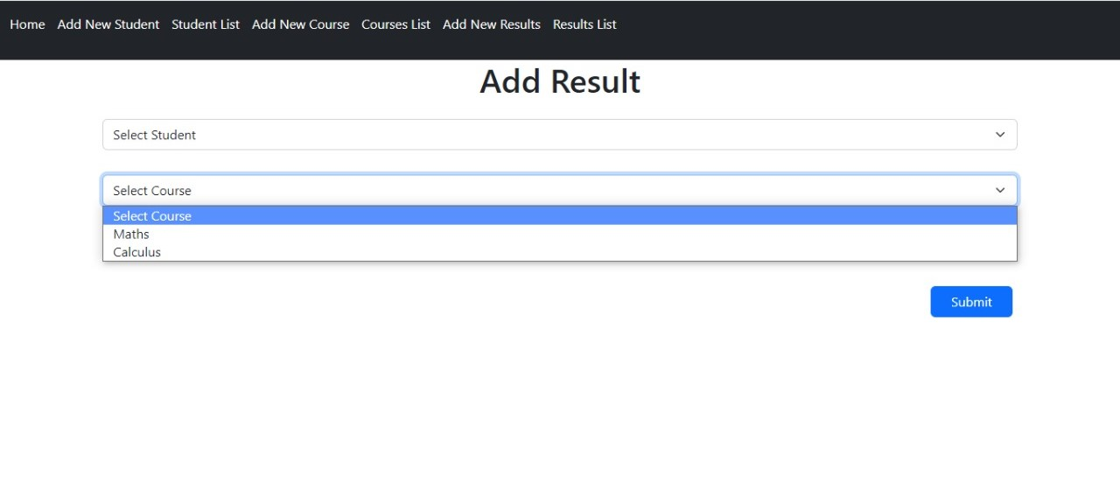
Add result
It has three drop downs where you can select student, courses and grades from drop down

Slide 11
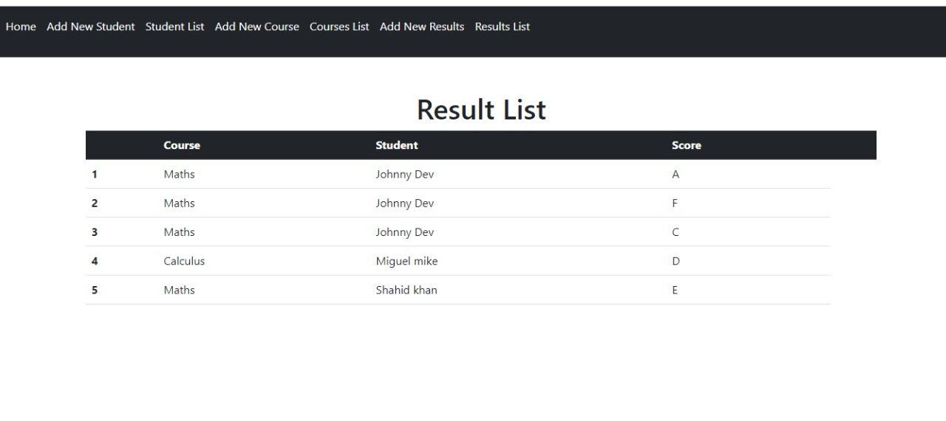
Result list page
Showing all added entries. If we delete student or course, result will be automatically deleted from result list page.

