Slide 1



Big Data
Hadoop & Spark
Hisham AlQanneh – 2110017
Zaid jehad Tabatebi -2110012

Slide 2
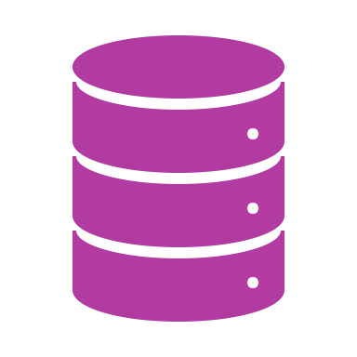
Introduction
Efficient data management is crucial in healthcare for quality patient care.
Hospitals generate vast amounts of data daily.
Apache Hive, Hadoop, and Google Cloud Dataproc provide robust solutions for managing and processing this data.

Slide 3

Abstract
Implemented a hospital database using Apache Hive.
Supported by Hadoop for distributed data processing.
Managed with Google Cloud Dataproc for scalability and ease of use.
Includes staff, doctors, nurses, departments, rooms, patients, medical records, and billing information.

Slide 4
Environment Setup
1- Prerequisites
Apache Hive
Hadoop cluster
Google Cloud Dataproc
2-Setup Steps
Initialize Hadoop cluster using Dataproc.
Configure Hive to use the Hadoop cluster.
Verify environment with sample queries.

Slide 5
Database and Table Creation
Database Creation

Slide 6
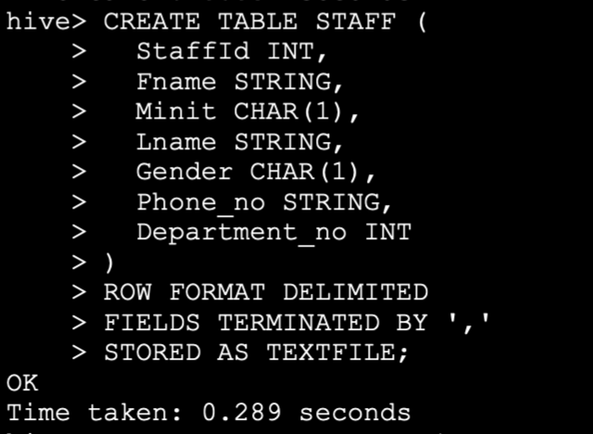
Database and Table Creation
Table Creation Examples

Slide 7
Table Creation (continued)
Created tables for:
Staff
Doctor
Nurse
Department
Room
Patient
Medical Record
Bill

Slide 8
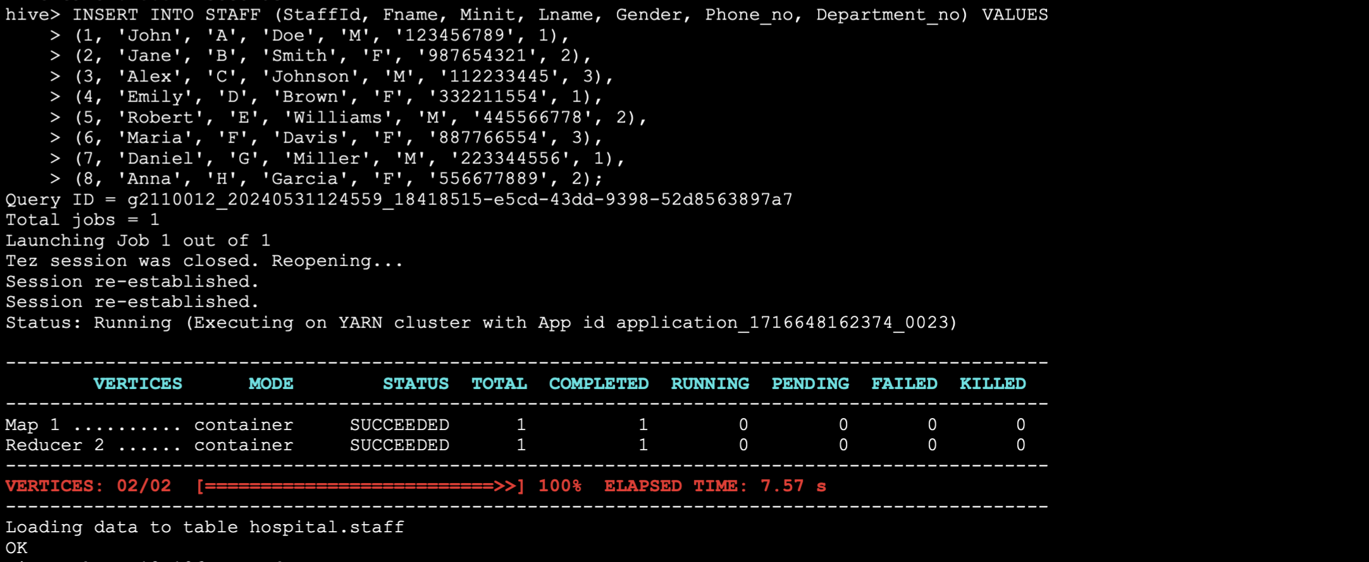
Data Insertion
Data Insertion

Slide 9

Data Querying
Basic Queries
Join Queries

Slide 10

Conclusion
The hospital database implementation provides a robust foundation for data management.
Effective for small to medium-sized datasets.
Future optimizations needed for scalability and performance.
Apache Hive, Hadoop, and Google Cloud Dataproc offer a powerful combination for handling complex healthcare data

