Slide 1

Big Data
Spark

Slide 2

Introduction
Background:
The Titanic was a British passenger liner that sank in the North Atlantic Ocean in 1912 after hitting an iceberg.
Over 1,500 passengers and crew lost their lives, making it one of the deadliest commercial peacetime maritime disasters in modern history.
Objective:
To analyze the Titanic dataset to uncover survival rates based on different features such as passenger class, gender, and age group.

Slide 3
Dataset Overview
Description:
The dataset contains information on 891 passengers.
Key features include Survived, Pclass, Sex, Age, among others.
Data Cleaning:
Removed unnecessary columns: PassengerId, Name, SibSp, Parch, Ticket, Fare, Cabin, Embarked.
Filled missing values in the Age column with "unknown".
Created an AgeGroup column to categorize ages.

Slide 4
Data Processing
Steps:
Loaded the dataset using PySpark.
Inspected and cleaned the data.
Converted data types where necessary.
Handled missing values appropriately.
Created meaningful groups for analysis (AgeGroup).

Slide 5
Unique Values and Null Counts
Unique Values in Pclass:
Displayed unique passenger classes: 1, 2, 3.
Null Counts:
Ensured no null values in key columns after cleaning.

Slide 6
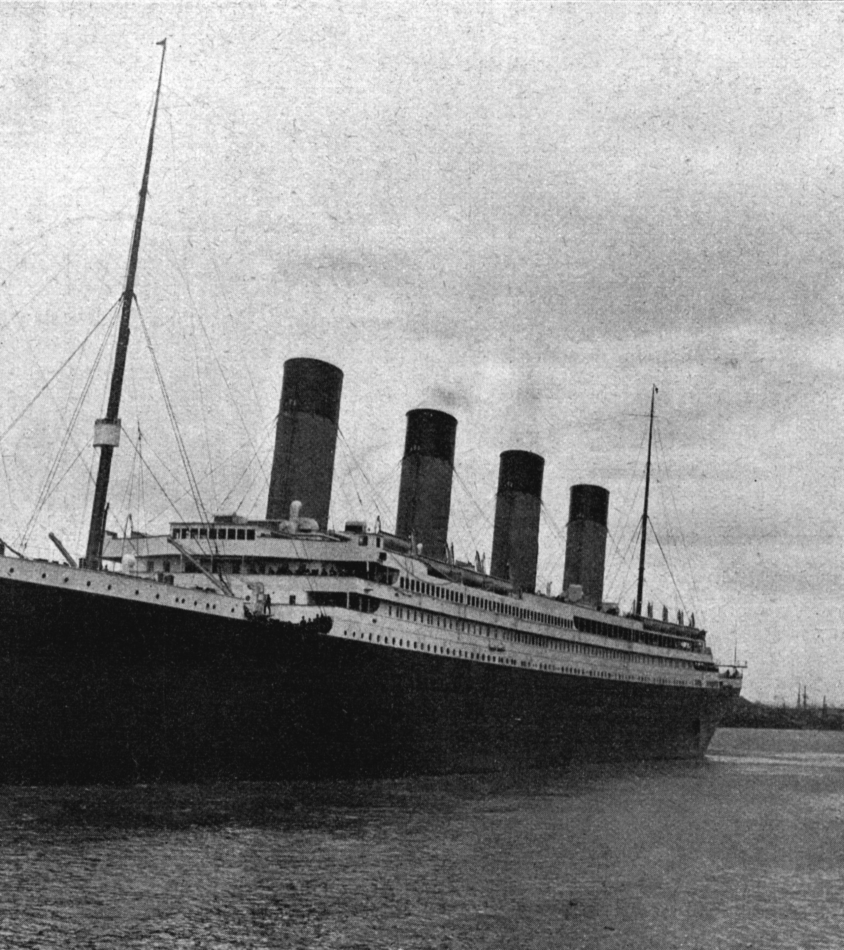
Gender Distribution
Counts:
Number of female passengers: 314
Number of male passengers: 577
This Photo by Unknown author is licensed under CC BY-SA.

Slide 7
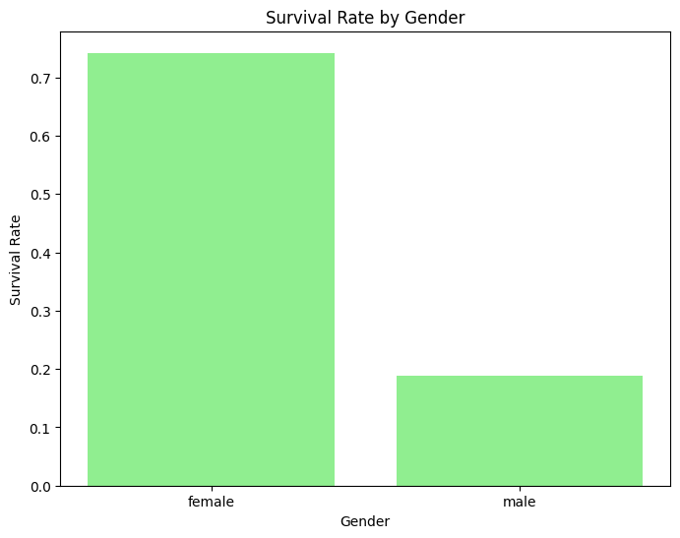
Survival by Gender
Counts:
Number of female passengers who survived: 233
Number of male passengers who survived: 109

Slide 8
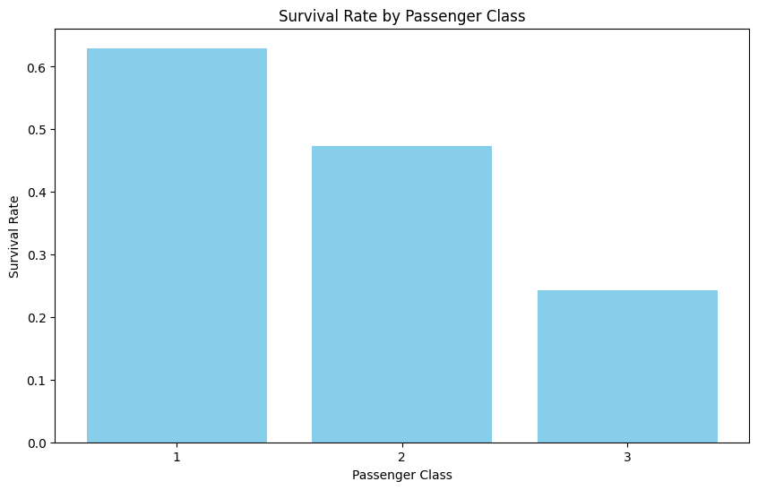
Survival Rate by Passenger Class
Rates:
Calculated survival rates for each passenger class.

Slide 9
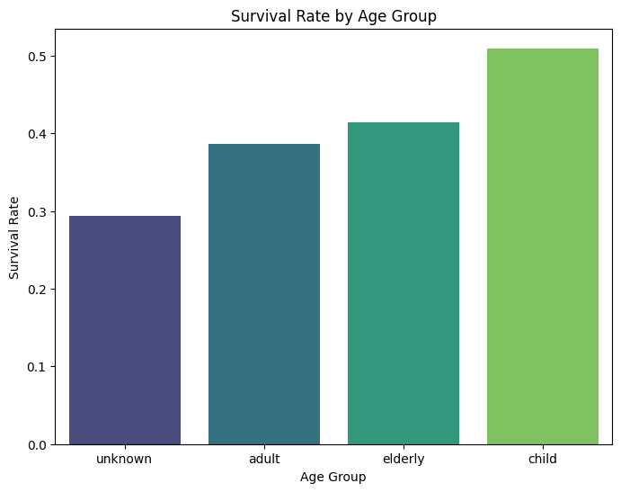
Survival Rate by Age Group
Age Groups:
Created age groups: child, adult, elderly, unknown.
Survival Rates:
Calculated survival rates for each age group.

Slide 10
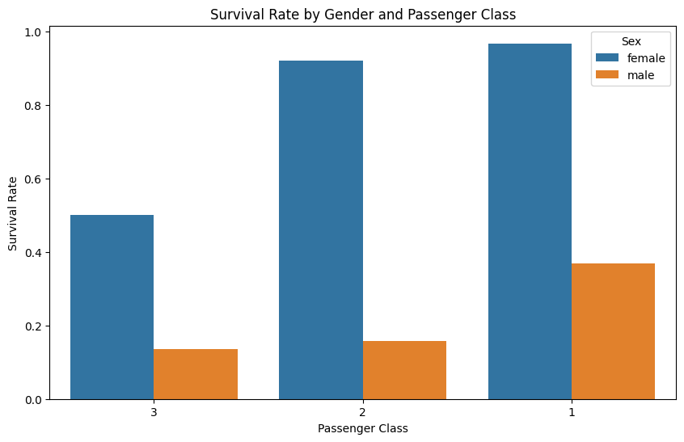
Gender and Class Survival Analysis
Combination Analysis:
Calculated survival rates by combining gender and passenger class.

Slide 11
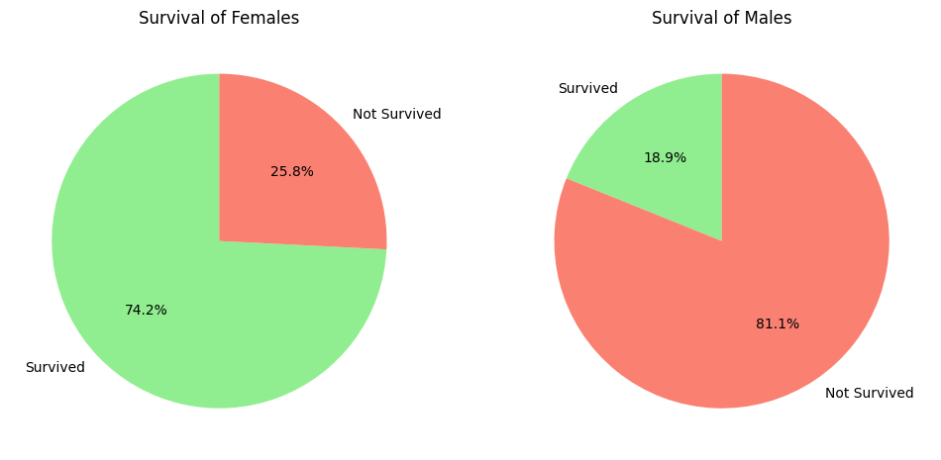
Pie Charts of Survival
Pie charts showing survival rates of males and females separately.

Slide 12
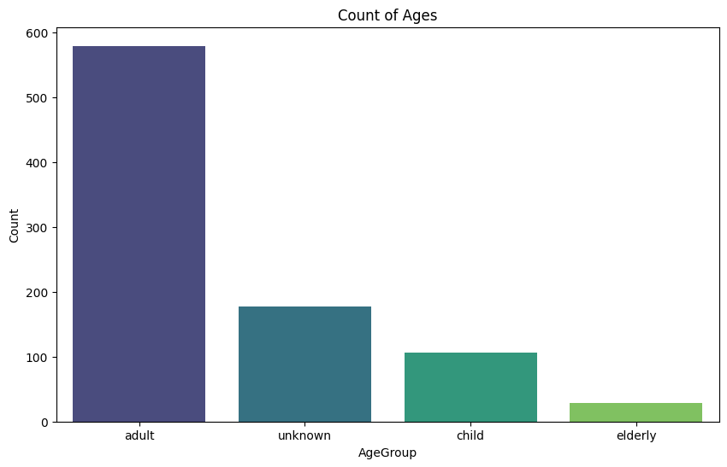
Count of Age Groups
Count of Age Groups
Age Group Distribution:
Count of passengers in each age group.
Visualization:
Bar chart showing the count of passengers by age group.

Slide 13

Conclusion
Conclusion
Key Insights:
Females had a higher survival rate compared to males.
First-class passengers had a higher survival rate than second and third-class passengers.
Children had a higher survival rate compared to adults and elderly passengers.

Slide 14
Name student
Zaid jehad Tabatebi –2110012
Hisham AlQanneh – 2110017

