Slide 1
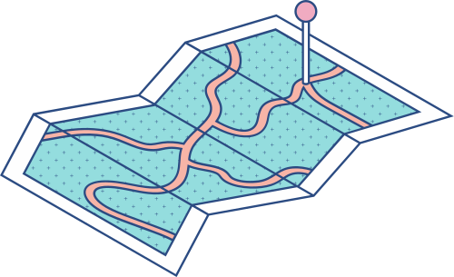




Information Retrieval System
A look at a System with the use of TF-IDF vs Non.

Slide 2
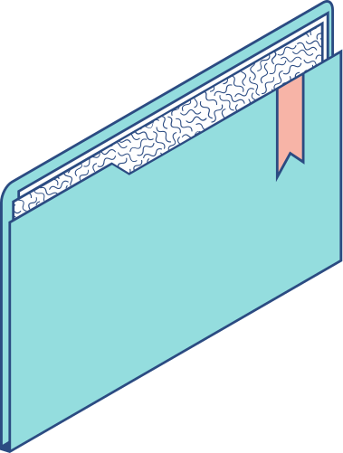
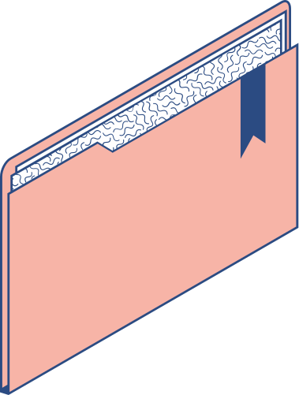
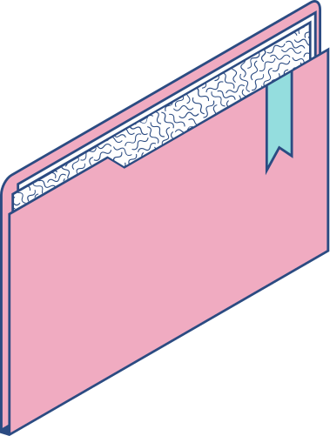
THE DATASET USED TO TEST THE SYSTEM:
Dataset
News paper Dataset. Contains over 20 documents. Each document has at least 25,000 lines or more. Multiple newspaper sites. 6 Documents were used to test. Topics like: Science, Cars, Medicine, Religion and many more.

Slide 3
The Steps of the Retrieval System:
1
2
3
4
5
6
STEP
STEP
STEP
STEP
STEP
STEP
Inverted Index
Document Processing
Retrieval Evaluation
Classification
Evaluation
GUI
splits the text and
maps each word to a row number next tokenization
sorting alphabetically and lastly skip list index is created.
Training naive bayes classifier on documents for label predication
Using metrics like Precision, Recall and F1 Score to measure Each code Efficiency
User interface to take in query and return search results
Removing stop words,
Lemmatization
First code TF-IDF
Second code Bag of Words(BOW)

Slide 4
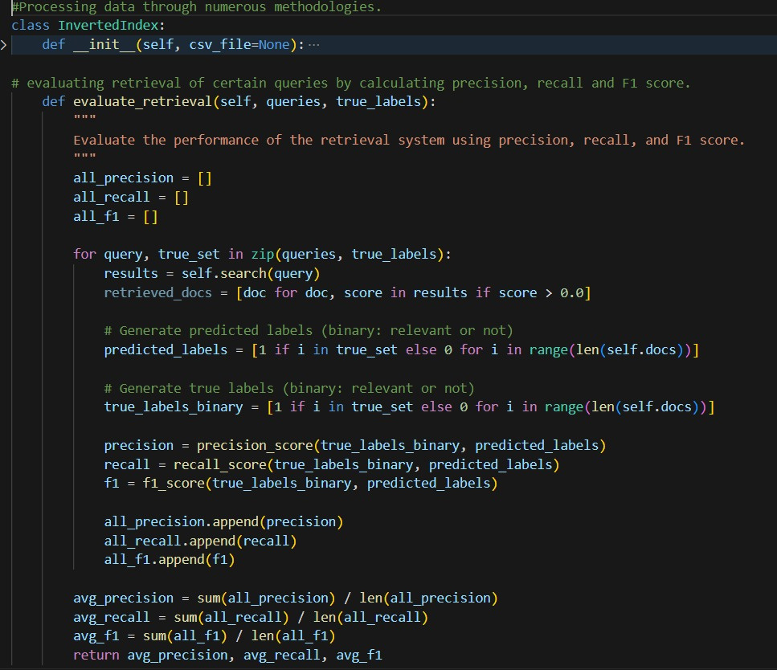
Code
Initialization for the class and the evaluation function

Slide 5
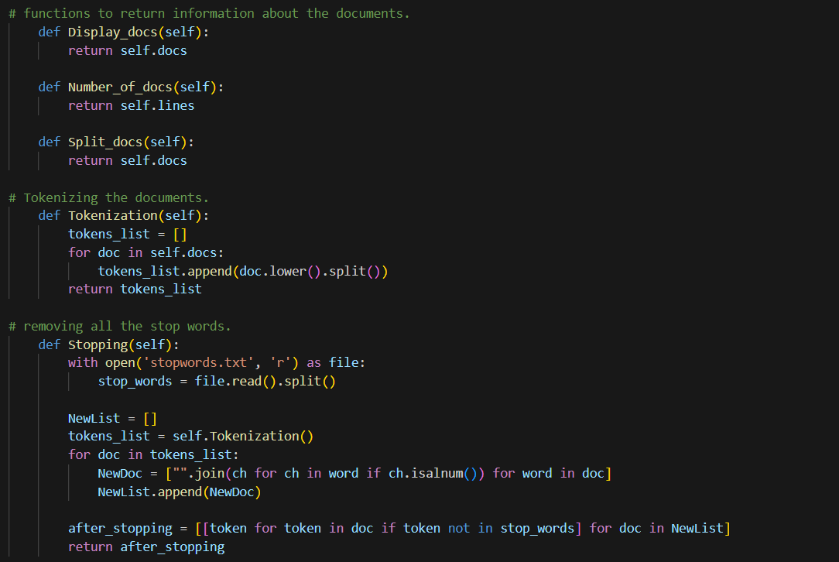
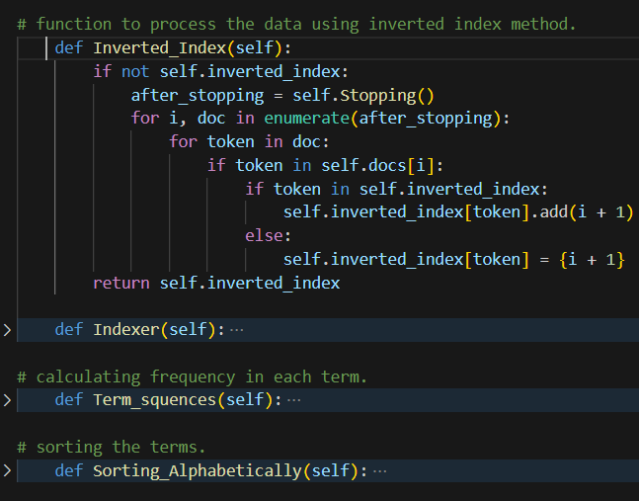
Proccessing documents and inverted index application

Slide 6
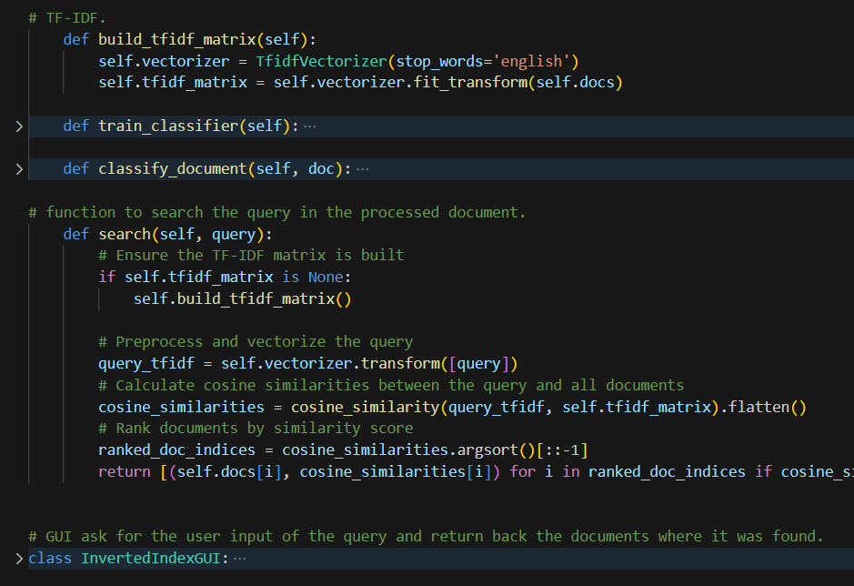
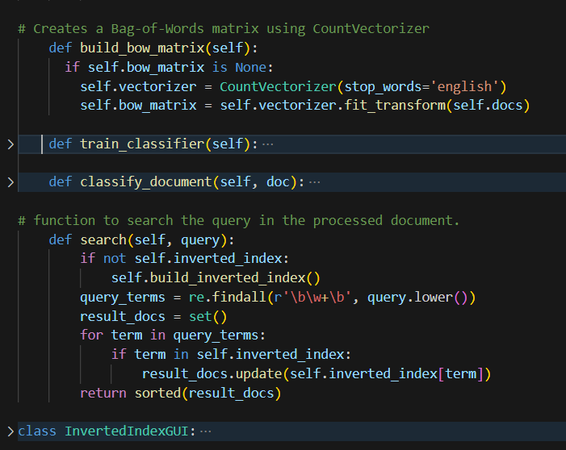
Building TF-IDF Vs BOW and search algorithm with the GUI

Slide 7
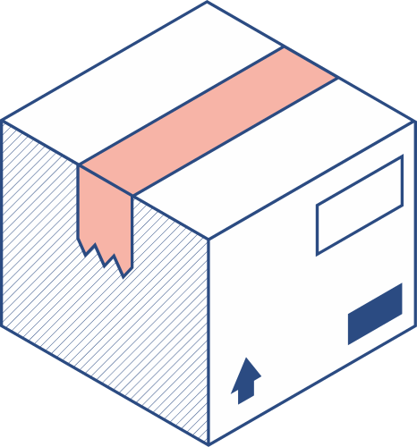
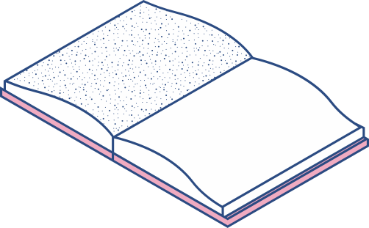

TF-IDF System | Bag of Words
Simple and easy to use implementation wise and method of working. Prioritizing the documents through weighing and therefore helps the system in conducting the search in efficient ways returns back high value and relevant data preventing any other data from overshadowing | Simple and efficient representation of text for machine learning algorithms. interpretable for data and is not a complex model Ignores word order and context, leading to loss of semantic meaning.

Slide 8
Dashboard of the Evaluation:
We gathered the Evaluation metrics data like the Precision, Recall and F1 Score from our retrieval system for 4 different queries for 6 distinct documents and showed the results using the
Dashboard.

Slide 9

Conclusion
The use of TF-IDF can make the system have higher efficiency in terms of retrieval process as when combined with the indexing methods. That when evaluating a system that have the tool TF-IDF we will have higher recall and precision values and so that means having a system that can take queries to search and return back relevant and usable data for users and system like the one we implemented can be further improved and used in other domains since it is high quality.

Slide 10
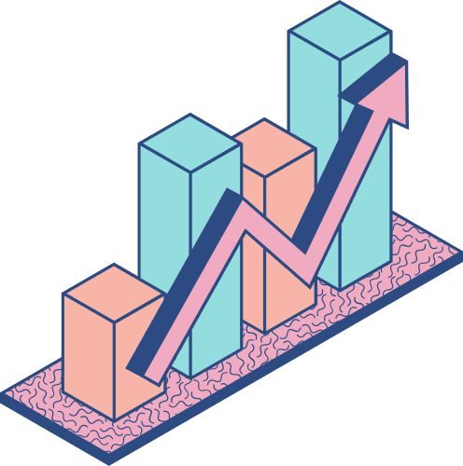
THANKS!
Made By:
Ghazal Helal - Ayat Omar - Zaid Eltabatebi
Instructor: Dr.Ola Al-Surakhi
Information Retrieval

