Slide 1
Lane Detection System

Slide 2
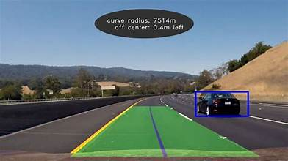
What is lane detection?
The Lane detection system for the cars is a way to detect the lanes of the road to make the move easier from side to another using python language and it’s a Constraint Satisfaction Problem approaching the model-based and learning-based methods to detect and the distance for the car in the front.

Slide 3
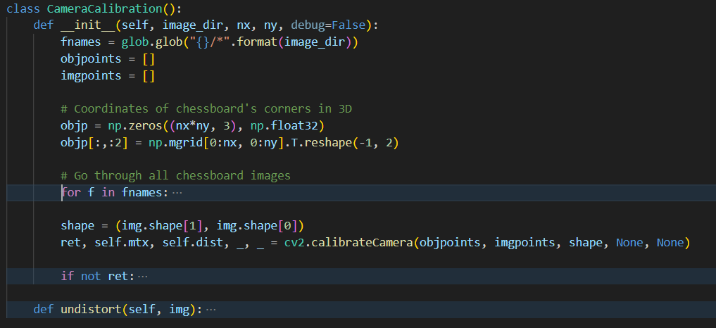
Important elements of the system:
Calibration of cameras:
Using a collection of photos, the system first calibrates the camera Lens distortions to get adjusted.

Slide 4
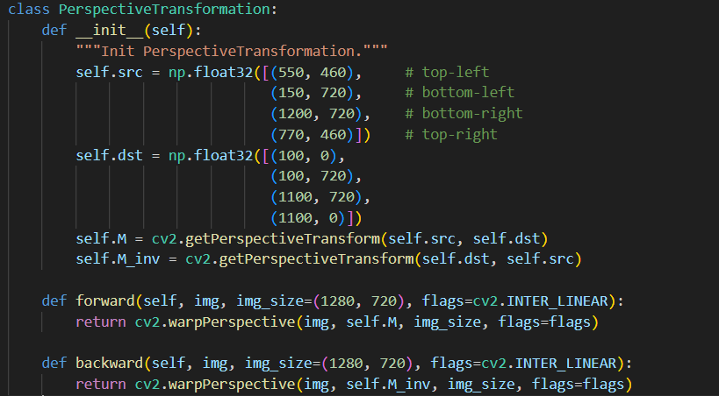
Important elements of the system:
Perspective Shift:
this transformation streamlines the lane recognition process and facilitates lane line identification and tracking.

Slide 5
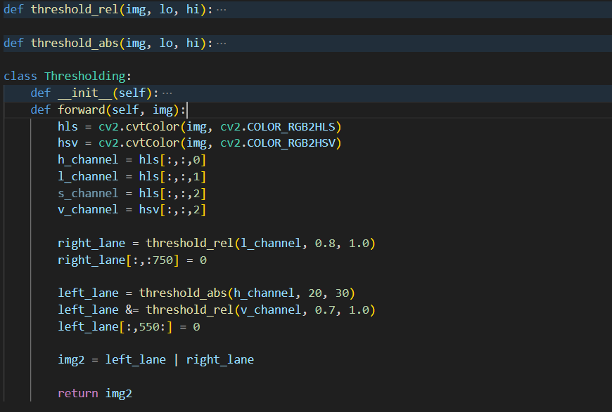
Important elements of the system:
Limiting
Using thresholding to improve the visibility of the lane lines in the pictures.

Slide 6
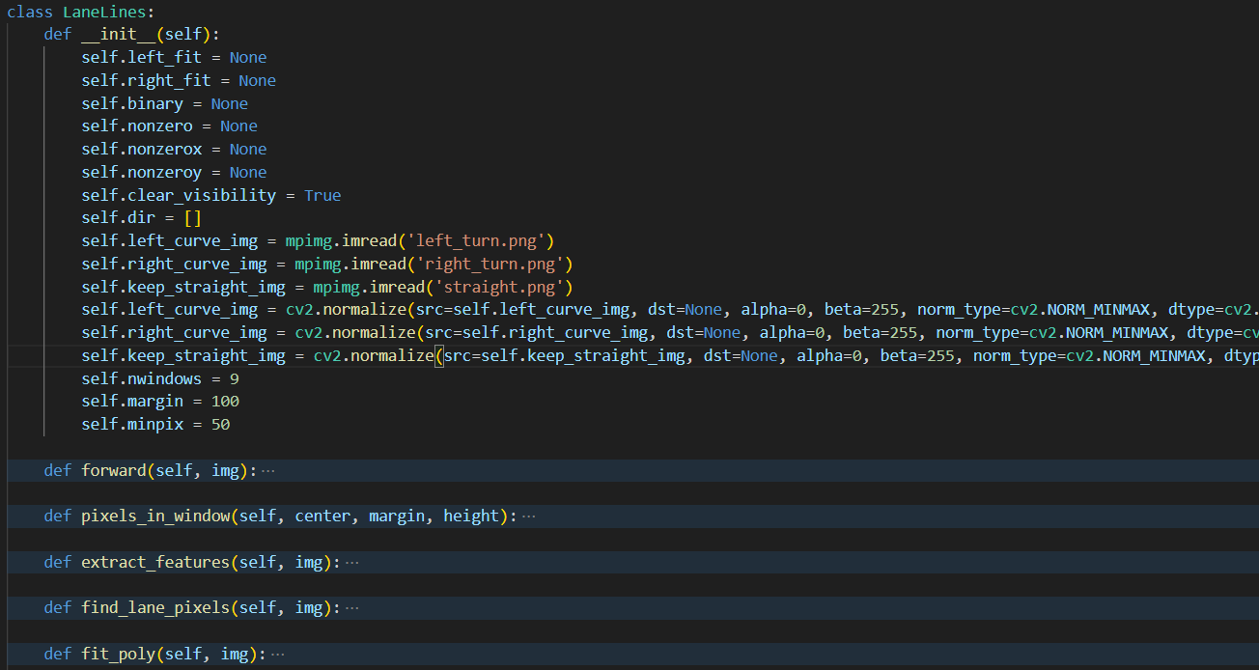
Important elements of the system:
Identifying Lane Lines:
Using thresholding to improve the visibility of the lane lines in the pictures.
Snippet of the code:

Slide 7
Use Cases
Autonomous Driving:
The system aids in identifying and tracking lane lines, allowing the vehicle to navigate within lanes autonomously.
Driver Assistance Systems:
This technology provide real-time feedback to human drivers. This includes alerts when the vehicle deviates from the lane.
Traffic Monitoring and Management:
The system detects and analyzes lane usage patterns, aiding in traffic flow management.
Smart Parking Systems:
The system can assist drivers in aligning their vehicles within parking space Traffic Monitoring and Management.
Augmented Reality Navigation:
navigation systems. AR displays can overlay lane information directly onto the driver's view.

Slide 8
Peas of the system
Agent
FindLaneLines class: Core for lane detection, overseeing image/video frame processing to detect and visualize lane lines.
Environment
The agent analyzes a stream of car-mounted camera frames to identify and follow lane lines on the road.
Sensors
The camera records frames, utilizing VideoFileClip for videos,camera calibration corrects distortions,serving as form of sensing.
Actuators
FindLaneLines class acts as actuators, performing lane detection, thresholding, perspective adjustments, image undistorting, and outcome visualization.

Slide 9
Formulating the problem
Initial State:
Start with a raw image, calibrate the camera for processing.
Agent Actions:
Transform, threshold, recognize lanes, calibrate, visualize.
Transition Model:
Image processing operations on each frame.
Performance Measurement:
Measure accuracy, recall, video tracking, and efficiency.
Goal state:
Processed frame with visible lane lines for driver assistance or autonomous driving.

Slide 10
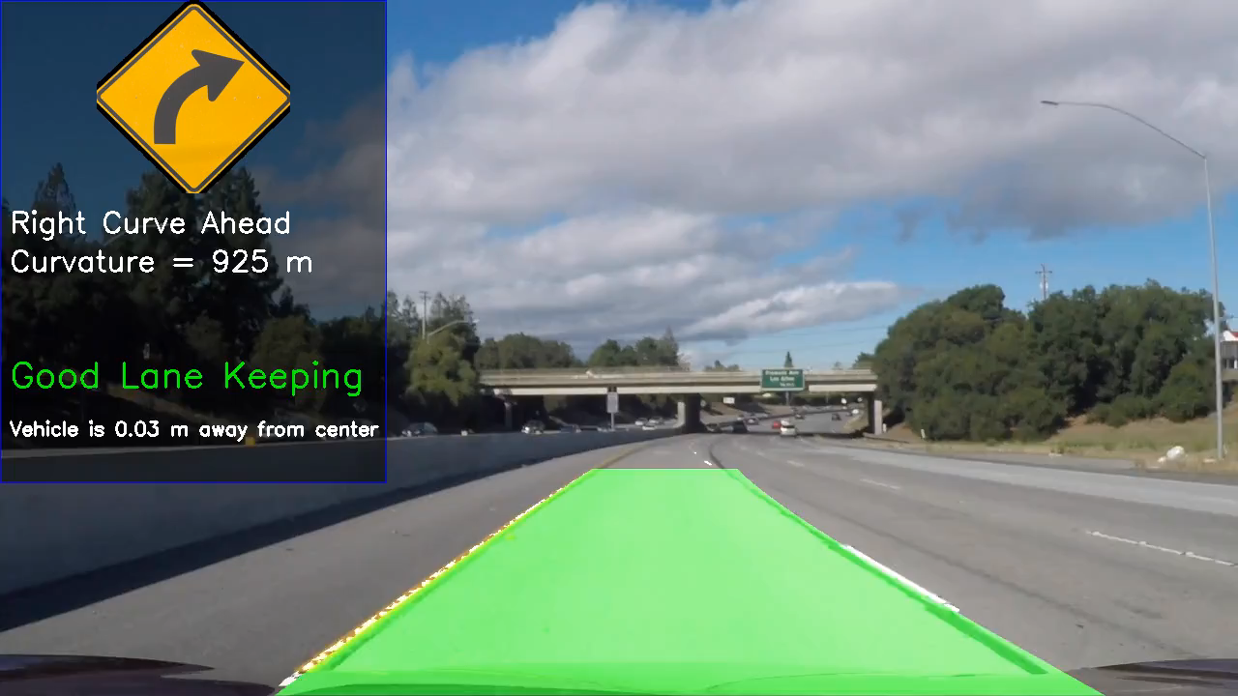
Results:

Slide 11
Conclusion:
The project solves the problem of recognizing lanes in car cameras. It uses a streamlined process for accurate identification and works well in different driving conditions. This is useful for self-driving cars and helping drivers.

Slide 12
Name: Ghazal Helal, Zaid Jehad, Ayat Omar
ID: 2020001, 2110012, 2020091
Course: Fundamentals of Artificial Intelligence
Instructor: Dr.Ahmad Daraiseh
THANKS!

