Slide 1
Hackathon 2024
Local Job Market Analysis : Design a tool that analyzes the local job market and provides information about job opportunities and trends
Deep Kumawat & Zaid Kaladia

Slide 2

Enter Login and personal information
Input Location
Input the domain to get job or internships in.
Input all the skills
Then the platform will recomend relatable job listings

Slide 3






Slide 4






One Stop Platform
One platform where you get access to all the internship and job opportunities.

Slide 5
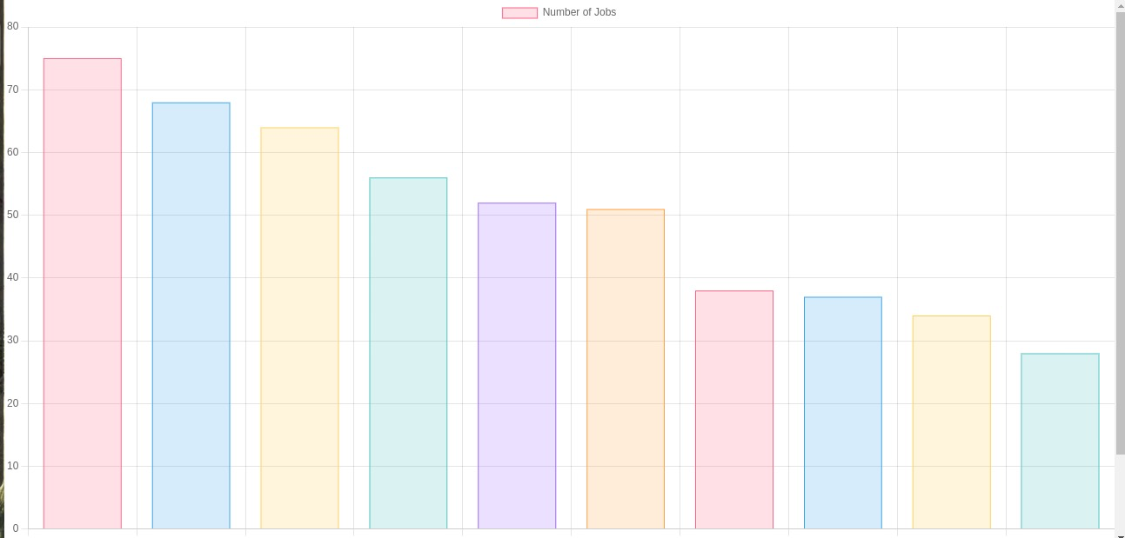
Most Real time in market demand skill
Showcase the most demanding skills in your local

Slide 6
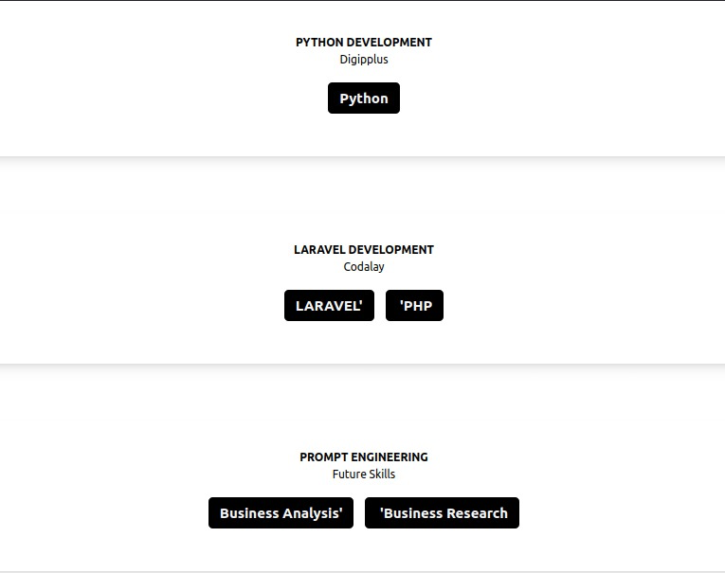
Skill recommendation, that opens the maximum doors of opportunities for you

Slide 7
Specially tailored for each professions
Showcase the job and internship opportunities displayed by the core companies of that field

Slide 8
Difficulty Faces
Skill sorting and matching due to inconsistent data provided by the job portals
Scraping over 500 jobs for a specific domain for work from home as well as in-office.
We tried dozens of request to parse through the on-demand content provider of naukri.com.

Slide 9
Achivements

Slide 10
Showcasing output of India’s No. 1
Internship providing platform:
Internshala

Slide 11
Showcasing output of India’s No. 1
Job providing platform:
naukri.com

Slide 12
Skill Stack
Python(BeautifulSoup, Selenium, httpx, flask)
Express
NodeJs
React
Tailwind
Chartjs

