Slide 1

GROUP PROJECT BY: ZAID M.KHAN(BAI-23S-032) ABRAR DAR(BAI-23S-011) WAJEEHA ZEHRA(BAI-23S-O63) MARYAM SOHAIL(BAI-23S-003)
SUBJECT:DATABASE
TEACHER’S NAME;AQSA UMAR

Slide 2
WHAT IS DATABASE?
A database is a structured collection of data that is organized and stored in a way that allows for efficient retrieval, management, and update of that data. It is a systematic and organized way to store, manage, and retrieve information. Databases are used in a wide range of applications, including websites, business applications, scientific research, and more.

Slide 3
“KEY COMPONENTS”
Database: The overall container that holds all the data and database objects.
Table: A structured set of data organized in rows and columns.
Row (Record): A single entry or data record in a table.
Column (Field): A vertical set of data points in a table, representing a particular attribute of the data.
Primary Key: A unique identifier for each record in a table, used to enforce entity integrity.
Foreign Key: A field in a table that refers to the primary key in another table, establishing a link between the two tables.
Index: A data structure that improves the speed of data retrieval operations on a database table.
Query: A request for data or information from a database, typically written in a query language like SQL.
Database Management System (DBMS): Software that provides an interface for interacting with the database.

Slide 4
10.Normalization: The process of organizing the data in a database to reduce redundancy and improve data integrity.
11.Denormalization: The process of optimizing a normalized database for performance by reintroducing redundancy.
12.Transaction: A single unit of work or a sequence of operations that are executed as a single unit.
13.ACID Properties: A set of properties (Atomicity, Consistency, Isolation, Durability) that guarantee database transactions are processed reliably.
14.Schema: A blueprint that defines the structure of the database, including tables, fields, and relationships.
15.Relational Model: A model for representing data as tables with rows and columns, and relationships between tables.
16.SQL (Structured Query Language): A domain-specific language used for managing and manipulating relational databases.
17.Backup and Recovery: Processes to create copies of data to prevent data loss and procedures to restore data in case of a failure.
18.Views: Virtual tables that are based on the result of a SELECT query, providing a way to present specific data subsets

Slide 5

RESTAURANT MANAGEMENT SYSTEM

Slide 6
HERE IS OUR DATABASEOF
RESTAURANT MANAGEMENT SYSTEM
create database RESTAURANT;
USE RESTAURANT;
CREATE TABLE employees (
employee_id INT PRIMARY KEY,
employee_name VARCHAR(255),
position VARCHAR(255),
salary DECIMAL(10, 2));
INSERT INTO employees VALUES
(1, 'zaid', 'manager', 50000.00),
(2, 'maryam', 'chef', 45000.00),
(3, 'wajeeha', 'cook', 35000.00),
(4, 'abrar', 'chef', 45000.00);
CREATE TABLE menu_items ( item_id INT PRIMARY KEY, item_name VARCHAR(255),
price DECIMAL(8, 2));
INSERT INTO menu_items VALUES
(1, 'chicken biryani', 100.99),
(2, 'Chicken Alfredo', 35.99),
(3, 'pasta', 55.99),
(4, 'chicken chowmeim', 65.99);

Slide 7
CREATE TABLE orders (
order_id INT PRIMARY KEY,
customer_id INT, order_date DATE,
total_amount DECIMAL(10, 2),
FOREIGN KEY (customer_id) REFERENCES customers(customer_id));
INSERT INTO orders VALUES
(11, 1, '2023-01-01', 28.99),
(22, 2, '2023-02-15', 42.50),
(33, 3, '2023-02-15', 42.50),
(44, 4, '2023-02-15', 42.50);
CREATE TABLE customers (
customer_id INT PRIMARY KEY, customer_name VARCHAR(255), phone_number VARCHAR(15));
INSERT INTO customers VALUES
(1, 'wasay', '+1234567890'),
(2, 'zohan', '+9876543210’),
(3, 'meer', '+9876443210’),
(4, 'balaaj', '+9856543210');
CREATE TABLE order_items (
order_item_id INT PRIMARY KEY,
order_id INT, item_id INT, quantity INT,
FOREIGN KEY (order_id) REFERENCES
orders(order_id),
FOREIGN KEY (item_id) REFERENCES
menu_items(item_id));
INSERT INTO order_items VALUES
(101, 11, 1, 2),
(102, 22, 2, 5),
(103, 33, 3, 2),
(104, 44, 4, 9);
CREATE TABLE tables (
table_id INT PRIMARY KEY, table_number INT,
capacity INT);
INSERT INTO tables VALUES
(111, 121, 4),
(222, 131, 6),
(333, 141, 6),
(444, 151, 6);

Slide 8
CREATE TABLE reservations ( reservation_id INT PRIMARY KEY, customer_id INT, table_id INT, reservation_date DATE, num_of_guests INT, FOREIGN KEY (customer_id) REFERENCES customers(customer_id), FOREIGN KEY (table_id) REFERENCES tables(table_id));
INSERT INTO reservations VALUES (666, 1, 111, '2023-01-15', 3), (777, 2, 222, '2023-02-28', 5), (888, 3, 333, '2023-02-27', 6),(999, 4, 444, '2023-02-21', 7);
CREATE TABLE payments ( payment_id INT PRIMARY KEY, order_id INT, payment_date DATE, amount_paid DECIMAL(10, 2), FOREIGN KEY (order_id) REFERENCES orders(order_id));INSERT INTO payments VALUES (54, 11, '2023-01-23', 28.99), (55, 22, '2023-02-10', 42.50), (56, 33, '2023-02-25', 42.50), (57, 44, '2023-02-28', 42.50);CREATE TABLE ingredients ( ingredient_id INT PRIMARY KEY, ingredient_name VARCHAR(255), quantity_in_stock INT);
INSERT INTO ingredients VALUES (1111, 'Tomatoes', 100),(2222, 'Chicken Breast', 50),
(3333, 'garlic', 50),(4444, 'onion', 50);
CREATE TABLE dishes ( dish_id INT PRIMARY KEY, dish_name VARCHAR(255), price DECIMAL(8, 2), chef_id INT, FOREIGN KEY (chef_id) REFERENCES employees(employee_id));
INSERT INTO dishes VALUES (454, 'Margherita Pizza', 15.99, 1), (456, 'Grilled Salmon', 18.99, 1), (457, 'Grilled onion', 16.99, 1), (458, 'Grilled chicken', 20.99, 1);
CREATE TABLE chef_specials ( chef_special_id INT PRIMARY KEY, dish_id INT, special_date DATE, FOREIGN KEY (dish_id) REFERENCES dishes(dish_id));
INSERT INTO chef_specials VALUES (344, 454, '2023-01-10'), (345, 456, '2023-02-25'),(346, 457, '2023-02-25’),
(347, 458, '2023-02-25');

Slide 9
HAS
RESTURAURANT
R_ID
I_ID
CASHIER
N_CUST
PAID TO
name
RESERVATION
T_id
id
id
HAS
date
C_id
BOOKS
PAYMENT
amout
C_id
name
MANAGER
TELLS
O_id
PAY
id
D_id
name
It_id
0_id
sp
id
id
CUSTOMER
quantity
PREPARE
ORDER
CHEF
P_no
GIVE ORDER TO
GIVES
GIVE
name
TAKE
MAKE
name
quantity
id
id
id
price
id
MENU ITEM
WAITER
OF
ORDER ITEM
DISHES
name
O_id
O_i_id
C_id
price
GIVES
GIVES
SERVE TO

Slide 10
Now we use multiple queries here:

Slide 11
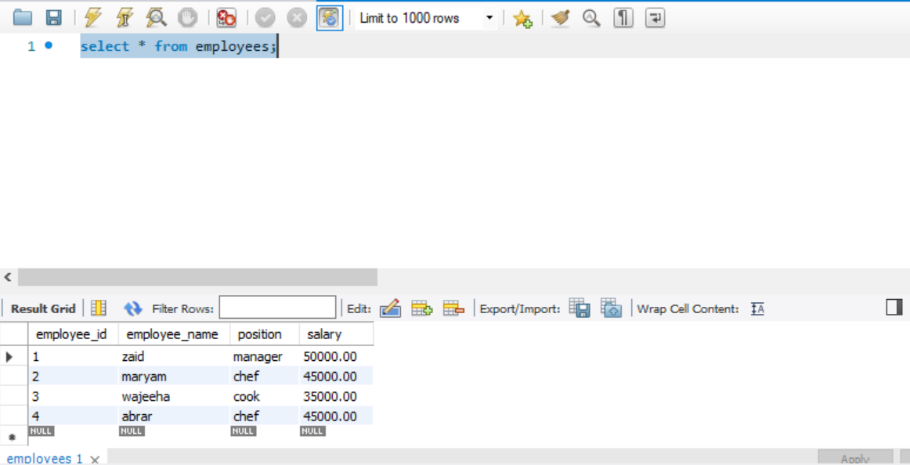
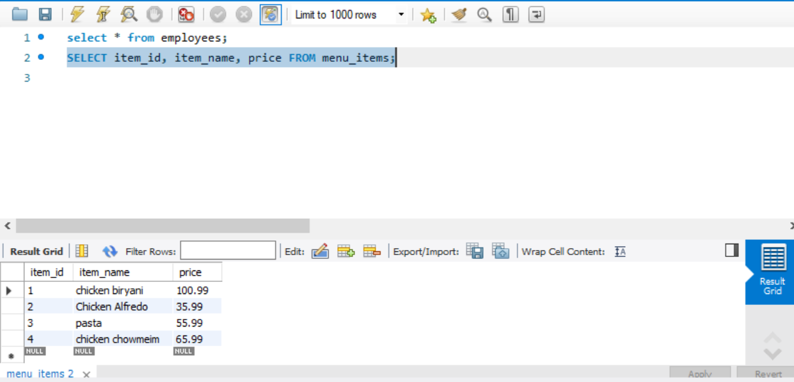

Slide 12
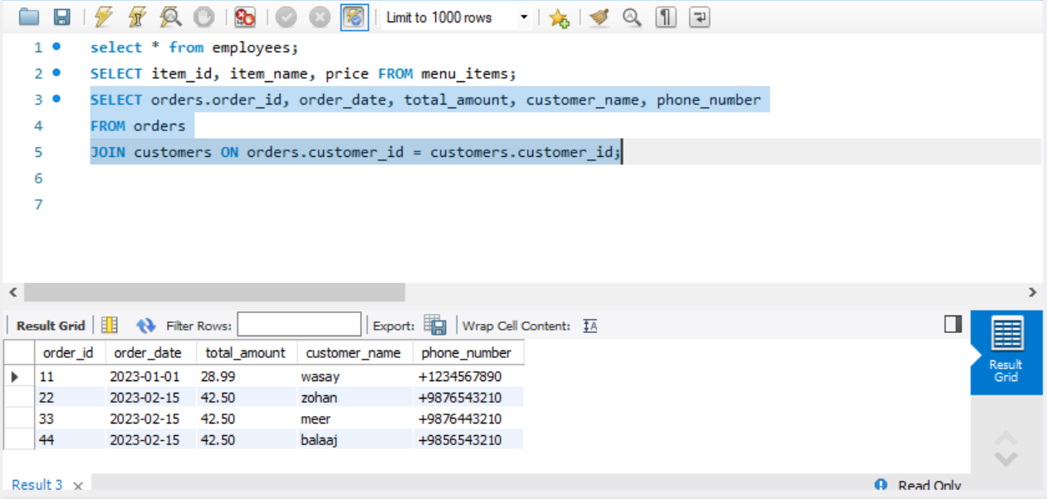
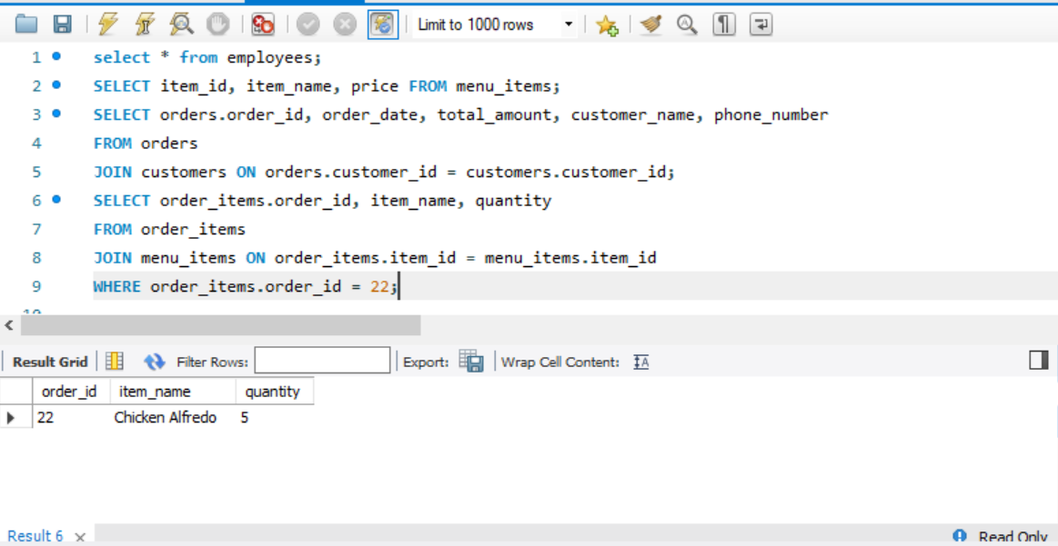

Slide 13
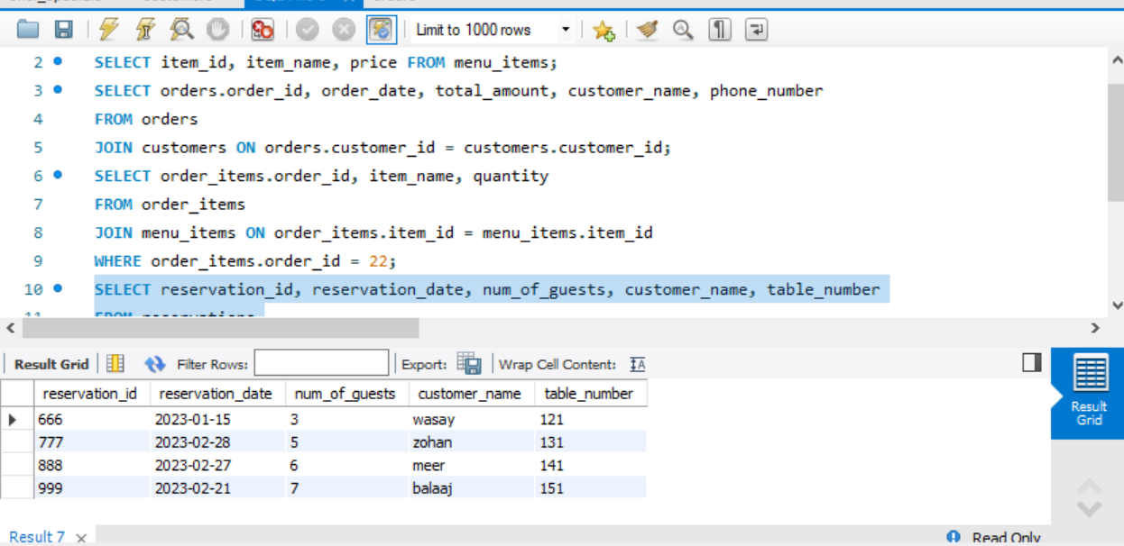
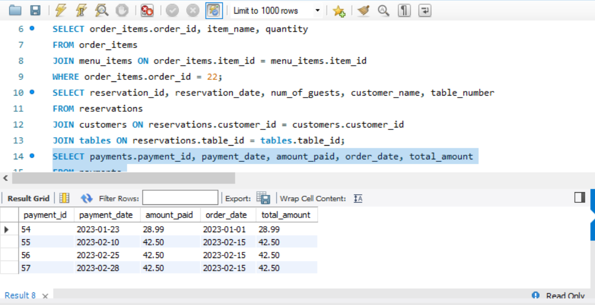

Slide 14
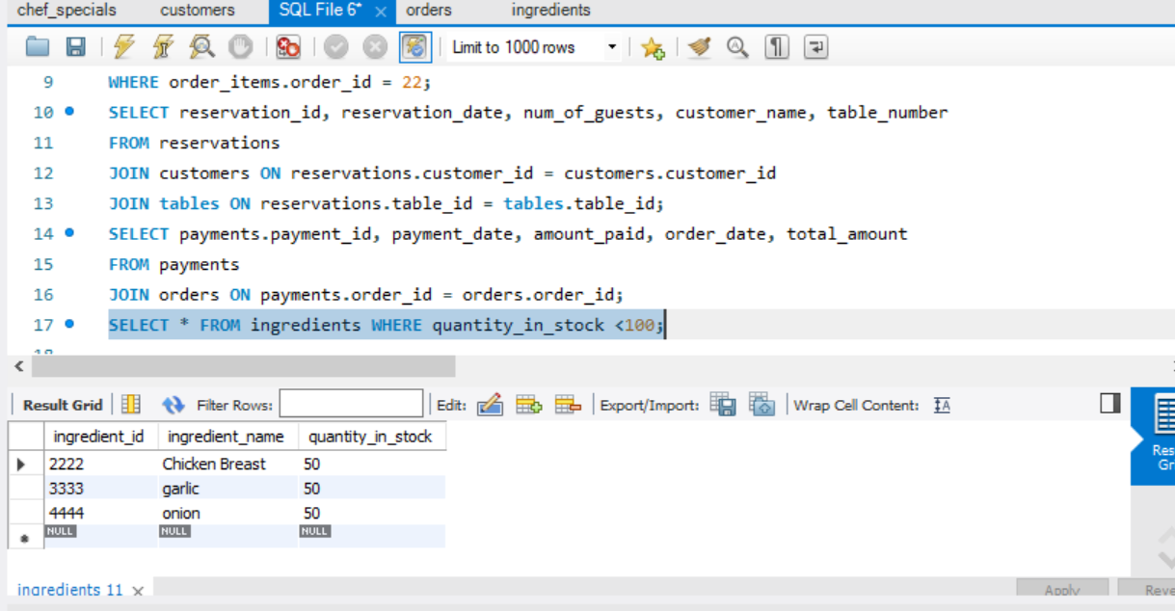
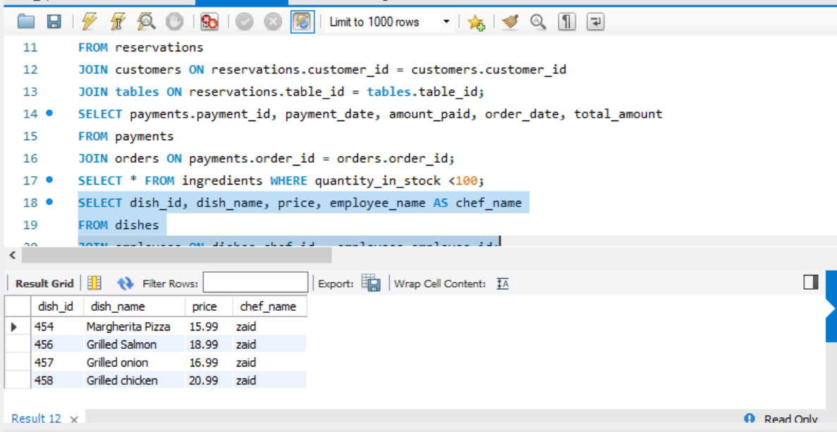

Slide 15
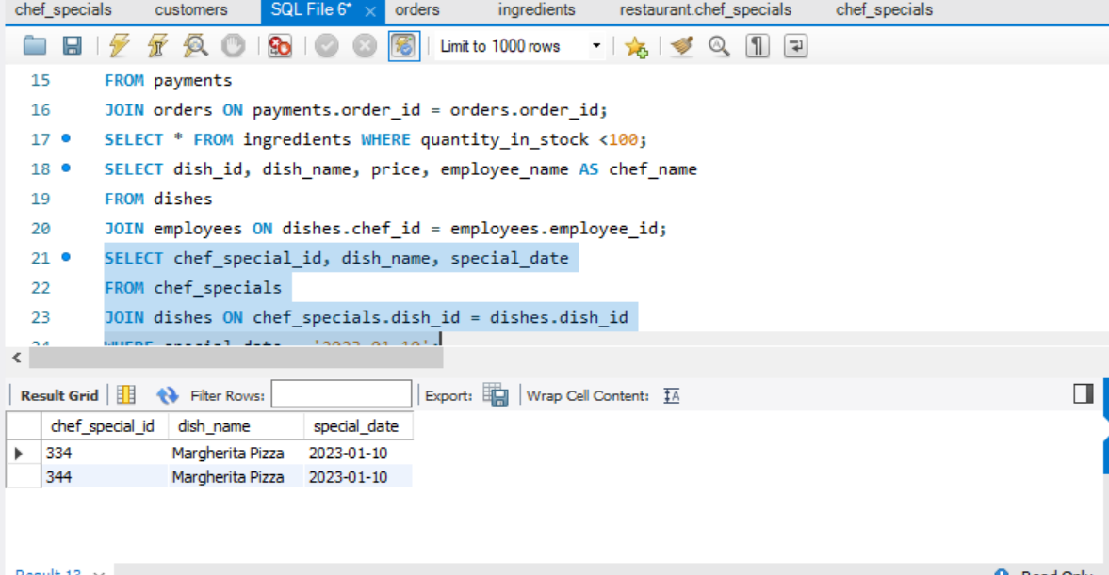
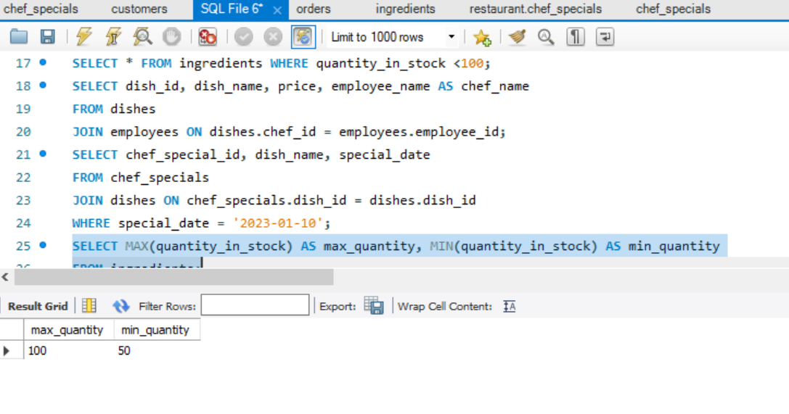

Slide 16
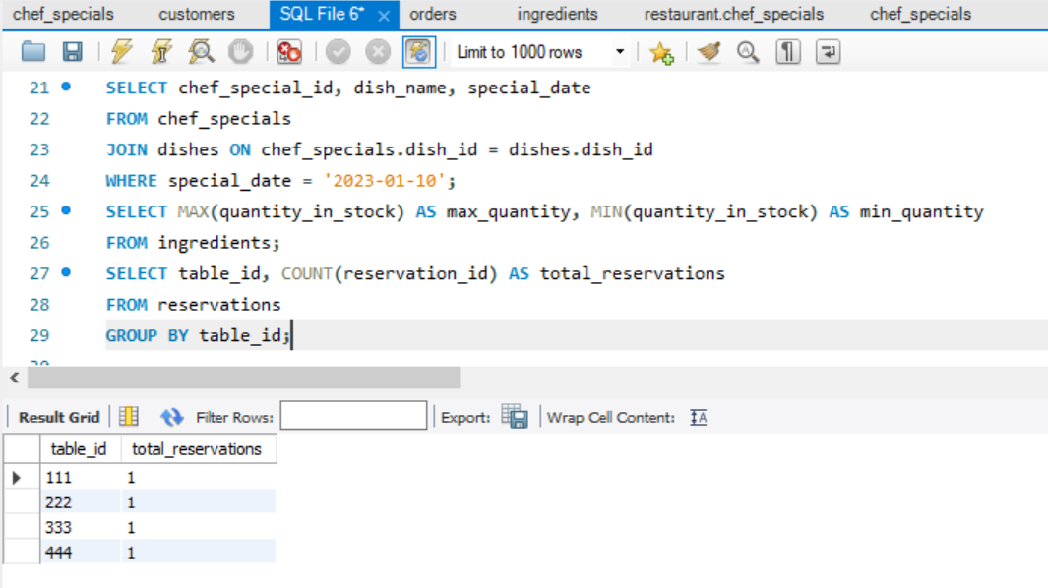
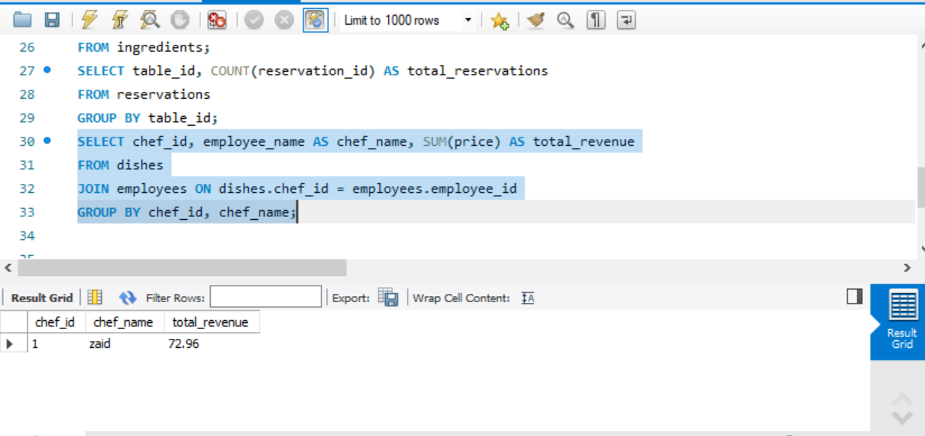

Slide 17
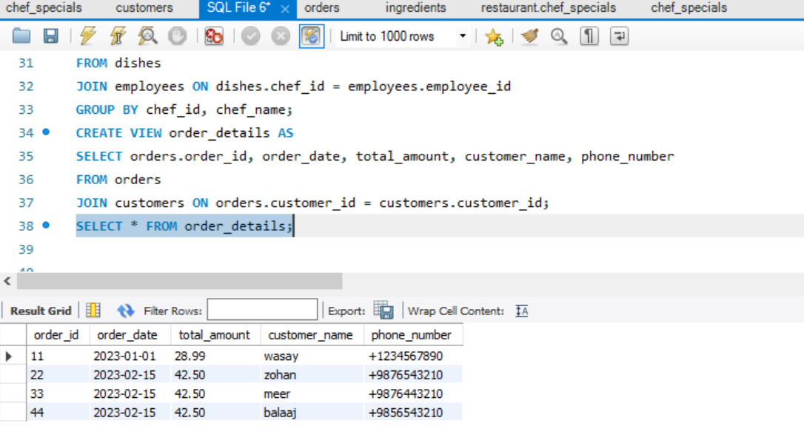
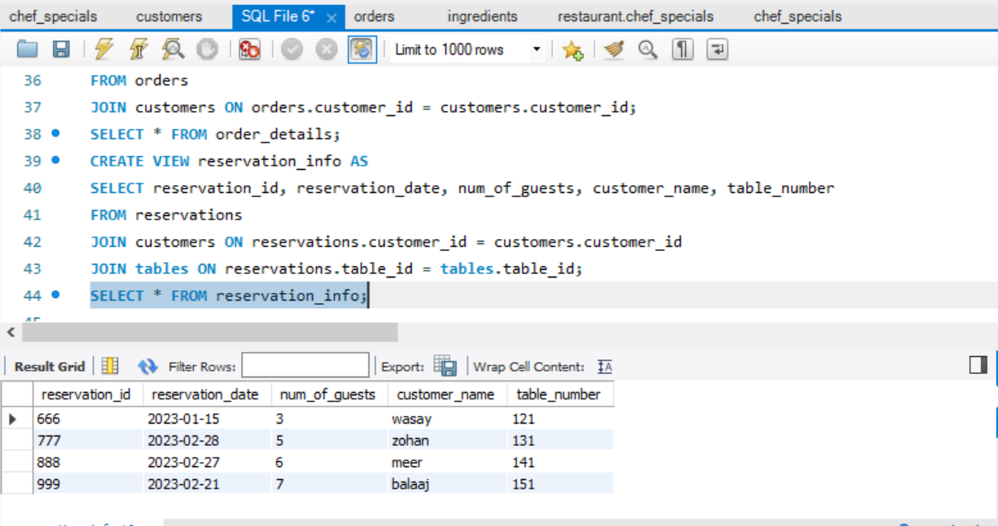

Slide 18
THANKYOU

