Slide 1

SMART INDIA HACKATHON 2026
Problem Statement ID : SIH26175
Problem Statement Title : DepthWizard - Single-View Height Estimation and 3D Flythrough
Theme : Disaster Management
PS Category : Software
Team ID : 129655
Team Name : Dev Up
LIVE project5.zaidansari.tech DOCS project5.zaidansari.tech/documentation

Slide 2






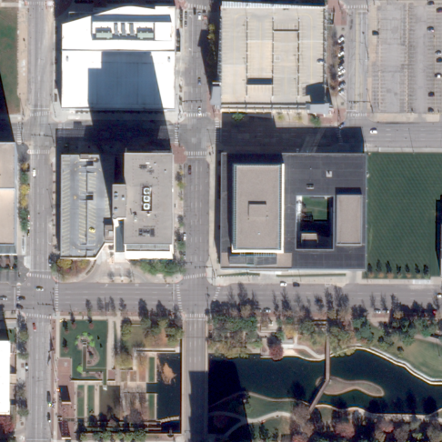
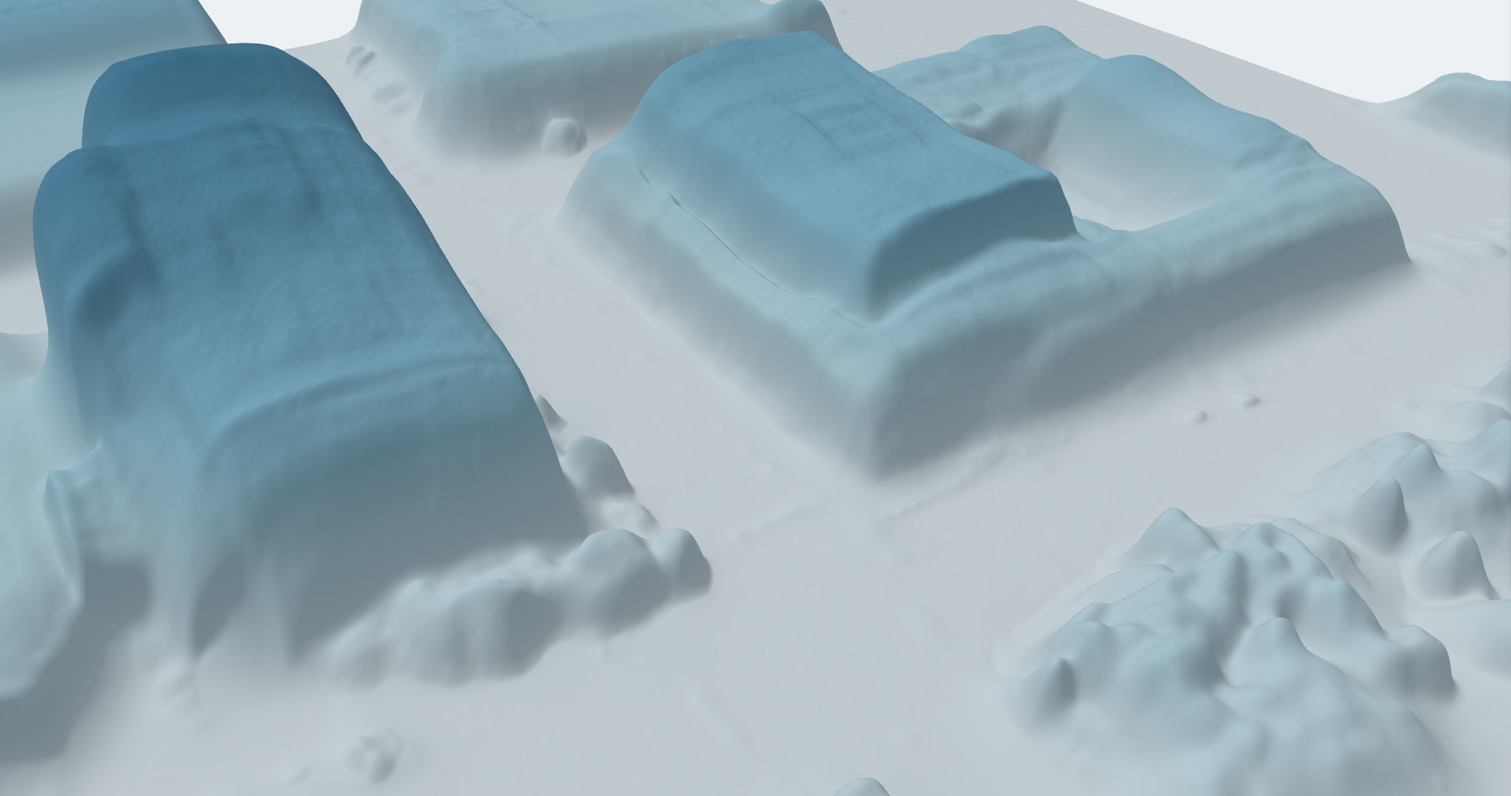
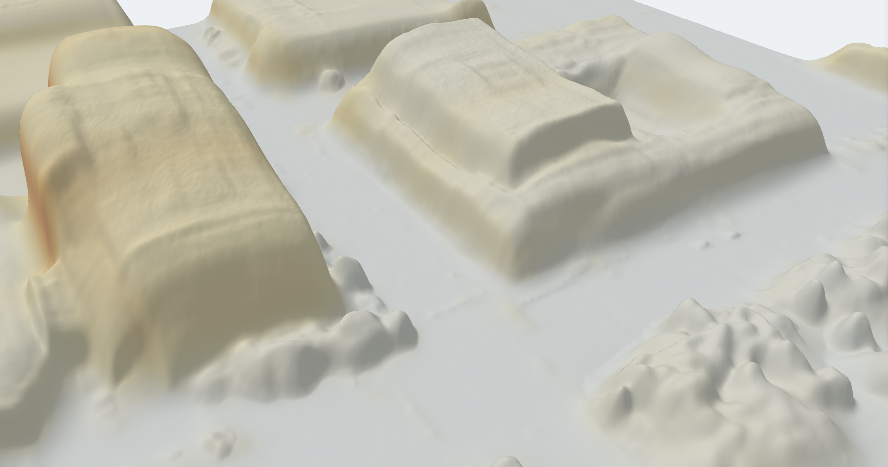
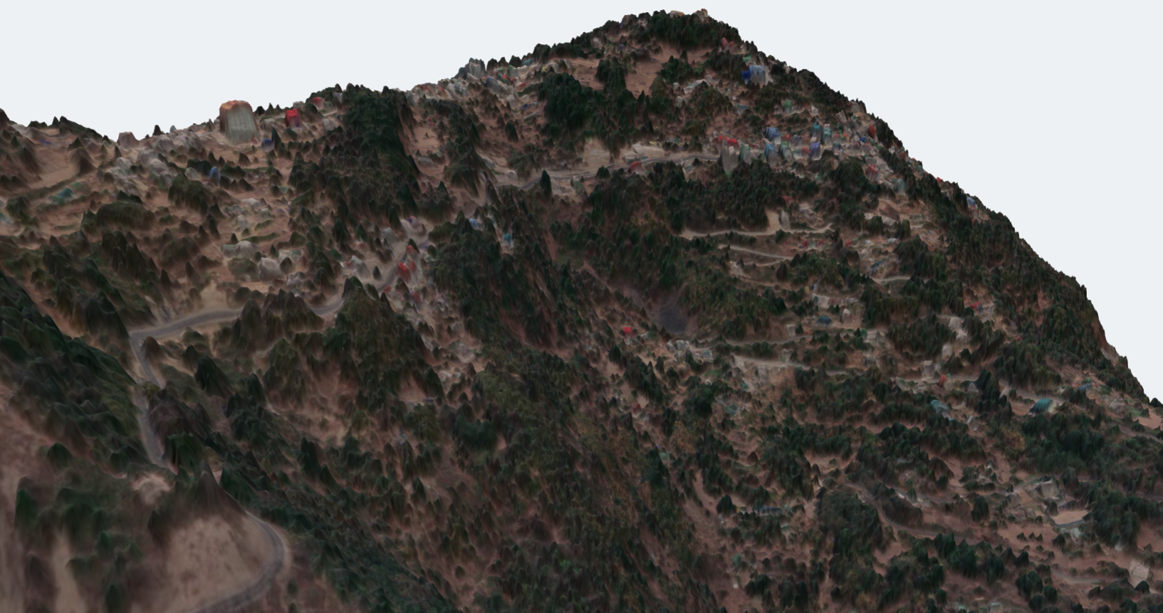
Dev Up
One satellite image in, a measurable 3D surface out. Height, how sure we are, and a scene to check it in.
DEPTHWIZARD
THE PROBLEM
OUR SOLUTION
“[Stereo, LiDAR and InSAR] can be cost-prohibitive, dependent on specific sensor availability, and computationally intensive.”
— ISRO, problem statement SIH26175
One image to a metric DSM
Confidence, not just height
A navigable 3D scene
01
Archives with no height
Depth Anything V2, fine-tuned on airborne-LiDAR heights. GeoTIFF out, metadata or not.
A per-pixel sigma beside every height, so the model says where it is unsure.
three.js flythrough with measure, flood and drag-to-compare-against-LiDAR tools.
Stereo and LiDAR cannot be flown into the past. Decades of Cartosat archive carry no height.
02
Relative depth, not metres
Validation inside the product
Absolute heights, two ways
Deployable, not a demo
Depth models learn from ground-level photos. From orbit they give shape, but no metric scale.
RMSE, MAE and correlation against LiDAR — per terrain class, not one flattering average.
Copernicus GLO-30 for any GeoTIFF, or ground control points via a power-law fit.
No GPU needed. The viewer is one HTML file that opens from disk, offline.
03
No confidence, no product
A bare height hides where it is wrong, and a checkpoint is not a scene an analyst can open.
SAC analysts · disaster responders · planners · foresters
THE GAP WE CLOSE
The single-view papers we build on stop at weights and a score. We ship metric height, calibrated confidence and a no-GPU 3D viewer — compared row by row on slide 6.
WHO FEELS IT
THE IDEA, RUNNING: ONE ARCHIVED IMAGE IN, A MEASURABLE SURFACE OUT — CAPTURES OF OUR PROTOTYPE, NOT MOCK-UPS
BEFORE · INPUT
AFTER · HEIGHT, IN 3D
AFTER · CONFIDENCE
SIKKIM, INDIA · HILLY
One Omaha tile, as flown.
Same tile: roofs, tree crowns and kerbs at 0.3 m.
Where the estimate is weak, the sigma says so.
967 m of relief across 2 km. Imagery © Maxar, CC BY-NC 4.0

Slide 3
















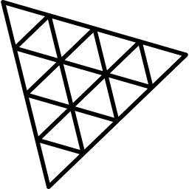

TECHNICAL APPROACH
Dev Up
ARCHITECTURE — ONE IMAGE TO A CHECKED SURFACE
HOW IT RUNS — HARDWARE, API, DATA
DESIGN CHOICES, AND WHY
INPUT LAYER
1
Trained on one consumer GPU
Metres learned from LiDAR
GeoTIFF with
geo metadata
Plain PNG / JPG,
no metadata
Cartosat-2S,
0.6 m
RTX 3060, 12 GB. Backbone: Depth Anything V2 Small, Apache 2.0, 24.8 M parameters.
Fine-tuning on airborne-LiDAR heights makes the output metric directly; a DEM supplies the ground under it.
NORMALISATION
Ground sample distance
read from metadata
Auto-zoom and resample
to a 0.3 m scale
2
Exported for CPU
Uncertainty as an output
MODEL CORE — DEPTH ANYTHING V2
ONNX, int8-quantised to 36.8 MB. Inference needs no GPU at all.
A twin head predicts sigma beside every height (heteroscedastic NLL with beta-NLL), so doubt is visible.
ViT encoder
DPT neck
Fine-tuned on
DFC2019 + GAMUS
DUAL HEAD
3
Served over HTTP
Built for ISRO's 0.6 m
Height mu,
per pixel
Log-variance sigma,
per pixel
POST /api/upload takes TIF, PNG or JPG; /api/result returns the DSM. Live on a two-core CPU host.
Auto-zoom reads a GeoTIFF's resolution and resamples Cartosat-2S to the scale the model learned.
POST-PROCESS
518 px tiling,
overlap blend, TTA
Scale anchor: GLO-30
or ground control
4
Files, not a database
Chosen by measurement
OUTPUT LAYER
GeoTIFF DSM and sigma, float32 scene tiles. The viewer is one 15 MB HTML file that opens from disk.
Regression, binned and head-tail-cut heads were all trained and scored; the simplest held its own, so it ships.
Absolute DSM /
relative DSM
Sigma map
three.js scene,
live error map
HOW IT IS VALIDATED
TECHNOLOGY STACK — EVERY DEPENDENCY FREE AND OPEN
Split region-disjoint, not random — adjacent tiles share buildings.
Scored on whole held-out tiles against airborne LiDAR, never on crops.
Reported per urban / sparse / forested / mixed, and per height band.
Held back no trained model is scored on the test split until the end.
Python 3.10
PyTorch
Hugging Face
ONNX Runtime
NumPy / SciPy
GDAL / rasterio
three.js
Docker
Scan: live demo

Slide 4



FEASIBILITY AND VIABILITY
Dev Up
TECHNICALLY PROVEN
OPERATIONALLY SIMPLE
ECONOMICALLY VIABLE
ALREADY WORKING
Built and measured: slide 7.
One image, CPU only, works offline.
₹0 licences, runs on existing PCs.
All three ISRO milestones are built.
THE HARD PROBLEMS, AND HOW EACH IS HANDLED
OPEN RISKS, AND WHAT ANSWERS EACH
PROBLEM ISRO judges on 0.6 m Cartosat-2S; open LiDAR training imagery is 0.3 m
No Indian ground truth exists yet
HANDLED Auto-zoom reads the GeoTIFF's pixel size and resamples to the scale the model learned. Its cost at 0.6 m is measured on the shipped model (slide 7); fine-tuning on 0.6 m-degraded tiles is next.
Over India we can only compare against another model, Google Open Buildings, so we report agreement, not accuracy. Answered by SAC stereo or DGPS control points in the pilot (below).
PROBLEM Cartosat-2S colour is not the aerial colour the model learned from
Tall buildings compress toward the mean
HANDLED Training jitters brightness, contrast and gamma to mimic sensor and haze; any band count loads. The cost on real Cartosat colour is not yet measured.
Open training data holds few towers (tallest 83 m), so they are under-called. Partly answered by ISRO's GAMUS (it moved the gap significantly) and a control-point fit; fully, only by tall-building LiDAR.
PROBLEM One image has no stereo parallax, so which heights can be trusted?
HANDLED Every pixel ships with an uncertainty (σ), calibrated against LiDAR. Unsure pixels are flagged for the analyst, not hidden.
DEPLOYMENT PLAN
1
Pilot
2
Validate
3
Integrate
4
Scale
PROBLEM An absolute DSM needs ground elevation a single image cannot give
Open Bhoonidhi CartoDEM and LISS-4 tiles; per-terrain metrics.
SAC Cartosat stereo or DGPS turns the Sikkim check into accuracy.
Container behind an internal API; the viewer opens from disk.
Batch the archive: every scene gains a height layer.
HANDLED Copernicus GLO-30 terrain plus our above-ground heights, on by default. GLO-30's own error (< 4 m, LE90) is inherited, and stated.
COST ESTIMATE
TESTING PLAN
PROBLEM Field offices have no GPU and often no reliable internet
Licences ₹0 — every dependency open source
Training one consumer RTX 3060 GPU
Compute ~1 min per km² on a desktop CPU*
Hosting one two-core CPU server, live today
Imagery already flown and already paid for
Done region-disjoint LiDAR validation
Done second city, with a 338 m buffer
Done ISRO's 0.6 m, simulated, on the shipped model
Next held-out test split, scored once
Next Indian truth: SAC stereo or DGPS
HANDLED Inference runs on an ordinary desktop CPU, about a minute per km²; results open in a 3-D viewer that ships as one offline HTML file.
*Derived: 5.0 s per 1024 px tile (0.094 km²), single pass, measured on a desktop CPU.

Slide 5
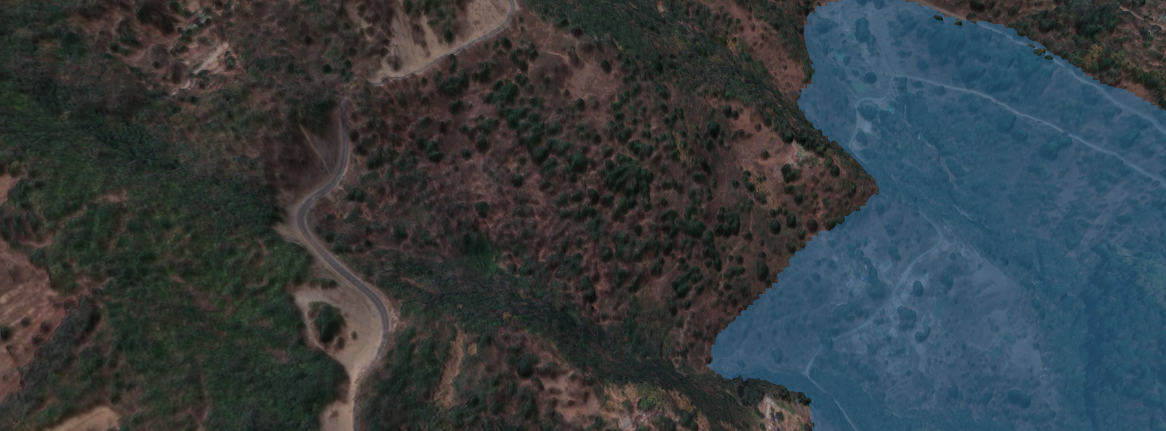




IMPACT AND BENEFITS
Dev Up
DISASTER USE CASE — BUILT, ON INDIAN TERRAIN
BEFORE AND AFTER, FOR THE PEOPLE WHO USE IT
SIKKIM · LIVE FLOOD TOOL
TODAY
WITH DEPTHWIZARD
SOCIAL
Wait for a stereo pair or a survey flight.
A surface from one post-event image — about a minute per tile on a CPU web host.
Disaster response
SOCIAL
One height, no error bar.
Height plus a per-pixel sigma that ranks where it is likely wrong.
Trust in the number
1,143 m WATER LEVEL
20.5 % GROUND UNDER WATER
44 BUILDINGS FLOODED
ECONOMIC
Decades of single-view Cartosat with no height.
Every archived scene can gain a height layer, with no new tasking.
The archive
Raise the water and the viewer counts ground under water and buildings flooded, and flags the ones too close to call from its own sigma. Ground from Copernicus GLO-30; a flat-water model, labelled as one. Imagery © Maxar, CC BY-NC 4.0.
ECONOMIC
Building heights need a survey budget.
Free and open; 36.8 MB runs offline on a laptop CPU.
WHO IT SERVES
Municipal bodies
DISASTER RESPONSE
ISRO AND SAC
URBAN PLANNING
ENVIRONMENTAL
New LiDAR or stereo sorties to fly.
None: it reuses imagery already flown.
Post-event surfaces without waiting for a stereo pair.
Height for the single-view Cartosat archive.
Building heights for FSI and shadow checks (AMRUT).
Survey flights
FORESTRY
TELECOM ROLLOUT
ENVIRONMENTAL
Canopy height needs airborne LiDAR.
A canopy-height proxy from optical imagery alone.
Canopy height proxies for biomass and encroachment.
Line-of-sight and tower siting without a LiDAR survey.
Forest cover
0 new flights
1 image
1 min / km²
0 licence fees
input is imagery already flown and paid for
no stereo pair, no revisit wait
on a desktop CPU, single pass*
any state agency can adopt it
Scales by batch, on CPUs agencies already own: the whole archive, not one scene. *Derived: 5.0 s per 1024 px tile (0.094 km²) measured on a desktop CPU.

Slide 6




RESEARCH AND REFERENCES
Dev Up
RESEARCH THAT CHANGED WHAT WE BUILT
TRIED, MEASURED, REJECTED
HOW WE COMPARE
Depth Anything V2 Yang et al., NeurIPS 2024. The backbone we fine-tune.
Ordinal / binned head All heads land at a 0.43–0.49 slope. No gain.
PARAMETER
STEREO OR LIDAR SURVEY
PUBLISHED SINGLE-VIEW
DEPTHWIZARD
HTC-DC Net Chen et al., TGRS 2023. Head-tail cut, distribution constraints.
Shadow photogrammetry Oracle shadows reach r 0.503; our earlier net, 0.787.
One archived image
Depth Any Canopy Rege Cambrin et al., ECCV-W 2024. The recipe for aerial height.
LDS tail reweighting Pixels above 20 m are 7.5% but carry 78.8% of error.
Absolute metric height
Beta-NLL Seitzer et al., ICLR 2022. Keeps the mean head learning.
Two-model ensemble Error correlation 0.925 — averaging buys nothing.
Per-pixel uncertainty
IM2HEIGHT, TSE-Net Mou & Zhu 2018; Chen & Zhu 2025, both arXiv. Prior single-view height.
Global de-compression A rescale moves error, it does not remove it.
Scored per terrain
Runs with no GPU
DATA AND REFERENCE SURFACES
PROBES WE RAN, AND WHAT EACH CLOSED
3D viewer shipped
DFC2019 Track 1 US3D at 0.3 m GSD with airborne LiDAR truth.
01 Tall buildings Data, not capacity. Open 0.3 m sets hold few towers.
Failure modes published
yes
partial
no
GAMUS ISRO's recommended set. 6,204 tiles, 0.33 m, DC and Philadelphia.
03 Guided filtering Squaring off roofs made every metric worse.
Two rows the alternatives win. A stereo survey gives absolute height directly and ships mature viewers — the table is only useful to a panel if the rows we lose are still in it.
Copernicus GLO-30 Free 30 m global DEM; the absolute metric anchor.
04 Where detail went Detail follows the ground area one token covers.
EVIDENCE BEHIND EVERY NUMBER
GlobalBuildingAtlas Published 5.9 m RMSE over Asia — the external bar.
05b ISRO's 0.6 m Shipped model, 80 tiles: +15% per building after auto-zoom.
Slide 7 is our preliminary work. Each figure on it regenerates from the evidence pack in the repository, and the documentation site walks through data, training, evaluation and failures in full.
Google Open Buildings A cross-check over India, never used as truth.
06 Height compression Measured: 0.473 × truth + 2.66 m.
Maxar Open Data Sikkim imagery, CC BY-NC 4.0, © Maxar Technologies.
Scan: pitch video
Live project5.zaidansari.tech
Docs project5.zaidansari.tech/documentation
Evidence github.com/…/sih2026-depthwizard/docs/evidence-pack.md

Slide 7
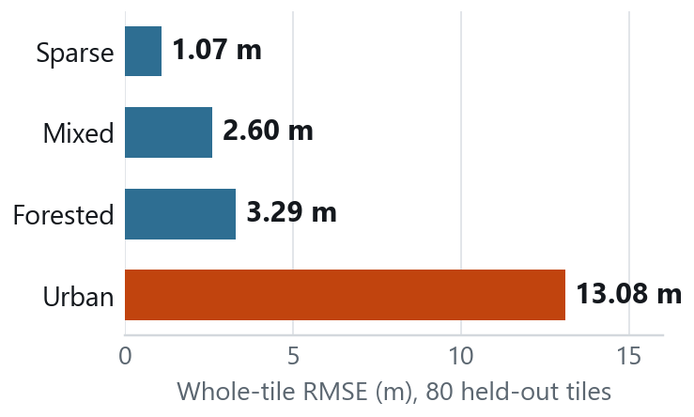
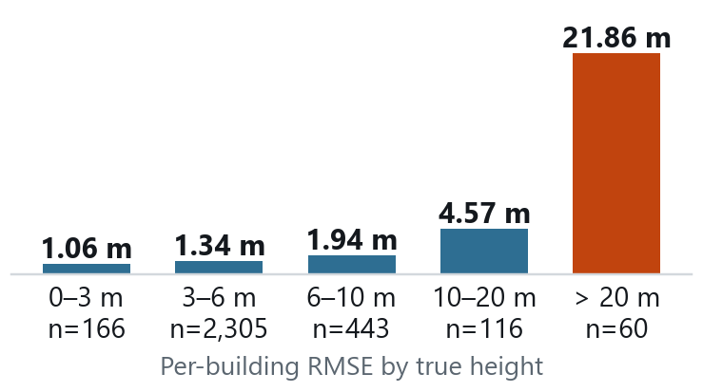

PRELIMINARY WORK
Dev Up
3.464 m
6.008 m
0.063
+15 %
per-building RMSE vs airborne LiDAR;
5.9 m published for Asia
whole-tile RMSE on 80 held-out
tiles from unseen regions
calibration error of the per-pixel
uncertainty (ECE)
per-building error at ISRO's 0.6 m,
after auto-zoom (80 tiles)
ACCURACY ACROSS THE FOUR LANDSCAPES ISRO NAMES
ISRO'S 0.6 M CARTOSAT-2S, SIMULATED ON THE SHIPPED MODEL
Three of four classes at or under 3.3 m, correlation never below +0.77. Urban is one specific thing: the buildings above 20 m.
Hilly: DFC2019 has no hills, so Sikkim is a cross-check, not a score.
INPUT
PER BUILDING
BUILDINGS ≤ 20 M
WHOLE TILE
0.3 m, native
3.464 m
1.667 m
6.008 m
0.6 m, untreated
4.185 m
2.090 m
6.738 m
0.6 m, auto-zoom
3.999 m
2.095 m
6.494 m
Auto-zoom cuts the 0.6 m penalty from +21% to +15%, all on tall buildings; under 20 m it does not help. We had pre-registered ≤ 10% and missed it. 0.6 m is simulated by downsampling, so this is the resolution gap, not the sensor gap.
BUILT AND WORKING TODAY
Elevation extraction
fine-tuned DA-V2 with a sigma head
Scale calibration
GLO-30 absolute DSM; GCP power-law fit
WHERE THE ERROR LIVES
Visualisation
three.js flythrough, measure, compare
Live web app + API
upload a GeoTIFF, download the DSM
77% of squared error comes from 1.9% of buildings. Under 10 m, 94% of the stock, we are at 1.4 m. Above 20 m we under-call by 15.6 m; we pre-registered −13 m and missed it.
Flood tool
water level over Indian terrain
Offline + CPU
one HTML viewer; ONNX int8, no GPU
HOW THESE WERE MEASURED
80 whole held-out US tiles, 3,090 buildings, region-disjoint from training, against airborne LiDAR; no trained model has seen the test split. Full method: project5.zaidansari.tech/documentation
Scan: documentation

