Slide 1

SMART INDIA HACKATHON 2026
DEPTHWIZARD
One satellite image in, a measurable 3D surface out.
PROBLEM STATEMENT ID
SIH26175
PROBLEM STATEMENT TITLE
Single-View Height Estimation and 3D Terrain Visualisation
THEME
Space Technology
PS CATEGORY
Software
TEAM ID
<fill from portal>
TEAM NAME (ON PORTAL)
Dev Up
BUILT AND MEASURED, NOT PROPOSED
3.62 m
39 %
509 ms
per-building RMSE
against airborne LiDAR
better than the 5.9 m
GlobalBuildingAtlas bar
per tile on CPU alone,
no GPU in the loop
The palette is the model's own output scale: 0 m at the left, 155 m at the right.

Slide 2






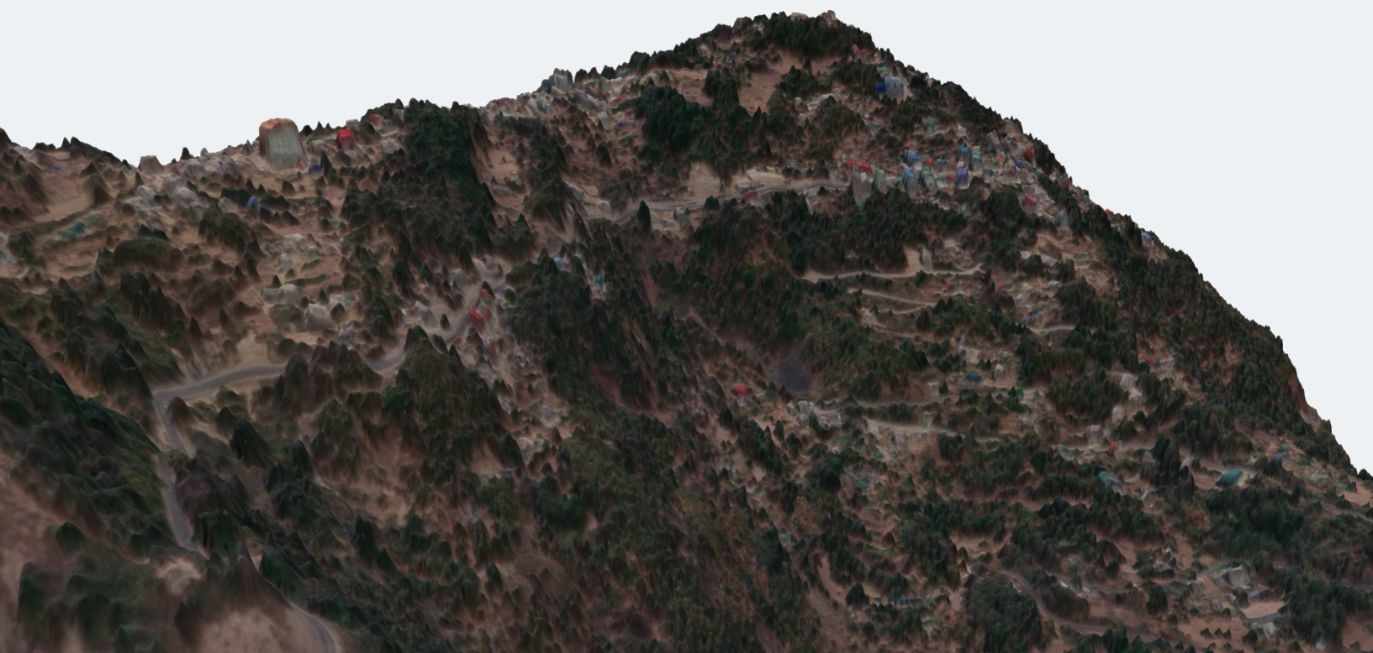
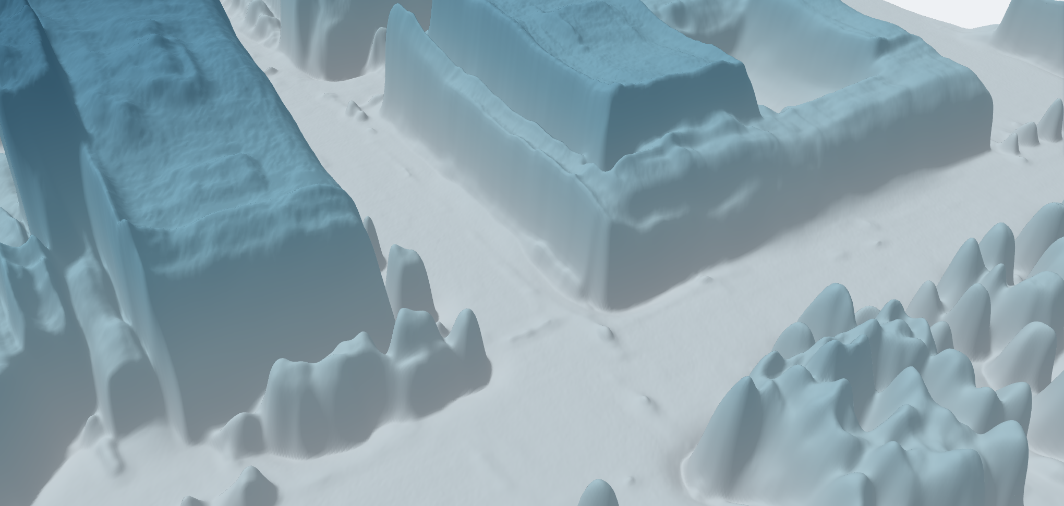
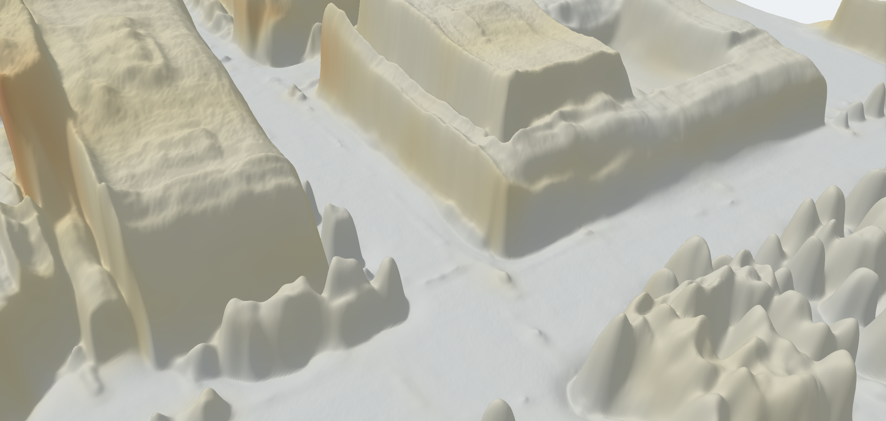
Dev Up
One satellite image in, a measurable 3D surface out. Every submission promises accuracy. This one reports it.
DEPTHWIZARD
THE PROBLEM
OUR SOLUTION
01
Archives with no height
One image to a metric DSM
Confidence, not just height
A navigable 3D scene
Decades of Cartosat single-view imagery exist. Stereo and LiDAR cannot be flown into the past.
Depth Anything V2 fine-tuned on DFC2019 LiDAR. GeoTIFF out, metadata or not.
A per-pixel sigma beside every height. Where it says unsure, it is wrong — monotonically.
three.js flythrough, drag-to-compare against reference, and a live error map.
02
Answers with no confidence
Single-view height is ill-posed. One number implies a certainty the model does not have.
Validation inside the product
Absolute heights, two ways
Deployable, not demo-ware
03
Checkpoints are not products
RMSE, MAE and correlation against LiDAR — per terrain class, not one flattering average.
Copernicus GLO-30, or ground control points via a power-law fit.
No GPU: 509 ms per tile. The viewer is one 15 MB HTML file that opens from disk.
The literature ships weights and an eval script. An analyst needs a scene they can open and check.
THE PRODUCT, RUNNING — CAPTURES OF THE LIVE VIEWER, NOT MOCK-UPS
SIKKIM, INDIA
OMAHA, HEIGHT ABOVE GROUND
OMAHA, MODEL CONFIDENCE
967 m of relief across 2 km, image draped on the surface.
Flat roofs, tree crowns and kerbs resolved at 0.3 m.
Per-pixel sigma: where the estimate is weak, it says so.

Slide 3








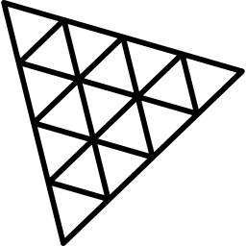




TECHNICAL APPROACH
Dev Up
ARCHITECTURE — ONE IMAGE TO A CHECKED SURFACE
TECH STACK
DECISIONS, AND WHY
1
INPUT
GeoTIFF, or a plain PNG / JPG with no metadata at all
The head was chosen by measurement
2
GSD NORMALISE
auto-zoom reads ground sample distance, resamples to 0.3 m
Python 3.11
PyTorch
Regression, binned and head-tail-cut heads were all trained and scored. All three land at a 0.43–0.49 slope, so the simplest ships.
3
DA-V2 BACKBONE
ViT encoder and DPT neck, fine-tuned on DFC2019 LiDAR
Transformers
ONNX Runtime
Uncertainty is calibrated, not decorative
4
DUAL HEAD
height mu and log-variance sigma, emitted per pixel
ECE 0.077, and a sigma-vs-error rank correlation of +0.829 on held-out tiles.
NumPy / SciPy
OpenCV
5
TILED INFERENCE
518 px sliding window, overlap blending, plus TTA
Export is checked, not assumed
6
SCALE ANCHOR
Copernicus GLO-30, or ground control by power-law fit
GDAL / rasterio
three.js r169
ONNX agrees with PyTorch to 0.0010 cm over 804,972 inputs. int8 costs 0.161 m for a 63% smaller file.
7
OUTPUTS
GeoTIFF DSM, sigma map, three.js scene with a live error map
React
Docker
Resolution is handled explicitly
HOW IT IS VALIDATED
WHAT SHIPS
Auto-zoom reads GSD from metadata and resamples, recovering all but 3.6% of the coarse-input penalty.
Split region-disjoint, not random — adjacent tiles share buildings.
Scored on 80 whole tiles, 11,983,760 pixels, 3,090 buildings.
Reported per urban / sparse / forested / mixed, and per height band.
Held back the test split is untouched until the very end.
An elevation module emitting a GeoTIFF DSM and a sigma map, and a viewer that opens it and checks a height against reference data. No GPU, no network.

Slide 4



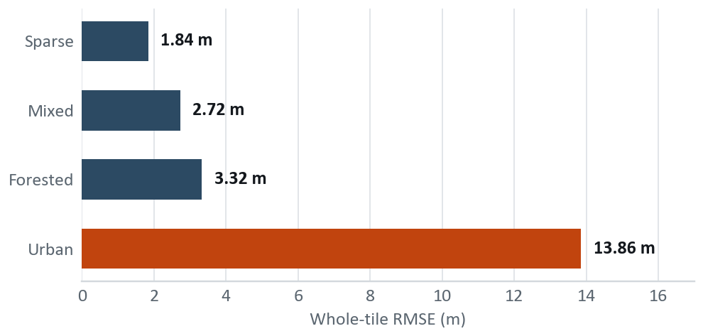

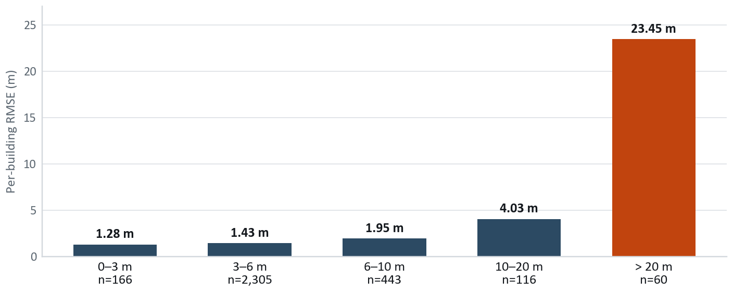
FEASIBILITY AND VIABILITY
Dev Up
TECHNICALLY PROVEN
OPERATIONALLY SIMPLE
ECONOMICALLY VIABLE
SOCIALLY USEFUL
Built and measured, not proposed.
One image in. No GPU, no network.
Every dependency free and open.
Planning, disaster and forestry use height.
ACCURACY ACROSS THE FOUR LANDSCAPES ISRO NAMES
THE TWO REAL RISKS, AND WHAT ANSWERS THEM
Three of four classes sit under 3.4 m, and correlation never drops below +0.58. The fourth is the honest problem, and it is one specific thing.
No Indian ground truth exists to validate against
Our only Indian check is Sikkim against Google Open Buildings: bias −6.94 m on 168 footprints. That is model-vs-model agreement, not accuracy, and we report it as such. No public Indian scene carries LiDAR truth.
Tall buildings compress toward the mean
A data problem, not an architecture one: training tops out at 82.8 m while validation reaches 155.3 m. Answered by a power-law control-point fit that cuts tall-tile RMSE 24.9%, and structurally by adding tall-building LiDAR.
URBAN 13.86 M, DECOMPOSED
79% of squared error comes from 1.9% of buildings. Under 10 m — 94% of the stock — we are at 1.4 m. Urban RMSE is 60 tall buildings dominating a squared metric.
WHAT REDUCES THE INDIAN-DOMAIN RISK BEFORE WE HAVE THE DATA
Resolution auto-zoom normalises GSD; measured to recover all but 3.6%.
Look angle off-nadir spans 4.8 to 28.9 degrees in DFC, so degradation is measurable on data we hold.
Terrain leakage ruled out — on 31-degree slopes, height-vs-slope correlation is −0.044.
Licensing every dependency is free and open, so nothing blocks deployment on ISRO imagery.

Slide 5





IMPACT AND BENEFITS
Dev Up
WHO IT SERVES
KEY BENEFITS
ISRO AND SAC
URBAN PLANNING
One image replaces a stereo pair — no revisit wait.
Height from single-view Cartosat archives, no new acquisition.
Building heights for FSI checks and shadow studies under AMRUT.
No GPU procurement: 36.8 MB runs on a field laptop.
DEPTH
WIZARD
Decades of existing archive gain a new product.
DISASTER RESPONSE
FORESTRY
Municipal bodies get heights with no survey budget.
Post-event surface models where a stereo pair cannot be waited for.
Canopy height proxies for biomass and encroachment monitoring.
Disaster teams get a surface model in minutes.
TELECOM ROLLOUT
Line-of-sight and tower siting without a costly LiDAR survey.
Free and open — adoptable by any state agency.
1 image
0 GPUs
36.8 MB
4 terrains
input needed, not a stereo pair
509 ms per tile on a laptop CPU
the whole model, quantised, offline
scored separately, never averaged

Slide 6



RESEARCH AND REFERENCES
Dev Up
RESEARCH THAT CHANGED WHAT WE BUILT
TRIED, MEASURED, REJECTED
HOW WE COMPARE
Depth Anything V2 Yang et al., NeurIPS 2024. The backbone we fine-tune.
Ordinal / binned head All heads land at a 0.43–0.49 slope. No gain.
PARAMETER
STEREO OR LIDAR SURVEY
PUBLISHED SINGLE-VIEW
DEPTHWIZARD
HTC-DC Net Chen et al., TGRS 2023. Head-tail cut, distribution constraints.
Shadow photogrammetry Oracle shadows reach r 0.503; the net reaches 0.787.
One archived image
Depth Any Canopy Ouaknine et al., 2024. The recipe for aerial height.
LDS tail reweighting Pixels above 20 m are 7.5% but carry 78.8% of error.
Absolute metric height
Beta-NLL Seitzer et al., ICLR 2022. Keeps the mean head learning.
Two-model ensemble Error correlation 0.925 — averaging buys nothing.
Per-pixel uncertainty
Scored per terrain
IM2HEIGHT, TSE-Net Prior single-view height — our baseline for the field.
Global de-compression A rescale moves error, it does not remove it.
Runs with no GPU
DATA AND REFERENCE SURFACES
PROBES WE RAN, AND WHAT EACH CLOSED
3D viewer shipped
DFC2019 Track 1 US3D at 0.3 m GSD with airborne LiDAR truth.
01 Tall buildings More tall examples? No — training tops out at 82.8 m.
Failure modes published
yes
Copernicus GLO-30 Free 30 m global DEM; the absolute metric anchor.
03 Guided filtering Squaring off roofs made every metric worse.
partial
no
TWO ROWS THE ALTERNATIVES WIN
GlobalBuildingAtlas Published 5.9 m RMSE over Asia — the external bar.
04 Where detail went Detail follows the ground area one token covers.
A stereo survey gives absolute height directly and ships mature viewers. The table is only useful to a panel if the rows we lose are still in it.
ISRO Bhoonidhi Registered. CartoDEM 30 m and LISS-4 are the free tiers.
05 Eval resolution Cartosat-class input costs 3.6% after auto-zoom.
THE BAR WE ARE MEASURED AGAINST
Google Open Buildings A cross-check over India, never used as truth.
06 Height compression Measured: ours = 0.473 × truth + 2.66 m.
3.62 m per-building RMSE against airborne LiDAR, versus 5.9 m published for Asia. Scored on 3,090 buildings across 80 held-out tiles.

