Slide 1

SMART INDIA HACKATHON 2026
TITLE PAGE
PROBLEM STATEMENT ID
SIH26175
PROBLEM STATEMENT TITLE
Single-View Height Estimation and 3D Terrain Visualisation
THEME
Space Technology
PS CATEGORY
Software
TEAM ID
<fill from portal>
TEAM NAME (REGISTERED ON PORTAL)
Dev Up
BUILT AND MEASURED, NOT PROPOSED
3.62 m
39 %
509 ms
per-building RMSE against
airborne LiDAR, 3,090 buildings
better than the 5.9 m
GlobalBuildingAtlas Asia bar
per tile on CPU alone,
no GPU required

Slide 2






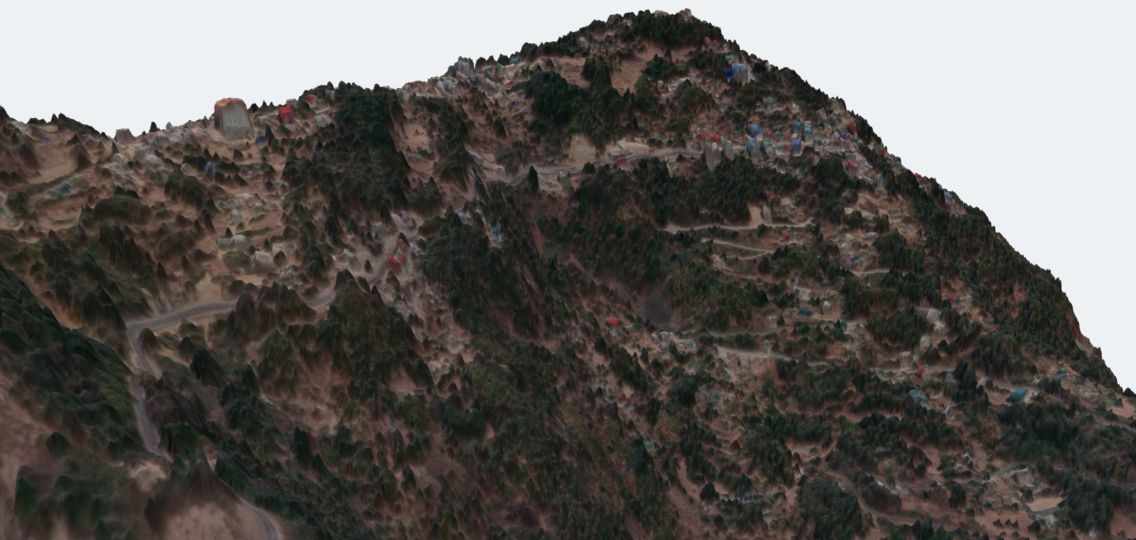
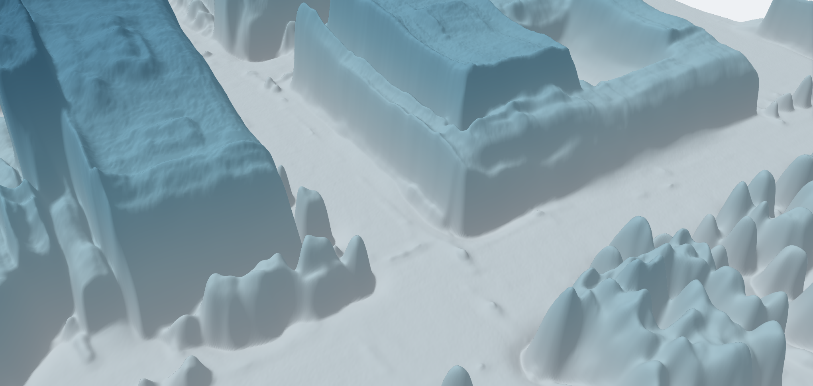
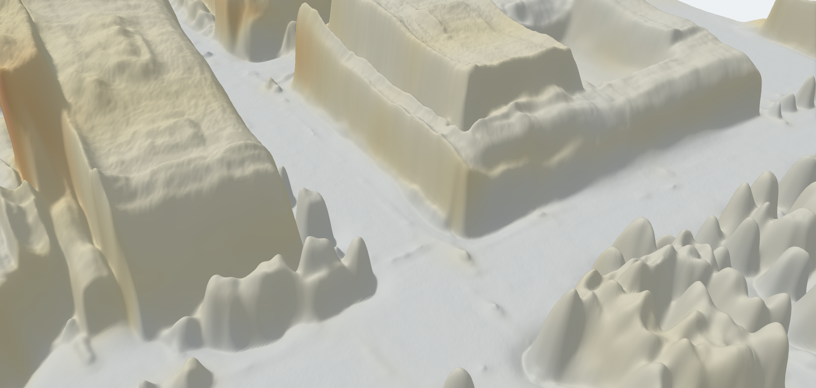
IDEA TITLE
Dev Up
DepthWizard one satellite image in, a measurable 3D surface out
Height from a single view. No stereo pair, no LiDAR, no second pass of the satellite. Every competing submission promises accuracy. This one reports it.
THE PROBLEM
PROPOSED SOLUTION
01
Archives with no height
India holds decades of Cartosat single-view imagery. Stereo and LiDAR give height, but cost more and cannot be flown into the past.
One image to a metric DSM
Depth Anything V2 fine-tuned on DFC2019 LiDAR. GeoTIFF out, or a relative DSM when the input carries no geospatial metadata.
A confidence map, not just a height
A heteroscedastic head emits per-pixel sigma beside every height. Where it says it is unsure, it is wrong, monotonically.
02
Answers with no confidence
Single-view height is ill-posed. A model that emits one number implies a certainty it does not have, so an analyst cannot act on it.
A navigable 3D scene
three.js flythrough with the image projected onto the surface, drag-to-compare against reference, and a live error map.
Validation built into the product
RMSE, MAE and correlation against LiDAR, reported per terrain class rather than as one flattering average.
03
Checkpoints are not products
The literature ships weights and an eval script. An analyst needs to open a scene, fly through it, and check a height against a reference.
Absolute heights, two independent ways
Copernicus GLO-30, or ground control points via a power-law fit that declines rather than degrade a scene.
Deployable, not demo-ware
The model needs no GPU: 509 ms per tile on CPU. The viewer is one 15 MB HTML file, six scenes baked in, opening straight from disk.
Sikkim, India
967 m of relief across 2 km. Satellite image draped on the recovered surface; terrain from Copernicus GLO-30, everything standing on it is ours.
Omaha, height above ground
The DSM itself. Flat roofs, tree crowns and kerb lines resolved at 0.3 m.
Omaha, model confidence
Per-pixel sigma. The viewer states where the estimate is weak instead of hiding it.

Slide 3






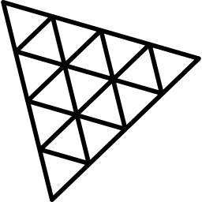



TECHNICAL APPROACH
Dev Up
A monocular depth backbone re-purposed as a metric height regressor, with calibrated uncertainty and a browser renderer.
PIPELINE
Input
GeoTIFF, or plain
PNG / JPG
GSD normalise
auto-zoom to a
0.3 m ground scale
DA-V2 backbone
ViT encoder, DPT
neck, fine-tuned
Dual head
height mu and
log-variance sigma
Tiled inference
518 px sliding
window, plus TTA
Scale anchor
GLO-30 DEM or
ground control
DSM and viewer
GeoTIFF, sigma map,
three.js scene
TECHNOLOGY STACK
DECISIONS, AND WHY
01
The head was chosen by measurement
Binned and head-tail-cut heads were both trained and scored. All three land at a 0.43-0.49 slope, so the simplest ships.
Python 3.11
PyTorch
Transformers
NumPy / SciPy
OpenCV
02
Uncertainty is calibrated, not decorative
ECE 0.077, sigma-vs-error rank correlation +0.829 on held-out tiles.
ONNX Runtime
three.js r169
Web UI
GDAL / rasterio
Docker
HOW IT IS VALIDATED
03
Split region-disjoint, not random. Adjacent tiles share buildings, so a random split leaks and flatters the score.
Scored on 80 whole tiles, 11,983,760 valid pixels, 3,090 buildings. Whole tiles, not crops.
Reported per urban / sparse / forested / mixed, plus per-building and per-height-band breakdowns.
Held back the test split is untouched until the very end, and holds one building above 30 m, so it will flatter us. We will say so.
Export is checked, not assumed
ONNX agrees with PyTorch to 0.0010 cm over 804,972 inputs. int8 costs 0.161 m for a 63% smaller file.
04
Resolution is handled explicitly
auto-zoom reads GSD from metadata and resamples, recovering all but 3.6% of the coarse-input penalty.
WHAT SHIPS
An elevation module emitting a GeoTIFF DSM plus a per-pixel sigma map, and a viewer that opens it, flies through it, and checks a height against reference data. Both run with no GPU and no network.

Slide 4
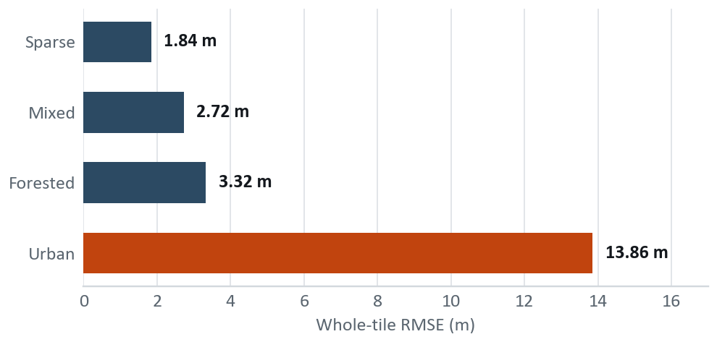
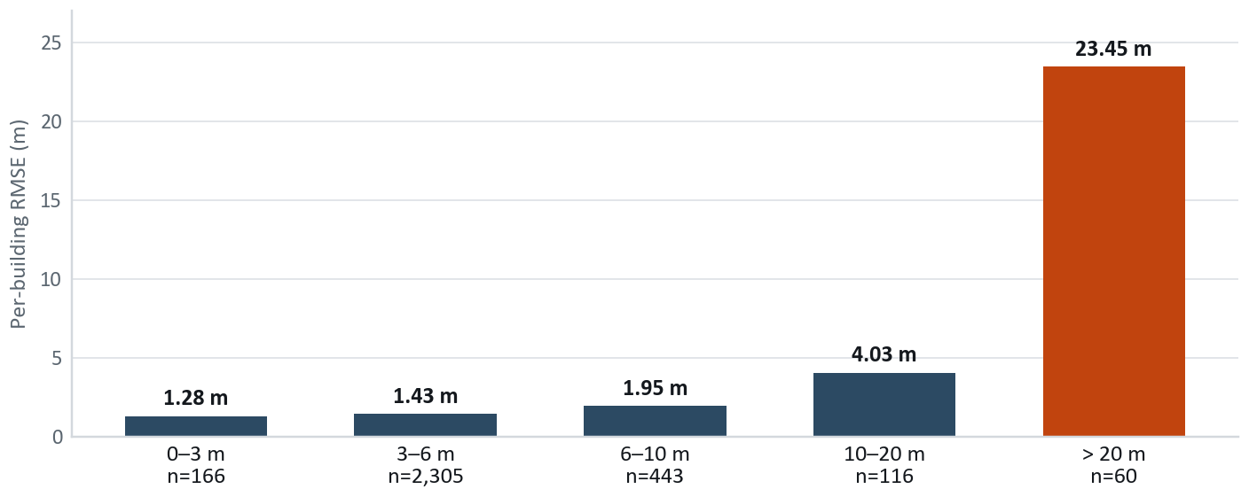
FEASIBILITY AND VIABILITY
Dev Up
The feasibility question is already answered: the system exists. What follows is where it is strong, and where it is not.
ACCURACY ACROSS THE FOUR LANDSCAPES ISRO NAMES
THE TWO REAL RISKS, AND WHAT ANSWERS THEM
01
No Indian ground truth exists to validate against
Our only Indian check is Sikkim against Google Open Buildings: bias -6.94 m on 168 confident footprints. That is model-vs-model agreement, not accuracy, and we report it as such. Cartosat at 0.25-2.5 m is a priced product; free LISS-4 at 5.8 m spans a building in 2-3 pixels. No public Indian scene carries LiDAR truth. This is the honest limit of what we can claim today.
02
Tall buildings compress toward the mean
Proven to be a data problem, not an architecture one: training tops out at 82.8 m while validation reaches 155.3 m, and fine-tuning on the few tall buildings we have moved transfer bias the wrong way (-18.22 to -19.10 m). Answered by a power-law control-point fit that cuts tall-tile RMSE 24.9%, and structurally by adding tall-building LiDAR.
Three of four classes sit under 3.4 m, and correlation never drops below +0.58. The fourth is the honest problem, and it is one specific thing.
URBAN 13.86 M, DECOMPOSED
79% of all squared error comes from 1.9% of the buildings. Under 10 m, which is 94% of the stock, we are at 1.4 m. Urban RMSE is not a city problem: it is 60 tall buildings dominating a squared metric.
WHAT REDUCES THE INDIAN-DOMAIN RISK BEFORE WE HAVE THE DATA
Resolution auto-zoom normalises GSD; measured to recover all but 3.6%.
Look angle off-nadir spans 4.8-28.9 degrees in DFC, so degradation vs view angle is measurable on data we already hold.
Terrain leakage ruled out. On 31-degree slopes, height-vs-slope correlation is -0.044.
Licensing every dependency is free and open, so nothing blocks deployment on ISRO's own imagery once access exists.

Slide 5





IMPACT AND BENEFITS
Dev Up
Height is the missing dimension in India's satellite archive. Recovering it from imagery that already exists is the whole point.
WHO IT SERVES
ISRO and SAC
Height from single-view Cartosat archives with no new acquisition.
Urban planning
Building heights for FSI checks, sky-view and shadow studies under AMRUT.
Disaster response
Rapid post-event surface models where a stereo pair cannot be waited for.
Telecom rollout
Line-of-sight and tower siting from imagery rather than costly LiDAR survey.
Forestry
Canopy height proxies for biomass estimation and encroachment monitoring.
BENEFITS
Economic
Social and civic
Environmental and strategic
One image replaces a stereo pair: half the acquisition, none of the revisit wait.
No GPU procurement. The quantised model runs on a field laptop.
Existing archives gain a new product without re-flying anything.
Planners and municipal bodies get building heights with no survey budget.
Disaster teams get a surface model in minutes, with its uncertainty shown rather than hidden.
Open, free dependencies keep it adoptable by any state agency.
Canopy and biomass proxies from imagery already being collected.
No new flights means no additional survey emissions.
Reduces dependence on foreign commercial elevation products.
1 image
0 GPUs
36.8 MB
4 terrains
input needed, where stereo
photogrammetry needs two
509 ms per tile on an
ordinary laptop CPU
the entire model, quantised
and running offline
scored separately rather than
averaged into one number

Slide 6
RESEARCH AND REFERENCES
Dev Up
Each item below changed what we built. The note beside it says how.
RESEARCH
DATA AND REFERENCE SURFACES
TRIED, MEASURED, REJECTED
Depth Anything V2
Yang et al., NeurIPS 2024. The backbone we fine-tune. arxiv.org/abs/2406.09414
HTC-DC Net
Chen et al., IEEE TGRS 2023. Head-tail cut and distribution constraints. arxiv.org/abs/2309.16486
Depth Any Canopy
Ouaknine et al., 2024. The published recipe for adapting Depth Anything to aerial height.
Beta-NLL
Seitzer et al., ICLR 2022. Keeps the mean head learning under a heteroscedastic loss. arxiv.org/abs/2203.09168
IM2HEIGHT, TSE-Net
Prior single-view height estimation. Our baseline for what the field already achieves.
IEEE GRSS DFC2019 Track 1
US3D, Jacksonville and Omaha at 0.3 m GSD with airborne LiDAR truth. Training and validation.
Copernicus GLO-30
Free 30 m global DEM, the absolute metric anchor. AWS Open Data.
GlobalBuildingAtlas
Published 5.9 m building-height RMSE over Asia. The external bar this work is measured against.
ISRO Bhoonidhi
bhoonidhi.nrsc.gov.in. Registered; CartoDEM 30 m and LISS-4 are the free tiers.
Google Open Buildings 2.5D
Sentinel-2 derived. Used only as a cross-check over India, never as truth.
Ordinal / binned head
Trained and scored. All three heads land at a 0.43-0.49 slope. No gain over regression.
Shadow photogrammetry
Oracle shadows ray-cast from truth reach only r 0.503. The network already reaches r 0.787.
LDS tail reweighting
Premise fails here. Pixels above 20 m are 7.5% of building pixels but already carry 78.8% of error.
Two-model ensemble
Error correlation 0.925. The models make the same mistakes, so averaging buys nothing.
Global de-compression
A linear rescale cannot change correlation by construction. It moves error, it does not remove it.
PROBES WE RAN, AND WHAT EACH ONE CLOSED
01 Tall-building supervision
Can more tall examples move the tail? No. Training holds 166 buildings above 30 m and tops out at 82.8 m; fine-tuning on them moved transfer bias the wrong way, -18.22 to -19.10 m.
03 Guided filtering
Can a post-process sharpen rounded roofs into blocks? No. Guided filtering and morphological toggle contrast each made every metric worse.
04 Where the detail went
What governs detail is the ground area one backbone token covers, not the post-process. That reframed the whole resolution question.
05 Evaluation resolution
Does the model survive Cartosat-class 0.6-1.0 m input? With auto-zoom, all but 3.6% of the coarse-input penalty is recovered.
06 Height compression
Found by eye in the viewer, then measured: ours = 0.473 x truth + 2.66 m, and it cannot be corrected at inference time.

