Slide 1

SMART INDIA HACKATHON 2026
DEPTHWIZARD
One satellite image in, a measurable 3D surface out.
PROBLEM STATEMENT ID
SIH26175
PROBLEM STATEMENT TITLE
DepthWizard - Single-View Height Estimation and 3D Flythrough
THEME
Disaster Management
PS CATEGORY
Software
TEAM ID
47
TEAM NAME (ON PORTAL)
Dev Up
BUILT AND MEASURED, NOT PROPOSED
3.67 m
38 %
509 ms
per-building RMSE
against airborne LiDAR
better than the 5.9 m
GlobalBuildingAtlas bar
per tile on CPU alone,
no GPU in the loop
The palette is the model's own output scale: 0 m at the left, 155 m at the right.

Slide 2






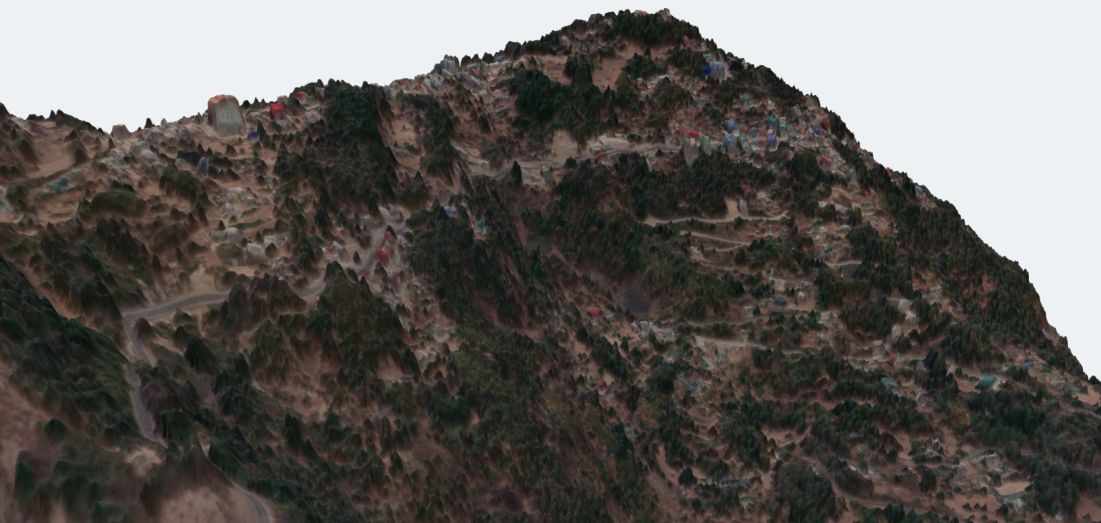
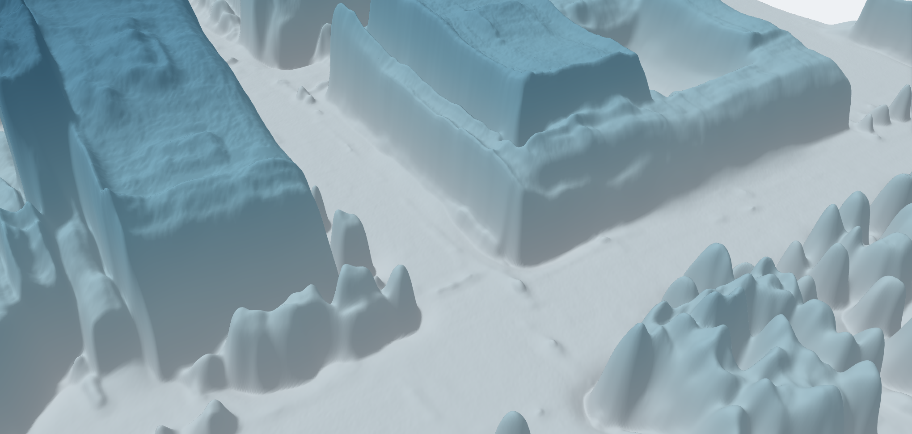
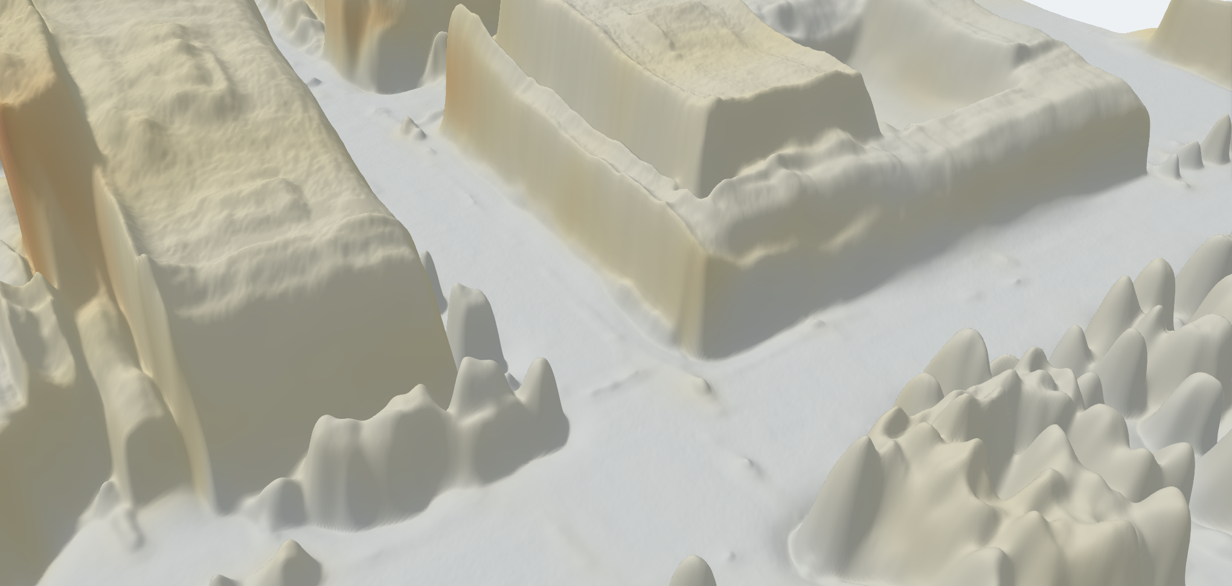
Dev Up
One satellite image in, a measurable 3D surface out. Every submission promises accuracy. This one reports it.
DEPTHWIZARD
THE PROBLEM
OUR SOLUTION
01
Archives with no height
One image to a metric DSM
Confidence, not just height
A navigable 3D scene
Decades of Cartosat single-view imagery exist. Stereo and LiDAR cannot be flown into the past.
Depth Anything V2 fine-tuned on DFC2019 + GAMUS LiDAR. GeoTIFF out, metadata or not.
A per-pixel sigma beside every height. Where it says unsure, it is wrong — monotonically.
three.js flythrough, drag-to-compare against reference, and a live error map.
02
Answers with no confidence
Single-view height is ill-posed. One number implies a certainty the model does not have.
Validation inside the product
Absolute heights, two ways
Deployable, not demo-ware
03
Checkpoints are not products
RMSE, MAE and correlation against LiDAR — per terrain class, not one flattering average.
Copernicus GLO-30, or ground control points via a power-law fit.
No GPU: 536 ms per tile. The viewer is one 15 MB HTML file that opens from disk.
The literature ships weights and an eval script. An analyst needs a scene they can open and check.
THE PRODUCT, RUNNING — CAPTURES OF THE LIVE VIEWER, NOT MOCK-UPS
SIKKIM, INDIA
OMAHA, HEIGHT ABOVE GROUND
OMAHA, MODEL CONFIDENCE
967 m of relief across 2 km, image draped on the surface.
Flat roofs, tree crowns and kerbs resolved at 0.3 m.
Per-pixel sigma: where the estimate is weak, it says so.

Slide 3















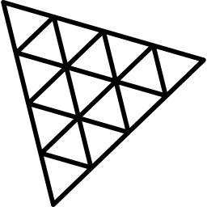

TECHNICAL APPROACH
Dev Up
ARCHITECTURE — ONE IMAGE TO A CHECKED SURFACE
DEPLOYMENT AND ADOPTION PATH
DECISIONS, AND WHY
INPUT LAYER
1
Pilot on what is already open
The head was chosen by measurement
GeoTIFF with
geo metadata
Plain PNG / JPG,
no metadata
Cartosat single-view
archive
Run over Bhoonidhi CartoDEM and LISS-4 tiles we can access today, and publish per-terrain metrics rather than one average.
Regression, binned and head-tail-cut heads were all scored. All three land at a 0.43–0.49 slope, so the simplest ships.
NORMALISATION
Ground sample distance
read from metadata
Auto-zoom and resample
to a 0.3 m scale
2
Validate on Indian truth
Uncertainty is calibrated
MODEL CORE — DEPTH ANYTHING V2
With SAC-held Cartosat stereo or DGPS control points, the Sikkim model-vs-model check becomes a real accuracy number.
ECE 0.063, sigma-vs-error rank correlation +0.866 on held-out tiles.
ViT encoder
DPT neck
Fine-tuned on
DFC2019 + GAMUS
DUAL HEAD
3
Integrate
Export is checked, not assumed
Height mu,
per pixel
Log-variance sigma,
per pixel
Ships as a container behind an internal API. The viewer needs no server and opens from disk on an analyst's own machine.
ONNX agrees with PyTorch to 0.0007 cm over 804,972 inputs; int8 costs 0.030 m.
POST-PROCESS
518 px tiling,
overlap blend, TTA
Scale anchor: GLO-30
or ground control
4
Scale across the archive
Resolution is handled explicitly
OUTPUT LAYER
Batch the back catalogue. Every new acquisition gains a height layer at no extra tasking cost.
Auto-zoom resamples by GSD, recovering all but 3.6% of the coarse-input penalty.
GeoTIFF DSM
Sigma map
three.js scene,
live error map
HOW IT IS VALIDATED
TECHNOLOGY STACK — EVERY DEPENDENCY FREE AND OPEN
Split region-disjoint, not random — adjacent tiles share buildings.
Scored on 80 whole tiles, 11,983,760 pixels, 3,090 buildings.
Reported per urban / sparse / forested / mixed, and per height band.
Held back the test split is untouched until the very end.
Python 3.10
PyTorch
Hugging Face
ONNX Runtime
NumPy / SciPy
GDAL / rasterio
three.js
Docker

Slide 4



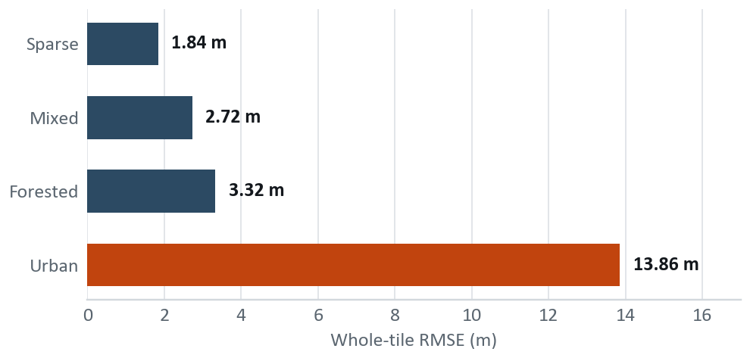

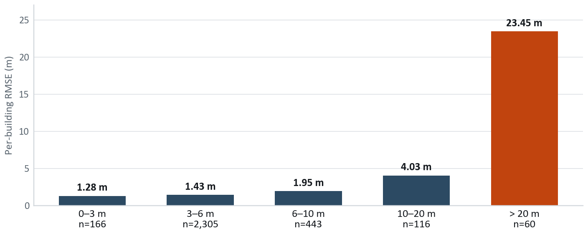
FEASIBILITY AND VIABILITY
Dev Up
TECHNICALLY PROVEN
OPERATIONALLY SIMPLE
ECONOMICALLY VIABLE
SOCIALLY USEFUL
Built and measured, not proposed.
One image in. No GPU, no network.
Every dependency free and open.
Planning, disaster and forestry use height.
ACCURACY ACROSS THE FOUR LANDSCAPES ISRO NAMES
THE TWO REAL RISKS, AND WHAT ANSWERS THEM
Three of four classes sit under 3.4 m, and correlation never drops below +0.58. The fourth is the honest problem, and it is one specific thing.
No Indian ground truth exists to validate against
Our only Indian check is Sikkim against Google Open Buildings: bias −6.94 m on 168 footprints. That is model-vs-model agreement, not accuracy, and we report it as such. No public Indian scene carries LiDAR truth.
Tall buildings compress toward the mean
A data problem, not an architecture one: training tops out at 82.8 m while validation reaches 155.3 m. Answered by a power-law control-point fit that cuts tall-tile RMSE 24.9%, and structurally by adding tall-building LiDAR.
URBAN 13.86 M, DECOMPOSED
79% of squared error comes from 1.9% of buildings. Under 10 m — 94% of the stock — we are at 1.4 m. Urban RMSE is 60 tall buildings dominating a squared metric.
WHAT REDUCES THE INDIAN-DOMAIN RISK BEFORE WE HAVE THE DATA
Resolution auto-zoom normalises GSD; measured to recover all but 3.6%.
Look angle off-nadir spans 4.8 to 28.9 degrees in DFC, so degradation is measurable on data we hold.
Terrain leakage ruled out — on 31-degree slopes, height-vs-slope correlation is −0.044.
Licensing every dependency is free and open, so nothing blocks deployment on ISRO imagery.

Slide 5




IMPACT AND BENEFITS
Dev Up
WHO IT SERVES
KEY BENEFITS
ISRO AND SAC
URBAN PLANNING
One image replaces a stereo pair — no revisit wait.
Height from single-view Cartosat archives, no new acquisition.
Building heights for FSI checks and shadow studies under AMRUT.
No GPU procurement: 36.8 MB runs on a field laptop.
DEPTH
WIZARD
Decades of existing archive gain a new product.
DISASTER RESPONSE
FORESTRY
Municipal bodies get heights with no survey budget.
Post-event surface models where a stereo pair cannot be waited for.
Canopy height proxies for biomass and encroachment monitoring.
Disaster teams get a surface model in minutes.
TELECOM ROLLOUT
Line-of-sight and tower siting without a costly LiDAR survey.
Free and open — adoptable by any state agency.
1 image
0 GPUs
36.8 MB
4 terrains
input needed, not a stereo pair
536 ms per tile on a laptop CPU
the whole model, quantised, offline
scored separately, never averaged
Every one of these runs on imagery that has already been flown and already been paid for. The cost avoided is the second acquisition, not the first.

Slide 6



RESEARCH AND REFERENCES
Dev Up
RESEARCH THAT CHANGED WHAT WE BUILT
TRIED, MEASURED, REJECTED
HOW WE COMPARE
Depth Anything V2 Yang et al., NeurIPS 2024. The backbone we fine-tune.
Ordinal / binned head All heads land at a 0.43–0.49 slope. No gain.
PARAMETER
STEREO OR LIDAR SURVEY
PUBLISHED SINGLE-VIEW
DEPTHWIZARD
HTC-DC Net Chen et al., TGRS 2023. Head-tail cut, distribution constraints.
Shadow photogrammetry Oracle shadows reach r 0.503; the net reaches 0.787.
One archived image
Depth Any Canopy Ouaknine et al., 2024. The recipe for aerial height.
LDS tail reweighting Pixels above 20 m are 7.5% but carry 78.8% of error.
Absolute metric height
Per-pixel uncertainty
Beta-NLL Seitzer et al., ICLR 2022. Keeps the mean head learning.
Two-model ensemble Error correlation 0.925 — averaging buys nothing.
Scored per terrain
IM2HEIGHT, TSE-Net Prior single-view height — our baseline for the field.
Global de-compression A rescale moves error, it does not remove it.
Runs with no GPU
3D viewer shipped
DATA AND REFERENCE SURFACES
PROBES WE RAN, AND WHAT EACH CLOSED
Failure modes published
DFC2019 Track 1 US3D at 0.3 m GSD with airborne LiDAR truth.
01 Tall buildings Data, not capacity — and GAMUS then proved it.
yes
partial
no
Copernicus GLO-30 Free 30 m global DEM; the absolute metric anchor.
03 Guided filtering Squaring off roofs made every metric worse.
Two rows the alternatives win. A stereo survey gives absolute height directly and ships mature viewers — the table is only useful to a panel if the rows we lose are still in it.
THE BAR WE ARE MEASURED AGAINST
GlobalBuildingAtlas Published 5.9 m RMSE over Asia — the external bar.
04 Where detail went Detail follows the ground area one token covers.
3.464 m per-building RMSE against airborne LiDAR, versus 5.9 m published for Asia. Scored on 3,090 buildings across 80 held-out tiles.
Where it fails: buildings above 20 m are under-called by 15.6 m. We pre-registered −13 m and missed it. GAMUS improved it significantly (p = 0.0002); no open data at this resolution reaches 50 m.
GAMUS ISRO's recommended set. 6,204 tiles, 0.33 m, DC and Philadelphia.
05 Eval resolution Cartosat-class input costs 3.6% after auto-zoom.
PITCH
VIDEO
QR
Google Open Buildings A cross-check over India, never used as truth.
06 Height compression Measured: ours = 0.473 × truth + 2.66 m.

