Slide 1
A Comparison between Sensex
and Gdp rate of India

Slide 2
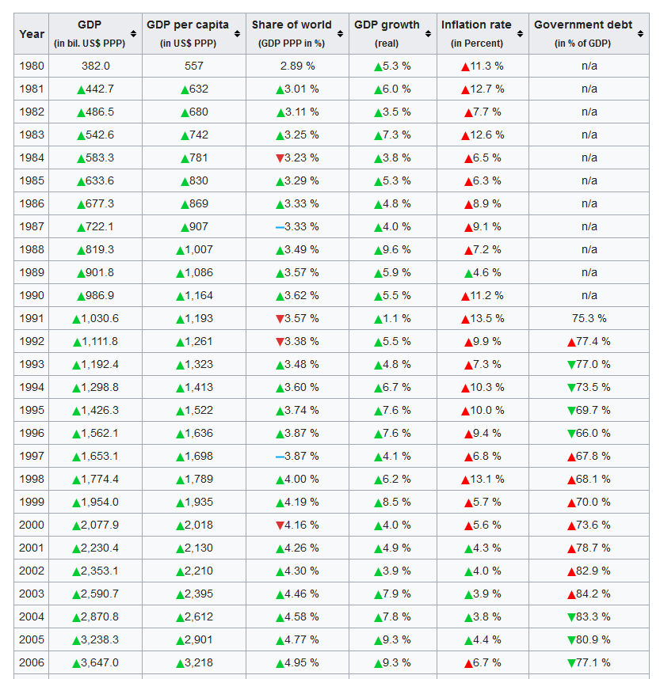
Sample Data set of Gdp of India taken from wikipidea

Slide 3
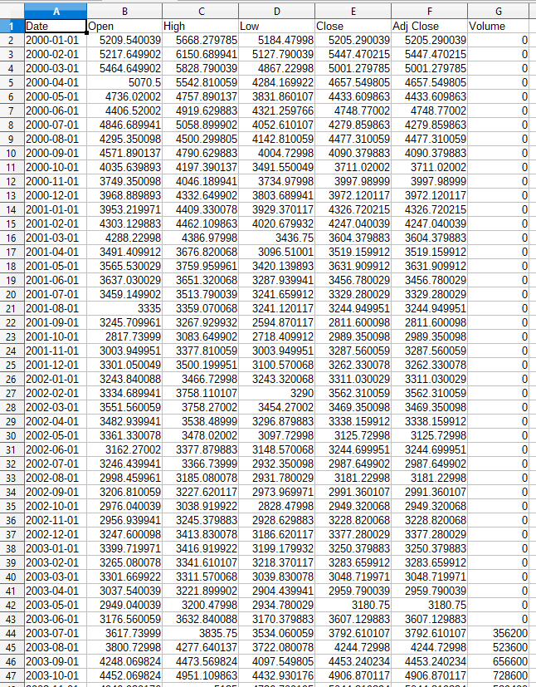
Sensex Historical Data taken from BSE’s website

Slide 4
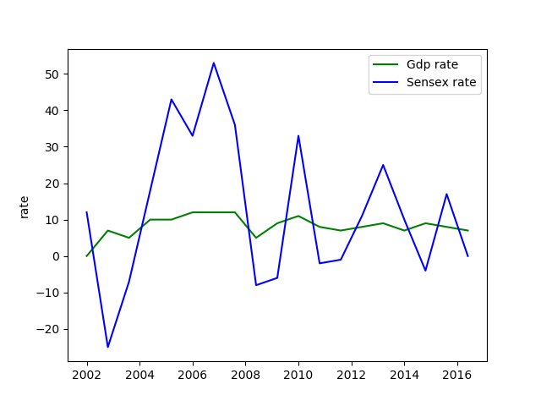
Result

Slide 5
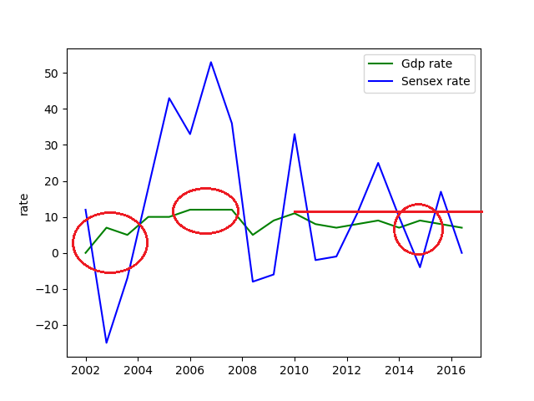
Observation
Red marked areas are those where share market behaved opposite to economy

Slide 6
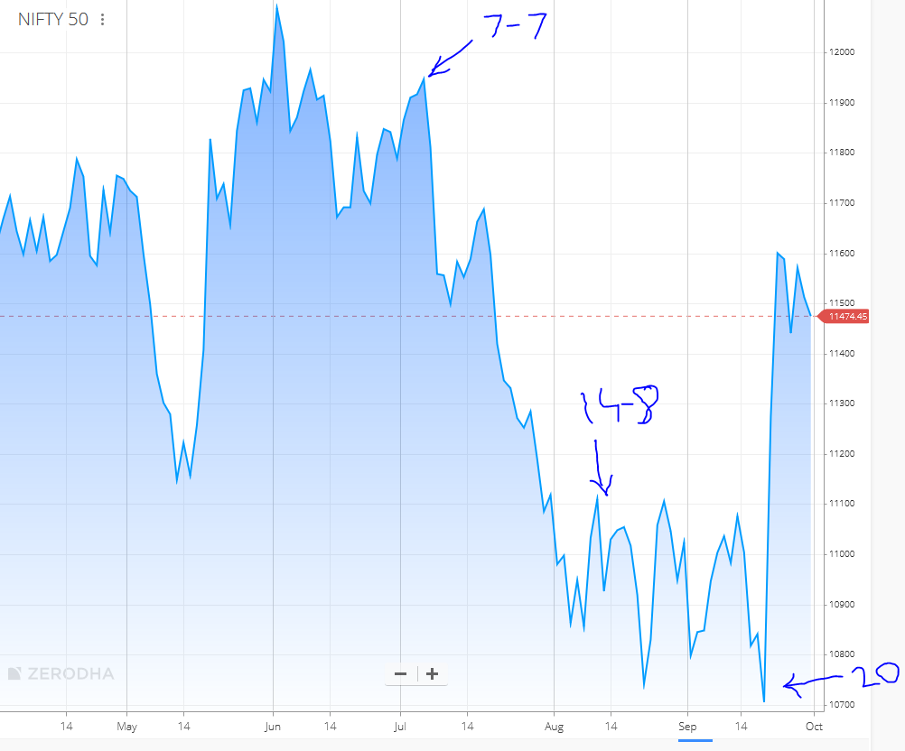
Recent Events

Slide 7
Conclusion:
After analysing 20 years of data I found that it is not necessary that economy behave’s same as share market.
Thankyou

