Slide 1


DreamOS
Find your files by what they are about, not by what they are called
Final Year B.Tech Project | Final Monitoring, 13 October 2026
Zaid Ali Syed (2305139) Om Vyas (2305170) Krushna Kadam (2305165)
Institute of Information and Communication Technology, MGM University

Slide 2


PART 1 - THE PROBLEM
Every computer has a folder like this
final_final_v3.txt
Untitled document.txt
CV2.txt
scan0007.txt
Which one is the resume I sent to the company?
backup_of_backup.txt
new_doc_2026_03_11.txt
notes.txt
important_dont_delete.txt
Computers find files by name. People remember what a file is about.
DreamOS | 2

Slide 3
PART 1 - THE IDEA
What if you could just ask?
You type
Like a librarian who has read every book in your house, and never tells anyone what is on your shelves.
“find my invoices”
“open the second one”
“what is related to my resume?”
No cloud. No account. No uploads.
DreamOS finds, opens and groups the files for you - on your own computer.
DreamOS | 3

Slide 4







PART 1 - OBJECTIVES
Six things we set out to do
Find by meaning
Understand requests
Organise safely
Search files by what they say, not what they are named
One box that works out whether you want to find, open, relate or organise
Tag and sort files, and undo every move
Show connections
Remember the chat
Keep data private
Show which files belong together, and why
Make follow-up questions like “open it” work
Never send files or questions to a server, and prove it
DreamOS | 4

Slide 5
PART 2 - LITERATURE REVIEW
What already exists
Windows Search and Spotlight
The building blocks come from research on word and sentence meaning: Mikolov et al. (word vectors) and Reimers and Gurevych (Sentence-BERT). Plain version: each sentence becomes a point on a map, and similar sentences land close together.
Match the words in a query against the words in a file. A query has to share vocabulary with the file.
Everything
Extremely fast, but only looks at file names.
LSFS (ICLR 2025 paper)
Shows that searching files by meaning works at the operating-system level, but it is built for AI agents that call an API, not for a person typing.
DreamOS | 5

Slide 6
PART 2 - RESEARCH GAPS
Where the existing work stops
1
Built for machines, not people
Meaning-based search is shown as an API for software agents. Nobody offers one simple box for a person that finds and acts.
2
Privacy is promised, not shown
Few systems show, in a way you can check, that no data leaves the computer.
3
Real limits are rarely reported
Short everyday queries and large folders are where meaning search breaks. We measure both and report what we find.
DreamOS | 6

Slide 7

PART 3 - OUR SOLUTION
How DreamOS works, in four steps
1. Read
2. Index
3. Understand
4. Answer
Each file is cut into pieces. A local AI model turns each piece into a point on the meaning map.
→
The points and the file details are stored on your computer, in two local databases.
→
Your question is worked out: find, open, relate, organise, or suggest workspaces.
→
You get cards with the best files, the reason they matched, and buttons to act on them.
DreamOS | 7

Slide 8
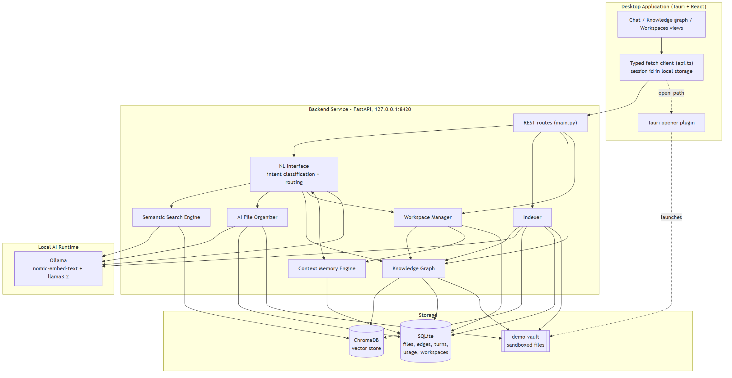
PART 3 - ARCHITECTURE
Everything runs on one computer
DreamOS | 8

Slide 9
PART 3 - MODULES
Six modules, each with one job
01
02
03
Understanding
Search
Organiser
Works out what you want from a plain sentence
Finds files close in meaning, and says when it is only a guess
Suggests categories and tags, moves files, and can undo
04
05
06
Connections
Memory
Workspaces
Links files that are similar, that name each other, or share tags
Remembers the chat so follow-ups make sense
Suggests groups of related files and opens them together
DreamOS | 9

Slide 10
KEY IDEA 1 - MEANING AS LOCATION
Similar files sit close together
Every piece of text becomes a list of 768 numbers, a location on a very large map.
Texts about the same thing land near each other, even with no words in common.
Finding a file = finding the nearest points to your question.
Plain comparison: a library shelved by subject, not by the author's surname.
A real example
“find something about a meeting”
It returns the team notes, though the file names say nothing about meetings.
Honest note: very short queries are harder, and we measure that on slides 20 and 21.
DreamOS | 10

Slide 11
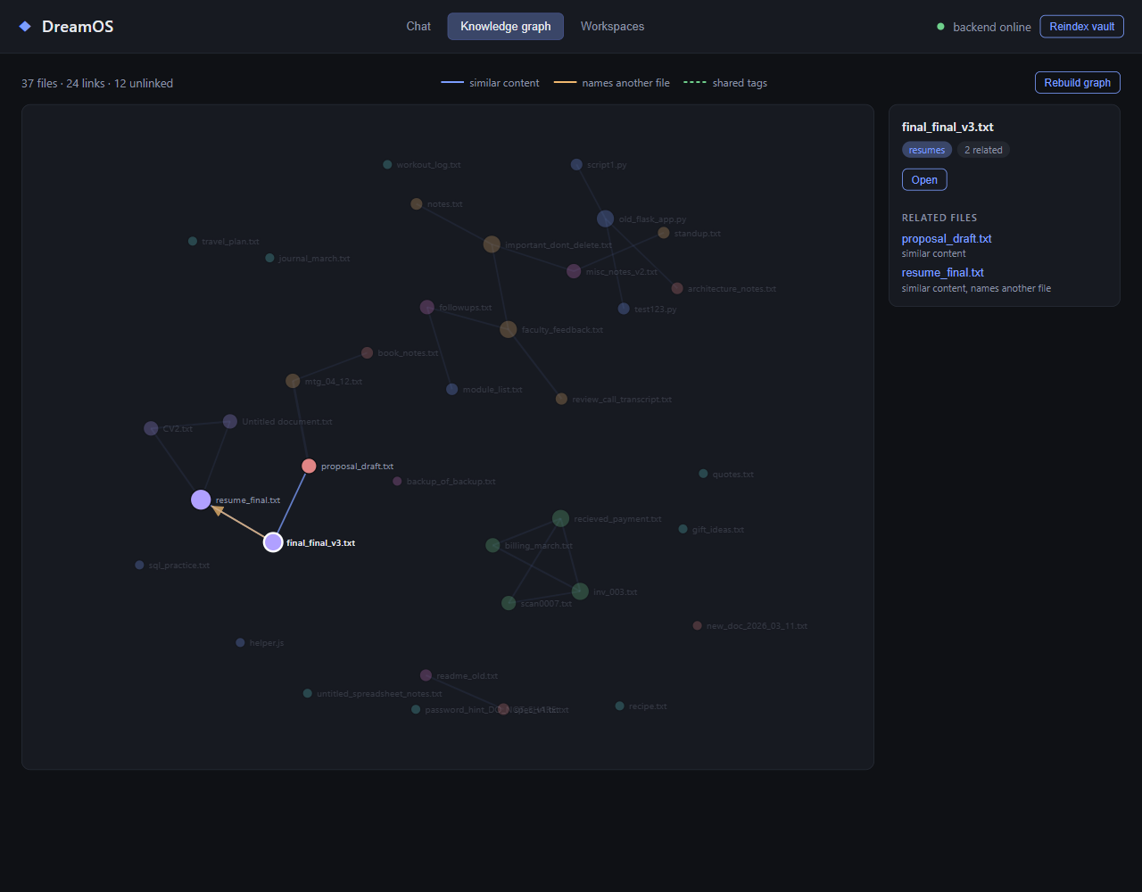
KEY IDEA 2 - CONNECTIONS
A map of how your files relate
Three kinds of link: similar content, one file names another, shared tags.
Each file keeps only its strongest links, so the picture stays readable.
Click any file to see what it is connected to, and why.
DreamOS | 11

Slide 12
KEY IDEA 3 - MEMORY
Follow-up questions just work
You
find my invoices
DreamOS
Found 2 file(s) matching ‘invoices’.
You
open the second one
DreamOS
Opening recieved_payment.txt...
Why this is hard: a computer has to know that “the second one” refers to the list it showed a moment ago. We decide that with rules first, and use the AI model only as a last resort.
DreamOS | 12

Slide 13

KEY IDEA 4 - PRIVACY YOU CAN CHECK
Nothing leaves this computer
The app tells you where it sends requests. Right now the answer is: only to this computer.
Inside the app
Checking it yourself
A Privacy tab lists every service DreamOS talks to
It marks each one as “this computer only” or “another computer”
If someone points it at a remote model, the warning turns red
Run netstat -ano in a terminal. The DreamOS service listens on 127.0.0.1 only, which means it cannot be reached from another computer.
DreamOS | 13

Slide 14





PART 3 - TECHNOLOGY
What it is built with
Desktop app
React, TypeScript, Tauri (a small native window)
Service
Python with FastAPI
AI models
Ollama running nomic-embed-text (meaning) and llama3.2 (understanding)
Storage
SQLite for details and history; ChromaDB for meaning vectors
Testing
pytest with 116 automated tests; GitHub Actions on every push
DreamOS | 14

Slide 15
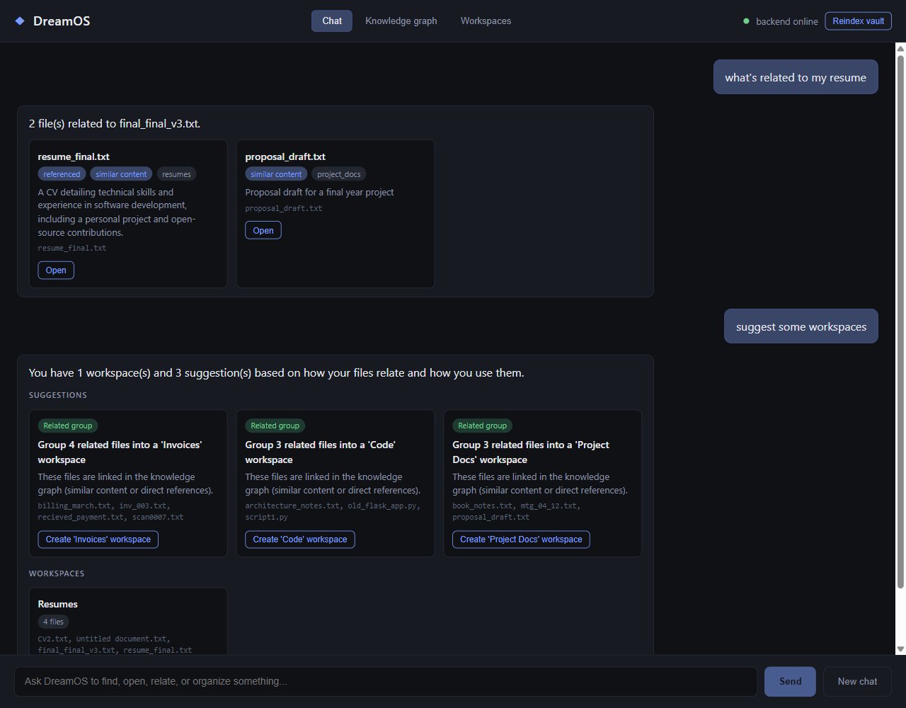
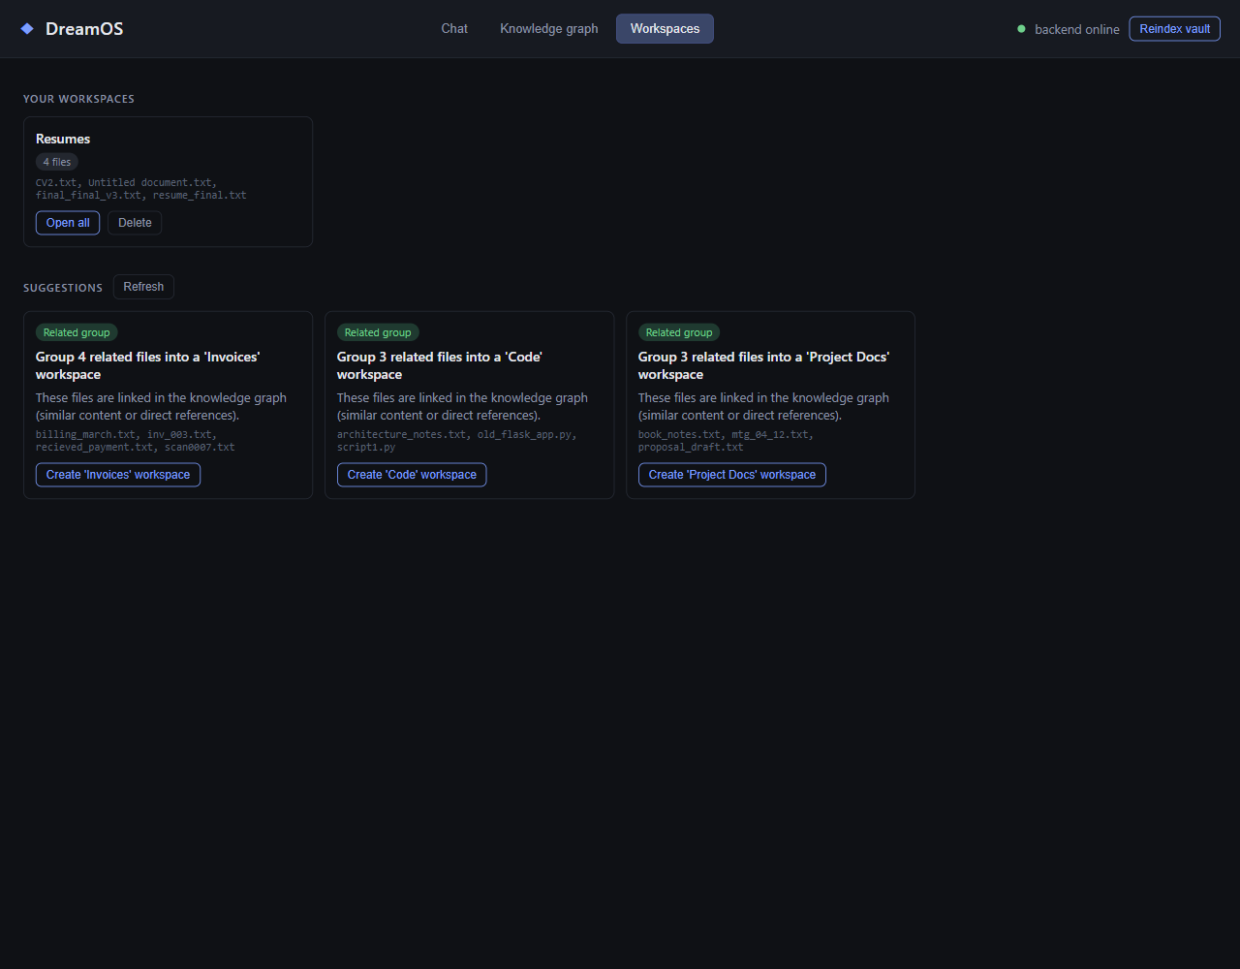
PART 3 - THE APP
What the user sees
Chat: ask in plain words; cards show why each file matched
Workspaces: suggested groups, one click to create and open
DreamOS | 15

Slide 16
PART 4 - TESTING
How we checked it works
Small checks
One piece at a time: does the ranking, the memory rule and the reversal work?
116 automated tests, run offline in under a minute
Joined-up checks
Pieces together: index a folder, search it, organise it, undo it
Run against the real AI models
Real app
The desktop window itself, driven like a user would drive it
Opened and checked inside the running app
DreamOS | 16

Slide 17
PART 4 - LARGE-SCALE TESTING
Could it cope with a real-sized folder?
We generated fake but realistic folders: 500, 2,000 and 5,000 files.
Twelve topics: invoices, recipes, research notes, code, and more.
Half of the files also carry a sentence from another topic, to make it harder.
The real AI models did the work, on an ordinary laptop with no graphics card.
Every number on the next slides comes from one script, which anyone can rerun.
The question we asked
If my folder has five thousand files, will I wait minutes for an answer?
DreamOS | 17

Slide 18
PART 4 - RESULTS
Rebuilding the map of 5,000 files takes two minutes
446.5 s
to index 5,000 files (about 11 files every second)
50.7 ms
median search time at 500 files; 203.5 ms at 5,000 files
DreamOS | 18

Slide 19
PART 4 - RESULTS
Before and after fixing what the tests exposed
Every embedding call waited about one second. The cause: the name "localhost" was tried over IPv6 first. Fix: use 127.0.0.1. Measured: about 1 s down to about 15 ms per call.
The relationship map grew with the square of the file count. Fix: vectorise it with NumPy, and test that the answers are unchanged.
A follow-up about a new topic was answered with an old result. Fix: direct evidence now wins over the AI's guess, with a test that fails on the old behaviour.
DreamOS | 19

Slide 20
PART 4 - RESULTS
Is the answer the right one?
1.00
What this does and does not show
It shows that the topics separate cleanly in meaning at this size.
It does not show quality on your real documents. Those are not in the test, on purpose.
Test files were generated, so they are easier than real ones. We say so in the report.
A harder test on real documents is the next step.
of the top 5 answers are on the right topic, on the 5,000-file set
DreamOS | 20

Slide 21

PART 5 - HONEST LIMITS
Where DreamOS is weaker
One-word questions
“meeting notes” can rank a file that only mentions a meeting above the real notes. We show such results as guesses, and never open a guess.
Borderline wording
A 3-billion-parameter model sometimes misreads the intent of a sentence. Measured on new phrasings: 88% correct.
Very large folders
Some steps still grow with the square of the file count. Fine for thousands of files; tens of thousands would need a better method.
One computer, Windows only
Not designed for several users, phones, or syncing between machines.
DreamOS | 21

Slide 22
PART 5 - CONCLUSION
What we delivered
Six working modules, tested end to end
A privacy check you can run yourself
Tested at 5,000 files, with the weak spots reported
Three real defects found and fixed during testing
Future scope
Test on real documents, with consent
Faster method for very large folders
Scanned documents and images
Installer that includes the AI models
DreamOS | 22

Slide 23
QUESTIONS
Plain-English glossary
Embedding
Vector database
A list of numbers that stands for the meaning of a piece of text
A store that finds the nearest meaning-points quickly
Knowledge graph
Local model
A map of which files are linked, and why
An AI model that runs on this computer, with no internet
Cosine similarity
Average linkage
How close two meaning-points are, from 0 (unrelated) to 1 (the same)
A way to group files that avoids joining two groups by one weak link
DreamOS | 23

Slide 24

Thank you
Questions and live demo
github.com/zaidwhy/dreamos-college-project (private, available to examiners)

