Slide 1


DreamOS
An AI-Native Semantic File Management Shell
PROJECT MONITORING - II
All six proposed modules are implemented, tested and packaged
Guide :- Dr. Minakshi Rajput
Zaid Ali Syed (2305139) | Om Vyas (2305170) | Krushna Kadam (2305165)
B.Tech Information Technology - IICT, MGM University | September 2026

Slide 2

Problem statement and objectives
THE PROBLEM
OBJECTIVES - ALL DELIVERED
Desktop operating systems organize files around folders and filenames chosen at the moment of saving. As a machine grows to thousands of files, this breaks down: the name chosen months ago rarely matches how the file is described today.
1
Semantic index of a file vault using local embedding models
2
One natural-language interface that classifies intent and routes it
3
Retrieve by meaning, ranked by similarity; open the top match directly
Design and implement a locally-run, AI-native file management layer that retrieves, opens and organizes files by describing their meaning in natural language - without exact names, folder locations or a cloud service.
4
Local LLM summary, tags and category, applied reversibly
5
Entirely local and offline-capable, preserving privacy
6
Knowledge graph, context memory and intelligent workspace manager
DreamOS - Project Monitoring II
2

Slide 3
Literature review
Two lines of work: dense embeddings, and semantic / AI-native file systems
Foundation: dense embeddings
Closest related work: LSFS
Mikolov et al. [2]: text mapped into a vector space where distance tracks semantic relatedness - the basis of every modern embedding model.
Reimers and Gurevych, Sentence-BERT [3]: efficient embeddings of whole sentences and paragraphs - exactly what DreamOS does once per indexed file.
DreamOS uses nomic-embed-text through Ollama, with the Chroma vector database [4] for nearest-neighbour retrieval.
Shi et al. [1], "From Commands to Prompts: LLM-based Semantic File System for AIOS", ICLR 2025: embedding-vector file indexes with an LLM front end as a substitute for command-based file operations.
Validates the architectural bet DreamOS makes.
But it serves LLM agents through an API - not an end user through a conversational interface, and it is not shown running fully local.
Existing consumer tools are keyword- or metadata-driven
Windows Search [5] matches lexically | macOS Spotlight [6] adds metadata and heuristics | Everything [7] indexes filenames only. A query must share vocabulary with the target file.
DreamOS - Project Monitoring II
3

Slide 4
Comparison and research gap
System | Retrieval basis | Strength | Limitation vs. DreamOS
Windows Search | Keyword / metadata index | Built into the OS, fast | No semantic matching; cannot act on the result from one query
macOS Spotlight | Keyword / metadata + heuristics | Fast, system-wide | Not embedding-based; not conversational
Everything (voidtools) | Filename index (NTFS MFT) | Extremely fast filename lookup | Filename only, no content understanding
AIOS LSFS [1] (ICLR 2025) | LLM + embedding-vector file index | Proves embedding file indexing at OS level | API for LLM agents, not an end-user chat; not shown fully local
DreamOS (this project) | Local embeddings + local LLM intent routing | One interface to search, open, relate, organize; fully local and private | Baseline being proposed
Research gap
Where semantic file indexing exists in the literature it is an API layer for LLM agents, not one natural-language surface for end users, and it is not demonstrated running entirely on local models. DreamOS targets that gap: one conversational interface, backed by a locally-run embedding model and a locally-run LLM, that retrieves files by meaning and acts on them - with no file content or query leaving the machine.
DreamOS - Project Monitoring II
4

Slide 5
Functional requirements
11 of 11 implemented
ID | Requirement | Status
FR1 | Accept one natural-language message through a chat-style interface | Implemented
FR2 | Classify intent (search, open, related, workspace, organize, other) with a local LLM | Implemented
FR3 | Semantic search returning ranked results with similarity score and snippet | Implemented
FR4 | Resolve an "open" request to the best match and launch it in its default app | Implemented
FR5 | Generate an AI summary, tag list and category for a file | Implemented
FR6 | Apply an AI-organized move and reversibly revert it | Implemented
FR7 | Preview all unorganized files before applying any suggestion | Implemented
FR8 | Index and incrementally re-index a folder, skipping unchanged files by hash | Implemented
FR9 | Build a graph of relationships between files (similar, referenced, shared tags) | Implemented (new)
FR10 | Retain conversational context across turns and resolve follow-ups | Implemented (new)
FR11 | Recommend workspace actions from usage patterns and file relationships | Implemented (new)
FR9-FR11 were planned for Monitoring II and III; recommendations are surfaced in the Workspaces tab and on request.
DreamOS - Project Monitoring II
5

Slide 6
Technical requirements and technology stack
Languages and frameworks
Data storage
Backend: Python 3, FastAPI, Uvicorn, Pydantic
Frontend: TypeScript, React, Vite, d3-force (graph layout)
Desktop shell: Tauri v2 (Rust) with the opener plugin
AI runtime: Ollama - nomic-embed-text (embeddings), llama3.2 (intent, summaries, tags)
SQLite: file metadata, graph edges, conversation turns, usage events, workspaces
ChromaDB: persistent local vector store, one entry per file chunk
All derived tables keyed on file id, so they survive organizer moves
Tools
Hardware and runtime
Git and GitHub (private repository) with CI on every push
pytest: 107 tests, fully offline (embeddings and LLM mocked)
Mermaid diagrams; pptxgenjs and docx-js for deliverables
WiX and NSIS (Tauri bundler) for Windows installers
No GPU required: both models run on CPU through Ollama
Runs on a single machine; no API keys, no network at runtime
Sandboxed demo vault - never a real personal folder
DreamOS - Project Monitoring II
6

Slide 7
System architecture
added since Monitoring I
Client-server on one machine: Tauri/React client, local FastAPI service, Ollama, two local stores
DESKTOP APPLICATION - Tauri (Rust) + React
Chat view
search, open, related, organize
Knowledge graph view
d3-force SVG
Workspaces view
suggestions and workspaces
Tauri opener
launches files in default apps
HTTP / JSON, session id
BACKEND SERVICE - FastAPI, 127.0.0.1:8420
REST routes (main.py)
NL Interface
intent routing
Semantic Search
vector similarity
AI Organizer
categorize, revert
Knowledge Graph
file relationships
Context Memory
sessions, usage
Workspace Manager
recommendations
Indexer
embed + upsert
LOCAL AI RUNTIME AND STORAGE (nothing leaves the machine)
Ollama
nomic-embed-text + llama3.2
SQLite
files, edges, turns, usage, workspaces
ChromaDB
persistent vector store
demo-vault
sandboxed files
DreamOS - Project Monitoring II
7

Slide 8
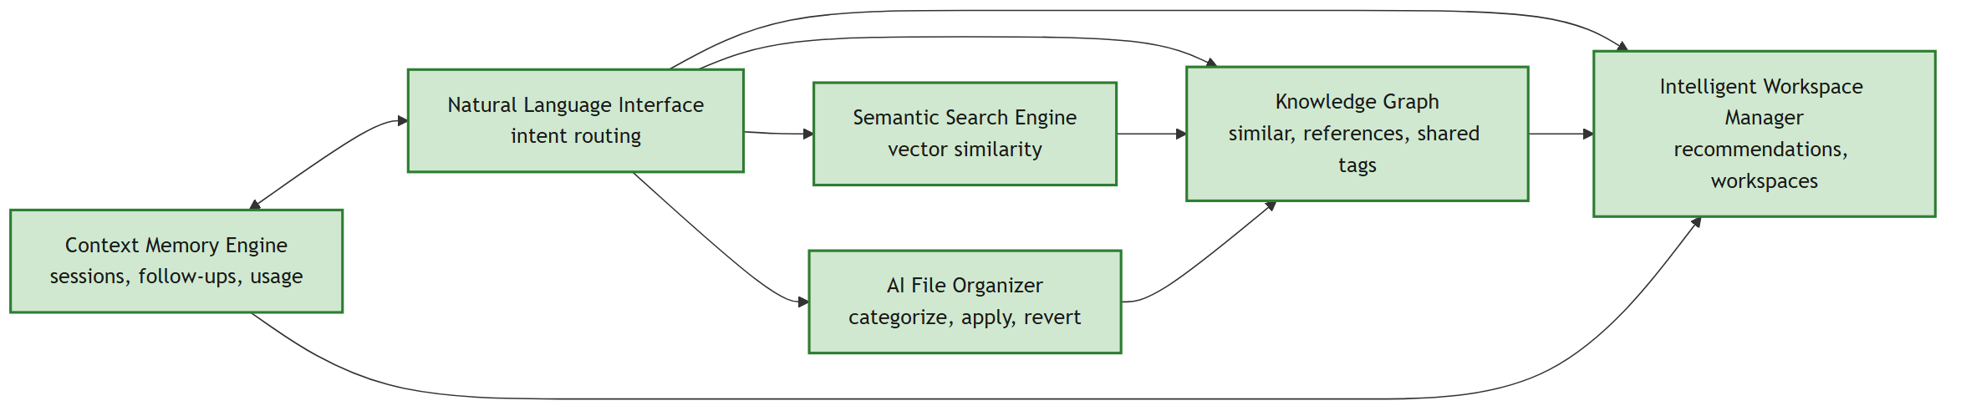
Module design
The proposal specifies six modules - all six are now built (solid = implemented)
Module | Input / output | Status
Natural Language Interface | In: message + session. Out: intent and routed response (hits, suggestions, related files, workspaces, open path) | Built
Semantic Search Engine | In: query. Out: ranked hits above the similarity threshold | Built
AI File Organizer | In: file. Out: summary, tags, category, reasoning; reversible apply / revert | Built
Knowledge Graph | In: embeddings, text, tags. Out: typed weighted edges and clusters | Built (new)
Context Memory Engine | In: turns and open events. Out: resolved follow-ups, usage counts | Built (new)
Intelligent Workspace Manager | In: clusters, usage, organizer state. Out: recommendations and workspaces | Built (new)
DreamOS - Project Monitoring II
8

Slide 9
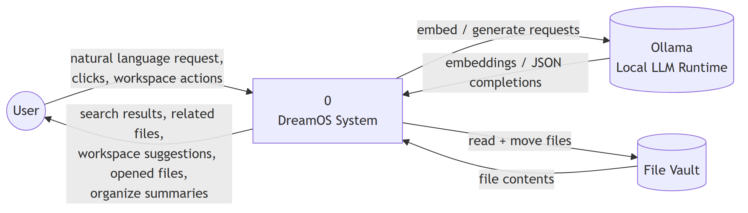
Data flow diagram - context level (DFD 0)
DreamOS is one process between the user, the local LLM runtime and the file vault
DreamOS - Project Monitoring II
9

Slide 10
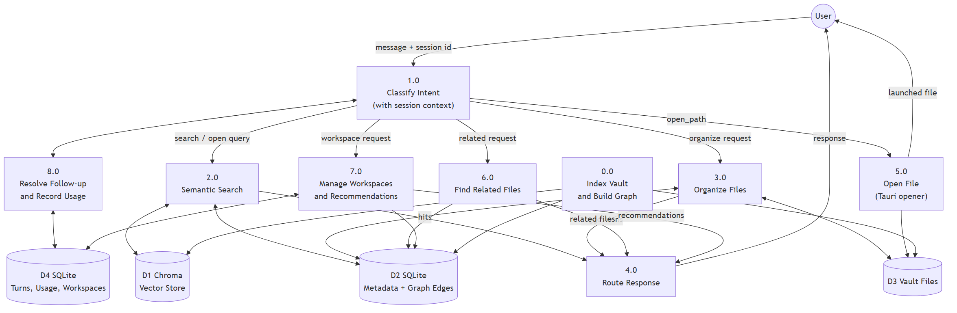
Data flow diagram - level 1
Intent classification fans out to search, organize, related-files, workspace and open-file processes; memory feeds classification
DreamOS - Project Monitoring II
10

Slide 11
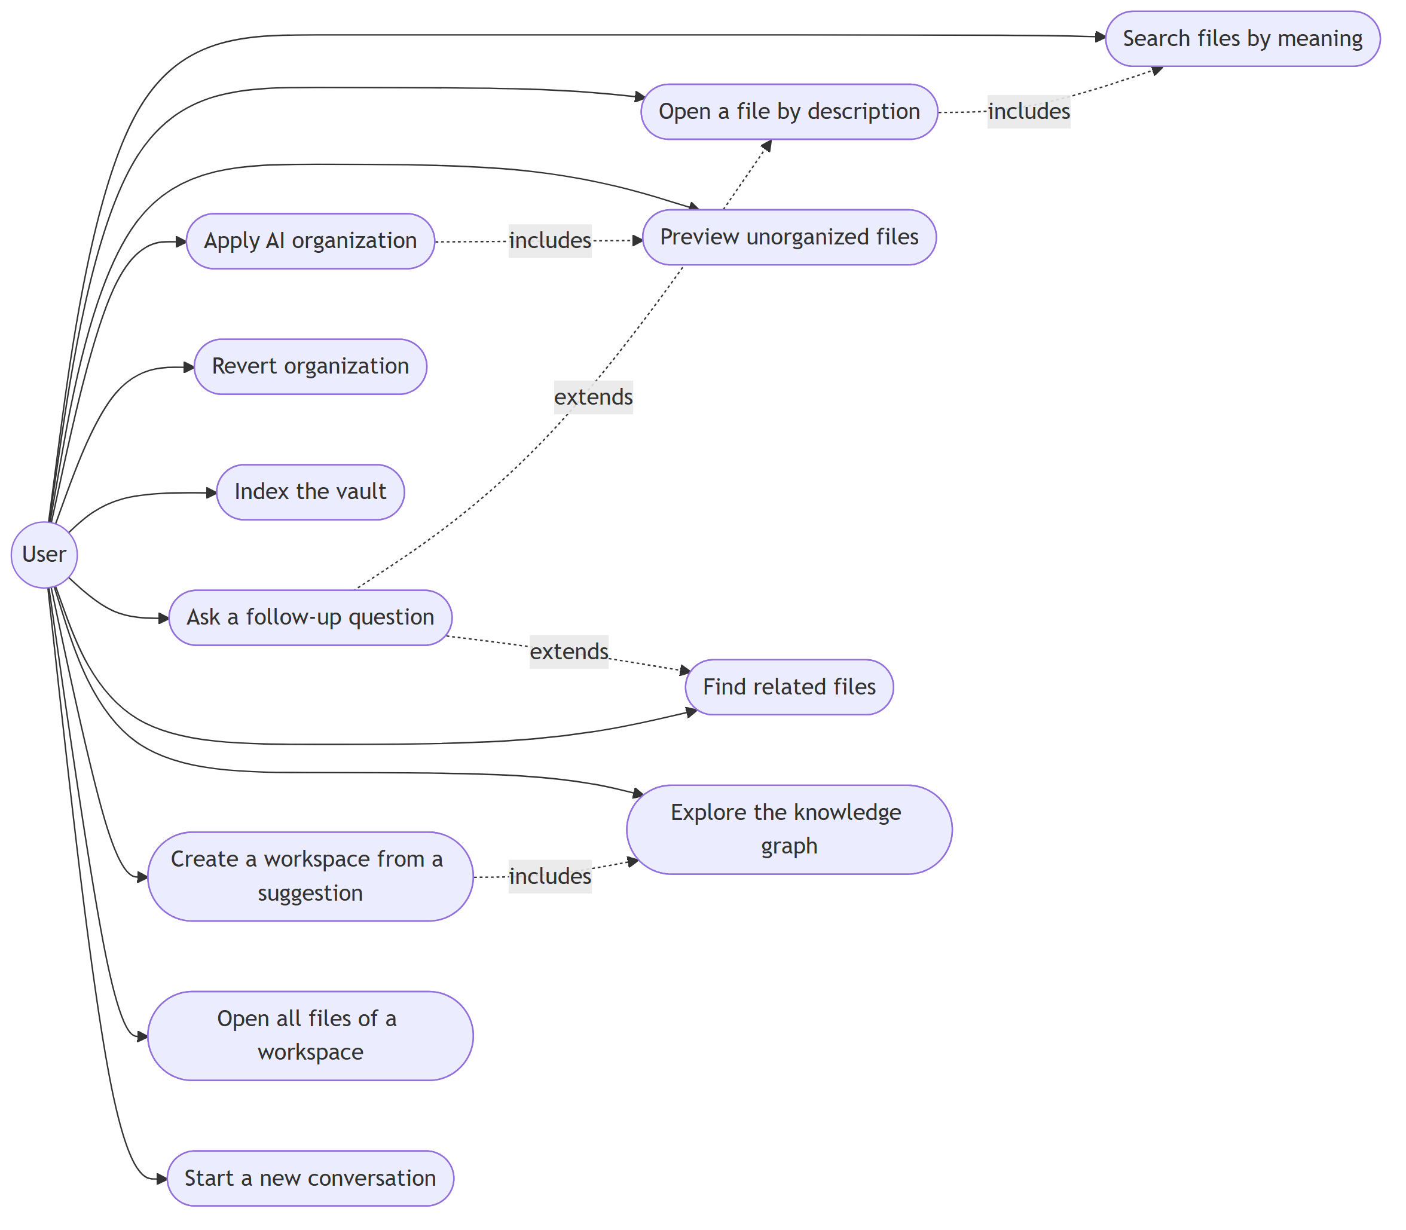
UML - use case diagram
Twelve user-facing actions (six existed at Monitoring I)
Added since Monitoring I
Ask a follow-up question ("open it", "the second one")
Find related files
Explore the knowledge graph
Create a workspace from a suggestion
Open all files of a workspace
Start a new conversation (clears memory)
DreamOS - Project Monitoring II
11

Slide 12
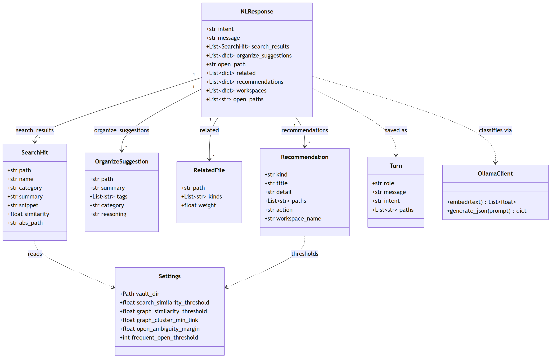
UML - class diagram
Response and settings data classes in backend/app
DreamOS - Project Monitoring II
12

Slide 13
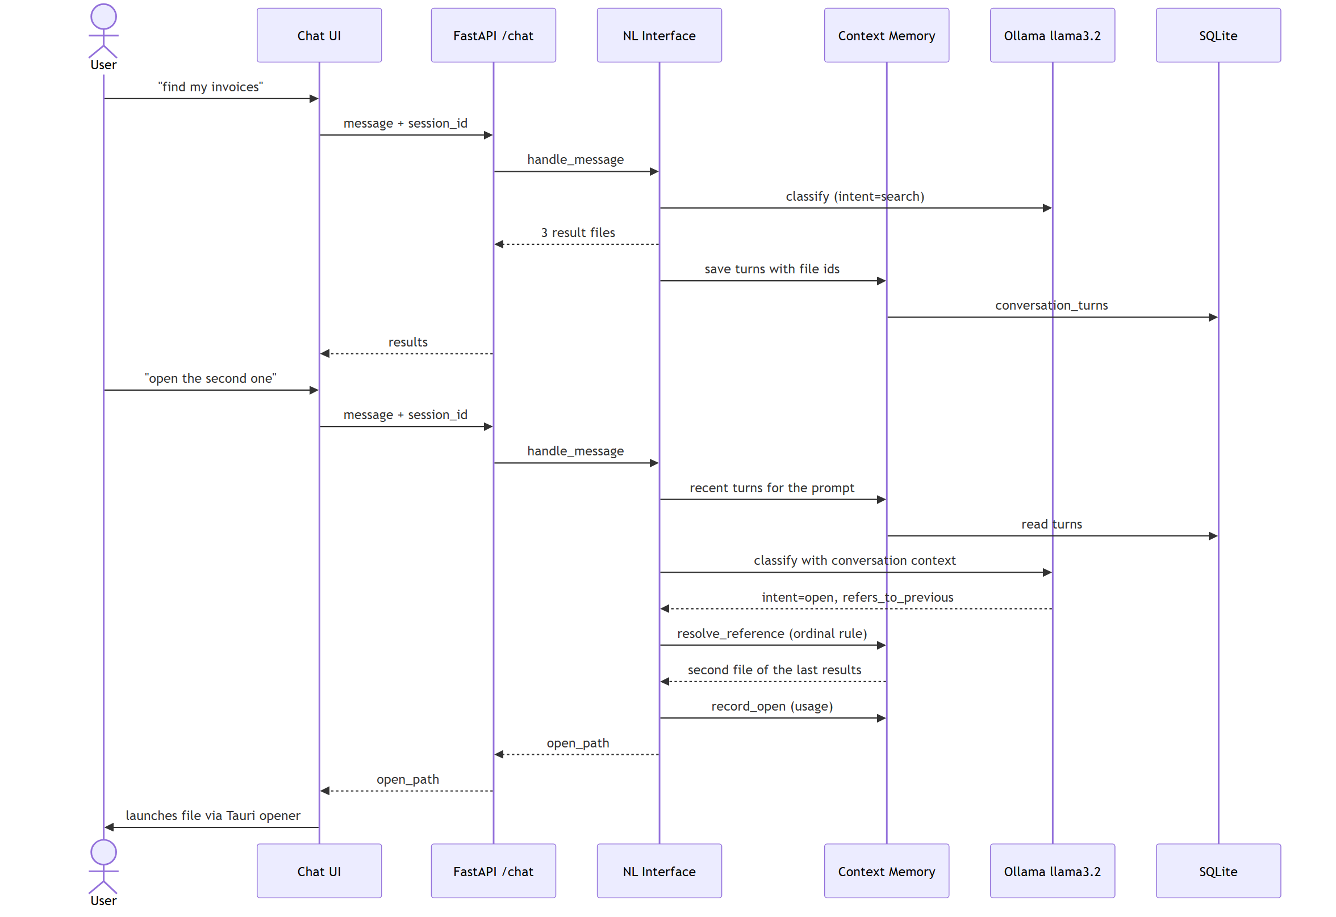
UML - sequence diagram: a follow-up question
"find my invoices", then "open the second one" - resolved from remembered results
DreamOS - Project Monitoring II
13

Slide 14
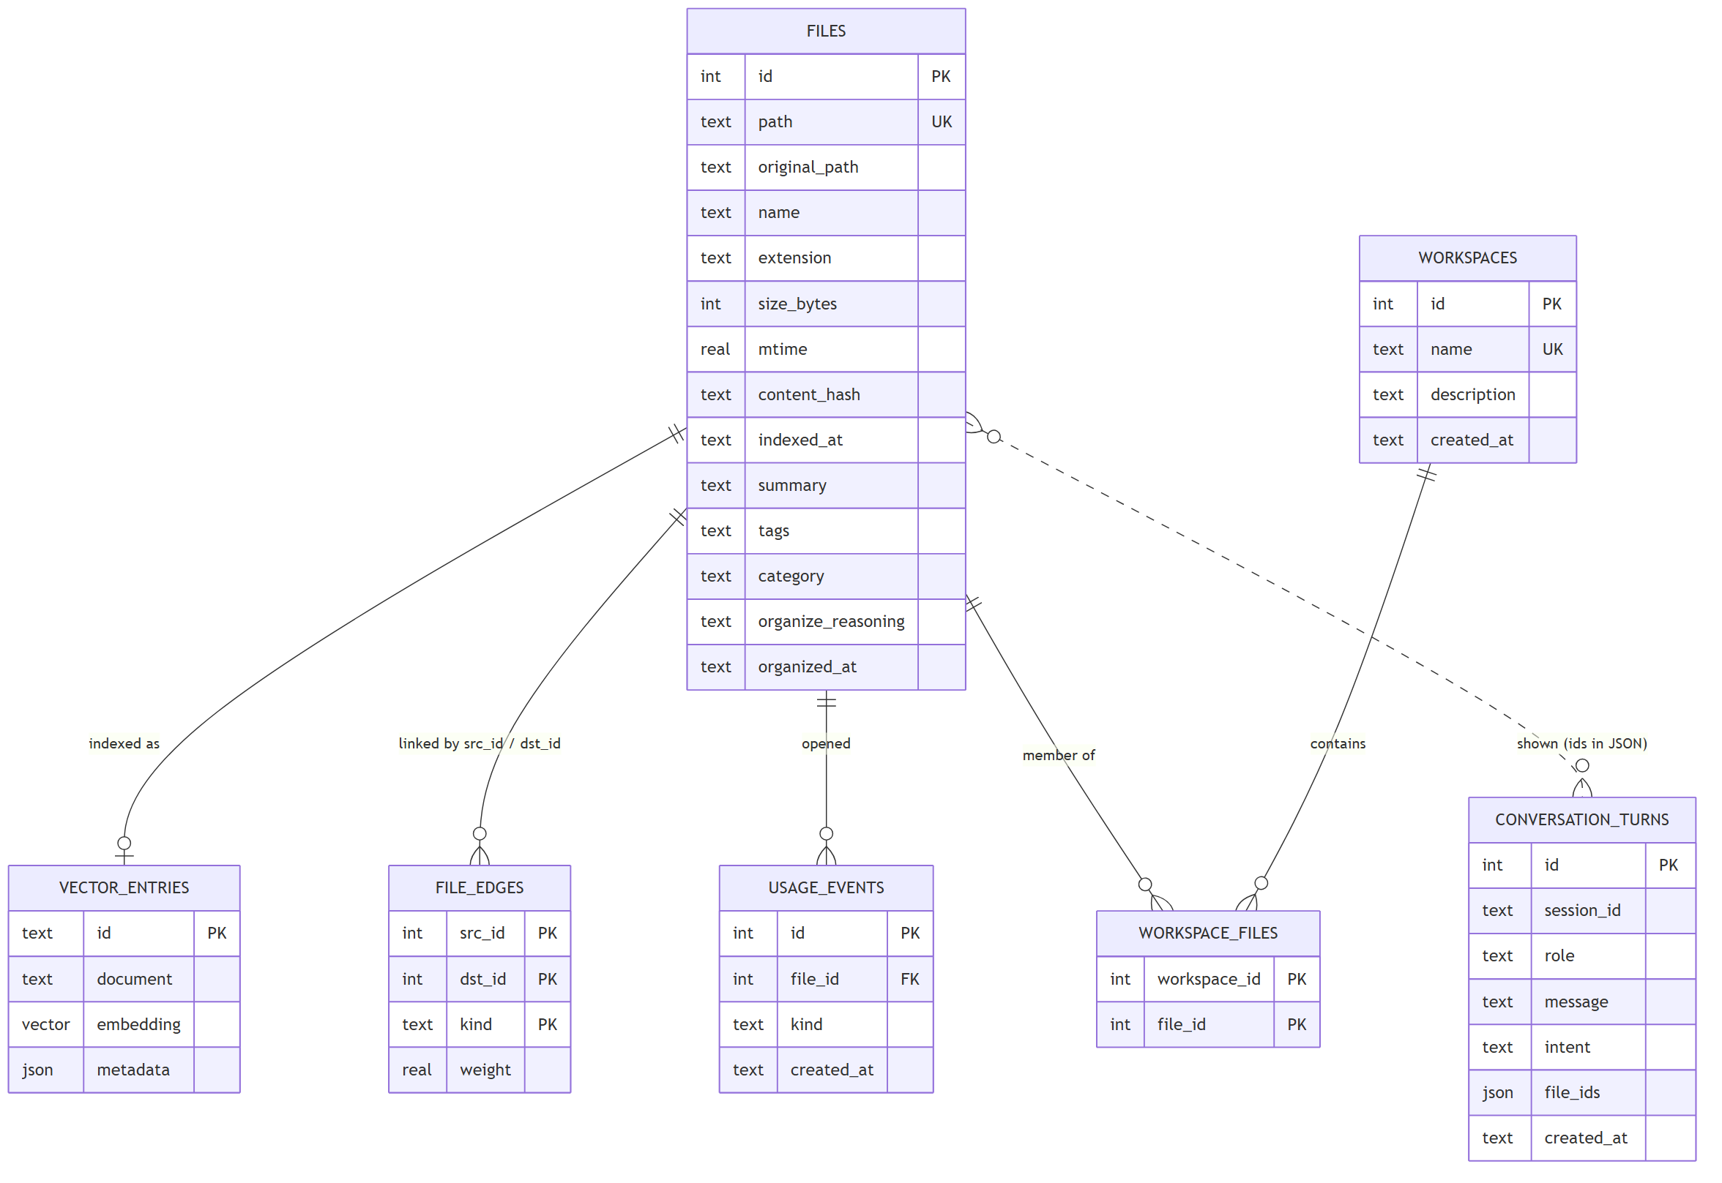
Database design
SQLite for relational data, ChromaDB for vectors, linked by file path
Design decisions
Every derived table (edges, turns, usage, workspaces) is keyed on files.id, not the path.
The organizer renames paths on apply and revert; an id survives that, so nothing needs re-syncing after a move.
content_hash lets re-indexing skip unchanged files.
Edges are rebuilt after each index run that changed something - idempotent, so safe to repeat.
Conversation turns store file ids, so a remembered result still resolves after a move.
DreamOS - Project Monitoring II
14

Slide 15
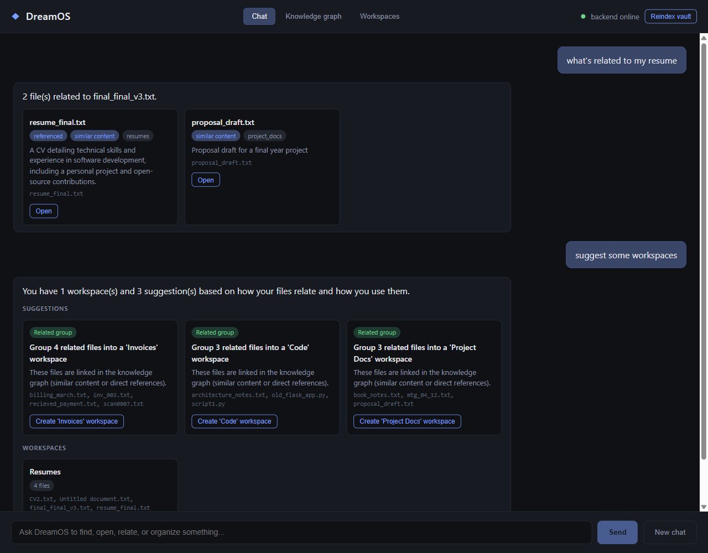
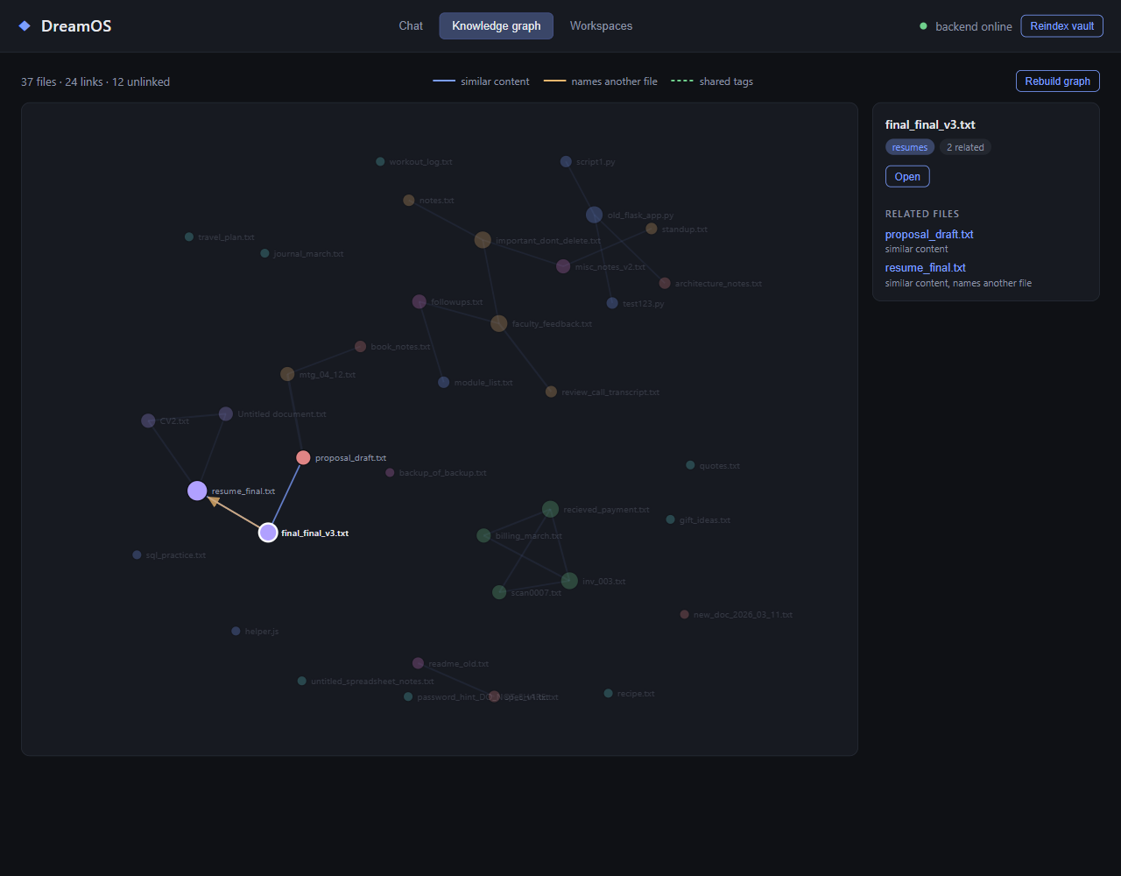
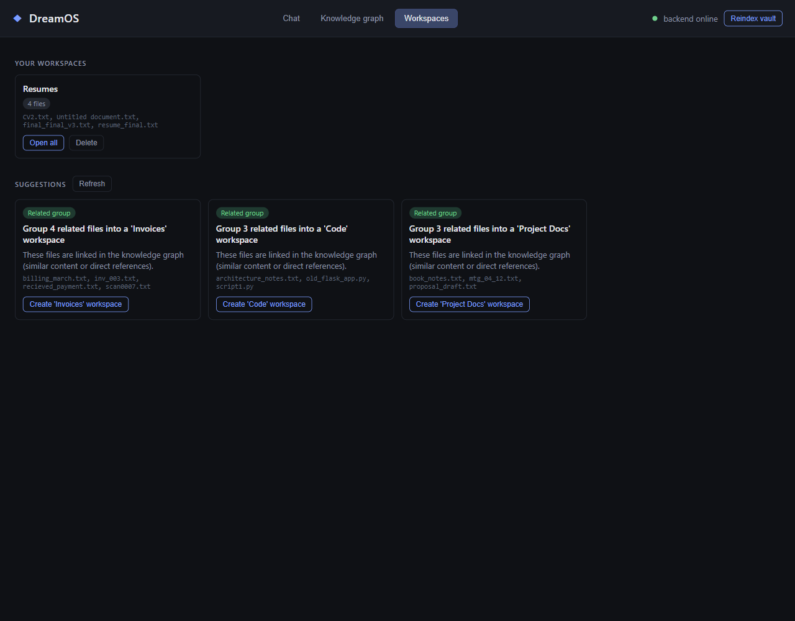
User interface
Three views in one desktop shell - screenshots of the running application
Chat: related files with the reason they are linked, and workspace suggestions
Knowledge graph: nodes by category, edges by kind; a selected file and its neighbours
Workspaces: a workspace created from a suggestion, and the remaining suggestions
Verified inside the real Tauri desktop shell (WebView2 debug port): workspace "Open all" and click-to-open launch files with no permission errors.
DreamOS - Project Monitoring II
15

Slide 16
Implementation status
6 / 6
107
88%
proposed modules built, integrated, tested and packaged
automated tests, all offline; CI on every push
intent routing on phrasings the prompt was never tuned on (23 of 26)
Built at Monitoring I
Built since
Chat interface routing search, open and organize
Semantic search with a tuned similarity threshold
AI organizer with reversible apply / revert
Incremental indexer, one-click launcher, Windows installers
Knowledge Graph: similar, references and shared-tag edges; interactive graph view
Context Memory Engine: persisted sessions, follow-ups ("open it", "the second one"), usage tracking
Workspace Manager: explainable recommendations and one-click workspaces
Related-files and workspace intents; clickable results
DreamOS - Project Monitoring II
16

Slide 17
Knowledge graph: three edge kinds, two measured fixes
Report section 5.2 - measured on the real models and the 37-file demo vault
Edge kinds
Fix 1: raw similarity misleads
Fix 2: clusters must not chain
similar: files whose embeddings are close; each file nominates its 3 strongest neighbours
references: directed - a file names another file (final_final_v3 -> resume_final)
shared_tag: at least two AI-generated tags in common
37 files, 24 links, 12 unlinked
Across 666 file pairs: median cosine 0.52, max 0.83
An unrelated pair (notes / spec_v1, 0.72) outscored a real invoice pair (0.67)
Fix: subtract the corpus mean before comparing; real groups then rank at the top and a 0.25 threshold works
Connected components merged 4 resumes with 3 unrelated files through two weak edges (a 7-file group)
Fix: average-linkage - merge only while the average pair weight stays above 0.12
Result: Resumes 4, Invoices 4, Code 3, Project Docs 3
DreamOS - Project Monitoring II
17

Slide 18
Context memory and workspace manager
Report sections 5.3 and 5.4
Context Memory Engine
Workspace recommendations (rule-based, explainable)
Every turn is stored with the ids of the files it showed, so follow-ups survive a restart and a file move
"the second one" and "open it" are resolved by rules; the 3B model's own flag is only a fallback
Two candidates within 0.05 similarity: show both instead of guessing
Once the user opens one, it wins the next tie
Recommendation | Trigger
Related group | Cluster of 3 to 12 files not already in a workspace
Frequently used | Files opened at least 3 times
Possible duplicate | Similarity of 0.9 or more, or identical content hash
Needs organizing | Indexed files with no category
Stale files | Untouched for 90+ days and never opened
Rules, not the language model: reproducible, explainable, and no extra model calls. A workspace opens all its files in one click.
DreamOS - Project Monitoring II
18

Slide 19
Retrieval quality: measurement and fix
Report section 5.5 - 27 labelled queries plus 4 off-topic ones, split into tuning and held-out halves
Approach | Result | Decision
Fixed cutoff of 0.55 (original) | Correct file found for 20 of 27 queries; precision 0.63 ("meeting" returned nothing) | Replaced
nomic task prefixes | Top-1 21 to 24 of 27, but no cutoff separates a weak right answer (0.56) from junk (0.57); needs re-embedding | Not adopted
LLM query expansion | Top-1 fell to 13 of 27: the 3B model's descriptions drift | Rejected
Near-best cutoff + keyword boost | 27 of 27 found (14 of 14 held-out); top-1 24 of 27 (13 of 14 held-out); precision 0.82; no re-embedding | Adopted
Re-measured through the production endpoint: identical numbers. Weak matches are labelled low confidence and open never launches below 0.55. Residual: "meeting notes" still ranks workout_log first (it mentions "the project meeting"), and 3 of 4 off-topic file-shaped queries return labelled guesses.
DreamOS - Project Monitoring II
19

Slide 20
Testing and verification
Report section 5.6
Level | What was done | Result
Unit and integration | 107 pytest tests: indexing, search and keyword boost, organizer, graph, memory, workspaces, intent routing, reset script, HTTP API | 107 passed, offline
Continuous integration | GitHub Actions runs the suite on every push (Linux) | Passing
Test strength | Key guards deliberately broken to confirm a test fails | Each caught
Intent routing, real model | 32-message tuning set and a 26-message held-out set on llama3.2; prompt rewritten and compared | Held-out 80% to 88%
End to end, real models | Follow-ups, ambiguity then usage resolution, organize and revert, graph rebuild on indexing | As designed
Retrieval | 31-query labelled set with tuning and held-out halves | 27/27 found; top-1 24/27
Real desktop shell | Workspace Open all and click-to-open driven over WebView2's debug port | No permission errors
The intent prompt scored 32/32 on the tuning set it was tuned against - the held-out figure is the honest one.
DreamOS - Project Monitoring II
20

Slide 21
Known limitations and remaining work
Report sections 5.8 and 6
Known limitations (documented, not hidden)
Remaining work (Monitoring III)
Very short queries are best-effort: a file that merely contains the word can outrank the answer ("meeting notes" ranks workout_log first)
Off-topic file-shaped queries return labelled low-confidence guesses; non-file requests are turned away by the intent router
The 3B intent router misses borderline wording ("which files should I archive")
Clustering is conservative: some related files stay unlinked
Similarity is pairwise and search scores every chunk: fine for hundreds of files, not thousands
Scale and performance: a larger vault, timing, an approximate neighbour method if needed
Retrieval: test the embedding-prefix option end to end, judged by the labelled evaluation set
Final project report: results, discussion, conclusion, future scope
Research paper, drawing on the measurements in this report
Final GitHub submission and installer hand-off
DreamOS - Project Monitoring II
21

Slide 22
References
[1] Z. Shi, K. Mei, M. Jin, Y. Su, C. Zuo, W. Hua, W. Xu, Y. Ren, Z. Liu, M. Du, D. Deng, and Y. Zhang, "From Commands to Prompts: LLM-based Semantic File System for AIOS," in Proc. 13th Int. Conf. on Learning Representations (ICLR 2025). arXiv:2410.11843.
[2] T. Mikolov, K. Chen, G. Corrado, and J. Dean, "Efficient Estimation of Word Representations in Vector Space," arXiv:1301.3781, 2013.
[3] N. Reimers and I. Gurevych, "Sentence-BERT: Sentence Embeddings using Siamese BERT-Networks," in Proc. EMNLP-IJCNLP, 2019.
[4] Chroma, "Chroma: the open-source embedding database," github.com/chroma-core/chroma.
[5] Microsoft, "Windows Search overview," Microsoft Learn documentation.
[6] Apple Inc., "Spotlight User Guide," support.apple.com.
[7] voidtools, "Everything - locate files and folders by name instantly," voidtools.com.
DreamOS - Project Monitoring II
22

