Slide 1
Hybrid feature extraction method using Term Frequency-Inverse Document Frequency and Latent Dirichlet Allocation to detect fake news articles
Zainul Abedin Khatik
X18110096
M.Sc. Data Analytics, Cohort A

Slide 2


What, why and implications
What is fake news?
Is social media to blame for?
Implications
https://www.buzzfeednews.com/article/craigsilverman/viral-fake-election-news-outperformed-real-news-on-facebook
Morgan Freeman was declared dead in 2010 by CNN news channel.
https://www.snopes.com/fact-check/morgan-freeman-death-hoax/
Manual and Automatic detection of fake news
Polifact, FactCheck.org, snopes.com
Notes:
(During the election fake websites had produced false content, which had generated around 8.7 millions shares, comments and reaction on Facebook. Ironically, which was larger than the total of 7.3 millions news stories published by Buzzfeed )

Slide 3
Background & Motivation
Using Machine learning algorithms
Granik and Mesyura (2017) and Jain and Kasbe (2018)
Fontanarava et al. (2017)
Kotteti et al. (2018)
Feature extraction using TFIDF along with Machine learning algorithms
Ahuja et al. (2019), Kotteti et al. (2018), Gilda (2017) and Ahmed et al. (2017)
Feature extraction using LDA along with Machine learning algorithms
Prihatini et al. (2018) implemented feature extraction technique using TF-IDF and Latent Dirichlet Allocation individually.

Slide 4
Research question
“Would the combination of Term Frequency-Inverse Document Frequency (TFIDF) and Latent Dirichlet Allocation (LDA) for feature extraction improve the accuracy in detecting fake news compared to features extracted individually by TFIDF and LDA?"
Objectives
Investigated the state of art techniques in the area of fake news detection
Investigated feature extraction techniques TFIDF & LDA

Slide 5
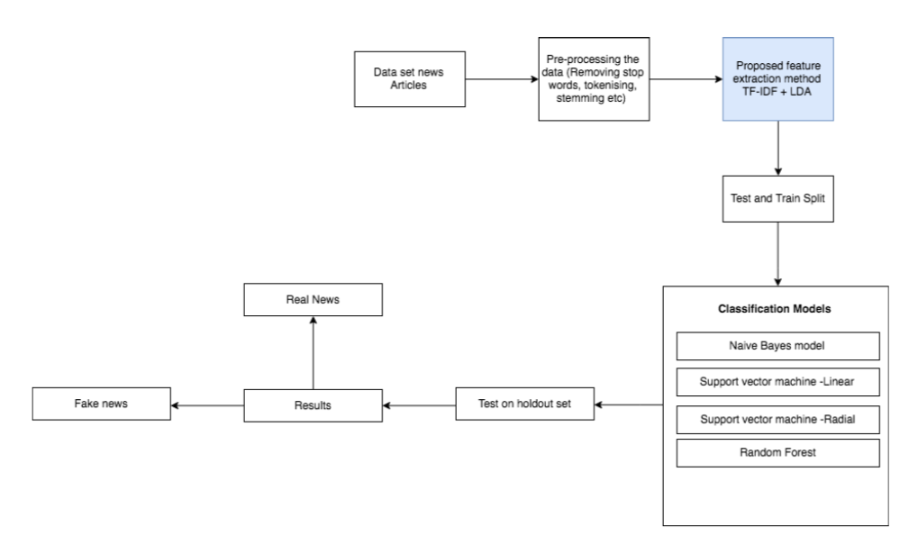
Process flow Diagram

Slide 6
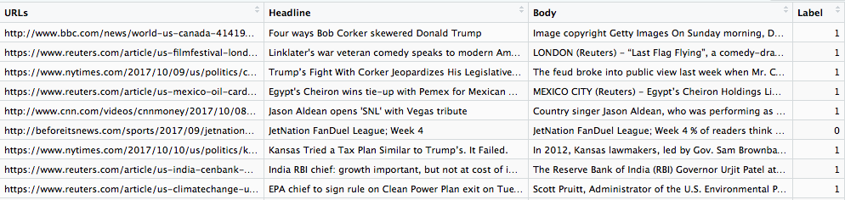
Dataset description
The dataset is maintained by author Jruvika and it is obtained from Kaggle, the author has extracted the dataset from PolitiFact (a Fact checking organization based in USA).
The dataset contains 4009 news articles in which 2137 news articles are fake and 1872 news articles real.
Real news articles is assigned as 1 and fake news articles is assigned as 0
Notes:
EDA – Welsh t test on length or article – Real articles are longer

Slide 7
Preprocessing
Stop words
Tokenization
Case folding
Stemming

Slide 8
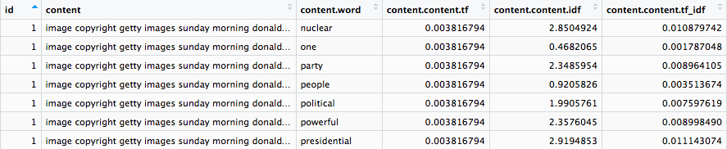
Proposed Hybrid Feature extraction method
TFIDF
LDA

Slide 9
Models employed
SVM
Naïve Bayes
Random Forest
Experiments
TFIDF with machine learning algorithms
LDA with machine learning algorithms
TFIDF + LDA with machine learning algorithms

Slide 10
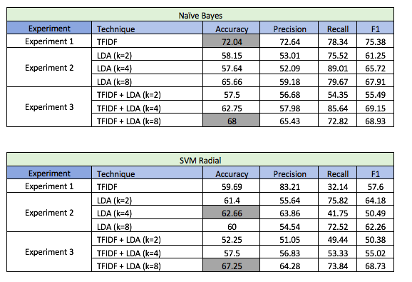
Evaluation and RESULTS

Slide 11
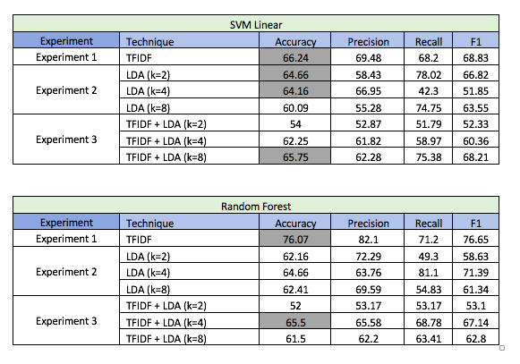
Evaluation and RESULTS
Continued..

Slide 12
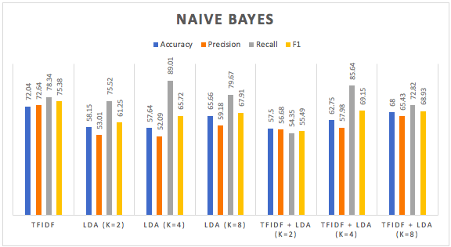
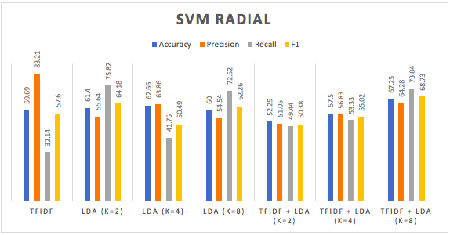
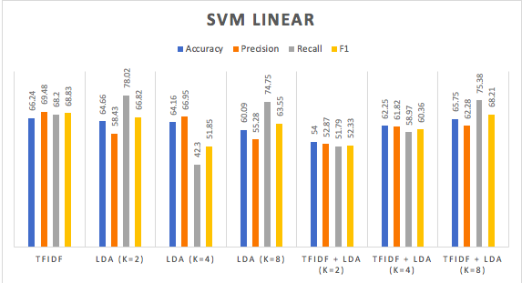
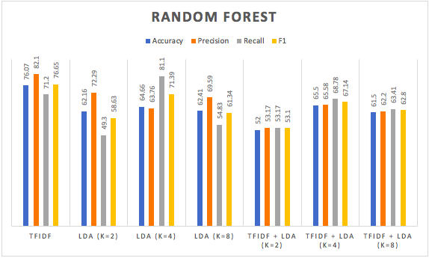

Slide 13
Conclusion & Future work
Limitations
Future work
Notes:
Wang et al. (2016)

