Slide 1
GROUP 10
Group members
Zain ul abideen ali 233604
Arfa Imran 233596
Fatima khalid 233526

Slide 2
Objectives
Add and remove products from the cart.
Product Recommendations
Item Quantity Management
View Cart.
Calculate the total cost of items in the cart.
Apply discounts and sales tax.
Cart Expiration
Checkout Process

Slide 3
Introduction
Our shopping cart application offers a streamlined experience for adding, removing, and viewing products. With built-in validation and a helpful cart expiration feature.

Slide 4
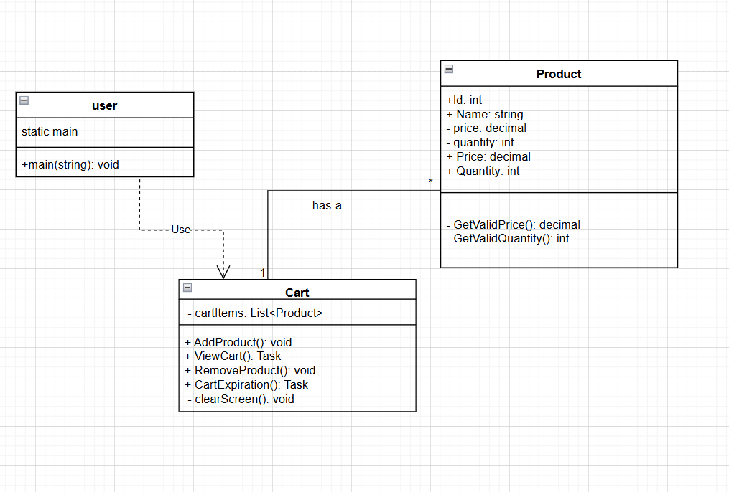
UML design of our application

Slide 5
Add Product in Cart
We used list data structure for this operation
We also added some Recommended products
user can select them just by entering their Ids.

Slide 6
Quantity Management System
We've implemented QUANTITY MANAGEMENT in the cart. If a user enters the ID of an existing product, our console application will prompt them to enter the desired quantity. The quantity of that product will then be updated accordingly.

Slide 7
REMOVE PRODUCT
For the delete operation in the cart, we utilized the predefined Remove() method for lists in C# to remove products based on their specified IDs
We used pre Defined method FirstOrDefault(c=>c.Id==Id) if id is found in the list it will return that product(in the list) other wise it will return NULL

Slide 8
VIEW CART
We used for each loop for printing products present in the list.
We used Composite Formatting for our cart Display.

Slide 9
Calculation for tax/total/discount
We used decimal data type for storing decimal values like total, tax, subtotal etc.
Why we used decimal data type?
Precision: decimal provide a high degree of precision making it ideal for making it ideal for calculations involving monetary values where even small differences can matter

Slide 10
Cart Expiration
We utilized C#'s asynchronous capabilities to efficiently delete products from the cart. To improve user experience, the cart will automatically be cleared after 3 minutes of inactivity
C# asynchronous capabilities like Task.delay() and await.

Slide 11
Check Out Process
Users can proceed to checkout from their cart. Once the checkout process is complete, their cart will be emptied.

