Slide 1
Internship Experience
BIG DATA ANALYTICS
By
BEEGOO, UMME ZAINAB RUKHSAAR
COMPANY NAME:
OceanDBA Ltd
POSITION:
Junior System and Database Engineer
MENTOR/MANAGER:
Mr Joffrey Michaie
INTERNSHIP PERIOD:
4thNovember 2019 – 27th March 2020

Slide 2






Agenda
Introduction
Familiarise with Linux
Familiarise with MariaDB
Familiarise with Web Platforms
(R&D) Nginx
(R&D) Nginx + Ldap auth
Skills Acquired

Slide 3





Introduction
Operating since 2016, OceanDBA has been providing MySQL Consulting, MariaDB Training, RemoteDBA and Support Services to approximately 100 Customers.
As a Junior System and Database Engineer at OceanDBA Ltd, I have been able to develop my skills in Linux, MySQL, MariaDB and also Nginx mostly.
Some of the companies trusting OceanDBA are:

Slide 4
Familiarise with Linux
Linux is a free open source OS based on Unix that can be installed on PCs, laptops, mobiles and more.
Popular Linux OS distributions include Debian, Ubuntu, Fedora and Red Hat.
What makes Linux powerful?
-open source
-customization
-security
System basic commands-Man pages(display the user manual of any command that we can run):
-ls, cd, cp
-pwd: show current position
-less, more, cat: display file contents
-chown: change owner and group of files
-ln -s file link: create symbolic link
-ssh –p port user@host: connect using port p
(ssh root@188.40.116.196 –p)

Slide 5

Installed and Started MariaDB and MySQL
Familiarise with MariaDB and MySQL
CONSTRAINTS
NOT NULL | a column cannot have a NULL value
UNIQUE | all values in a column are different
PRIMARY KEY | combination of NOT NULL and UNIQUE
FOREIGN KEY | uniquely identifies a row/record in another table
CHECK | all values in a column satisfies a specific condition

Slide 6
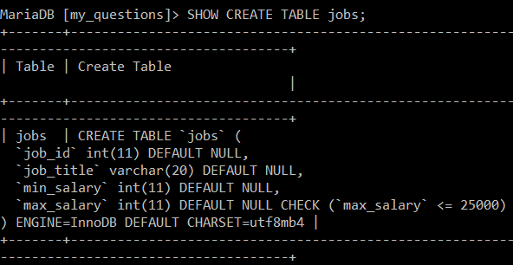
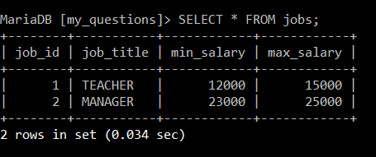
Write a SQL statement to create a table named jobs including columns job_id, job_title, min_salary, max_salary and check whether the max_salary amount exceeding the upper limit 25000.
Question Example on MySQL
NOTE:
Values(3,“SHOPKEEPER”,8000,26000) will not be entered into the table as the max salary exceeds the upper limit 25000 and the CHECK constraint will ensure that it satisfies the condition.

Slide 7
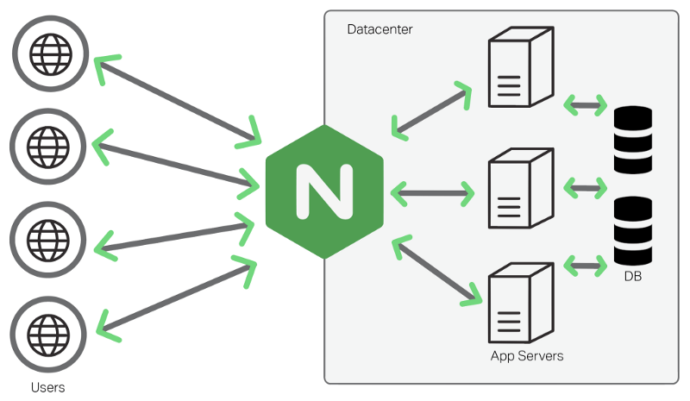
Familiarise with Web Platforms
Nginx is a free and open-source web server used to host websites and application of all sizes. It is used as a reverse proxy, HTTP cache and load balancer.
Installation of Nginx + Php-fpm
apt-get install nginx
/etc/init.d/nginx start or systemctl start nginx
systemctl status nginx (to check if nginx is running)
/etc/nginx/nginx.conf (location of main configuration file)

Slide 8


Created a debian 9 VM from scratch with different IP address to install softwares
Installation and Configuration of:
- DoKuWiki – is an open source wiki program written in PHP that doesn’t require a database
- PhpMyAdmin – is a free software tool written in PHP, to handle the administration of MySQL over the Web
- Redmine – is a free and open source, web-based project management and issue tracking tool. It allows users to manage multiple projects and associated subprojects.

Slide 9
(R&D) Check if Nginx can cache offline pages
Scenario:
-cache enabled on nginx cache
-backend server nginx works and backend server nginx is stopped
-cache content is still served
-forward and reverse proxy
Home Computer
(A)
sends requests
forwards requests
Website Origin
(C)
Forward Proxy
(B)
Internet
Home Computer
(A)
Website Origin
(C)
forwards response back to A
sends requests to B

Slide 10
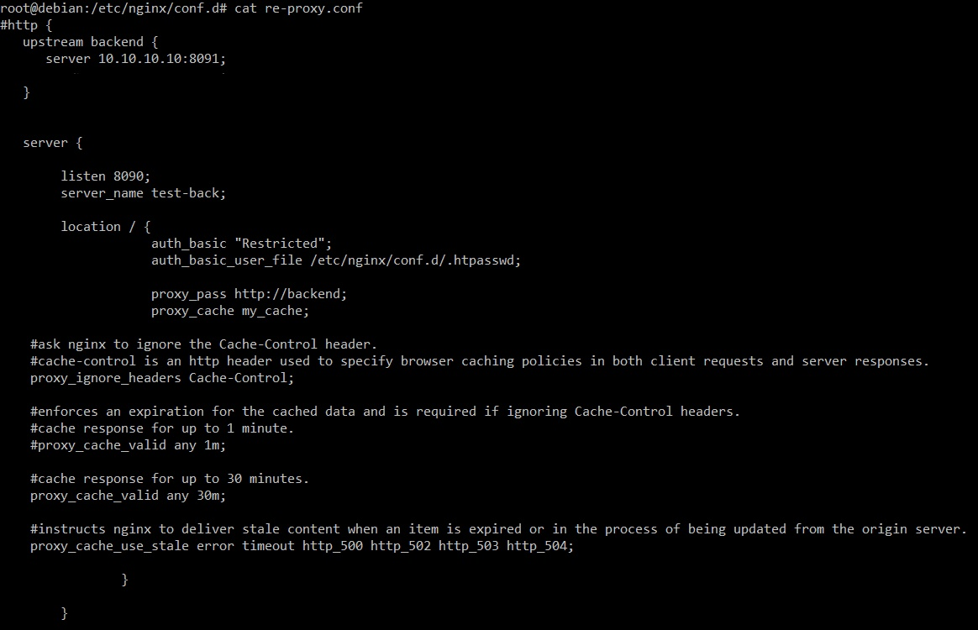
This is the reverse proxy server with IP 10.10.10.11 and in this, I have defined which server to include in the load balancing scheme (10.10.10.10).
This server accepts all traffic to port 8090 and passes it to the upstream.
The proxy_ignore_headers Cache-Control will ask nginx to ignore the Cache-Control header.
The proxy_cache_valid sets the caching time for different response codes. Nginx will serve cached data if the gateway times out, thus it will be valid after 30 minutes.
As for the proxy_cache_use_stale, it will allow us to get the expected outcome, that is serving cached content when web server is offline.

Slide 11
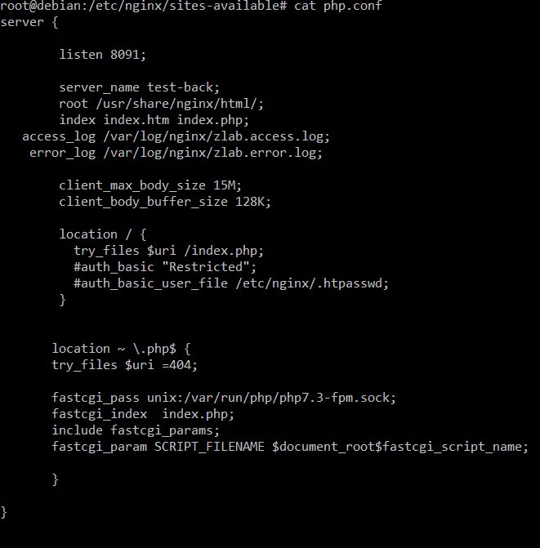
This is the server with IP 10.10.10.10 and I have created a file named php.conf in /etc/nginx/sites-avalaible directory and I have configured the server which is listening on port 8091.
The proxy_cache_path should also be added in the nginx configuration to have the expected result.

Slide 12
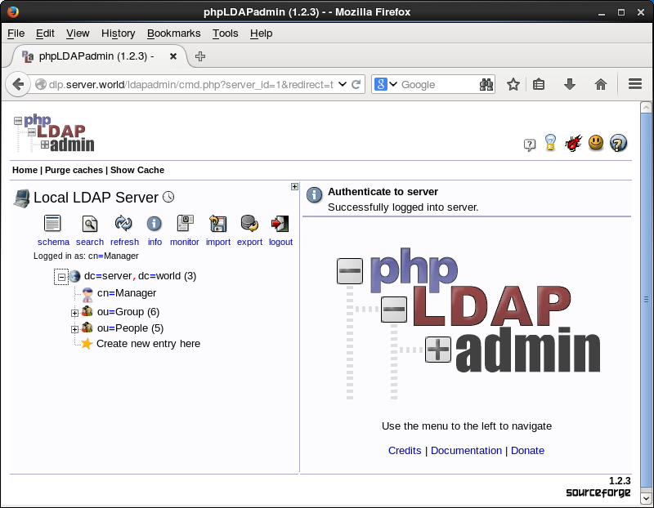
(R&D) Nginx + Ldap auth
Scenario:
-configure nginx for ldap authentication instead of basic auth
-create a htpasswd to restrict access

Slide 13
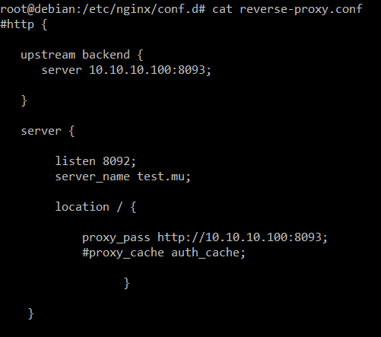
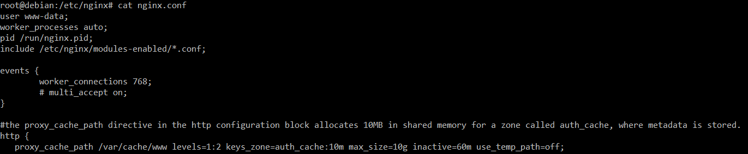
The localhost:8093 forwards connections from local port 9999 to localhost:8093 on the server and then we can connect to database.
I have configured the reverse-proxy with IP 10.10.10.101 which is listening on port 8092 and the server name is test.mu.
The proxy_cache auth_cache defines a shared memory zone used for caching. The same zone can be used in several places.
The proxy_cache_path directive in the http configuration block, which is in the nginx configuration, creates a local disk directory called cache, and allocates 10 MB in shared memory for a zone called auth_cache, where metadata is stored.

Slide 14
Skills Acquired
Being successful in the real world has inspired me to work harder and assume my roles and responsibilities in the particular field.
Moreover, I have developed my confidence level and working with a team has taught me how to communicate within a group and it was an opportunity for me to apply what I have learned.
At last, this internship has helped me to gain valuable work experience and real life exposure. Being a part of such group of people has been a unique and promising experience for me and I consider myself lucky to be part of OceanDBA team.

Slide 15
THANK YOU

