Slide 1
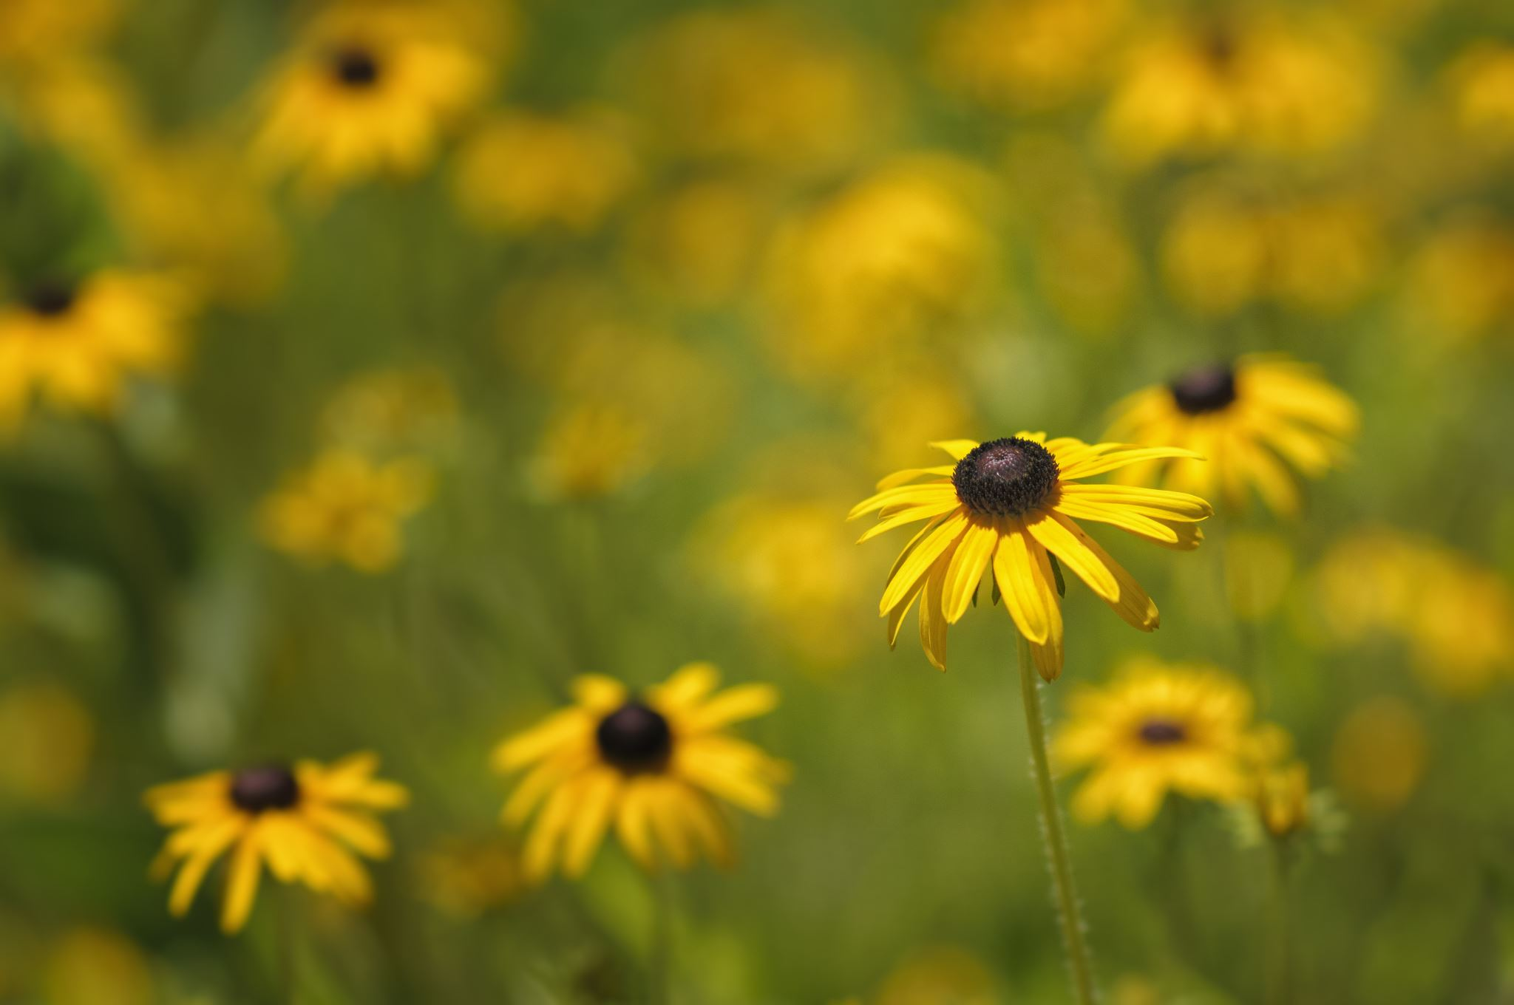
Title
Flowers

Slide 2
Chapter 1: Flowers Cycle

Slide 3
Indoor Plants
The quick brown fax jumps over
The lazy dog. The quick brown fax jumps over the lazy dog the quick brown fax jumps over the lazy dog.

Slide 4
Outdoor Plants
The quick brown fax jumps over
The lazy dog. The quick brown fax jumps over the lazy dog the quick brown fax jumps over the lazy dog.

