Slide 1

European University of Lefke
Department of Software Engineering
Graduation Project
Supervisor Dr. Zafer Erenel
Mukhammadkodir Zainabidinov
Student Number 194140

Slide 2

Computer-Assisted Multiple Choice Exam System
Date of presentation: June 13, 2023

Slide 3

Problem Statement
Paper-based: Students answer questions on paper, requiring manual grading by instructors.
Physical presence: Exams are typically conducted in a designated location, such as a classroom or exam hall.
Limited feedback: Feedback on performance may be delayed, as instructors need time to grade and provide results.

Slide 4

Objectives
Provide an easy-to-use interface for quiz creation and management
Implement robust user authentication and authorization
Enable real-time performance tracking and analytics

Slide 5
TECHNOLOGIES USED
MongoDB: A NoSQL database for flexible and scalable data storage
Express.js: A fast and minimalist web application framework for Node.js
React: A powerful JavaScript library for building user interfaces
Node.js: A runtime environment for server-side JavaScript development
Redux: A predictable state container for managing application state
Axios: A promise-based HTTP client for making API requests.
5

Slide 6
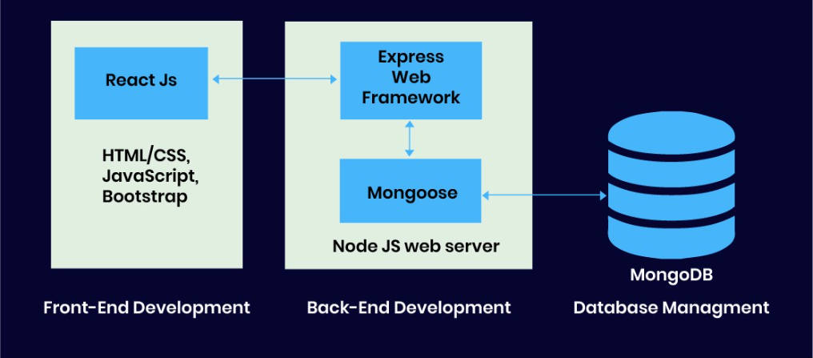
Project System Architecture

Slide 7

Features & Functionalities
User Registration and Authentication
Quiz Creation and Management
Different Question Types (Multiple Choice, True/False, etc.)

Slide 8
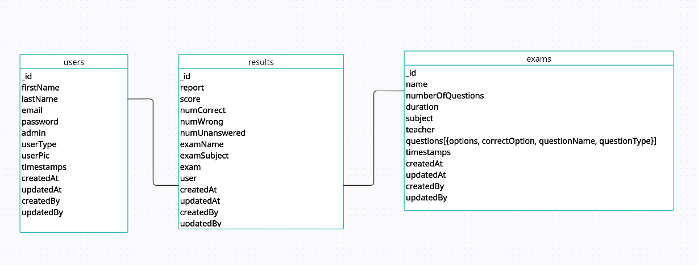
Database of the project

Slide 9

Demonstration of the project

Slide 10

Thank you for your attention!

