Slide 1
ECO346 / ASSIGNMENT 01
FALL 2026 • SECTION B
The literacy divide
in rural Punjab
GENDER GAP / 11 AGE BANDS
Education spending, literacy by age, and what better graphics help us see.
PREPARED BY
Zainab Kamran
10–14
55–59
FA24-BEDS-080 / COMSATS UNIVERSITY, LAHORE
35.8
pp
largest male–female literacy gap / ages 55–59
PSLM 2019–20 / RURAL PUNJAB / VARIANT 0
01 / 04
Notes:
Suggested opening (about 55 seconds): This project studies rural Punjab, variant zero, using PSLM 2019–20. We examined student education spending, and literacy across 11 age groups for men and women. One result stands out: for people aged 55–59, the male literacy rate is 35.8 percentage points above the female rate. This is descriptive evidence, not proof of why the gap occurs.

Slide 2
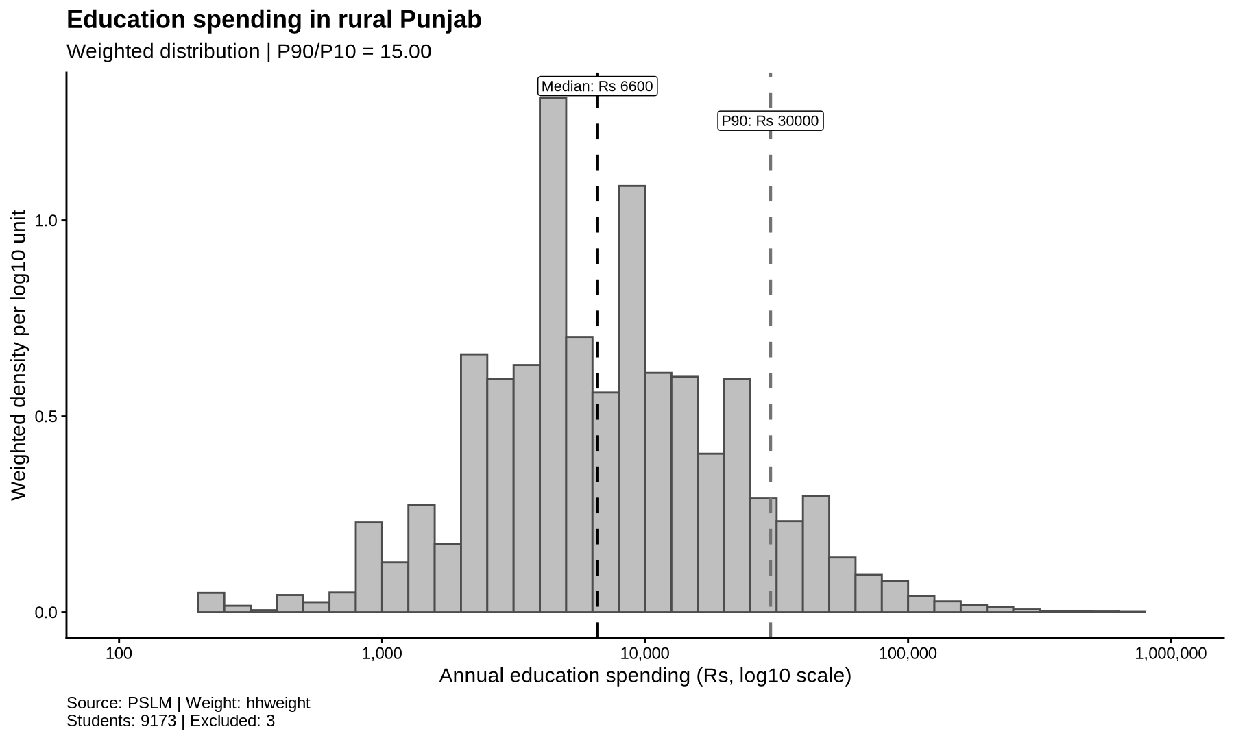
02 / EDUCATION EXPENDITURE
Spending needs more than an average.
9,173 students / Weighted median Rs 6,600 / P90 Rs 30,000
HOW TO READ THIS FIGURE
01 / LOGARITHMIC X-AXIS
Rs 100 → Rs 1,000,000
02 / TYPICAL SPENDING
Weighted median: Rs 6,600
03 / HIGHER SPENDING
P90: Rs 30,000 | 15× P10
PSLM 2019–20 / RURAL PUNJAB / VARIANT 0
02 / 04
Notes:
Suggested discussion (about 60 seconds): Here is the actual R-generated histogram for rural Punjab. The sample has 9,173 students reporting positive annual spending and valid survey weights; three are outside the plotted Rs 100–1,000,000 range. A logarithmic X-axis makes spending across orders of magnitude easier to compare. The weighted median is Rs 6,600 and the 90th percentile is Rs 30,000. The ratio of the weighted 90th to 10th percentiles is 15.00, indicating substantial variation in annual education spending. The heights are survey-weighted density per log10 unit, not raw student counts.

Slide 3
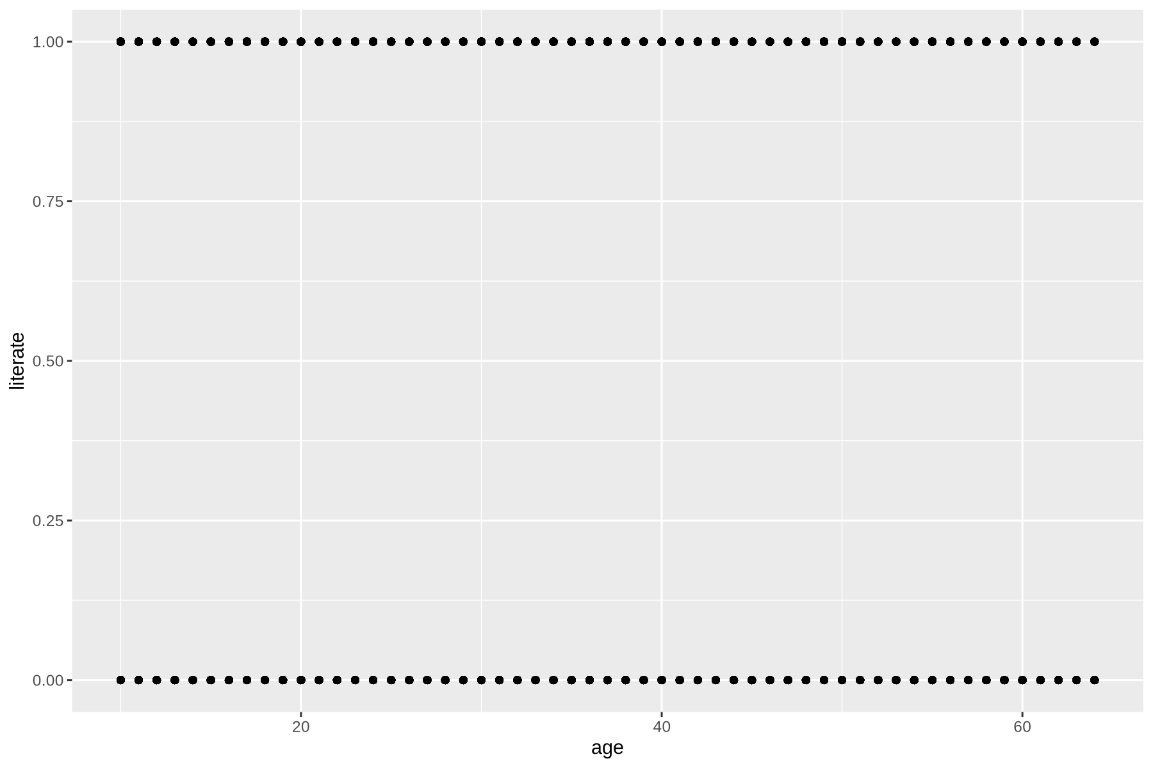
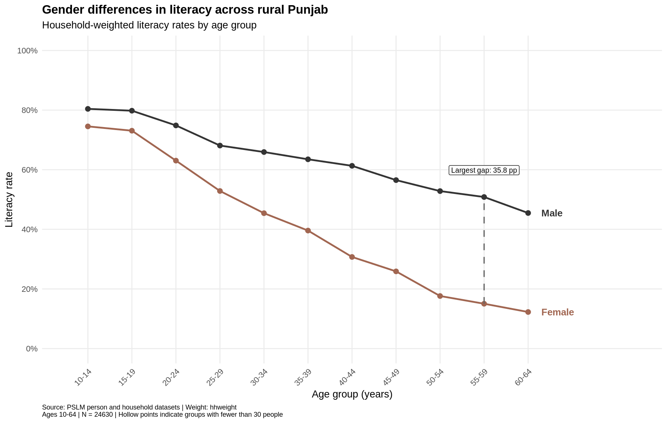
03 / THE MAKEOVER
Raw points hide the gender pattern.
BEFORE / DEFAULT SCATTERPLOT
AFTER / WEIGHTED GROUP RATES
WHAT CHANGED
Less overplotting • Comparable group rates • Direct labels and gap annotation
PSLM 2019–20 / RURAL PUNJAB / VARIANT 0
03 / 04
Notes:
Suggested discussion (about 105 seconds): The left panel is the original default ggplot scatterplot exported from R; every person is shown as a binary literacy outcome, but many points overlap. The right panel is the actual redesigned R graph based on household-weighted literacy rates in 11 five-year age bands. Grouping makes the age trend and differences between male and female literacy visible, direct labels reduce lookup effort, and a dashed line highlights the 55–59 gap of 35.8 percentage points. The sample includes 24,630 eligible person observations. The trade-off is that aggregation hides individual records and variation within each age band.

Slide 4
04 / THE CENTRAL FINDING
The gender gap widens
across age groups.
LITERACY RATE BY SEX
LARGEST OBSERVED GAP
Ages 15–19 / gap 6.7 pp
35.8
Men
79.8%
pp
Women
73.1%
Ages 55–59
Ages 55–59 / gap 35.8 pp
Men
50.8%
Women
15.0%
Limitation: These cross-sectional age differences cannot show how the same individuals changed over time.
PSLM 2019–20 / RURAL PUNJAB / VARIANT 0
04 / 04
Notes:
Suggested closing (about 65 seconds): The key finding is not simply that male literacy exceeds female literacy. The difference varies greatly between age bands: at ages 15–19, female literacy is 73.1% and male literacy is 79.8%, a gap of 6.7 points. At ages 55–59, women are 15.0% and men 50.8%, a 35.8-point gap. This is consistent with a more equal literacy profile for younger cohorts, but we cannot infer causal drivers, or the life course of an individual, from this cross-sectional comparison. Thank you; I can explain the weighting and plotting choices.

