Slide 1



Slide 2

One-Clicks Picks
Supervised by:
Muhammad Kamran
Group Members:
Rimsha Arshad(FA17-BSE-051)
Zainab Sajjad(FA17-BSE-053)
Department of Computer Science
COMSATS University Islamabad, Attock Campus

Slide 3
Outline
Introduction
Working flow
Problem statement
Objectives
Methodology
Modern tools
Benefits
References
_______________________________

Slide 4

Introduction
One-clicks picks shopping platform is an android and web based project which show nearest mall based on your location by turning on your device location or user can search shop of their own interest from the menu The system mainly consists of 2 modules :
1)User
2)Admin
User modules is android based while admin and manager is on website.
User can avail two services by using this application i.e., to shop groceries online and to put complaints if face any issue regarding services.
Admin can handle upcoming request on Panel/mall and clear bills of customers. Perform crud operations on items and keep record of sales persons and generate sales reports.
_______________________________

Slide 5
Use case Sign Up:

Slide 6
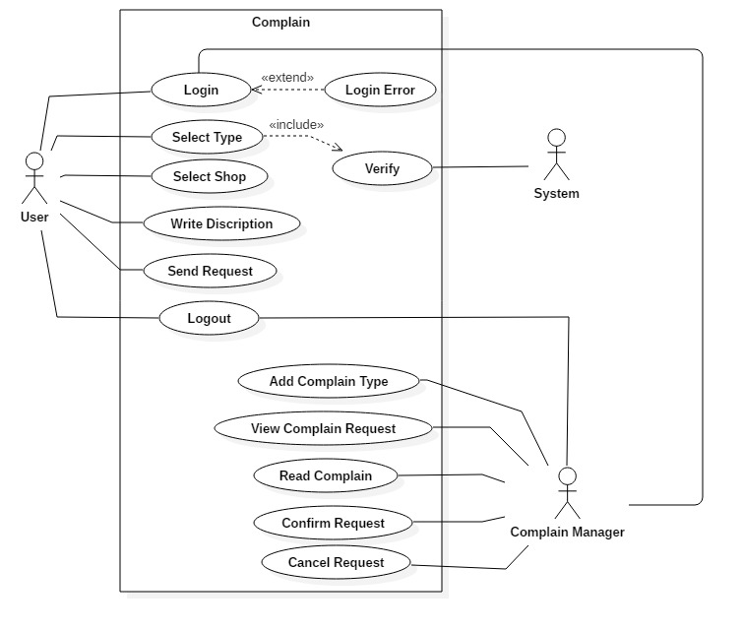
USE CASE Put Complaints

Slide 7
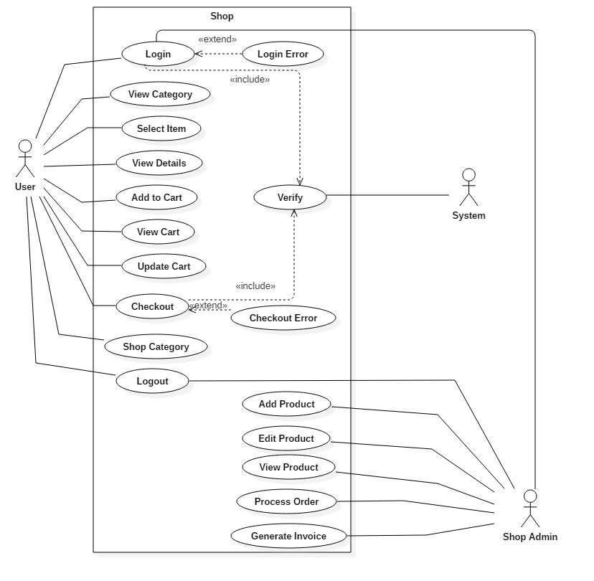
Shop Groceries online

Slide 8
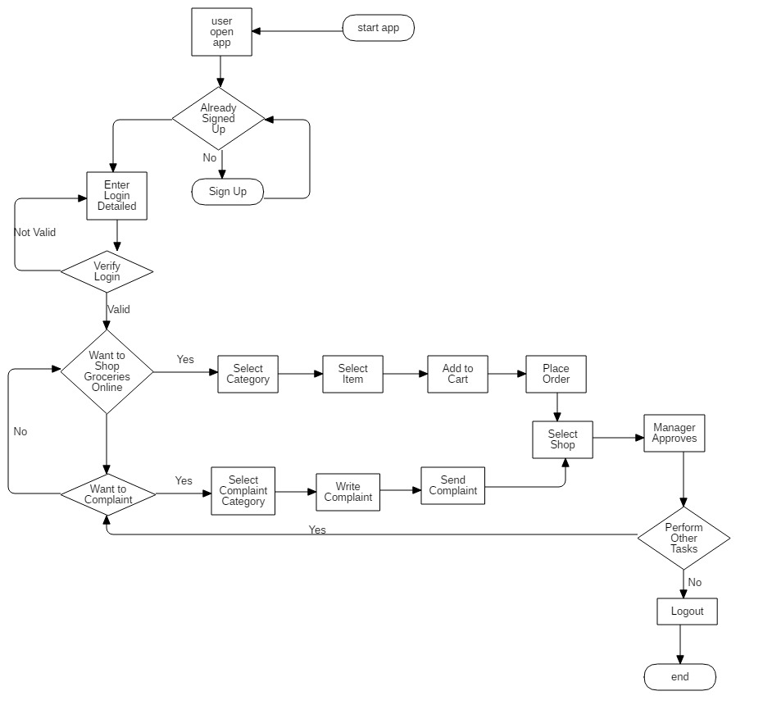
Working flow(Flow Chart)
_______________________________

Slide 9
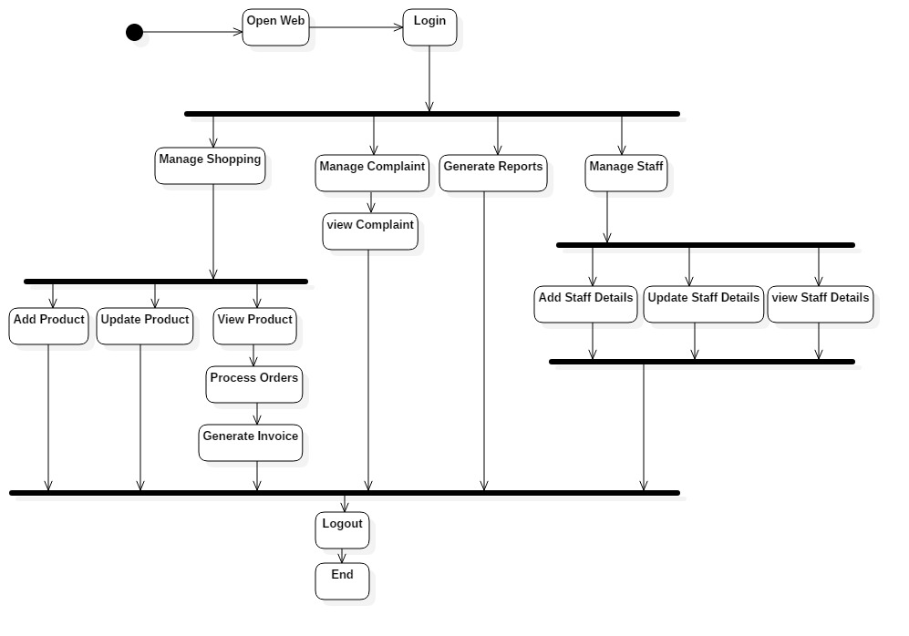
Working flow(Admin)
_______________________________

Slide 10
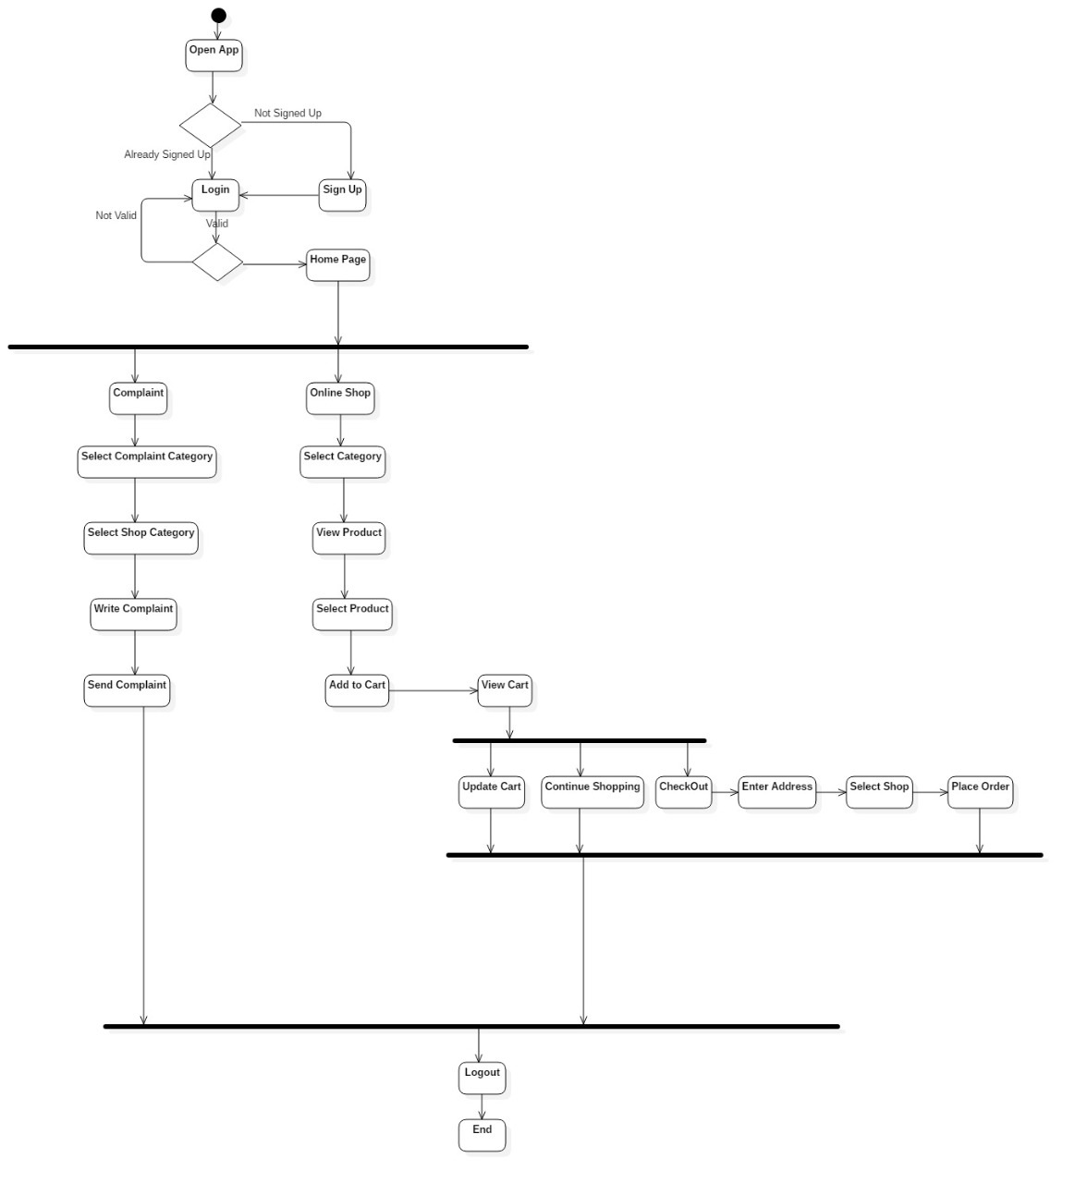
Working flow
_______________________________

Slide 11
Problem statement
User face issues of time consumption and cost to go out for shopping.
As in this area there is no such online platform for delivering grocery at home. So people face many issues during this quarantine (COVID19).People can’t go outside for shopping.
The main problem is that during such situation people living in community areas can’t go outside and avail such services.
Q.1. How to do shopping during such situation(covid19)?
_______________________________

Slide 12
Objectives
To deliver the products specially in colony areas where Grocery and crockery shops are too far.
From business prospective ,our main aim is to make application useable for maximum no of users.
To provide user facility to order items anytime inside Attock.
To provide a system that will reduce the unnecessary usage of cost as there will be no need to go anywhere, ensuring efficient usage of money.
_______________________________

Slide 13
Development Requirements
Software Requirements dependence:
IDE: Android Studio 3.5
Programming language: PHP, HTML, JAVA, CSS, XML, JavaScript
Database: MYSQL
Tools: Android Studio, visual studio code, Photoshop
JDK
SDK
_______________________________

Slide 14
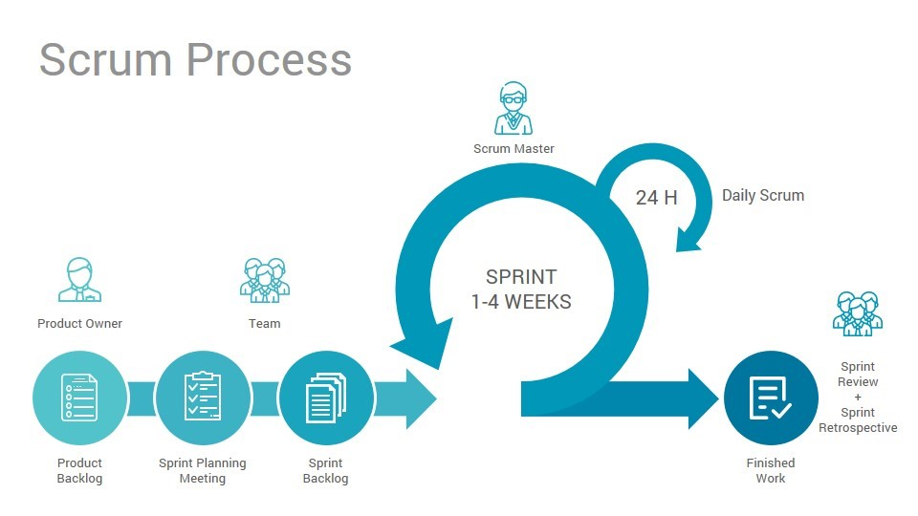
Rationale behind Selected Methodology
_______________________________

Slide 15
Rationale behind Selected Methodology
We select this model because our application is e-commerce based and we need more meeting with our user for product description and prices. This basic advantage of this model is having more meetings with the supervisor.
_______________________________

Slide 16
Modern tools
Tools | Version | Rationale
Android studio | 3.3.2 | IDE
MySQL | 2018 | DBMS
Adobe Photoshop/Ms visio/star UML | CC 2017 | Design Work/Diagram work
MS Word | 2016,2013 | Documentation
MS Power Point | 2016 | Presentation
Visual code studio | 2019 | Code editor
Technology | Version | Rationale
XML, Java | 6.0 | Programming language
Javascript,HTML5 ,CSS3 | - | Programming language
Google API | - | Google API
_______________________________

Slide 17
Benefits
Developers End:
This project will award the developers with practical experience of the market.
It will provide the developers the opportunity to learn and polish their development skills.
From the business POV, this project has the potential to provide monetary benefit to the developers.
_______________________________

Slide 18
Benefits
User’s End:
This project will save time and monetary cost spent on reaching and finding trustworthy services to avail.
Interaction with the service providers will become faster and authentic.
Shopping or ordering groceries from home will become easy task as clicking some controls.
As a whole, this application will act as ‘multistore shop’ for the residents of the attock where this application is adapted.
_______________________________

Slide 19
Benefits
Business End:
As we all know that if someone opens new brand/mall so might be there is chances of loss when well established brand already exist so in this case it’s base approach to provide people online service and start affiliate marketing or deliver this system to the mall and get some commission .
_______________________________

Slide 20
References
https://play.google.com/store/apps/details?id=com.mafcarrefour.pakistan
https://play.google.com/store/apps/details?id=com.matechco.hummart
https://play.google.com/store/apps/details?id=com.global.foodpanda.android
_______________________________

