Slide 1









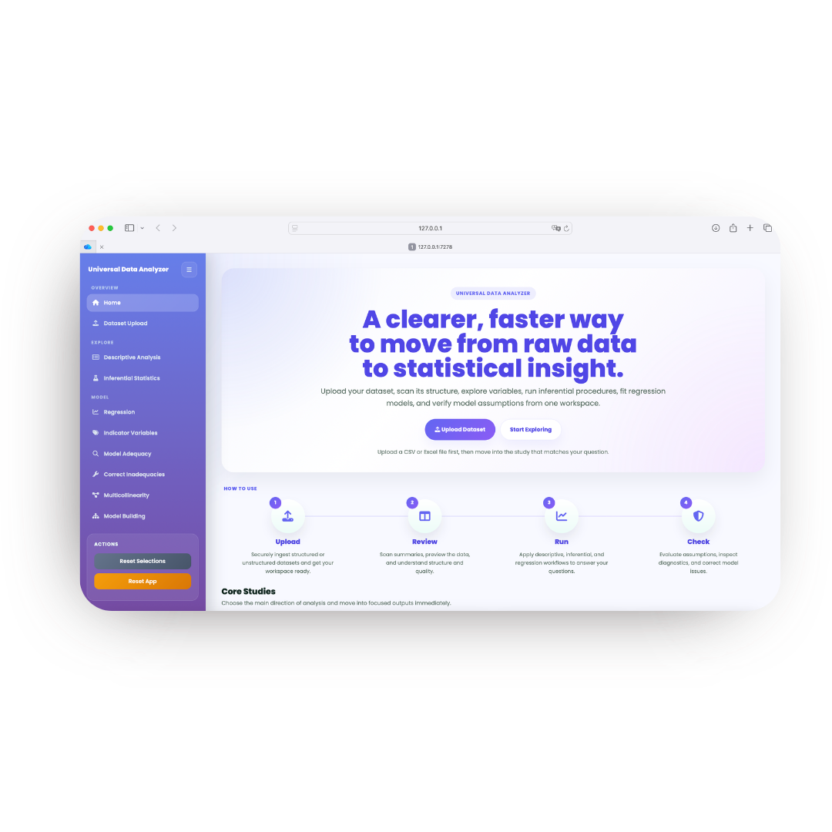
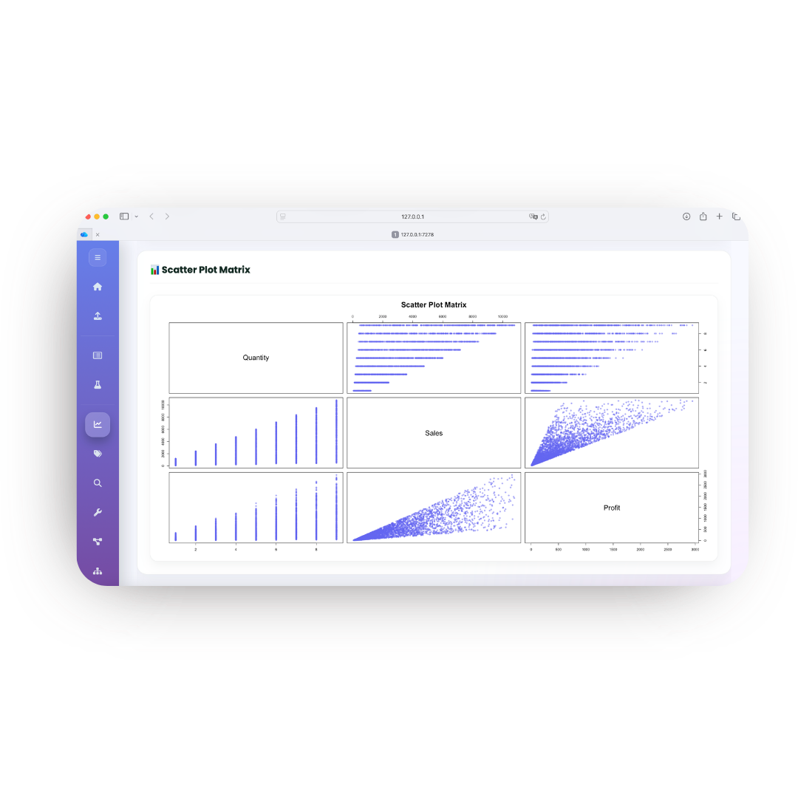

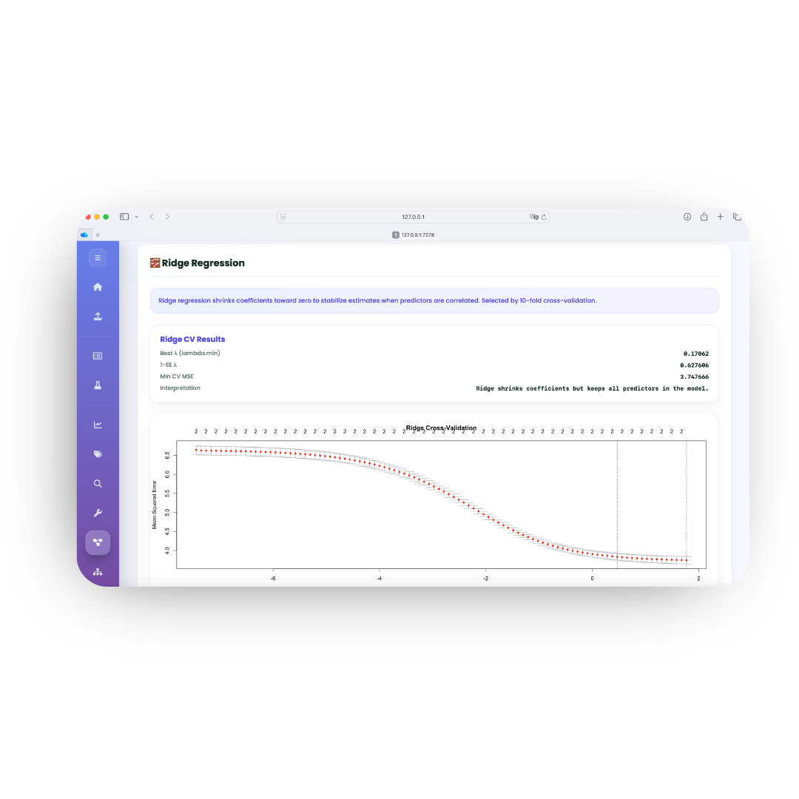
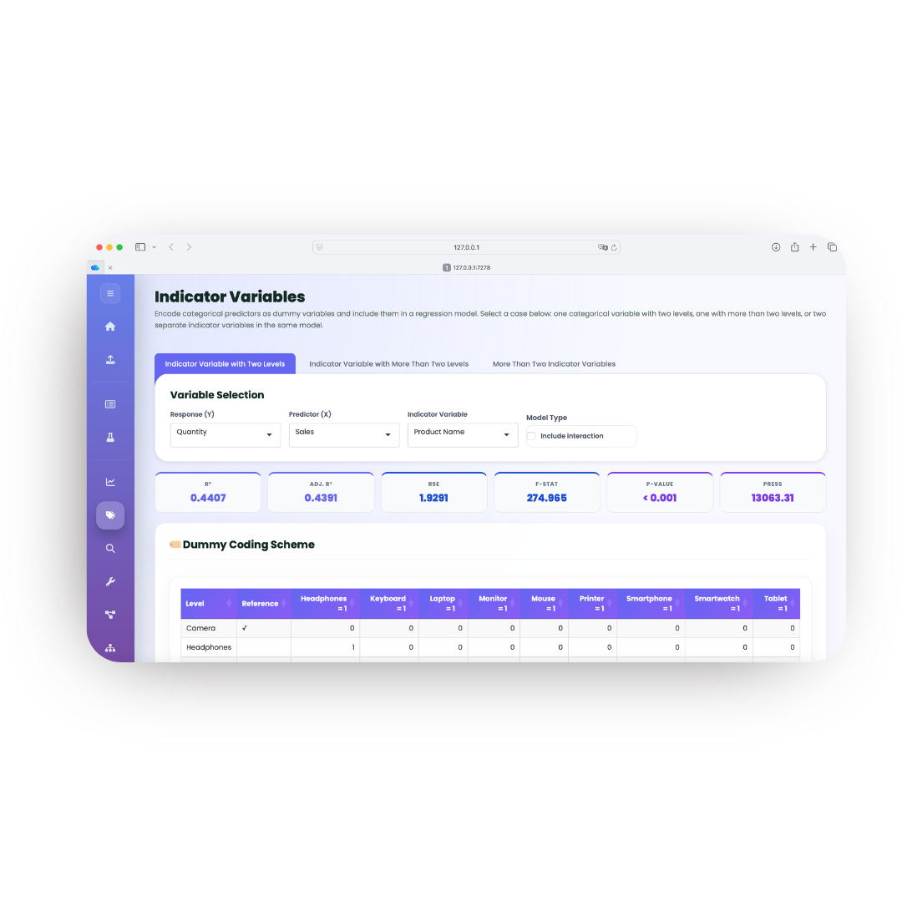

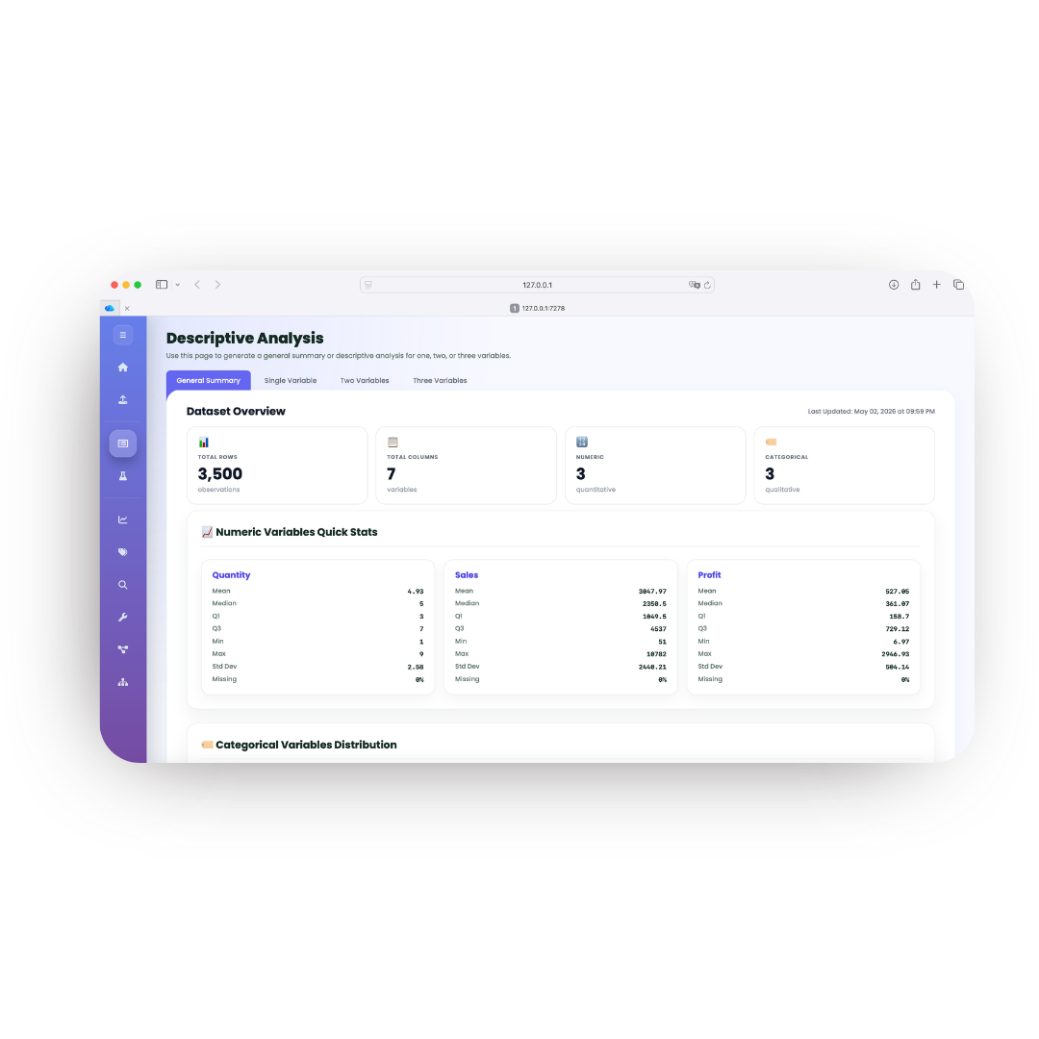
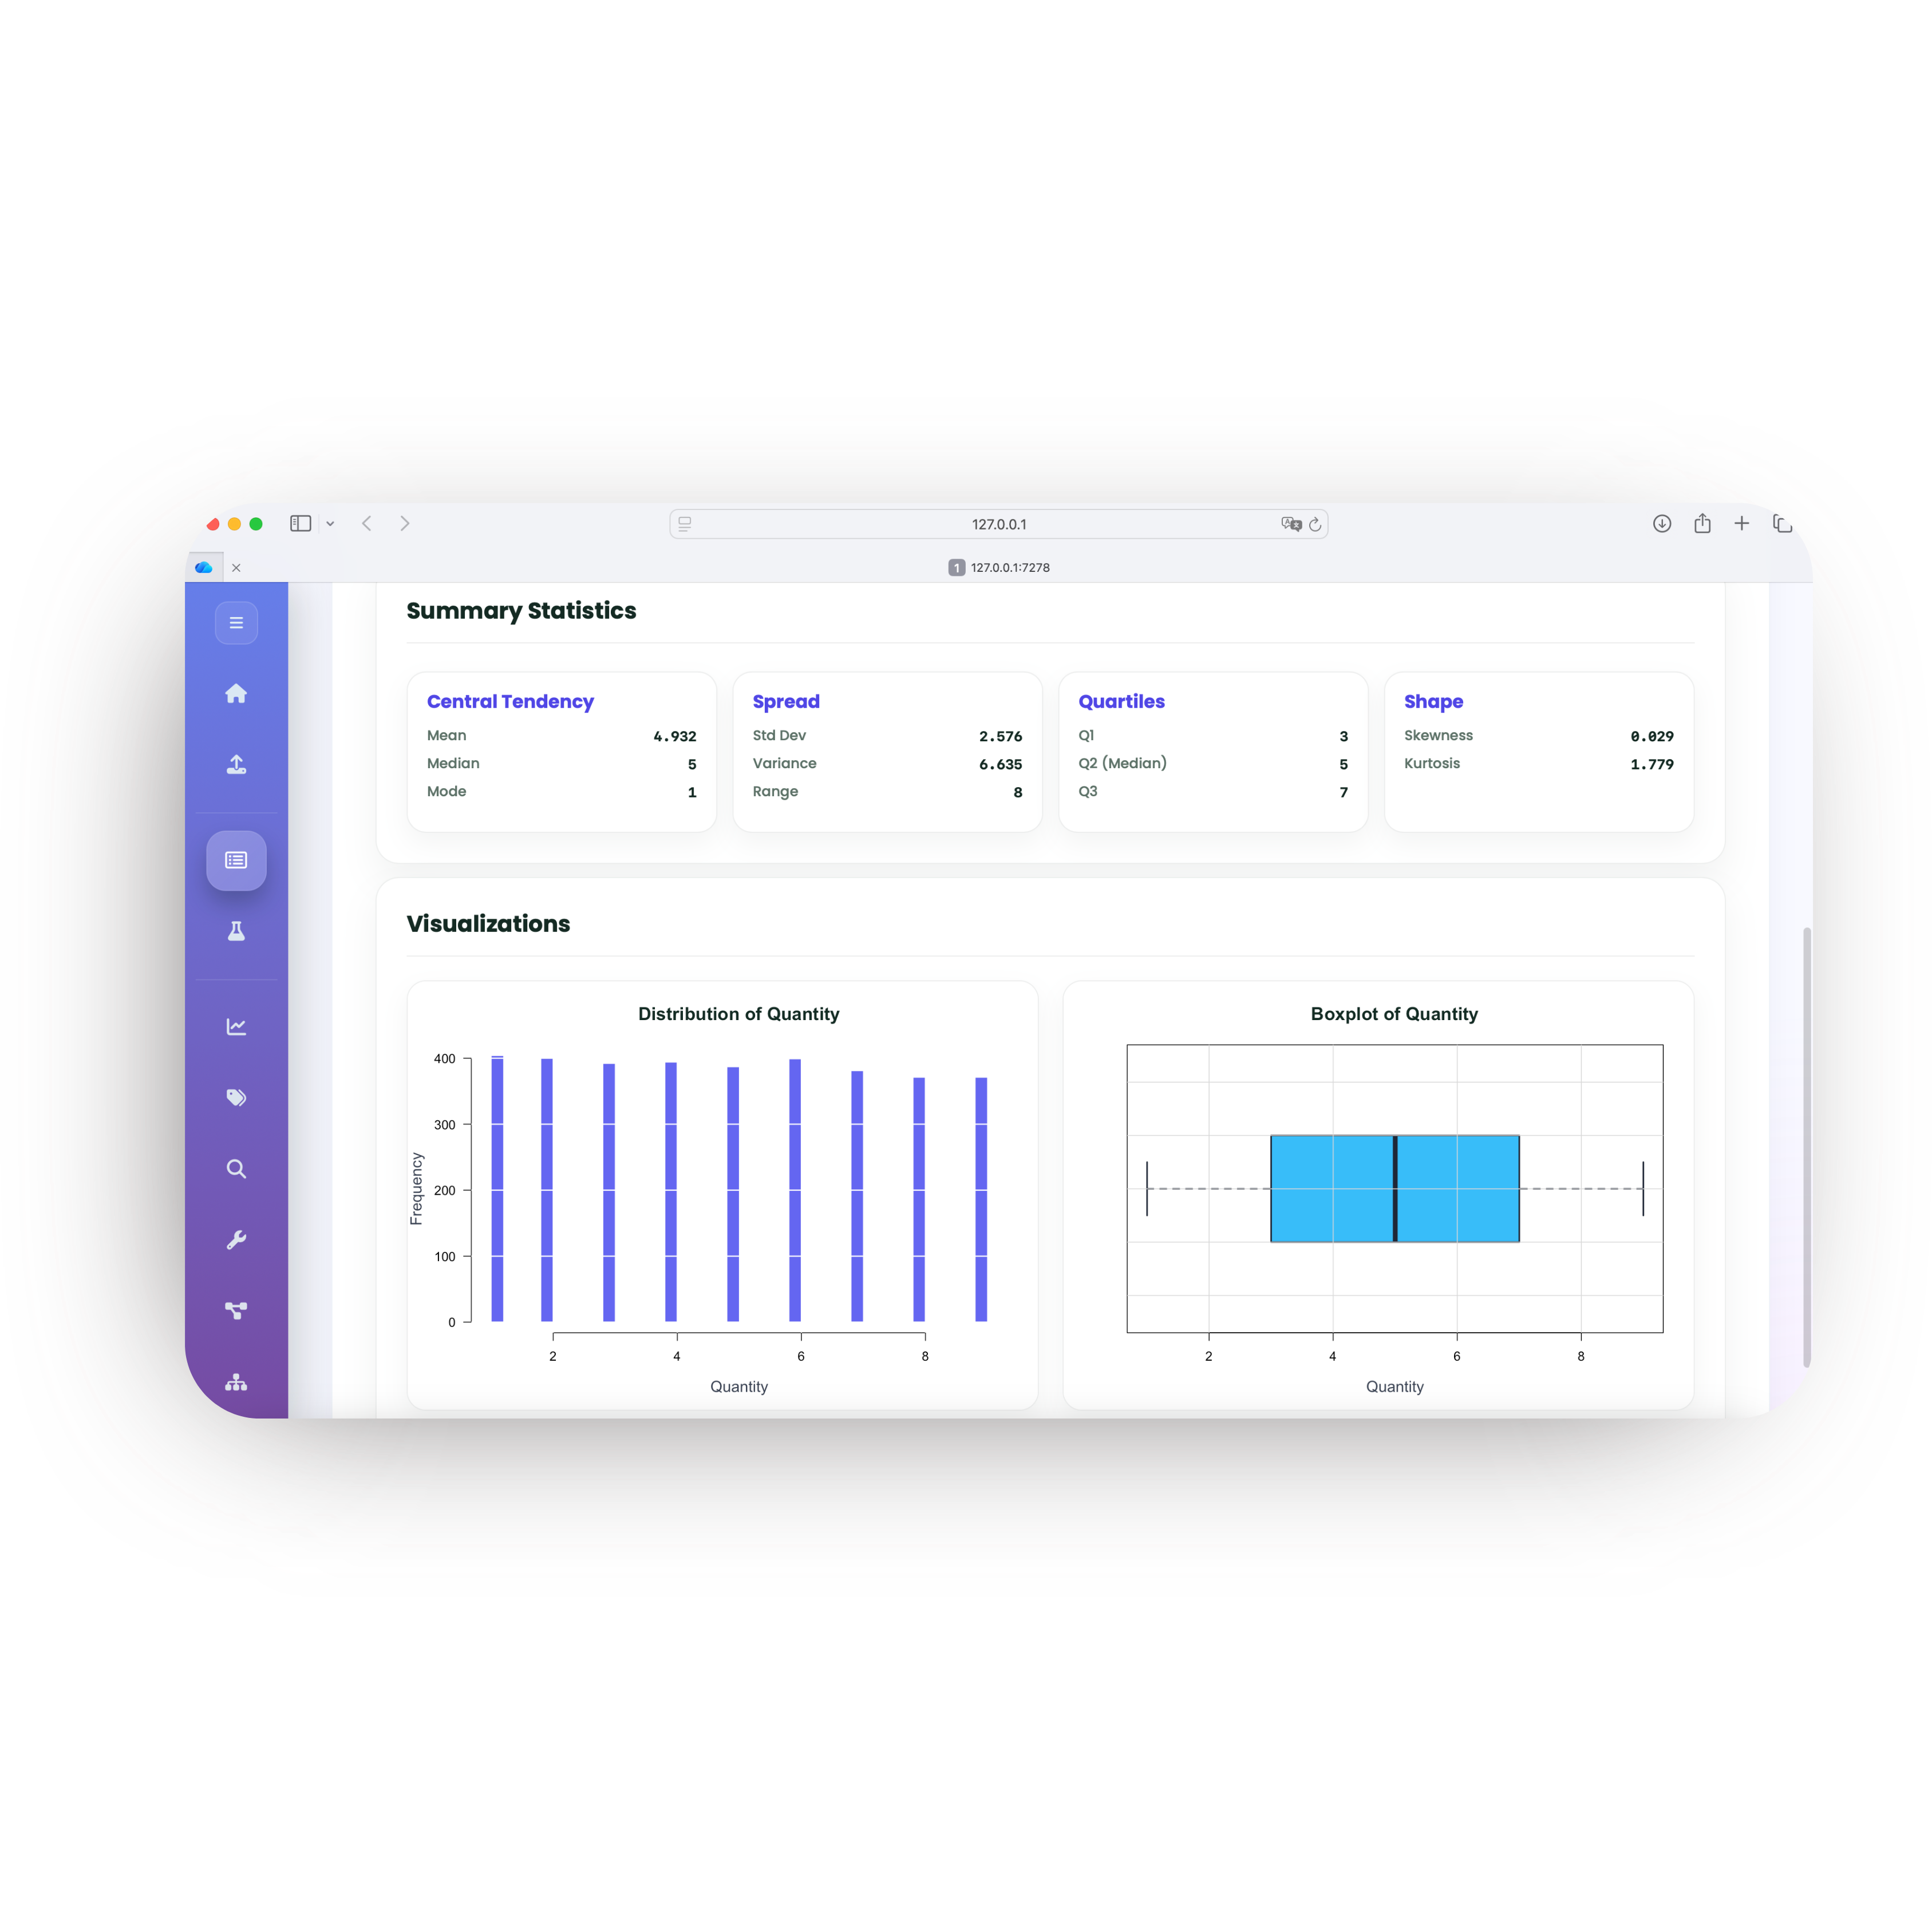
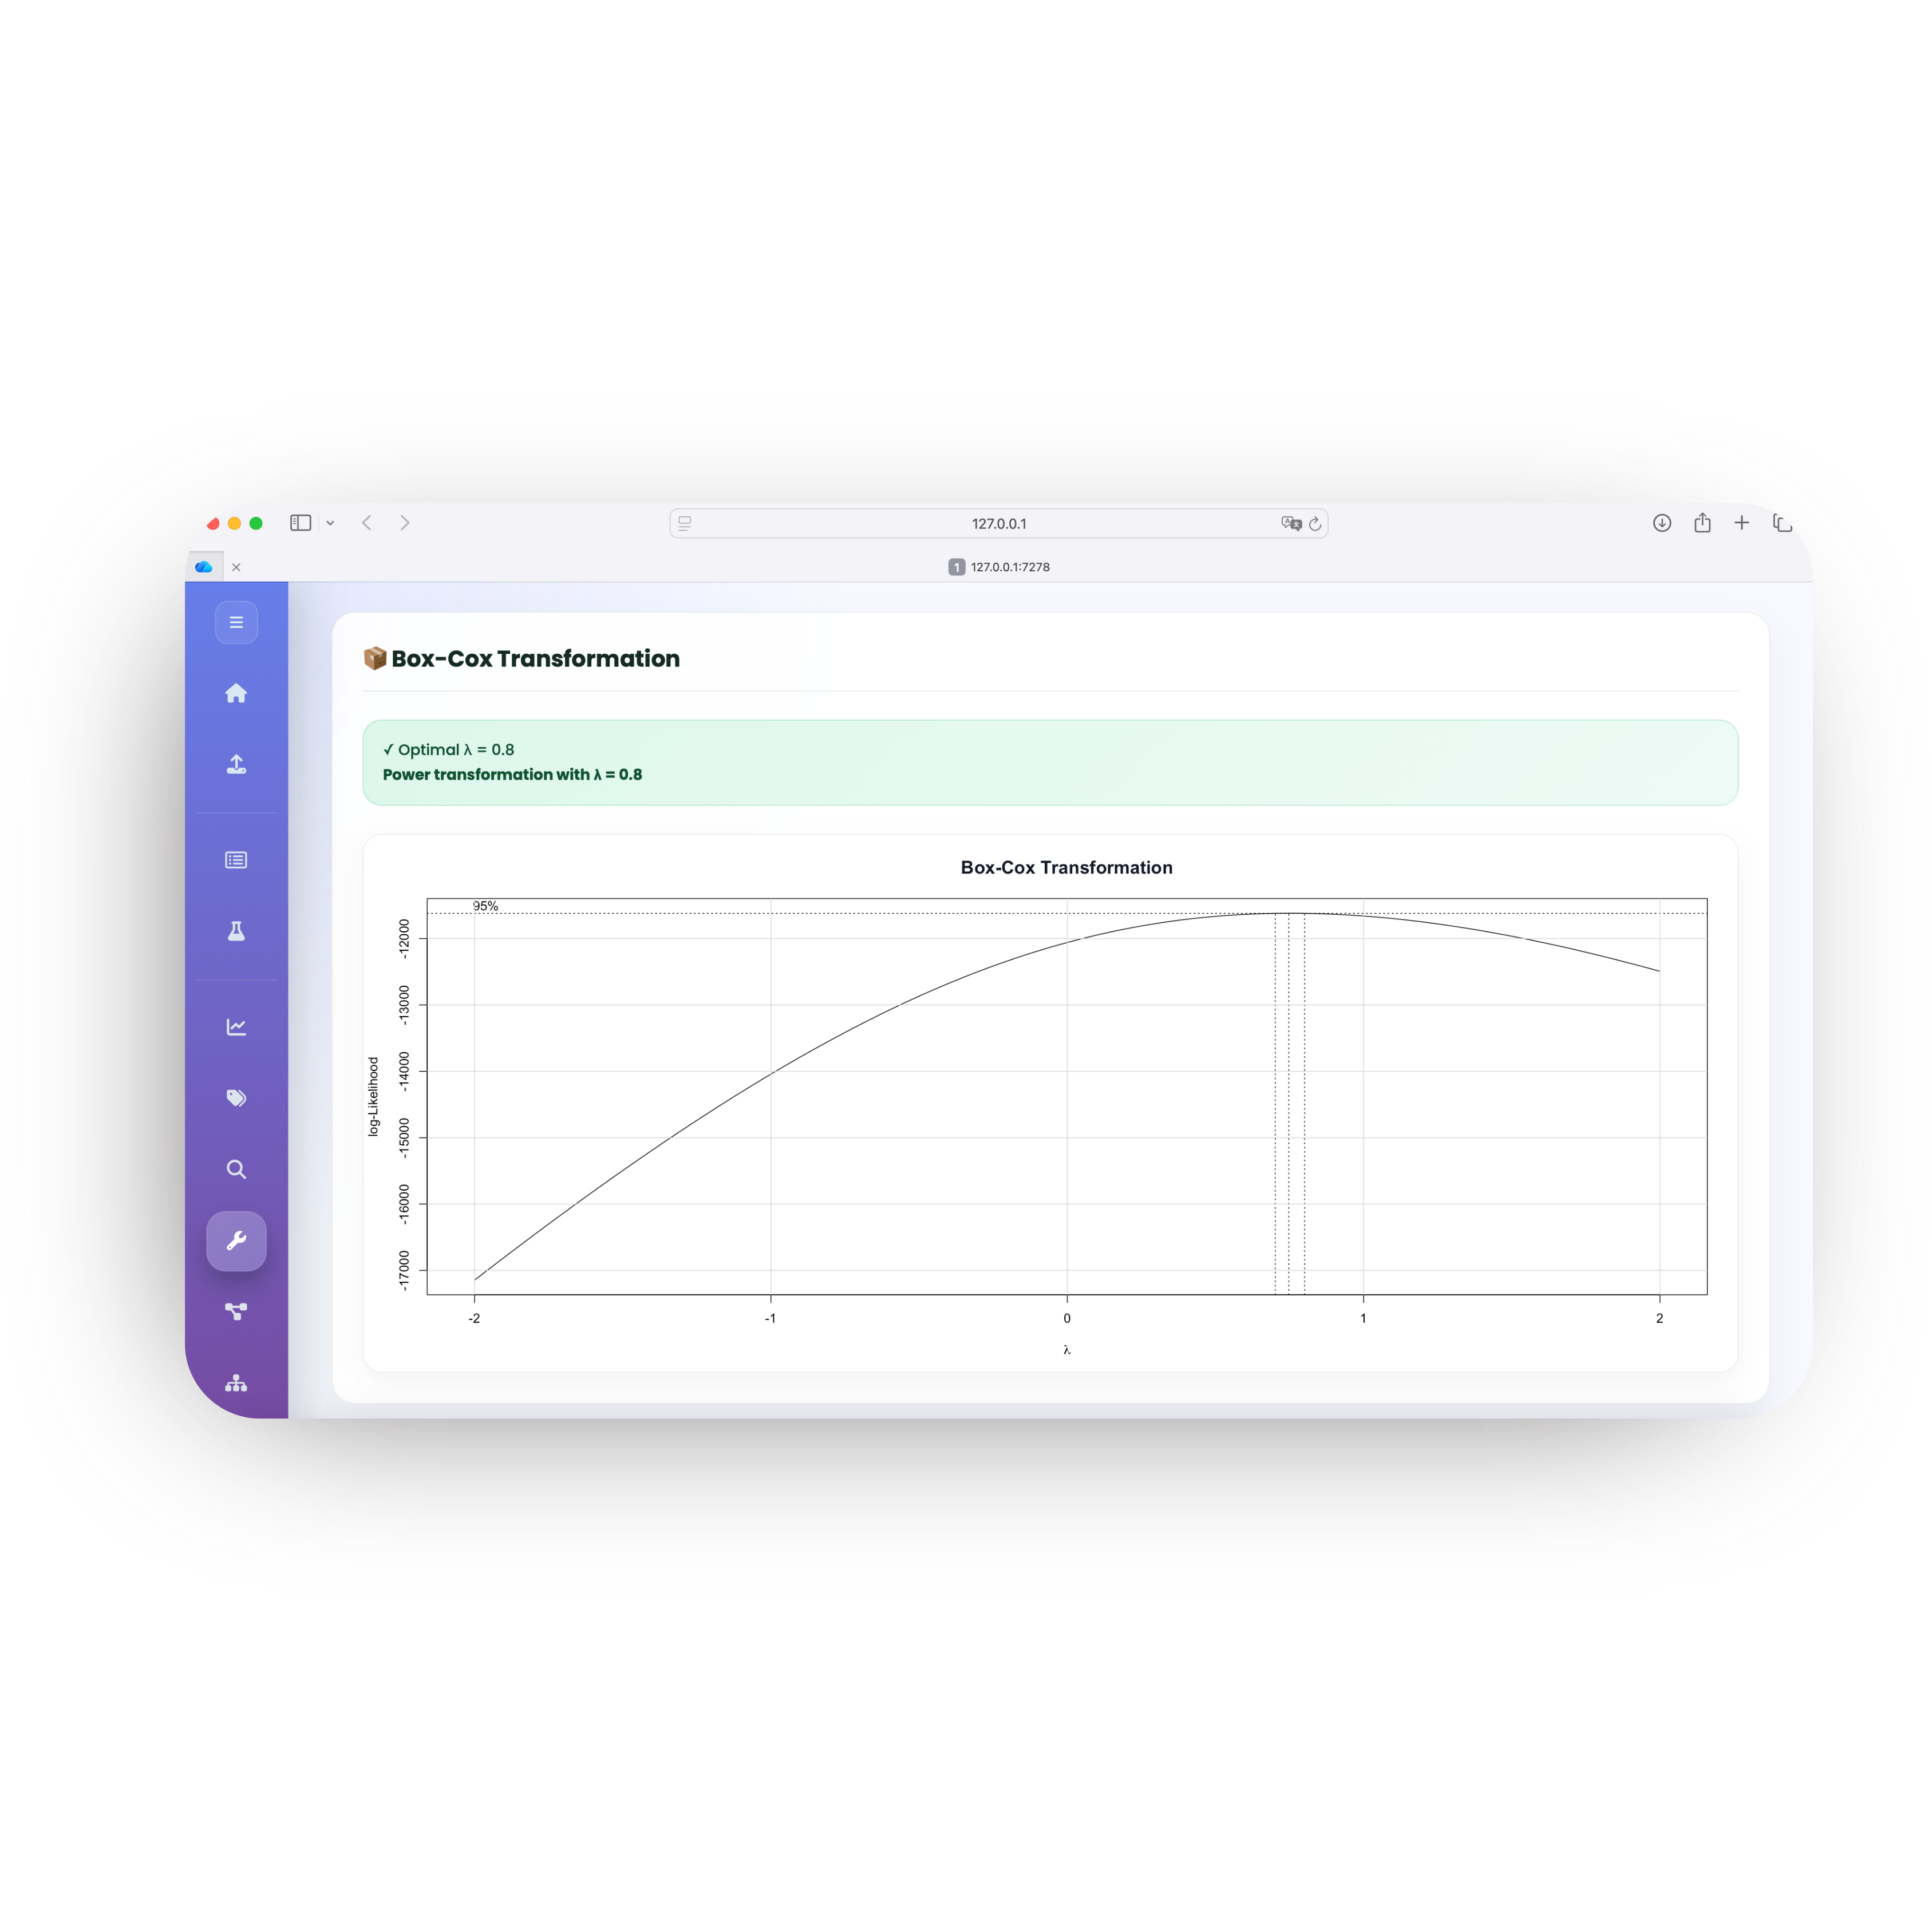
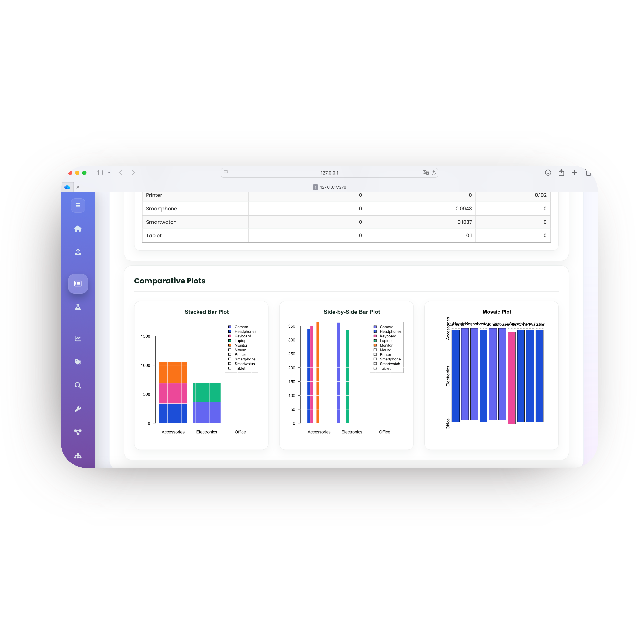
Universal Data Analyzer
An Interactive Web Application for Statistical Data Analysis
Done by: Zainab Alturaiki, Farah Almutairi, Leen Ghazi, Reema, Najla Aljaloud, Reema Al Hweamel
INTRODUCTION
KEY FEATURES
Statistical analysis often requires switching between multiple software tools and writing complex code, creating barriers for non-technical users. There is a growing need for an integrated, user-friendly platform that guides users through the complete data analysis workflow, from data upload to model validation, without requiring programming knowledge.
Data Upload & Preview
Ingest CSV/Excel files; review structure and quality.
Regression Modeling
Simple & multiple linear regression with diagnostics.
Multi-collinearity
VIF detection with Ridge/Lasso regression cross-validated against OLS.
Descriptive Analysis
Single, two, and multi-variable exploration with plots.
Indicator Variables
Categorical predictors as dummy variables in models.
Model Adequacy
Check normality, homoscedasticity, independence.
Inferential Statistics
Normality tests, t-tests, Wilcoxon, group comparisons.
Model Building
Best subset, forward, backward, stepwise, via MSE, Adj. R², Cp, AIC, BIC.
Corrections
Box-Cox, Box-Tidwell, Weighted Least Squares.
PROPOSED SOLUTION
WORKFLOW
The Universal Data Analyzer addresses this gap by providing a single, cohesive environment for exploratory, inferential, and regression-based analyses.
1
2
3
4
R Shiny Framework
Interactive web app requiring no coding from the end user.
Upload
Review
Run
Check
Full Pipeline
Data upload → exploration → inference → modeling → validation.
Ingest datasets
Scan & explore
Analyze data
Validate model
File Support
CSV and Excel uploads with automatic type detection.
APPLICATION SCREENSHOTS
Modern UI
Clean, guided navigation with sidebar and home-first workflow.
TOOLS & TECHNOLOGIES
Core: R, Shiny, shinyjs
Data I/O: readr, readxl, DT
Statistics: moments, lmtest, MASS
Testing: nortest, randtests
Visualization: corrplot, plotrix
UI: shinycssloaders
OBJECTIVES
1
Build an integrated R Shiny application that streamlines the entire data analysis workflow within a single interface.
2
Eliminate the need for programming knowledge by exposing statistical methods through a guided graphical interface.
3
Support the full regression-modeling pipeline, from descriptive exploration to inference, model selection, and assumption checking.
4
Provide rigorous diagnostic tools (VIF, residual analysis, Box-Cox) and remediation methods (Ridge, Lasso, WLS) within the same platform.
CONCLUSION
The Universal Data Analyzer provides a comprehensive, code-free environment for statistical analysis, from raw data to validated models, in a single, integrated platform. By combining descriptive exploration, hypothesis testing, regression modeling, and assumption checking into one interactive application, it makes rigorous statistical methods accessible to researchers without programming expertise.
Universal Data Analyzer · Built with R Shiny · 2026

