Slide 1
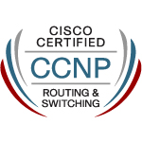
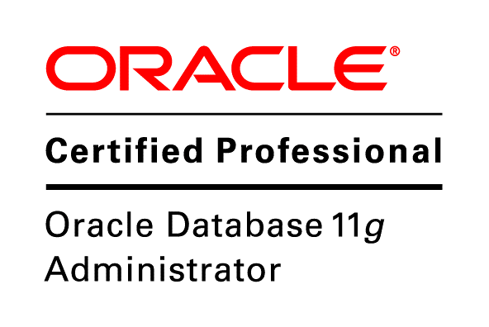
on-premise flatcar linux kubernetes, docker swarm and nfs rwx storageclass for analytic tools
Screencast by: Zainal Abidin Assegaf
NARUTO.ASSEGAF@GMAIL.COM
+6287809301668

Slide 2
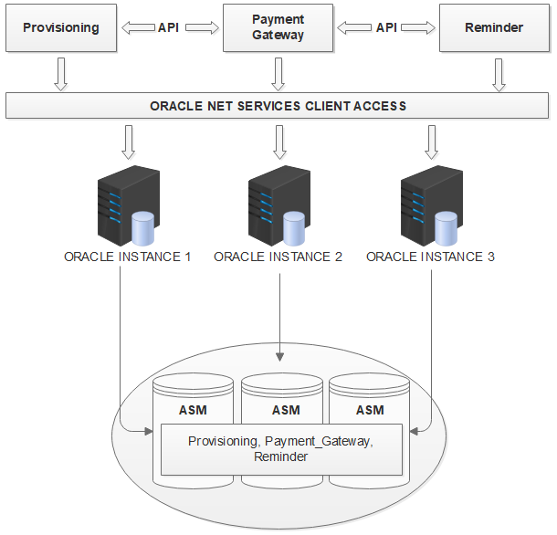
current cluster technology
oracle rac domain used rac-scan
but there are applications that will not work with oracle domain rac-scan
like yii2, laravel, spring boot, pentaho, etc.
application used only single node, with jdbc thin client oracle rac ip for either node 1,2 or 3
what if we want application to used all nodes of oracle rac

Slide 3
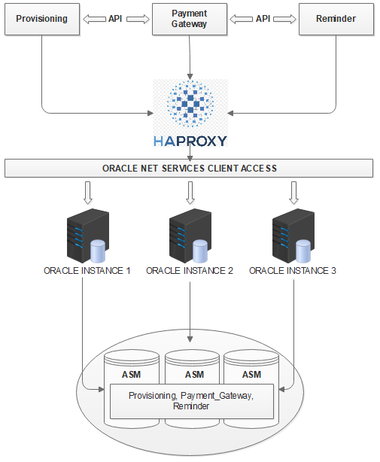
current cluster technology
we need help from haproxy
haproxy will provide vip from 2 haproxy high availability with keep alive
haproxy will provide static ip for applications yii2, laravel, spring boot, pentaho, etc.
haproxy will round-robin request to all oracle rac node
although haproxy used ping as health check, but this will get the job done to improve performance database response time
this is great but we only use OSI L3/L4
applications ⬄ haproxy ⬄ oracle rac
we will implement new cluster technology, and we will use OSI L3/L4/L7

Slide 4
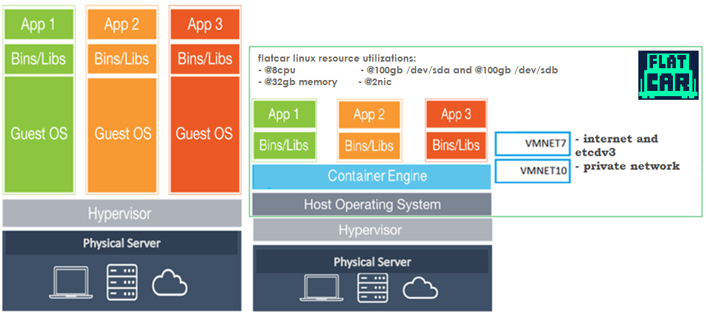
virtual machines vs container

Slide 5

design capacity
we used flannel with below configuration:
ExecStartPre=ETCDCTL_API=2 /usr/bin/etcdctl --ca-file=/etc/ssl/certs/ca.pem --cert-file=/var/lib/etcd/ssl/etcd-node.pem --key-file=/var/lib/etcd/ssl/etcd-node-key.pem --endpoints="https://10.9.56.101:2379,https://10.9.56.102:2379,https://10.9.56.103:2379" set /coreos.com/network2/config '{ "Network":"10.244.0.0/16", "SubnetLen": 24, "SubnetMin": "10.244.0.0", "SubnetMax":"10.244.255.0", "Backend": {"Type": "vxlan"} }'
for every k8s masters or k8s minions nodes will be automatically assigned flannel ip 10.244.*.*/24, via docker0 ethernet

Slide 6
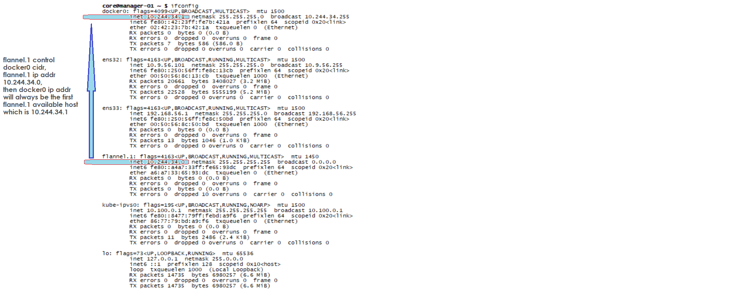
ifconfig
kube api-server
--service-cluster-ip-range=10.100.0.0/16
--cluster-cidr=10.244.0.0/17
kubernetes svc (service) ip will be using kube-ipvs0 cidr range which is 10.100.0.0/16
kubernetes svc ip must be reachable from any coreos cluster node host or container apps

Slide 7

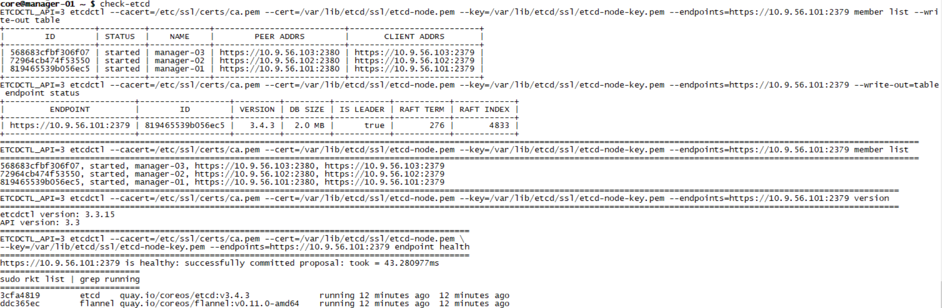
etcd master

Slide 8
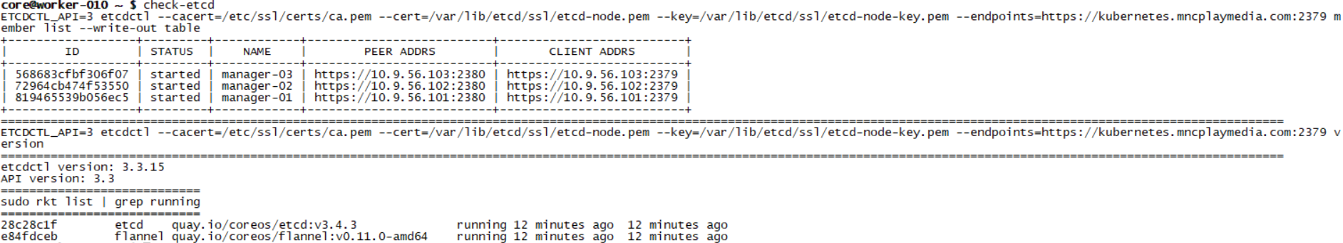
etcd proxy

Slide 9

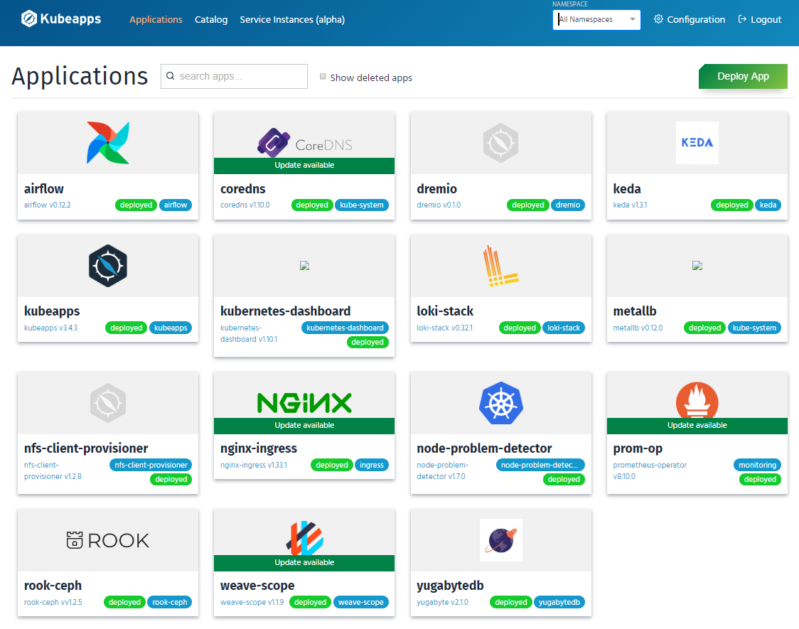
helm

Slide 10
microservices design
operating system: flatcar linux latest stable
orchestration: kubernetes v1.16.7
orchestration: docker swarm and nfs server
etcd: v3.4.3
flannel: v0.11.0-amd64
docker: 18.06.3-ce
helm: v3.1.1
k8s master (etcdv3 master) resources @cpu:8 and @memory:32gb, 3 nodes. with kubelet & proxy
k8s minion (etcdv3 proxy) resources @cpu8 and @memory:32gb, 19 nodes
swarm manager (etcdv3 proxy) @cpu:8 and @memory:32gb, 1 nodes
1 nic for internet (external access) subnet 10.9.56.0/24 and etcdv3
1 nic for private network subnet 192.168.56.0/24
thin storage provisioning for /dev/sda 200gb and /dev/sdb 200gb in all nodes except docker swarm
we will used rook.io as our k8s persistent volume, with ceph cluster storage provider with thin storage provisioning for /dev/sdb in all nodes 200gb

Slide 11
dns
coredns deployed via helm with custom values.yaml
bitnami external-dns
kubedns
storytel/dnsmasq

Slide 12
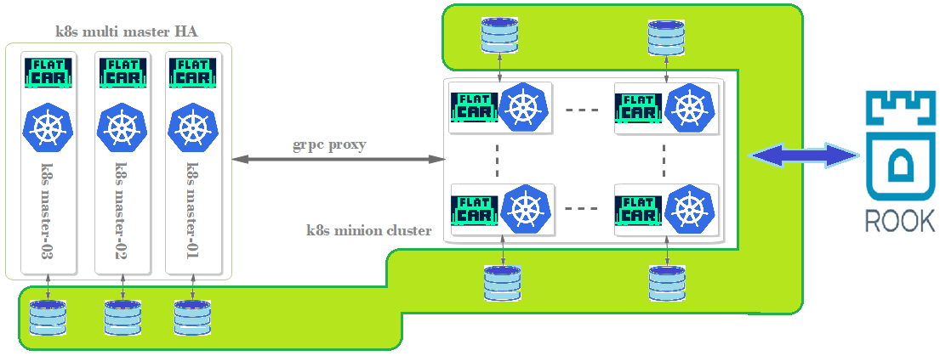
rook.io ceph cluster pvc storageclass
k8s master components (apiserver, controller manager, scheduler, proxy, kubectl, kubelet)
k8s minion components (proxy, kubelet, kubectl)
for every k8s masters and minion will have added disk /dev/sdb without partition and filesystem
rook.io will used block storage for useAllNodes: true and useAllDevices: true for k8s default StorageClass

Slide 13
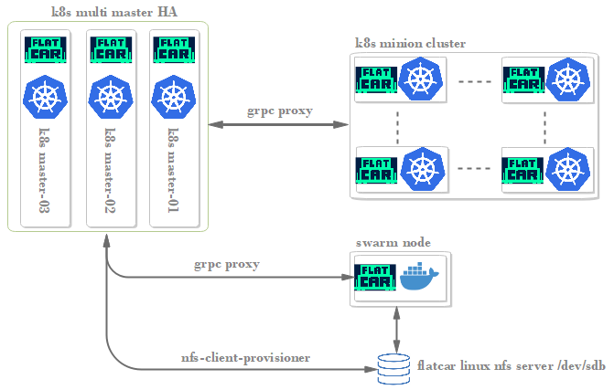
nfs rwx storageclass
flatcar linux nfsd.service via systemd for kubernetes rwx storageclass via helm chart nfs-client-provisioner

Slide 14
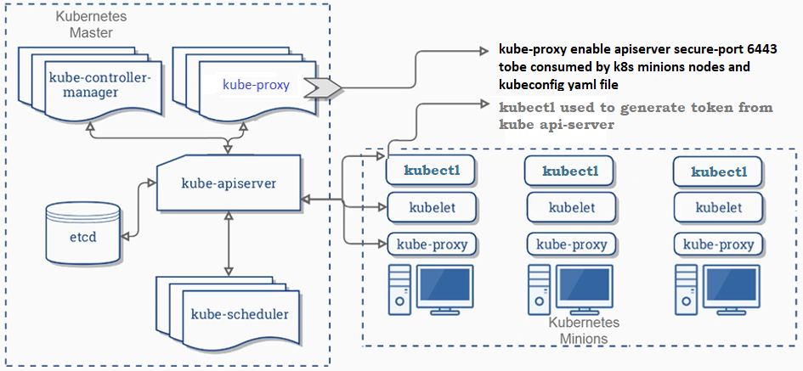
architecture

Slide 15
flatcar linux cluster
flatcar linux operating system is cluster horizontal by default
flatcar linux utilized etcd and flannel to create cluster horizontal operating system
flatcar linux etcd master will be installed kubernetes master binary (kubectl,apiserver,controller manager,scheduler,kubelet,proxy)
flatcar linux etcd proxy will be installed kubernetes minion binary (kubelet,proxy)
Kubernetes master and minion binary will be managed by systemd
flannel utilized etcdv2 api, so we need to enable etcd with v3.4.x api v2 for flannel
kubernetes api-server utilized etcdv3 api as default storage backend
flatcar linux time via ntpd not systemd-timesyncd

Slide 16
flatcar linux aliases
check-ceph: check k8s rook ceph cluster osd status, disk status, pool stats, tree, pg stat, total disk size, total disk size from rados, version
check-config: check k8s config get-clusters, current-context, get-contexts, view
check-etcd: check etcd member list, endpoint status, version, endpoint health, etcd rkt container status
check-iptables: check -t nat -L –n, netstat –tunlp, ip route, route, netstat –i, brctl show
check-ipvsadm: check ipvsadm –ln, -l –c, -l –timeout, -l –stats, -l --rate
check-k8s: check k8s kubectl get cs, cluster-info, get nodes --show-labels, nodes -o wide, version, get endpoints kubernetes
check-kubectl: kubectl get deploy,rc,rs,svc,pv,pvc,po,DaemonSet,ingress -o wide --all-namespaces
check-service: systemctl --type=service | grep running and systemctl --type=service | grep -v running
check-swarm: check docker volume ls, node ls, cluster all node ip address, label, network ls, service ls, stack ls
sjf: sudo journalctl -f
dim: docker images
dps: docker ps

Slide 17
docker subnet
docker will used flannel subnet
etcd must be available before flannel and docker
etcd and flannel will be availalable via systemd rkt container
rkt container is coreos container engine
my design is not using --network-plugin=“cni”
we used flannel0 and docker0
flannel will automatically create virtual ethernet related to any docker apps expose port to maintain bandwidth performance

Slide 18
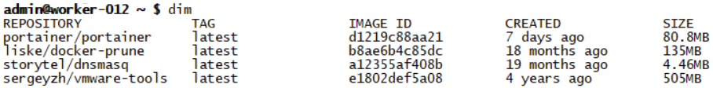
docker via systemd
portainer/portainer enable gui for every k8s master and minion and docker swarm
liske/docker-prune delete dangling docker image for every k8s master and minion
sergeyzh/vmware-tools enable vmotion in vmware vsphere via vmware-tools
storytel/dnsmasq expose cluster-ip k8s to all coreos host

Slide 19
kubernetes interconnection requirements
any kubernetes master or minion must be able to ping any docker applications inside kubernetes pod
any docker applications inside kubernetes pod must be able to be discovered via svc.ns.svc.cluster.local
must be able to interconnect via apiserver secure port 6443
must be able to ping all kubernetes cluster-ip for all services

Slide 20


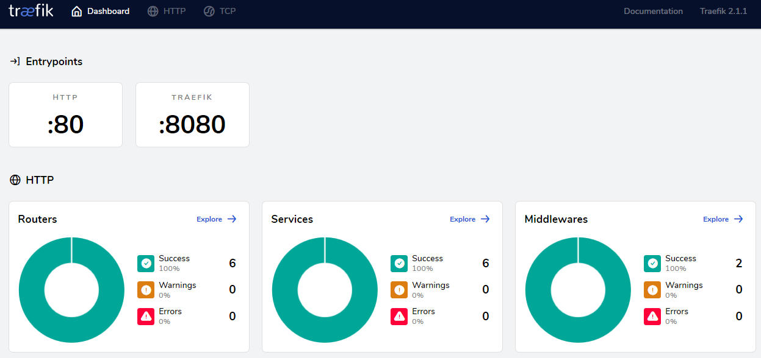
layer7 ingress kubernetes
kubernetes will be using nginx ingress controller
nginx ingress controller loadbalancer ip will be provided by metallb
layer7 ingress docker swarm

Slide 21
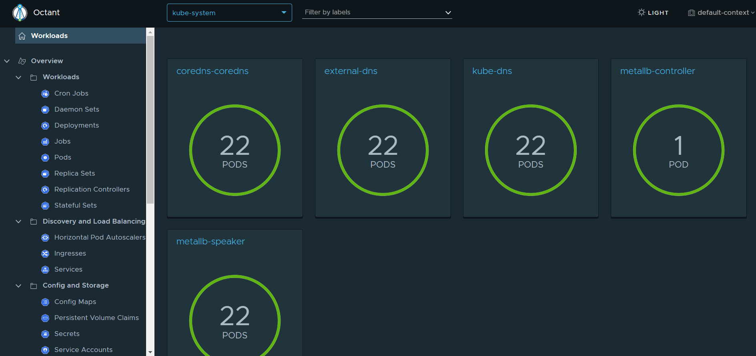
dashboard VMware octant
octant is light
octant is real-time, no need to refresh
octant can not have ingress due to there is no octant service

Slide 22
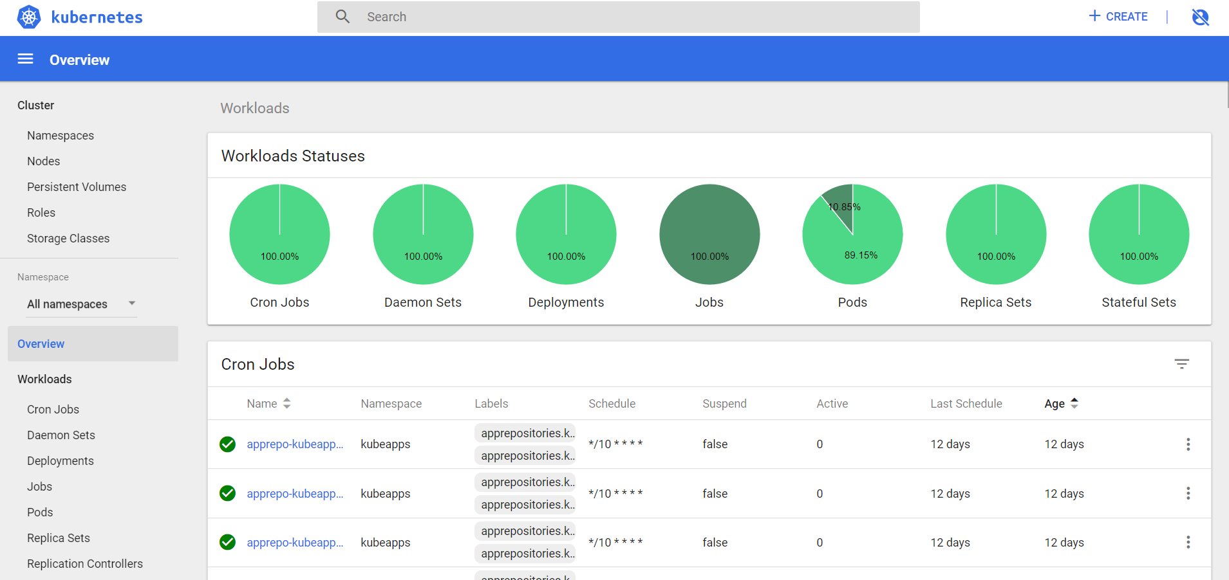
kubernetes dashboard
kubernetes dashboard visualization provide quick overall cluster status for any error and any namespace

Slide 23
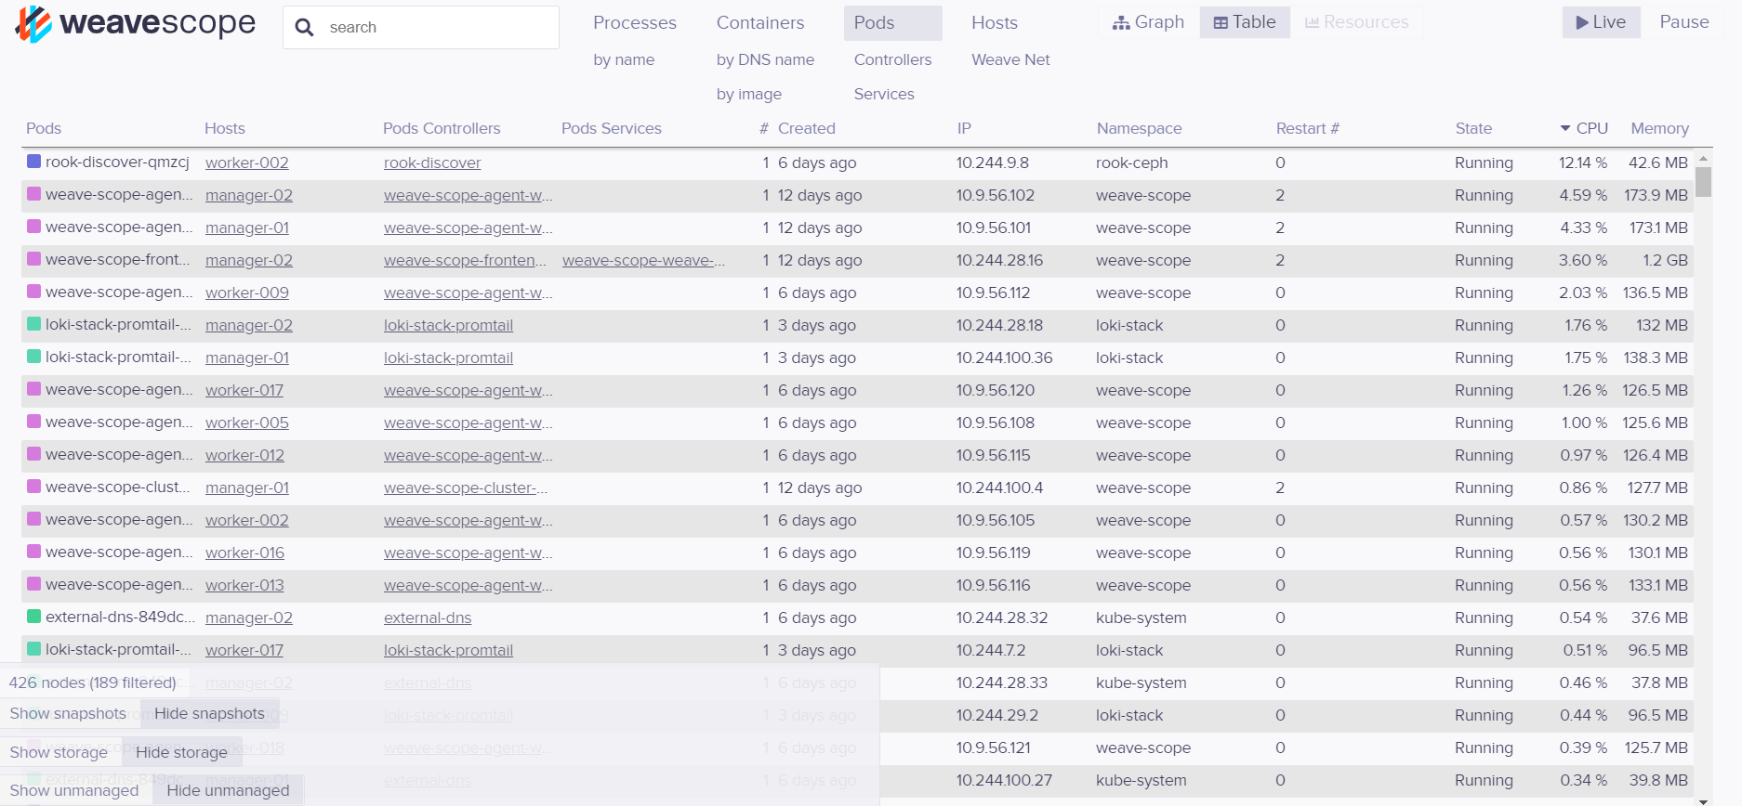
monitoring docker apps
weave-scope monitoring high cpu utilization for any nodes

Slide 24
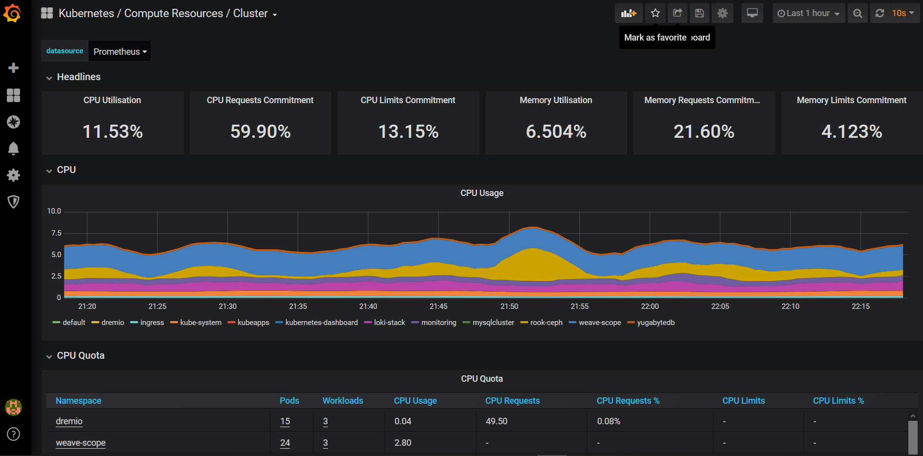
monitoring k8s cluster
Prometheus and grafana for overall k8s cluster monitoring

Slide 25
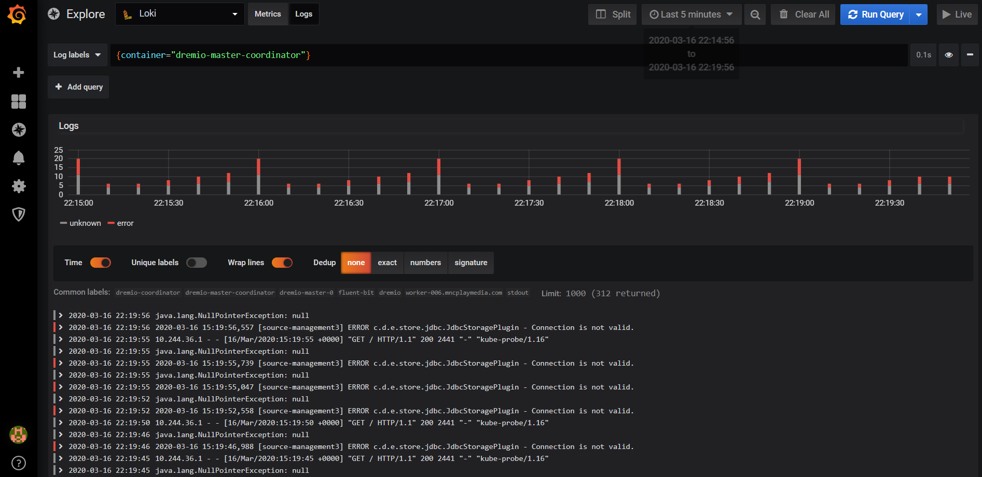
logging
grafana with loki feed from fluentd, for apps log monitoring

Slide 26
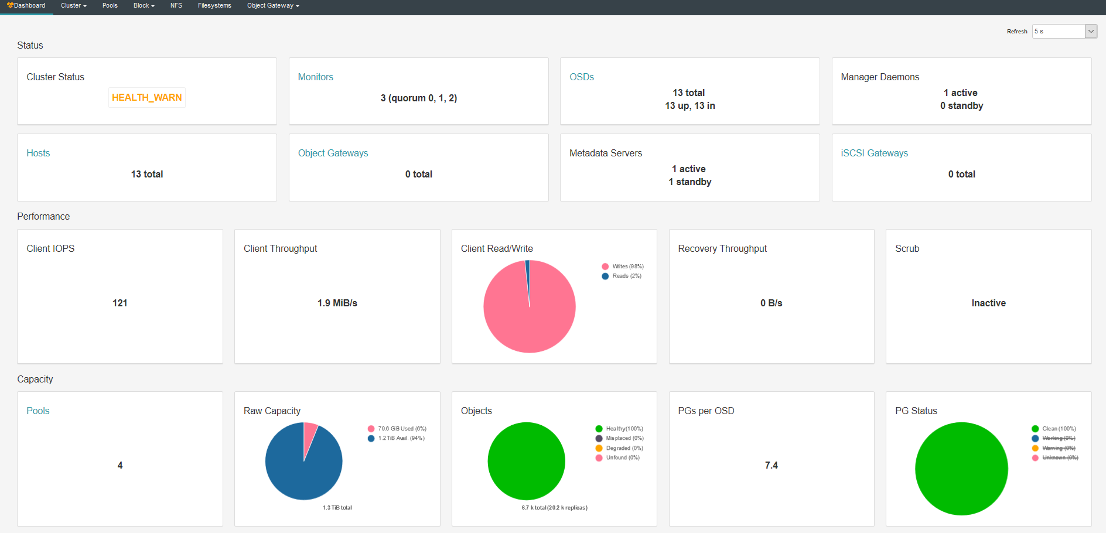
persistent volume
we will used rook.io ceph cluster provider block storage as kubernetes default storageclass

Slide 27

docker swarm
swarm nodes will be able to consume k8s kubedns 10.100.0.10 due to storytel/dnsmasq via system and etcd
kubernetes doesn’t speak swarm and swarm doesn’t speak kubernetes, if we don’t separate the orchestration nodes, it will caused coreos cluster node down due to lack of cpu, memory, and storage
docker swarm will be used for applications which does not applicable to deploy in kubernetes
we enable nfs server in docker swarm node with itsthenetwork/nfs-server-alpine:latest
we mount nfs disk internally via /dev/sdb for nfs
nfs server reqired for apache airflow pvc ReadWriteMany, multiple workers
apache airflow can’t used rook ceph cluster rbd, cephfs, or nfs
we already tried but kubelet can’t mount the bounded rook ceph cluster rbd, cephfs or nfs pvc with rwx
previously we have tried nfs, and succefully kubelet mount bounded pvc with rwx for coreos mount internal disk dedicated specifically for nfs purpose

Slide 28
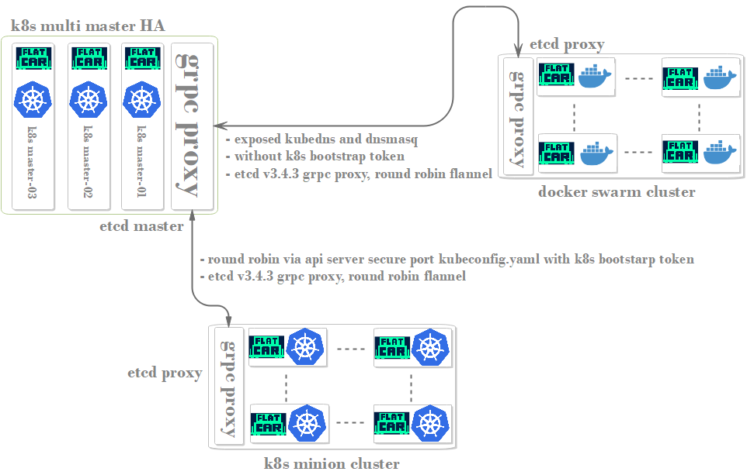
interconnection k8s with swarm
docker swarm application accessed kubernetes kubedns fqdn

Slide 29
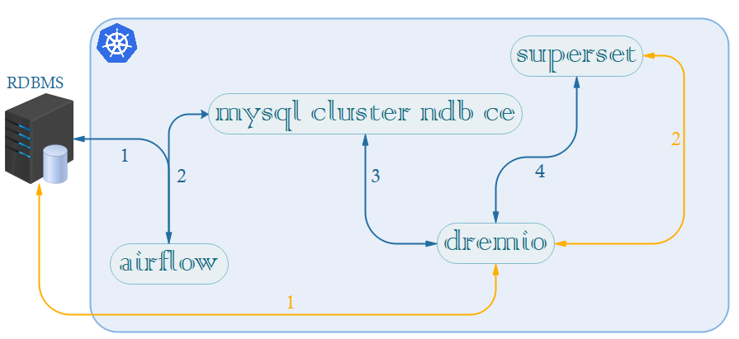
data pipeline
We can do ingestion from external RDBMS to mysql cluster ndb ce via apache airflow and connect dremio datalake engine, finally visualize via apache superset
Or we can direct connection from external RDBMS to dremio datalake engine and visualize via apache superset

Slide 30
research
learning dremio best practice
learning superset best practice

Slide 31
limitations
don’t delete ceph deployment, it will crash ceph disk partition and need to re-create kubernetes cluster. due to ceph metadata will be deleted
can not update kubernetes version, etcd, flannel, etc. due to coreos ignition config
solutions
backup daily all vm

Slide 32
Thank you

