Slide 2

Oracle Mobile Strategy
One common platform for both desktop-based and mobile enterprise applications
Extend enterprise applications and data to mobile clients
Support multiple platforms using standards based technologies.

Slide 3
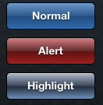

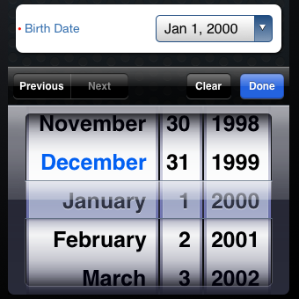
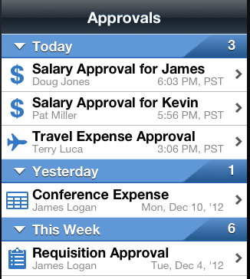
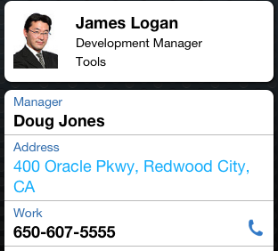


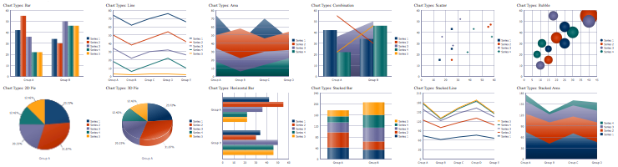
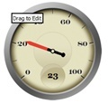
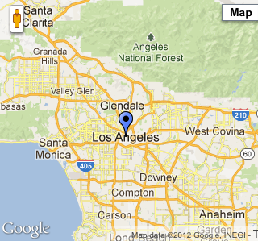
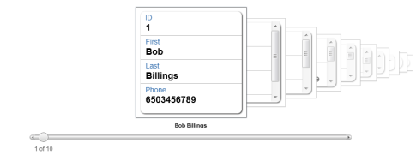
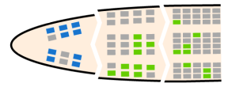
ADF Mobile Components
Basic Components
ListView
Forms
Charts
Gauge
T-Maps
Carousel
GeoMap
Oracle proprietary and confidential
Notes:
Device Native Container: An application container or template compiled as device native application binary. This provides the runtime environment for an ADF Mobile application to run as an on-device, native application in the mobile device’s operation system (for example Apple iOS). Beyond hosting all of the client-side components for an ADF Mobile application, it also provides a couple of user interface navigation features: the Spring Board and the Tab Bar that allows user to navigate to a particular feature.
Web View: Web View is a part of the Device Native container that leverages device’s web engine to display and process web-based content. In an ADF Mobile application, Web View is the primary mechanism to render and deliver the application user interface.
Server HTML: Server HTML represents web-based user interface that are generated on the server and delivered as a web page to the ADF Mobile application. Generation of the HTML code occurs entirely on a remote server, as well as business and page flow logic. Server HTML can access device native services such as camera through the JavaScript API supported by Phone Gap, as long as it is running inside an ADF Mobile application. Common options for server HTML-based pages are ADF Mobile browser and ADF Faces Rich Client-based pages.
Local HTML: Local HTML are web pages developed using JDeveloper or third-party tools/frameworks that are directly embedded within an ADF Mobile application. These pages are delivered as a part of the ADF Mobile application. Local HTML files can access device native features through the JavaScript APIs supported by the Phone Gap.
ADF Mobile AMX Views: AMX views are based on the new AMX component that delivers JavaServer Faces-like development experience to developing HTML5-based user interface. Developers define AMX views using UI and code editors in the JDeveloper, and these views are embedded into the ADF Mobile applications and deployed to the device. During runtime, JavaScript Engine in the Web View renders AMX view definitions into HTML5 controls. AMX components are built to deliver mobile optimized user experiences out of box, and supports device native user experience through extensive animation and touch gesture support.
ADF Controller: A mobile version of the ADF Controller that supports a subset of ADF Task Flow components available to a server-based ADF application. It supports both bounded and unbounded ADF Task Flows, and a subset of events/scopes that are supported by the server-based ADF.
Java: Provides a Java Runtime environment for the ADF Mobile application. This Java Virtual Machine is implemented in device-native code, and is embedded/compiled into each instance of the ADF Mobile application as part of the native application binary. This JVM is based on the JavaME Connected Device Configuration (CDC) specification.
Managed Beans: Managed Beans are Java classes that an ADF Mobile developer can write to extend the capabilities of the framework. This allows any ADF/Java developers to leverage existing development skills to program, for example, additional business logic necessary to process data returned from the server. Managed Beans are executed by the embedded Java support, and therefore must conform to the JavaME CDC specifications.
ADF Model: ADF Model in an ADF Mobile application supports a subset of Business Logic components available to server-based ADF application. It contains the binding layer that provides an interface between the business logic components and user interface, as well as the execution logic to invoke REST or SOAP-based web services.
Application Configuration: Refers to services that allows key application configurations to be downloaded and refreshed. For example, URL end points for a Web Services or Remote URL connection. Application configuration services downloads configuration information from WebDav-based server-side service.
Credential Management, SSO, and Access Control: Refers to client-side services that provides security-related services for an ADF Mobile application. For example, a local credential store that securely caches user credentials to support offline authentication. Another example would be access control services that would show/hide application features based on user access.
Phone Gap: Phone Gap is an open-sourced code library that provides a common JavaScript API/interface to access different device services such as the camera. Phone Gap provides majority of the device-services integration for an ADF Mobile application. Phone Gap JavaScript APIs are further abstracted as Device Data Controls in the JDeveloper Design Time for AMX-based views, allowing developers to integrate device services by simply dragging and dropping Data Controls to their AMX Views.
Device Native Views: These are views written in device native language (for example Objective C for iOS), compiled as native libraries, and then incorporated into an ADF Mobile application. Device native views are to be used as rare exceptions when AMX or other web-based UI are not sufficient to fully support certain application functionality that only native code can deliver. For example, a view that requires intensive graphical processing support.
Local Data: Refers to data stores that reside on the device – in ADF Mobile, these are implemented as encrypted SQLite databases. Full CRUD operations are supported to this local data store through the Java layer, using JDBC-based APIs.
On the server side, the Configuration Server refers to a WebDav-based server that hosts configuration files used by the Applicaction Configuration services. The Configuration Server is delivered as a reference implementation/sample – developers and IT administrators can leverage any common WebDav services hosted on common J2EE server for this purpose.

Slide 4
More Resources
ADF Mobile on OTN
Datasheet
Tutorial
Demos
Discussion
ADF Mobile Blog – http://blogs.oracle.com/mobile/
Twitter.com/JDeveloper
Facebook.com/JDeveloper

