Slide 1
⚙️
MAVI CORE
Manufacturing Execution System
Digitize Your Shop Floor Operations
No-Code App Builder • Real-Time Analytics • Multi-Table Database
Product Introduction 2026

Slide 2
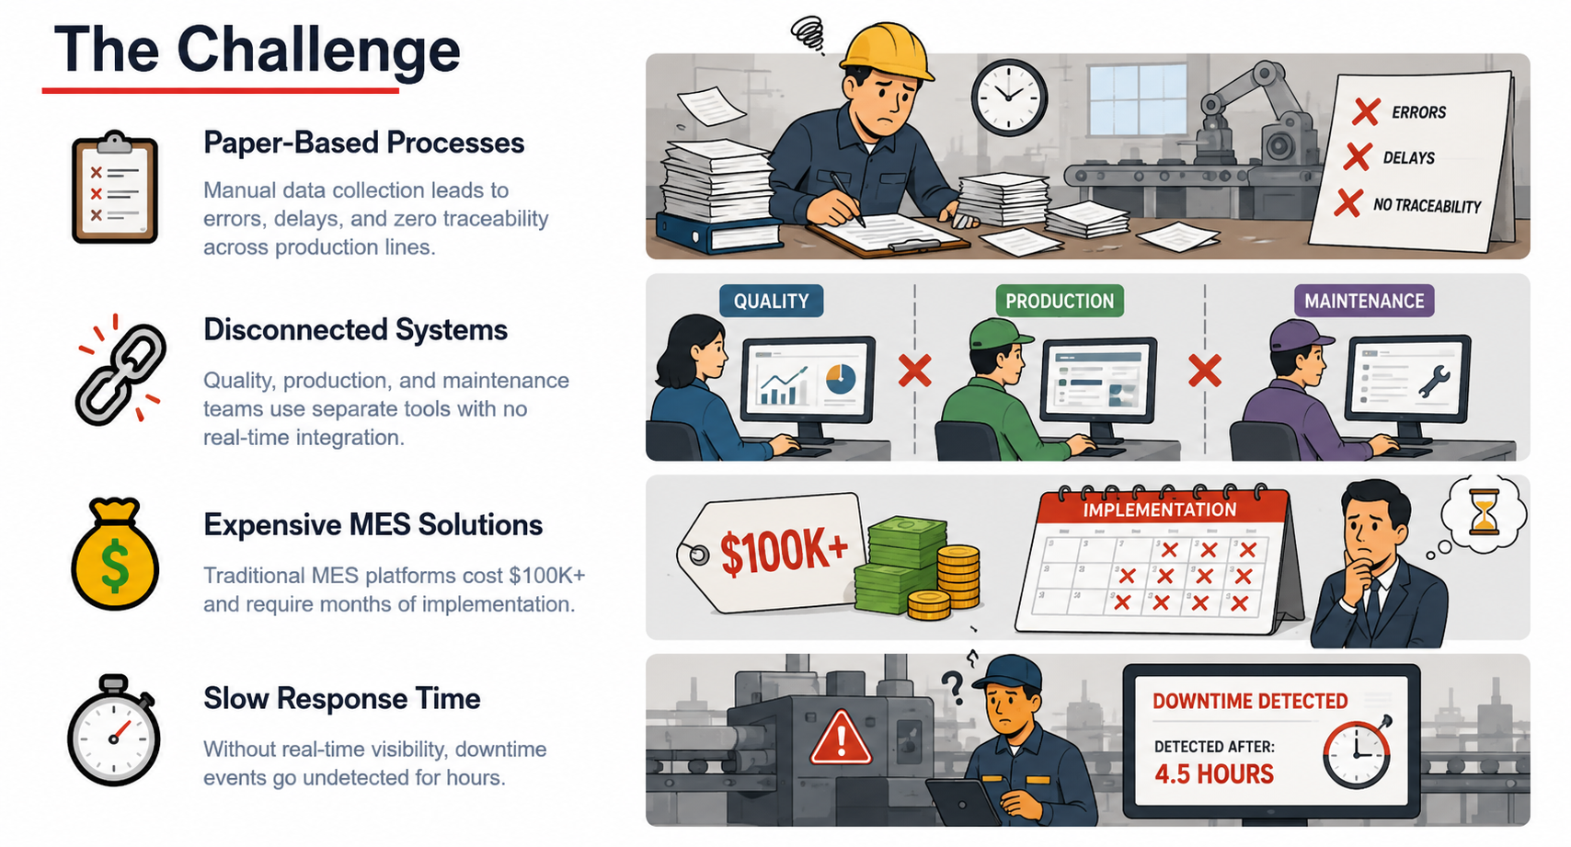

Slide 3
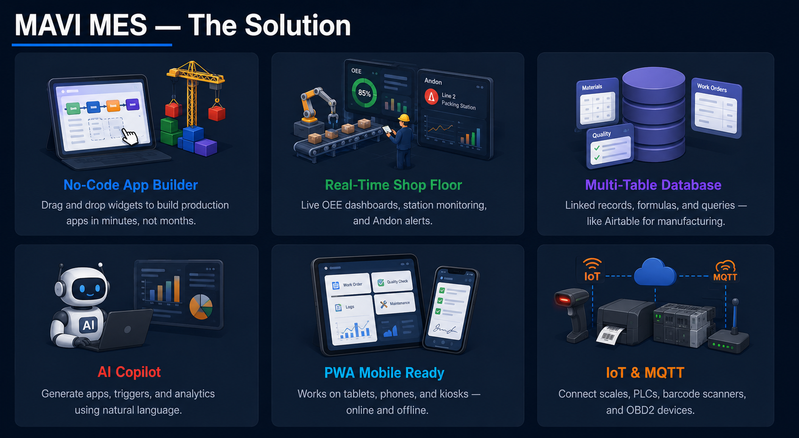

Slide 4
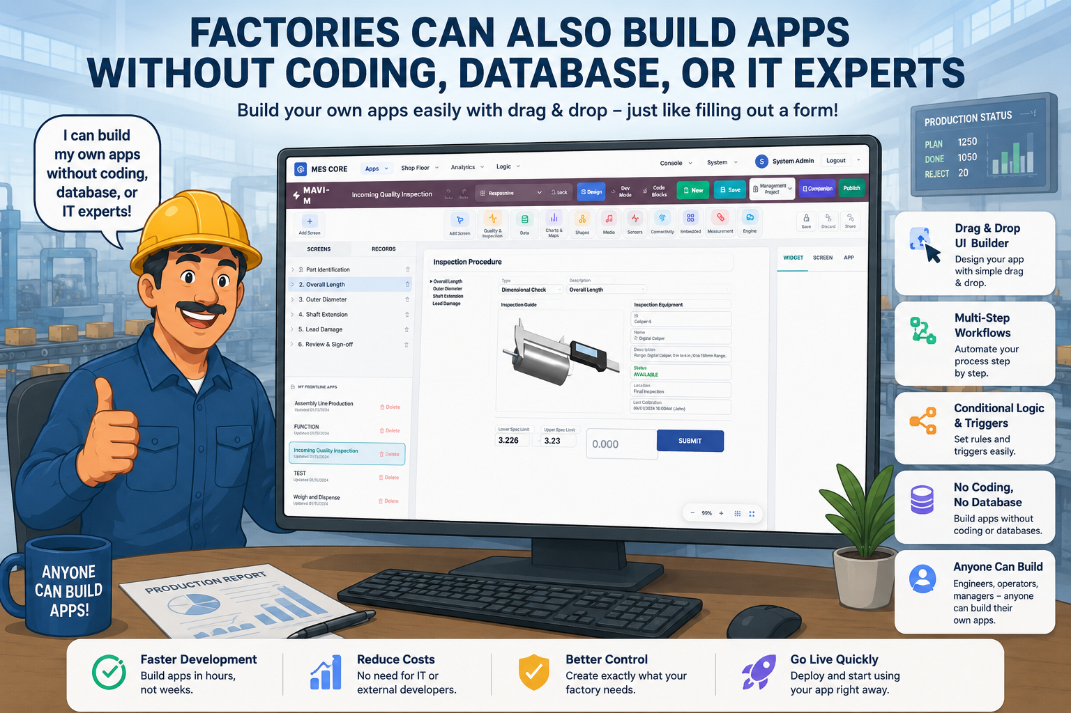

Slide 5
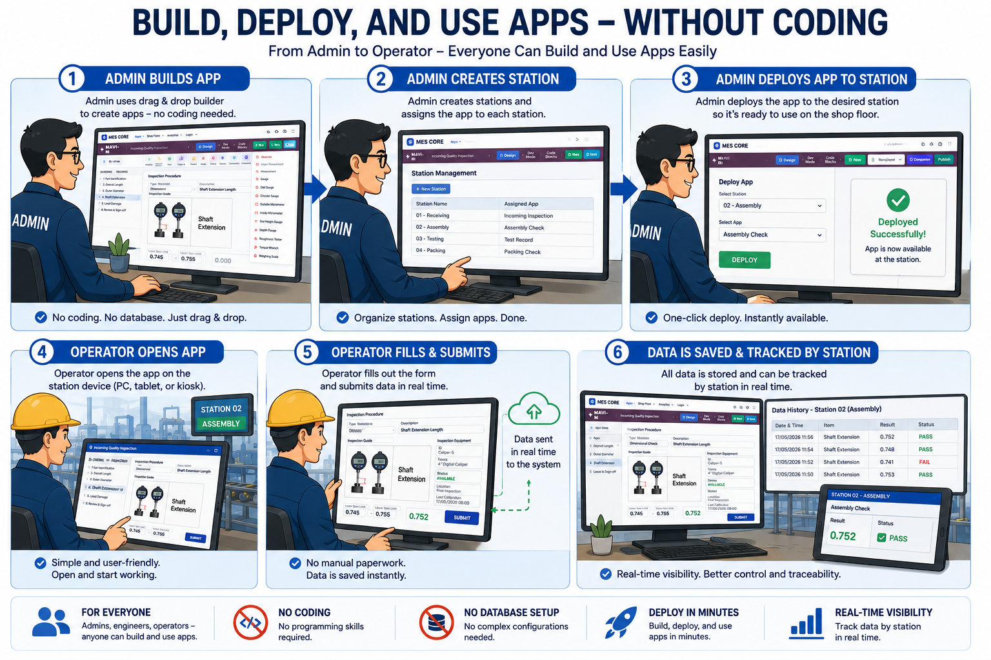

Slide 6
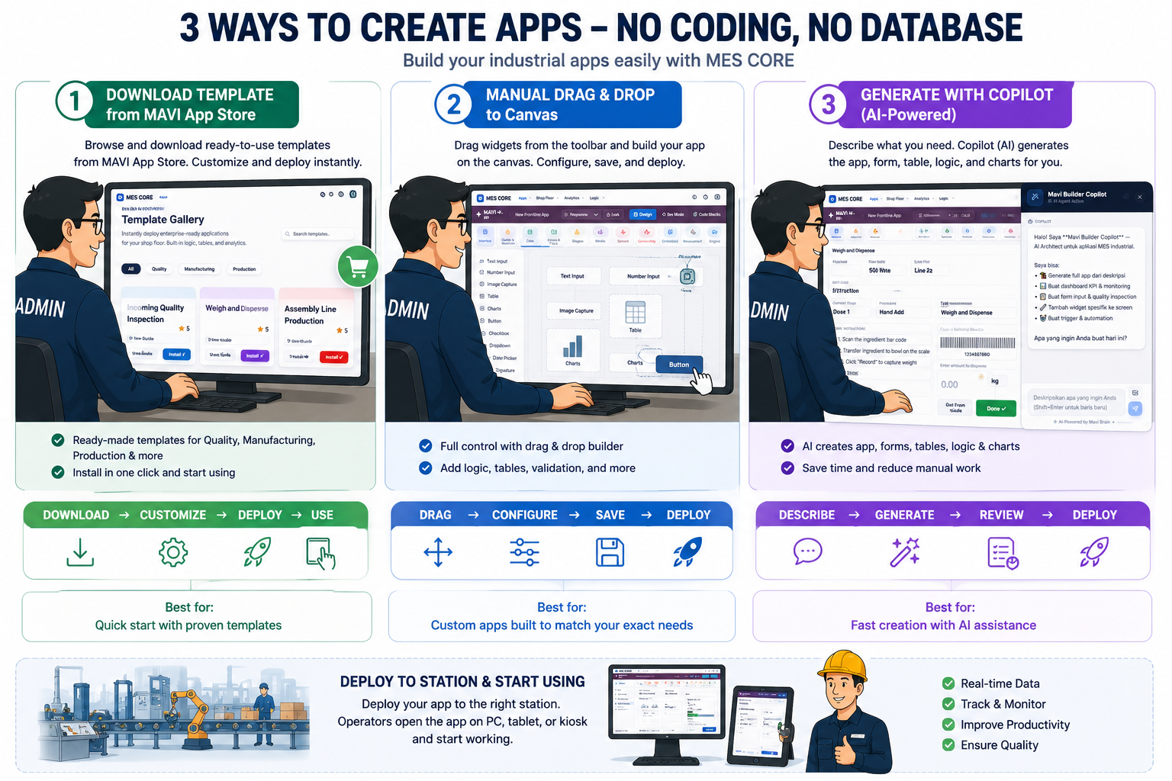

Slide 7
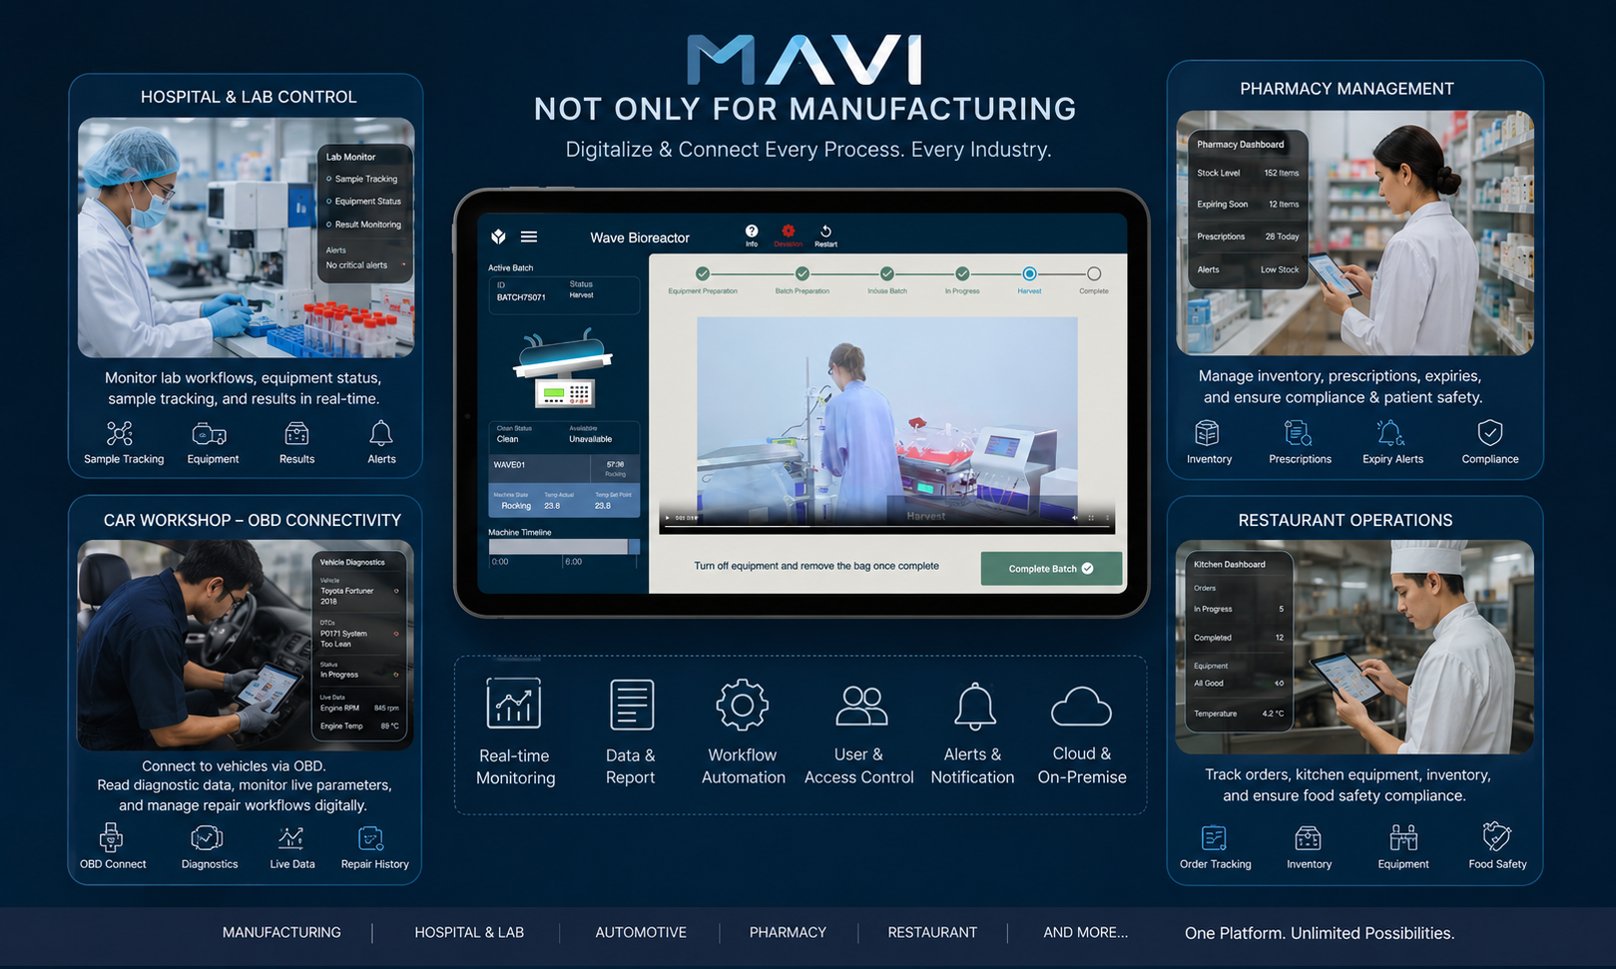

Slide 9
🚀
Ready to Digitize
Your Shop Floor?
MAVI MES — Built for Modern Manufacturing
Get Started Today →
Contact: sales@mavi-mes.com | www.mavi-mes.com

