Slide 1
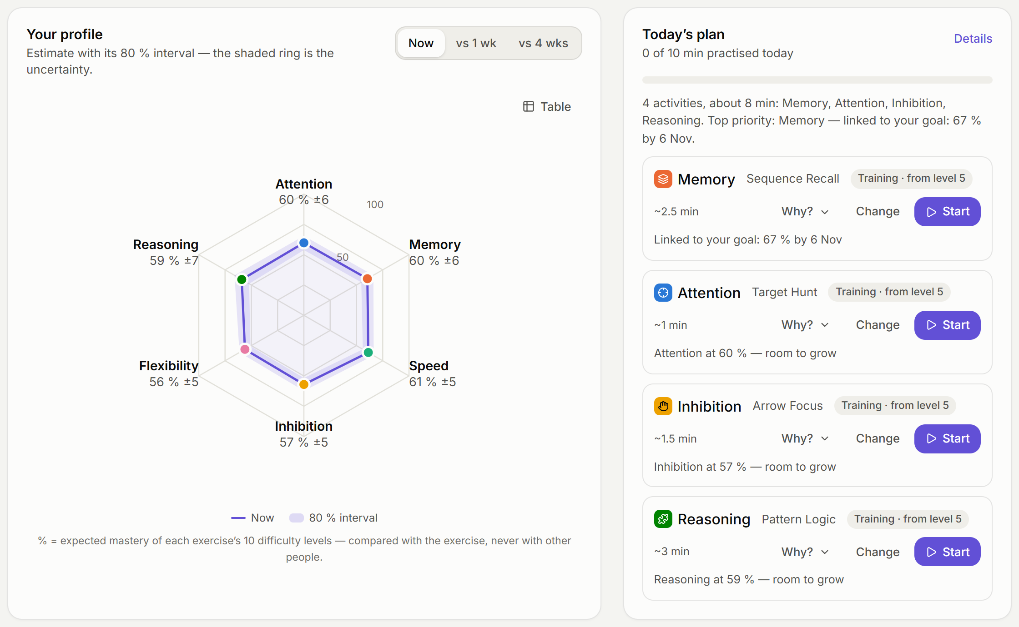
CogniTwin
A cognitive growth agent
with an honest Brain Twin
Assess · Understand · Coach · Improve
Non-clinical · uncertainty-aware · explainable · local-first
Team CogniTwin · CISTAC 1.0 — AI4Brain challenge
Notes:
Imagine a fitness tracker for thinking skills that tells you not just a number, but how sure it is — and why. That is CogniTwin.

Slide 2




What is wrong with cognitive apps today
One-time snapshots
Overclaiming
Black-box AI coaches
Clinical drift
A test gives one number, once — but skills change from week to week.
Precise-looking scores and promises of transfer the evidence does not support.
Advice that cannot show where it comes from — or is simply invented.
Scores slide into health language without any validation behind it.
CogniTwin measures continuously, shows uncertainty and exposes evidence. Automated checks help keep coaching within its non-clinical scope.
Notes:
Cognitive tests give one number, once. Brain-training apps overclaim. AI coaches invent things. And it is easy to slide into medical language. We designed against all four.

Slide 3




Our answer: four layers, one rule
Assess
Understand
Coach
Improve
6 language-free tasks
Adaptive check-ins
Fair device calibration
Bayesian % + 80 % interval
Brain Twin with full history
Uncertainty grows when idle
Evidence-backed insights
Rules + optional Claude
Guardrails & “Why?”
80 % target difficulty
Plan that explains itself
Goals, missions, projections
One rule: facts come from a tested engine · language comes from AI · uncertainty is shown everywhere
Notes:
Our rule: facts come from a deterministic, tested engine; language comes from AI; uncertainty is shown everywhere.

Slide 4
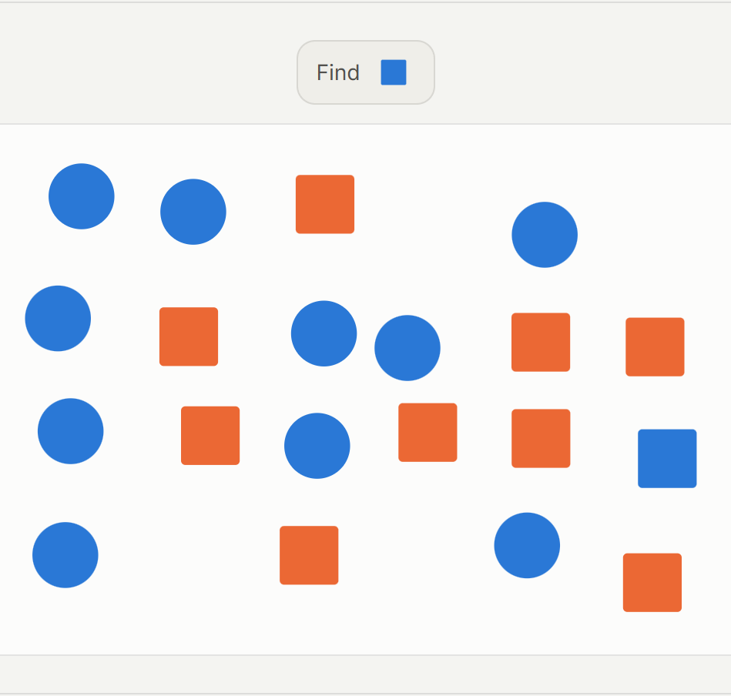
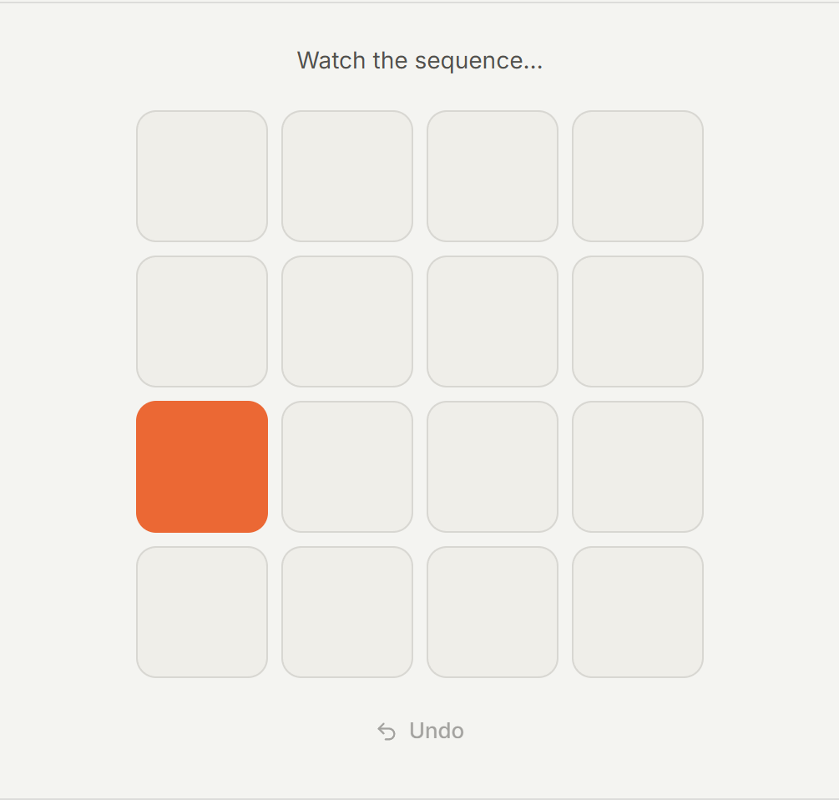
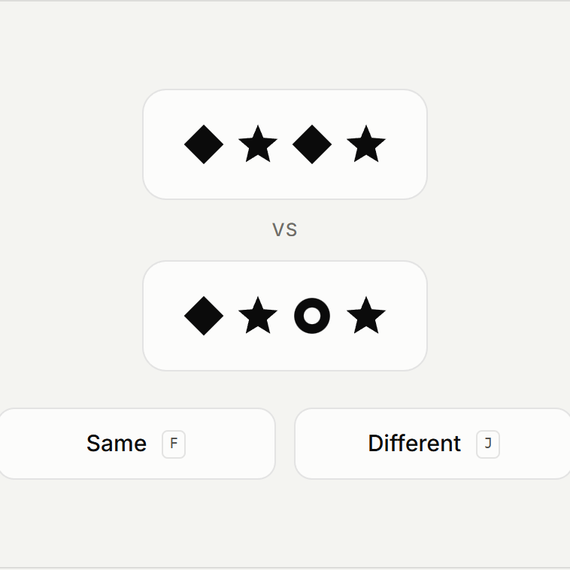


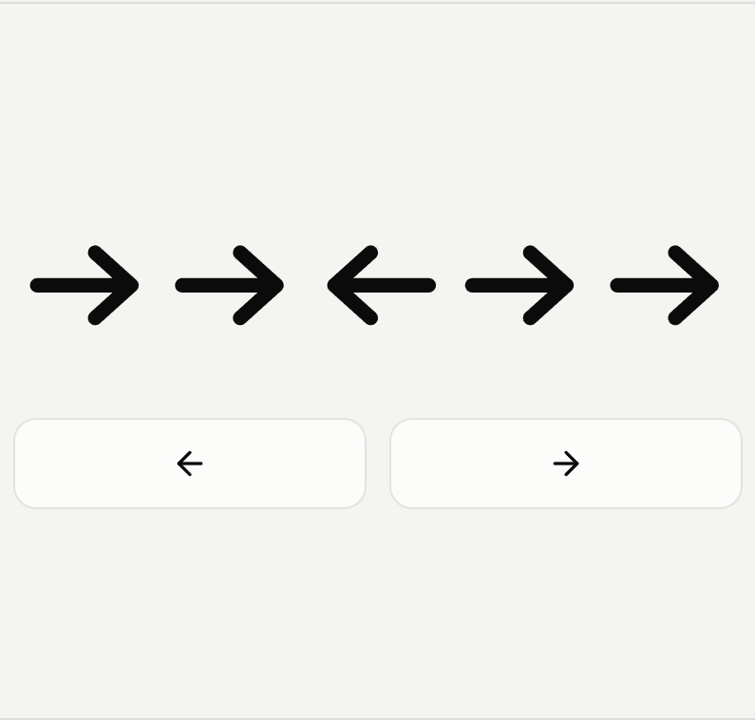
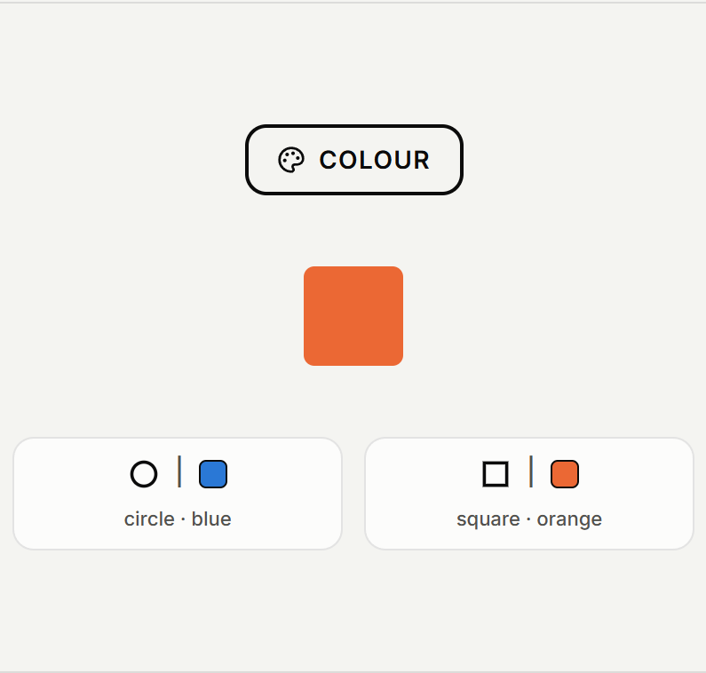
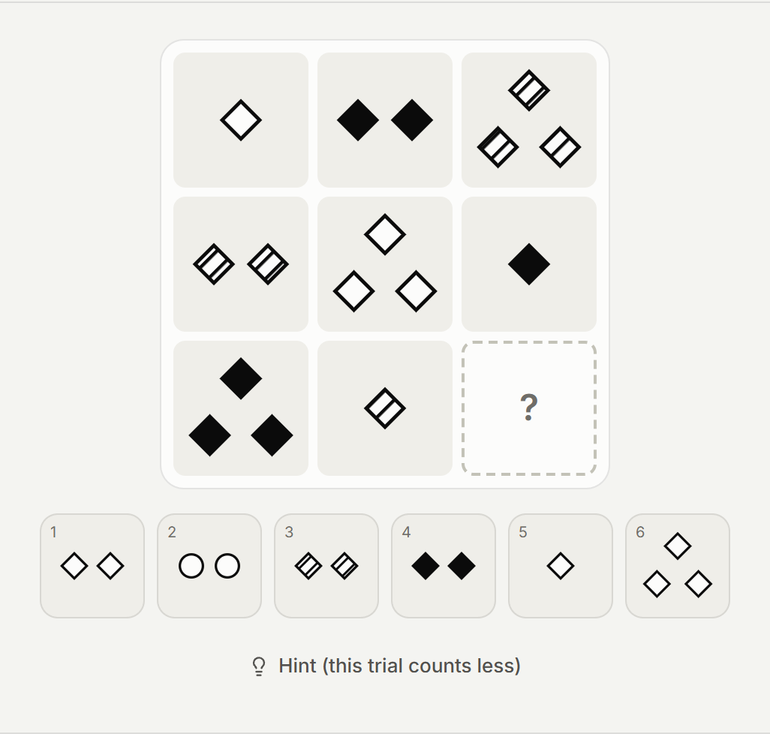


Assess: six adaptive, language-free tasks
Adaptive check-ins
Each trial picked where it is most informative; stops when precise. ~30 % less error.
Generated, language-free
Fresh stimuli every time: nothing to memorise, no reading or language bias.
Attention · Target Hunt
Memory · Sequence Recall
Speed · Symbol Sprint
10-tap fairness calibration
Response windows scale to the device and hand speed — phone, trackpad or mouse.
Score, time, errors, behaviour
Every trial: correctness, RT, error type, condition, interruptions, hints.
Inhibition · Arrow Focus
Flexibility · Rule Switch
Reasoning · Pattern Logic
Notes:
Six tasks, one per dimension, no words, generated fresh every time. Check-ins are adaptive — they stop as soon as the estimate is precise. A 20-second calibration makes timing fair on any device.

Slide 5
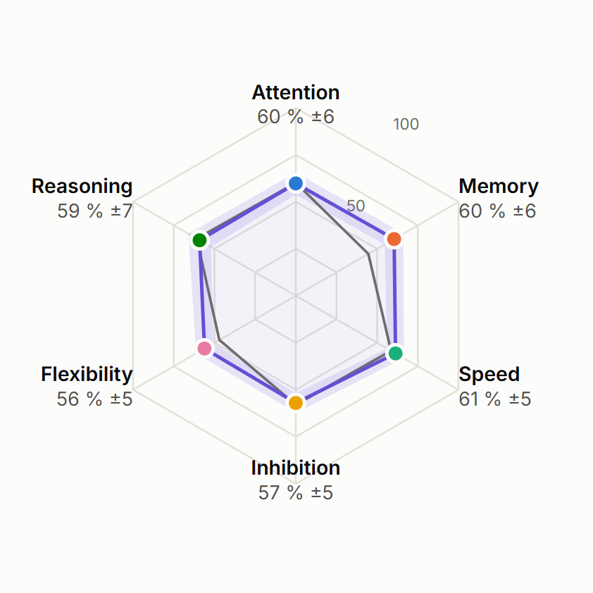



Understand: a percentage that knows how sure it is
60 %
80 % interval 55–66 · high confidence
Expected mastery of the task’s 10 levels — compared with the task, never with other people.
Bayesian item-response model
Every trial updates an ability estimate and its uncertainty on one scale, whatever the level.
Honest about stale knowledge
The Brain Twin widens the interval when a skill is not practised (73 % vs 33 % coverage).
Full, replayable history
A snapshot after every session: replay, progress curves, heatmaps, session log.
Purple: today with its 80 % interval (shaded) · grey: 4 weeks ago
Notes:
Every trial updates a Bayesian model. You see a percentage and an 80 % interval. If you stop practising, the twin becomes less sure — honestly. Every session is a snapshot you can replay.

Slide 6
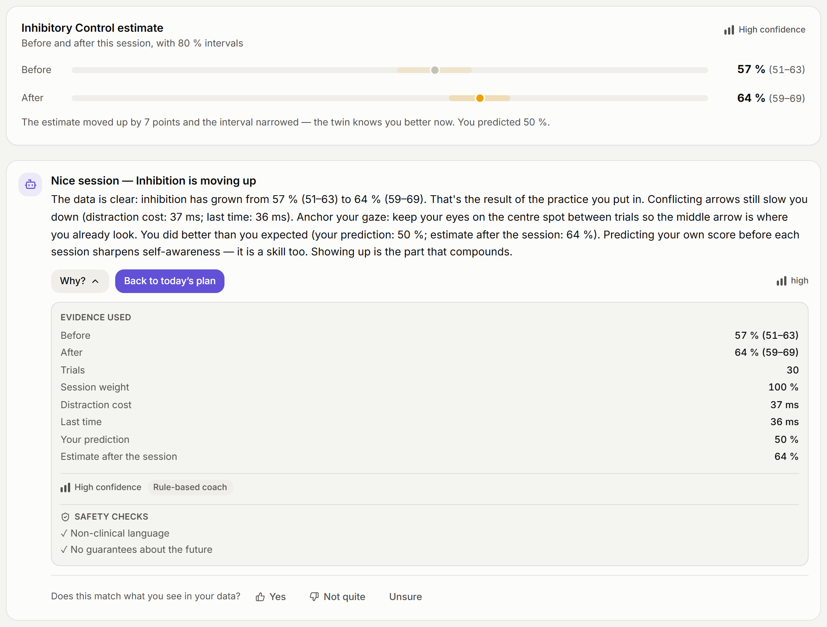
One session, fully explained
1
Before → after
The estimate moves and its 80 % interval narrows: the twin now knows you better.
2
A finding, not a guess
The coach narrates insights the engine computed — with one strategy to try next.
3
“Why?” on every message
Evidence, confidence, source (rules or AI) and the safety checks that passed.
Notes:
Live: run 20 seconds of Arrow Focus, show the difficulty path, the interval narrowing, then click "Why?". Every coach message shows the evidence, confidence, source and safety checks.

Slide 7


Coach: the engine decides, AI phrases, guardrails verify
Insight engine
Narrative
Guardrails
“Why?” panel
Trends, fast errors, fatigue, costs, rule slips — each with evidence + confidence
Local rule-based coach or Claude with aggregates and filtered chat
Language checks · cited numbers · confidence cap
Evidence, confidence, source and checks on every message
38
Evidence
0
term patterns checked in replies and suggestions; semantic accuracy still needs review
Numbers must match cited source evidence; failed checks trigger regeneration or fallback.
health questions sent to the model: a fixed, reviewed reply points to professionals
Notes:
The coach can only talk about insights the engine found, with evidence. A safety layer blocks clinical words, numbers not in your data and promises about the future. If the AI fails, the rule-based coach answers.

Slide 8
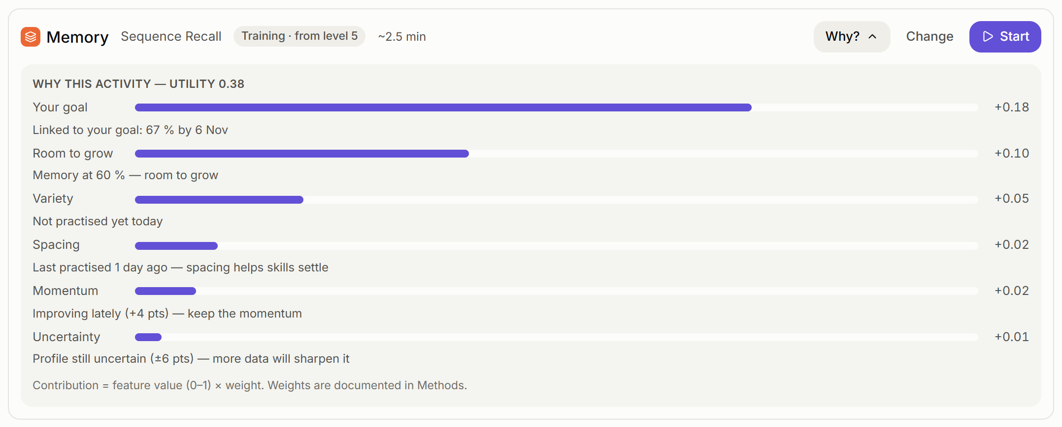



Improve: a plan that explains itself
≈ 80 % success, every trial
Difficulty follows you; eases after two misses or when strain builds.
An evolving plan
Re-ranked after each session, with a diff: “Reasoning switched to training — profile now confident”.
Goals → weekly milestones
Self-set or suggested goals with a path and a model-based chance.
Everyday missions
Real-life practice so gains do not stay inside the app.
Notes:
Training keeps you around 80 % success — hard enough to learn. The plan is a transparent formula; click "Why?" and you see each weight. After every session the plan is re-ranked and says what changed.

Slide 9
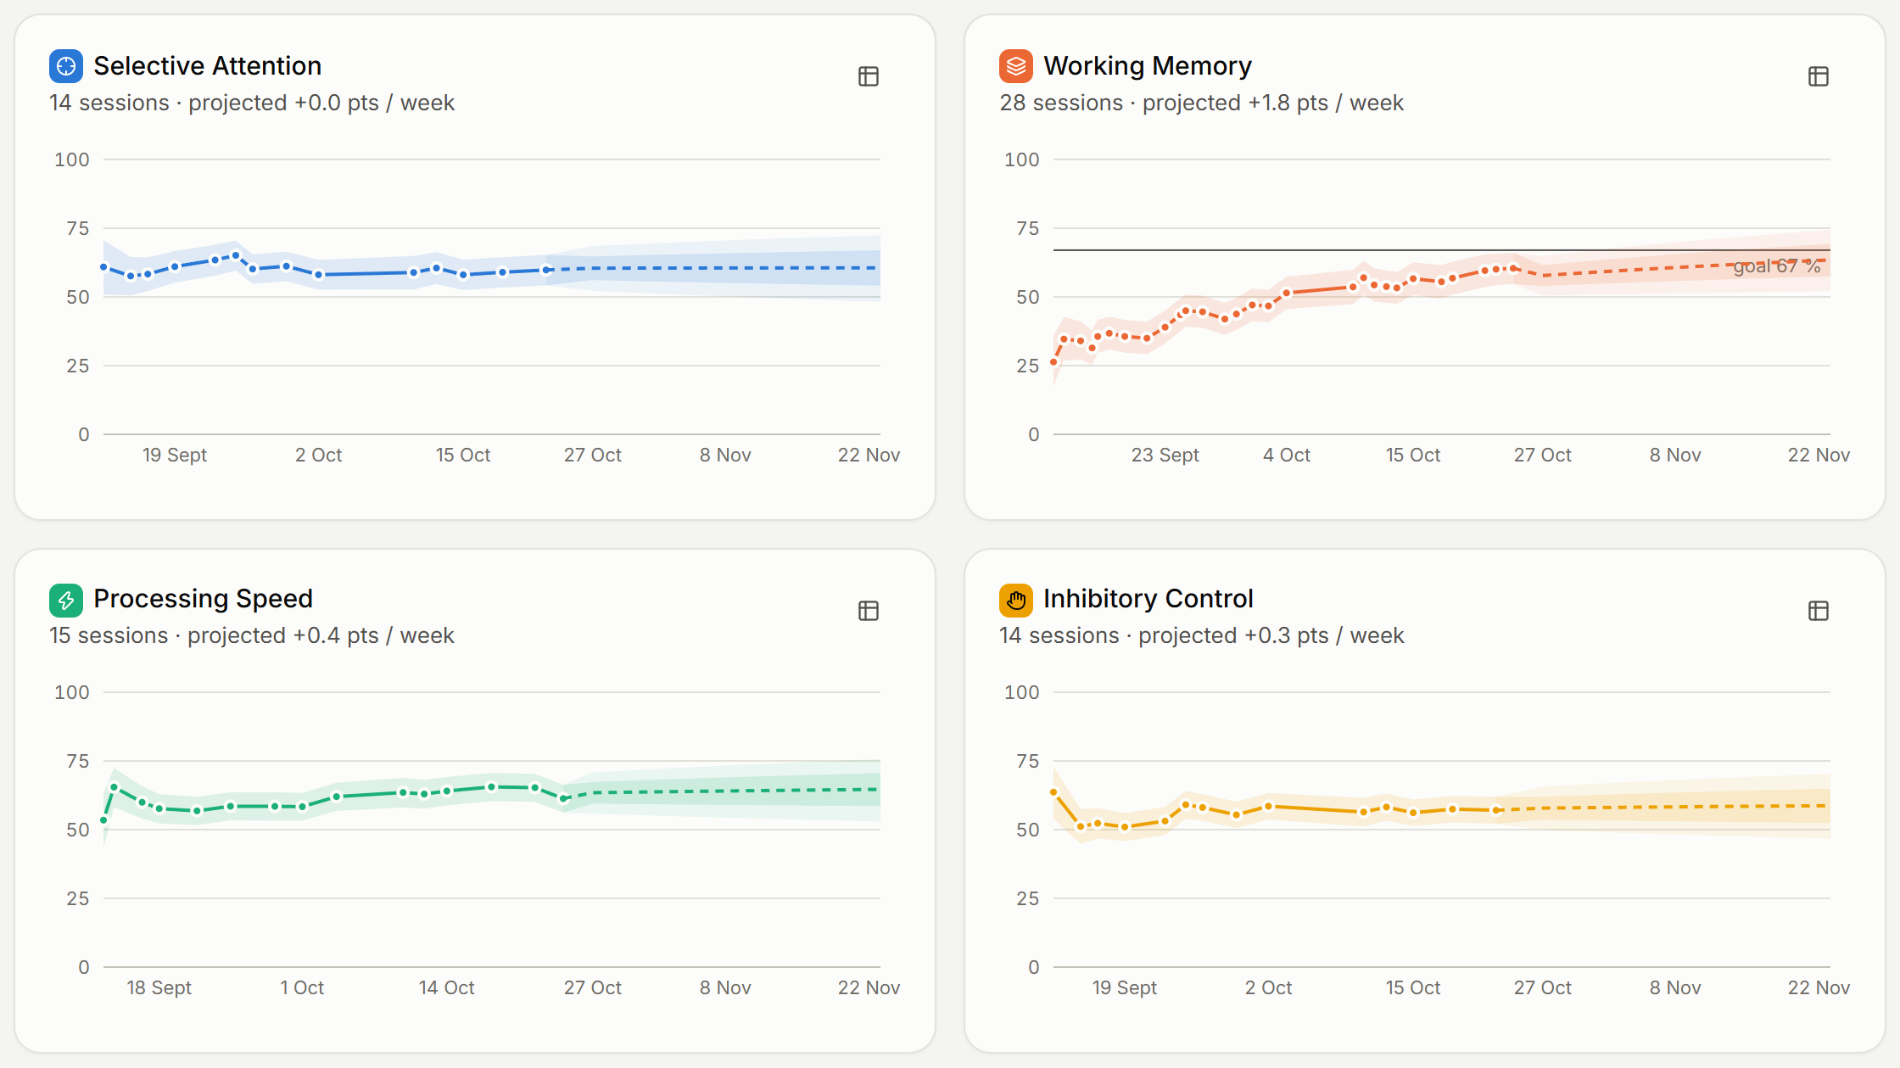
Predictive growth — never as certainty
89 %
of true levels 14 days ahead fell inside the 80 % band (simulation, 150 learners)
50 / 80 %
fans that widen with time: dashed line = projection, never data
≈ 57 %
example goal chance — always labelled a model estimate, not a promise
Notes:
Projections are fans, not lines. They fit the learner’s own curve and widen with the horizon. In simulation, our 80 % band contained the real future level 89 % of the time.

Slide 10
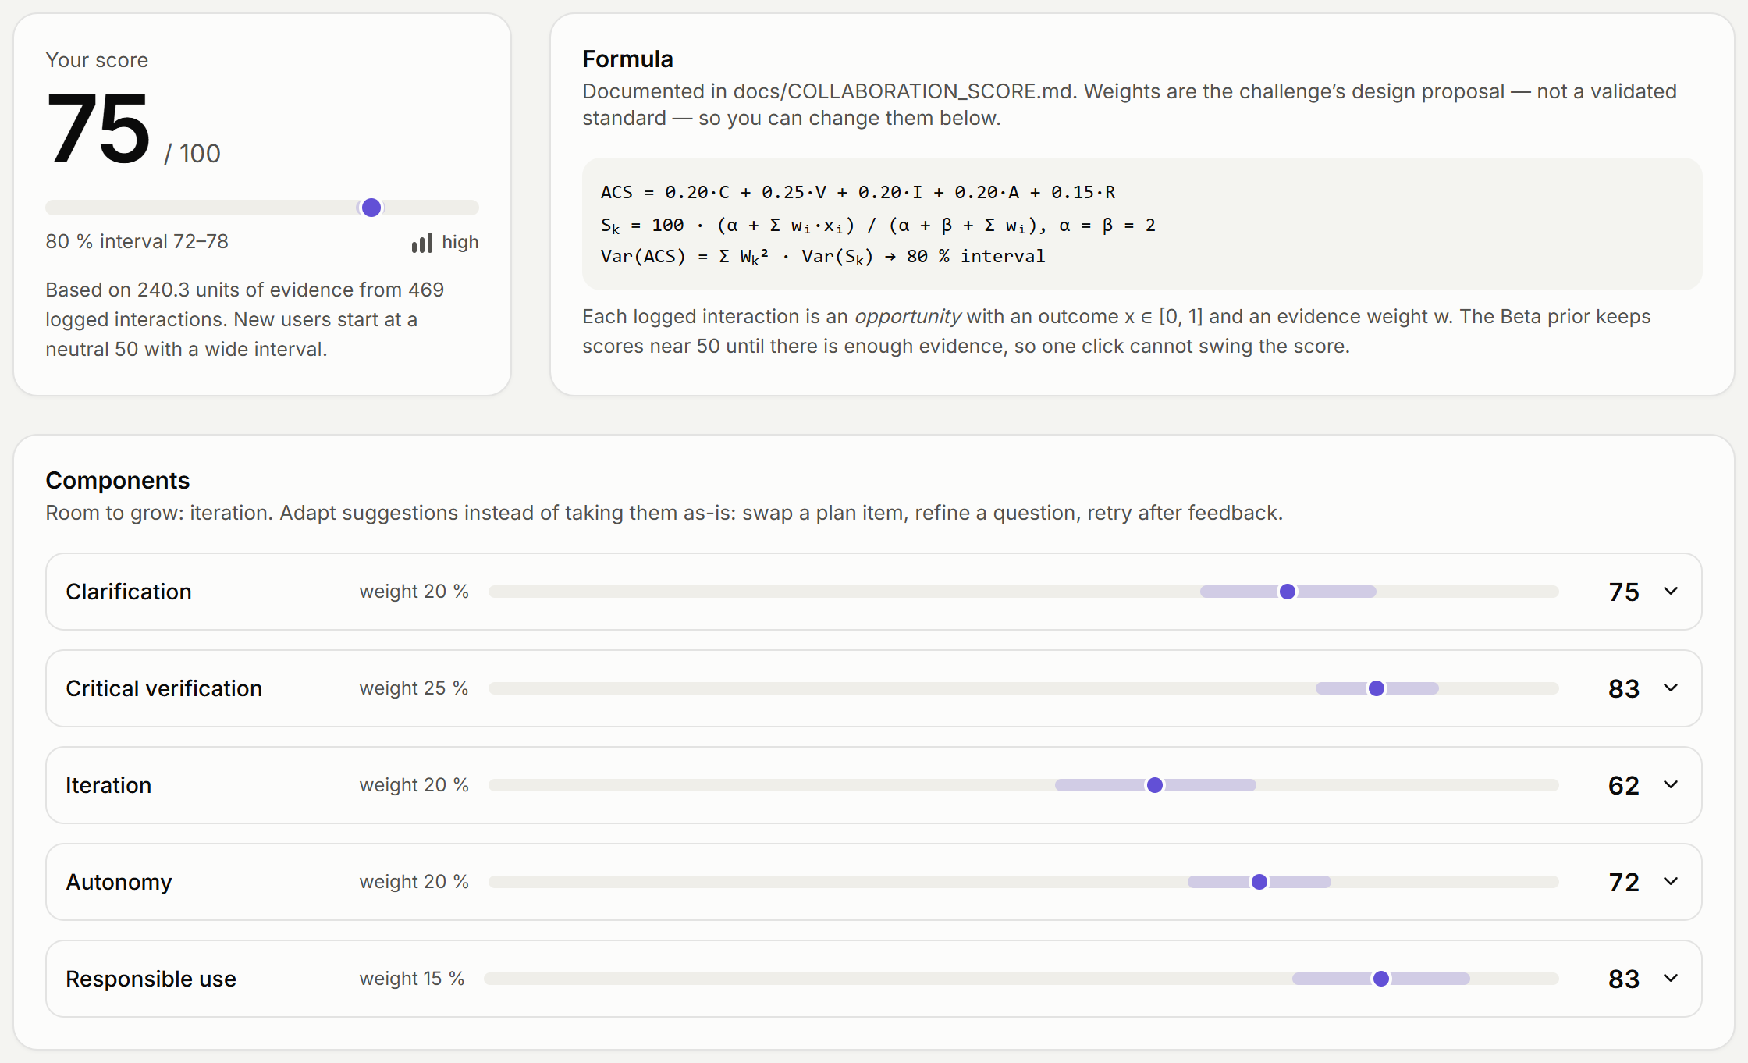
AI Collaboration Score: how well you work with AI
ACS = 0.20 C + 0.25 V + 0.20 I + 0.20 A + 0.15 R
Each component = Beta(2,2)-smoothed share of good outcomes over logged opportunities, with an 80 % interval. Includes an announced “Verify the coach” game.
Notes:
The AI Collaboration Score rewards asking why, checking claims, adapting suggestions, staying autonomous and using AI responsibly. New users start at 50 with a wide interval; the weights are editable because they are a proposal. In simulation it separates a critical collaborator from blind trust and disengagement.

Slide 11

Emotion-aware and voice coaching — responsibly
Behaviour
always on · weight 1.0
Misses in a row, slowing, rhythm, interruptions
Working state
Changes only
in the zone · under strain · getting tired · distracted
coach tone · break suggestions · training difficulty — never a score
Self-report
optional · weight 0.8
Mood & energy check-in before a session
Camera cues
The camera can never decide alone
optional · on-device · weight 0.4
Four averages, no images kept
A state needs non-camera support (unit-tested). Voice prefers local output; browser services may process text or audio.
Notes:
Emotion-aware, but honest: faces are not emotions. Camera cues are on-device, aggregated, low-weight, and can never decide alone — we test that. Voice coaching reads feedback aloud and accepts spoken questions.

Slide 12




Trust by design
Local-first
Granular consent
Non-biometric by default
Stored locally. Optional AI sends aggregates and filtered chat.
AI narrative, voice and camera off by default; every change logged.
Every feature works without camera or microphone.
Retention & deletion
Portability
Non-clinical checks
30 / 90 / 365 days or until deleted; delete one session or everything.
Export all as JSON; import is validated and the twin recomputed.
Coach and UI copy scanned for clinical terms by automated tests.
Notes:
Your data never leaves your device unless you opt in, and then only aggregates. Export, delete, choose retention. The non-biometric mode is the default and complete.

Slide 13
Validated by simulation with known ground truth
r ≈ 0.9
−30 %
73 % vs 33 %
ability recovered from one 1–3 minute adaptive check-in (6 tasks × 300 users)
estimation error with adaptive testing vs random difficulty, same trial count
interval coverage while learning: Brain Twin vs a model that never forgets
89 %
99 % / 0 %
127
of true 14-day-ahead levels inside the projected 80 % band
random pressing detected / false alarms on genuine users
automated tests pass locally; simulation and build pass
Honest limit: simulation validates the measurement machinery, not construct validity — a pilot study with real participants is the next step.
Notes:
We validated the machinery with synthetic users of known ability, run through the real engine. One check-in recovers ability with r around 0.9; adaptive testing cuts error by about 30 percent; the twin keeps intervals honest while people learn; noise is caught.

Slide 14






Built to generalise and to survive
A new dimension = 3 files
Local operation; static hosting
Local coach and storage; serve the static build over HTTP.
Task spec
Picked up automatically
generator, ladder, metrics
Brain Twin
Planner
Coach & insights
Projections
Docs generator
Validation
Storage & import resilience
IndexedDB → localStorage → memory; imports validated and recomputed.
Registry entry
definition, biases, strategies
AI failures degrade gracefully
Task view
No key, network error, refusal or unsafe draft → rule-based answer.
rendering + scoring
Noisy data handled
Interruptions and random pressing are detected and down-weighted.
Notes:
Adding a dimension touches three files; the twin, planner, coach and docs pick it up automatically. It runs offline, survives storage and AI failures, and 50 tests run in CI.

Slide 15
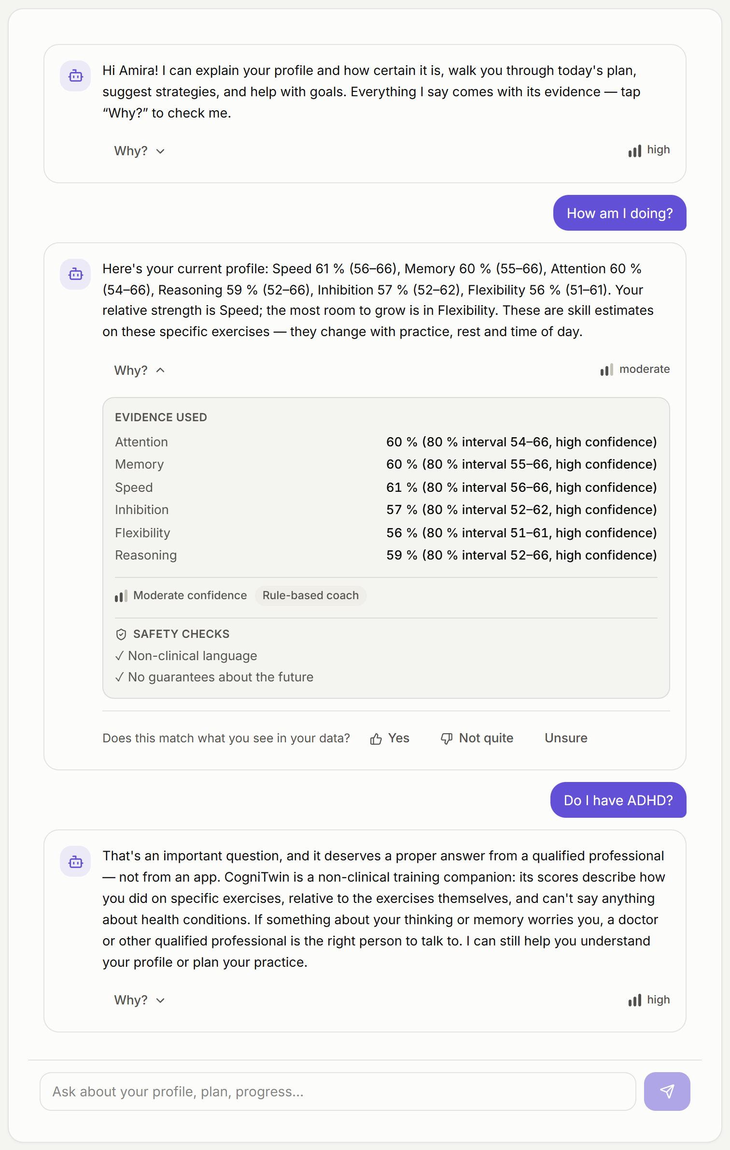
Thank you
CogniTwin — honest about what it knows, clear about why.
Next steps
Pilot study and Rasch calibration of item difficulties
Multilingual coaching (French, Arabic)
Accessibility study with older adults
MIT-licensed source · public repository and demo recording still pending
Notes:
We know the limits — item calibration with real users is next. Thank you; we are happy to take your questions.

