Slide 1
HOD Action Plan
English Middle & High School · Grades 5–9
Dubai Schools Al Khawaneej · Academic Year 2026–2027
Zain Glenn

Slide 2
Vision
What I am here to build
“A cohesive, standards-driven English department where every student is challenged by a well-sequenced curriculum, every teacher is growing professionally, and every decision is grounded in evidence — not assumption.”
Listen before leading
Audit before acting
Systems over heroics
Understand the department before changing it.
Know the gaps before designing solutions.
Make excellent practice the default, not the exception.
Zain Glenn · HOD Interview 2026–2027
Dubai Schools Al Khawaneej

Slide 3
Four Strategic Priorities
Academic Year 2026–2027
01
02
03
04
Curriculum Coherence
Differentiated Teacher Development
Data-Informed Decisions
Grade 9 Transition Readiness
Every class across all five year groups has a complete, standards-aligned unit plan reviewed and approved before teaching begins.
Coaching calibrated to where each teacher is — not a one-size programme. Experienced teachers get leadership; developing teachers get structure.
Standards coverage, attainment, and plan quality tracked across all year groups throughout the year. Evidence — not end-of-year reports — drives decisions.
Students leaving Grade 9 are prepared for upper secondary English. Planning and assessment at this level must reflect that expectation explicitly.
Zain Glenn · HOD Interview 2026–2027
Dubai Schools Al Khawaneej

Slide 4
Term 1 — Establish
24 Aug – 6 Dec 2026 · 13 weeks · 2 units per teacher
Weeks 1–2 Foundation
Rolling Unit Reviews
Observation Round 1
End of Term Review
· Meet every teacher individually — listen before setting direction
· Audit previous year’s plans: standards coverage, essential question quality, assessment alignment
· Begin informal classroom visits before formal observations
· Teachers submit each unit plan before teaching it
· HOD reviews: essential question, standard-to-task alignment, sequencing
· Approve, revise, or reject — every decision written and documented
· No unit taught without an approved plan
· Formal observation of every teacher — at least once
· Focus: does the classroom match the approved plan?
· Post-observation conversation within 48 hours — specific, not general
· Standards coverage check across all five year groups
· Flag gaps to individual teachers in coaching conversations
· One-page summary to SLT: coverage position and PD focus for T2
Zain Glenn · HOD Interview 2026–2027
Dubai Schools Al Khawaneej

Slide 5
Terms 2 & 3 — Develop & Consolidate
Term 2: 4 Jan – 14 Mar 2027 · Term 3: 29 Mar – 2 Jul 2027 · 2 units per teacher per term
Term 2 — Develop
Term 3 — Consolidate
→ Rolling unit reviews continue — each unit approved before teaching
→ Gather attainment data for standards taught in T1
→ Identify patterns across classes in the same year group
→ PLT session: assessment design — how does the task generate evidence?
→ Observation Round 2 — compare against T1 baseline
→ Mid-year standards coverage report to SLT
→ Rolling unit reviews continue through to final units
→ Standards completion push — every year group targets ≥85% coverage
→ Grade 9 transition review: analytical writing, reading, inquiry readiness
→ Individual development reviews with every teacher
→ Curriculum audit for 2027–2028: which standards were consistently undertaught?
→ End-of-year report to SLT: outcomes, gaps, recommendations
Zain Glenn · HOD Interview 2026–2027
Dubai Schools Al Khawaneej

Slide 6
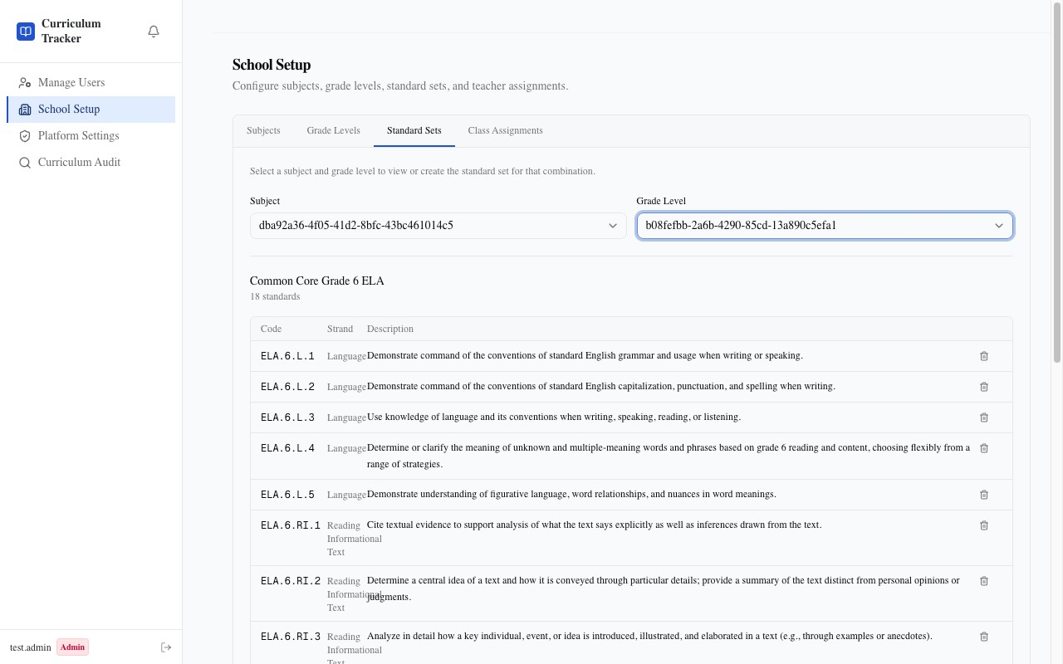
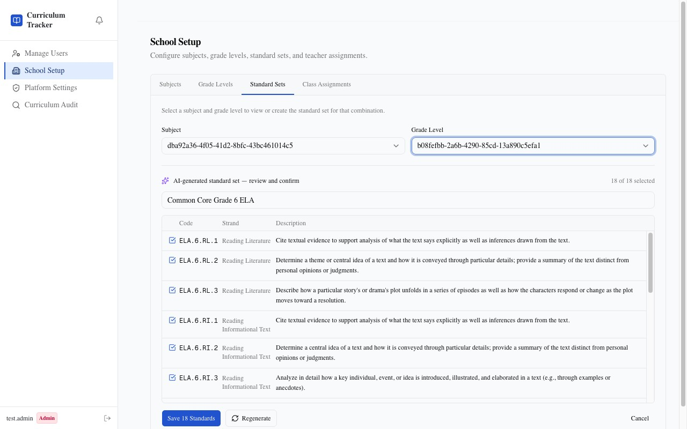
Curriculum Technology
Built for DSK — live at curriculum-tracker-five.vercel.app
A web-based curriculum tracker I built specifically for this school context.
→ Real-time standards coverage heatmap across all classes and year groups
→ Unit plan submission & HOD approval workflow — every decision written and time-stamped
→ HOD feedback recorded against each unit plan — approve, revise, or reject
→ AI-assisted standard suggestion and gap-filling for teachers
→ Live with Grade 6 ELA (41 standards) — ready to scale to all five year groups
NYSED Grade 6 ELA — 41 standards mapped by strand
Building it required designing every HOD workflow in this plan—the review cycle, the feedback loop, the coverage audit—and making each one concrete and repeatable.
AI-generated standard set — reviewed and confirmed before saving
Zain Glenn · HOD Interview 2026–2027
Dubai Schools Al Khawaneej

