Slide 1

Notes:
15-minute talk. Introduce yourself briefly, then move fast — this deck has ~14
slides for ~15 minutes, so keep the motivation slides short and save time for
the results (slides 7-10), which are the core of the talk.

Slide 2
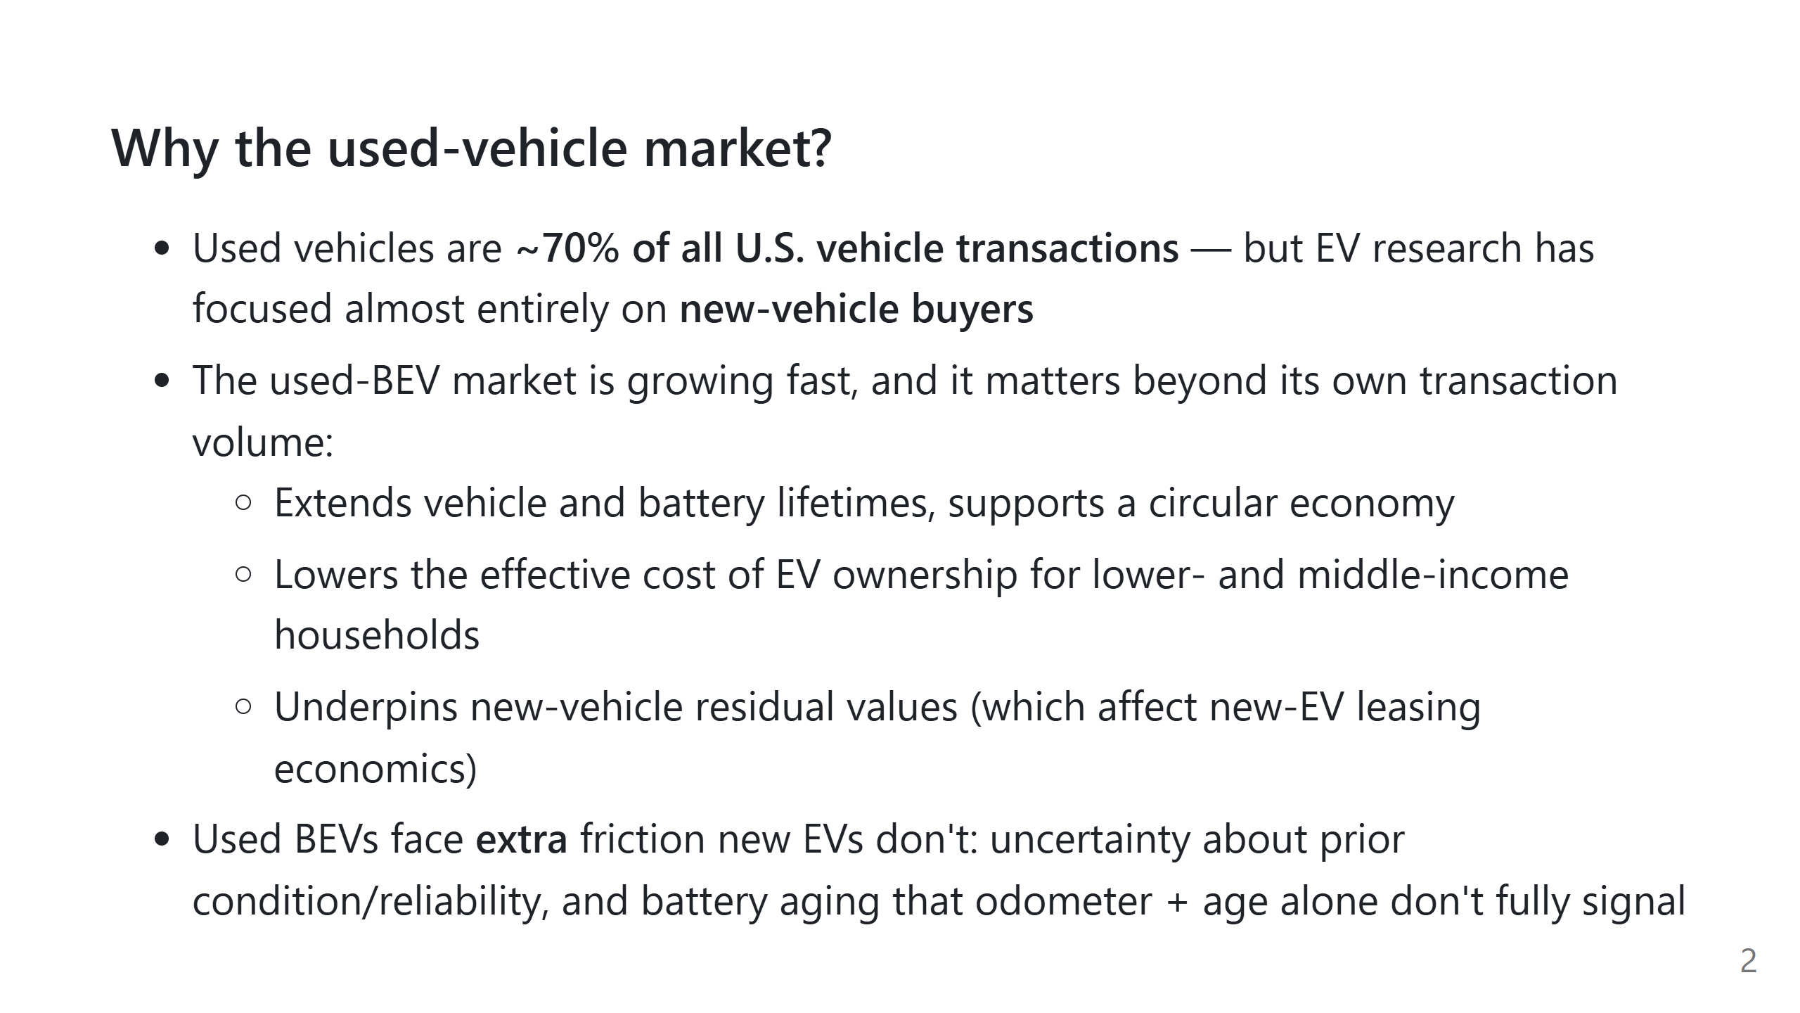
Notes:
Frame this as: everyone studies new EV adoption, almost nobody studies the
used side, even though it's the bigger market and has its own distinct
barriers (condition uncertainty, battery health uncertainty).

Slide 3
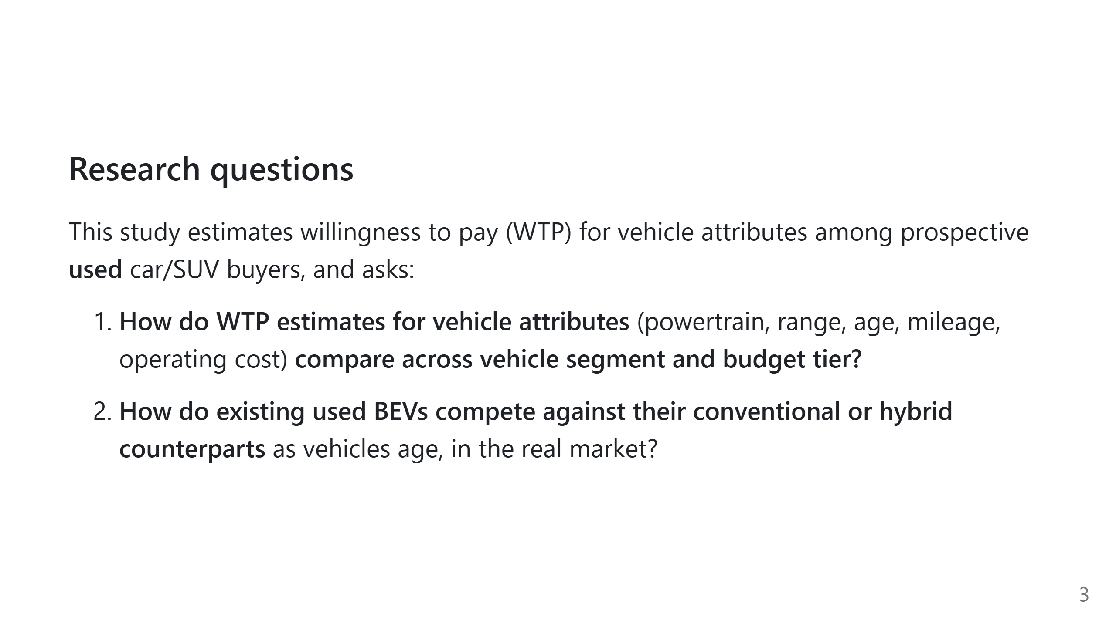
Notes:
These are literally the two subsection headers in the Analysis section (Q1,
Q2) — keep the framing identical to the paper so the audience can map talk
structure to any handout.

Slide 4
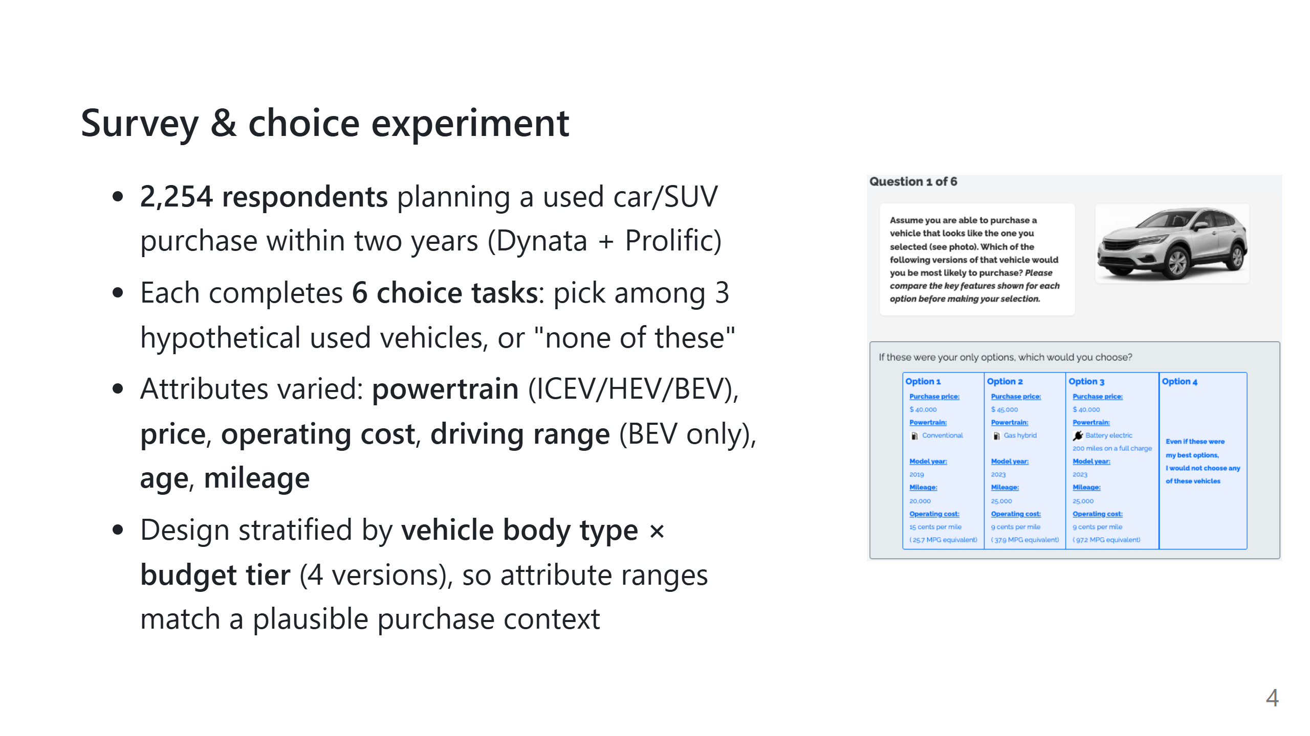
Notes:
Point at the image: this is literally what a respondent saw. Walk through one
row to show the attribute list. Mention respondents picked their own
budget and a vehicle image (car or SUV style) before the DCE tasks, which is
what drove the 4-way stratification.

Slide 5
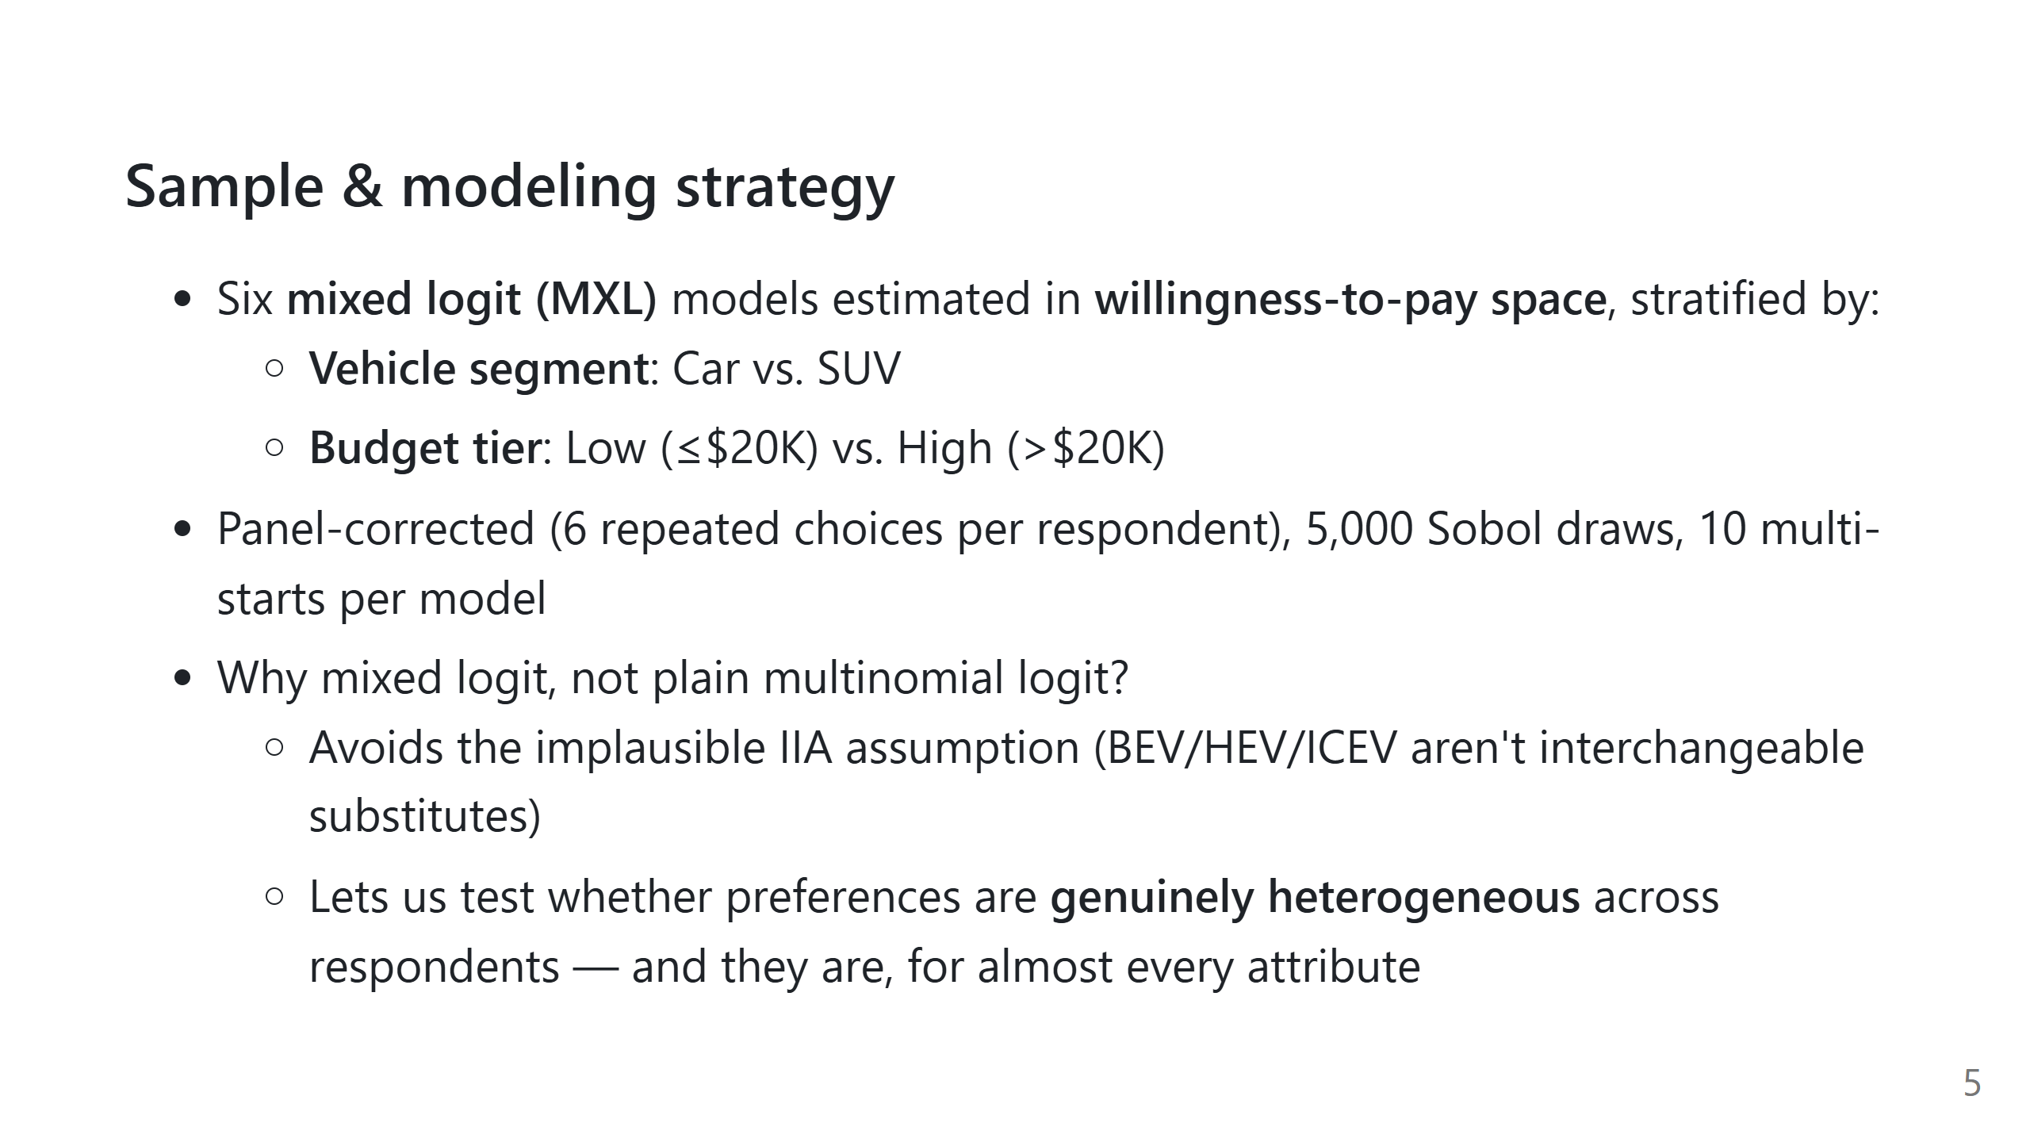
Notes:
Keep this slide light on math — the audience wants the *why*, not the
likelihood function. The key sentence to say out loud: "estimating directly
in dollar terms lets us read willingness-to-pay off the model with no extra
post-processing."

Slide 6
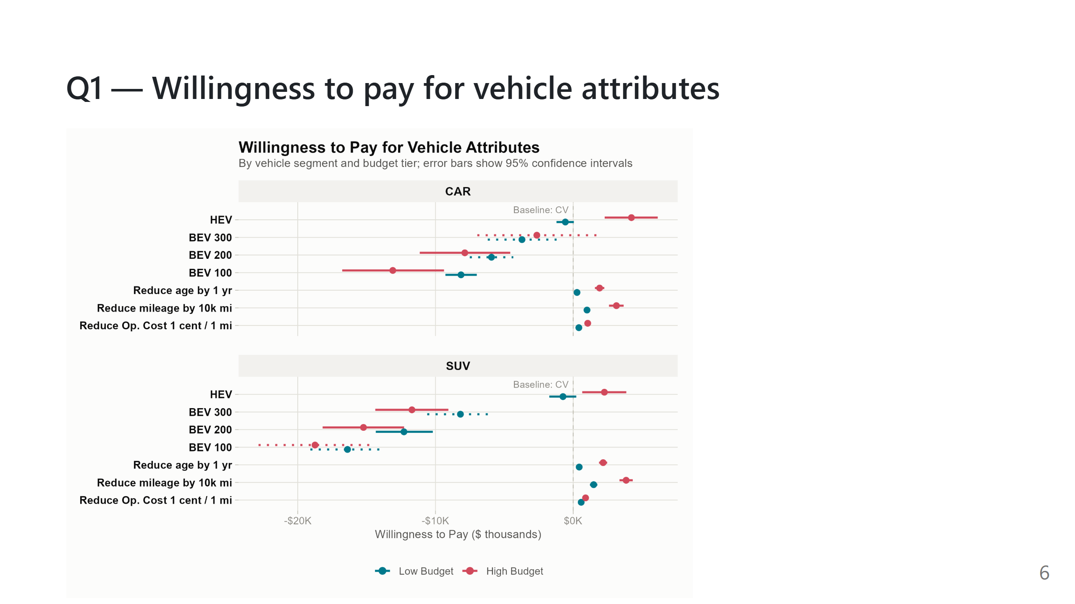
Notes:
This is the main results figure. Walk it top to bottom for one panel (say
CAR) before comparing to SUV. Key points to hit verbally:
- HEV: real premium for high-budget buyers (~$4,200 car / ~$2,300 SUV),
no premium for low-budget buyers
- BEV: penalty everywhere, but shrinks sharply as range rises
- Only high-budget car buyers at 300-mile range get statistically
indistinguishable-from-zero BEV penalty

Slide 7
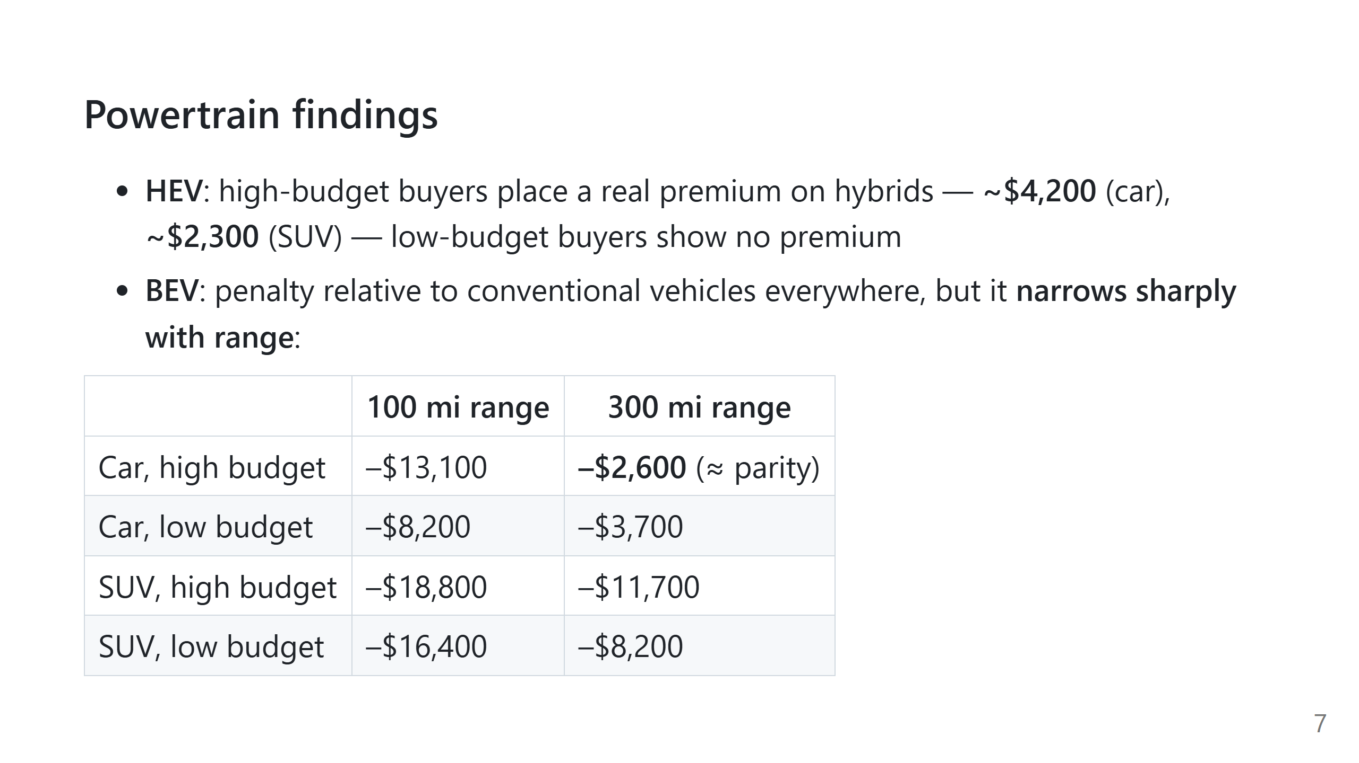
Notes:
The "≈ parity" cell (car, high-budget, 300mi) is the one combination where
the confidence interval spans zero — i.e. not statistically different from
a conventional vehicle. Emphasize that this is the ONLY such combination, and
that added range is the single most effective lever for closing the BEV
valuation gap, especially for higher-budget car buyers.

Slide 8
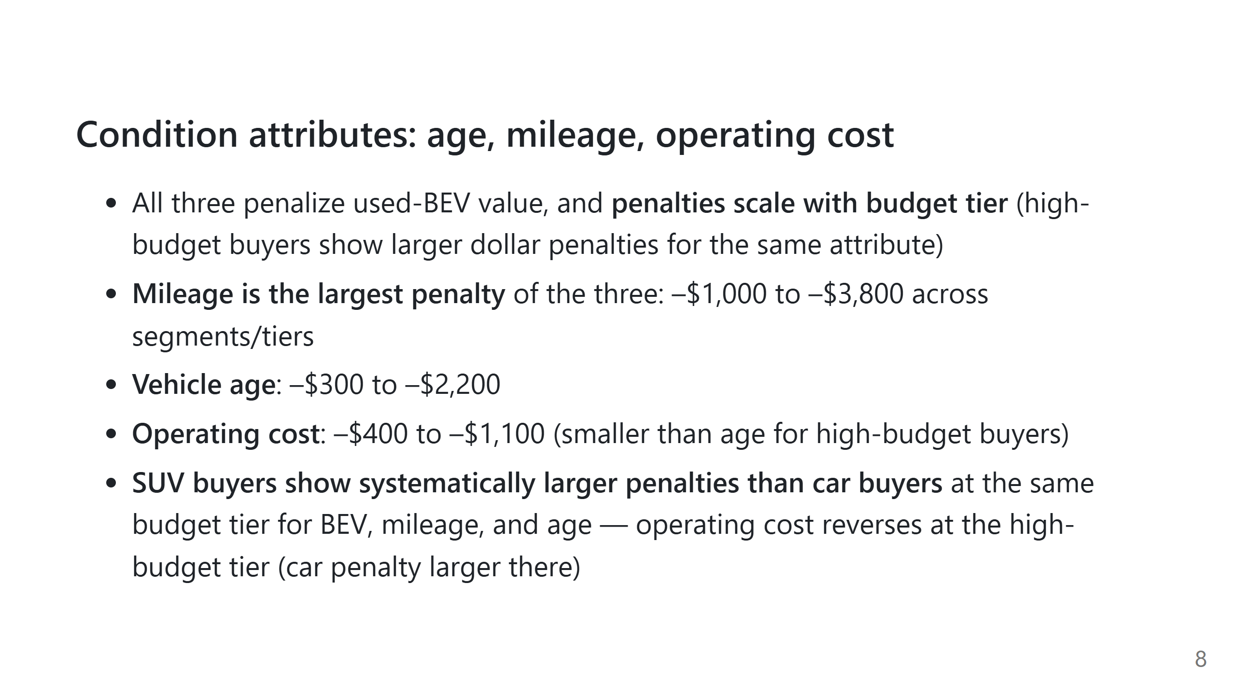
Notes:
Don't over-narrate every number — the table is there to point at. The
takeaway sentence: "the BEV gap is narrowest, and closest to parity, among
higher-budget car buyers buying longer-range vehicles."

Slide 9
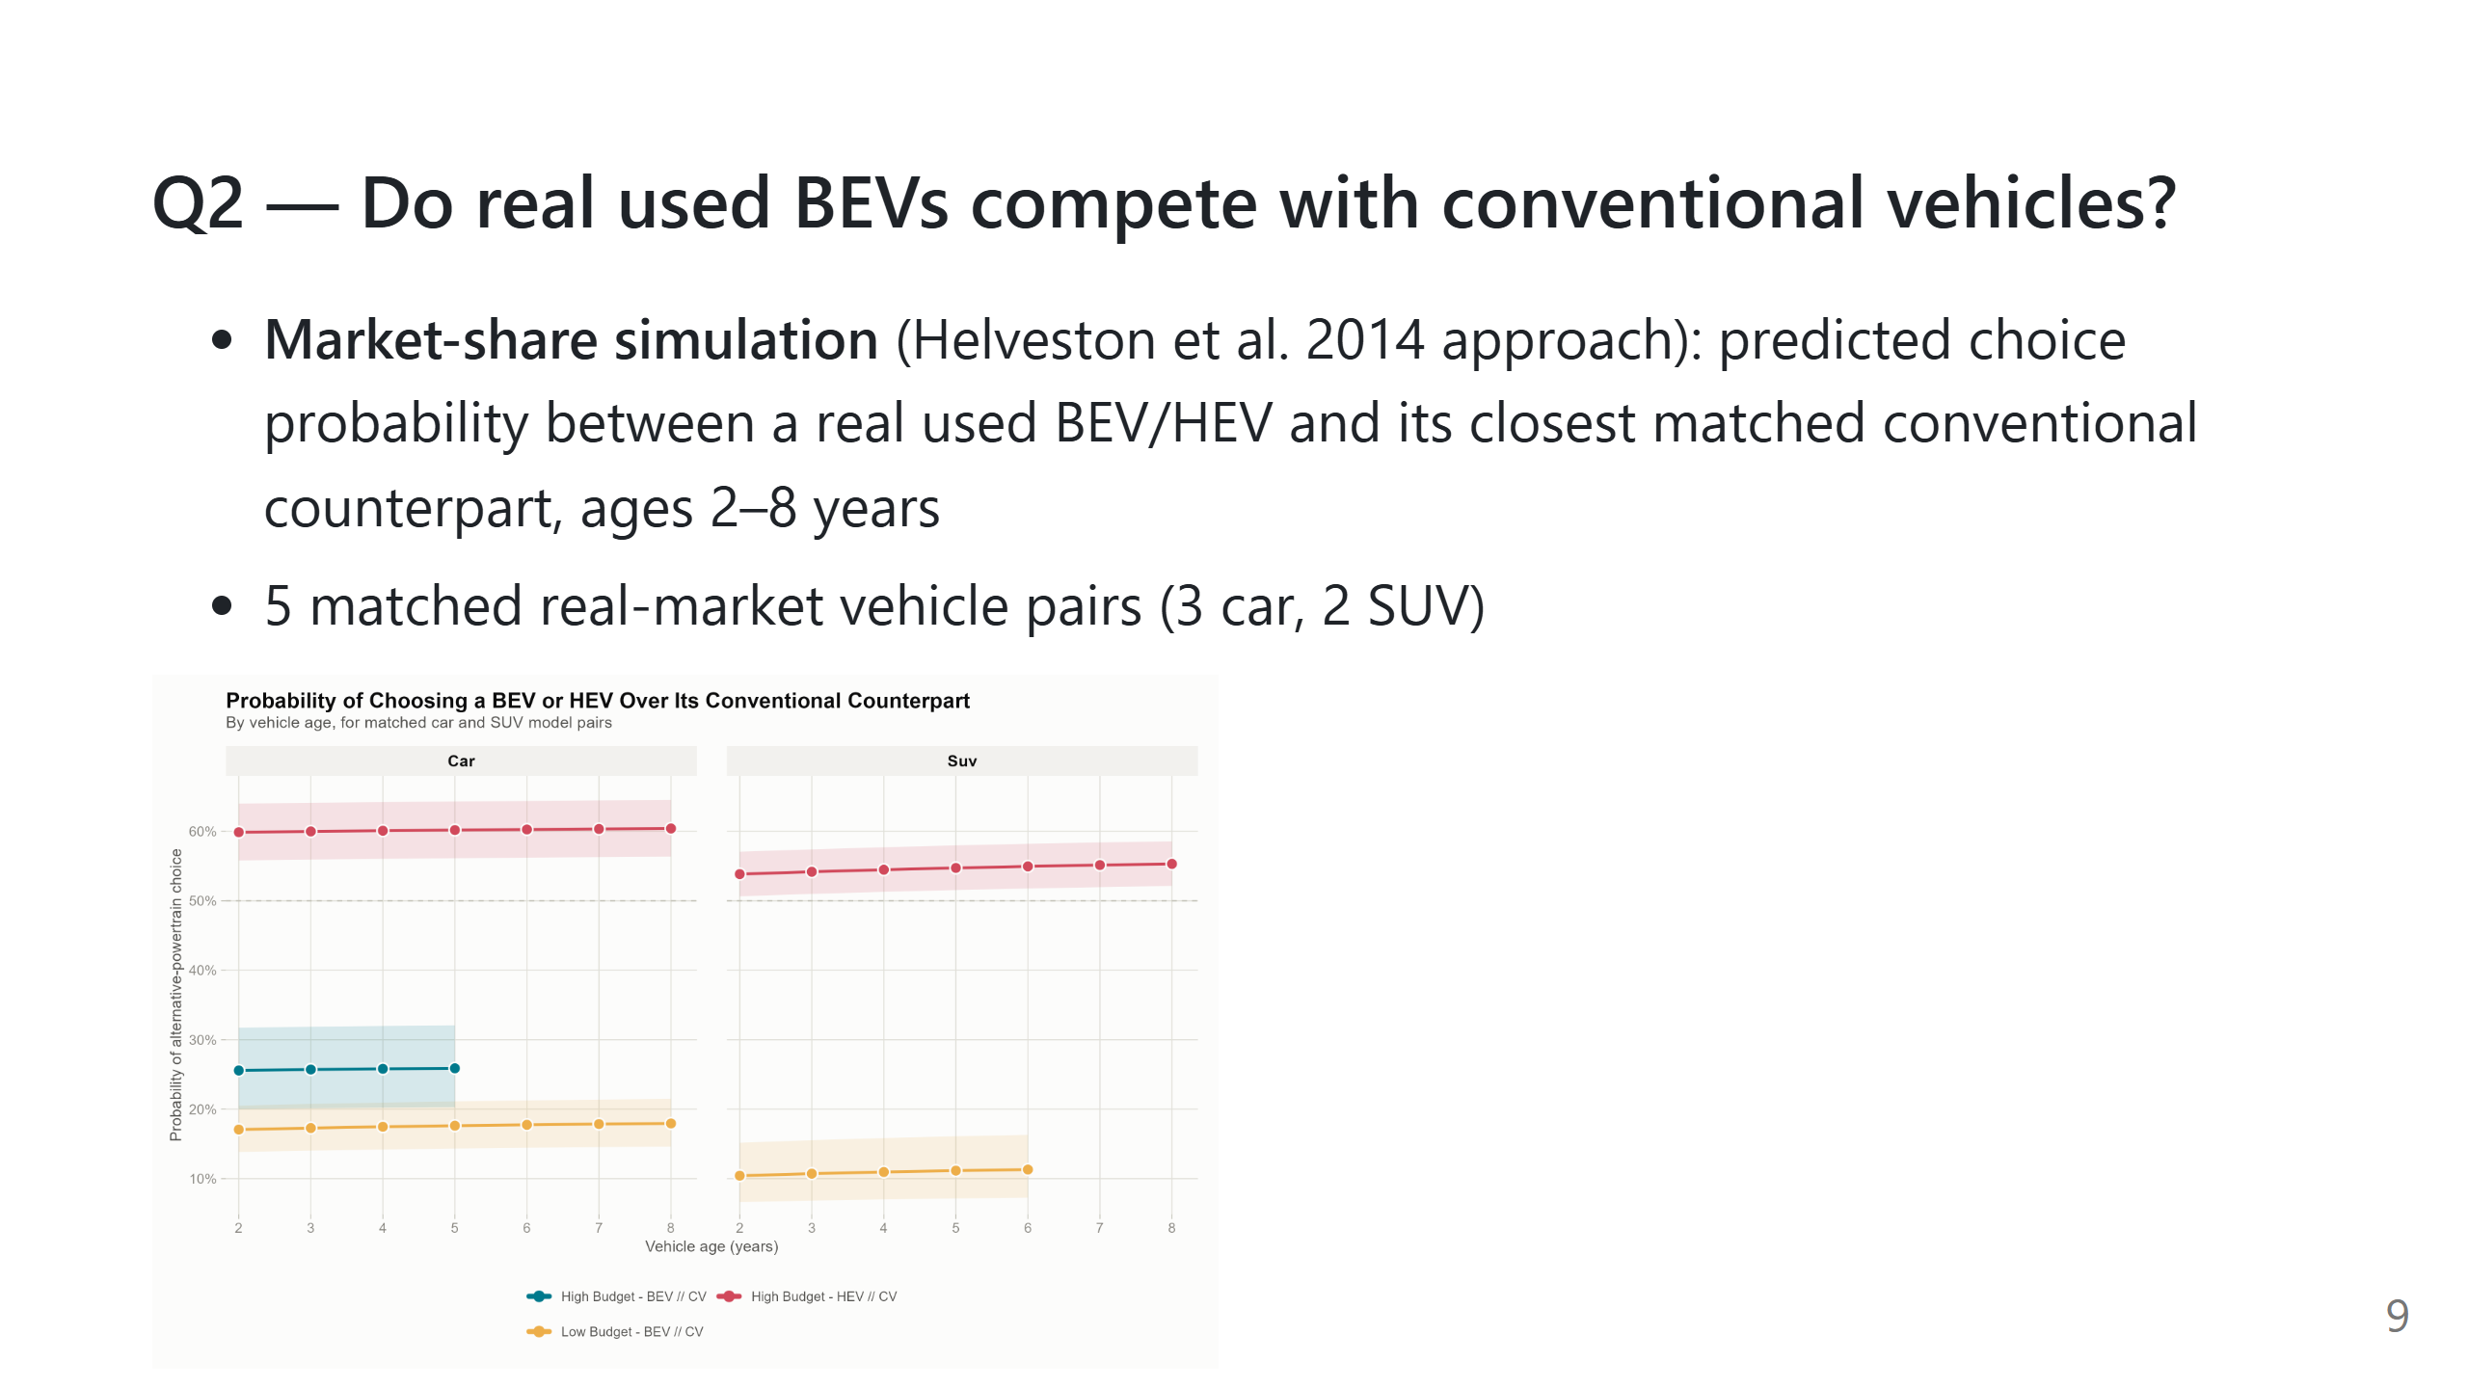
Notes:
Explain the dashed 50% line = choice parity. Two HEV pairings sit above it
across the ENTIRE age range already. No BEV pairing gets close at any age.

Slide 10
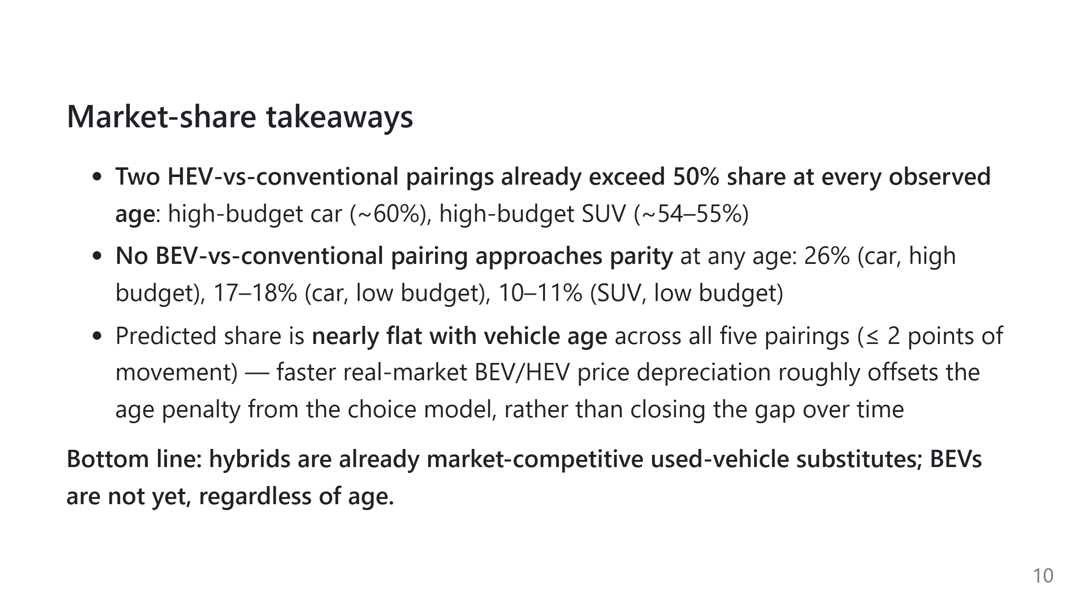
Notes:
This is a good place to pause and let the finding land — it's the most
counter-intuitive result in the paper (many would expect BEV share to climb
with age due to steep depreciation).

Slide 11
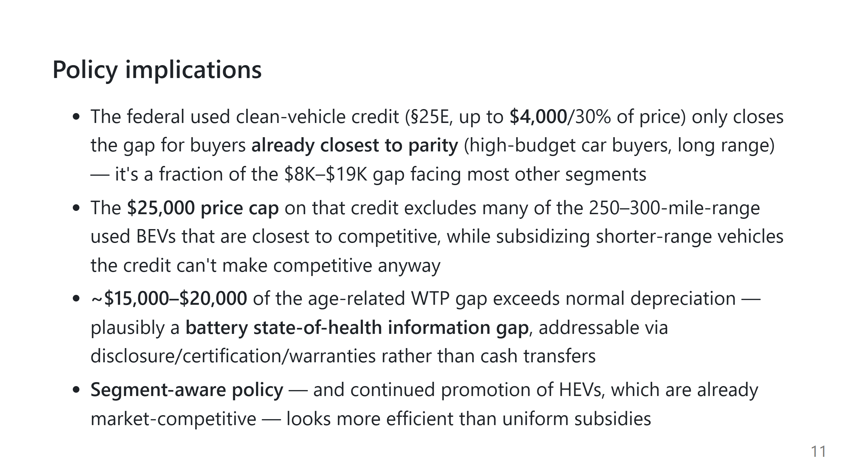
Notes:
This slide is dense; pick 2 of the 4 bullets to actually speak to in detail
depending on audience (policy audience → credit design bullets; industry
audience → HEV/battery-health bullets).

Slide 12
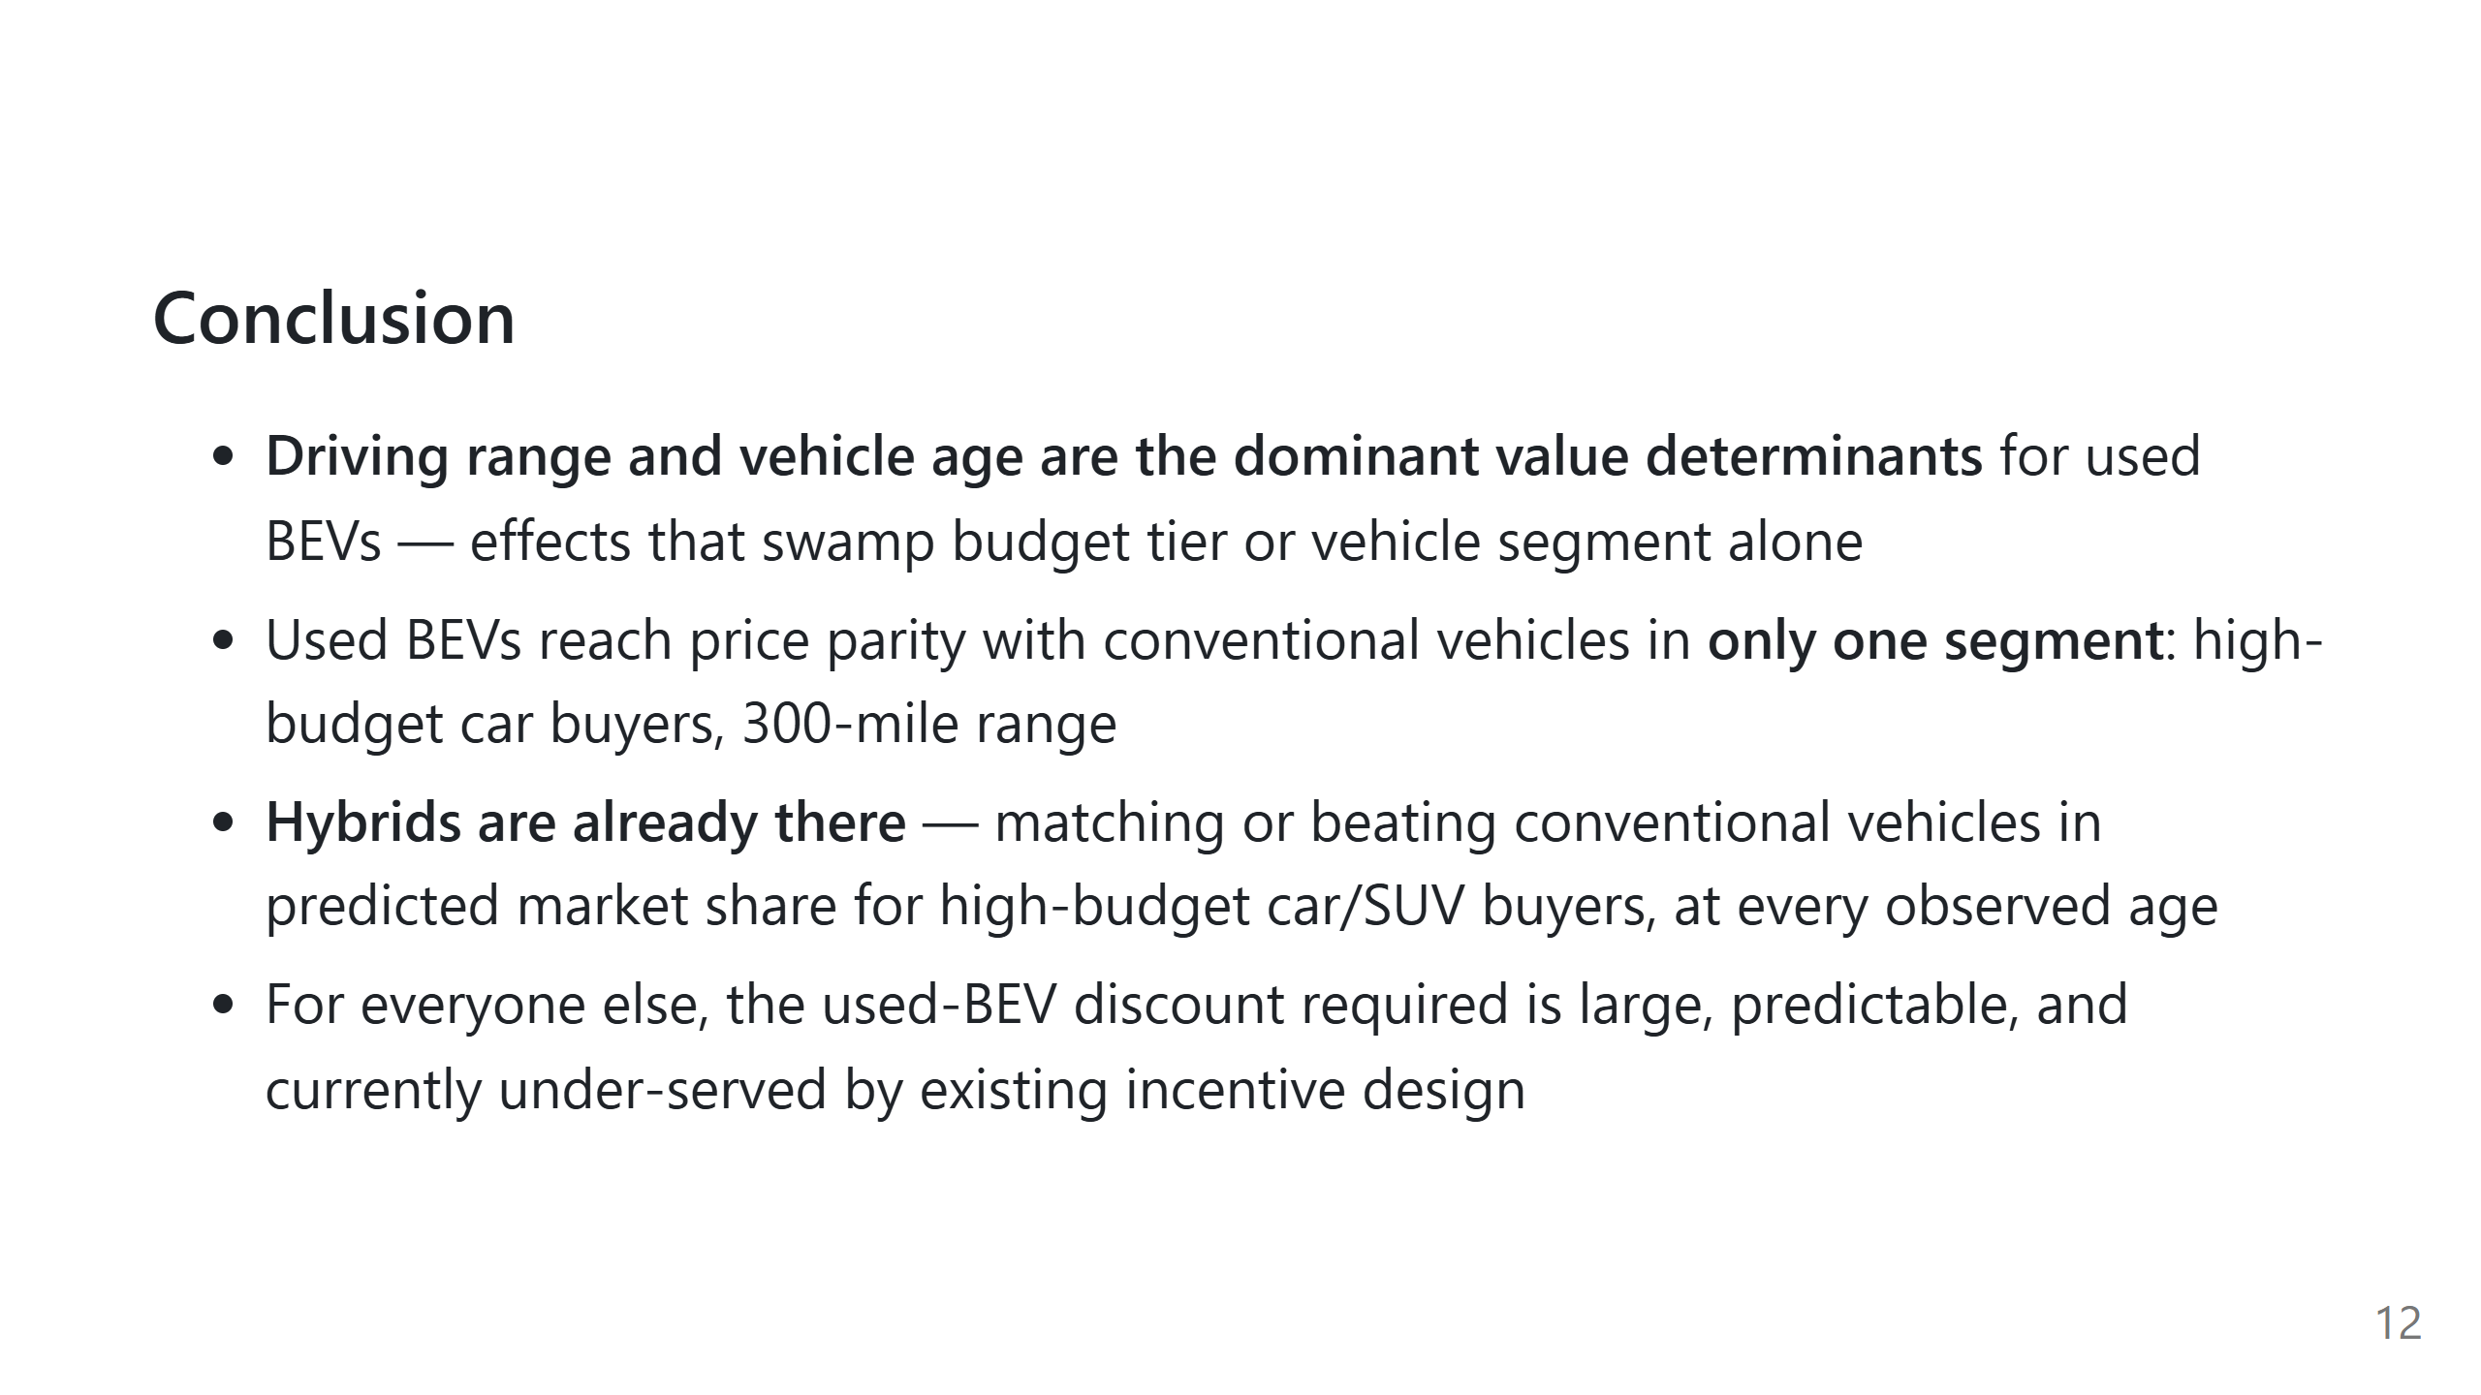
Notes:
This is the "if they remember one slide" slide. Say the four bullets slowly.

Slide 13
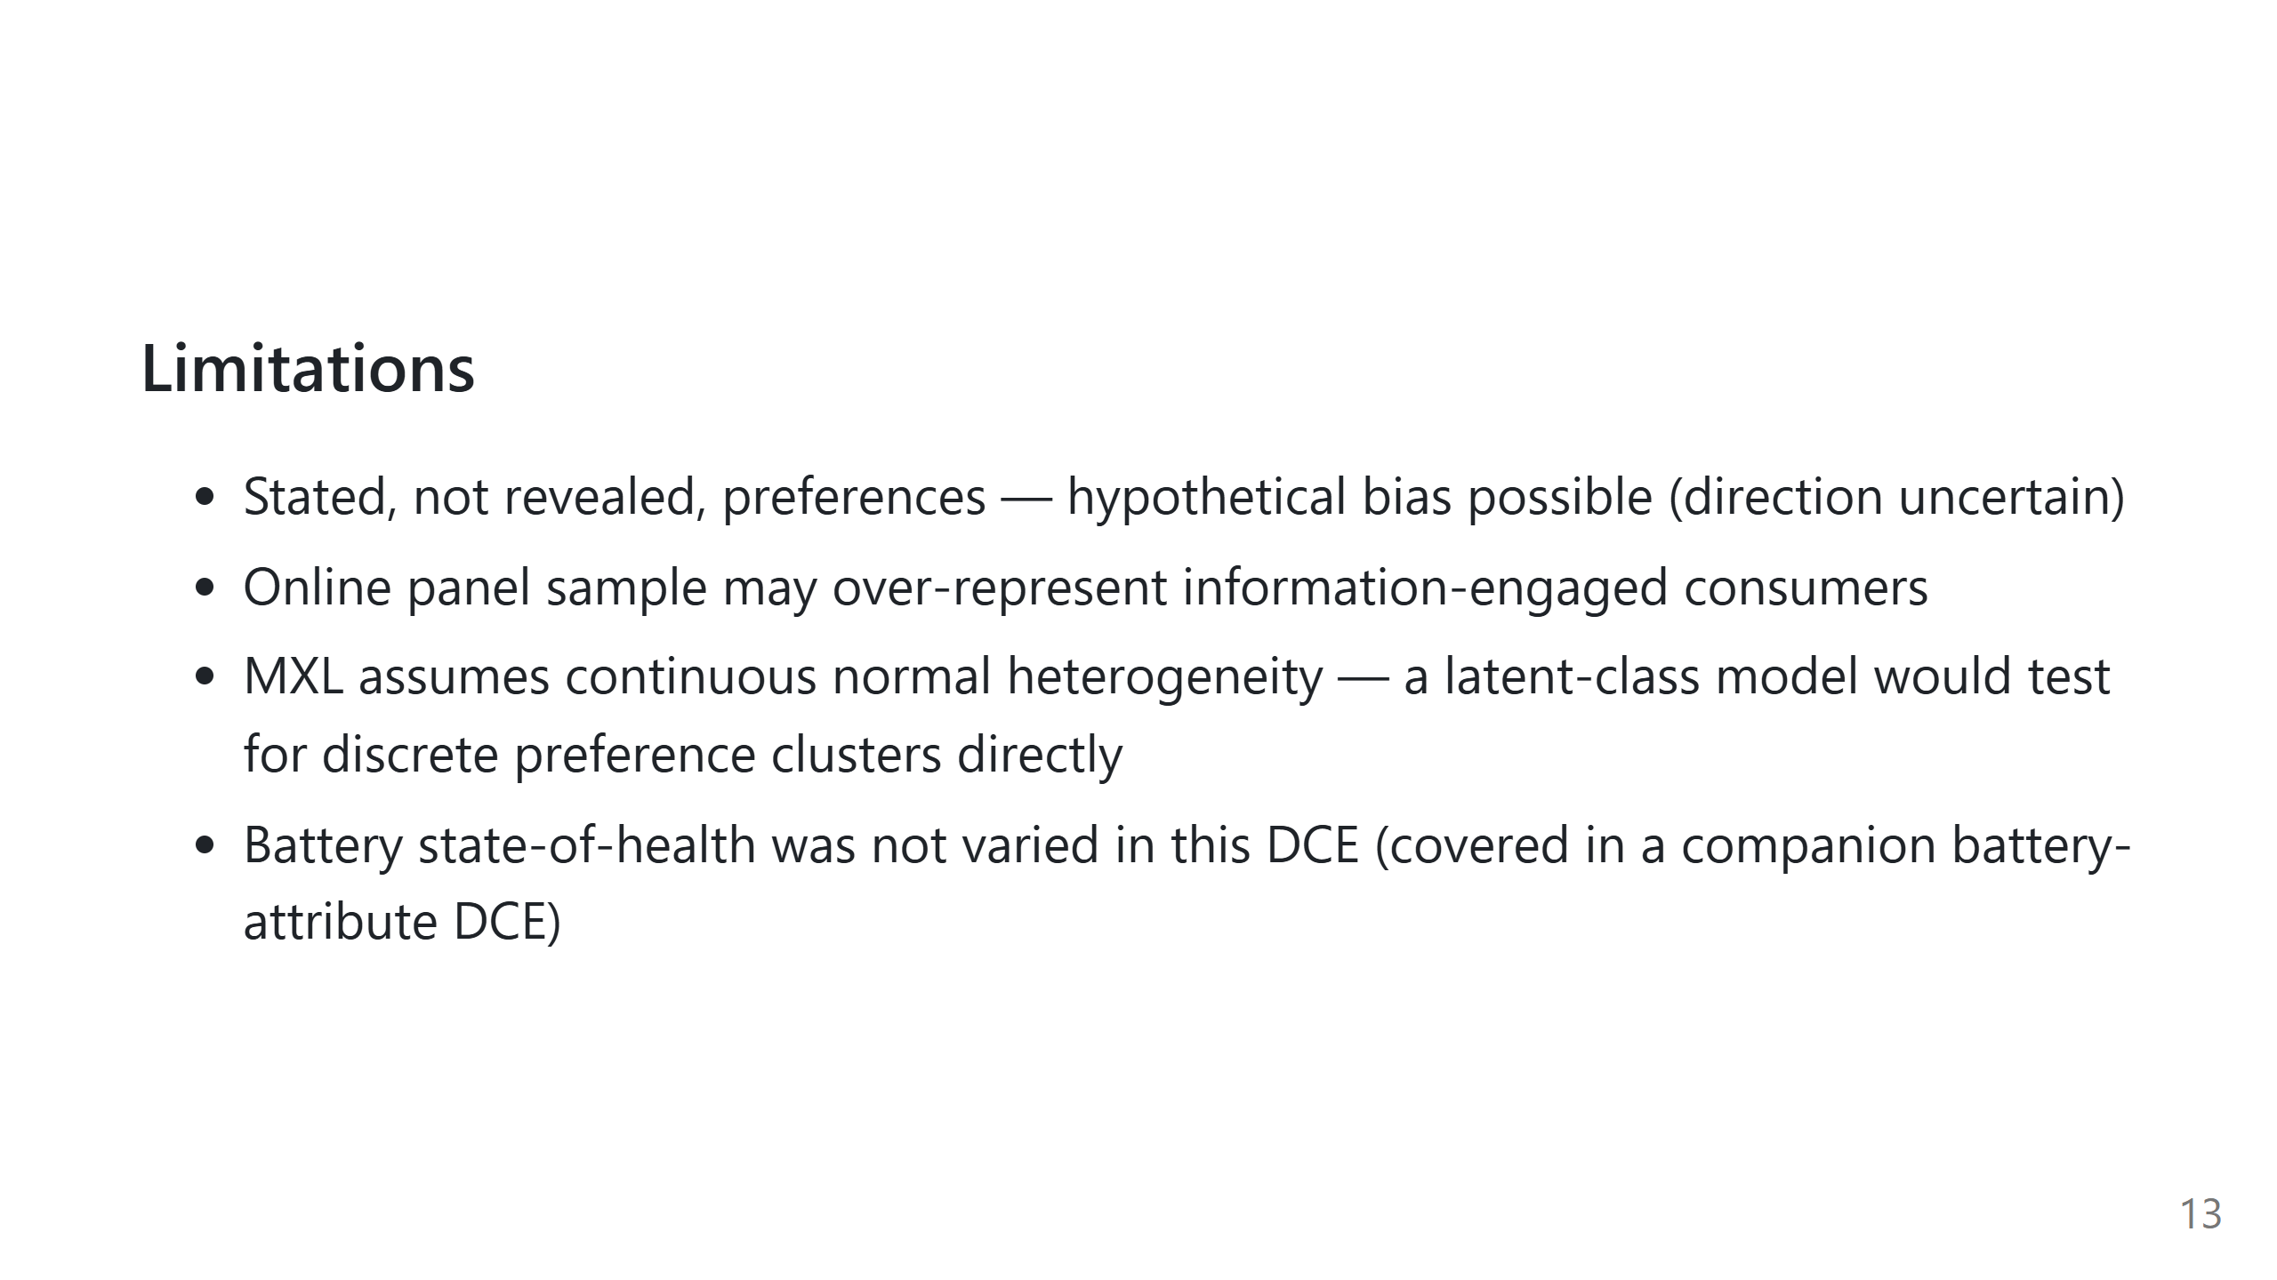
Notes:
Quick slide, ~30 seconds. Don't dwell — just show you've thought about it.

Slide 14

Notes:
Leave this up during Q&A.

