Slide 1
GDS Processing for Cadence in Matlab
By Zainulabideen Khalifa
Notes:
This is an overview of the library which includes motivation, GDSii file format basics, operations and functions and procedure to process layout components. It enables the user to go from HFSS to cadence in one run and eliminate the need to draw manually in Cadence except for actives in PEX.

Slide 2
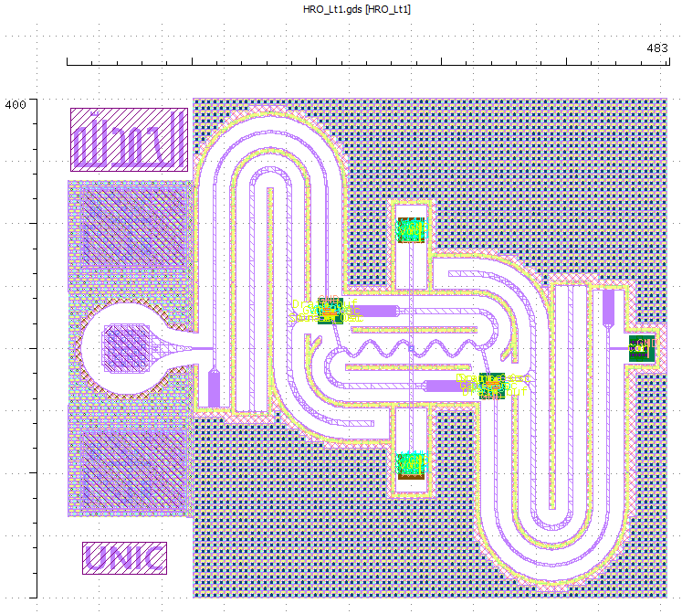
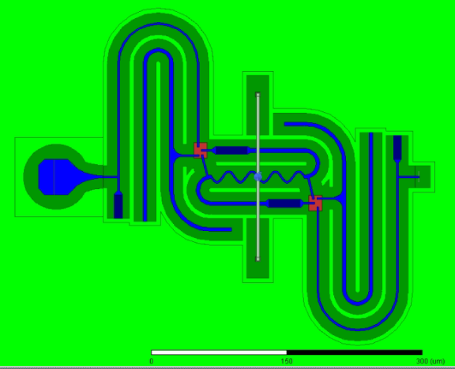
HFSS → Cadence Layout
Notes:
The codes in the library enables you to transform the metals, fill the fillings based on a mosaic block and fill the vias between the metals. Also, you can transform images to Logos.

Slide 3
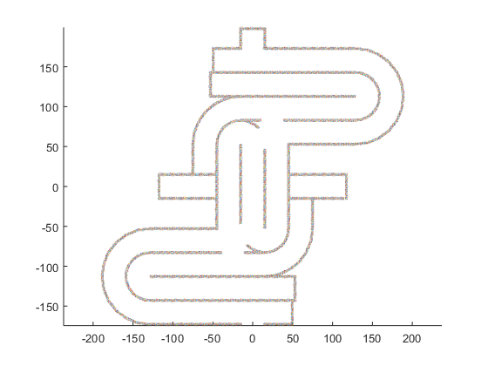

Slide 4
Overview
Each code will have the following general structure:
Import GDS libraries from HFSS or Cadence
Perform the needed operations
Assign layer and data type numbers (mapping).
Export the GDS library.

Slide 5
GDSII File Basics
>> glib = in_glib
glib is a GDSII library:
Library name : HRO_M8_HFSS.gds
Database unit : 1e-09 m
User unit : 1e-06 m
Structures : 1
1 ... HRO_M8_HFSSstruct (11)
>> gstr = glib(1)
gstr is a GDSII structure with 11 elements:
sname = HRO_M8_HFSSstruct
cdate = 120-7-21, 13:31:41
mdate = 120-7-21, 13:31:41
>> gelm = gstr(1)
gelm is a GDSII element:
Type: boundary (1)
layer = 1
dtype = 0
>> XY = gelm(1)
ans =
2.1000 -2.1000
2.1000 0.2630
2.5290 0.5770
3.0150 0.9430
...
gds_library
gds_structures
gds_elements
Different types: “boundary” , “SREF” or … etc
Layer number
Data type number

Slide 6
GDSII File Basics
>> cell2mat(xy(gstr(1)))
65 30
55 30
55 20
65 20
65 30
>> cell2mat(xy(gstr(2)))
55 5
80 5
80 30
70 30
70 15
55 15
55 5
>> cell2mat(xy(gstr(3)))
50.0100 50.0100
100.0100 25.0100
150.0100 50.0100
125.0100 75.0100
50.0100 50.0100
>> cell2mat(xy(gstr(4)))
134.1400 10.0000
140.0000 15.8600
140.0000 24.1400
134.1400 30.0000
125.8600 30.0000
120.0000 24.1400
120.0000 15.8600
125.8600 10.0000
134.1400 10.0000

Slide 7
Main Operations
The goad is to manipulate the layout to pass DRC and maintain your structure from EM point of view.
Operations:
(Discretize): Discretize to correct for allowed angles and minimum grid.
(minWidth): Correct for minimum Width/Space.
Generate vias between metals
Fill metal block fillings like (Grid_Wall)
With these operations, you can convert any design from HFSS to Cadence without any DRC errors.

Slide 8
Operations - Discretize

Slide 9
Operations - minWidth

Slide 10
Functions
% % ----------------------General Functions--------------------------------
% function GDS_plot(igds,str)
% function [ogstr] = GDS_MATH(ig1,ig2,operation,units)
% function [ogstr] = GDS_Merge(igstr,units)
% function [ogstr] = GDS_combine_gstrcells(igstr)
% function [ogelm] = GDS_Create_box(d,c)
% function [ogelm] = GDS_Create_Octagonal(d_side, center, max45)
% function [ogstr] = GDS_Create_Grid(igstr,NxN)
% function [ogstr] = GDS_Split_gstr(igstr,NxN,units)
% function [RC,Center] = GDS_Mosaic_calc(igelm,Mosaic)
% function [ogstr] = GDS_Mosaic(igds,Mosaic,RC,Center)
% function [ogds] = GDS_Shift(igds,shift)
% function [ogds] = GDS_reset(igds,info)
% function [iglib] = GDS_auto_rename_glib(iglib,sname)
% % ----------------------Layout specific Functions------------------------
% function [ogstr] = GDS_checkvias(igstr,d)
% function [ogstr] = GDS_Mosaic_intersections(igds,Mosaic_gstr,units)
% function [ogstr] = GDS_Mosaic_imprint(block_gstr,bbox_block,igstr,bbox_gstr,units)
% function [ogstr] = GDS_Discretize_gstr(igstr,minGrid,units)
% function [ogelm] = GDS_minWidth_gelm(igelm,minWidth,minGrid,SmallestWireWidth,units)
% function [ogstr] = GDS_minWidth_gstr(igstr,minWidth,minGrid,SmallestWireWidth,units)
% function [xo,yo] = Discritize_2P(X,Y,minGrid)
% function [XY,count] = minWidth_corr(XY,minWidth,minGrid,SmallestWireWidth,units)
% % ----------------------ST55 Functions-----------------------------------
% function [info] = GDS_ST55(str)
% function [ogstr] = GDS_ST55_Generate_tileNot(igstr)

Slide 11
Needed layers from HFSS
M8 or your line metal layer
Shielding
Shrunk version of shielding for via filling
Grid_Wall filling layers (connected with shielding)
tileNot layer
Keep in mind that all layer must have the same reference point.

Slide 12
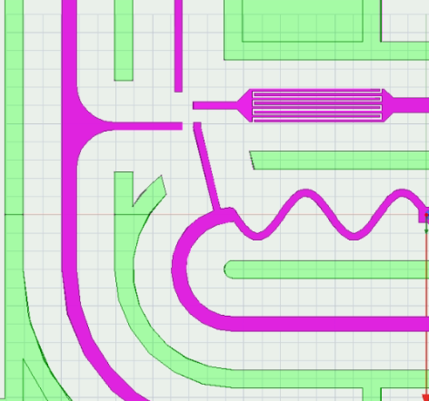
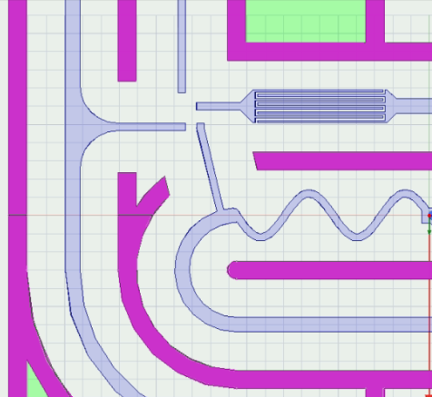
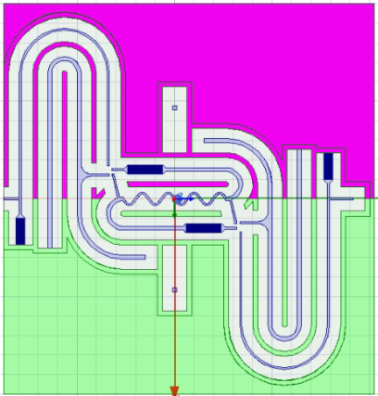
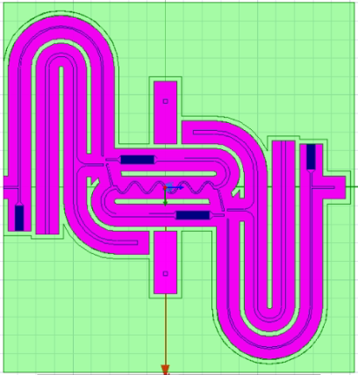
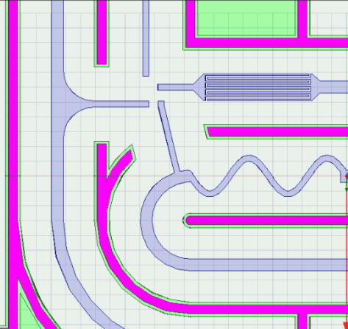
Needed layers from HFSS

Slide 13
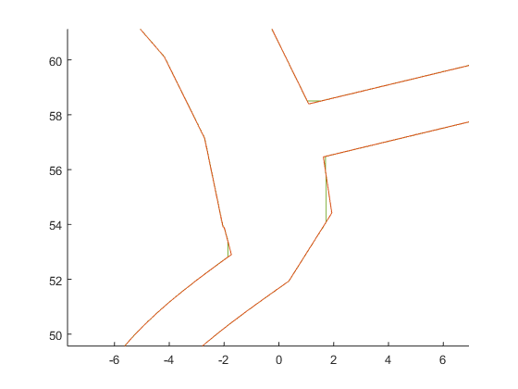

Processing M8
Export the GDS layer from HFSS
Import in Matlab
Discretize and minWidth
Split (Why ?!)
Reset layer and dtype
Export

Slide 14
Processing Vias
There are two procedures for processing vias:
Processing vias between the shield walls and the ground layer.
Processing vias between the shield walls itself.

Slide 15
Processing Wall-Ground Vias

Slide 16
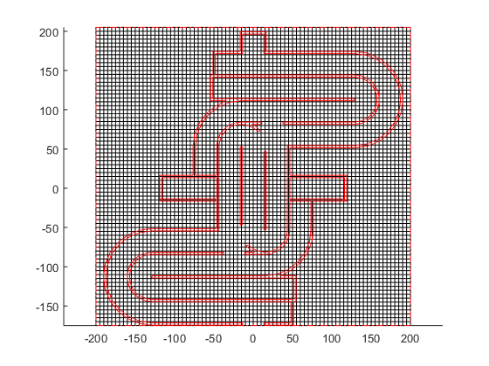
Processing Wall-Ground Vias

Slide 17
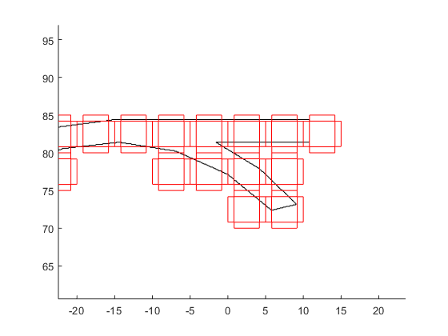
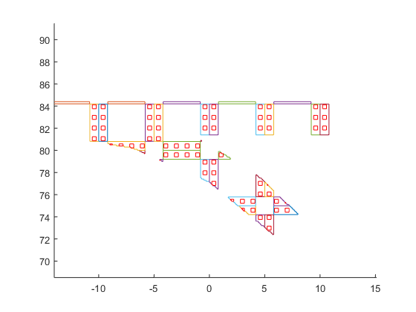
Processing Wall-Ground Vias

Slide 18
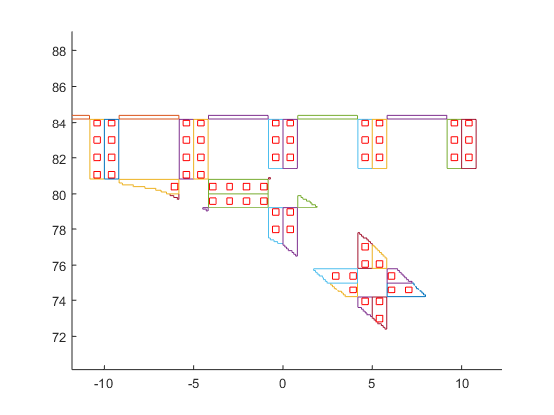
Processing Wall-Ground Vias

Slide 19
Processing Wall-Wall Vias

Slide 20
Processing Wall-Wall Vias

Slide 21
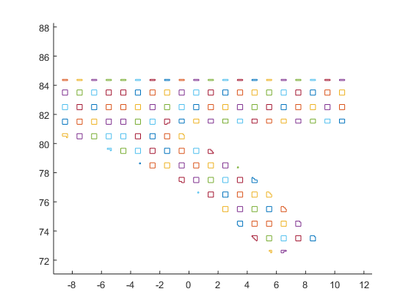
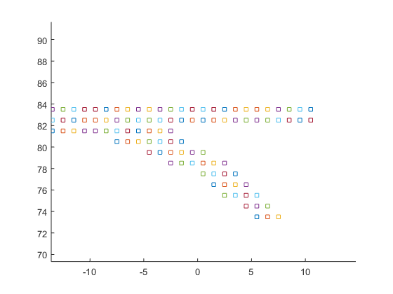
Processing Wall-Wall Vias

Slide 22
Processing Fillings and Wall Metals

Slide 23
Processing Fillings and Wall Metals

Slide 24
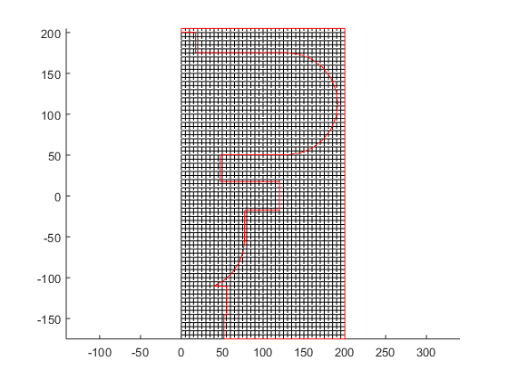
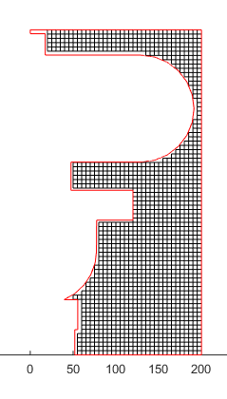
Processing Fillings and Wall Metals

Slide 25
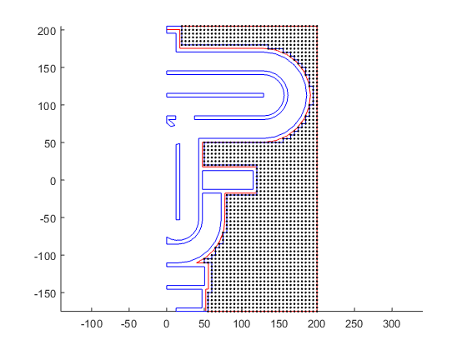
Processing Fillings and Wall Metals

Slide 26
Processing tileNOT filling
Export the GDS layer from HFSS
Import in Matlab
Discretize
Split
Reset layer and dtype
Export

Slide 27
THE END !

