Slide 1
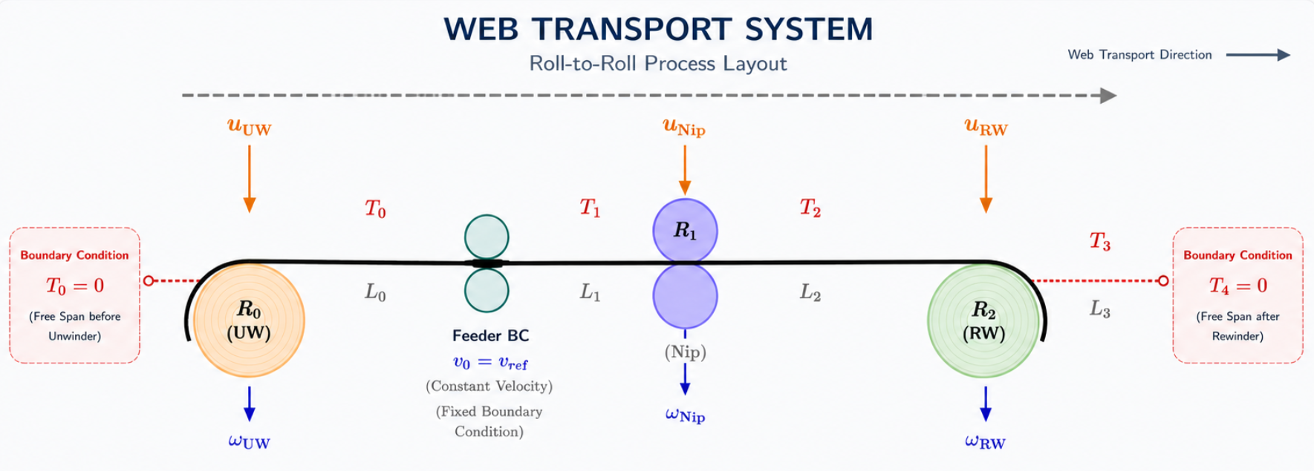
R2R Dashboard Mathematical Workflow
Working equations, plant presets, excitation cases, simulation metrics, SysID estimates, and validation roadmap
Simulation: tension RMSE + overshoot
SysID: kt, kf, EA
Validation: logging, drift, retuning
Plants: P01-P10 EA presets
Future work
Dashboard mathematics, plant presets, excitation studies, and validation outputs
01

Slide 2
How the Dashboard Works
R2R SysID Validation
1. Plant
2. Excitation
3. Controller
4. RK4 Model
5. Outputs
P01-P10 preset
EA_N + metadata
baseline R/L/J/f/b
ET1, ET3, ET6
E_Toggle, EVR
amplitude + noise
Outer tension PI
velocity PI
ZOH motor voltage
1 ms physics
tensions + speeds
logged rows
Simulation metrics
SysID estimates
validation plots
Simulation path
SysID and validation path
The selected plant changes the physical stiffness used in the state equations.
Logged simulation rows become the regression data for parameter identification.
Excitation adds repeatable motor-voltage perturbations to the closed-loop controller output.
SysID estimates kt_UW, kt_Nip, kt_RW, kf_UW, kf_Nip, kf_RW, and EA.
The simulator logs T1/T2/T3, omega_UW/omega_Nip/omega_RW, motor inputs, and velocities.
Validation tabs compare logging rate, excitation profile, drift sensitivity, and retuning cost.
The result panel summarizes tension_rmse_N, max_overshoot_N, t90_s, control_effort_rms_V, samples, and duration.
Calculation panels show one worked example so every output can be traced back to equations.
Dashboard mathematics, plant presets, excitation studies, and validation outputs
02

Slide 3
Core State Equations Used by the Backend
R2R SysID Validation
State model
The equations tab now shows only equations that feed backend simulation, metrics, and SysID.
State and input vectors
Web torque balance
x = [T1, T2, T3, omega_UW, omega_Nip, omega_RW]
u = [u_UW, u_Nip, u_RW]
v_i = R_i * omega_i
tau_web,UW = (T3 - T1) * R_UW
tau_web,Nip = (T1 - T2) * R_Nip
tau_web,RW = (T2 - T3) * R_RW
Reduced three-span tension dynamics
Roller velocity dynamics
dT1/dt = (EA/L1)(v_Nip - v_UW) - lambda_T(T1 - T1_ref)
dT2/dt = (EA/L2)(v_RW - v_Nip) - lambda_T(T2 - T2_ref)
dT3/dt = (EA/L3)(v_RW - 0.5(v_UW + v_Nip))
- lambda_T(T3 - T3_ref)
domega_i/dt = (kt_i*u_i + tau_web,i - kf_i*omega_i) / J_i
J_i: roller inertia
kt_i: voltage-to-torque gain
kf_i: viscous friction
u_i: motor voltage command
These equations create the next state used for controller updates, metric calculations, and the logged rows that feed SysID.
Dashboard mathematics, plant presets, excitation studies, and validation outputs
03

Slide 4
Controller, ZOH, and Time Scales
R2R SysID Validation
Outer tension PI correction
Velocity PI and feedforward
e_i = T_ref,i - T_i
c_i = Kp_star*e_i + (Kp_star/TI)*integral(e_i dt)
v_ref,UW = v_line - c1 - 0.5*c3
v_ref,Nip = v_line + c1 - c2 - 0.5*c3
v_ref,RW = v_line + c2 + c3
tau_cmd,i = Kvel*e_omega,i + (Kvel/TI_vel)*integral(e_omega,i dt) + tau_ff,i
tau_ff,i = kf_i*omega_ref,i - tau_web,i
u_i = clamp(tau_cmd,i / kt_i)
Every 1 ms
Every 10 ms
Between PI ticks
Every Tlog
RK4
PI
ZOH
PLC
Fast physics step updates tension and roller speed.
Controller computes a new motor-voltage command.
Held input u stays constant while RK4 keeps integrating.
Logged data becomes the source for SysID.
Example
If Ts = 10 ms and dt = 1 ms, one controller action contains 10 small physics calculations. Logging at Tlog = 20 ms records every second controller action, which directly affects SysID data density and accuracy.
Dashboard mathematics, plant presets, excitation studies, and validation outputs
04

Slide 5
Plant Presets: What Changes Between P01-P10
R2R SysID Validation
Current dashboard behavior
Dynamic safety policy
Why plant choice changes results
Each plant uses supplement Table S12 EA_N and metadata.
P01-P02 are inside the extracted baseline EA range. P03-P10 are high-EA cases; the app recommends zero excitation unless retuned inputs and exact arrays are supplied.
EA multiplies strain rate in dT/dt. A stiffer web converts the same speed mismatch into a larger tension-rate response.
Exact per-roller R, L, J, f, and b arrays are not yet supplied in the extracted JSON.
The backend therefore keeps baseline R/L/J/f/b until those arrays are available.
Plant
Material / scale
EA_N
Regime
Recommended input
P01
PE / lab
3,200 N
O-UD
0.080 V
P02
PET / lab
9,600 N
O-UD
0.046 V
P03
PET / lab
40,000 N
H-Osc
0 V safety
P04
PET / pilot
50,000 N
O-UD
0 V safety
P05
Paper / prod
144,000 N
O-UD
0 V safety
P06
Al / lab
310,500 N
H-Damp
0 V safety
P07
Al / pilot
414,000 N
H-Osc
0 V safety
P08
Al / prod
1,242,000 N
O-UD
0 V safety
P09
Cu / lab
351,000 N
H-Damp
0 V safety
P10
Cu / pilot
351,000 N
O-UD
0 V safety
Validation meaning: plant comparisons are EA-driven until full per-roller arrays are added.
Dashboard mathematics, plant presets, excitation studies, and validation outputs
05

Slide 6
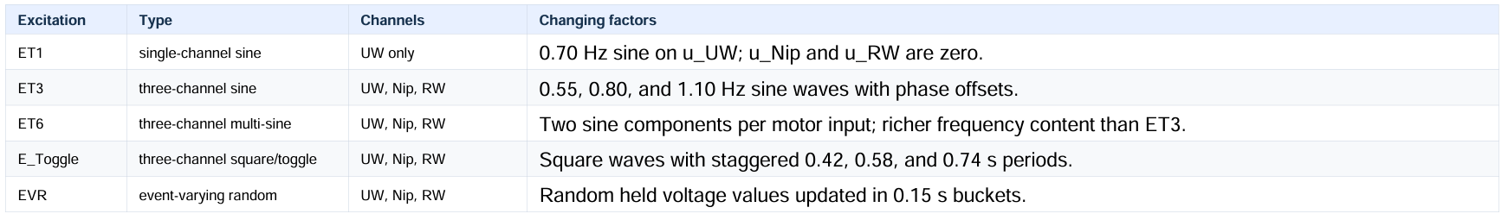
Excitation Types: What Changes in the Inputs
R2R SysID Validation
Excitation
Type
Channels
Changing factors
ET1
single-channel sine
UW only
0.70 Hz sine on u_UW; u_Nip and u_RW are zero.
ET3
three-channel sine
UW, Nip, RW
0.55, 0.80, and 1.10 Hz sine waves with phase offsets.
ET6
three-channel multi-sine
UW, Nip, RW
Two sine components per motor input; richer frequency content than ET3.
E_Toggle
three-channel square/toggle
UW, Nip, RW
Square waves with staggered 0.42, 0.58, and 0.74 s periods.
EVR
event-varying random
UW, Nip, RW
Random held voltage values updated in 0.15 s buckets.
Why excitation changes the result
Dashboard behavior
Equation tab
reference
Excitation changes which motor channels move, how much frequency content reaches the system, and whether the logged data contains enough independent motion to identify kt, kf, and EA.
Amplitude, tension noise, and omega noise alter the data quality. Larger amplitude improves excitation but can destabilize high-EA reduced-model runs; noise degrades SysID accuracy.
Dashboard mathematics, plant presets, excitation studies, and validation outputs
06

Slide 7
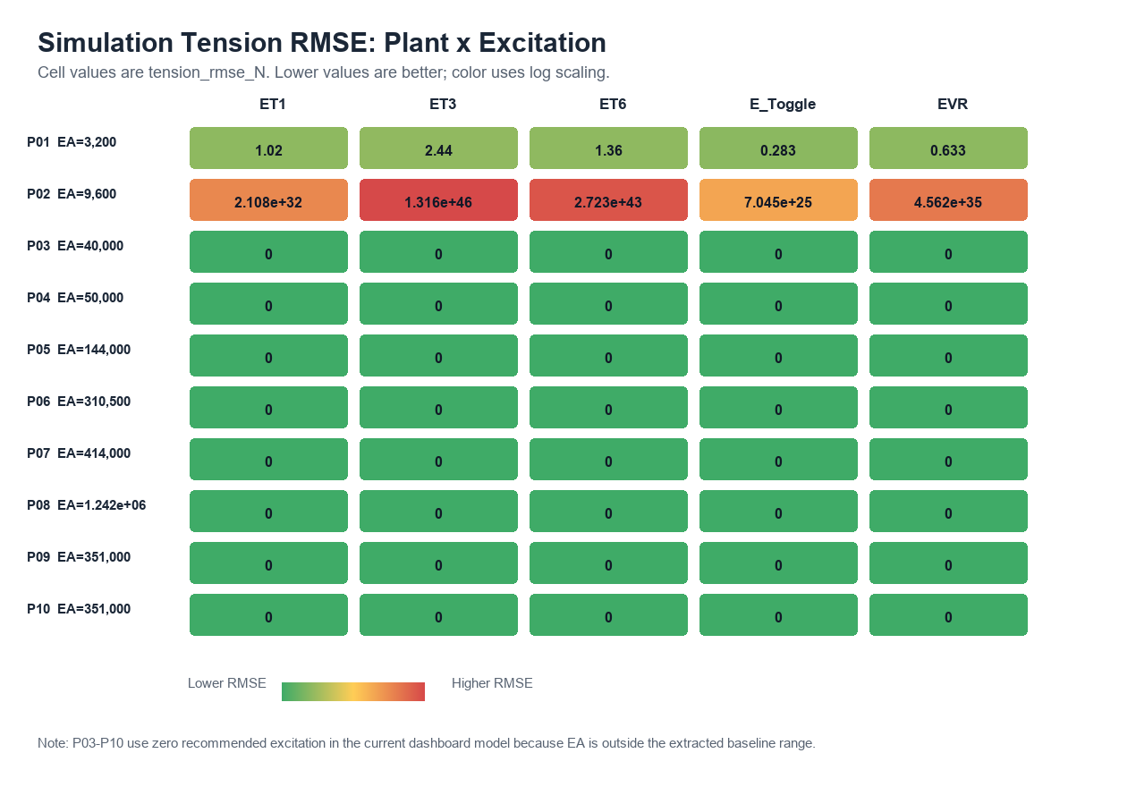
Simulation Outputs: Tension RMSE and Overshoot
R2R SysID Validation
Metrics calculated after each simulation run
Dashboard card
Dashboard card
Workbook
tension_rmse_N = sqrt( sum((T_i[k] - Tref_i)^2) / (3N) )
max_overshoot_N = max_i,k( T_i[k] - Tref_i )
control_effort_rms_V = sqrt( sum(u_i[k]^2) / (3N) )
t90_s = first logged time all spans enter the settling band
RMSE
Overshoot
XLSX
Average tracking error across T1, T2, and T3.
Largest positive tension excursion above target.
Summary sheet plus time-series data sheet.
How to read the simulation result
Plant changes EA_N and therefore the stiffness term inside dT/dt.
Excitation changes the voltage waveform added to u_UW, u_Nip, and u_RW.
The app logs each simulated state, calculates metrics, and writes the Excel summary for download.
Comparing plant/excitation pairs shows which inputs keep tension tracking stable.
Example report graph: plant-by-excitation tension RMSE comparison
Dashboard mathematics, plant presets, excitation studies, and validation outputs
07

Slide 8
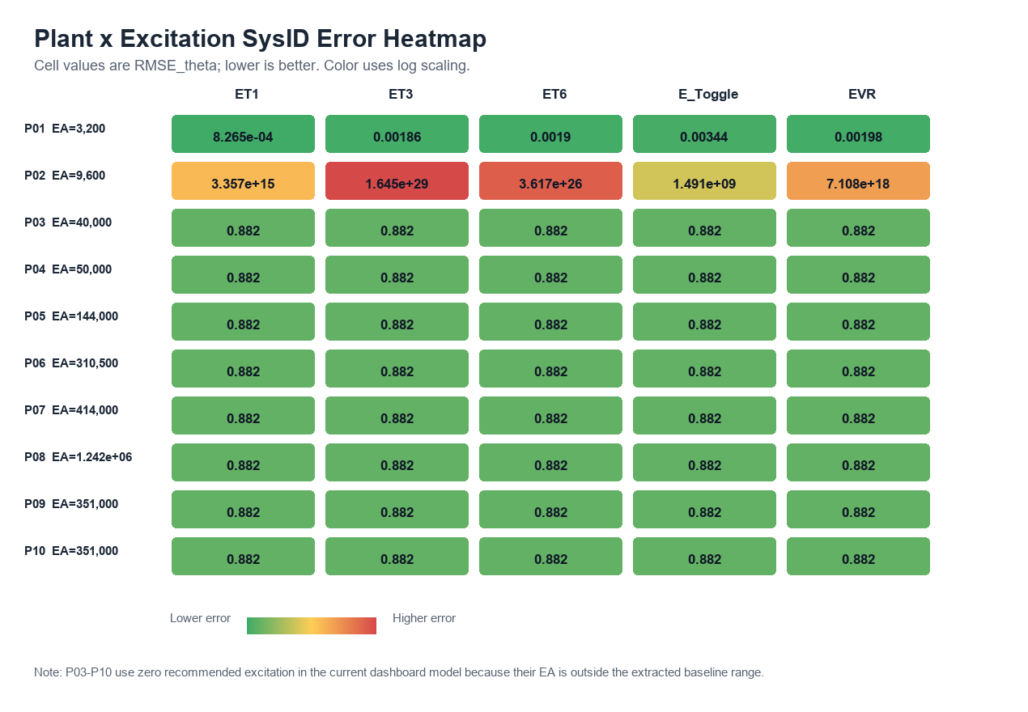
SysID Outputs: kt, kf, and EA
R2R SysID Validation
Motor parameter regression
Web stiffness regression
J_i*domega_i/dt - tau_web,i = kt_i*u_i - kf_i*omega_i
Solve a two-parameter least-squares problem per roller:
[u_i, -omega_i] * [kt_i, kf_i]^T = J_i*domega_i/dt - tau_web,i
Outputs: kt_UW, kt_Nip, kt_RW, kf_UW, kf_Nip, kf_RW
dT_i/dt + lambda_T(T_i - T_ref,i)
= EA * speed_strain_i / L_i
All spans share one least-squares estimate of EA.
Output: EA
Estimator output
Estimator output
Estimator output
Why excitation matters for SysID
ktension
kfriction
EA
A single channel can leave some parameters weakly observed.
Multi-channel/toggle/random inputs create richer independent motion.
Voltage-to-torque gain group reported as kt_* estimates.
Viscous-friction group reported as kf_* estimates.
Elastic modulus-area product estimated from tension dynamics.
Noise-free and sensor-noise cases should be validated separately.
Example report graph: SysID RMSE by plant and excitation
Dashboard mathematics, plant presets, excitation studies, and validation outputs
08

Slide 9
Validation Types Covered by the Dashboard
R2R SysID Validation
Paper parts
Logging rate
Excitation
Drift
Parameter extraction and paper-reference comparison for EA, R, L, J, f, and b.
Compares Tlog = 1-100 ms and checks how PLC data rate affects RMSE_theta.
Compares ET1, ET3, ET6, E_Toggle, and EVR under noise-free and sensor-noise cases.
Compares EA drift, friction f drift, and reel inertia J drift sensitivity.
Retuning
Compares CS-BO(30), HGS-only, HGS+BO(5), and HGS+BO(10).
All result tabs include worked calculations
Retuning cost used in dashboard
Validation question answered
Does the app reproduce the paper-style claim?
cost = RMSE + 0.25*overshoot + 0.15*t90 + 0.015*control_effort
Which plant/excitation/logging/noise condition changes the result?
What calculation produced the displayed number?
Dashboard mathematics, plant presets, excitation studies, and validation outputs
09

Slide 10
Future Work and Next Validation Steps
R2R SysID Validation
Noise validation
Plant fidelity
Retuning extensions
Run separate noise-free and sensor-noise validation sweeps.
Load exact per-plant R, L, J, f, and b arrays when available.
Extend BO and HGS retuning from deterministic comparison to plant-specific optimization.
Quantify how tension sensor noise and omega noise change RMSE_theta.
Retune excitation limits for P03-P10 high-EA plants.
Track real-evaluation budget, final cost, and tension performance together.
Add acceptance thresholds for each sensor-noise level.
Separate paper-reference validation from reduced-model safety policy.
Compare HGS+BO(5) with longer BO budgets across all plants.
Dashboard components to mature
Research validation target
Validation report generator: one-click PDF/DOCX/PPTX summaries from dashboard runs.
For every tab, state the paper claim, run the matching dashboard scenario, and report the numerical difference.
Plant/excitation comparison charts: heatmaps, grouped bars, and ranked tables.
Document when a result is a full dynamic validation versus a safety-policy placeholder.
Equation calculation examples: keep formulas synchronized with backend routes.
Keep outputs traceable: route, equation, input plant, excitation, noise, and metric.
Next milestone: validated noise-free/sensor-noise SysID report with BO/HGS retuning per plant
Dashboard mathematics, plant presets, excitation studies, and validation outputs
10

