Slide 1
Lecture 10
QA Jobs in Lahore
Website: https://qajobsinlahore.wixsite.com/qajobs
LinkedIn Group: SQA Jobs in Lahore
LinkedIn Page: QA Jobs in Lahore
Facebook Page & Group: QAJobsinLahore
Email: qajobsinlahore@hotmail.com
Instructor: Ahmed Hassan Course: Security Testing
Date: 11 August 2024
LinkedIn: https://www.linkedin.com/in/imahmedhassan/

Slide 2
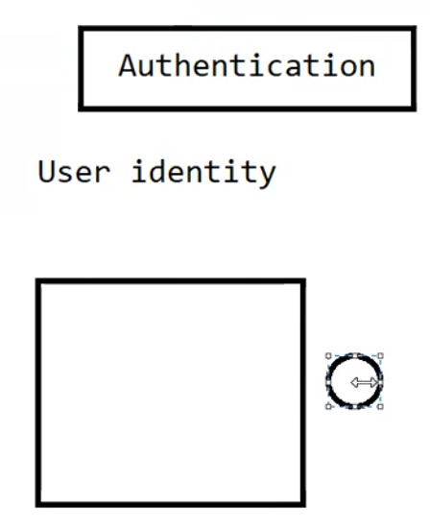
Authentication vs Authorization
Authentication is about identifying the User.
Example of the company and the employee.

Slide 3
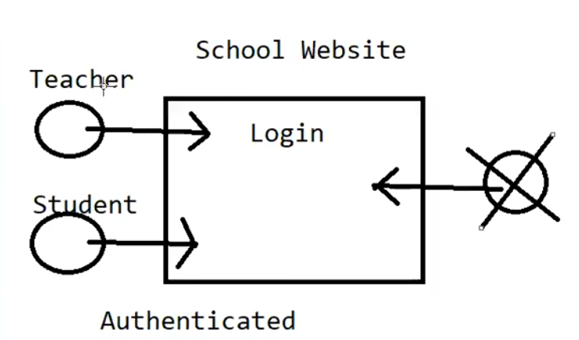
Authentication vs Authorization
Authentication is about identifying the User.
Real website example.

Slide 4
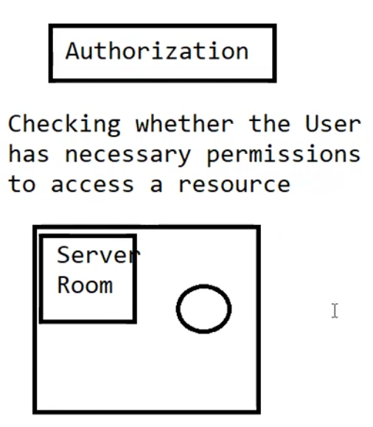
Authentication vs Authorization
Authorization is about checking
whether the User has permissions
to access a resource.
Example of the company
and the employee.

Slide 5
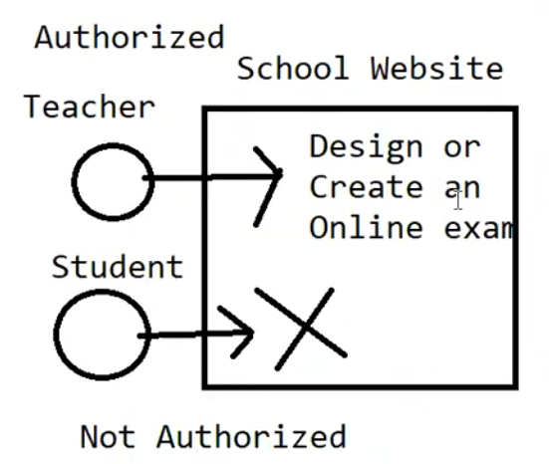
Authentication vs Authorization
Authorization is about checking whether the User has permissions to access a resource.
Real website example.

Slide 6
Security Testing Terminology - DAST
DAST stands for Dynamic Application Security Testing.
A type of black box Security Testing performed on the running Application from its UI.
Example: https://demo.testfire.net/

Slide 7
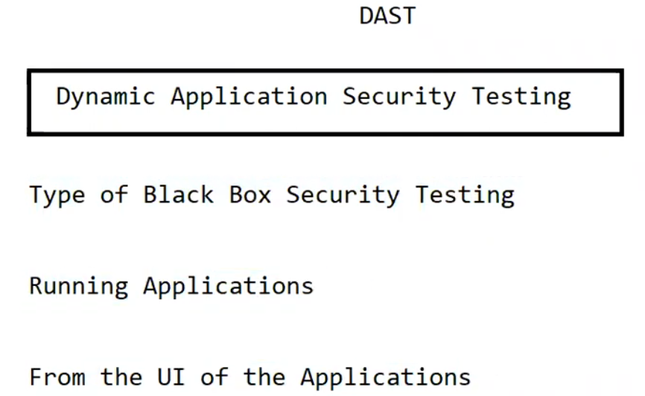
Security Testing Terminology - DAST

Slide 8
Input Validation and Output Encoding
Input Validation
  Size of Data
  Type of Data
  Range of Data
Output Encoding is a security technique used in web development to convert potentially harmful characters from user input into a safe format before displaying them on a web page.
https://demo.testfire.net/
https://tutorialsninja.com/demo/index.php?route=account/register

Slide 9
Top 40 Security Testing Interviews Questions
Q 1) What is Security Testing?
Q 2) What is “Vulnerability”?
Q 3) What is “SQL Injection”?
Q 4) List the attributes of Security Testing?
Q 5) What is “Penetration Testing”?
Q 6) Why “Penetration Testing” is important?
Q 7) List down some factors that can cause vulnerabilities?
Q 8) List the various methodologies in Security testing?
Q 9) What is a Cookie?
Q 10) What are the types of Cookies?

Slide 10
Top 40 Security Testing Interviews Questions
Q11: Can you explain what is security testing and what is the purpose behind it?
Q12: How do you identify potential security vulnerabilities? What are the tools you use?
Q13: Can you explain the different types of security testing?
Q14: Have you ever found a critical security bug in a production environment? How did you handle it?
Q15: Can you explain the difference between penetration testing and vulnerability scanning?
Q16: Can you describe how you would approach testing an application for injection vulnerabilities?
Q17: What is encryption, and how does it relate to security testing?
Q18:What is password tracking, and how can it be prevented?
Q19: Why is OWASP being run, and what does it hope to achieve?
Q20: As far as information security is concerned, why is web application security so important?

Slide 11
Top 40 Security Testing Interviews Questions
Q21: Explain the three categories of vulnerabilities and how each affects online applications’ safety.
Q22: What is an SSL certificate?
Q23: What is Burp Suite?
Q24: What are the two versions of Burp Suite?
Q25: What is the target section in Burp Suite?
Q26: How can users test the vulnerability in Burp Suite?
Q27: What is the Comparer in Burp Suite?
Q28: What is the proxy tab in Burp Suite and what can users do with it?
Q29: What is the purpose of the Burp Suite Intruder?
Q30: What are the uses of Burp Suite?

Slide 12
Top 40 Security Testing Interviews Questions
Q31: What is the decoder used for?
Q32: What is the role of the Sequencer in Burp Suite?
Q33: What is the repeater in Burp Suite?
Q34: How many types of attack can be performed in burp suite?
Q35: What is the purpose of spidering a website?
Q36: What is an active scan?
Q37: How long does an active scan typically take?
Q38: What will the URL show when a user checks if a website is vulnerable?
Q39: What is the purpose of the URL?
Q40: What is ZAP used for?

Slide 13
Checklist for Manual Security Testing
What to Test:
Authentication
Test for weak passwords, account lockout policies, and session management vulnerabilities.
Authorization
Ensure proper access controls are in place and functioning as expected.
Data Validation
Check for vulnerabilities to SQL injection and other injection flaws.
Session Management
Test for vulnerabilities in session handling, such as session fixation or hijacking.
File Uploads
If applicable, test for security controls around file uploads to prevent malicious file execution.
What Not to Forget:
Test for Known Vulnerabilities
Utilize resources like OWASP Top 10 to guide testing efforts towards common web vulnerabilities.
Business Logic Testing
Assess the application for logical flaws that could be exploited.

Slide 14
Assignment # 10
Q1: What is the difference between Authentication and Authorization? Explain in your own words.
Q2: Perform DAST on the following website login page. (https://www.flipkart.com/)
Q3: Perform Input Validation and Output Encoding on the following website registration page.
(https://tutorialsninja.com/demo/)
Q4: Write down the answers of all the most important Security testing questions in your own words which is mentioned in this lecture.

Slide 15
Assignment # 10
  Email the assignment at qajobsinlahore@hotmail.com
  Attach the word file which contains all the screen shots and also attach word file of security testing important questions.
  Subject name should be “Assignment 10” and also mention your name.

Slide 16
Last Date to submit all Assignments
Last Date to submit your all assignments is 24 August 2024.

Slide 17
How to get the Certificate
Send screen shot of all the assignments which you have submitted. E.g. (10 Assignments).
Mention correct spelling of your name in the email.
Highlight your achievement on LinkedIn and on CV as well and do mention about me (Ahmed Hassan) and our platform (QA jobs in Lahore) as well.
LinkedIn: https://www.linkedin.com/in/imahmedhassan/

Slide 18
Information about Previous Courses which QA Jobs in Lahore has covered
Manual Testing.
Database Testing.
API Testing.
Performance Testing.
Web Automation Testing with java using Selenium.
Mobile Automation Testing with java using Appium.

Slide 19
What’s Next???
Web Automation Testing with Python using cypress.

Slide 20
Questions & Answers & Feedback

Slide 21


