Slide 1
Academics
“ACADEMICS” is a unique and very comprehensive solution built on dot net technology with more than 50 integrated modules taking care of Student’s academics to Office administrative activities.

Slide 2
Modules
SL No | Modules | Description
1 | Financial Accounts | Masters Creation Cash Book ,Bank Book ,Balance Sheet , P/L
2 | Common Master | All Master i.e.{ Session , Program , Semester, Subject }
3 | Enquiry | Enquiry of New Student and Follow up
4 | Academic | Defines all the Academic Activities of Students
5 | Fee | All Fee transactions
6 | Time Table | Defines Time Table and Reallocation of Faculties
7 | Exam | Examination Activities ,assignments and Class Tests
8 | Store | Transaction related to purchase , transfer , Stock
9 | Hostel | Hotel Management , Room Allotment and Reports
10 | Library | Book Purchase ,Accession, Binding ,Barcode , Circulation
11 | Transport | Fleet Management , Route Sheet , Maintenance
12 | Mess | Management of Fooding of Students and Employees
13 | Canteen | Management of Readymade Items
14 | Utility | User Management and other utilities
15 | SMS & Email | Sms and Email Management

Slide 3
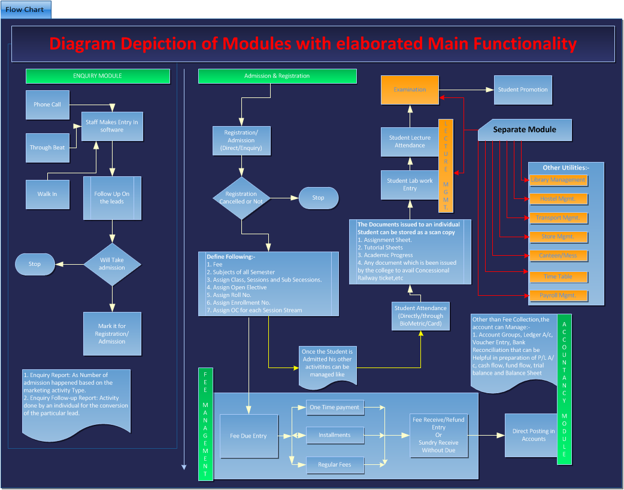

Slide 4
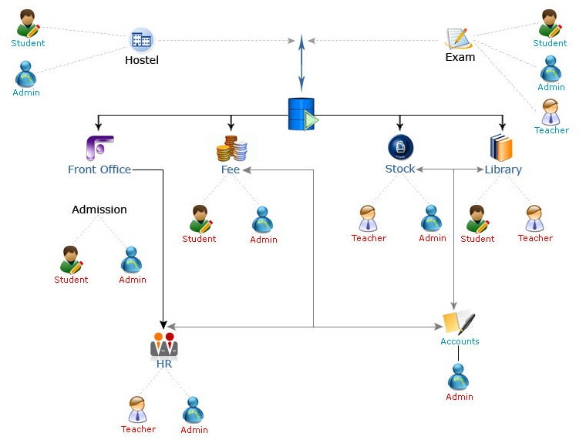
Implementation structure

Slide 5
Availability & Usefulness
Preparatory Schools, High Schools, Intermediate Schools, and Schools belonging to different board(Government, Semi Government & Private)
Coaching Centers
Colleges (Degree/Post Degree)
Professional Institutions like Engineering Colleges, Medical Colleges, Management Colleges, Colleges providing vocational training, etc.
Research Institute

Slide 6
Key Benefits
Facilitates centralized data repository
Since application covers daily routine work there is no redundancy of Data Entry
Works on Offline and online data synchronization
The Database is never in direct access to the general user therefore helps in reducing data theft and accidental damage to data.
Mobile Enables
Exporting of reports to MS-Word, MS-Excel, PDF documents
The ERP can be integrated with Smart cards, Biometric readers, RFID technology
Extremely secure, login authenticated system.
Accelerating and expand communications with email reports.
Integrates key functions of finance, payroll and fee collection
Single student database for school administration, library and fee collection.
Single employee database for school administration, library and payroll.

Slide 7
Benefit to Management
Gets complete control over Finances of the school including income and expenditure details
Gets all the data in one place and helps in decision making
Can monitor the growth of the School both financially as well as in terms of academics
Can access inventory (stock) details of the School including purchases
Can seamlessly communicate with all the students and staff of the institution
Can obtain customized reports with statistics
Easy access to view all the records at a go.
Minimization of redundant activities
Instant View of MIS report on different parameters
Provide Single point of integration and control from Academics to Administrative.

Slide 8
Benefit to Administration/office staff & Teachers
Can automate fee collection, accept payments online, generate quick reports
Can administrate and generate payroll accounting & attendance details
Can contact students, staff, management effortlessly
Can initiate timely correspondence to other departments
Can handle day to day activities like time table generation in a click of a button thus saving a great deal of time
Simplifies handling of students records in terms of student’s attendance in class, examination cum test activities, etc.
Facilitates easy handling to class schedules, time table and question paper planning.
Get online access to the system from home or from office.
Easy access to vital information at one click.
Can craft lesson as per school’s requirements
Can generate student reports by a click of a button

Slide 9
Benefit to Students & parents
Easy access to online information like school calendar, homework, announcements etc.
Can access lessons, submit homework, tests and projects on-line
Can track attendance, fees dues, notices, events & schedules etc.
Get easy access about the performance, attendance and fees due of their ward
Can easily communicate with teachers, principal & administrative staff
Can access results of wards for various examinations

Slide 10
Key clients
SL No | State | Name
1 | Kanpur | Indus Institute of Technology, etc.
2 | Lucknow | Global Group Of institutions, etc.
3 | Azamgarh | DAV PG College, etc.
4 | Varanasi | Dr. Ghanshyam Singh Mahavidyalaya, etc.
5 | Rudrapur | Chanakya Law College, etc.
6 | Gwalior | Excellent Circle of Studies, etc.
7 | Dehradun | Doon World School, etc.
8 | Bareilly | Gurukul Academy, etc.
9 | Patna | Indian Institute of Health & Research Center, etc.
10 | Moradabad | Moradabad Institute of Technology (MIT), etc.
11 | Jaipur | NIMS University, etc.
12 | Ghaziabad | R.C.C.V. Girls Degree College, Etc.
13 | Rudrapur | Indian Institute of Management (IIM), Etc.
14 | Gorakhpur | Omega Institute, Etc.
15 | Nainital | Vidya Mandir, Etc.

Slide 11
Thank you

