Slide 2
Presentation Layout
Problem Statement
Objectives
Existing System & Literature Review
Proposed System & Architecture
Implementation
System Design (DFDs, Class Diagram, ERD)
Results & Outputs
Testing
Conclusion & Future Scope
References

Slide 3
Problem Statement
Organizations manage large volumes of unstructured HR documents: resumes, job descriptions, reports, and scanned correspondence.
Manual document review is slow, labour-intensive, and inconsistent; HR teams spend most of their time reviewing resumes, around 23 hours to fill a single position.
Keyword search matches literal words, not meaning, so a search for “machine learning engineer” misses an “ML researcher”.
Existing tools rarely answer plain-language questions over a company’s own documents with any proof of where the answer came from.

Slide 4
Objectives
Ingest and process heterogeneous documents (PDF, Word, scanned images) with OCR text extraction.
Enable semantic search and retrieval over the document collection.
Provide grounded question answering via Retrieval-Augmented Generation (RAG) with source citations.
Automate resume screening and ranking against defined job criteria.
Automate candidate intake from Gmail and reporting.

Slide 5
Existing System & Literature Review
System / Approach | Semantic Retrieval | Natural-Language Q&A | Automated Ranking | Provenance / Citations | Open / On-Premise
Traditional ATS (Greenhouse, Workday) | No (keyword) | No | Rule-based only | Limited | Mostly cloud
AI recruitment (Eightfold AI) | Yes | Limited | Yes (ML) | Weak | No (proprietary)
Cloud Document AI | Partial | No | No | N/A | No (cloud)
RAG frameworks (LangChain) | Yes | Yes | Not HR-specific | Yes (if built) | Yes (self-host)
Hireflow (proposed) | Yes | Yes | Yes (weighted) | Yes (typed) | Yes

Slide 6
Proposed System & Architecture
Frontend & Backend: React 19 (TypeScript) single-page app with a layered FastAPI (Python) backend.
Document Processing: PDF, Word, scanned documents, and Gmail attachments processed with PyMuPDF and Tesseract OCR.
Semantic Search: extracted text is chunked, embedded with sentence-transformers, and stored in ChromaDB.
RAG Question Answering: retrieved context is supplied to an LLM (Anthropic Claude) to generate accurate, source-cited answers.
AI-Powered HR Screening: candidates are scored and ranked against job criteria with a transparent, weighted breakdown.
Data Storage & Security: PostgreSQL for application data, MinIO for files, Redis and Celery for async processing; JWT auth with per-user data isolation.

Slide 7
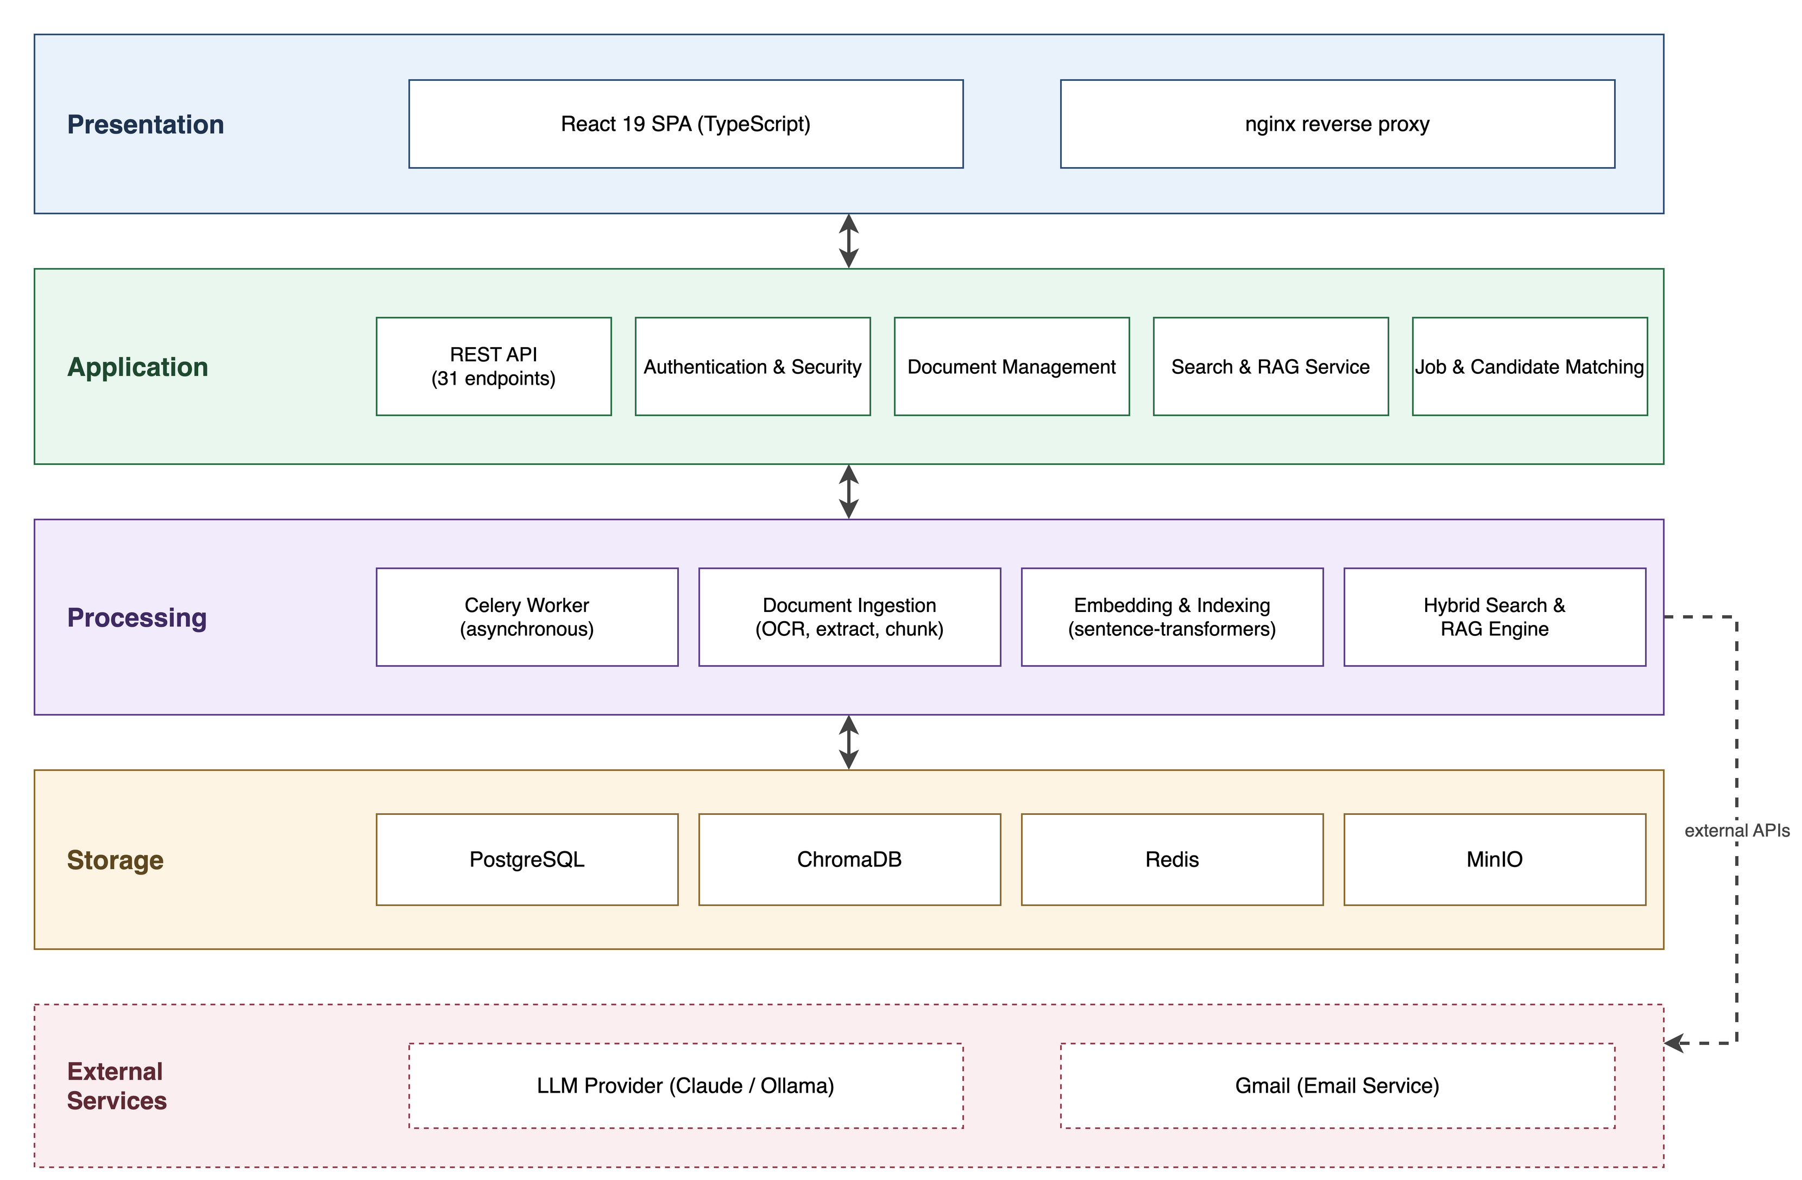
System Architecture

Slide 8
Implementation
Product vision and system design
Frontend design and implementation (React 19, TypeScript, Tailwind, shadcn/ui)
Backend design and implementation (layered FastAPI: API, Service, Domain, Adapter)
Asynchronous document-processing pipeline (Celery worker)
Hybrid search and RAG engine
Software testing
Containerization of the system (Docker)
User-manual preparation

Slide 9
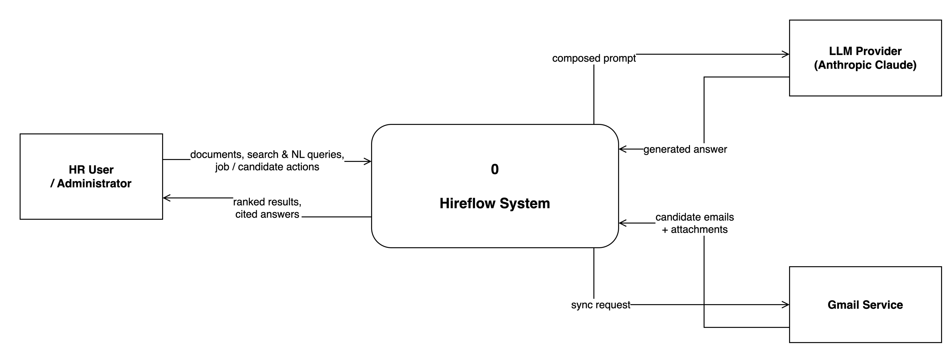
DFD Level 0 (Context)

Slide 10
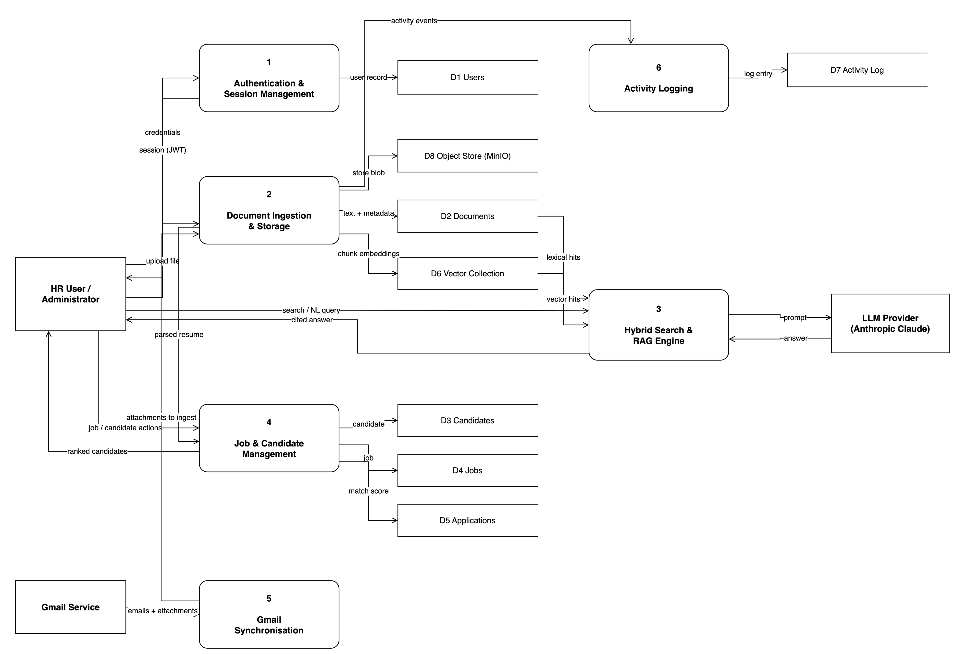
DFD Level 1

Slide 11
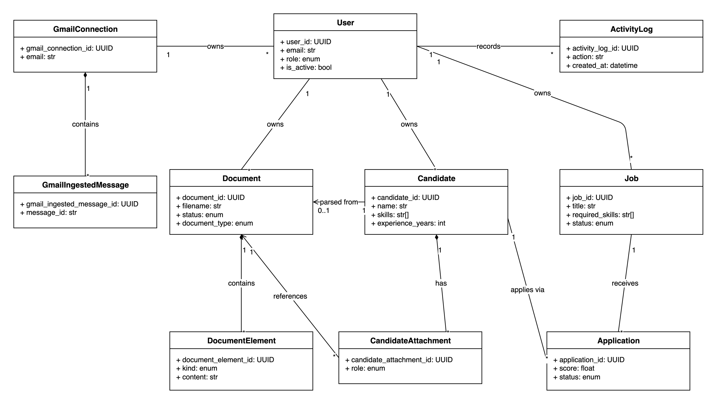
Class Diagram

Slide 12
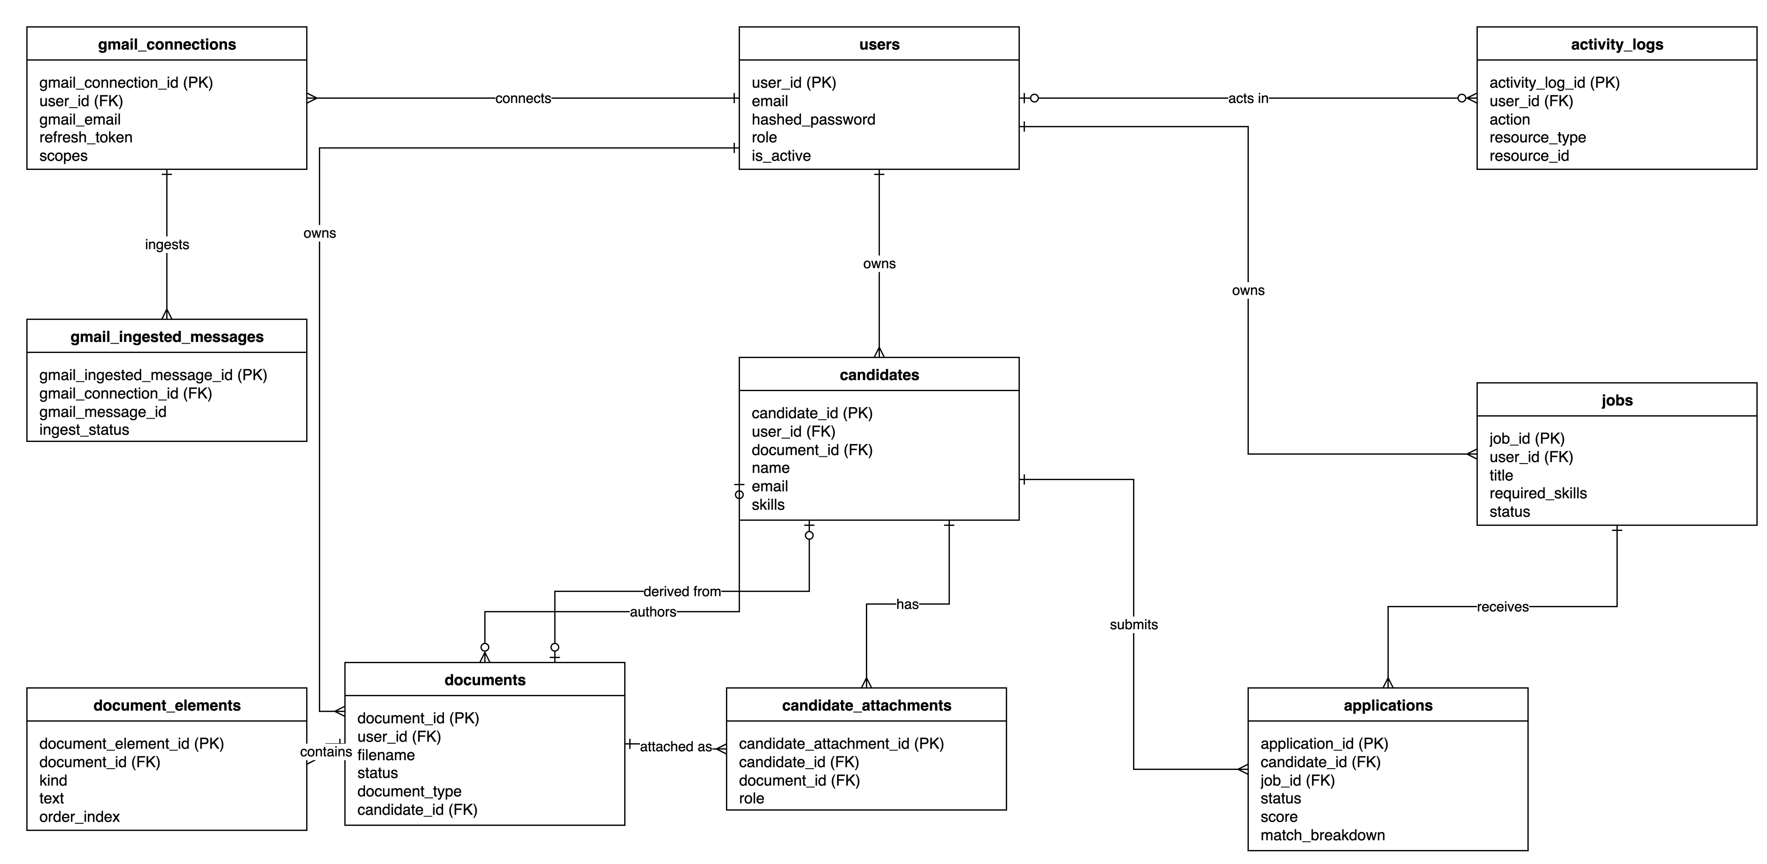
Database Design (ERD)

Slide 13
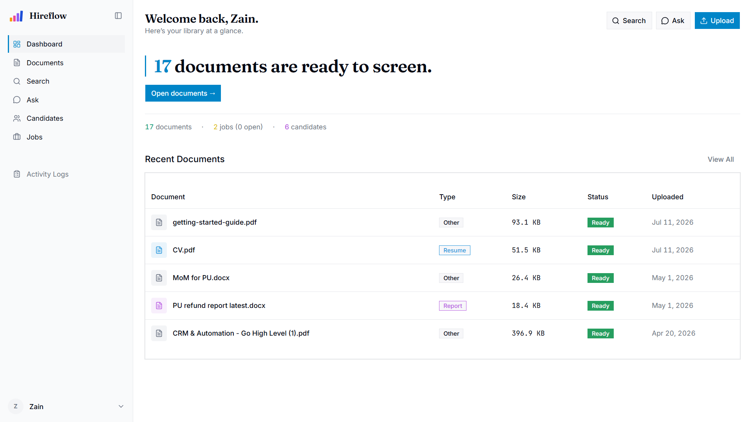
User Interface — Dashboard

Slide 14
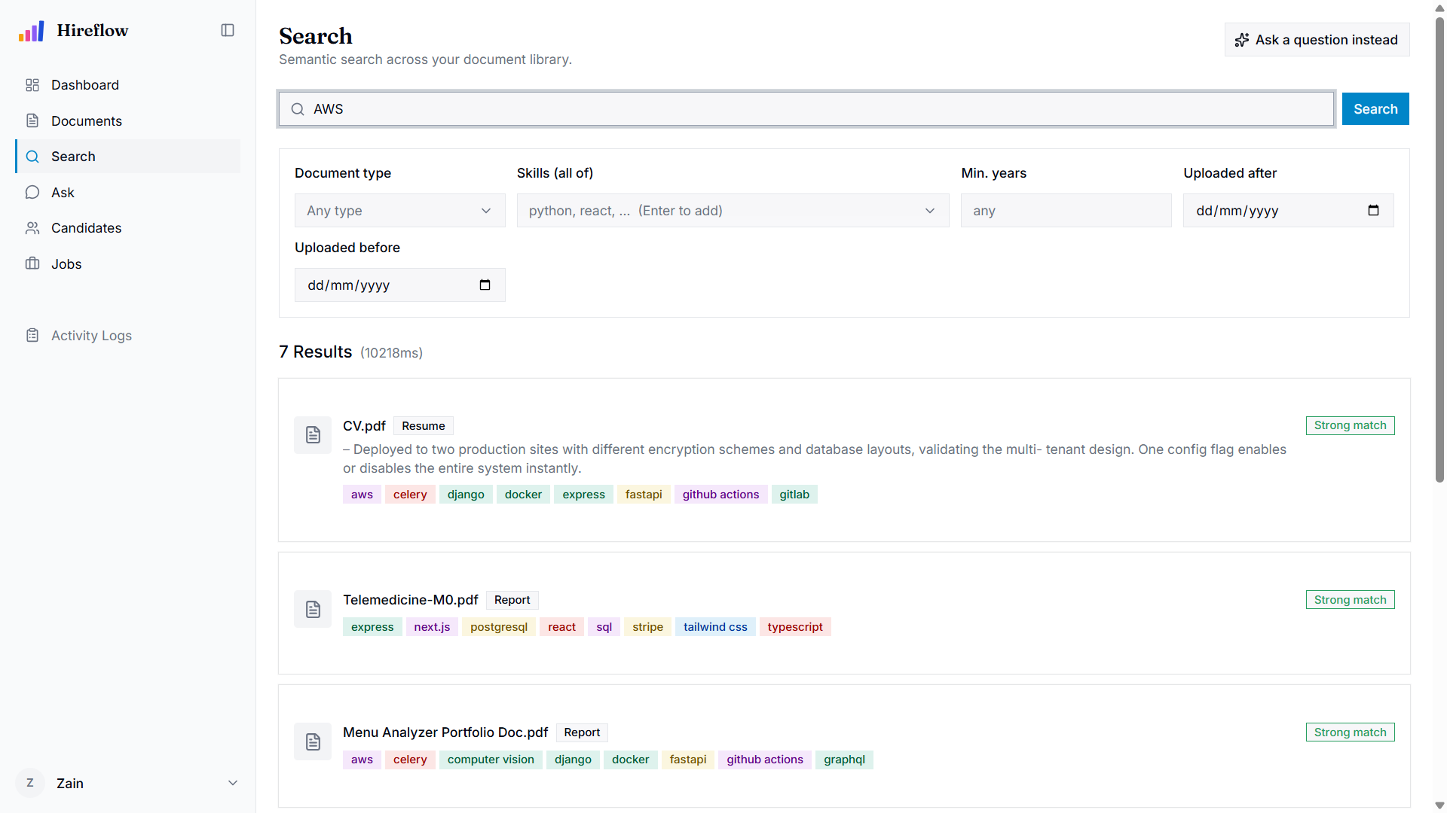
User Interface — Semantic Search

Slide 15
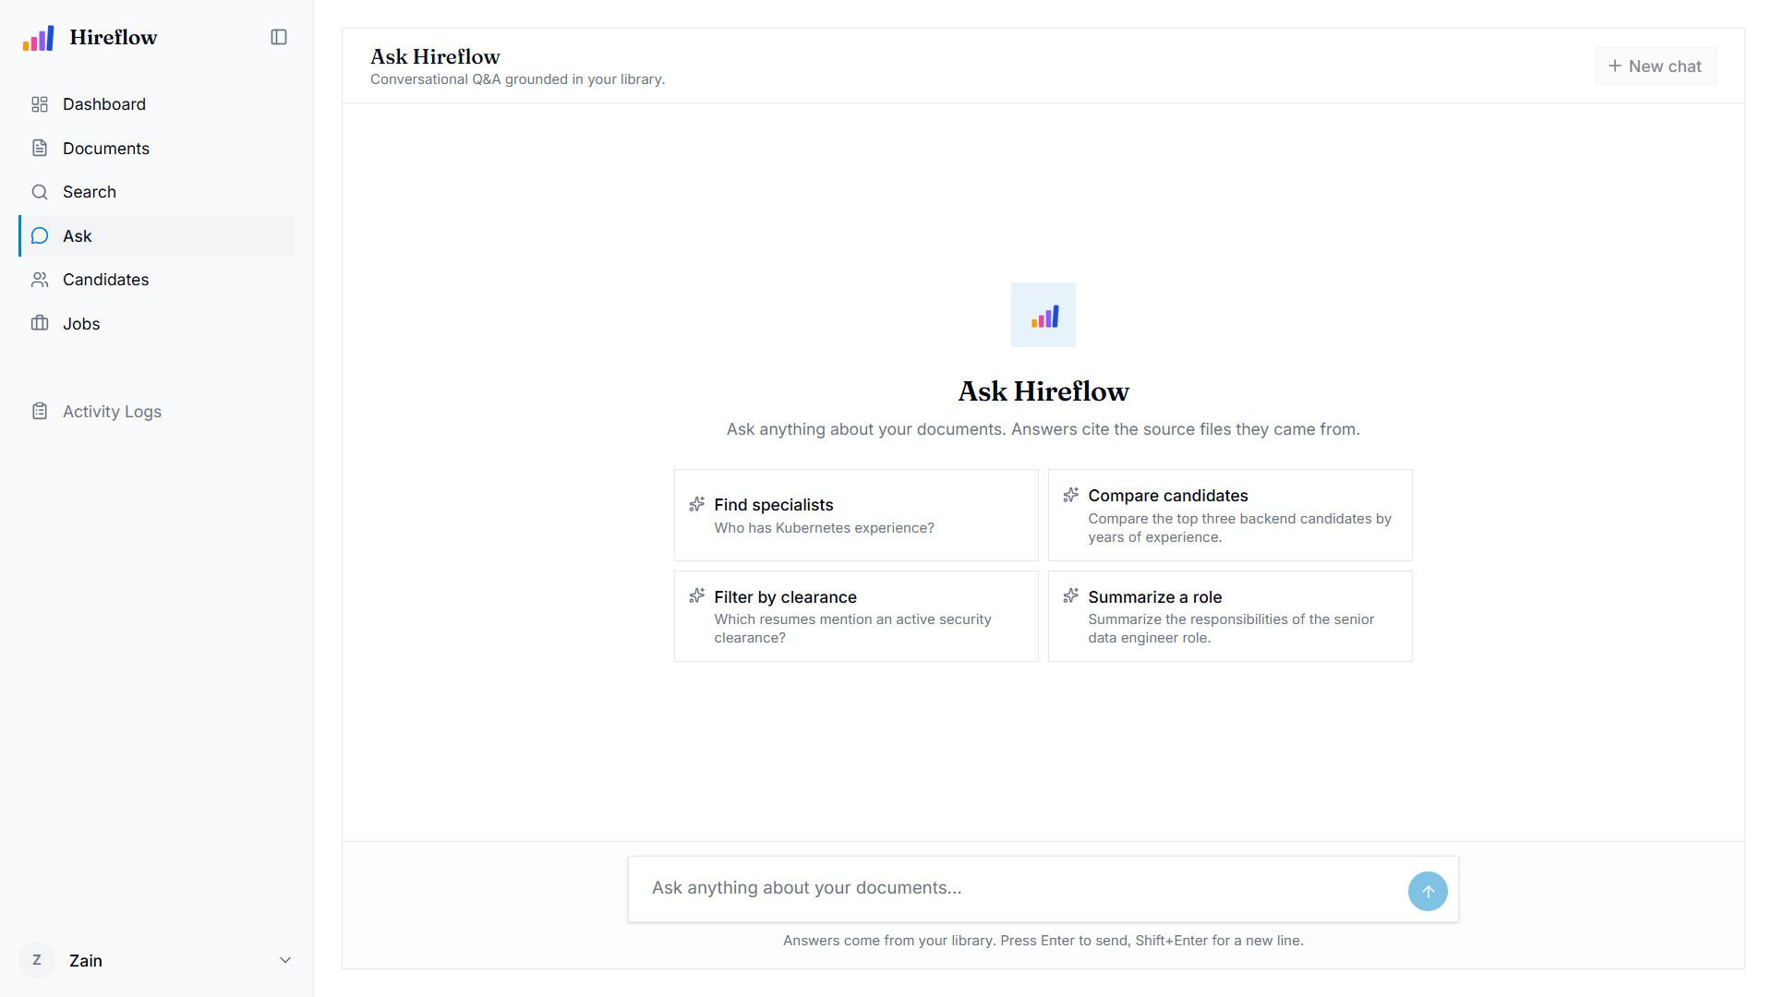
User Interface — Ask (RAG Q&A)

Slide 16
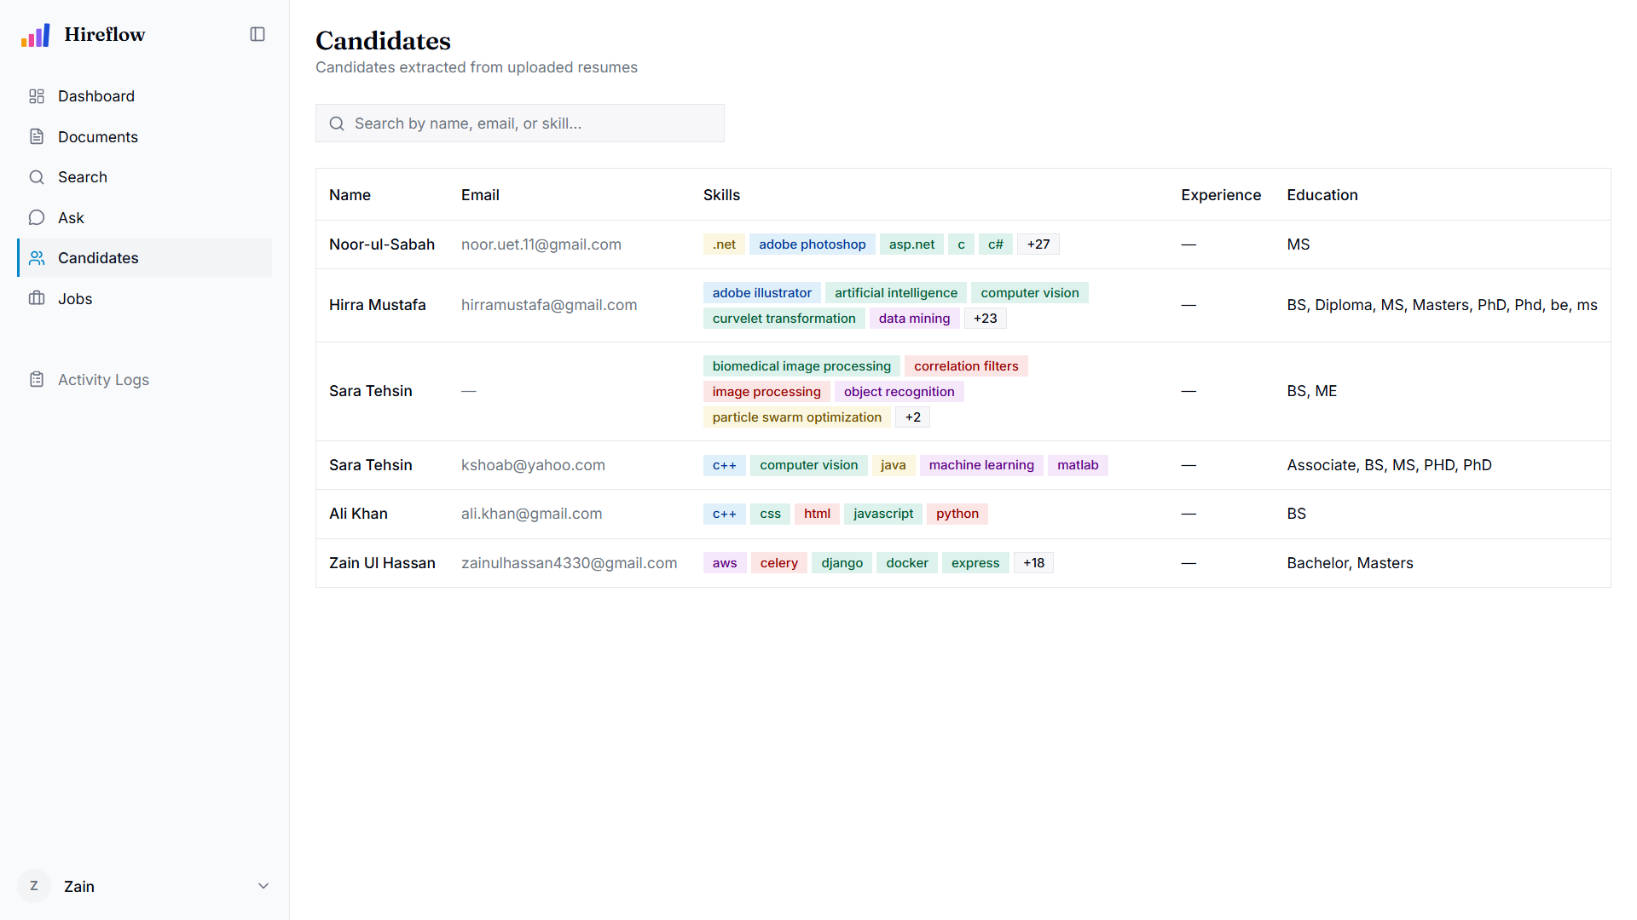
User Interface — Candidate Screening

Slide 17
Results & Outputs
Retrieval latency: hybrid search 72 ms median, 167 ms at the 95th percentile (server-side).
Ingestion throughput: about 44 s per text PDF to READY, about 4.1 s per scanned page; roughly 1.5 documents / minute at worker concurrency 1.
Embedding & LLM response: 0.57 ms per chunk on GPU; RAG time-to-first-token about 947 ms; full streamed answer about 1.5 s.
Prototype: 31 working REST API endpoints; grounded, source-cited answers; out-of-scope questions refused instead of hallucinated.

Slide 18
Testing
Unit testing of domain logic and services with in-memory fakes (no database or Docker required).
Integration & API testing driving full request/response cycles through FastAPI against real backing services.
Manual & UAT-style testing through the browser and curl for interactive surfaces (streaming chat, drag-and-drop, keyboard navigation).
Static analysis and linting (ruff, ESLint) run before every commit.

Slide 19
Testing — Key Test Cases
Test Case | Scenario | Expected Result | Status
TC-AUTH-006 | Login with valid credentials | HTTP 200; access + refresh tokens issued | Pass
TC-DOCS-001 | Upload PDF appears as ready | Status reaches ready within 60 s | Pass
TC-DOCS-046 | Auto-candidate from a resume | Candidate created on the on-ready hook | Pass
TC-SEARCH-005 | HR user sees only own documents | Owner scope enforced; empty result set | Pass
TC-RAG-001 | Grounded answer with citations | Answer cites at least one source | Pass
TC-RAG-002 | Out-of-scope question | Exact sentinel; no fabricated citations | Pass

Slide 20
Conclusion
Successfully developed an AI-powered HR platform that automates document processing, semantic retrieval, and resume screening.
Implemented RAG-based document retrieval with source-cited answers, improving search accuracy and reducing manual effort.
Automated the recruitment workflow through AI-based candidate ranking, Gmail resume synchronisation, and shortlist generation.
Designed a scalable, modular architecture with interchangeable AI components, ensuring maintainability and future extensibility.

Slide 21
Future Scope
Enhance security with login rate-limiting, token revocation, and stronger file validation.
Expand functionality with multilingual support, ATS integration, analytics dashboards, and real-time notifications.
Improve performance through quantitative benchmarking and domain-specific AI models for retrieval and ranking.
Increase accessibility with a native mobile application for recruiters.

Slide 22
References
Lewis, P., et al. (2020). Retrieval-Augmented Generation for Knowledge-Intensive NLP Tasks. NeurIPS 33, 9459–9474.
Reimers, N., & Gurevych, I. (2019). Sentence-BERT: Sentence Embeddings using Siamese BERT-Networks. EMNLP.
Vaswani, A., et al. (2017). Attention Is All You Need. NeurIPS 30.
Johnson, J., Douze, M., & Jégou, H. (2019). Billion-scale Similarity Search with GPUs (FAISS). IEEE TBD.
Smith, R. (2007). An Overview of the Tesseract OCR Engine. ICDAR.
Anthropic. (n.d.). Claude Documentation. docs.anthropic.com

Slide 23
Thank You
Any Queries?
AI Powered HR Screening and Document Retrieval System Using RAG

