Slide 2


Slide 3
Presentation Layout
Problem Statement
Objectives
Existing System & Literature Review
Proposed System & Architecture
Implementation
System Design (DFDs, Class Diagram, ERD)
Results & Outputs
Testing
Conclusion & Future Scope
References

Slide 4
Problem Statement
Organizations manage large volumes of unstructured HR documents: resumes, job descriptions, reports, and scanned correspondence.
Manual document review is slow, labour-intensive, and inconsistent; HR teams spend most of their time reviewing resumes, around 23 hours to fill a single position.
Keyword search matches literal words, not meaning, so a search for “machine learning engineer” misses an “ML researcher”.
Existing tools rarely answer plain-language questions over a company’s own documents with any proof of where the answer came from.

Slide 5
Objectives
Ingest and process heterogeneous documents (PDF, Word, scanned images) with OCR text extraction.
Enable semantic search and retrieval over the document collection.
Provide grounded question answering via Retrieval-Augmented Generation (RAG) with source citations.
Automate resume screening and ranking against defined job criteria.
Automate candidate intake from Gmail and reporting.

Slide 6
Existing System & Literature Review
System / Approach | Semantic Retrieval | Natural-Language Q&A | Automated Ranking | Provenance / Citations | Open / On-Premise
Traditional ATS (Greenhouse, Workday) | No (keyword) | No | Rule-based only | Limited | Mostly cloud
AI recruitment (Eightfold AI) | Yes | Limited | Yes (ML) | Weak | No (proprietary)
Cloud Document AI | Partial | No | No | N/A | No (cloud)
RAG frameworks (LangChain) | Yes | Yes | Not HR-specific | Yes (if built) | Yes (self-host)
Hireflow (proposed) | Yes | Yes | Yes (weighted) | Yes (typed) | Yes

Slide 7
Proposed System & Architecture
Frontend & Backend: React 19 (TypeScript) single-page app with a layered FastAPI (Python) backend.
Document Processing: PDF, Word, scanned documents, and Gmail attachments processed with PyMuPDF and Tesseract OCR.
Semantic Search: extracted text is chunked, embedded with sentence-transformers, and stored in ChromaDB.
RAG Question Answering: retrieved context is supplied to an LLM (Anthropic Claude) to generate accurate, source-cited answers.
AI-Powered HR Screening: candidates are scored and ranked against job criteria with a transparent, weighted breakdown.
Data Storage & Security: PostgreSQL for application data, MinIO for files, Redis and Celery for async processing; JWT auth with per-user data isolation.

Slide 8
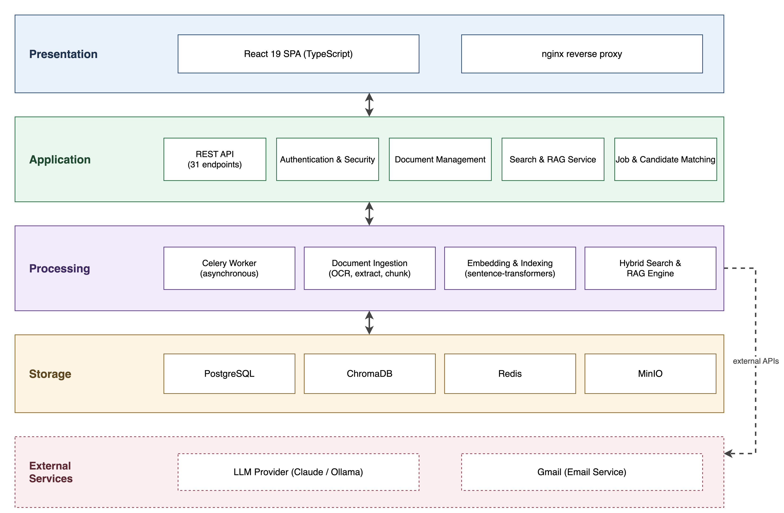
System Architecture

Slide 9
Implementation
Product vision and system design
Frontend design and implementation (React 19, TypeScript, Tailwind, shadcn/ui)
Backend design and implementation (layered FastAPI: API, Service, Domain, Adapter)
Asynchronous document-processing pipeline (Celery worker)
Hybrid search and RAG engine
Software testing
Containerization of the system (Docker)
User-manual preparation

Slide 10
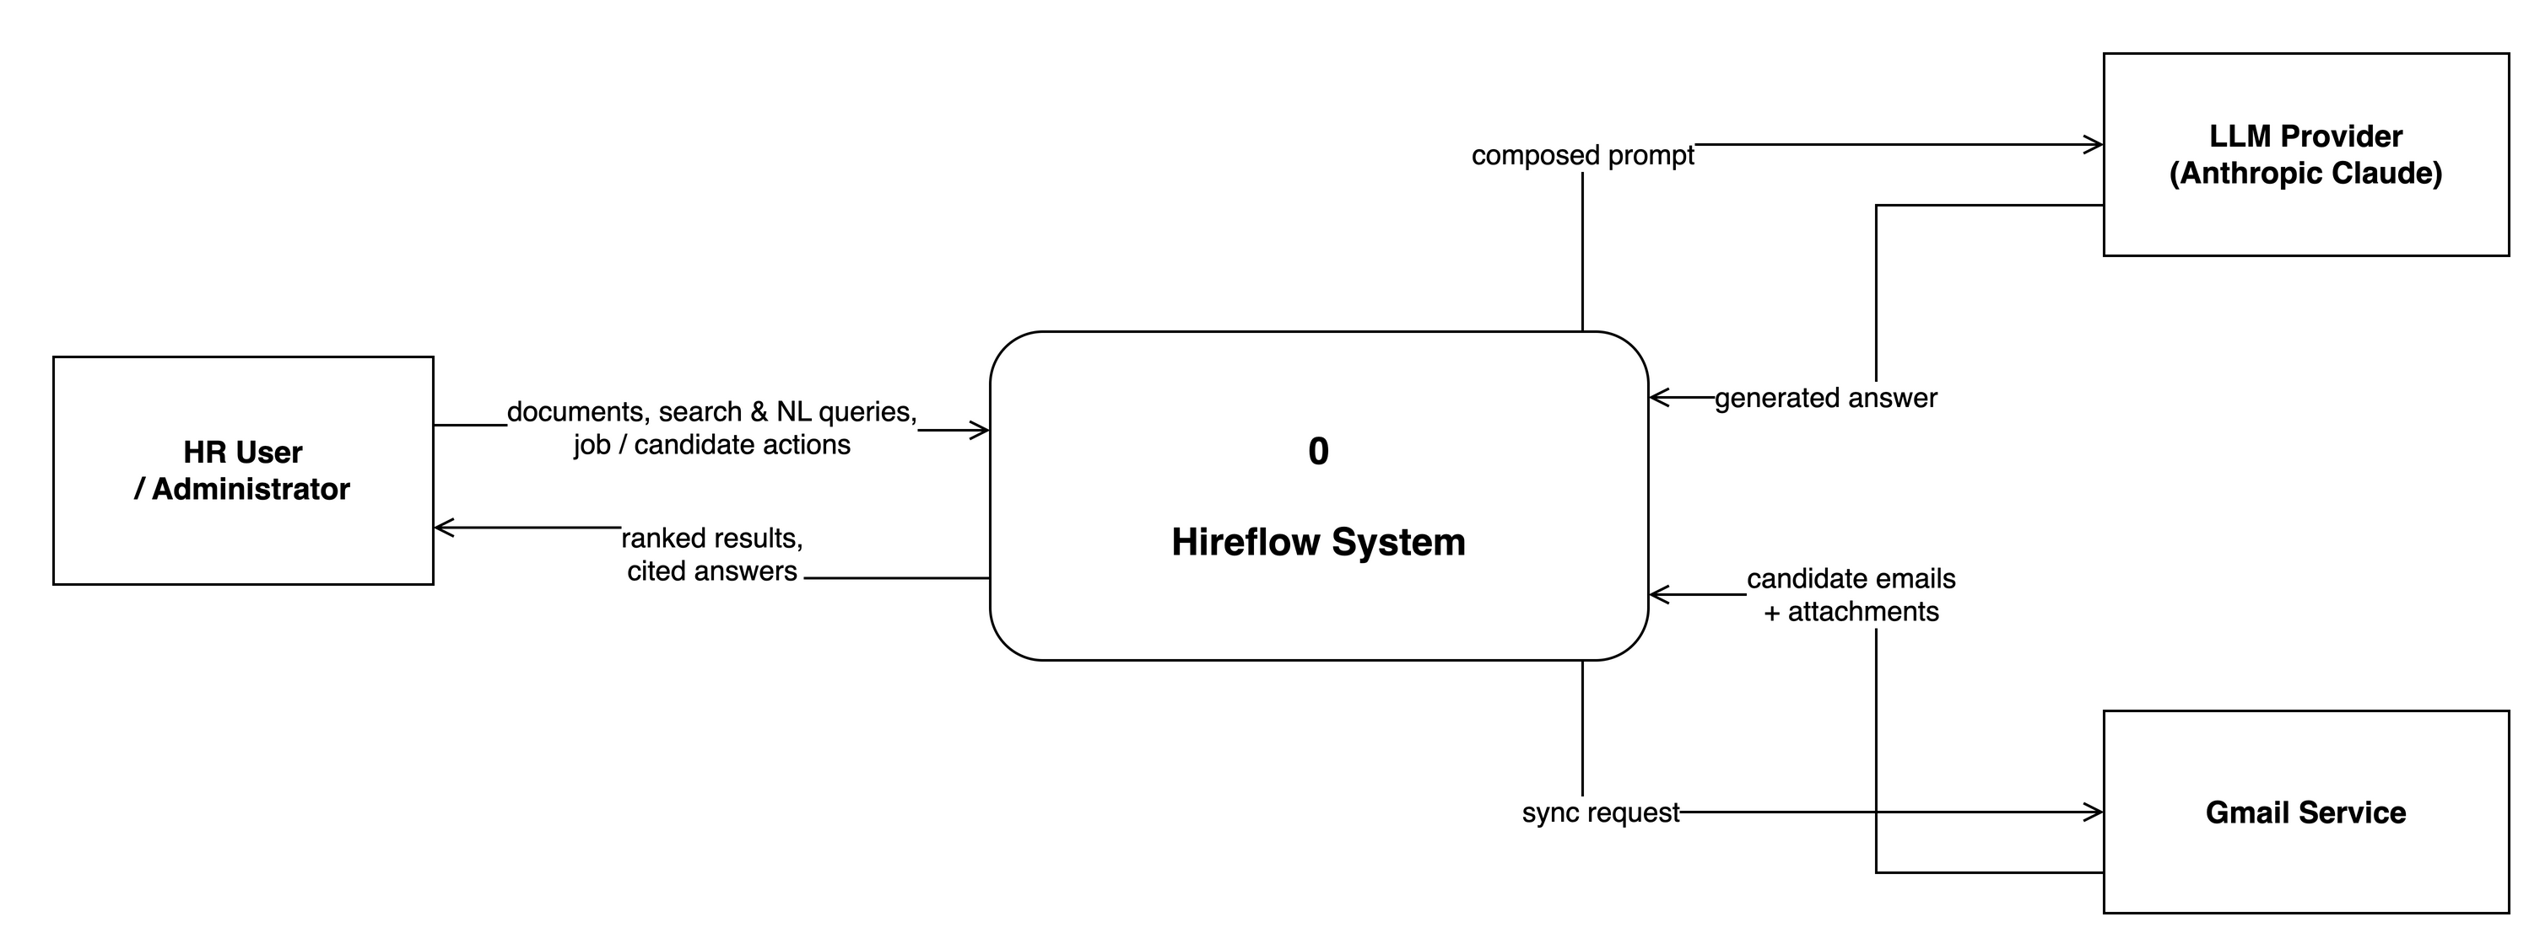
DFD Level 0

Slide 11
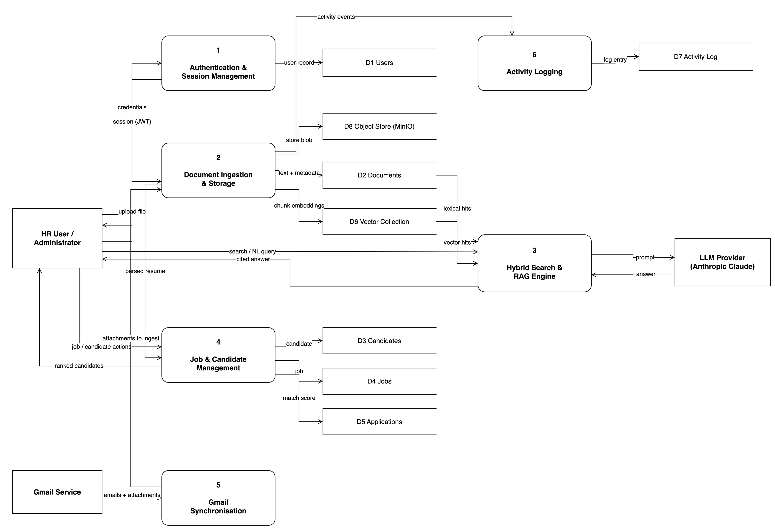
DFD Level 1

Slide 12
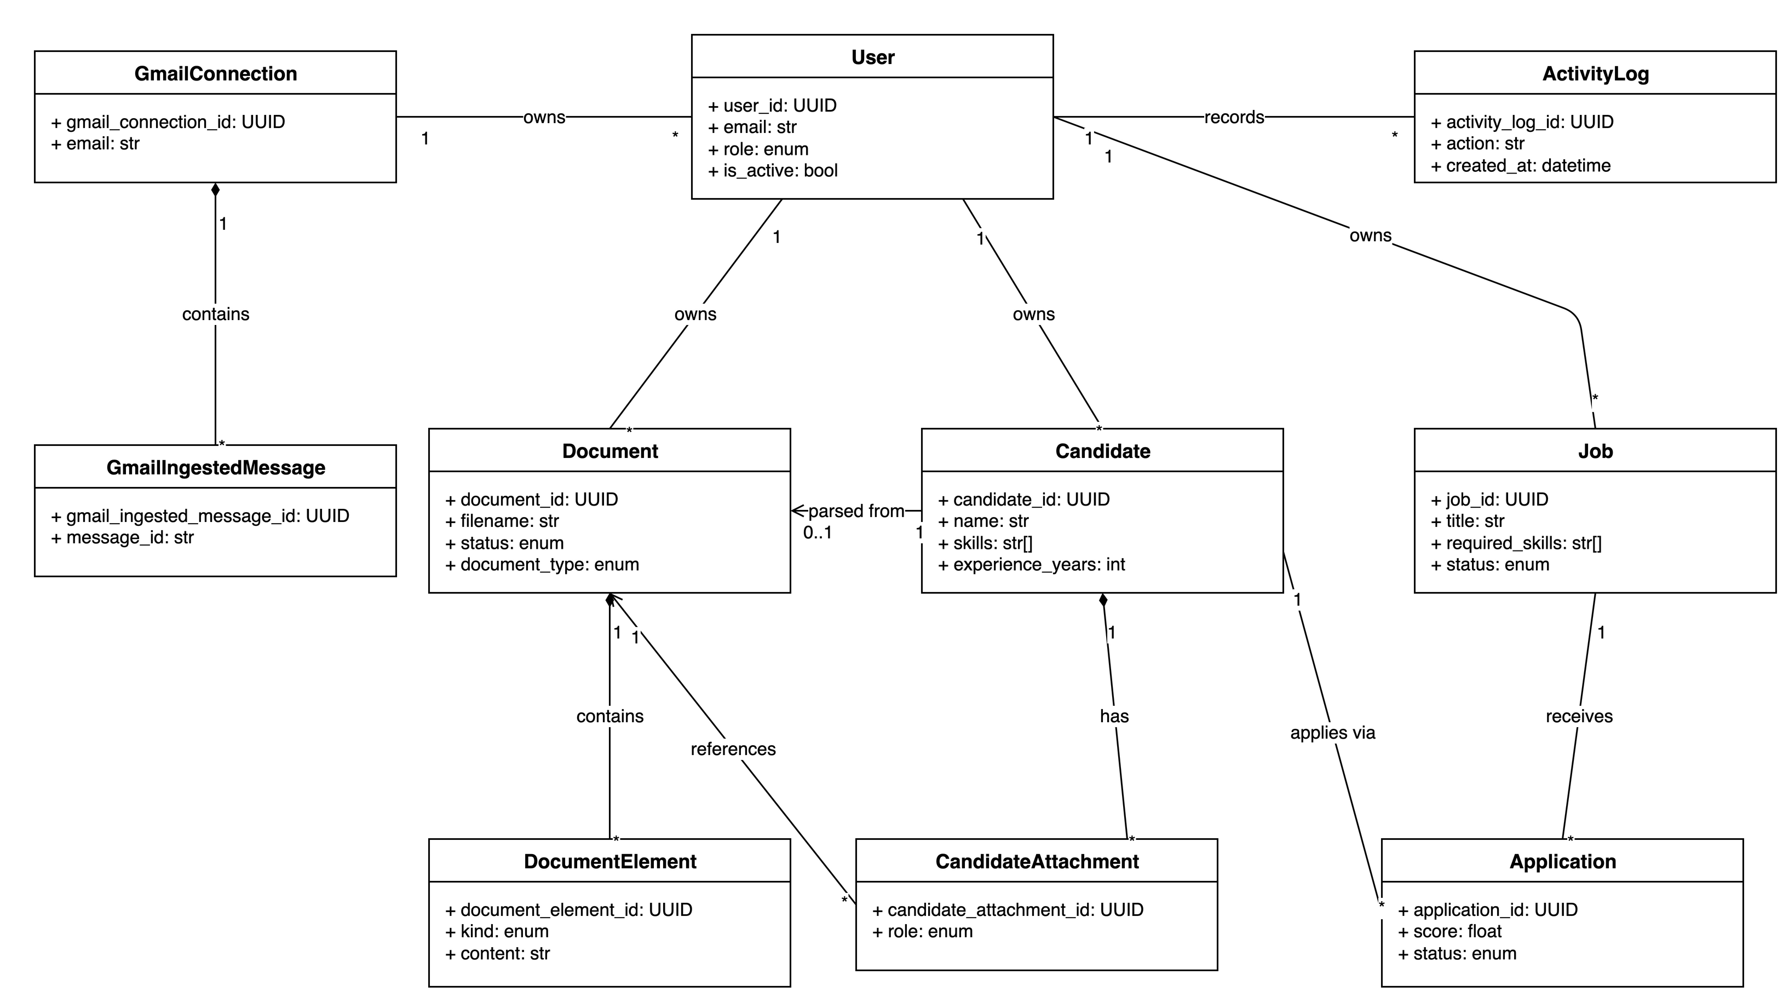
Class Diagram

Slide 13
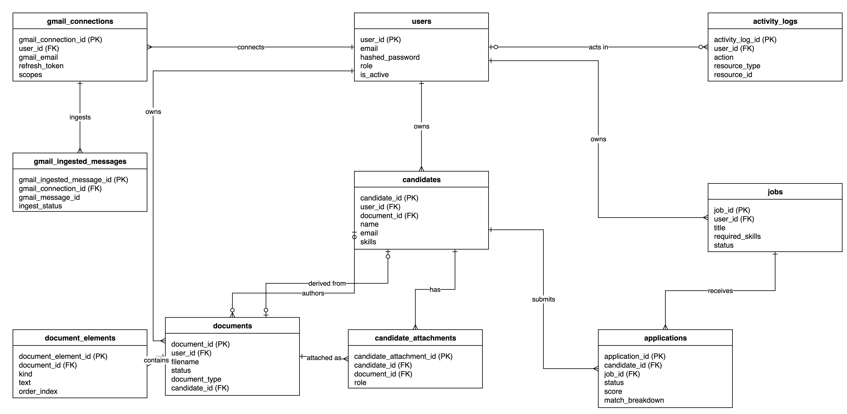
Database Design (ERD)

Slide 14
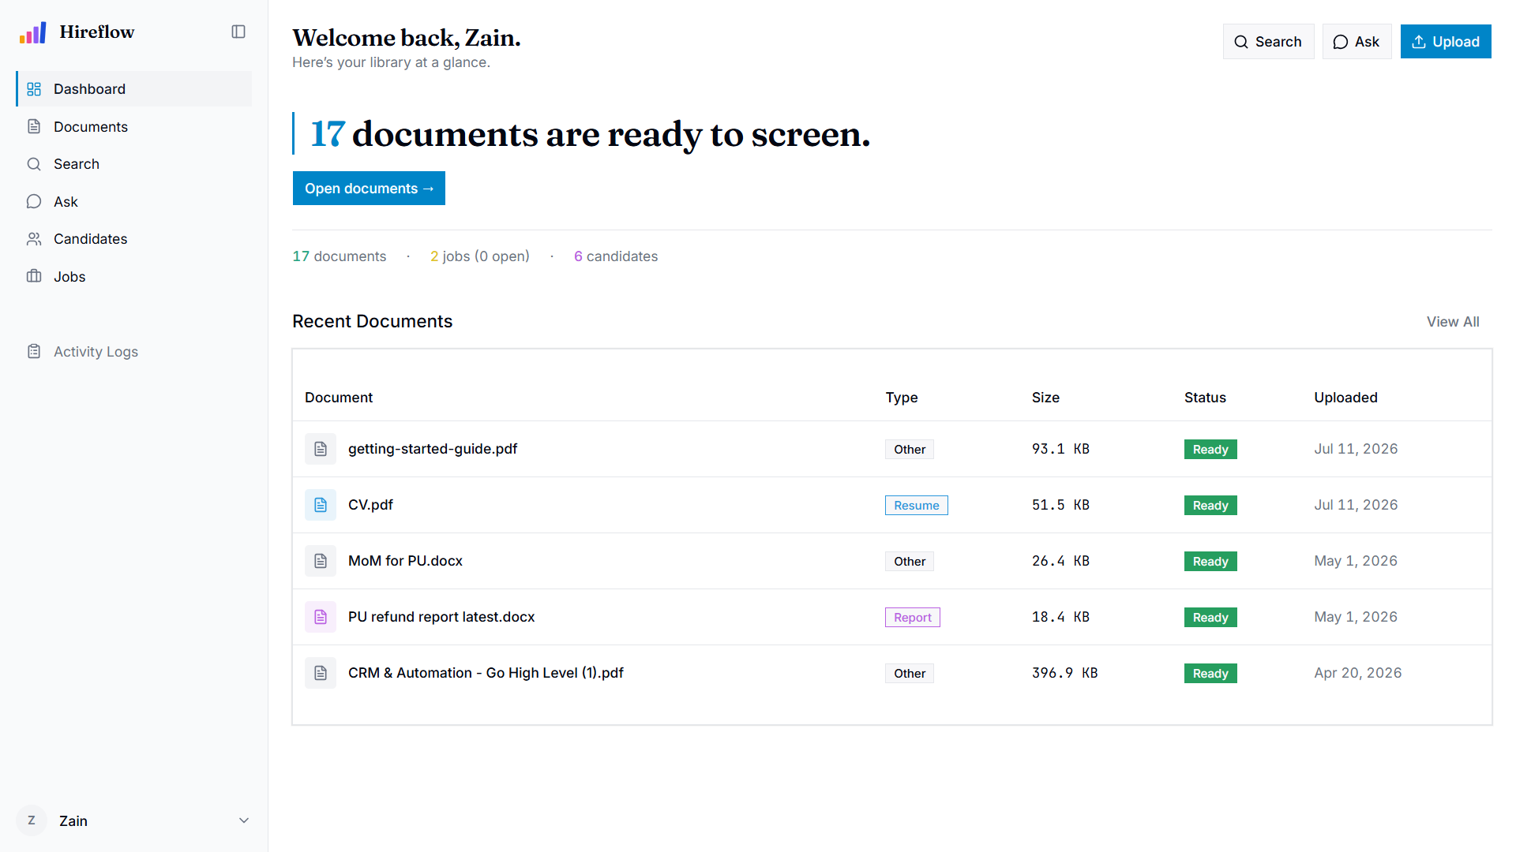
User Interface: Dashboard

Slide 15
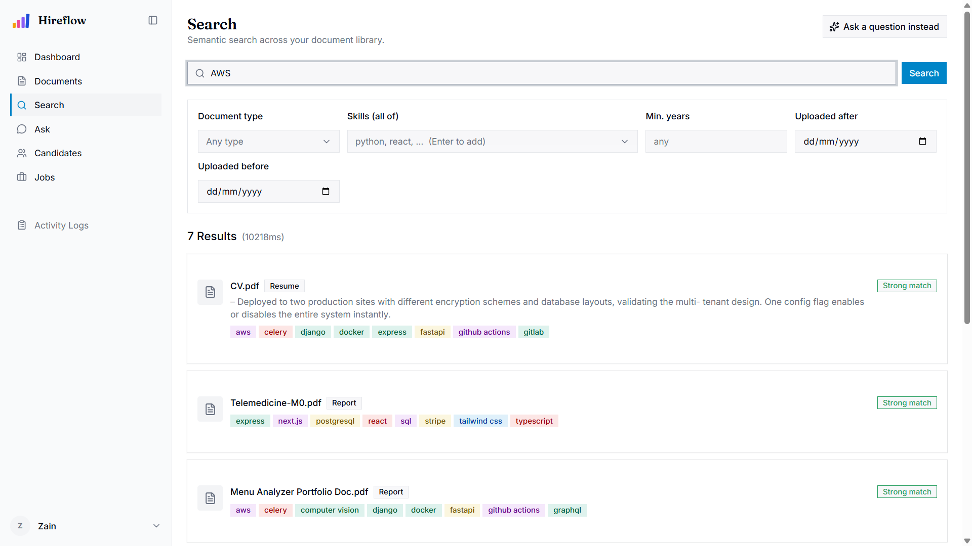
User Interface: Search

Slide 16
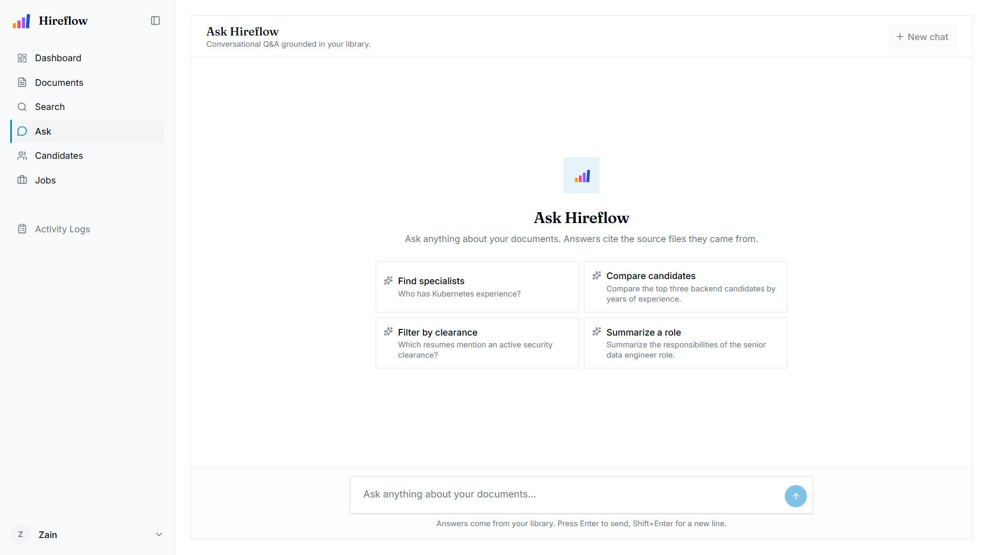
User Interface: Ask (RAG Q&A)

Slide 17
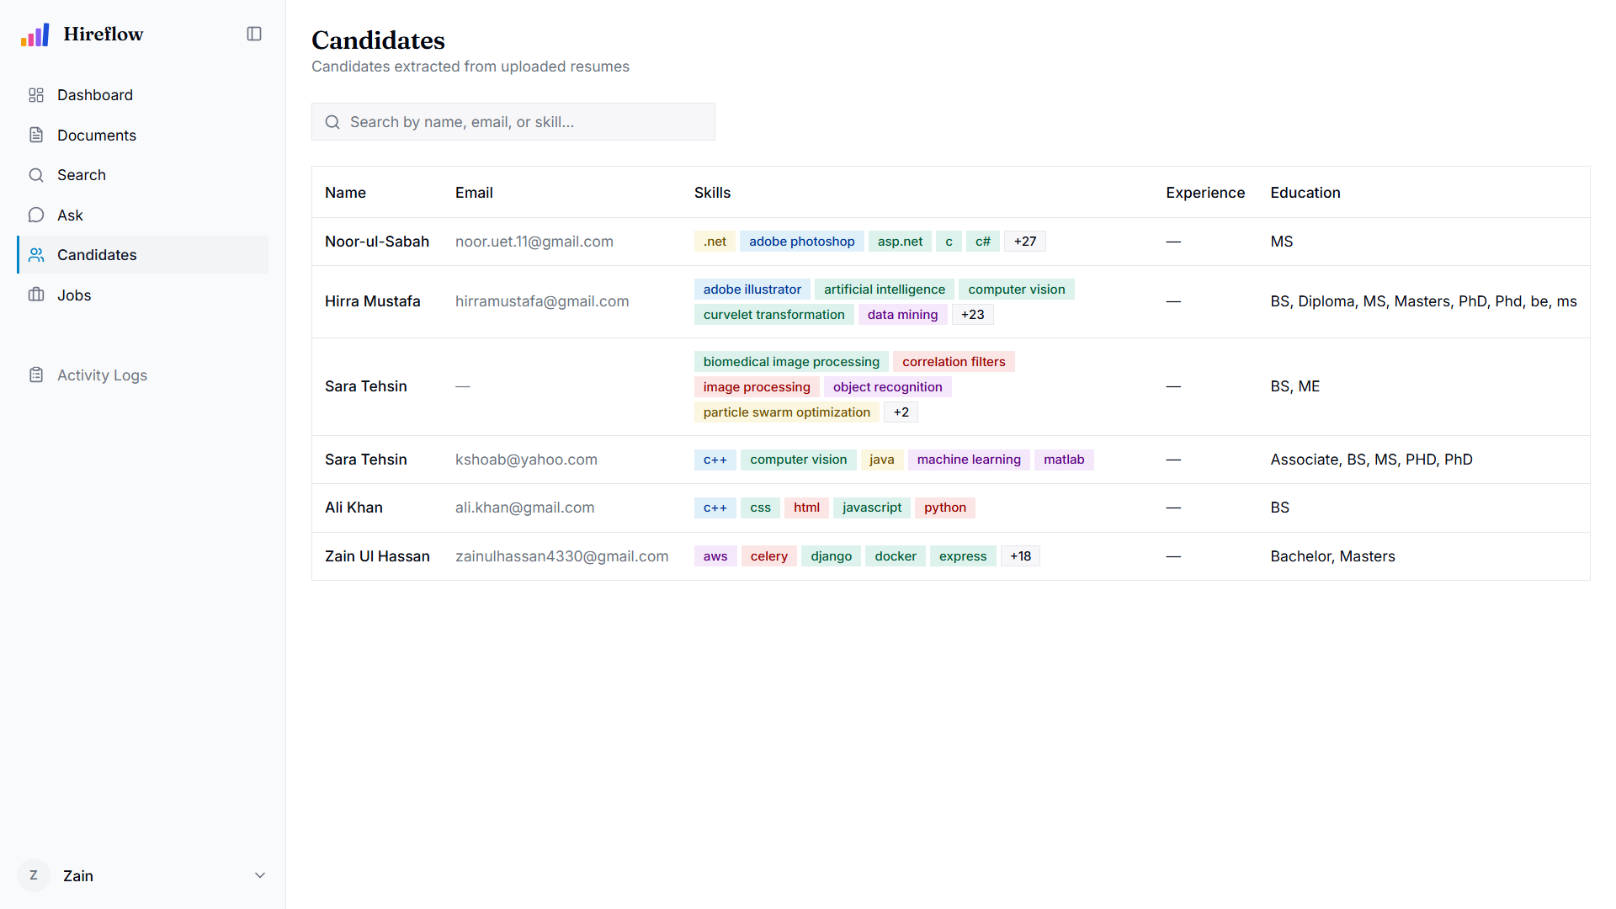
User Interface: Candidate Screening

Slide 18
Results & Outputs
Retrieval latency: hybrid search 72 ms median, 167 ms at the 95th percentile (server-side).
Ingestion throughput: about 44 s per text PDF to READY, about 4.1 s per scanned page; roughly 1.5 documents / minute at worker concurrency 1.
Embedding & LLM response: 0.57 ms per chunk on GPU; RAG time-to-first-token about 947 ms; full streamed answer about 1.5 s.
Prototype: 31 working REST API endpoints; grounded, source-cited answers; out-of-scope questions refused instead of hallucinated.

Slide 19
Testing
Unit testing of domain logic and services with in-memory fakes (no database or Docker required).
Integration & API testing driving full request/response cycles through FastAPI against real backing services.
Manual & UAT-style testing through the browser and curl for interactive surfaces (streaming chat, drag-and-drop, keyboard navigation).
Static analysis and linting (ruff, ESLint) run before every commit.

Slide 20
Testing: Key Test Cases
Test Case | Scenario | Expected Result | Status
TC-AUTH-006 | Login with valid credentials | HTTP 200; access + refresh tokens issued | Pass
TC-DOCS-001 | Upload PDF appears as ready | Status reaches ready within 60 s | Pass
TC-DOCS-046 | Auto-candidate from a resume | Candidate created on the on-ready hook | Pass
TC-SEARCH-005 | HR user sees only own documents | Owner scope enforced; empty result set | Pass
TC-RAG-001 | Grounded answer with citations | Answer cites at least one source | Pass
TC-RAG-002 | Out-of-scope question | Exact sentinel; no fabricated citations | Pass

Slide 21
Conclusion
Successfully developed an AI-powered HR platform that automates document processing, semantic retrieval, and resume screening.
Implemented RAG-based document retrieval with source-cited answers, improving search accuracy and reducing manual effort.
Automated the recruitment workflow through AI-based candidate ranking, Gmail resume synchronisation, and shortlist generation.
Designed a scalable, modular architecture with interchangeable AI components, ensuring maintainability and future extensibility.

Slide 22
Future Scope
Enhance security with login rate-limiting, token revocation, and stronger file validation.
Expand functionality with multilingual support, ATS integration, analytics dashboards, and real-time notifications.
Improve performance through quantitative benchmarking and domain-specific AI models for retrieval and ranking.
Increase accessibility with a native mobile application for recruiters.

Slide 23
References
Lewis, P., et al. (2020). Retrieval-Augmented Generation for Knowledge-Intensive NLP Tasks. NeurIPS 33, 9459–9474.
Reimers, N., & Gurevych, I. (2019). Sentence-BERT: Sentence Embeddings using Siamese BERT-Networks. EMNLP.
Vaswani, A., et al. (2017). Attention Is All You Need. NeurIPS 30.
Johnson, J., Douze, M., & Jégou, H. (2019). Billion-scale Similarity Search with GPUs (FAISS). IEEE TBD.
Smith, R. (2007). An Overview of the Tesseract OCR Engine. ICDAR.
Anthropic. (n.d.). Claude Documentation. docs.anthropic.com

Slide 24
Thank You

