Slide 2
Introduction

Slide 3
Project Overview
Project: AI-Powered HR Screening and Document Retrieval System
Technology: Retrieval-Augmented Generation (RAG)
Domain: Human Resources & Document Management
Primary Users: HR Personnel

Slide 4
Purpose
The project helps organizations in:
Managing large collections of unstructured documents
Searching and extracting meaningful information using AI
Automating resume screening and candidate evaluation
Reducing time-consuming manual document review

Slide 5
Project Scope
Document Processing
PDF, Word, and scanned images
OCR-based text extraction
Automatic document classification
Metadata generation and tagging
HR Screening
Gmail integration for resume collection
Multiple resume format support
Candidate ranking against job criteria
Shortlisting and export capabilities

Slide 6
Existing System

Slide 7
Current Approaches
Approach | Method | Limitation
Manual Review | Human effort | Time-consuming, error-prone
Keyword Search | Exact text matching | Misses semantically similar content
Traditional ATS | Rule-based filtering | Rigid criteria, misses good candidates
Basic OCR Tools | Text extraction only | No intelligent analysis

Slide 8
Related Technologies
Technology | Category | Year
LangChain | RAG Framework | 2022
FAISS | Vector Similarity Search | 2017
ChromaDB | Vector Database | 2022
Eightfold AI | AI Recruitment | 2016
Greenhouse | ATS, Resume Filtering | 2012
Google Document AI | Document Processing | 2020
Amazon Textract | Text Extraction | 2018
Tesseract | Open-source OCR | 2006

Slide 9
Limitations of Existing Systems
Technical Limitations
Cannot understand document context
No natural language question answering
Keyword-based search only
Limited to specific file formats
Practical Limitations
Document and HR tools are separate
Still requires significant manual review
No unified platform for both needs
Poor handling of unstructured data

Slide 10
Problem Statement

Slide 11
Core Problems
Document Management
Large document collections are hard to manage
Difficult to search without exact keywords
Manual classification is tedious
No way to ask questions about content
HR Screening
Resume screening is time-consuming
Good candidates are often overlooked
Manual email collection is tedious
No automated candidate ranking

Slide 12
Challenges Addressed
Challenge | Impact
Large document volumes | Difficult to find relevant information
Keyword-based search limitations | Semantically similar content is missed
No question answering capability | Users cannot query document content
Manual resume collection | HR spends time on repetitive tasks
Subjective candidate evaluation | Inconsistent screening decisions

Slide 13
Proposed System

Slide 14
Solution Overview
An AI-powered system that combines document management with HR screening:
Document Processing: Automated text extraction, classification, and tagging
Semantic Search: Find documents by meaning, not just keywords
RAG Module: Ask questions and get AI-generated answers from documents
HR Screening: Automated resume collection, parsing, and candidate ranking

Slide 15
Key Capabilities
Document Features
Upload PDF, Word, images
OCR for scanned documents
Automatic classification
Metadata extraction
Natural language search
HR Features
Gmail OAuth integration
Resume attachment sync
Skill and experience extraction
Job-based candidate matching
Shortlist and export to Excel

Slide 16
How RAG Works
Upload: Documents are added to the system
Extract: Text is extracted using OCR when needed
Chunk: Content is split into meaningful sections
Embed: Text chunks are converted to vector embeddings
Query: User asks a question in natural language
Retrieve: System finds semantically relevant chunks
Generate: AI produces an answer based on retrieved content

Slide 17
System Features Summary
Feature | Description
User Authentication | Login, password reset, role-based access
Document Upload | PDF, Word, image upload with processing
Search & Filter | Semantic search with metadata filters
RAG Q&A | Natural language questions over documents
Job Management | Create, edit, delete job postings
Resume Screening | View, shortlist, reject candidates
Email Integration | Gmail sync for resume collection
Activity Logs | Audit trail of system activities

Slide 18
Methodology

Slide 19
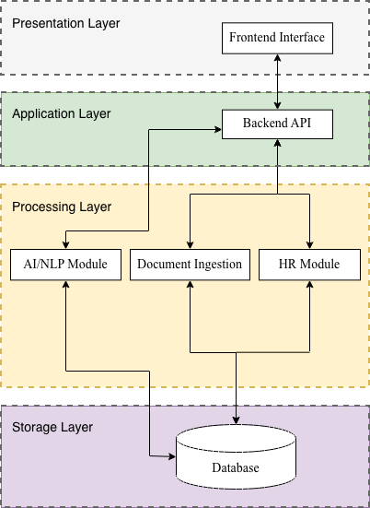
System Architecture
Architecture Diagram

Slide 20
Major Components
Component | Description
Document Ingestion | File uploads, format validation, routing
Processing Engine | OCR, text extraction, classification
AI/NLP Module | Embeddings, semantic search, RAG
Vector Database | Document embeddings for similarity search
HR Module | Gmail integration, resume collection, screening
Backend API | Business logic and coordination
Frontend Interface | Web application for user interactions
Security Layer | Authentication, authorization, audit

Slide 21
Development Approach
Phase 1: Planning
Requirements gathering
System architecture design
Database schema design
User interface planning
Phase 2: Implementation
Backend API development
AI/RAG component setup
Frontend development
Integration and testing

Slide 22
Data Flow
Document Processing Flow
User uploads document
System extracts text (OCR if needed)
Document is classified
Metadata is generated
Content is indexed for search
Search & Q&A Flow
User enters query
Query is parsed for intent
Relevant content is retrieved
Results are ranked
AI generates response

Slide 23
Tools and Techniques

Slide 24
Backend Technologies
Tool | Purpose
Python 3.9+ | Primary programming language
FastAPI | Backend web framework
PostgreSQL 13+ | Relational database for metadata
ChromaDB | Vector database for embeddings
LangChain | RAG framework and LLM orchestration
Tesseract OCR | Text extraction from images
PyMuPDF | PDF processing

Slide 25
AI and NLP Technologies
Technology | Purpose
OpenAI Embeddings | Text-to-vector conversion
Large Language Models | Answer generation and parsing
Semantic Search | Meaning-based document retrieval
Section Detection | Resume parsing with regex + LLM

Slide 26
Frontend and Infrastructure
Tool | Purpose
React / Next.js | Frontend web framework
OAuth 2.0 | Gmail authentication
Docker | Containerized deployment
HTTPS | Secure communication

Slide 27
Operating Environment
Server Requirements
Linux (Ubuntu 20.04+) or Windows Server
16 GB RAM minimum
Quad-core processor
500 GB SSD storage
Client Requirements
Modern web browser
JavaScript enabled
Stable internet connection
No installation required

Slide 28
Diagrams

Slide 29
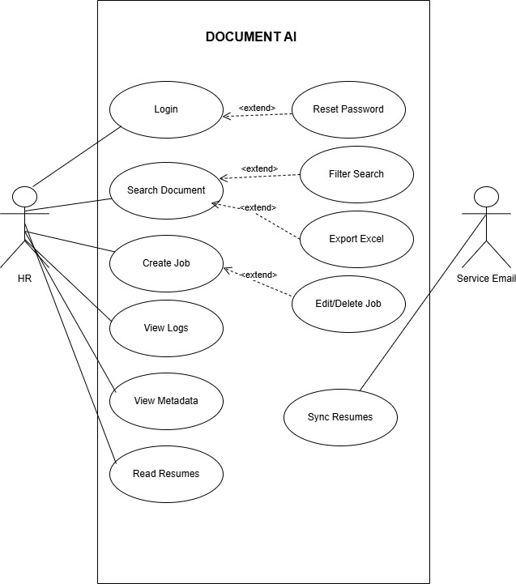
Use Case Diagram
Use Case Diagram

Slide 30
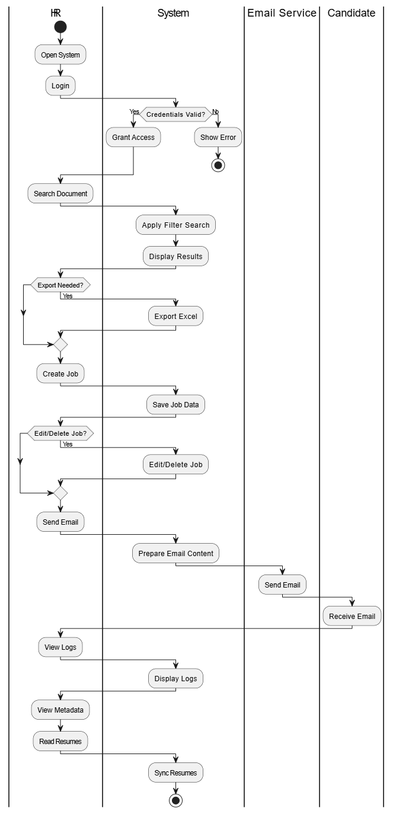
Activity Diagram
Activity Diagram

Slide 31
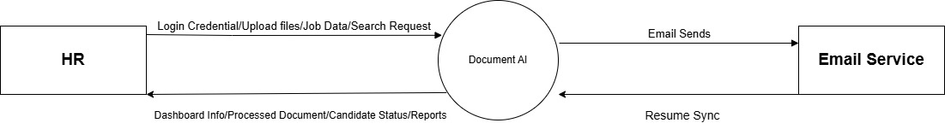
DFD Level 0
DFD Level 0

Slide 32
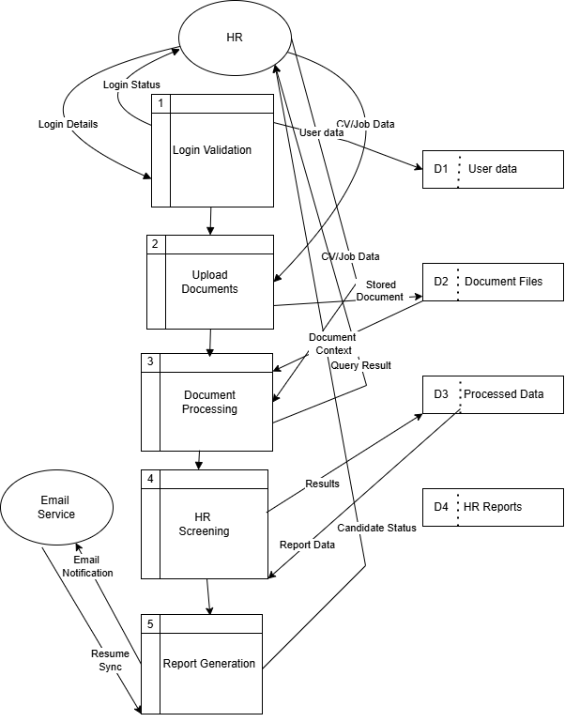
DFD Level 1
DFD Level 1

Slide 33
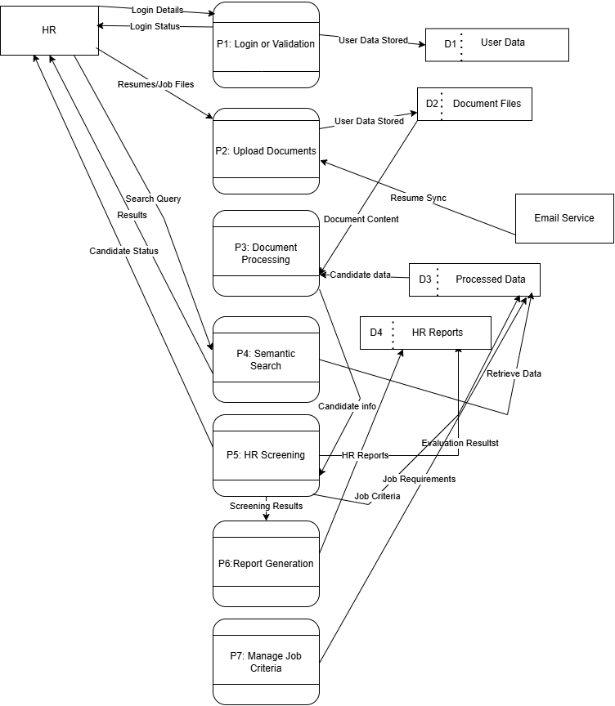
DFD Level 2
DFD Level 2

Slide 34
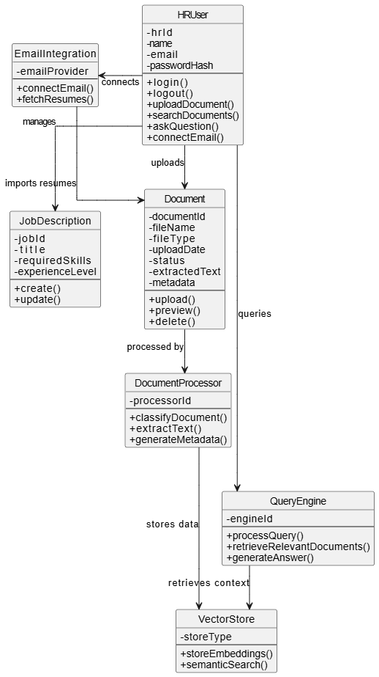
Class Diagram
Class Diagram

Slide 35
Contribution

Slide 36
Key Contributions
Technical Contributions
Unified document and HR platform
RAG-based question answering
Semantic search implementation
Hybrid chunking strategy for resumes
Practical Contributions
Automated email resume collection
AI-powered candidate ranking
Natural language interface
Reduced manual screening effort

Slide 37
Benefits
Benefit | Description
Time Savings | Reduces hours spent on manual document review
Improved Accuracy | AI reduces human errors in screening
Scalability | Handles large document collections efficiently
Ease of Use | Natural language queries, no training needed
Integration | Works with existing Gmail accounts
Compliance | Activity logging for audit trails

Slide 38
Comparison with Existing Solutions
Aspect | Traditional Systems | Proposed System
Search | Keyword-based | Semantic (meaning-based)
Q&A | Not available | RAG-powered answers
Resume Collection | Manual download | Automated Gmail sync
Candidate Ranking | Manual or rule-based | AI-powered matching
Platform | Separate tools | Unified solution

Slide 39
Limitations

Slide 40
Current Limitations
Technical Limitations
English language documents only
OCR accuracy depends on scan quality
Requires AI model API access
GPU recommended for local models
Scope Limitations
Limited to PDF, Word, images
Single organization deployment
Internet required for email sync
Designed for medium-scale workloads

Slide 41
Future Improvements
Technical Enhancements
Multi-language support
Improved OCR accuracy
Custom model fine-tuning
Advanced analytics dashboard
Feature Additions
Additional email providers
Mobile application
Multi-tenant support
Integration with HRIS systems

Slide 42
User Interface

Slide 43
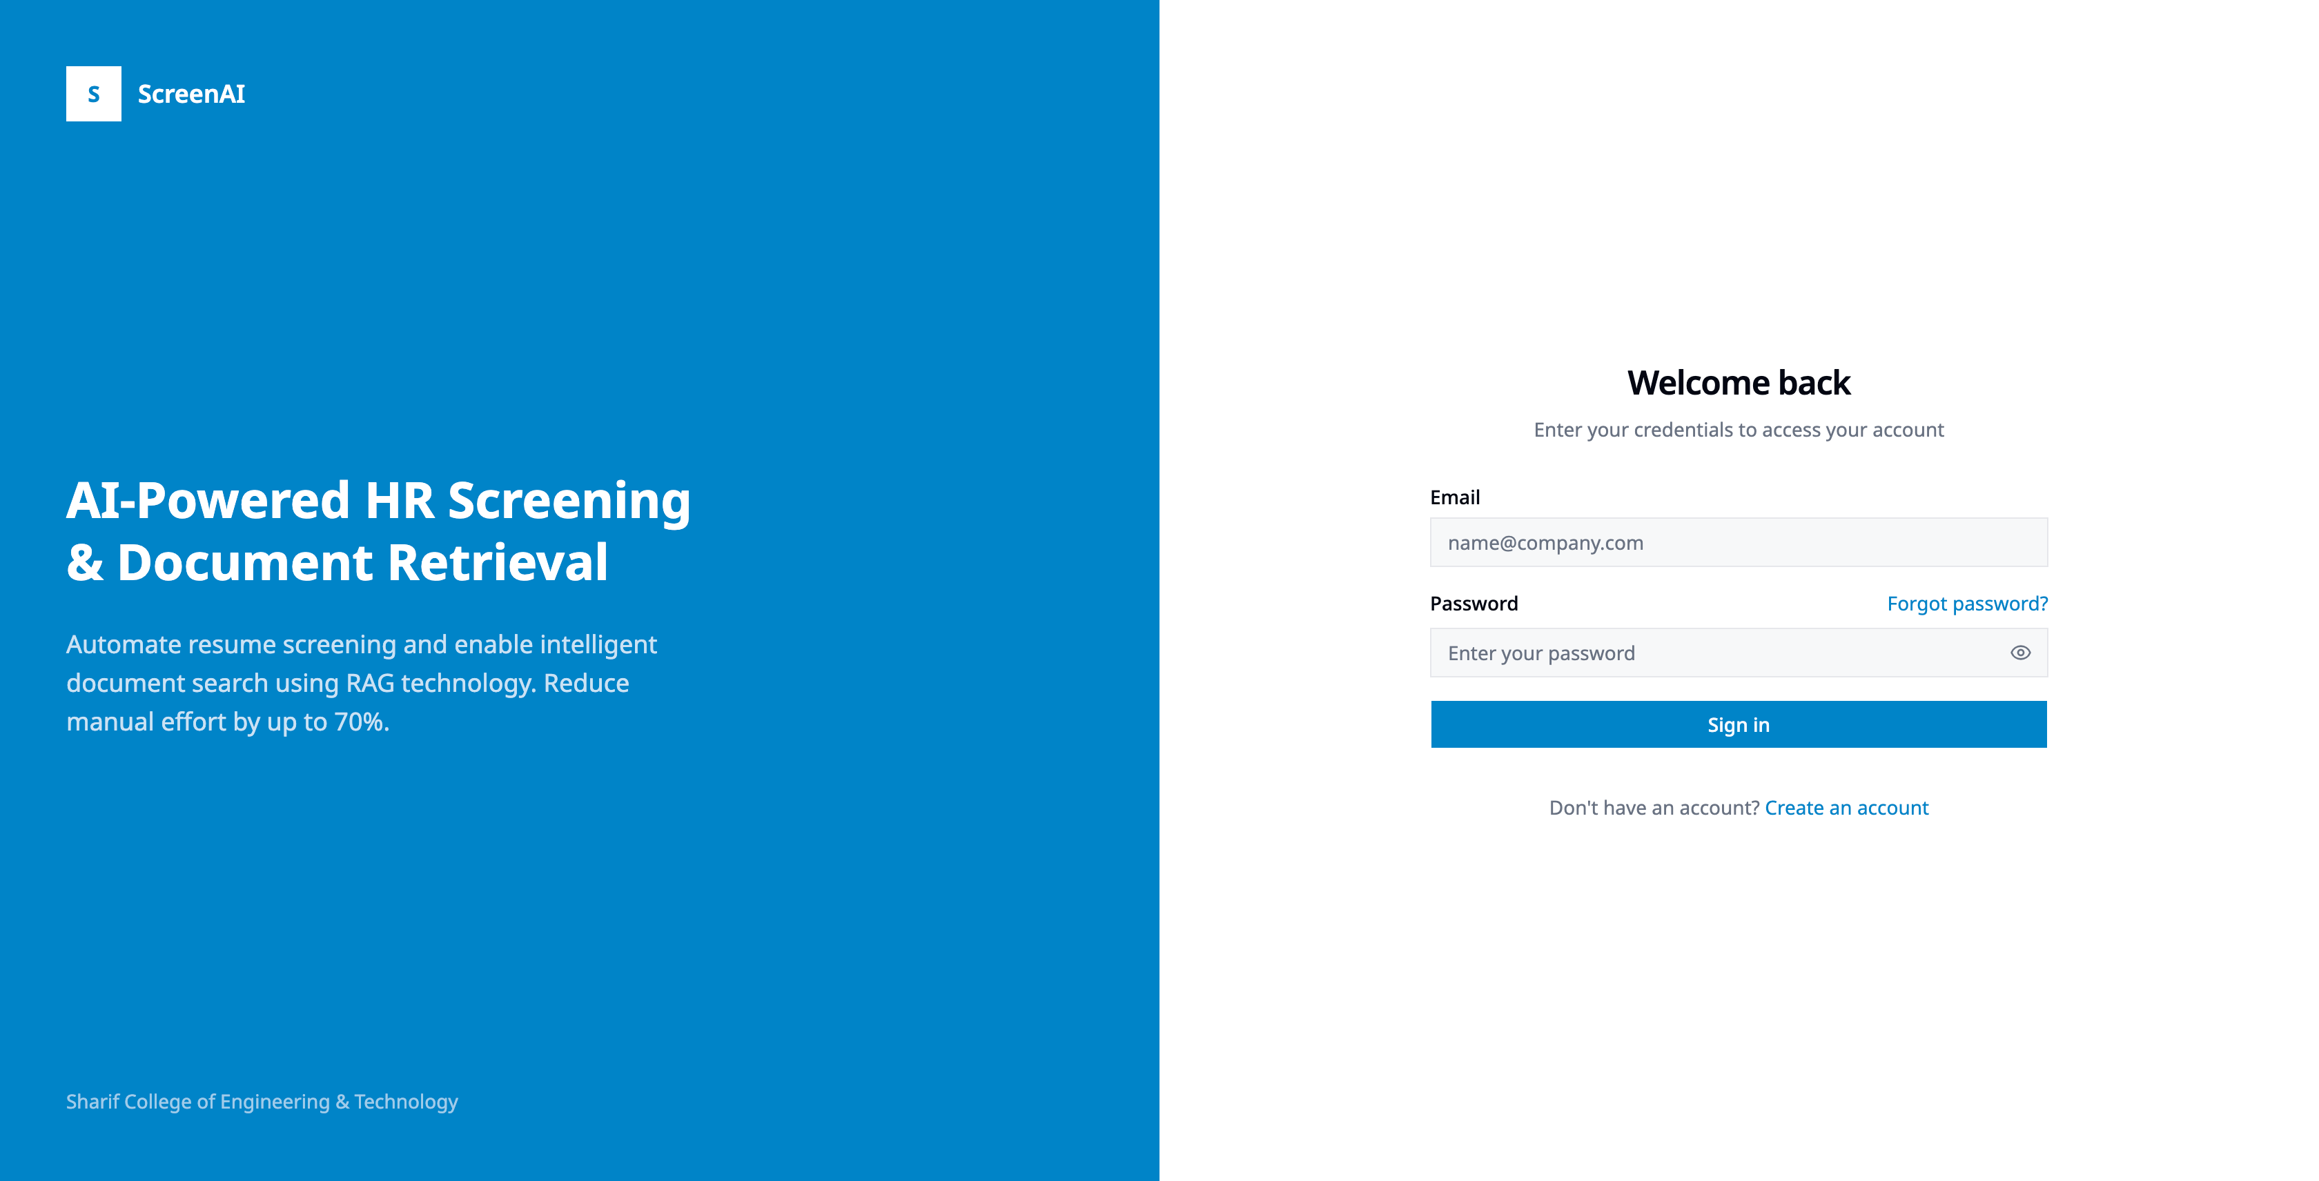
Login Screen
Login Screen

Slide 44
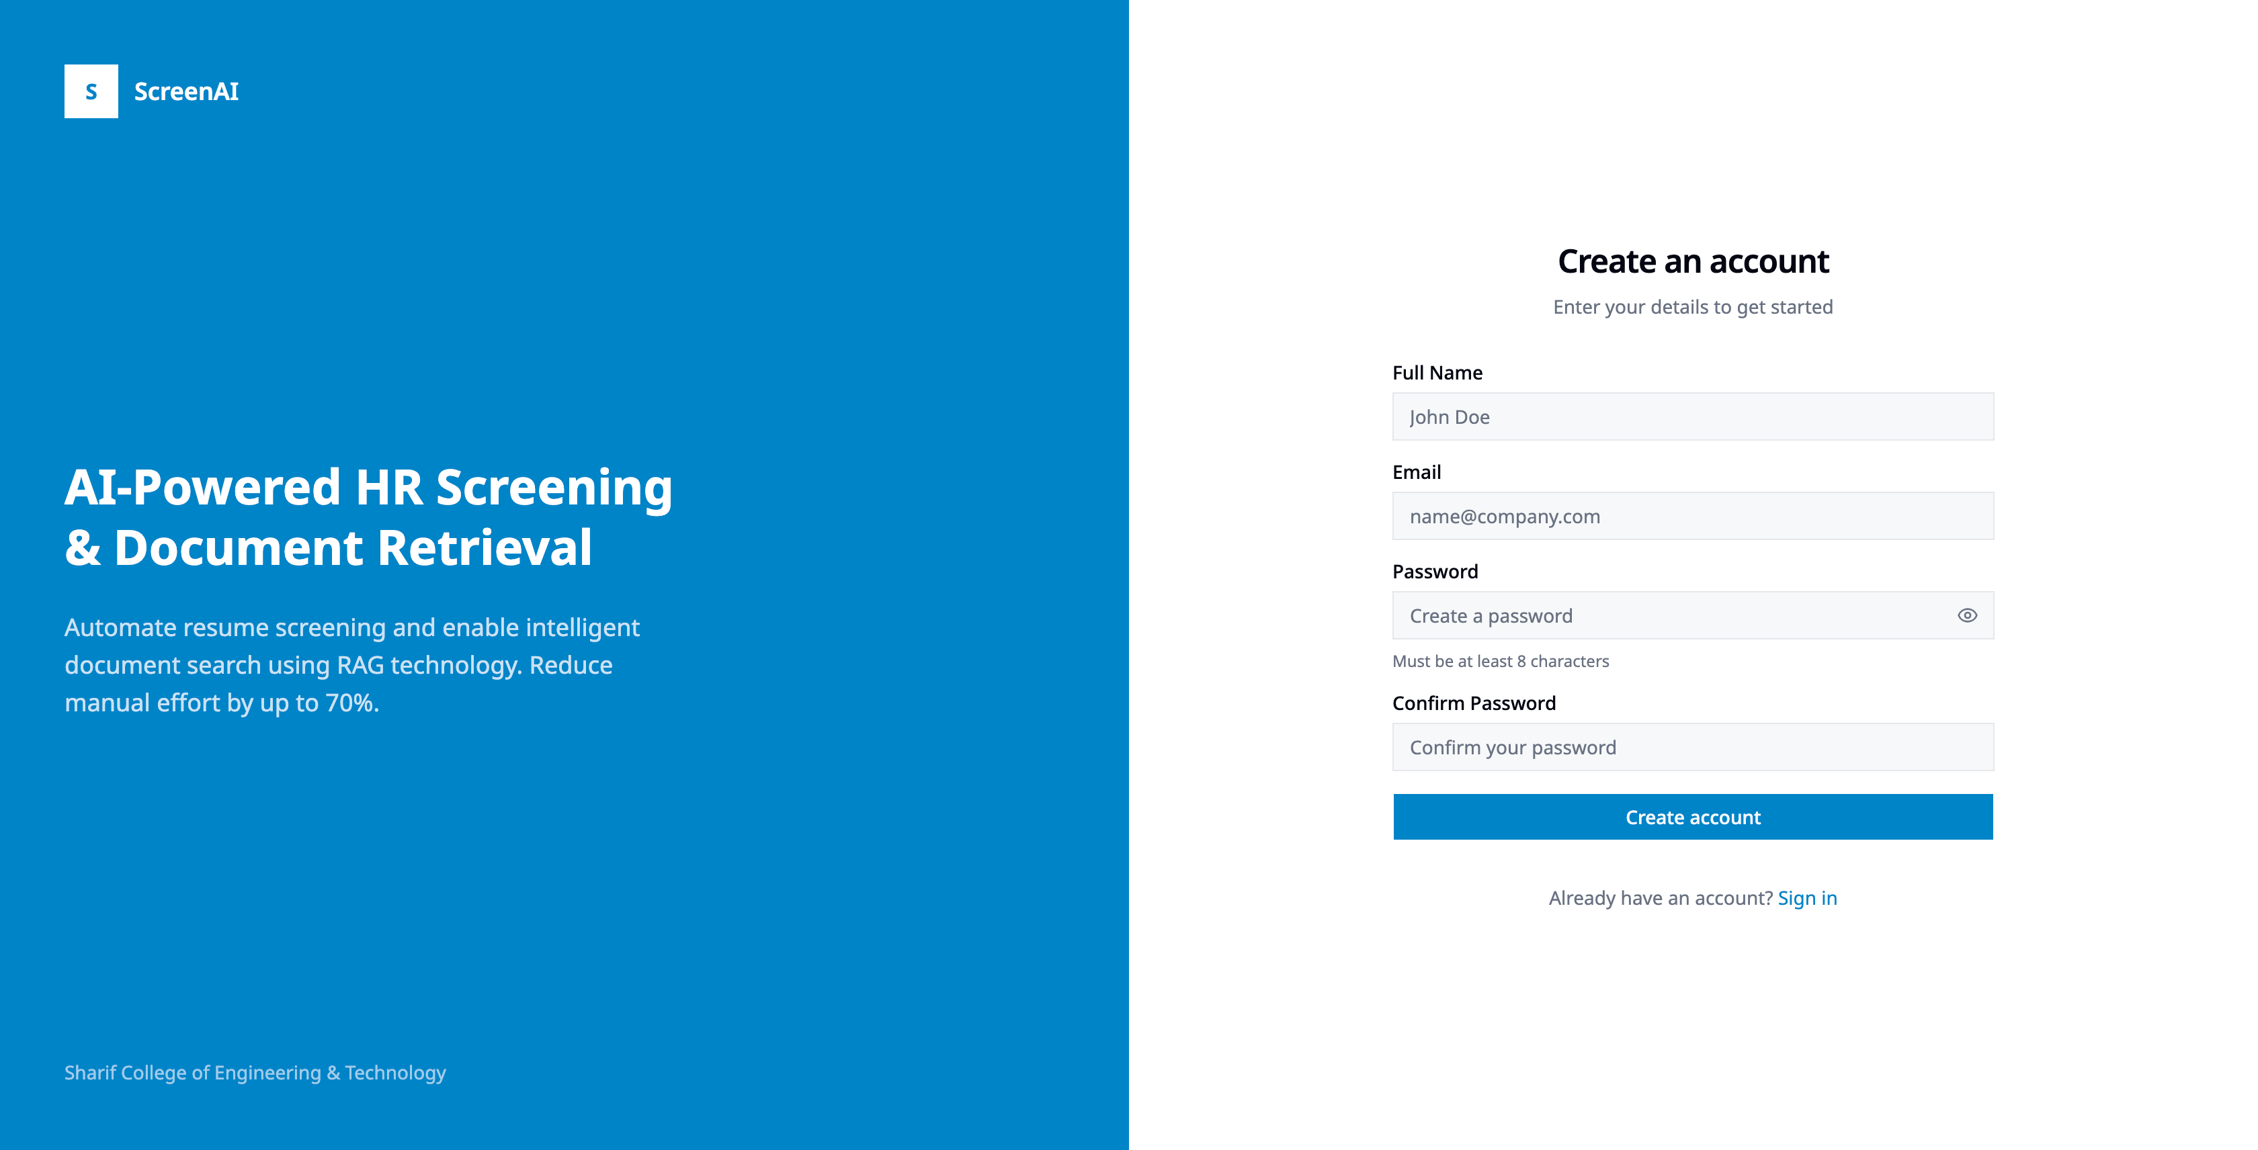
Signup Screen
Signup Screen

Slide 45
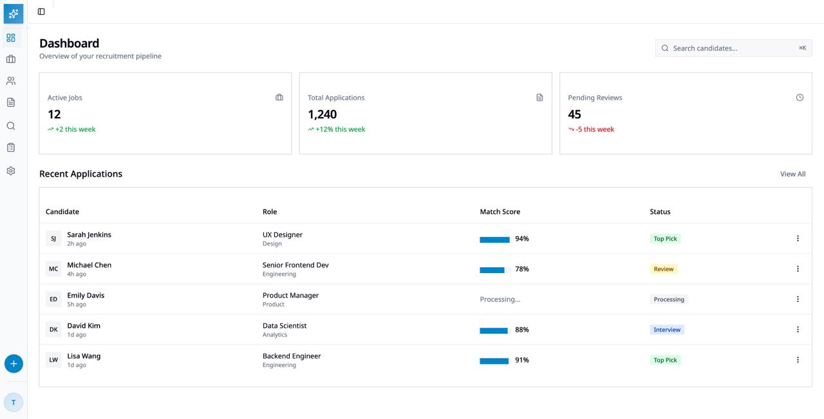
Dashboard
Dashboard

Slide 46
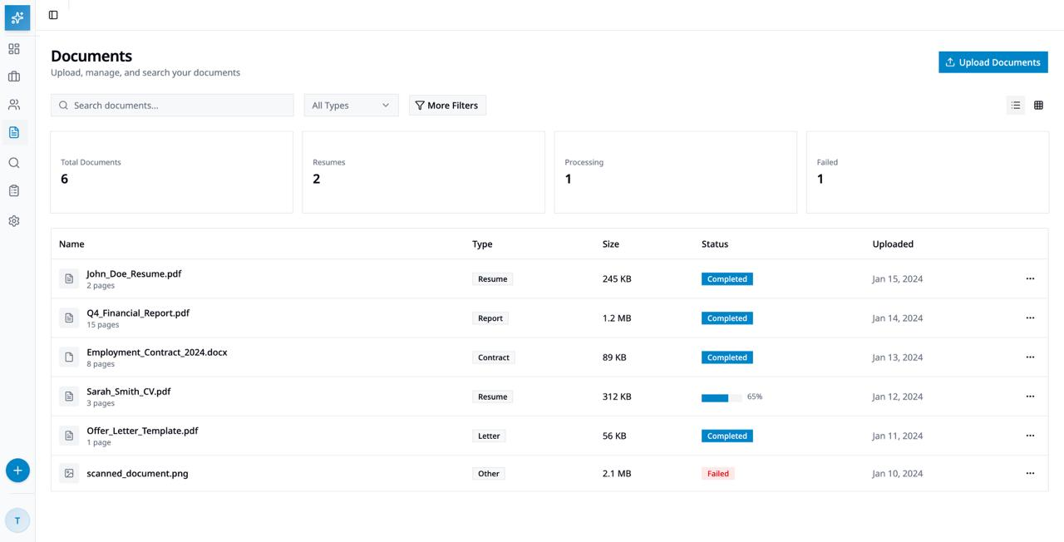
Document Management
Document Management

Slide 47
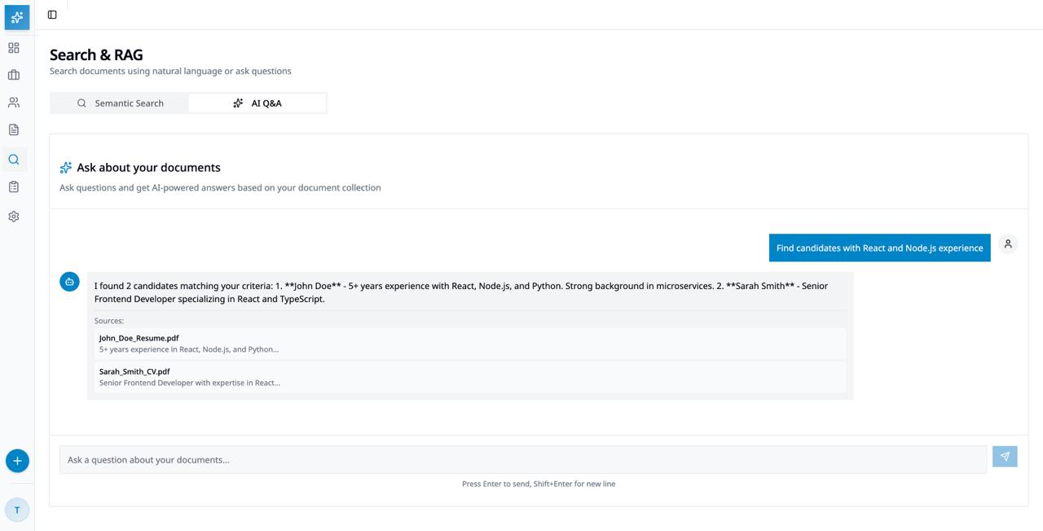
Search and RAG Interface
Search and RAG

Slide 48
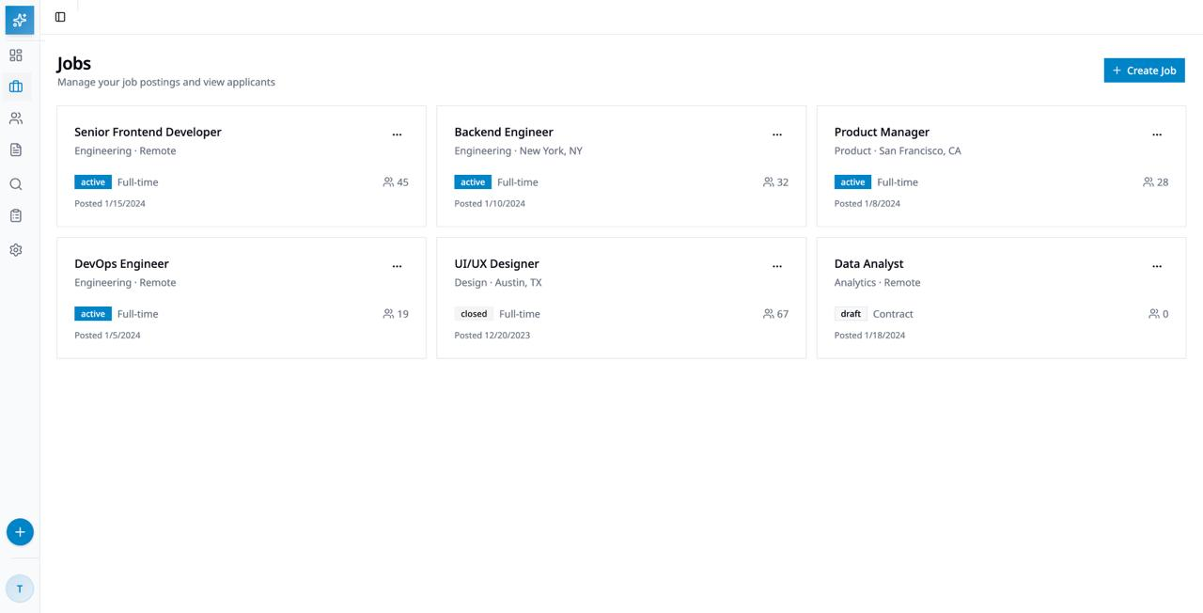
Jobs Listing
Jobs Listing

Slide 49
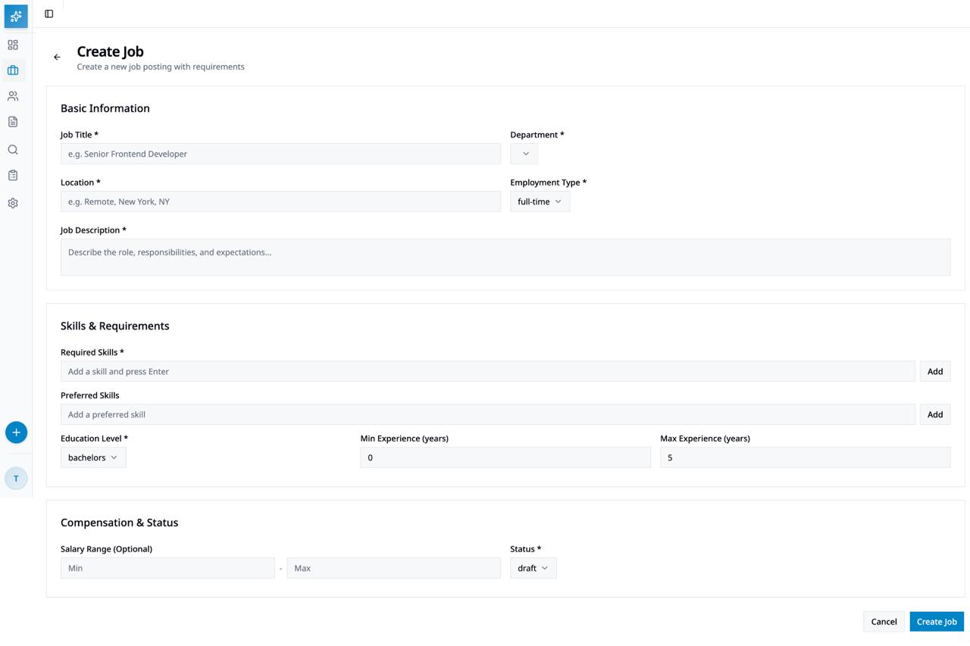
Create Job
Create Job

Slide 50
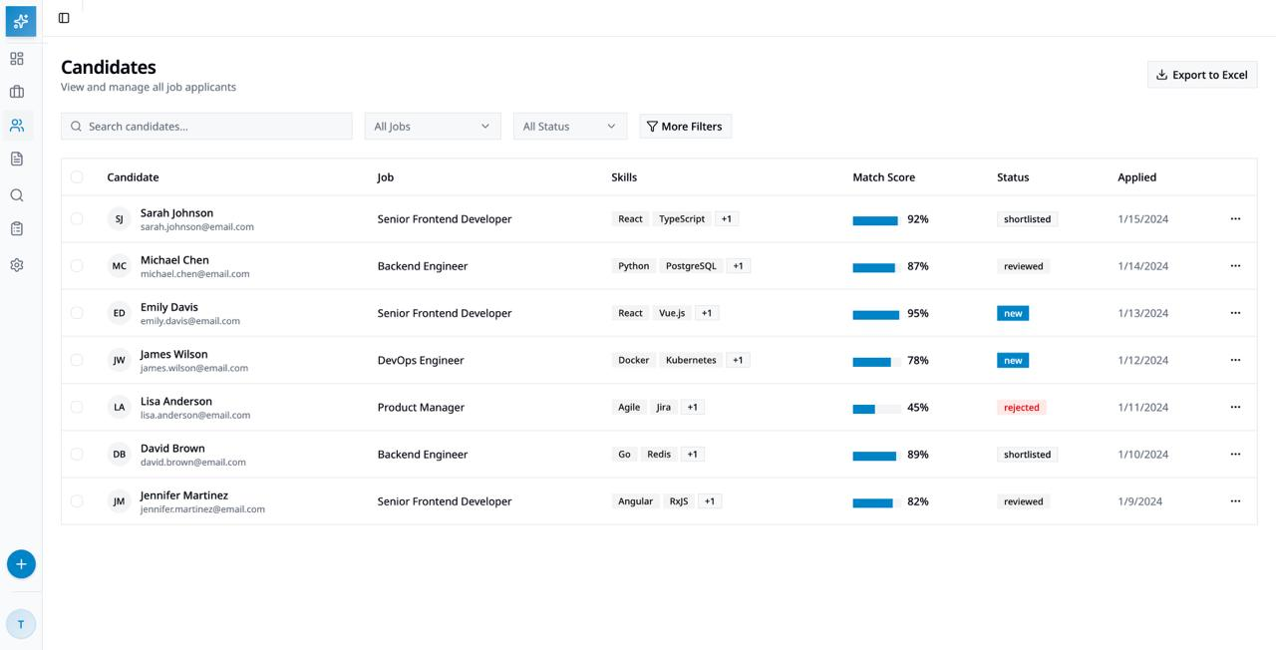
Candidates / Resume Screening
Candidates

Slide 51
Thank You

