Slide 1
Final project – GROUP 10 SPORTS news categorization and integration with AI chatbot
Course: GNG5300 - Machine Learning for Scientists and Engineers Professor: Olubisi Runsewe Date: 08/04/2022 Students:
Tareq Dawoudiah, 7136770
Neil Trerice, 300217430
Abu-Bakar Irfan, 7398283
Zain Ur-Rehman, 300207267

Slide 2
Agenda
Problem Formulation
Methodology
Data Description/Sources
Architecture Diagram
Chatbot
Implementation
Results and Evaluation
Conclusion
References
Demo

Slide 3
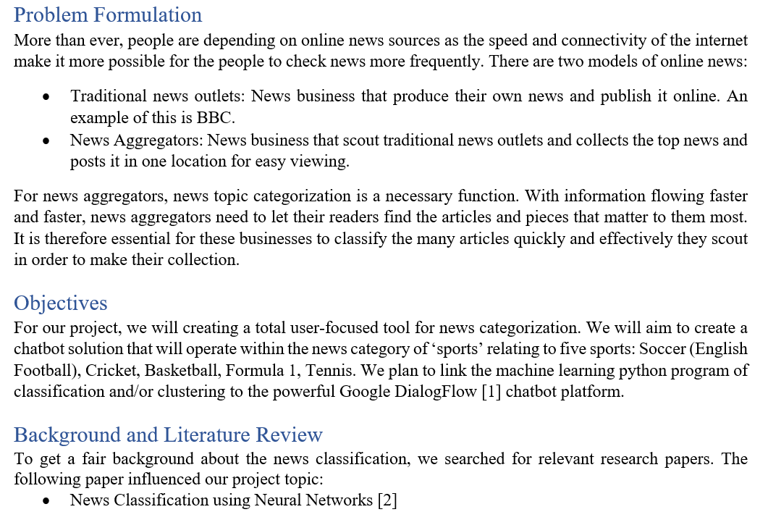

Slide 4
Problem Formulation
To create a chatbot tool that informs the user of
Latest news relating to a certain sport (soccer, cricket, basketball, formula 1, tennis)
Categorizing the sports news headline
Rules of the sports topic
History of the sports topic

Slide 5
Methodology
Classification
Multinomial Navier Bayes
Stochastic Gradient Descent
Logistic Regression
Support Vector Machine
Decision Tree
Nearest Neighbors Classification
Clustering
K-Means

Slide 6
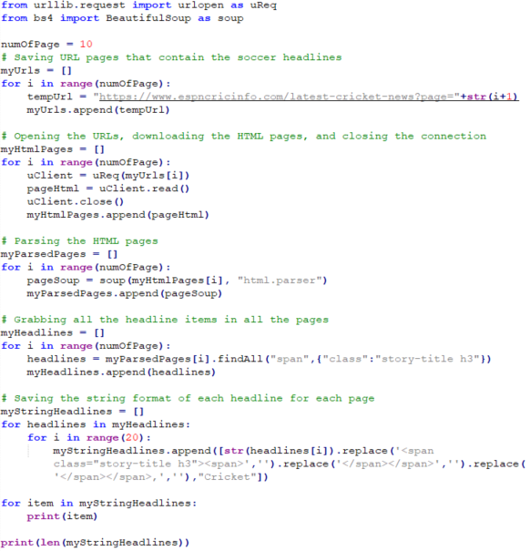
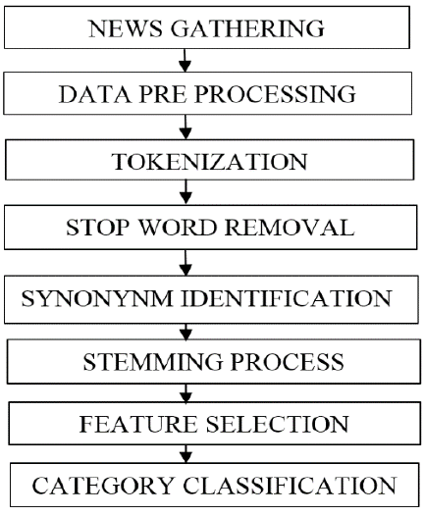
DATA DESCRIPTION and SOURCES
10,000 sports articles were collected for training purposes.
Web scraping library BeautifulSoup and Urllib used

Slide 7
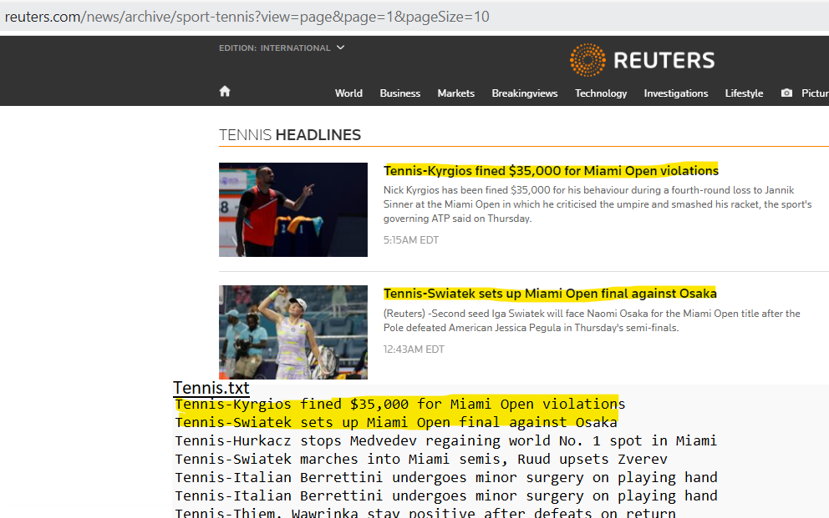

DATA DESCRIPTION and SOURCES
Cricket
https://www.espncricinfo.com/latest-cricket-news
Basketball
https://www.reuters.com/news/archive/basketball-nba
Tennis
https://www.reuters.com/news/archive/sport-tennis
FormulaOne
https://www.reuters.com/news/archive/sport-f1
Soccer
https://www.reuters.com/news/archive/soccer-england

Slide 8
CHATBOT – Introduction
Address queries instantly without a need of support agent
3 different types of Chatbots:
Rule based
AI
Hybrid
Many platforms available to build chatbots:
Wotnot
Intercom
Drift
Google DialogFlow

Slide 9
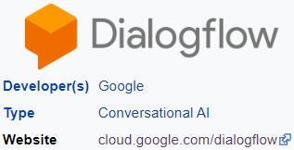
CHATBOT – SELECTION
Dialogflow is a natural language understanding platform that makes it easy to design and integrate a conversational user interface into your mobile app, web application, etc
DialogFlow is quite a good choice to learn how to create Chatbots. Free Standard Edition
Dialogflow Fulfillment lets developers to integrate the machine learning model using Python Flask API

Slide 10
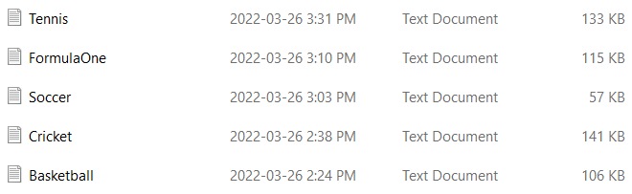
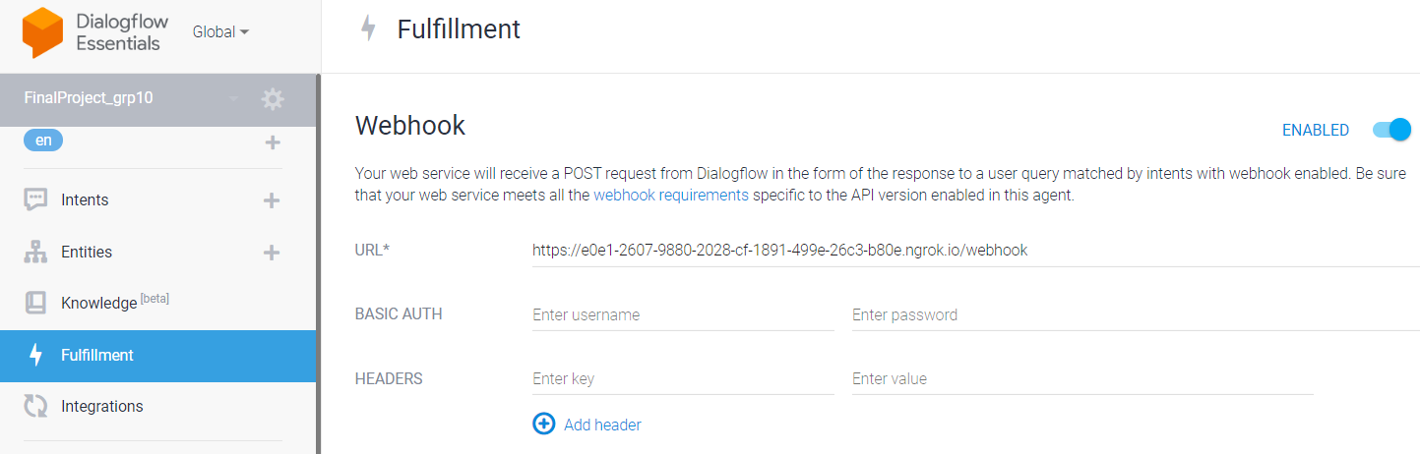

Architecture diagram
WebScrapping.py
Classification.py
app.py
def webhook()
Chatbot Web-based Platform:
Google DialogFlow
App.py and ngrok.exe running on PC environment

Slide 11


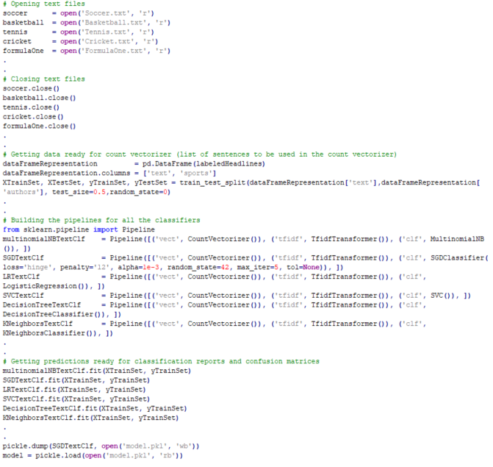
Implementation – MACHINE LEARNING MODEL
Use Count Vectorizer
Champion model is SGD (more details in later slides)
Use pickle to save the model

Slide 12
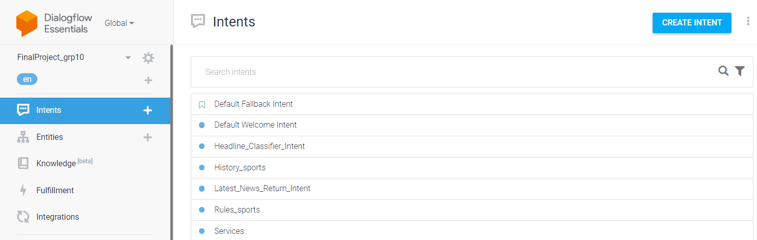
Implementation – DialogFlow AGENt
Agent: FinalProject_grp10
Agent has many intents
When user writes, DialogFlow matches the user expression to the best intent
Intent contains Training phrases, Action, and Responses

Slide 13
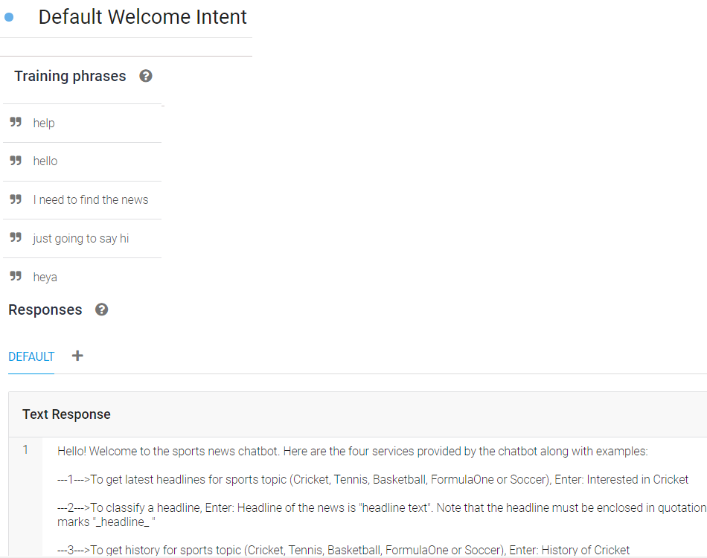
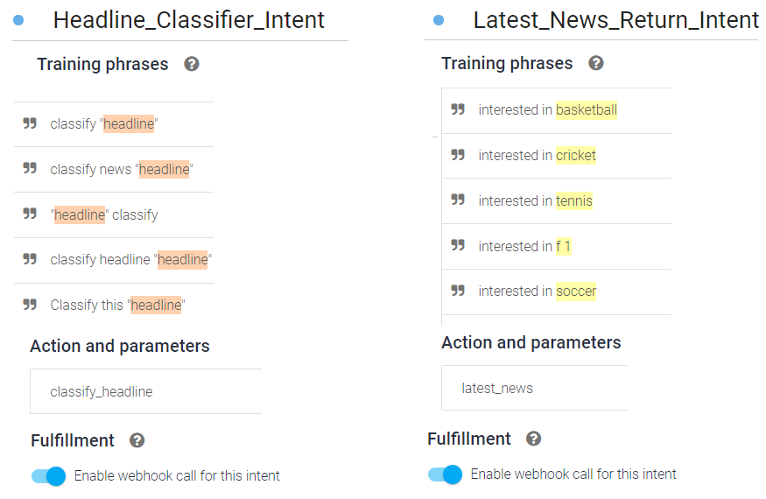
Implementation – DialogFlow Intents
Intent contains Training phrases, Action, and Responses
Enable webhook for all required intents that need response from external APIs

Slide 14
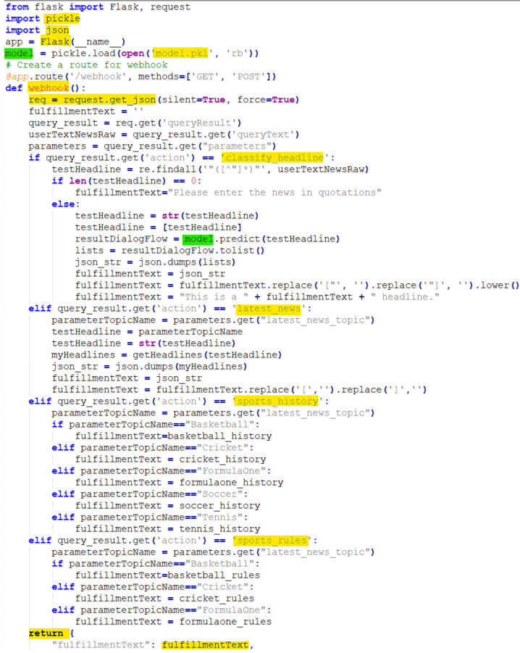
Implementation – Dialogflow API requests
app.py
App.py (a web app with flask) uses pickle to load the trained model. Also contains the route for webhook calls
To handle fulfillment, webhook service (in App.py) accepts JSON requests and return JSON responses
Webhook is http callbacks [5]
When DialogFlow needs webhook, it sends the request, and with that request, some request data to the webhook
The webhook uses model file or other functions/APIs to generate the response for that request
The response along with response data is sent back to DialogFlow
DialogFlow shows this response to the user

Slide 15
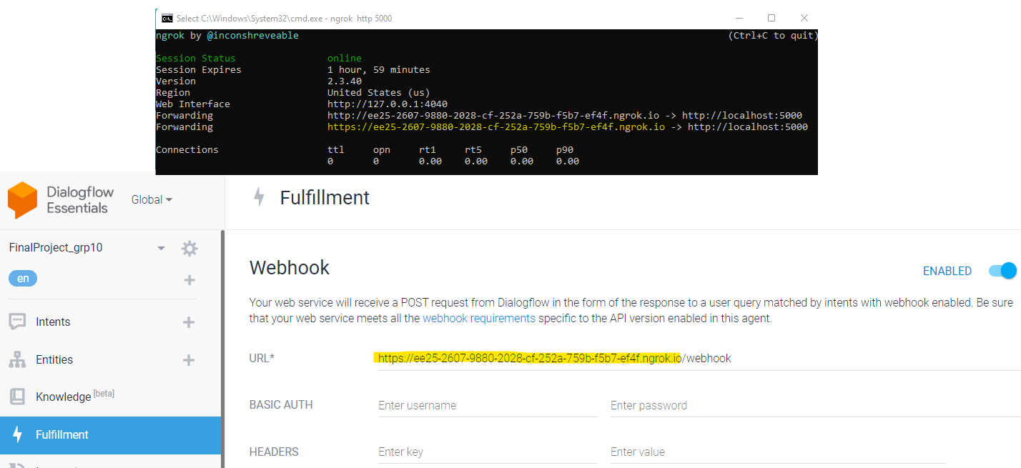
Implementation – Ngrok
Use Ngrok on PC: Application to temporarily expose local development machine/server to the internet
Use the https URL in the fulfillment section

Slide 16
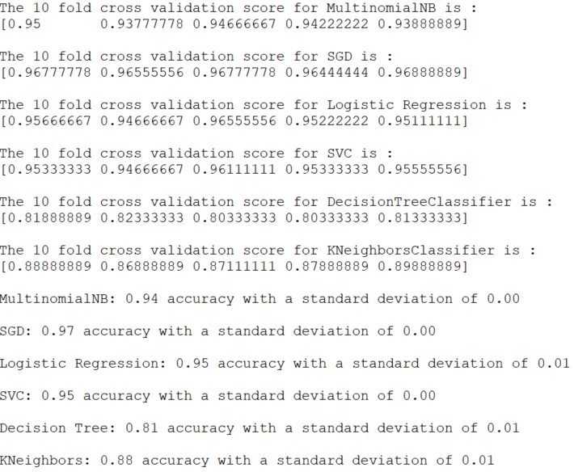
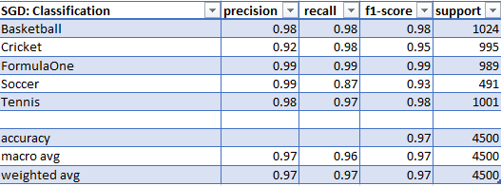
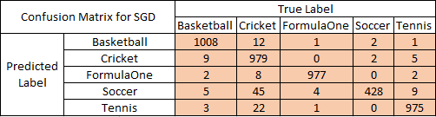
Results and evaluation – Classification (SGD)

Slide 17
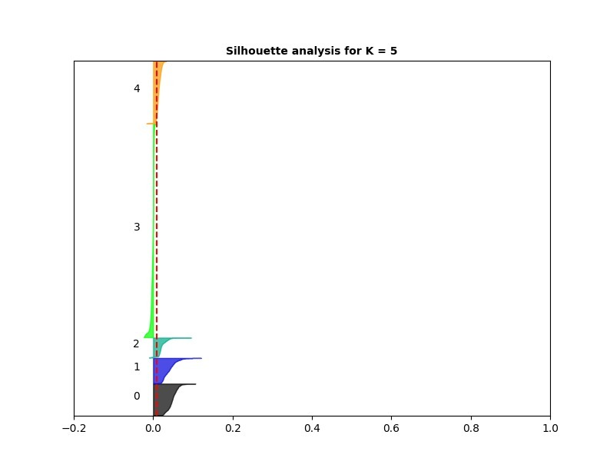
Results and evaluation – CLUSTERING (K-Means)
TFIDF Transformer as feature extractor
Out of 9,000 samples, the correct labeling count is: 3889
Out of 9,000 samples, the incorrect labeling count is: 5111
The Kappa score is: 0.32797159887798044
Soccer is cluster: 3
Basketball is cluster: 4
Tennis is cluster: 2
Cricket is cluster: 1
Formula One is cluster: 0

Slide 18
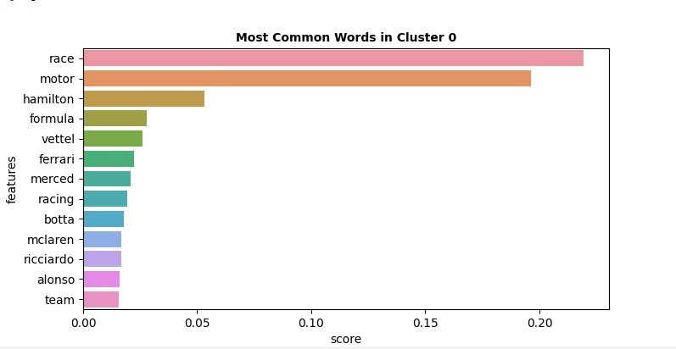
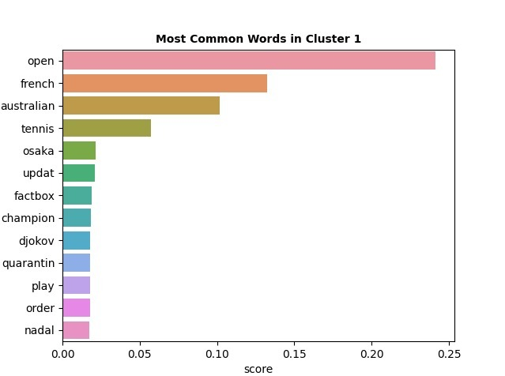
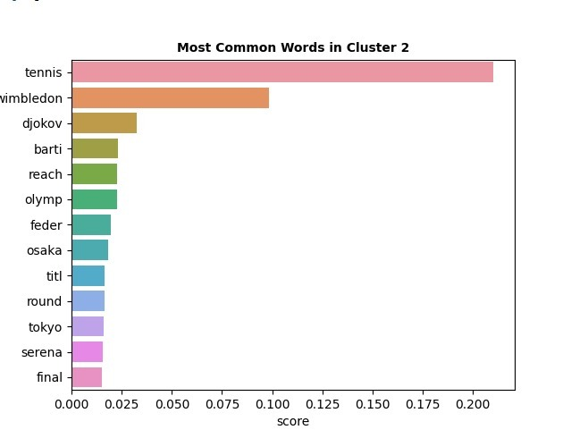
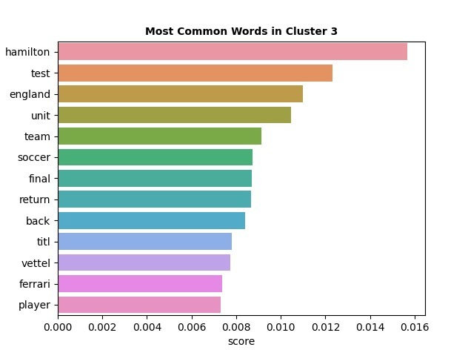
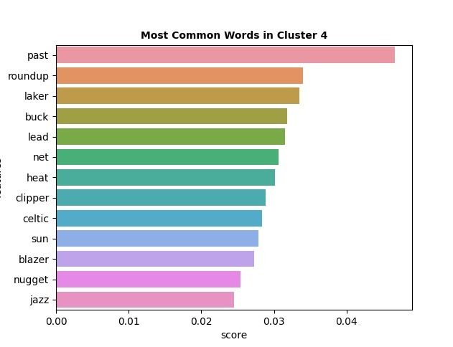
Results and evaluation – CLUSTERING (K-Means)
Determined top 13 most frequent words in each cluster

Slide 19
Project conclusions
Project outcomes
Development of Dialogflow Chatbot and integrating it with Python ML model
Chatbot provides four services: News Classification, Recent News, History and Rules for selected sports topics (cricket, basketball, formula one, soccer, tennis)
Explored various Classification and Clustering algorithms
Future work on this project
Incremental Model Training
Fake News Detection

Slide 20
References
[1] Google Dialog Flow Application: https://dialogflow.cloud.google.com/
[2] https://www.caeaccess.org/archives/volume5/number1/kaur-2016-cae-652224.pdf
[3] https://cloud.google.com/dialogflow/es/docs/agents-manage
[4] https://www.margo-group.com/en/news/a-brief-introduction-to-chatbots-with-dialogflow/
[5] https://cloud.google.com/dialogflow/es/docs/fulfillment-webhook

Slide 21
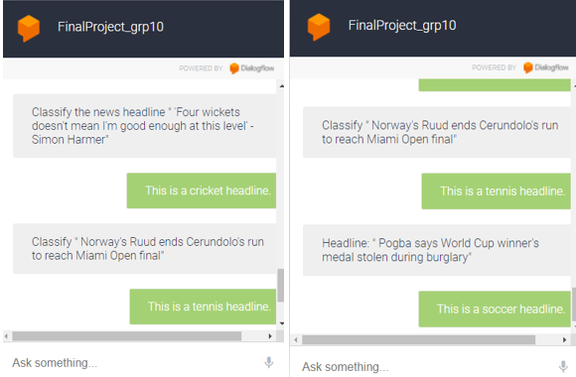
DEMO

Slide 22
Backup slides

Slide 23
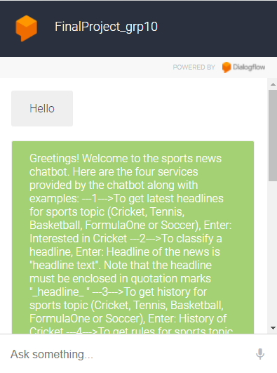
Backup slides – Testing the chatbot
Testing welcome intent
Type hello or hi to see the below response:

Slide 24
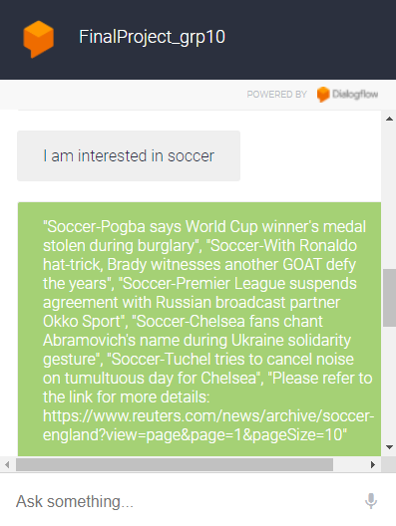
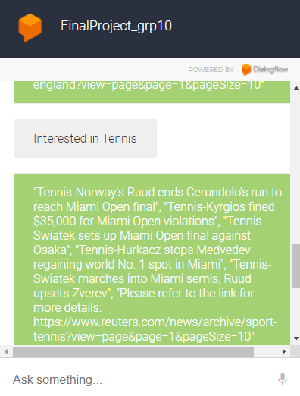
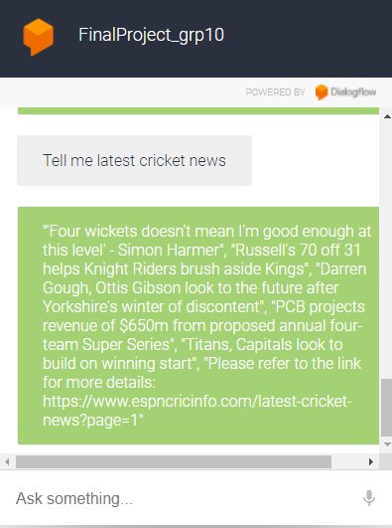
Backup slides – Testing the chatbot
Testing Latest Sports intent
To test this intent, enter phrases like:
I am interested in soccer
Interested in Tennis
Tell me latest cricket news

Slide 25
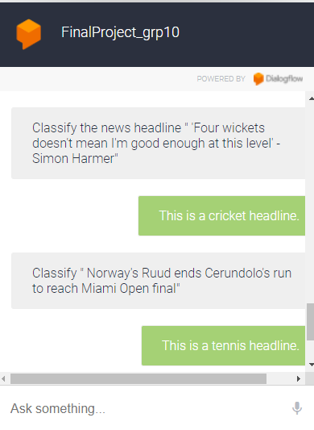
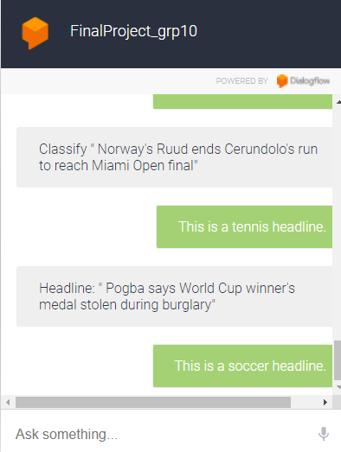
Backup slides – Testing the chatbot
Testing Classify Headline intent
To test this intent, pick one of the above headlines to see if the chatbot returns correct category of soccer, tennis, or cricket using the model.pkl file

Slide 26
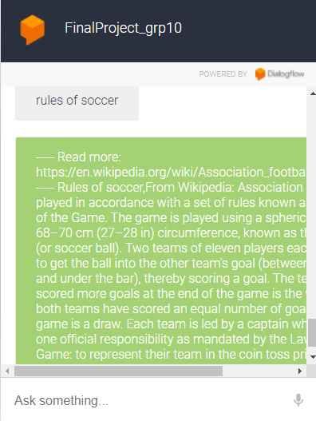
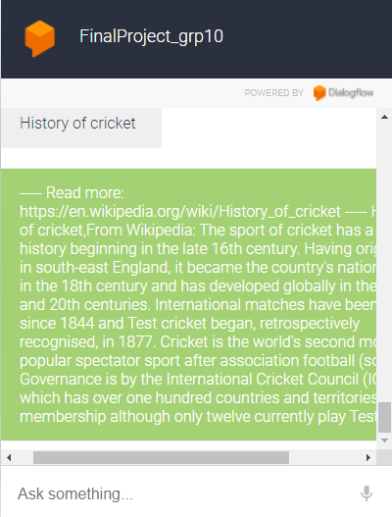
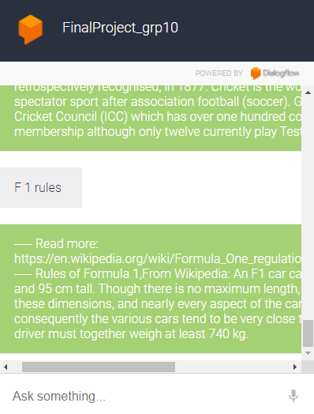
Backup slides – Testing the chatbot
Testing History and Rules intent
To test if the chatbot is correctly returning the pre-defined history and rules text to the user, enter phrases like:
rules of soccer
History of cricket
F 1 rules

Slide 27
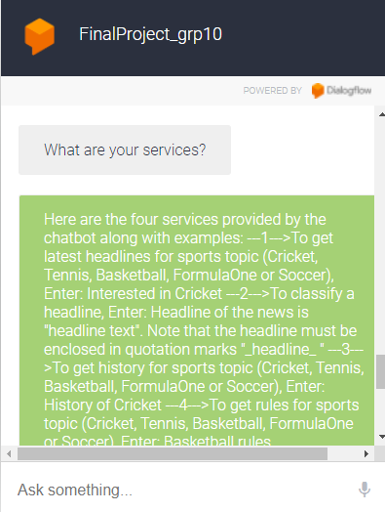
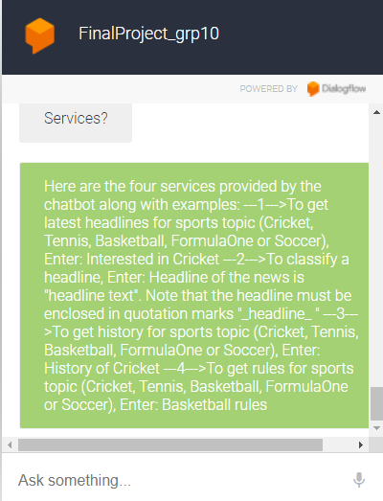
Backup slides – Testing the chatbot
Testing Services intent
To test if the chatbot is correctly returning the list of services provided by the chatbot, user can enter the following phrases:
What are your services?
Services?
services
What other services do you provide?

