Slide 1
SYSC5013 – SOFTWARE AGENTS ROBOCUP PROJECT USING JASON BDI
Abubakar Irfan
Tareq Dawoudiah
Zain Ur-Rehman

Slide 2
AGENDA
INTRODUCTION
DESIGN AND ARCHITECTURE
AGENT BEHAVIOUR & TESTING
DEMO
REFERENCES

Slide 3
INTRODUCTION
Beliefs-Desires-Intentions (BDI)
AgentSpeak
Jason Framework
Eclipse IDE

Slide 4
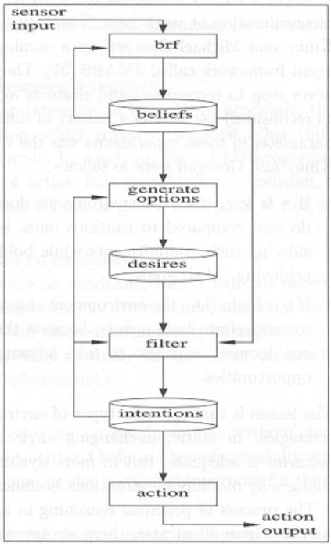
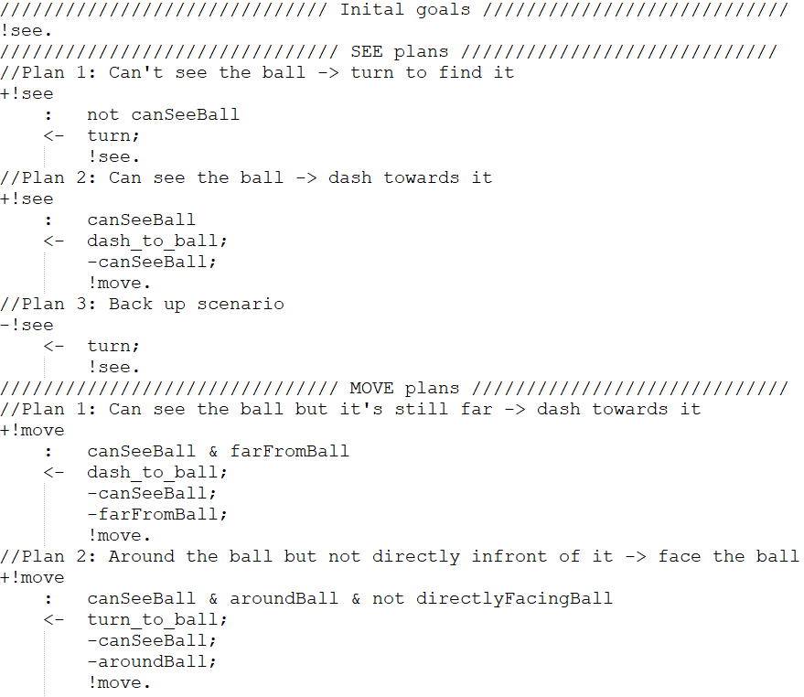
Jason BDI Architecture
BDI Architecture [2]
soccerAgent.asl

Slide 5
DESIGN AND ARCHITECTURE (1/2)
Jason Libraries such as Agent, AgArch, ActionExec, and TransitionSystem imported in Brain.java
Brain class extends the Jason-2.6.3 AgArch class
reasoningCycle function senses, deliberates, and acts based on the asl file
Override perceive and act functions in Brain class
Krislet
main()
Client
Server
rcssserver
soccerAgent.asl
AgArch
(Jason-2.6.3.jar)
use
extends
Brain
Brain (modified)
use
Memory
VisualInfo
ObjectInfo
use
use
PitchEnvironemnt
PlayerInfo
LineInfo
FlagInfo
GoalInfo
BallInfo
use
PlayerCondition

Slide 6
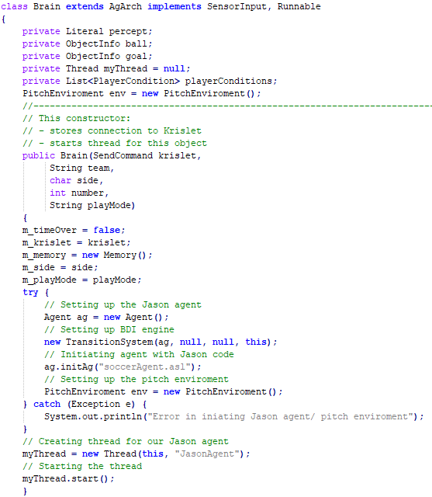
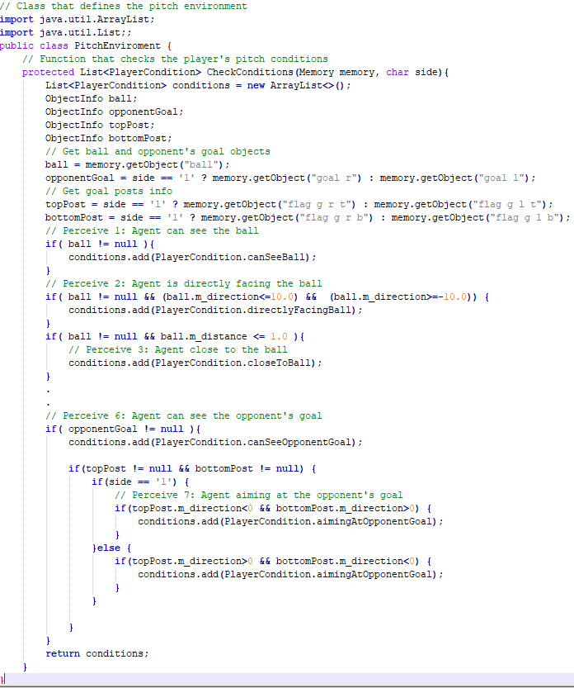
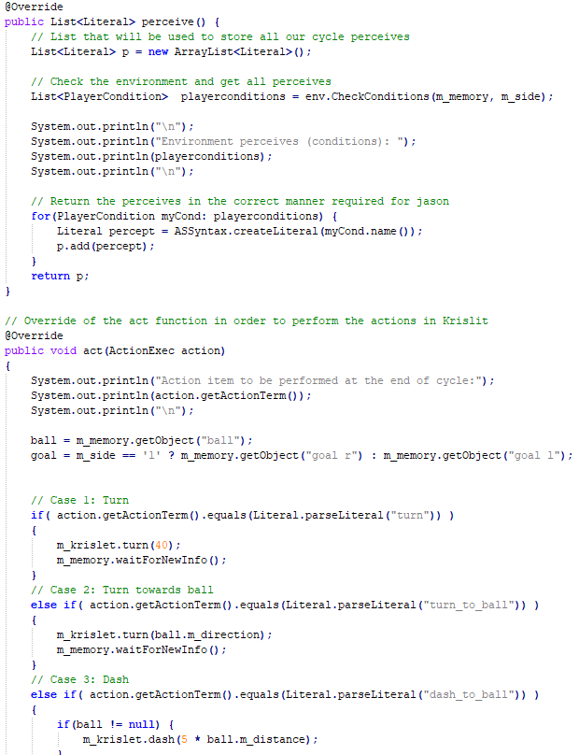
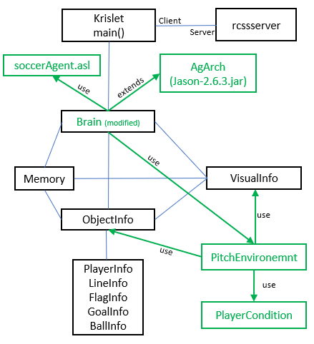
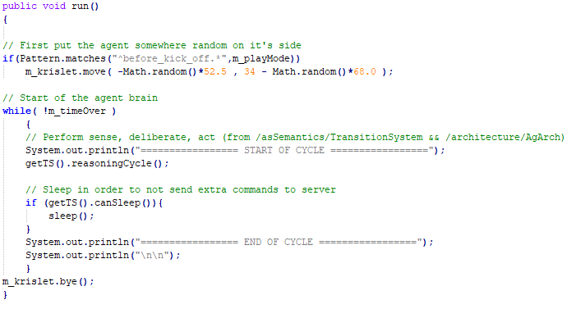
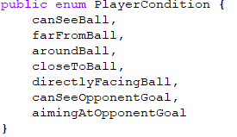
DESIGN AND ARCHITECTURE (2/2)
PitchEnvironment.java
Brain.java
PlayerCondition.java

Slide 7
AGENT BEHAVIOUR AND TESTING (1/2)
Agent behavior:
1) Find the ball
2) Dash to ball
3) Get close enough to kick the ball
4) Aim at the opponent’s goal
5) Kick the ball at the opponent’s goal
Environment events (conditions):
canSeeBall
closeToBall
aroundTheBall
farFromBall
directlyFacingBall
canSeeOpponentGoal
aimingAtOpponentGoal

Slide 8
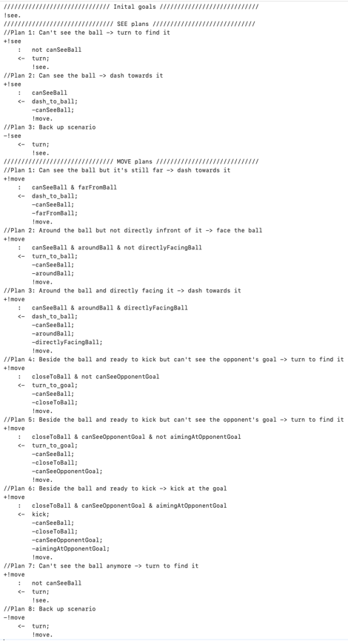
AGENT BEHAVIOUR AND TESTING (2/2)
The plans required for us to reach our goal are shown in the asl file to the left.
Mapping between asl actions and Krislit actions:
turn
turn_to_ball
turn_to goal
dash_to_ball
kick
For testing purposes, we created a batch file with one player to observe its behavior and made improvements accordingly

Slide 9
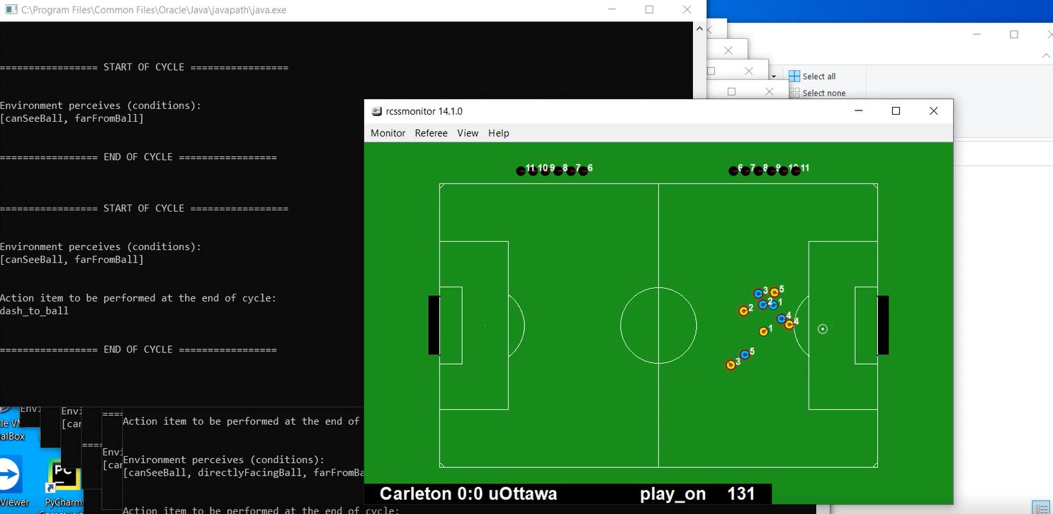
DEMO

Slide 10
REFERENCES
[1] “Belief-desire-intention software model,” Academic Dictionaries and Encyclopedias. [Online]. Available: https://en-academic.com/dic.nsf/enwiki/951131. [Accessed: 09-Dec-2021].
[2] “RoboCup Project,” SYSC5103 course website [Online]. Available: http://www.sce.carleton.ca/cgi-babak/agentcourse.cgi?RoboCupProject. [Accessed: 09-Dec-2021].

