Slide 1
Heekup
Raw data to Information Insights

Slide 2
Aspirations
Identify useful data streams
Design and implement modern data storage and collection architectures
Process Cooked Data
Build Statistical models for data analytics
Provide configurable easy to build reporting dashboards
Modernize data warehouses

Slide 3
Meet the team
Haaris Ghafoor:
  EME College, Tufts, Company name, Company name
Ahmad Jawad Asghar
  EME College, College Name (World Bank Sponsored), TFP, Aman Foundation, World Bank
Muhammad Zain Mustafa
  EME College, UMASS (Fulbright), IBM, BMS, LMKT

Slide 4
Combined Skills
Haaris:
  Integration, Product Development
  Industrial Experience:
    eHealth, Tax Management, IT
Javaad:
  Analytics, Business Development
  Industrial Experience:
    Public Health, Education, Public Policy
Zain:
  Architecture Design, Implementation
  Industrial Experience:
    IT, Telco, Biopharma

Slide 5
Partnerships
RRP
LMKT
E4 Technologies

Slide 6
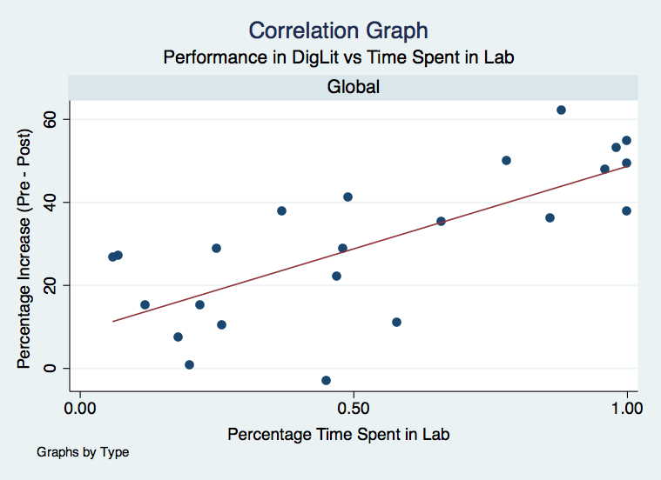
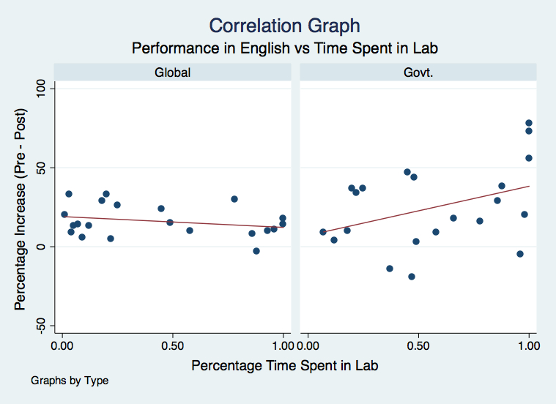
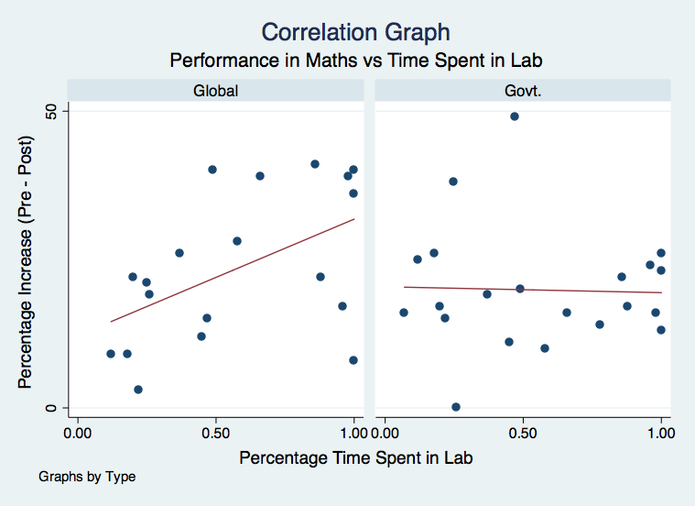
Students Performance is Predictable
The data shows the performance in class can be predicted
Using continuous data monitoring realistic statistical models for students performance can be developed
These models not help teachers focus on student’s weaknesses, providing individuals’ need specific education in class room
The predicative models have the ability to evolve as students strengths and weaknesses change over time.
Figure 1: Affect of time spent in lab on computer literacy
Figure 2: Affect of time spent in lab on English literacy
Figure 3: Affect of time spent in lab on Numeracy

Slide 7

Product Plans

