Slide 1
Predicting Performance
Draft 11 August 2015
Reading Room Project
Case Study

Slide 2
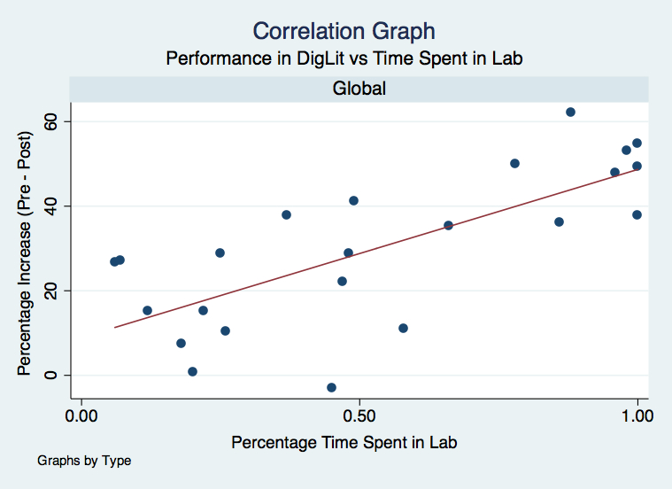
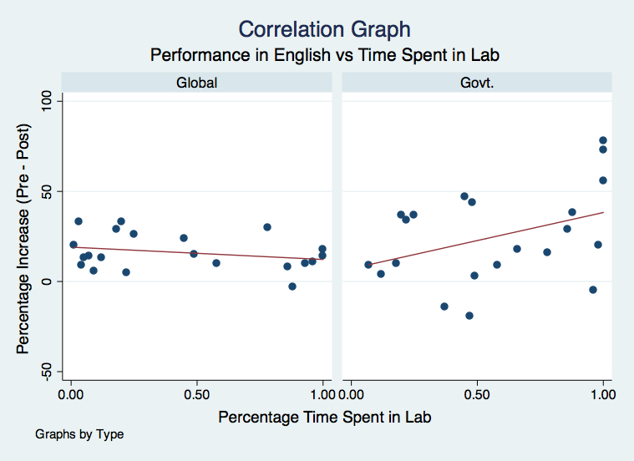
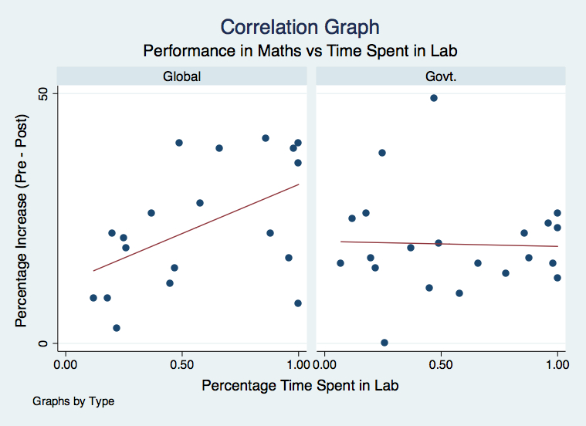
Students Performance is Predictable
The data shows the performance in class can be predicted
Using continuous data monitoring realistic statistical models for students performance can be developed
These models not help teachers focus on student’s weaknesses, providing individuals’ need specific education in class room
The predicative models have the ability to evolve as students strengths and weaknesses change over time.
Figure 1: Affect of time spent in lab on computer literacy
Figure 2: Affect of time spent in lab on English literacy
Figure 3: Affect of time spent in lab on Numeracy

