Slide 1
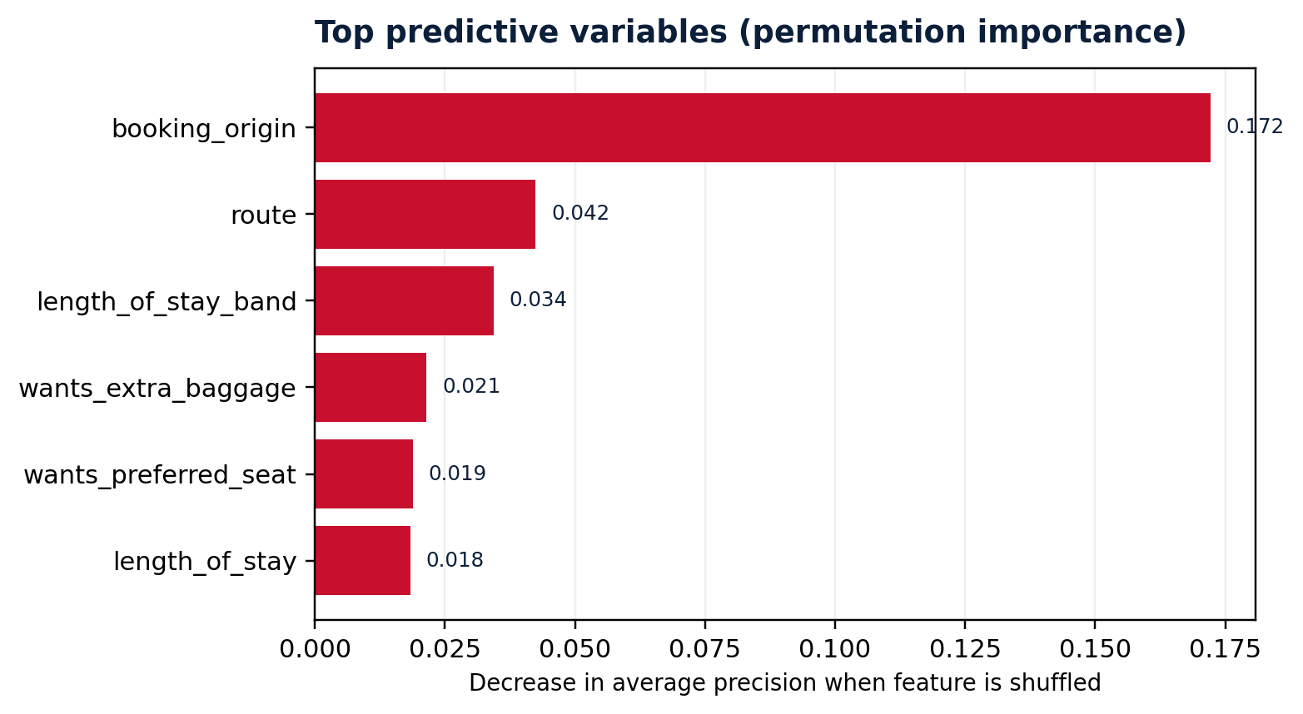
PREDICTING CUSTOMER BUYING BEHAVIOUR
MODEL FINDINGS
British Airways | Data Science Job Simulation | 50,000 booking records
50,000
14.96%
0.776
0.359
records analysed
completed bookings
5-fold CV ROC-AUC
5-fold CV average precision
0 missing values
Target class = 1
± 0.004 across folds
± 0.006 across folds
WHAT MOST HELPS PREDICT A BOOKING?
HOLDOUT TEST PERFORMANCE
RECALL
PRECISION
75.9%
29.6%
Captured most completed bookings
Many flagged customers do not book
F1-SCORE
ROC-AUC
42.6%
0.784
Precision/recall balance
Ranking performance on held-out data
RECOMMENDED NEXT STEP
Use scores to prioritise campaign audiences, then tune the decision threshold to campaign capacity and false-positive cost. Validate on newer booking cohorts before operational use.
INTERPRETATION NOTE
Booking rate is imbalanced (15% positive). Class-weighted Random Forest prioritises recall; accuracy at the selected 0.50 threshold is 69.4%. Feature importance reflects predictive association, not causation; booking_origin and route dominate.
Method: stratified 80/20 train–test split; 5-fold stratified CV on training set; one-hot encoding; 180-tree class-weighted Random Forest; test-sample permutation importance (n=3,000).

